Slide 1
Islam

Slide 2
Geography
Directions: On the Islamic Empire Map provided, identify the following:
Red Sea Persian Empire
Constantinople Byzantine Empire
Medina Western Europe
Mecca Arabian Peninsula
Indian Ocean Mediterranean Sea
Black Sea Iberia (Spain)
Egypt Kingdom of the Franks (France)
Rome Islamic Empire
Jerusalem Damascus
Fertile Crescent Africa

Slide 3
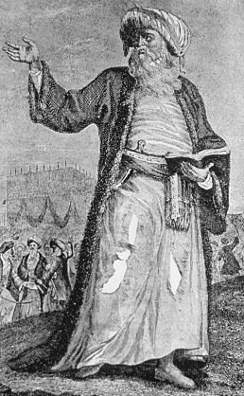
Origins (Beginnings) of Islam
Who is _____________
How did he become a _____________

Slide 4
Origins (Beginnings) of Islam
_________ did this take place?
__________did this take place?

Slide 5
Origins (Beginnings of) Islam
Where did it _____________

Slide 6
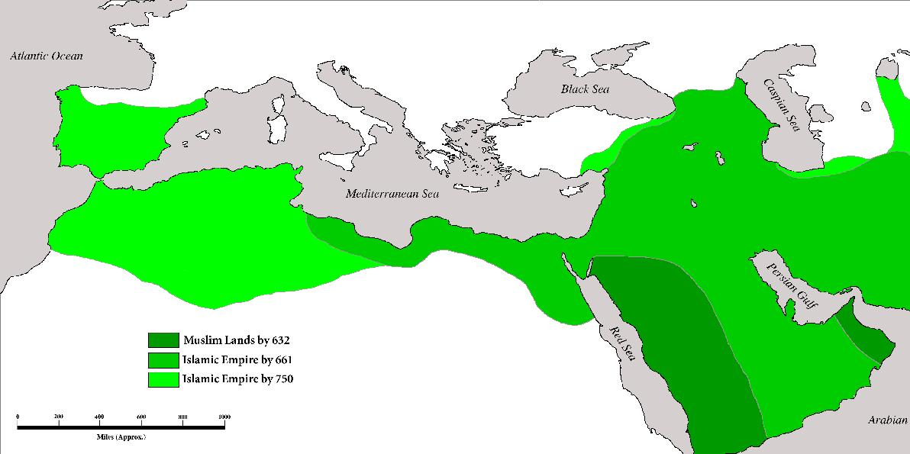

Slide 7
Origins (Beginnings of) Islam
What is the _____________

Slide 9
Origins (Beginnings of) Islam
Critical Thinking:
What is one way that Islam was able to spread between Mecca and Medina?

Slide 10
Origins (Beginnings of) Islam
Critical Thinking:
Take a look at your maps. Through what kind of geographical environments did Islam spread?
How would you describe how far Islam spread?

Slide 11
Origins (Beginnings of) Islam
Critical Thinking:
Deserts and mountains usually act as barriers to the spread of ideas.
Why do you think Islam was able to spread such a distance over difficult barriers such as deserts and mountains?

Slide 12
Origins (Beginnings of) Islam
Did Islam have political unity?
What does unity mean?

Slide 13
Historical Turning Points
What is a _____________
What is the ____________of the _________ of ___________ and __________

Slide 15
Historical Turning Points
What is the _____________of establishing the ____________ to ____________?

Slide 17
Historical Turning Points
What was the ___________ of the__________?

Slide 19
Historical Turning Points
What is the _______________ of the ______________?
Who ___________
______________?

Slide 21
Historical Turning Points
What is the ____________of the death of _____________

Slide 22
Historical Turning Points
How are _____________ different from ____________?

Slide 23
Historical Turning Points
Critical Thinking:
How can this difference between the Sunnis and Shi’ites impact their form of governments?

Slide 24
Religious Beliefs and Traditions
Who is ____________?
Is Islam monotheistic or polytheistic?

Slide 25
Religious Beliefs and Traditions
What is the ____________ of the ___________ for ____________?

Slide 26
Religious Beliefs and Traditions
What are the ____________of ____________?

Slide 27
Religious Beliefs and Traditions
How is _______ similar to ____________?
How is ________ ___________ to ____________?

Slide 28
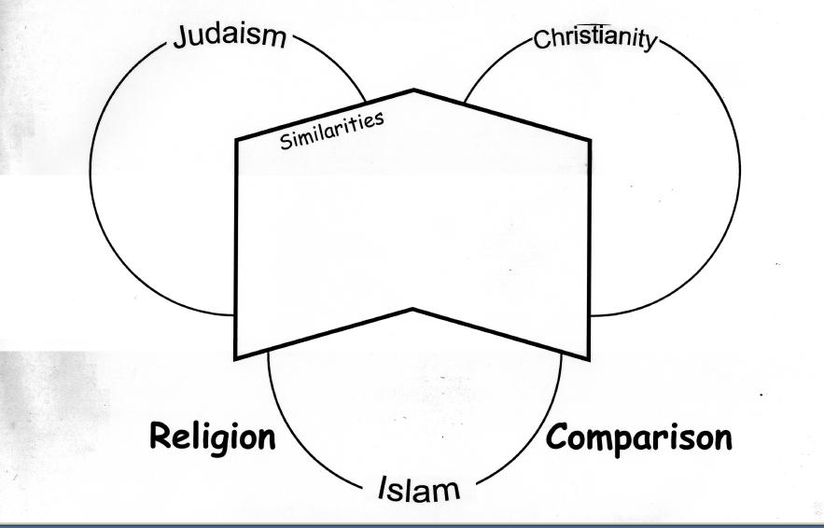

Slide 29
Social & Economic Impact of Islam
What _____________ spread along with the religion of Islam?
Critical Thinking:
How is having a common language advantageous to the growing Islamic Empire?
What does ___________ mean?

Slide 30
Social & Economic Impact of Islam
Critical Thinking:
How else did the growing Islamic Empire achieve unity?

Slide 31
Social Impact of Islam
Does _________ exist?

Slide 32
Cultural Contributions
____________________________

Slide 33
Cultural Contributions
__________________________

Slide 34
Cultural Contributions
___________________________

