Slide 1
Islam

Slide 2
Geography
Directions: On the Islamic Empire Map provided, identify the following:
Red Sea Persian Empire
Constantinople Byzantine Empire
Medina Western Europe
Mecca Arabian Peninsula
Indian Ocean Mediterranean Sea
Black Sea Iberia (Spain)
Egypt Kingdom of the Franks (France)
Rome Islamic Empire
Jerusalem Damascus
Fertile Crescent Africa
Baghdad Syria

Slide 3
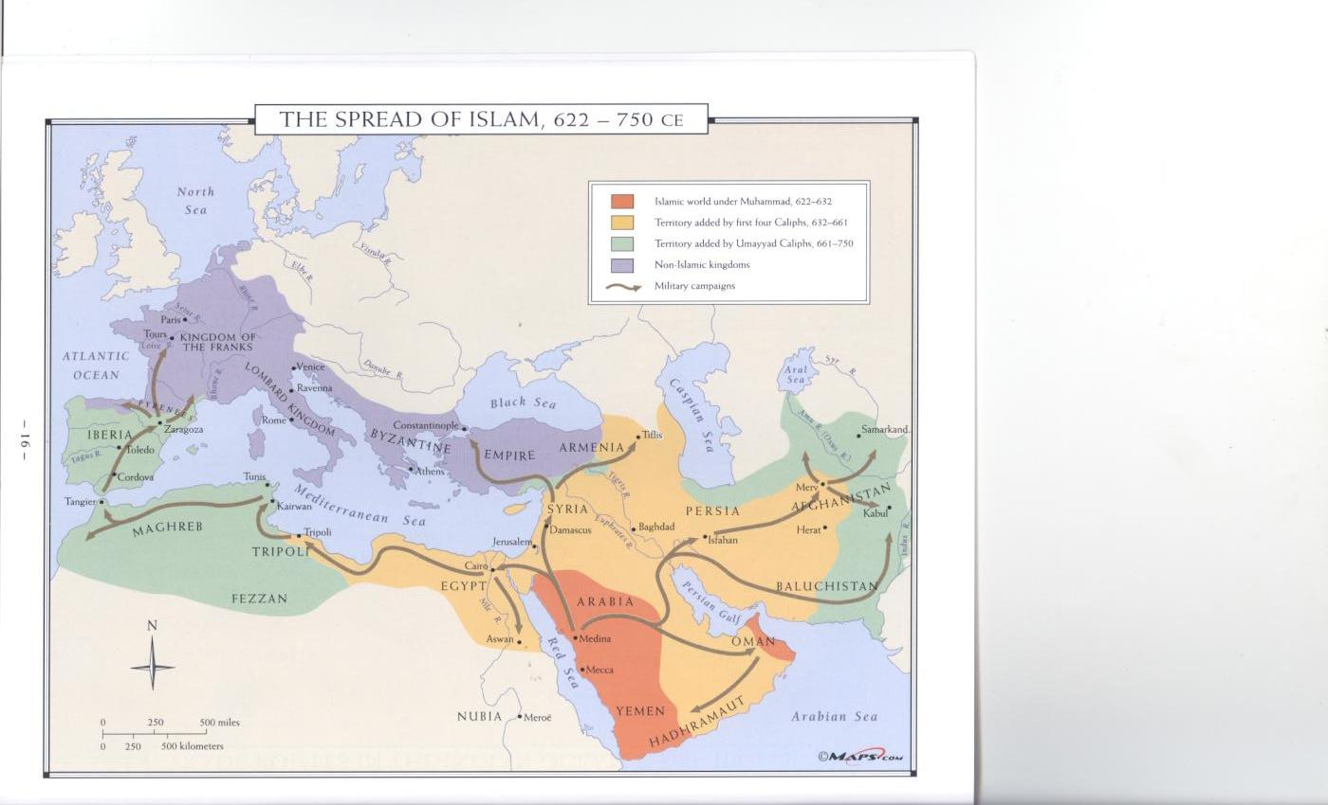

Slide 4
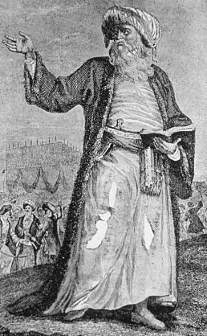
Origins (Beginnings) of Islam
The Prophet of Islam
The Founder of Islam
He received the word of God
Who is Muhammad?
How did he become a prophet?

Slide 5
Origins (Beginnings) of Islam
In Medina
On the Arabian Peninsula
He traveled to Mecca
(his home city)
A.D. 610
Where did this take place?
When did this take place?

Slide 6
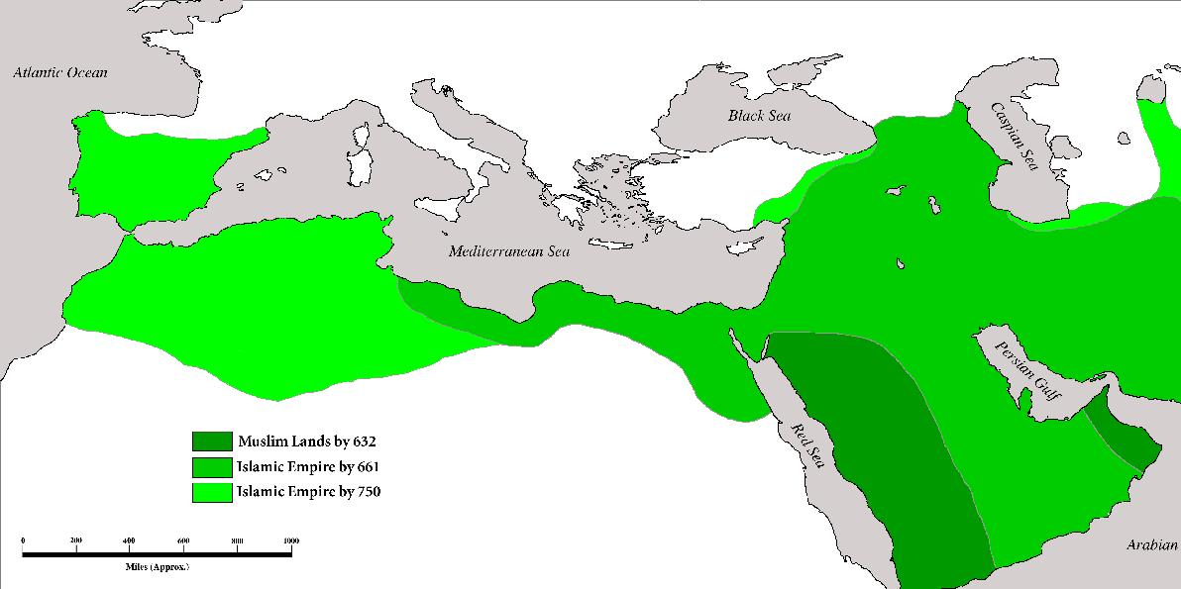
Tours
Iberia
Asia
Medina
Mecca
Africa

Slide 7
Origins (Beginnings of) Islam
First to Mecca and Medina
Then Across Asia
The Fertile Crescent
Iran (present-day)
Central Asia
Jerusalem & Damascus
Into Africa
Into Spain
Where did it spread?

Slide 8
Tours
Spain
Damascus
Asia
Jerusalem
Medina
Mecca
Africa

Slide 9
Tours
Iberia
Asia
Medina
Mecca
Africa

Slide 10
Origins (Beginnings of) Islam
Muslims were defeated here
Not allowed entry into France
What is the Battle of Tours?

Slide 11
Tours
Spain
Damascus
Asia
Jerusalem
Medina
Mecca
Africa

Slide 12
Film Clips
Chapter 1: Islam: Empire of Faith: Introduction
Chapter 2: The Beginning of the Islamic Empire

Slide 13
Origins (Beginnings of) Islam
Trade routes between Mecca and Medina
Critical Thinking:
What is one way that Islam was able to spread between Mecca and Medina?

Slide 14
Origins (Beginnings of) Islam
Desert environments
Mountain Barriers
Great Distances
Critical Thinking:
Take a look at your maps. Through what kind of geographical environments did Islam spread?
How would you describe how far Islam spread?

Slide 15
Origins (Beginnings of) Islam
Byzantine Empire was weak
Persian Empire was weak
Critical Thinking:
Deserts and mountains usually act as barriers to the spread of ideas.
Why do you think Islam was able to spread such a distance over difficult barriers such as deserts and mountains?

Slide 16
Origins (Beginnings of) Islam
At first, political unity was weak
It strengthened over time & conquests
Did Islam have political unity?
What does unity mean?

Slide 17
Historical Turning Points
It is a turning point in history for Islam
Islam was able to spread to those areas
What is a turning point?
What is the significance of the conquest of Jerusalem and Damascus?

Slide 18
Tours
Iberia
Damascus
Asia
Baghdad
Jerusalem
Medina
Mecca
Africa

Slide 19
Historical Turning Points
It is a turning point in history for Islam
Islam gained a strong hold in the area
What is the significance of establishing the Islamic capital to Baghdad?

Slide 20
Tours
Spain
Damascus
Asia
Baghdad
Jerusalem
Medina
Mecca
Africa

Slide 21
Historical Turning Points
Islam was not able to spread into France
France and the rest of Western Europe remained Christian.
What was the significance of the Battle of Tours?

Slide 22
Tours
Spain
Damascus
Asia
Baghdad
Jerusalem
Medina
Mecca
Africa

Slide 23
Historical Turning Points
It was a turning point in history for Islam
The Mongols
However, they adopted Islam as their religion
What is the significance of the Fall of Baghdad?
Who conqured Baghdad?

Slide 24
Tours
Spain
Damascus
Asia
Baghdad
Jerusalem
Medina
Mecca
Africa

Slide 25
Historical Turning Points
It is a turning point in history for Islam
Two factions emerge:
One faction is called the Sunnis
The other faction is called the Shi’ites
What is the significance of the death of Ali?

Slide 26
Historical Turning Points
Sunnis believed another leader of the religion (& state) had to be voted in
Shi’ites believed that the next leader should be a direct descendent from Muhammad
How are Sunnis different from Shi’ites?

Slide 27
Historical Turning Points
Sunnis are more likely to vote for an individual to be a leader (democratic principles)
Shi’ites will expect an individual to inherit leadership (authoritarian rule)
Critical Thinking:
How can this difference between the Sunnis and Shi’ites impact their form of governments?

Slide 28
Film Clips
Chapter 4: The Islamic Empire in Spain
Chapter 5: Christian Crusaders Attack the Islamic Empire
Chapter 6: The Aftermath of the Crusades on the Islamic Empire
Chapter 7: Saladin Drives the Crusaders out of Jerusalem
Chapter 8: The Mongols Invade the Islamic Empire

Slide 29
Religious Beliefs and Traditions
Allah (Arabic for God)
Monotheistic Religion
Who is Islam’s God?
Is Islam monotheistic or polytheistic?

Slide 30
Religious Beliefs and Traditions
The Qur’an (Koran)
It contains the word of God
As given to Muhammad
What is the name of the holy book for Islam?

Slide 31
Religious Beliefs and Traditions
Responsibilities of a Muslim (follower of Islam):
Allah is the only God; Muhammad is his prophet
Pray five times a day towards Mecca
Give Alms to the poor
Fast during Ramadan
Visit Mecca at least once in your lifetime
What are the Five Pillars of Islam?

Slide 32
Religious Beliefs and Traditions
Accepts Moses
Accepts Jesus as a prophet
How is Islam similar to Judaism?
How is Islam similar to Christianity?

Slide 33
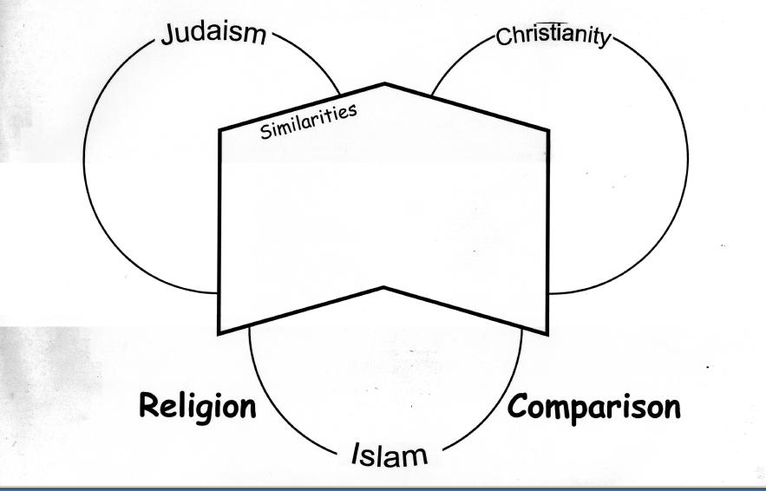

Slide 34
Social & Economic Impact of Islam
Arabic
It facilitated trade
It facilitated unity among the people
What language spread along with the religion of Islam?
Critical Thinking:
How is having a common language advantageous to the growing Islamic Empire?
What does facilitate mean?

Slide 35
Social & Economic Impact of Islam
Critical Thinking:
How else did the growing Islamic Empire achieve unity?

Slide 36
Social Impact of Islam
Slavery existed—but not by any one particular race
Does slavery exist?

Slide 37
Cultural Contributions
Arabic numerals
Actually adapted from India
Included the number zero
Algebra
Mathematics

Slide 38
Cultural Contributions
Medicine

Slide 39
Cultural Contributions
Expansion of geographic knowledge
Geography

Slide 40
Film Clip
Chapter 3: Contributions of the Islamic Empire

