Slide 1
The Crusades

Slide 2
What Were the Crusades?
Warfare between Christians and Muslims (mainly) in an attempt to capture Jerusalem

Slide 3
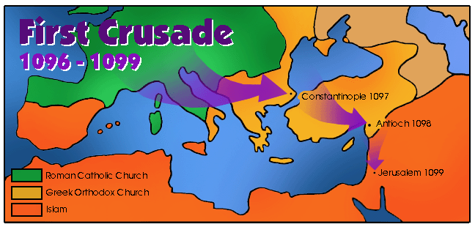
Map
Retrieved from: http://medievaleurope.mrdonn.org/crusades.html

Slide 4
When Were the Crusades?
The first Crusade begins around A.D. 1096

Slide 5
How Did The Crusades Get Started?
The First Crusade
The Problem: Around 1095, a new group of Arabs took control of Jerusalem.
They closed the city to Jewish and Christian pilgrims.
Retrieved from: http://medievaleurope.mrdonn.org/crusades.html

Slide 6
First Crusade
The Solution
Pope Urban acted
He called for a crusade - a volunteer army whose goal was to retake Jerusalem
Many people volunteered
Retrieved from: http://medievaleurope.mrdonn.org/crusades.html

Slide 7
Who Volunteered—and Why?

Slide 8
Crusades
Knights
chance to use their fighting skills
something they enjoyed and did well
delighted to have such a worthy battle to fight.
Retrieved from: http://medievaleurope.mrdonn.org/crusades.html

Slide 9
Crusades
Peasants
a chance to escape from their dreary life in the feudal system
the pope promised that if they died while fighting a holy crusade, they would automatically be welcomed into heaven.
Retrieved from: http://medievaleurope.mrdonn.org/crusades.html

Slide 10
Crusades
Others
it was a chance to have an adventure
and perhaps even to get rich
Retrieved from: http://medievaleurope.mrdonn.org/crusades.html

Slide 11
What Happened?
The crusaders won back Jerusalem!
Retrieved from: http://medievaleurope.mrdonn.org/crusades.html

Slide 12
Then What Happened?
Some men stayed.
Some headed home.
  Those who returned brought back new foods and new forms of culture.
  Retrieved from: http://medievaleurope.mrdonn.org/crusades.html

Slide 13
Then What Happened?
Some founded Crusader states
What is a Crusader State? A Christian state

Slide 14
But There Were More Crusades to Follow
More Crusades
It was a short victory
Less than 50 years later, Muslims once again conquered Jerusalem
The Second Crusade and Third Crusade were not successful.
Retrieved from: http://medievaleurope.mrdonn.org/crusades.html

Slide 15
Loss of Jerusalem
Christians lost Jerusalem to Saladin, a Muslim

Slide 16
Sack of Constantinople
The Fourth Crusade lasted from 1202-1204
Instead of attacking Jerusalem, the crusaders attacked Constantinople
Retrieved from: http://medievaleurope.mrdonn.org/crusades.html

Slide 17
What did the Crusaders to to Constantinople?
They stole statues, money, paintings and jewelry
They burned libraries
They destroyed churches
Retrieved from: http://medievaleurope.mrdonn.org/crusades.html

Slide 18
Why Did They Sack Constantinople?
Their ridiculous excuse was that they needed money to defend Constantinople from the same fate as Jerusalem, as well as to fund the rescue of Jerusalem
The people of Constantinople did not find this excuse acceptable, and they were filled with hatred for the west
Retrieved from: http://medievaleurope.mrdonn.org/crusades.html

Slide 19
What was the economic effect of the Crusades?

Slide 20
Economic Effect of Crusades
Stimulated trade
  Throughout the Mediterranean area
  Throughout the Middle East

Slide 21
What were the political effects of the Crusades?
Weakened Popes and nobles
Weakened Byzantine Empire

Slide 22
What Were the Social Effects of the Crusades?
Left a legacy of bitterness among Christians, Jews, & Muslims

Slide 23
Who Were the Mongol Armies?
Armies that invaded:
  Russia
  China
  Muslim states in Asia

Slide 24
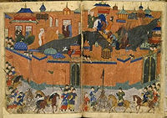
Mongols Sack Baghdad

Slide 25
What Did the Mongol Armies Do?
Destroyed cities and countryside
Created an empire

Slide 26
What Happened to Constantinople?
It fell to the Ottoman Turks in 1453
Ends the Byzantine Empire
Istanbul becomes capital of the Ottoman Empire
Ottoman Turks become Muslim

Slide 27
The Crusades

Slide 28
Economic Effects
Increased demand for goods/products from the Middle Eastern area
Stimulated production of goods for trade from Middle East
Encouraged the use of credit and banking
What were Economic effects of the Crusades?

Slide 29
Economic Concepts

Slide 30
Economic Concepts
loan
What were letters of credit?

Slide 31
Economic Concepts
Charging interest on money loaned
Against usury
Secularized Europe
(not religious)
What is usury?
What was the Church’s rule regarding the practice of usury?
Usury

Slide 32
Economic Concepts
Loan
Afford to trade more goods
Money is available
What are letters of credit?
How did it help to expand money supply?
Expedite Trade?

Slide 33
Economic Concepts
Arabic numerals used
New Accounting and bookkeeping practices

Slide 34
The Black Death (The Plague)
What was the socioeconomic impact of the Black Death?
  Decline in population (1/3 of the pop. Dies)
  Scarcity of Labor
  Towns freed from feudal obligations
  Decline of Church influence
  Disrupts trade

Slide 35
The Renaissance

Slide 36
Renaissance
“Rebirth”
In this case, of culture
What does Renaissance mean?

Slide 37
Renaissance
Geographically closest to Constantinople (Istanbul)
Home of old Roman Empire
Legacy of culture
Why does the Renaissance begin in Italy?

Slide 38
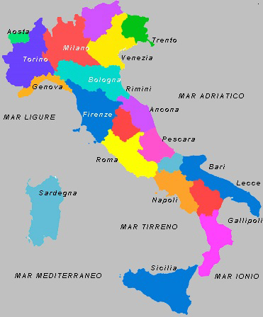
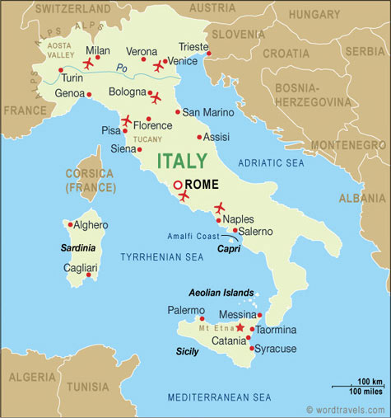
What was the importance of Florence, Venice, & Genoa?

Slide 39
Renaissance
All had access to trade routes
They connected Europe with Middle Eastern markets
Served as trading centers for the distribution of goods
Initially, all were independent city-states governed as republics
What was the importance of Florence, Venice, & Genoa?

Slide 40
Machiavelli
Served as an advisor to rulers
The Prince
Who was Machiavelli?
What book did he write?

Slide 41
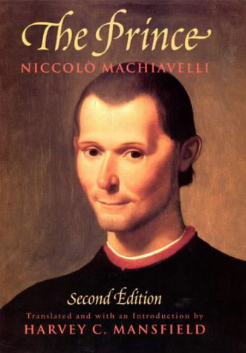
Machiavelli
Early modern treatise on government
What topic did the treatise (book) discuss?

Slide 42
Machiavelli
Supports absolute power of the ruler
Maintains that the end justifies the means
Advises that one should do good if possible, but do evil when necessary
What basic principles were in the book?

Slide 43
Machiavelli
Do whatever it takes to win
Define “the end justifies the means”.

Slide 44
Art and Literature
Religious
Focused on salvation, Church
Not 3-D (no depth)
Could be religious (Christianity)
Focus on individuals, secular (worldly) themes
Characteristics of Medieval Art & literature?
Characteristics of Renaissance art & literature?

Slide 45
Define “perspective”
Creating the illusion of depth in paintings (flat canvases)
(as an art term)

Slide 46
Renaissance Paintings
Lifelike: looked realistic, artists studied the body
Perspective: showed depth (3D)
Emotion: revealed artist’s feelings
Sometimes secular: (sometimes nonreligious)

Slide 47
So What Were Paintings Like Before the Renaissance?
Medieval Paintings

Slide 48
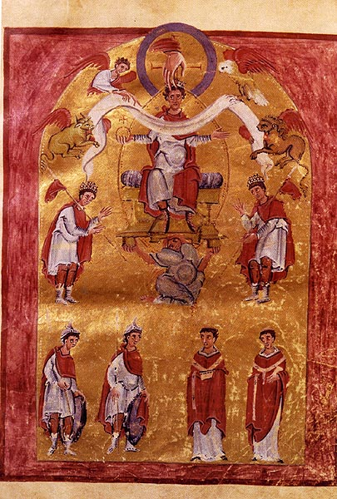
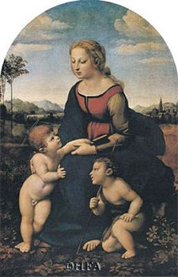
Renaissance or Medieval Art?

Slide 49
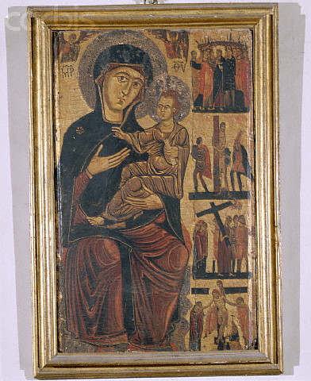
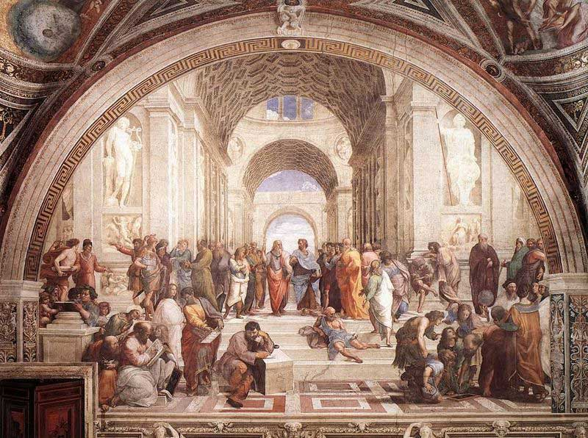
Renaissance or Medieval Art?

Slide 50
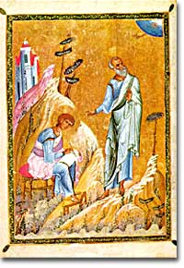
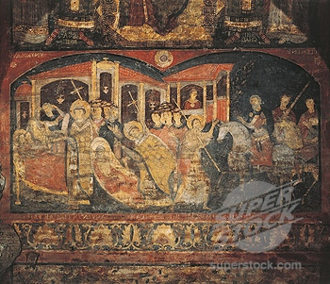
Renaissance or Medieval Art?

Slide 51
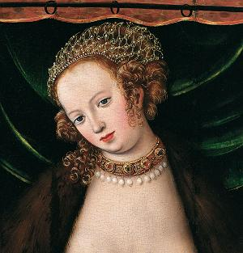
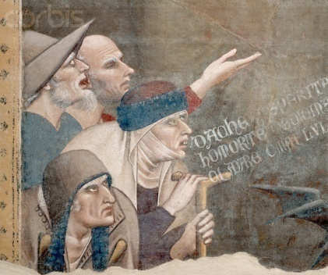
Renaissance or Medieval Art?

Slide 52
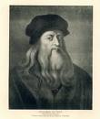
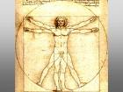
Who is Leonardo Da Vinci?
Italian painter, sculptor, architect, engineer, & scientist

Slide 53
What are two famous
The Mona Lisa
The Last Supper
paintings by Da Vinci?
Da Vinci’s Window

Slide 54
Who is Michelangelo?
Italian Renaissance Artist
  Sculptor
  Painter

Slide 55
Describe what Michelangelo
Painted the ceiling
did at the Sistine Chapel

Slide 56
Famous Sculpture?
The David

Slide 57
Italian Renaissance
Sponsored works (that glorified city-states)
Wealthy from newly expanded trade
What is a patron?
Why so many patrons of the arts now?

Slide 58
Renaissance
Humanist scholar
Sonnets
Who is Petrarch?
What did he write?

Slide 59
Renaissance
An interest in intellectual ideas
Often, an interest in the classics
Studies in Greek and Roman literature
Define humanism:
Define “classics”

Slide 60
Characteristics of a Humanist
Celebrated the individual
Stimulated (encouraged) the study of classical
Greek and Roman literature and culture
Supported by wealthy patrons

Slide 61
Renaissance
Education is becoming increasingly secular
How is education changing?

Slide 62
Northern Renaissance

Slide 63
Northern Renaissance
Northern Europe
  For example: Germany & England
Where does the Northern Renaissance take place?

Slide 64
Renaissance
Northern
Growing wealth from increased trade
Ideas spread
Why is Renaissance spreading to Northern Europe?

Slide 65
Gutenberg
German inventor
The printing press with moveable type
Who was Gutenberg?
What did he invent?

Slide 66
Gutenberg
Increased sale of books
(More people reading)
Helped disseminate ideas
The Bible (Gutenberg Bible)
What was the impact of the printing press?
What book was widely printed?

Slide 67
Writers
A writer (Dutch)
A Catholic
A humanist
The Praise of Folly
(Humanist & Religious ideas)
Who was Erasmus?
What did he write?

Slide 68
Sir Thomas Moore
A writer (from England)
Utopia (1516)
(a “perfect” place)
Who was Sir Thomas Moore
What did he write?

