Slide 1
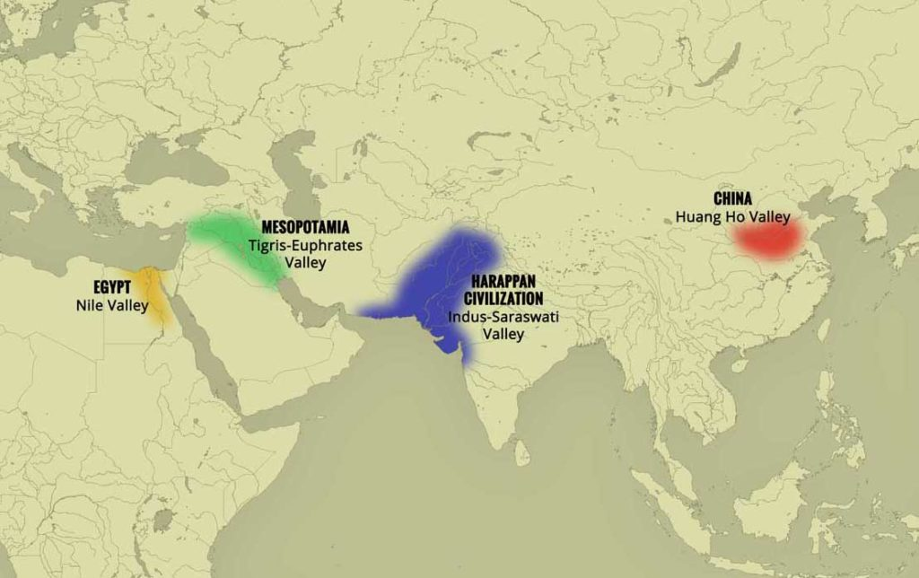
River Valley Civilizations (about 3500-500 B.C.E.)
River Valley Civilizations
(3500-500 B.C.E.)

Slide 2
Question to Ponder
Why do you think the early civilizations shown on the map developed around river valleys?

Slide 3
Mesopotamia
Tigris and Euphrates River
Identify on map
Then, identify the following:
Mediterranean Sea
Red Sea

Slide 4
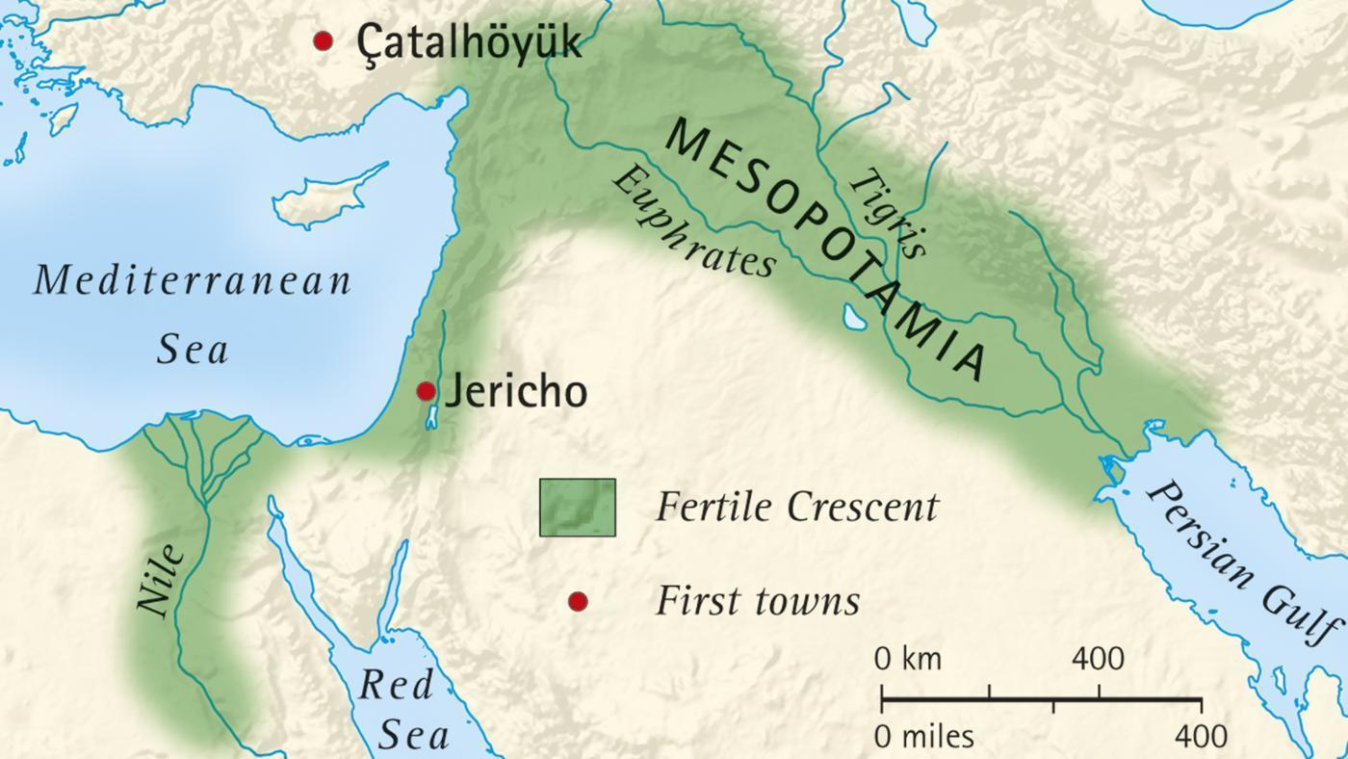
Mesopotamia

Slide 5
Mesopotamia
Asia
And more specifically, Southwest Asia
In which continent is the area located?

Slide 6
Nile River Valley: Egyptian Civilization
Nile River
On the map provided, locate the following places or geographic features:
Nile River
Nile Delta
And then locate:
Africa
Red Sea
Mediterranean Sea

Slide 7
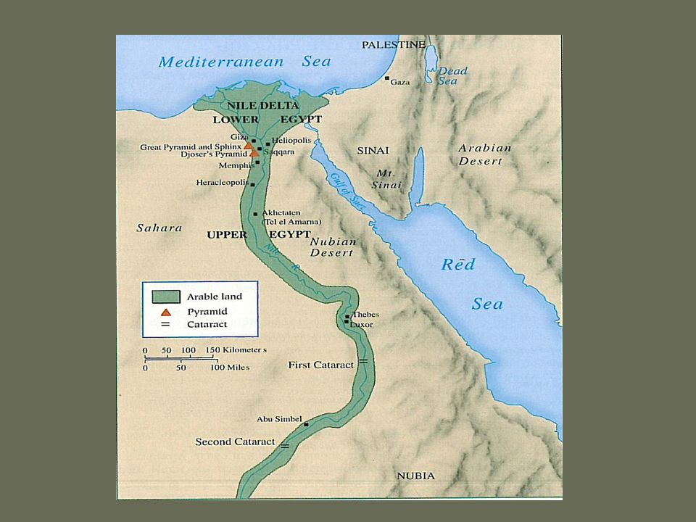
Nile River Valley: Egyptian Civilization

Slide 8
In Which Continent is the Nile River Valley located?
Africa

Slide 9
Indus River Valley: Indian Civilization
Indus River
Locate the Indus River Valley on your map
Then, locate the following:
Hindu Kush Mountains
Himalayan Mountains

Slide 10
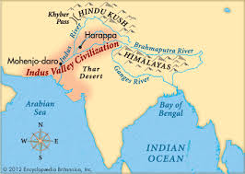
Indian River Valley: Indian Civilization

Slide 11
In Which Continent is the Indus River Valley located:
Asia
More specifically, South Asia

Slide 12
Huang He River Valley: Chinese Civilization
Huang He River
Locate on your maps the Huang He River Valley

Slide 13
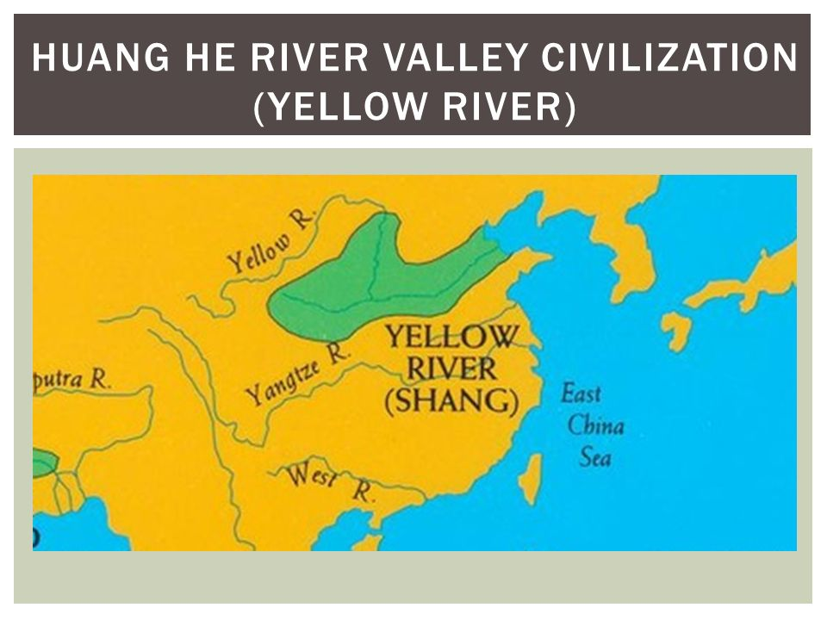
Huang He Valley: Chinese Civilization

Slide 14
In Which Continent is the Huang He River Valley?
Asia
More specifically, East Asia

Slide 15
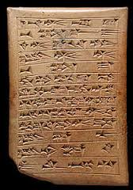
Key Cultural Characteristics
What writing system did Sumer develop?

Slide 16
What Are the Benefits of Developing Civilizations in These Areas?
Rich Soil (for farming)
Irrigation (for agriculture)
Areas easily protected from invasions by nomadic peoples

