Slide 1
Sketching and Dimensioning Terms
Pictures on Monday’s test will be very similar to those used
In this presentation

Slide 2
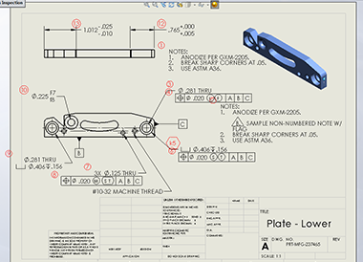
Term: Annotation
Definition: Explanatory notes added to a drawing.

Slide 3
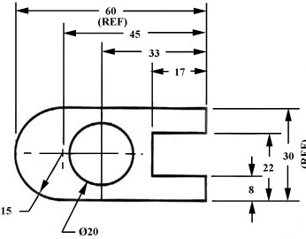
Term: Dimension Line
Definition: Thin lines capped with arrowheads, which may be broken along their length to provide space for the dimension numerals.

Slide 4
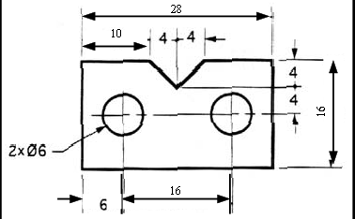
Term: Leader Line
Definition: Lines that are thin and used to connect a specific note to a feature.

Slide 5
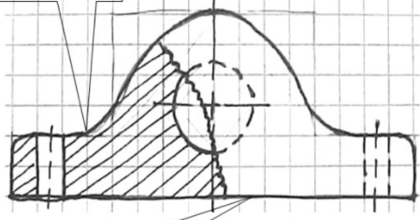
Term: Object Line
Definition: A heavy solid line used on a drawing to represent the outline of an object.

Slide 6
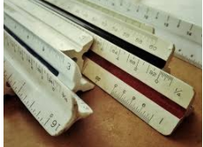
Term: Scale
Definition: A proportion between two sets of dimensions used in developing accurate, larger or smaller prototypes, or models of design ideas.

Slide 7
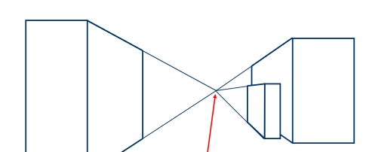
Term: Vanishing Point
Definition: A point in space, usually located on the horizon, where parallel edges of an object appear to converge.

Slide 8
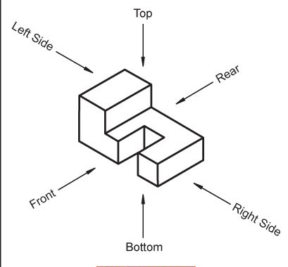
Term: Views
Definition: This is multiview projection, which is a system used to view an object. The six mutually perpendicular directions any object may be viewed are top, front, right-side, rear, left-side, and bottom. Top, front, and right-side views are also referred to as the three regular views because they are the three views most frequently used.

Slide 9
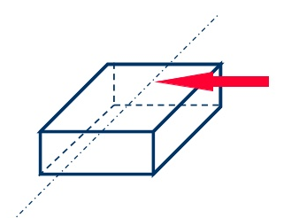
Term: Center Line
Definition: A line type that is used to indicate the axis of symmetry for a part or feature.

Slide 10
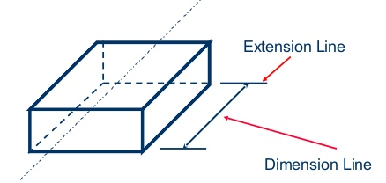
fThis red arrow
Term: Extension Line
Definition: A thin solid line perpendicular to a dimension line, indicating which feature is associated with the dimension.

Slide 11
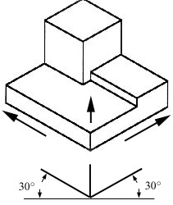
Term: Isometric
Definition: A form of pictorial drawing in which all three drawing axes form equal angles of 120 degrees with the plane of projection.

Slide 12
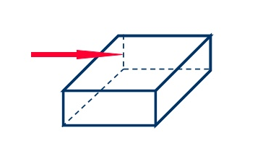
Term: Hidden Line
Definition: A line type that represents an edge that is not directly visible because it is behind or beneath another surface.

Slide 13
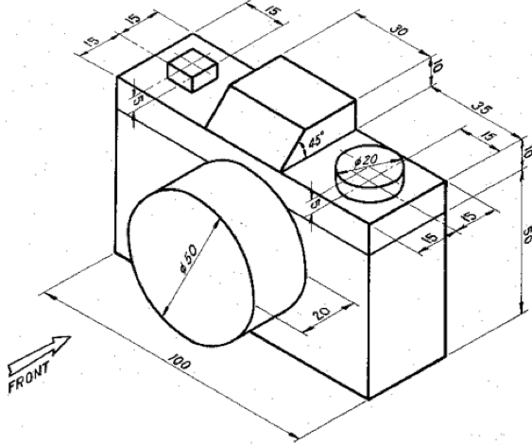
This distance
Term: Depth
Definition: The distance from front to back.

Slide 14
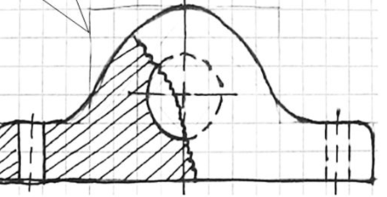
Term: Construction Line
Definition: Thin lines that serve as guides while sketching or drawing.

Slide 15
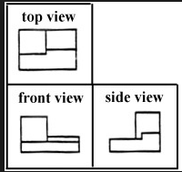
Term: Orthographic
Projection
Definition: A method of representing three-dimensional objects on a plane having only having 2 dimensions

Slide 16
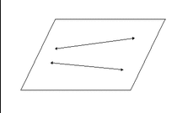
Term: Plane
Definition: A flat surface on which a straight line joining any two points would wholly lie.

Slide 17

Term: Three Dimensional
Definition: Having the dimensions of height, width, and depth.

Slide 18
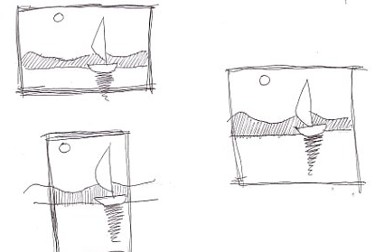
Term: Thumbnail Sketch
Definition: A preliminary visual of a possible idea for a design. These sketches are not full-size and have little detail. They are intended to quickly explore possible alternative designs.

Slide 19
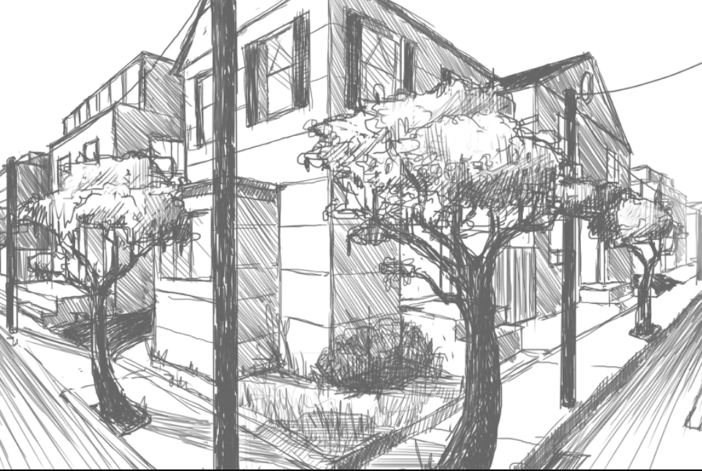
Term: 2-Point Perspective
Definition: A realistic way of drawing objects in three dimensions using a horizon line, a key edge, and two vanishing points.

Slide 20
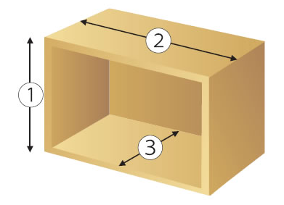
Term: Width
Definition: The measurement or extent of something from side to side.

Slide 21
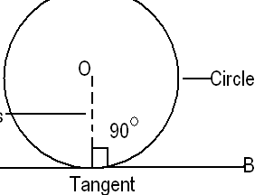
Term: Radius
Definition: A straight line from the center to the circumference of a circle or sphere.

Slide 22
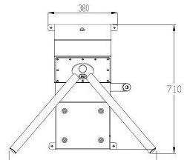
What is being measured here
Term: Height
Definition: The measurement of someone or something from head to foot or from base to top.

Slide 23
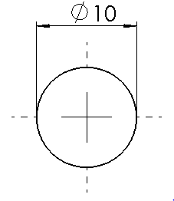
Term: Diameter
Definition: A straight line passing from side to side through the center of a circle or sphere.

Slide 24

Term: Line Weight
Definition: Also called line width. The thickness of a line, characterized as thick or thin.

Slide 25
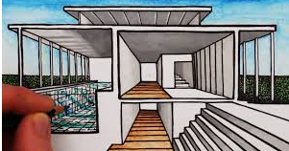
Term: 1-Point Perspective
Definition: A method of realistic drawing in which the part of an object closest to the viewer is a planar face, and all the lines describing sides perpendicular to that face can be extended back to converge at one point, the vanishing point

