Slide 1
Homework: A snapshot of parental attitudes and opinions
Notes:
Homework has become a hot topic in our school district and I have experienced some parental concerns in terms of how much homework was being completed by several of my students earlier this year. This has caused me to reconsider my beliefs and practice regarding homework in the elementary grades. The purpose of this project is to describe the parental feelings and opinions of homework at École St. Pius X. My goal is to explore parents’ understandings and perceptions of homework at École St. Pius X.

Slide 2
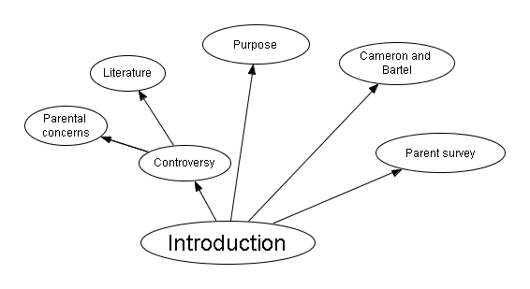
Notes:
This is a descriptive study of the homework engagement of the students at St. Pius as well as how this engagement impacts their lives. I will analyze survey data gathered from parent surveys. This project will be conducted within the theoretical framework of Cameron and Bartel’s 2007 study Homework Realities: A Canadian Study of Parental Opinions and Attitudes. Permission has been granted to adapt the questions for my survey.

Slide 3
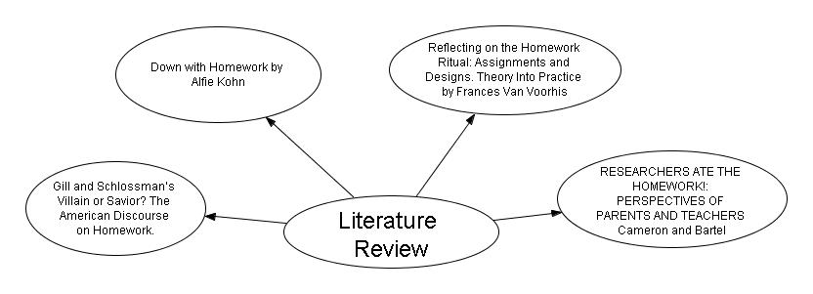
Notes:
There is quite a large body of literature on homework. I have focussed my attention on 4 separate studies. The first article by Gill and Schlossman details the history of homework in the 20th century. Down with homework by Alfie Kohn highlights the disadvantages of homework. Reflecting on the Homework Ritual assignments and designs is meant as a reflective tool to allow teachers to gain insights into their own homework beliefs and practices and the last study, Researchers Ate the Homework is written by Cameron and Bartel. This article documents the findings of their 2006 national survey of parents.

Slide 4
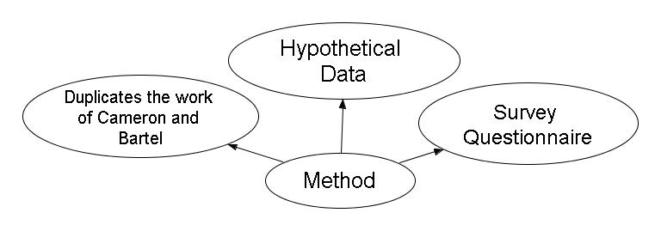
Notes:
This project duplicates the work of Linda Cameron and Lee Bartel of Ontario. I became interested in this issue earlier this school year when a parent questioned my homework policy. It is important to note that the findings within this report reflect hypothetical data. This data was created with approval from Dr. Steed. Once my research proposal has been approved by Calgary Catholic School District I will conduct the survey and compare the results to the hypothetical data in this report.
I obtained permission from Cameron and Bartel to use their survey questionnaire. I modified the questionnaire by omitting 11 questions; these questions had to be omitted because they would have enabled me to identify the participants. Because it is important to guarantee anonymity to the participants this becomes an ethical issue because the omitted questions concerned demographics of the parents responding to the survey. Since the school population is relatively small and I have been here for 5 years I know most of the families that attend our school.
Parents of our school community are the intended participants of this survey. There are approximately 140 parents in our school community I am hoping for about 100 responses from the survey at St. Pius X.

Slide 5
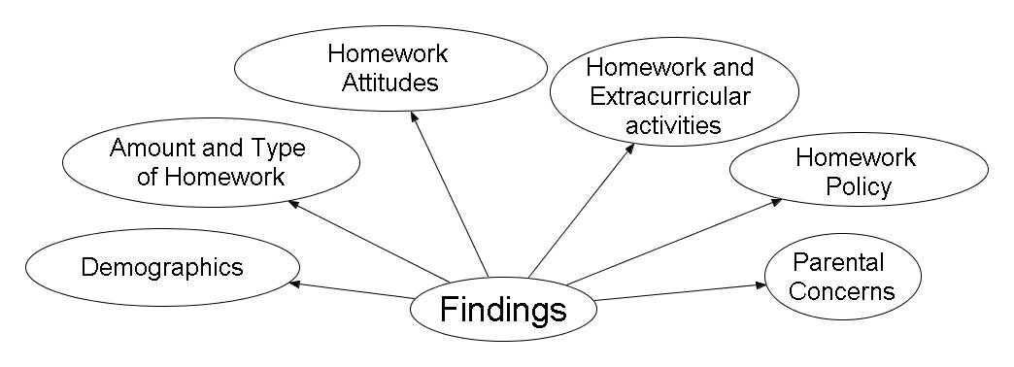
Notes:
I have divided the findings into five broad categories or themes. These categories are demographics, amount and type of homework, homework attitudes, homework and extracurricular activities, Homework policy, and parental concerns. Dividing the survey results in this way has made it easier to analyze and draw conclusions from the results.

Slide 6
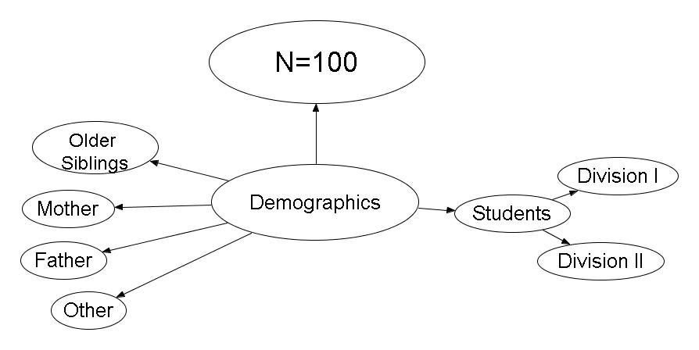
Notes:
This survey is aimed primarily at the parent community at École St. Pius. Other than the students themselves they are the group that is most affected by homework because they are the people students turn to for homework help. Our school community has about 140 families. I am encouraging both parents to complete the survey and I hope to receive about 100 returns on my survey. Because this report contains hypothetical data I have used the number 100 as my sample size.
In order to make conclusions on the data it was important to find out if the respondents were responding for children in division I or division II.

Slide 7
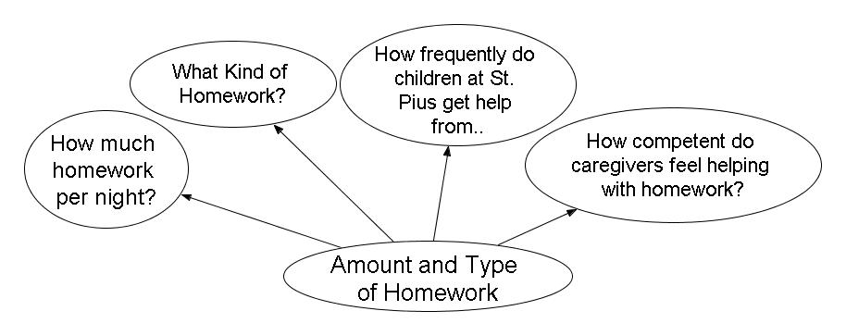
Notes:
The first category of questions in the survey is amount and type of homework. It is important to gain an understanding of how much or how little homework children are doing. From the literature I have read I have noticed that the more homework a student has the the less supportive parents tend to be. This is especially true in division I. What kind of homework is also an important consideration as well as how frequently children get help from different caregivers.

Slide 8
Amount of Homework
Notes:
Our school currently subscribes to the 10 minute per night per grade rule. 10 minutes for grade 1, 20 minutes for grade 2, 30 minutes for grade 3 and so on. The amount of time spent on homework has been mentioned to me in passing by several parents in the past.
This data would seem to indicate a fairly even response from all the grades at St. Pius X. However it does not necessarily mean that students in the higher grades do more homework. It is impossible to deduct that information because our school population is small and confidentiality would be difficult to maintain.

Slide 9
Type of Homework
Notes:
Type of homework as well as amount is one of the most important dimensions of the homework issue. As I compare the first 2 categories: Completing work started at school and Drill and practice to supplement school work the 80 % in the always field jumps out at me. The best explanation for this is that our school is a French Immersion school and drill and practice activities are commonly assigned in all grades to boost language skills. Most of the time this takes the form of reading practice. Lower numbers in the last 2 categories could indicate that mostly older students study for tests and do larger scale projects at home. As a teacher I had never really previously considered the type of homework I was asking students to complete. Most of my homework tasks were completion work and it was rarely differentiated. Looking at the national data and the data within this study has convinced me that my previous approach may not have been the best.

Slide 10
How frequently do children at St. Pius get help from...
Notes:
In French immersion homework help is always an issue because of the language barrier. Quite often parents can help their younger children by listening to them read or by getting instructions from the teacher on specific regular tasks. However by the time students reach division II they are quite often left to rely on their older siblings, the internet or any other resources they may be able to access. Some students may call their friends for help and a smaller number have the means to rely on private tutors, although these days this is rarer in French Immersion than it used to be.

Slide 11
How competent do caregivers feel helping with homework?
Notes:
Although the vast majority of our parents are not French speaking some parents still feel comfortable helping their children with homework to some degree. Most of our parents are professionals who hold high educational standards for their children. Parents of children in div II feel more competent because the French is still quite basic.
Although the vast majority of our parents are not French speaking some parents still feel comfortable helping their children with homework to some degree. Most of our parents are professionals who hold high educational standards for their children. Parents of children in division I feel more competent because the French is still quite basic. By division II parents start to feel less sure of themselves. It is around this time that parents start to ask for advice about homework. Parents usually ask how they can help their children. Parents who can afford it consider private tutors.

Slide 12
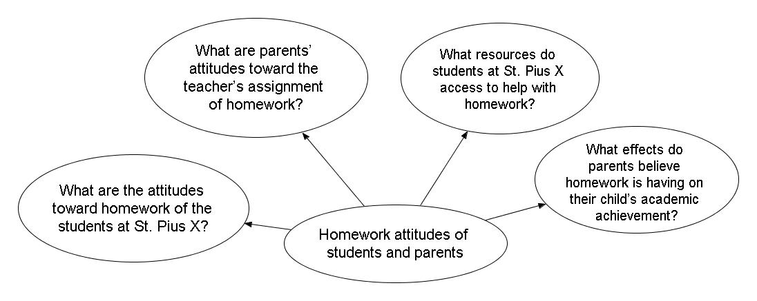
Notes:
This category of the survey examines the homework attitudes of students and parents. Parent`s attitudes toward the teacher`s assignment of homework, resources accessed to complete homework as well as the effects parents believe homework has on their child`s academic achievement are all examined.

Slide 13
What are the attitudes toward homework of the students at St. Pius X?
Notes:
These numbers reflect a mostly accepting attitude toward homework. This is typical of younger students who start school with a welcoming attitude toward homework. As they progress through the primary grades and more and more pressure is placed upon them their disdain for homework grows. Students go from being enthusiastic to very resistant. Most French Immersion parents support homework. The parents of French Immersion usually understand the extra demands a program such as French Immersion places on children.

Slide 14
What are parents’ attitudes toward the teacher’s assignment of homework?
Notes:
There seems to be a correlation in the data between the homework attitudes of children and the parents’ attitudes toward homework. The more enthusiastic and willingly cooperative the children are the more supportive parents seem to be. I have also noticed this informally in my daily practices as an elementary teacher.

Slide 15
What resources do students at St. Pius X access to help with homework?
Notes:
It is easy to conclude from this question that most if not all students within the École St. Pius X community have access to the internet at home. Once again this could be because our parents occupy a higher socio-economic bracket than the general population.

Slide 16
What effects do parents believe homework is having on their child’s academic achievement?
Notes:
The data from this question reinforces what I have suspected in the past. Most parents at our school are professional people who hold high standards for their children. It is not surprising therefore that 35% of respondents feel that the homework their children are asked to do has a very positive or at least a somewhat positive effect on their child’s academic achievement.

Slide 17
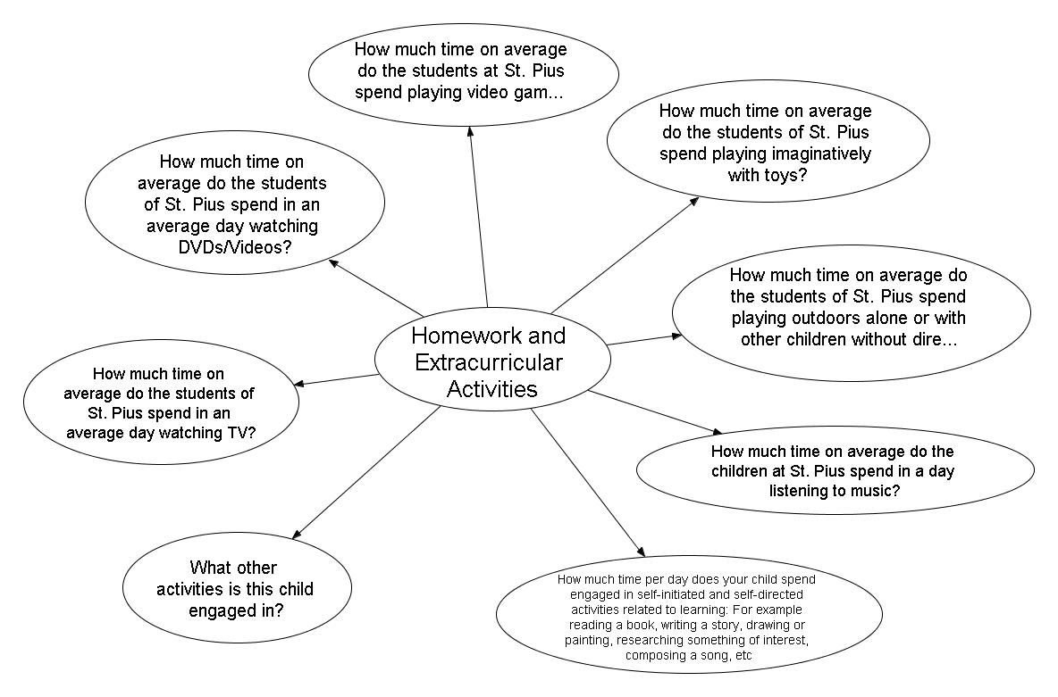
Notes:
Most of the students at St. Pius engage in some sort of extracurricular activity. These activities are varied but can be placed in the following categories; music, dance, swim, sports, religious, household, paid and other. It was important

Slide 18
What other activities are children at St. Pius X engaged in?

Slide 19
How much time on average do the students of St. Pius spend in an average day watching TV?
Notes:
To me, this was one of the most interesting questions in the survey. TV has long been labelled a waste of time by many people and I suspect that some of the numbers in the survey may not be quite accurate because even though parents know the survey is anonymous I am not sure they would have been completely honest. Some parents may also not know how much television their children watch. I look at the television viewing habits of my children and I know that they watch more than 1 hour per day of television on average yet the numbers in this table do not reflect that. I know that the students at St. Pius X watch television because of they understand references I sometimes make and I hear them talking about their favourite television programs.

Slide 20
How much time on average do the students of St. Pius spend in an average day watching DVDs/Videos?

Slide 21
How much time on average do the students at St. Pius spend playing video games per day?
Notes:
Video games have also gotten a very bad reputation from teachers and parents alike. Although writers like Steven Johnson have done much to reverse this trend video games are still blamed for wasting time and their perceived impact on students’ development. In my opinion this data represents moderate use of video games by the students of our school community. Like anything else this is probably the best approach.

Slide 22
How much time on average do the students of St. Pius spend playing imaginatively with toys?
Notes:
Most people would probably place more value on this type of play than video games or watching television. However, it would seem from the data that most children do not spend much time playing imaginatively with toys. From my own experience as a parent the 67% in the less that 10 minute column seems a bit high. I have seen my own children play imaginatively as their first choice. Although our family has no shortage of electronic devices my own children often prefer to play with their toys.

Slide 23
How much time on average do the students of St. Pius spend playing outdoors alone or with other children without direct supervision by an adult?
Notes:
Once again, this type of activity could be considered more valuable by parents because it is outdoors where children are typically more active. There might also be a correlation between the results of this question and the amount of time spent on structured extracurricular activities and free play time. Looking at my own family, where our children have few structured extracurricular activities, I notice that my own children spend a good portion of time playing outside with other neighbourhood children. Children who engage in many extracurricular activities simply might not have time to spend time playing outdoors.

Slide 24
How much time on average do the children at St. Pius spend in a day listening to music?

Slide 25
How much time per day does your child spend engaged in self-initiated and self-directed activities related to learning: For example reading a book, writing a story, drawing or painting, researching something of interest, composing a song, etc

Slide 26
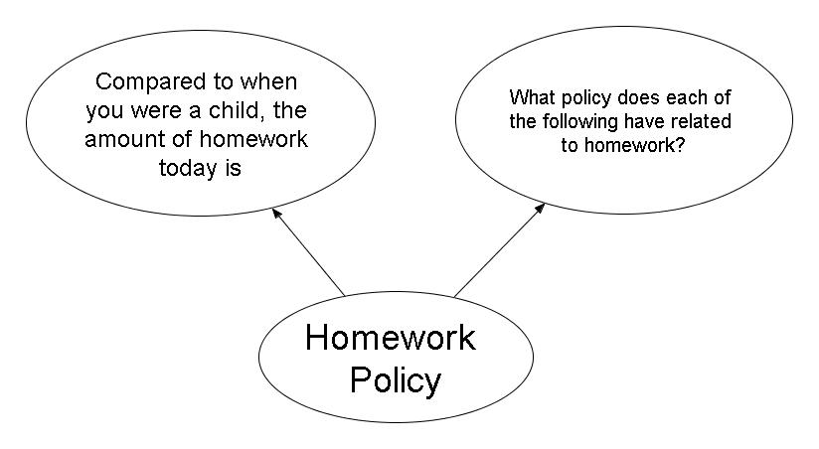
Notes:
Calgary Catholic School District has recently taken steps to revise the homework policy. As I mentioned before St. Pius X currently follows the 10 minute per grade level guidelines. There were 2 questions in this category. It is appropriate to ask about homework when the parents were young because it shows parents perceptions of school. Most people have memories about school, some are positive and some are negative. It may be reasonable to see a relationship between parent perceptions and student attitudes surrounding homework.

Slide 27
Compared to when you were a child, the amount of homework today is
Notes:
The data in this question reinforces some of the findings in Gill and Schlossman`s article on the history of homework. We can clearly see that parents remember doing less homework when they were children. Many parents also may have had fewer extra-curricular activities so it may seem to them that they had more free time when they were children. At the other end of the scale we see parents that had more homework when they were children. It could be that these parents come from other cultures or backgrounds and had more demands placed on them as children.

Slide 28
What policy does each of the following have related to homework?
Notes:
This information is clearly printed at the front of the agendas students receive in the fall. Our school asks that students go home and read through the information then sign off that they have read and understand the information. The data for this question do not indicate this knowledge. It would seem that some parents are unaware as to what the expectations are regarding homework. This is hardly surprising as most households have both parents working outside the home. Fatigue takes its toll. I can definitely empathize with the parents of our school community. The last thing I want to do when I get home after a long day of work is to spend time fighting with my child over mind-numbing homework tasks.

Slide 29
