Slide 1

keeping it
simple
future
in the

Slide 2
you can talk
about the
FUTURE
like this ...

Slide 3

ce soir
je vais regarder
la télé
PLUS AN
INFINITIVE
PRESENT TENSE
OF ALLER
tonight I’m going to watch tv

Slide 4
this way is
called the
FUTUR
PROCHE
Use it to talk about
the near future, i.e. what you are going to do …..

Slide 5
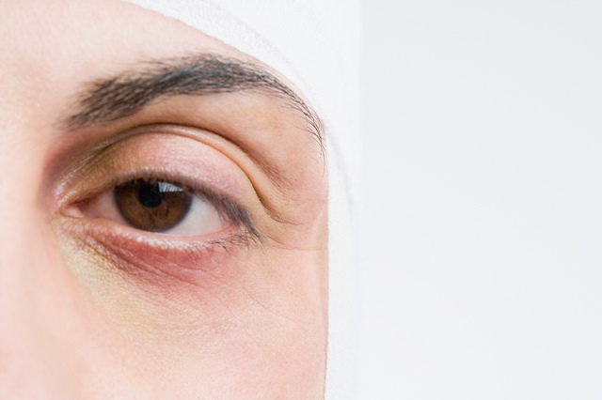
now look
at this
different
version ...

Slide 6
ce soir
je regarderai
la télé
PLUS AN
ENDING
STEM (same as
THE infinitive)
tonight I will watch tv

Slide 7
this way is
called the
FUTUR
SIMPLE
Use it to talk about
ANY FUTURE TIME, i.e. TO SAY WHAT YOU WILL DO, WHAT WILL HAPPEN ..

Slide 8

so how
does it
work
then?

Slide 9
STEM
the verb is
ONE
word
note -
RE verbs
lose the
final -E
(= the infinitive)
plus
ENDING

Slide 10
je | travailler
tu | jouer
il | partir
elle | descendr
on | boir
ai
as
a
a
look!
no -E
a

Slide 11
nous | travailler
vous | jouer
ils | partir
elles | descendr
ons
ez
ont
ont
look!
no -E

Slide 12
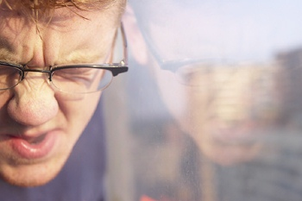
some
verbs
are
irregular
but the stem still
ends in -r

Slide 13
être | Je serai | devoir | Je devrai
avoir | J’aurai | pouvoir | Je pourrai
aller | J’irai | vouloir | Je voudrai
venir | Je viendrai | voir | Je verrai
faire | Je ferai | envoyer | J’enverrai
and others you will meet …..

Slide 14
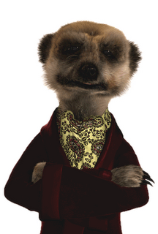
and that’s
the
FUTUR
SIMPLE
dubai image – yasser khairat
tv set image – yasib nasir
other images – clipart.com
© Rob Courtney King Edward VI School Southampton

