Slide 1
Nitrates
Temperature
Tests to be conducted
on the Charles River
Phosphates
Turbidity
Ph

Slide 2
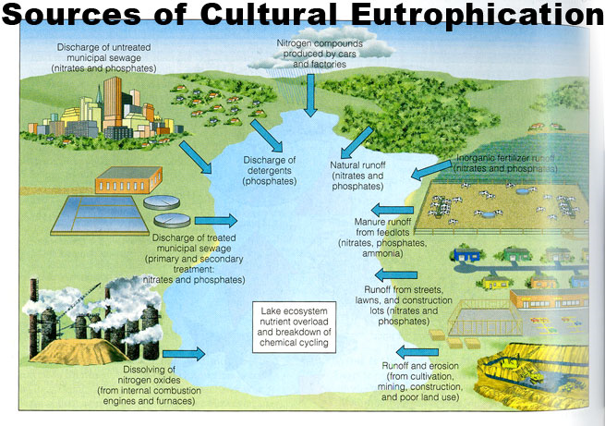

Slide 3
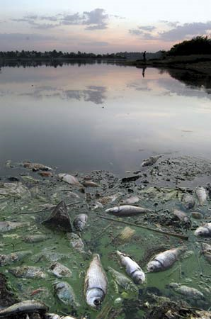
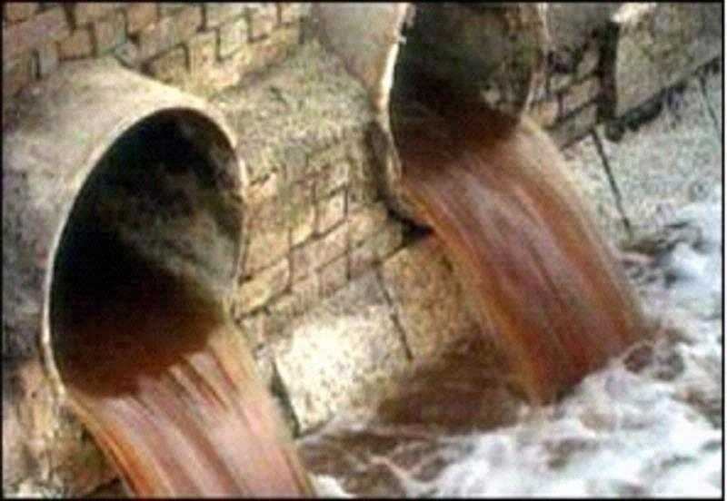

Slide 4
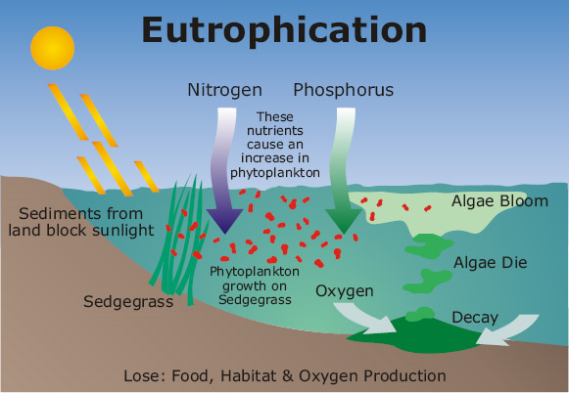

Slide 5
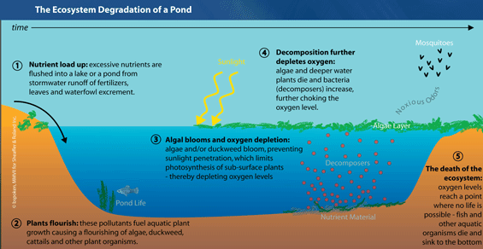

Slide 6
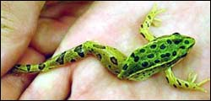
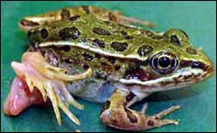
Excess levels of nitrogen, phosphorus causing deformed frogs
http://www.innovations-report.com/html/reports/environment_sciences/report-32266.html

Slide 7
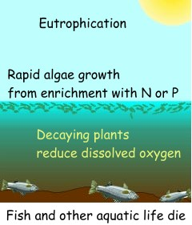
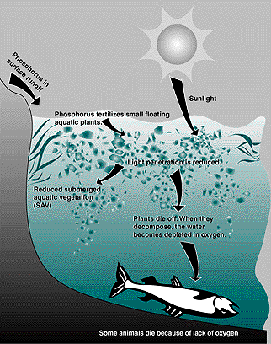
Vocabulary of Interest
Effluent
Point Source vs Non Point Source

Slide 8
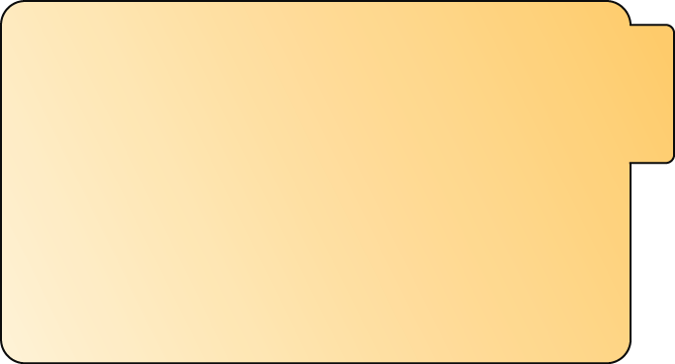
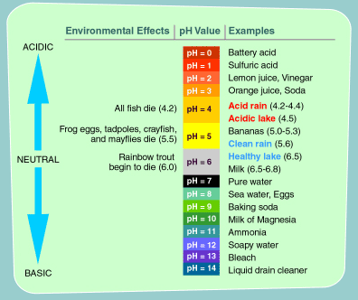


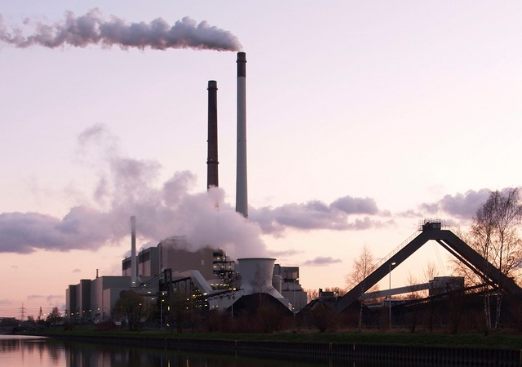
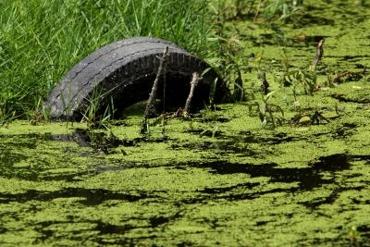
The Ph Scale.....What is an Acid? What is a Base
ACID
Pull
Pull
ACID- PH from 0-6._
BASE
BASE- PH 7._ - 14
Pull
Pull
NEUTRAL
PH - 7

Slide 9
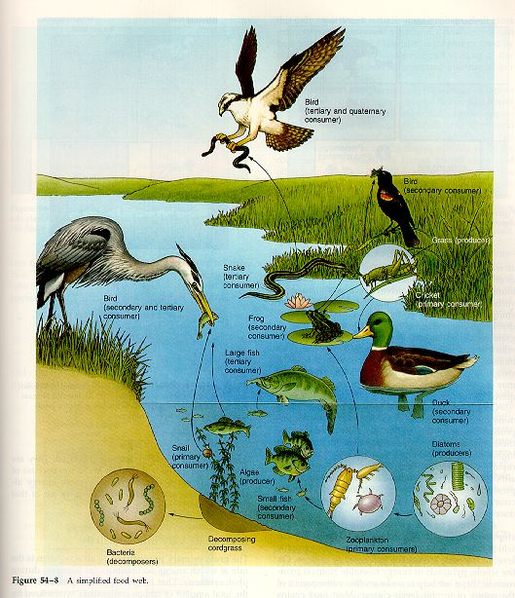
Producers
Consumers
decomposer

Slide 10
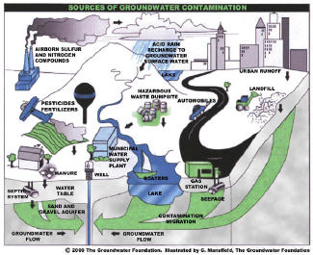
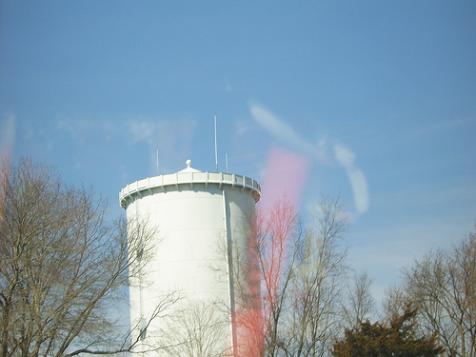
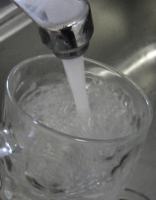
Where Does My Water Come From?
The origin of our water is five ground water supply wells referred to as Wells 1, 2, 3, 4, and 6. (Note: Well 5 was not fully constructed due to high levels of iron and manganese in its water.) The ground water supply is not exposed to air and is not subject to direct pollution and contamination like a river or reservoir (surface water). In fact, ground water is the highest quality of water available to meet the public health demand of water intended for human consumption. Wells 1, 2, and 6 are located in the Charles River Aquifer, while Wells 3 and 4 are located in the Neponset River Aquifer. The water system also includes five pumping facilities for the distribution of water, two water storage tanks, and approximately 76 miles of water main.

Slide 11
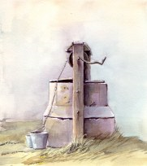
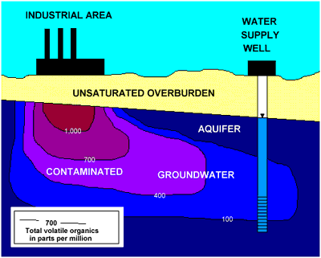
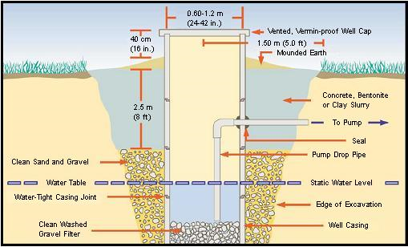

Slide 12
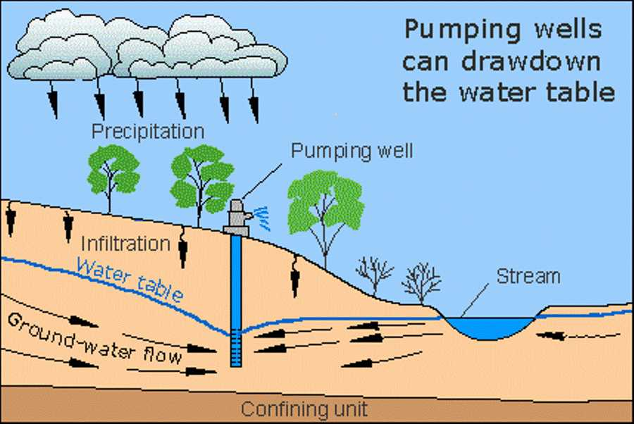

Slide 13
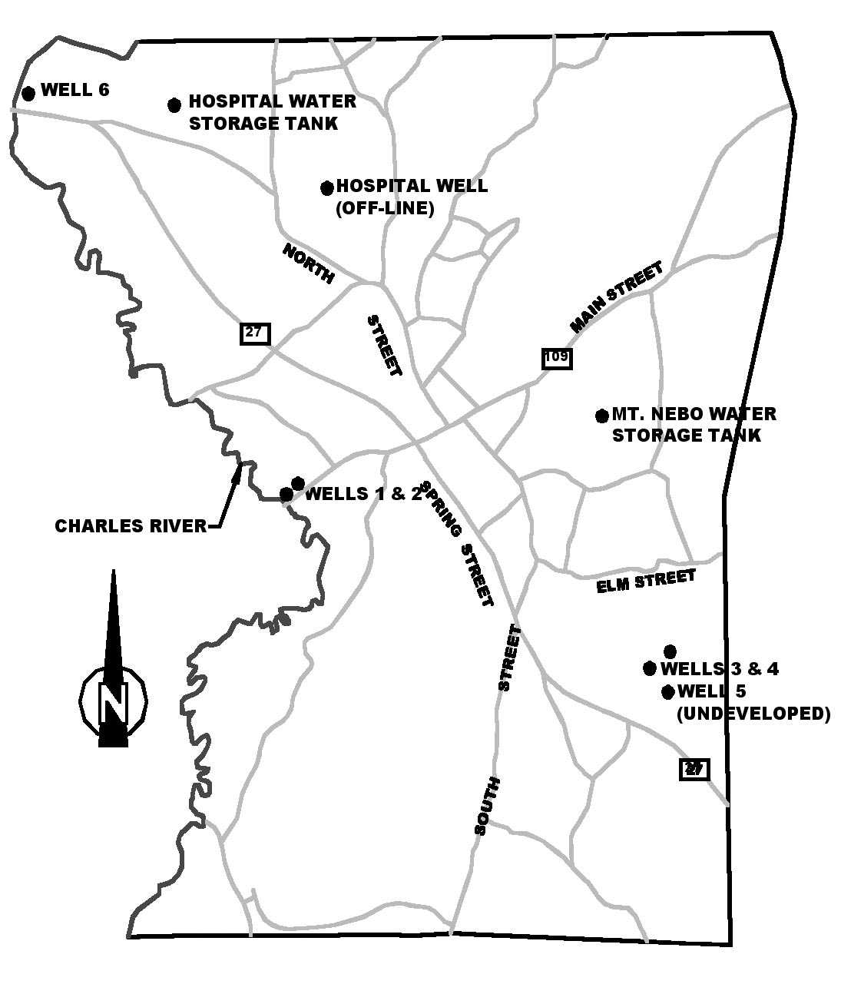

Slide 14
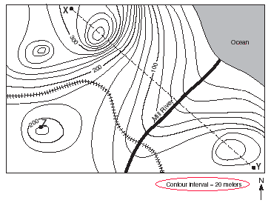
Topographic Map Review:

Slide 15
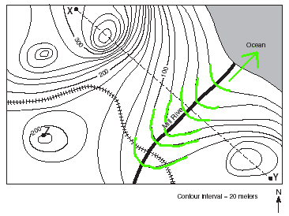

Slide 16
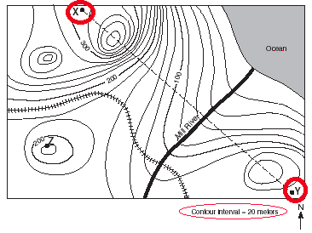
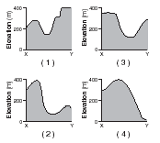
The best way to approach this is by the process of elimination. First of all, point X appears to be approximately 310 meters in elevation. Let's eliminate all the choices that don't begin at 310 meters:
That eliminates choices 1 & 3 right off the bat!
Next, we look at point Y, which appears to be approximately 130 meters.
That eliminates choice 4. That means choice 2 must be correct!

Slide 17
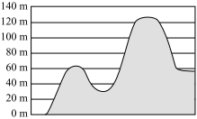
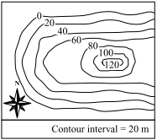
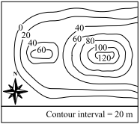
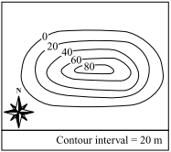
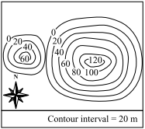
The diagram below shows a side view of a landform with different elevations.
A graph representing the side view of a landform with different elevations
Which of the following maps best represents this landform?
A.
B.
C.
D.
A
B
C
D

