Slide 1
Chapter 14
Ancient China

Slide 2
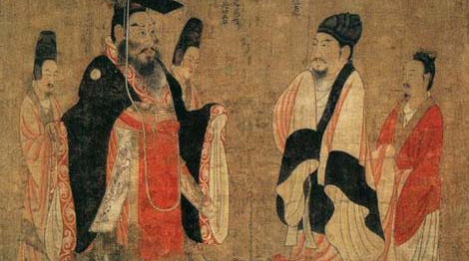
Pic depicting Ancient China. Image taken from: history.cultural-china.com.

Slide 3
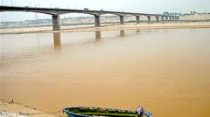
Section 1: Settling Along the Huang River
Image of the Huang River. Image taken from: justchina.org.

Slide 4
China’s Geography
China’s geography consists of a huge landmass, similar to the size of the United States. Most of China is covered with mountains and vast deserts, but the people were still able to make their living due to the river valleys. The Chinese people are extremely dependent on the Huang and the Chang Rivers as their water source.
Large settlements were in the China Plain, as it was the perfect place for agriculture.

Slide 5
An Isolated Country
With travel and trade difficult, ancient China was cut off from other civilizations and developed its own traditions and way of life.

Slide 6
The Shang Dynasty
The Shang Dynasty was able to rise to power, because small kingdoms began taking over other smaller kingdoms. Eventually, a person from one of the smaller kingdoms started the Shang Dynasty and was able to expand its empire.
The Shang kept power within the family by passing the rule from brother to brother and from youngest brother to son.

Slide 7
Oracle Bones
Oracle bones had questions written on them.
They would then be heated and cracked.
The king or priests would interpret the cracks to get an answer to their question.

Slide 8
Writing System
The Shang writing system did not have actual words, but rather pictures that represented words or ideas. This was called pictographs. In modern times, the Chinese language is difficult to learn, because it consists of thousands of pictographs.

Slide 9
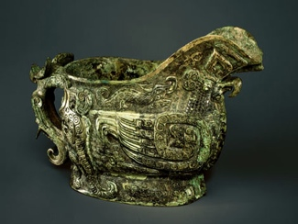
Bronze
Bronze became a very popular metal that was used in China. The Chinese people made decorated pots, cups and weapons out of bronze.
Chinese bronze artifact. Image taken from:
arts.cultural-china.com.

Slide 10
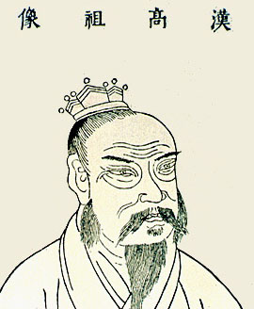
Section 2: China Under the Zhou Dynasty
Depiction of a Zhou
King. Image taken from:
chinatownconnection.com.

Slide 11
The Zhou Ascend to Kings!!!
The Zhou was able to gain power from the Shang, because the Shang rulers became corrupt and started to govern badly. The Shang rulers only cared about their own enjoyment and many people came to resent them. When the Zhou attacked the Shang, they did not even bother to put up a fight, but rather surrendered.

Slide 12
The Mandate of Heaven Argument
The Zhou kings claimed that they had the support of heaven, as the Shang did not oppose them during attack.
They claimed that it was the Mandate of Heaven that ascended them to the throne.
The Mandate of Heaven though had a draw back for rulers, because if they could not treat their subjects properly, then another ruler would receive the mandate to rule.

Slide 13
The Zhou Government
The Zhou kings depended on family members to help rule their large kingdom. After a time, the relationship between the Zhou kings and the nobles in charge of the regions or states dwindled.
Eventually, the nobles were trying to take over the Zhou king but with the help of his loyal noble friends he was able to defeat them.
After the fighting ended, the Zhou king never gained full support and respect and this led to chaos. Warlords started arising and even though they pledged allegiance to the Zhou king, they always tried to take power.

Slide 14
Warring States Period
The Zhou kings were loosing control of the country and fighting consumed the people. Millions had died during war between weaker and stronger states.
China was in total chaos for a total of 254 years before another dynasty was able to take power and unite China.

Slide 15
The Zhou Society
The Zhou society consisted of the Zhou king at the top, his appointed nobles who led the states, merchants, artisans, and slaves, but the majority of the Zhou society consisted of peasants.
The Chinese family was revered, as the family was at the top of their value list. Within the Chinese family, the older family members had the most power and respect. The younger family members had to earn respect.

Slide 16
The Economy
The Zhou strengthened the economy by using iron to make stronger farming tools that led to greater food production.
They built a network of roads that accommodated travel and trade.
Finally, they created their own coin that made trade easier.

Slide 17
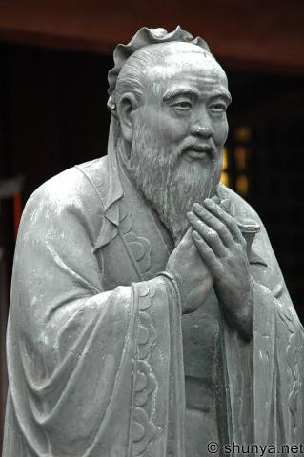
Section 3: Religions and Beliefs of Ancient China
Image of Confucius.
Image taken from:
shunya.net.

Slide 18
Spiritual Traditions
The Chinese people believed that there were good and bad spirits.
The good spirits brought: rainfall so crops could grow, they brought happiness, and safety to sailors.
The bad spirits brought bad things.
The Chinese believed that bad spirits could live in your house bringing bad luck.

Slide 19
Worshipping their ancestors….
Chinese people worshipped their ancestors, because they believed that family members lived on even after death.
They built shrines and even left food for their ancestors.

Slide 20
Confucius
Confucius lived in the time when the Zhou kings were loosing their power.
Confucius looked for ways to solve the problems of the time.
He became revered by his people and is said to be the first teacher of China.
Confucius looked around and noticed that officials did not often enforce the laws and thus people behaved badly.
He also noticed that officials could be easily bribed.
He believed that if the government went back to the ideology of the early Zhou kings, then the government would survive.

Slide 21
Relationships and Confucianism
The teachings of Confucianism are seen in the vision of a stable society that was based on specific relationships.
Confucius thought that the type of relationships we have between certain people defines how we behave.
Confucian believed that one of the most important relationships was that between a child and their parents. He believed that it was the duty to care and teach the young and in turn the young should respect their elders.

Slide 22
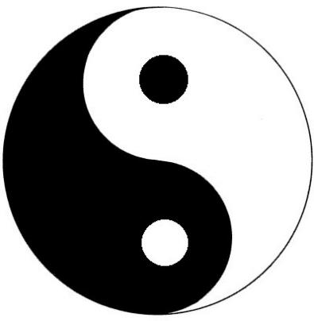
Daoism
Daoism is an ancient Chinese way of life that emphasizes a simple and natural existence. It is a philosophy of following the Dao or the natural way of the universe.
Picture representing
Daoism. Image taken from:
drmaryann.wordpress.com.

Slide 23
Laozi
Laozi is known as the founder of Daoism and the writer of the Dao Do Jing.

Slide 24
Paths to the Dao
Daoism states that in order to be one with the Dao, one must be patient and live a simple life, without rituals, morals, and learning.

