Slide 1
Chapter 20 Electrochemistry
Chemistry, The Central Science, 10th edition
Theodore L. Brown; H. Eugene LeMay, Jr.; and Bruce E. Bursten

Slide 2
Ch. 20
Electrochemistry
Oxidation States
Balancing Oxidation-Reduction Equations
Voltaic cells
Cell EMF
Spontaneity of redox reactions
The effect of concentration on EMF
Electrolysis

Slide 3
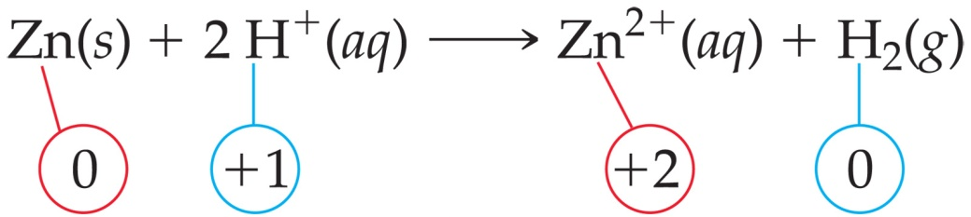
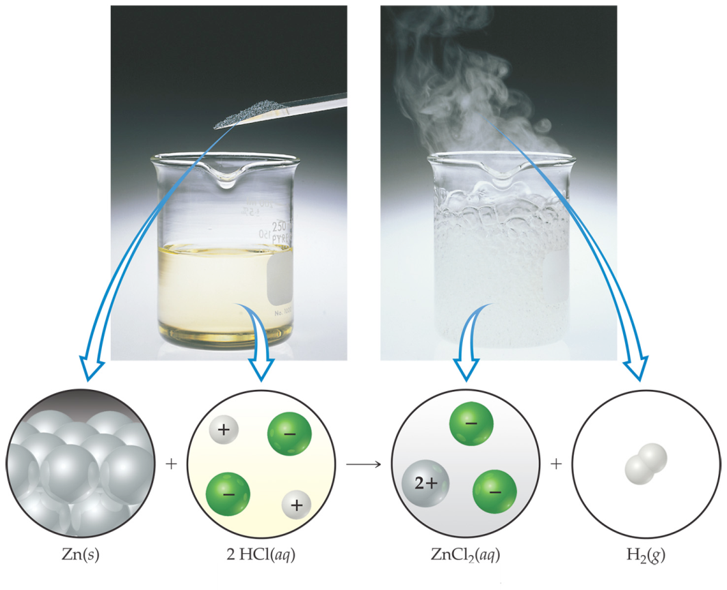
Electrochemical Reactions
In electrochemical reactions, electrons are transferred from one species to another. In order to keep track of what loses electrons and what gains them, we assign oxidation numbers.

Slide 4
Examples of reactions that are redox reactions
(write equations)
A piece of solid bismuth is heated strongly in oxygen.
A strip or copper metal is added to a concentrated solution of sulfuric acid.
Magnesium turnings are added to a solution of iron (III) chloride.
A stream of chlorine gas is passed through a solution of cold, dilute sodium hydroxide.
A solution of tin ( II ) chloride is added to an acidified solution of potassium permanganate
A solution of potassium iodide is added to an acidified solution of potassium dichromate.

Slide 5
Hydrogen peroxide solution is added to a solution of iron (II) sulfate.
Propanol is burned completely in air.
A piece of lithium metal is dropped into a container of nitrogen gas.
Chlorine gas is bubbled into a solution of potassium iodide.
Magnesium metal is burned in nitrogen gas.
Lead foil is immersed in silver nitrate solution.
Pellets of lead are dropped into hot sulfuric acid
Powdered Iron is added to a solution of iron(III) sulfate.

Slide 6
Combination: Oxidizing agent of one element will react with the reducing agent of the same element to produce the free element.
I⁻ + IO₃⁻ + H⁺ → I₂ + H₂O
Decomposition.
a) peroxides to oxides
b) Chlorates to chlorides
c) Electrolysis into elements.
d) carbonates to oxides

Slide 7
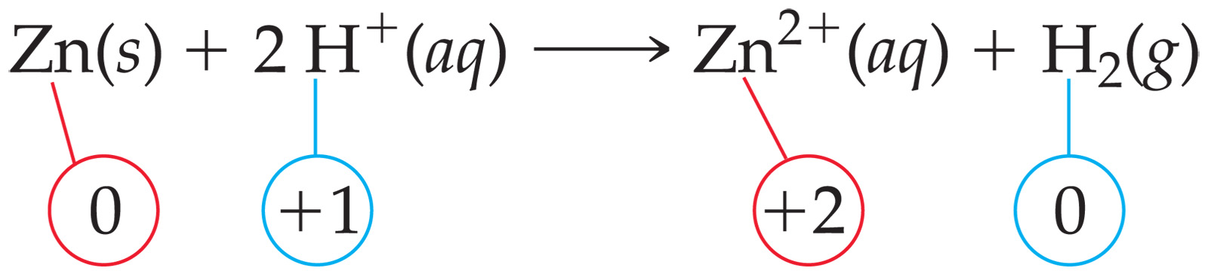
Oxidation and Reduction
A species is oxidized when it loses electrons.
  Here, zinc loses two electrons to go from neutral zinc metal to the Zn²⁺ ion.

Slide 8
Oxidation and Reduction
A species is reduced when it gains electrons.
  Here, each of the H⁺ gains an electron and they combine to form H₂.

Slide 9
Oxidation and Reduction
What is reduced is the oxidizing agent.
  H⁺ oxidizes Zn by taking electrons from it.
What is oxidized is the reducing agent.
  Zn reduces H⁺ by giving it electrons.

Slide 10
Assigning Oxidation Numbers
Elements in their elemental form have an oxidation number of 0.
The oxidation number of a monatomic ion is the same as its charge.
Nonmetals tend to have negative oxidation numbers, although some are positive in certain compounds or ions.
  Oxygen has an oxidation number of −2, except in the peroxide ion in which it has an oxidation number of −1.
  Hydrogen is −1 when bonded to a metal, +1 when bonded to a nonmetal.

Slide 11
Assigning Oxidation Numbers
Nonmetals tend to have negative oxidation numbers, although some are positive in certain compounds or ions.
  Fluorine always has an oxidation number of −1.
  The other halogens have an oxidation number of −1 when they are negative; they can have positive oxidation numbers, however, most notably in oxyanions.
The sum of the oxidation numbers in a neutral compound is 0.
The sum of the oxidation numbers in a polyatomic ion is the charge on the ion.

Slide 12
Balancing Oxidation-Reduction Equations
Perhaps the easiest way to balance the equation of an oxidation-reduction reaction is via the half-reaction method.
This involves treating (on paper only) the oxidation and reduction as two separate processes, balancing these half reactions, and then combining them to attain the balanced equation for the overall reaction.

Slide 13
Half-Reaction Method
Assign oxidation numbers to determine what is oxidized and what is reduced.
Write the oxidation and reduction half-reactions.
Balance each half-reaction.
  Balance elements other than H and O.
  Balance O by adding H₂O.
  Balance H by adding H⁺.
  Balance charge by adding electrons.
Multiply the half-reactions by integers so that the electrons gained and lost are the same.

Slide 14
Half-Reaction Method
Add the half-reactions, subtracting things that appear on both sides.
Make sure the equation is balanced according to mass.
Make sure the equation is balanced according to charge.

Slide 15
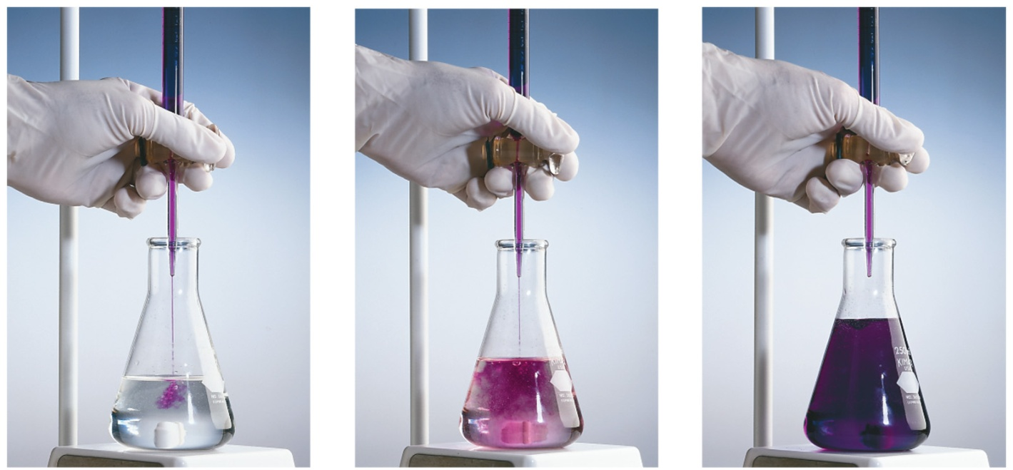
Half-Reaction Method
Consider the reaction between MnO₄⁻ and C₂O₄²⁻ :
MnO₄⁻(aq) + C₂O₄²⁻(aq) ⎯⎯→ Mn²⁺(aq) + CO₂(aq)

Slide 16
Half-Reaction Method
First, we assign oxidation numbers.
+7
+3
+2
+4
MnO₄⁻ + C₂O₄²⁻ ⎯⎯→ Mn²⁺ + CO₂
Since the manganese goes from +7 to +2, it is reduced.
Since the carbon goes from +3 to +4, it is oxidized.

Slide 17
Oxidation Half-Reaction
C₂O₄²⁻ ⎯⎯→ CO₂
To balance the carbon, we add a coefficient of 2:
C₂O₄²⁻ ⎯⎯→ 2 CO₂
The oxygen is now balanced as well. To balance the charge, we must add 2 electrons to the right side.
C₂O₄²⁻ ⎯⎯→ 2 CO₂ + 2 e⁻

Slide 18
Reduction Half-Reaction
MnO₄⁻ ⎯⎯→ Mn²⁺
The manganese is balanced; to balance the oxygen, we must add 4 waters to the right side.
MnO₄⁻ ⎯⎯→ Mn²⁺ + 4 H₂O
To balance the hydrogen, we add 8 H⁺ to the left side.
8 H⁺ + MnO₄⁻ ⎯⎯→ Mn²⁺ + 4 H₂O

Slide 19
Reduction Half-Reaction
8 H⁺ + MnO₄⁻ ⎯⎯→ Mn²⁺ + 4 H₂O
To balance the charge, we add 5 e⁻ to the left side.
5 e⁻ + 8 H⁺ + MnO₄⁻ ⎯⎯→ Mn²⁺ + 4 H₂O

Slide 20
Combining the Half-Reactions
Now we evaluate the two half-reactions together:
C₂O₄²⁻ ⎯⎯→ 2 CO₂ + 2 e⁻
5 e⁻ + 8 H⁺ + MnO₄⁻ ⎯⎯→ Mn²⁺ + 4 H₂O
To attain the same number of electrons on each side, we will multiply the first reaction by 5 and the second by 2.

Slide 21
Combining the Half-Reactions
5 C₂O₄²⁻ ⎯⎯→ 10 CO₂ + 10 e⁻
10 e⁻ + 16 H⁺ + 2 MnO₄⁻ ⎯⎯→ 2 Mn²⁺ + 8 H₂O
When we add these together, we get:
10 e⁻ + 16 H⁺ + 2 MnO₄⁻ + 5 C₂O₄²⁻ ⎯⎯→
2 Mn²⁺ + 8 H₂O + 10 CO₂ +10 e⁻

Slide 22
Combining the Half-Reactions
10 e⁻ + 16 H⁺ + 2 MnO₄⁻ + 5 C₂O₄²⁻ ⎯⎯→
2 Mn²⁺ + 8 H₂O + 10 CO₂ +10 e⁻
The only thing that appears on both sides are the electrons. Subtracting them, we are left with:
16 H⁺ + 2 MnO₄⁻ + 5 C₂O₄²⁻ ⎯⎯→
2 Mn²⁺ + 8 H₂O + 10 CO₂

Slide 23
Balancing in Basic Solution
If a reaction occurs in basic solution, one can balance it as if it occurred in acid.
Once the equation is balanced, add OH⁻ to each side to “neutralize” the H⁺ in the equation and create water in its place.
If this produces water on both sides, you might have to subtract water from each side.
(Practice Problems)

Slide 24
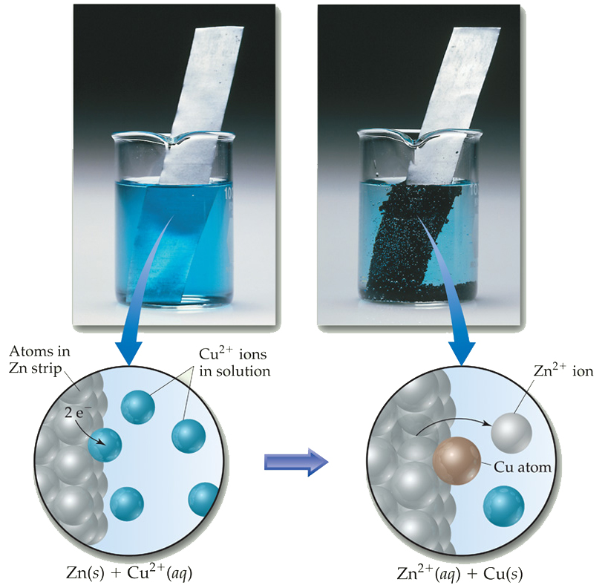
Voltaic Cells
In spontaneous oxidation-reduction (redox) reactions, electrons are transferred and energy is released.

Slide 25
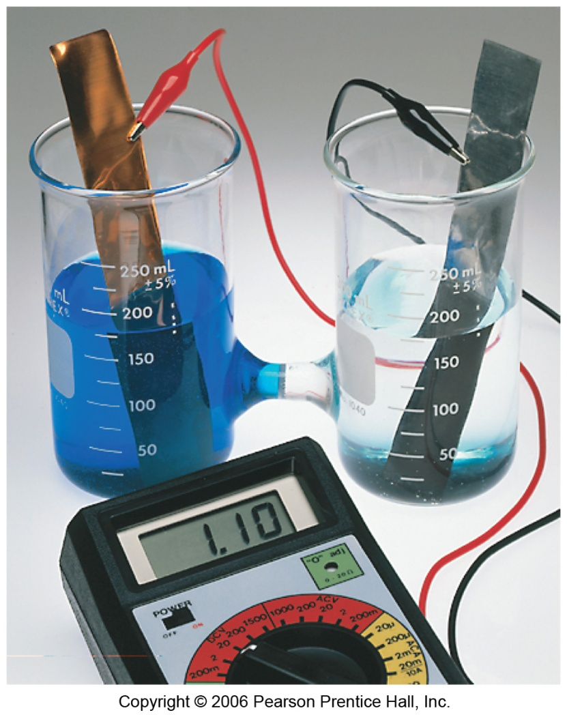
Voltaic Cells
We can use that energy to do work if we make the electrons flow through an external device.
We call such a setup a voltaic cell.
See ANIMATIONS

Slide 26
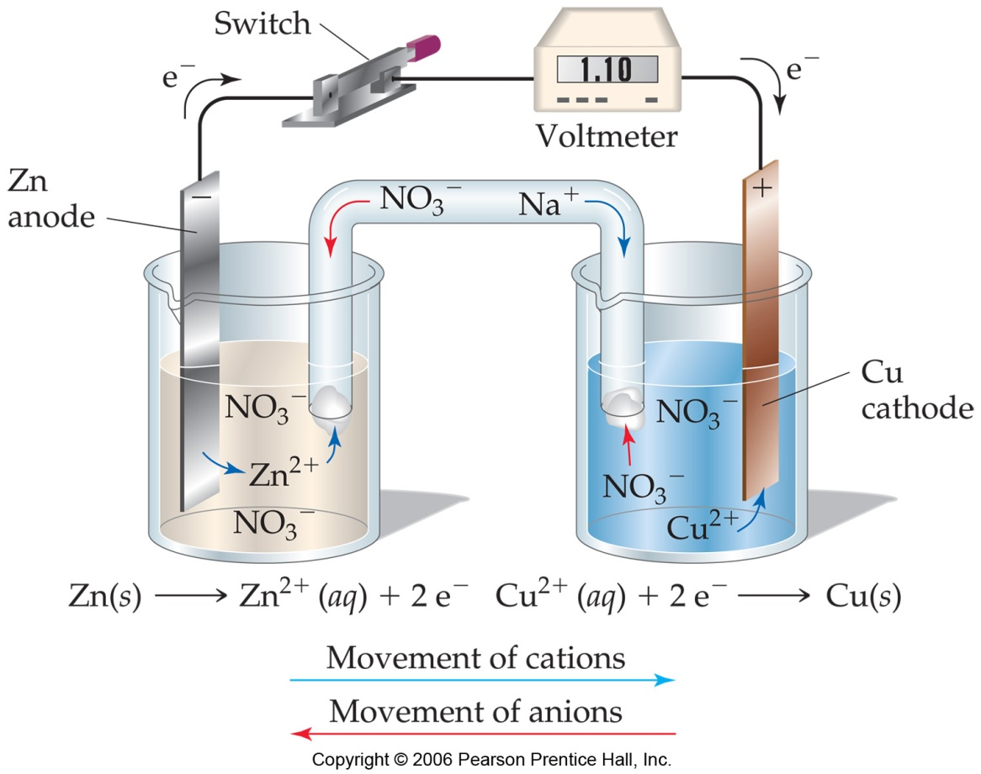
Voltaic Cells
A typical cell looks like this.
The oxidation occurs at the anode.
The reduction occurs at the cathode.

Slide 27
Voltaic Cells
Once even one electron flows from the anode to the cathode, the charges in each beaker would not be balanced and the flow of electrons would stop.

Slide 28
Voltaic Cells
Therefore, we use a salt bridge, usually a U-shaped tube that contains a salt solution, to keep the charges balanced.
  Cations move toward the cathode.
  Anions move toward the anode.

Slide 29
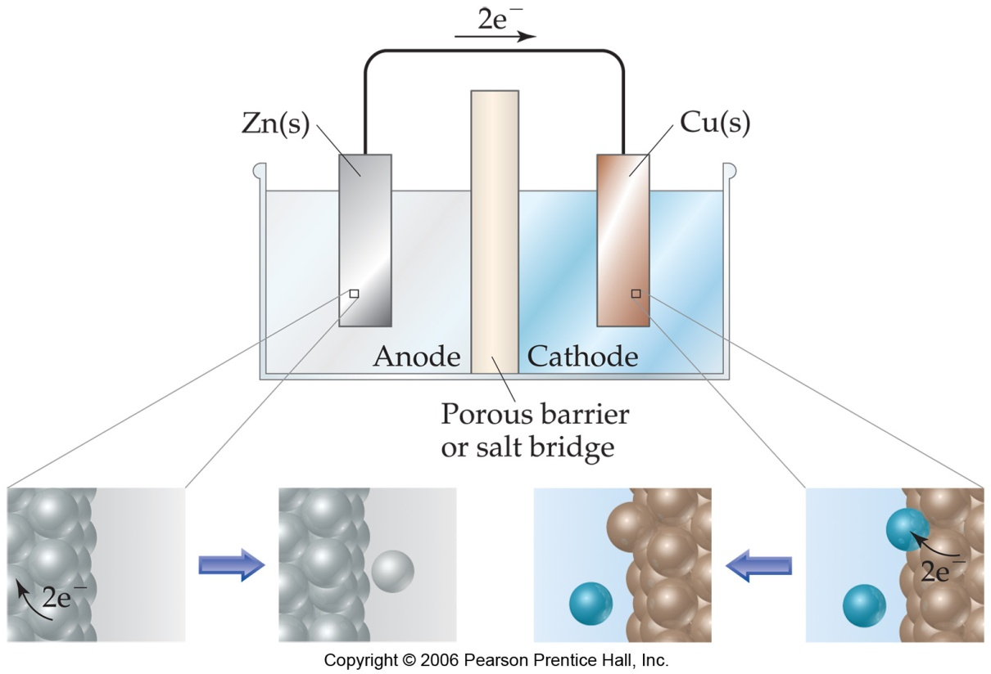
Voltaic Cells
In the cell, then, electrons leave the anode and flow through the wire to the cathode.
As the electrons leave the anode, the cations formed dissolve into the solution in the anode compartment.

Slide 30
Voltaic Cells
As the electrons reach the cathode, cations in the cathode are attracted to the now negative cathode.
The electrons are taken by the cation, and the neutral metal is deposited on the cathode.

Slide 31
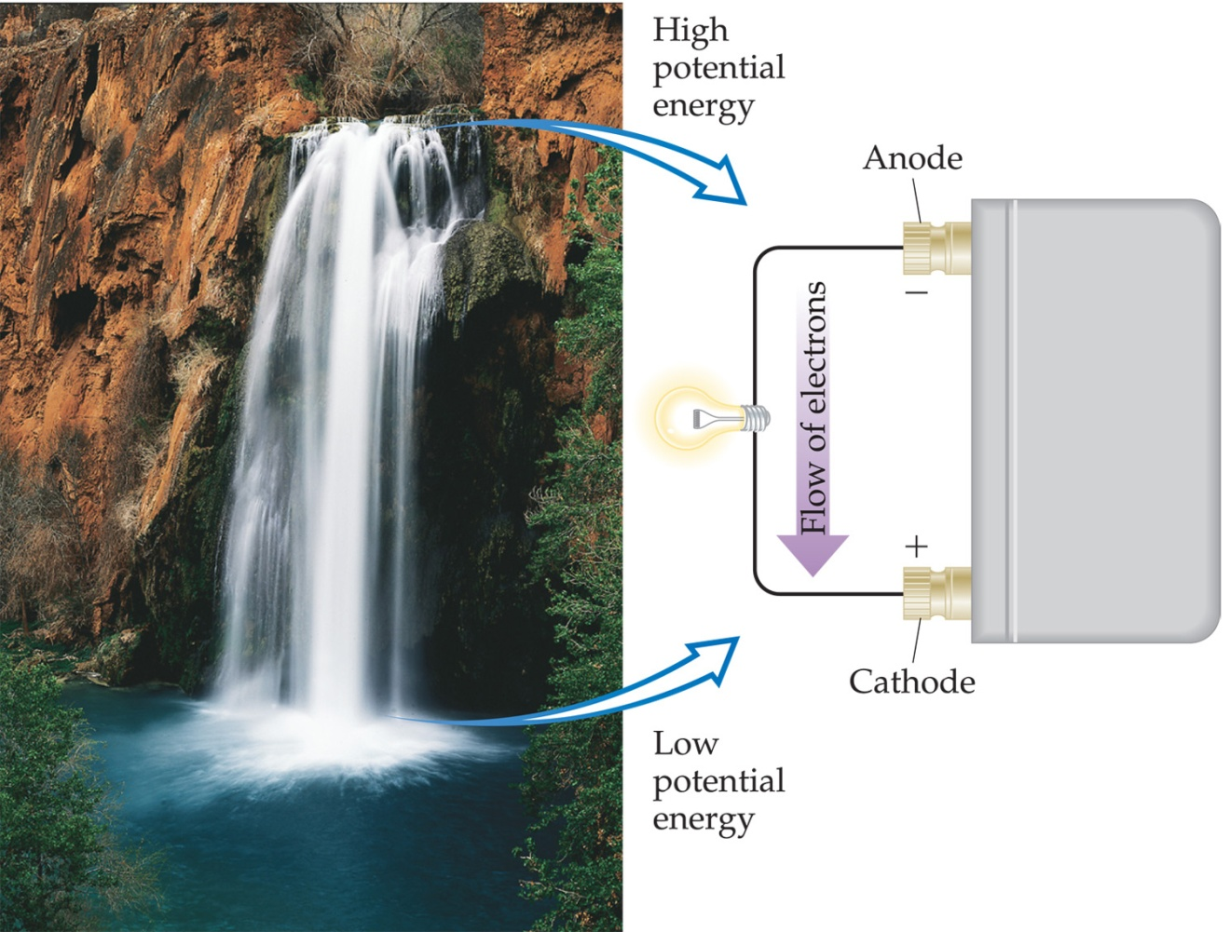
Electromotive Force (emf)
Water only spontaneously flows one way in a waterfall.
Likewise, electrons only spontaneously flow one way in a redox reaction—from higher to lower potential energy.

Slide 32
Electromotive Force (emf)
The potential difference between the anode and cathode in a cell is called the electromotive force (emf).
It is also called the cell potential, and is designated E_{cell}.
Cell potential is measured in volts (V).
J
C
1 V = 1

Slide 33
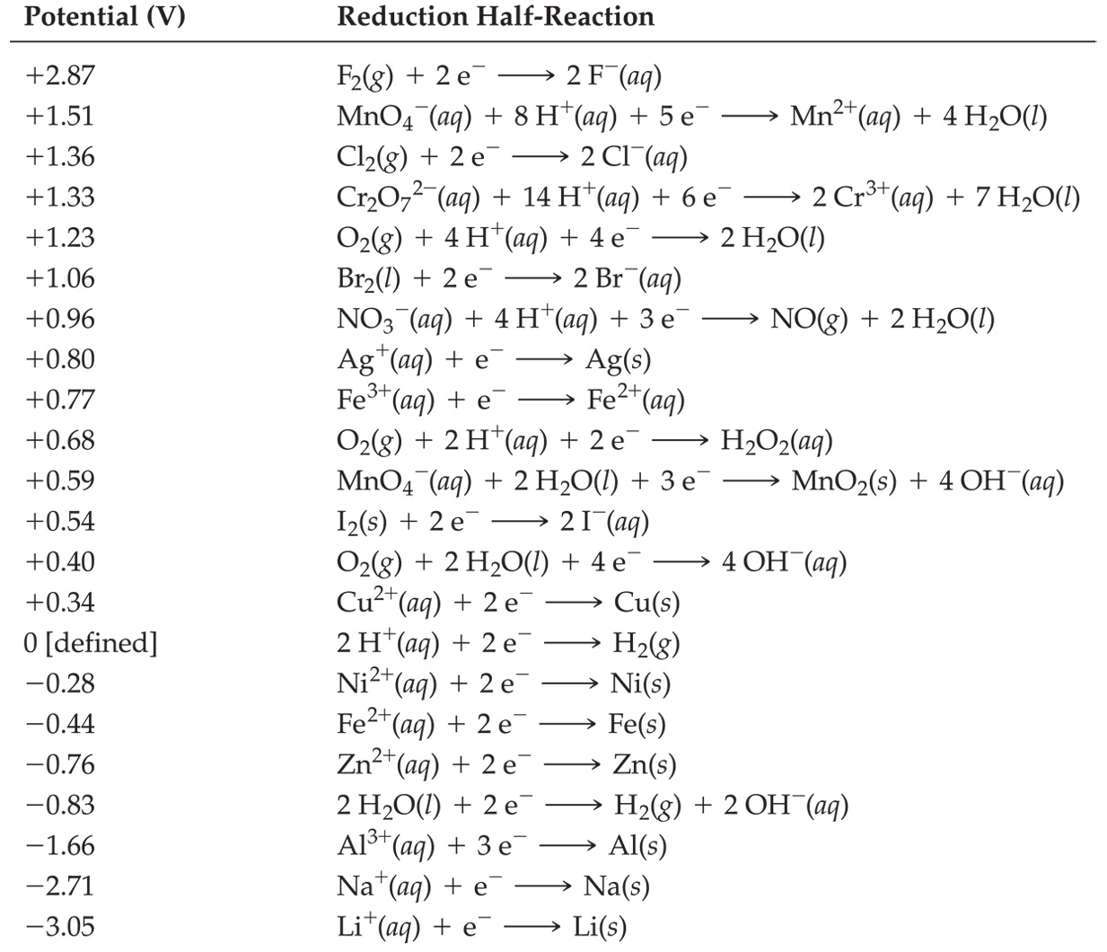
Standard Reduction Potentials
Reduction potentials for many electrodes have been measured and tabulated.

Slide 34
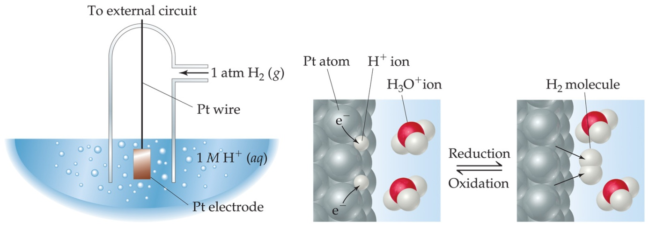
Standard Hydrogen Electrode
Their values are referenced to a standard hydrogen electrode (SHE).
By definition, the reduction potential for hydrogen is 0 V:
2 H⁺ (aq, 1M) + 2 e⁻ ⎯⎯→ H₂ (g, 1 atm)

Slide 35
Standard Cell Potentials
The cell potential at standard conditions can be found through this equation:
E_{cell}
= E_{red} (cathode) − E_{red} (anode)
°
°
°
Because cell potential is based on the potential energy per unit of charge, it is an intensive property.

Slide 36

Cell Potentials
For the oxidation in this cell,
For the reduction,
E_{red} = −0.76 V
°
E_{red} = +0.34 V
°
E_{cell}
=
E_{red}
(cathode) −
E_{red}
(anode)
°
°
°
= +0.34 V − (−0.76 V)
= +1.10 V

Slide 37
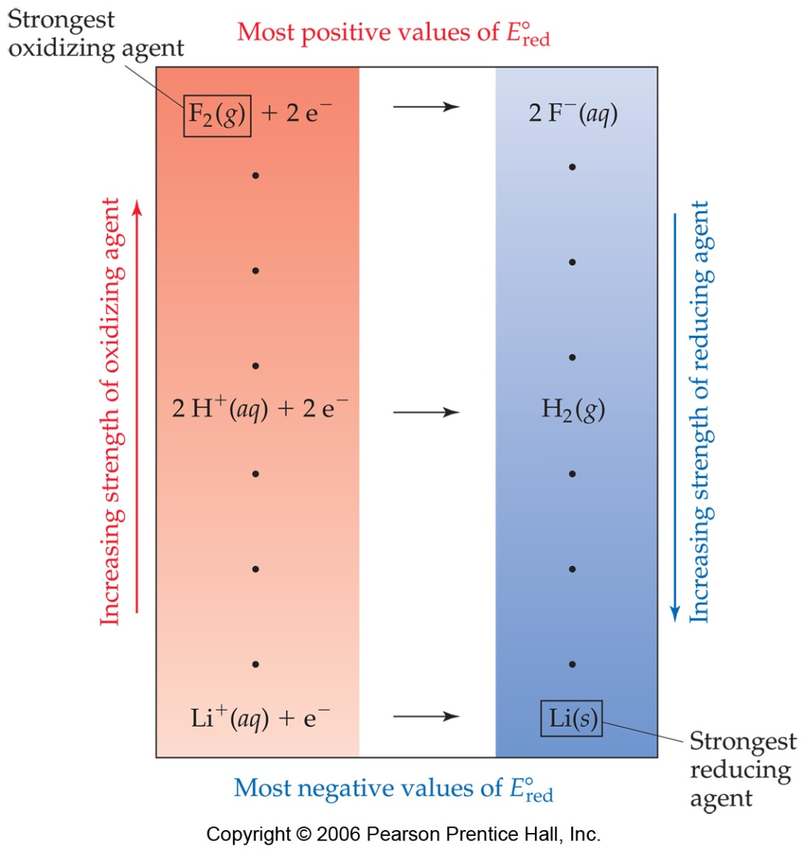
Oxidizing and Reducing Agents
The strongest oxidizers have the most positive reduction potentials.
The strongest reducers have the most negative reduction potentials.

Slide 38
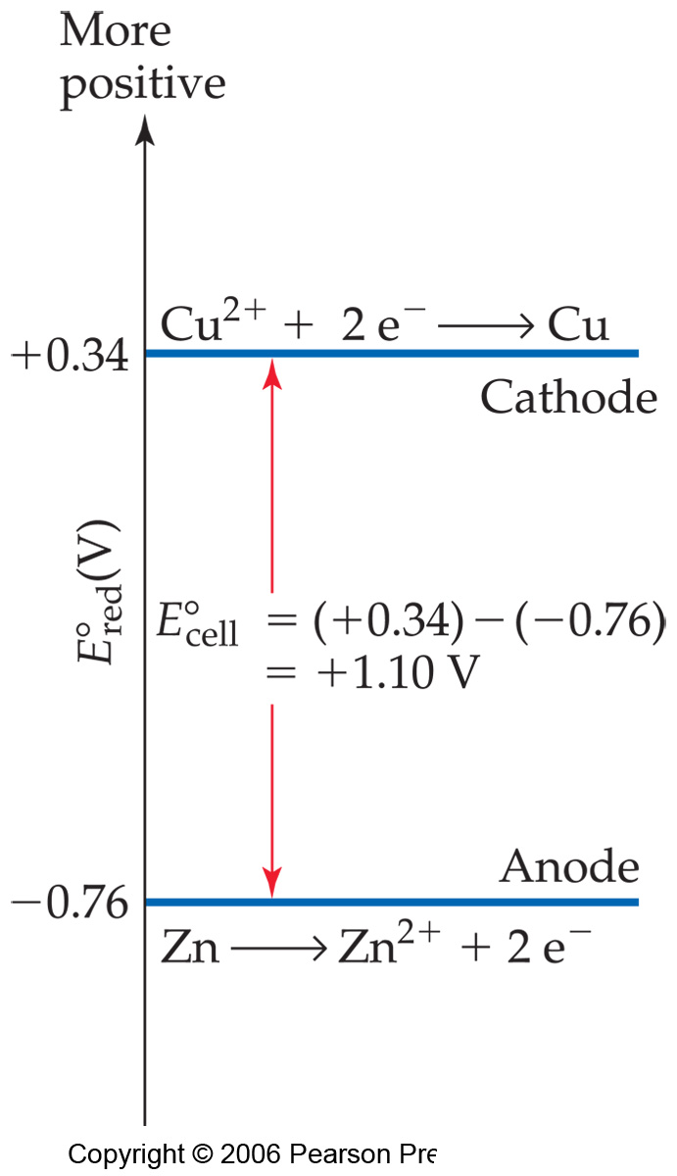
Oxidizing and Reducing Agents
The greater the difference between the two, the greater the voltage of the cell.

Slide 39
Free Energy
ΔG for a redox reaction can be found by using the equation
ΔG = −nFE
where n is the number of moles of electrons transferred, and F is a constant, the Faraday.
1 F = 96,485 C/mol = 96,485 J/V-mol
Under standard conditions,
ΔG° = −nFE°

Slide 40
Nernst Equation
Remember that
ΔG = ΔG° + RT ln Q
This means
−nFE = −nFE° + RT ln Q

Slide 41
Nernst Equation
Dividing both sides by −nF, we get the Nernst equation:
RT
nF
E = E° −
ln Q
or, using base-10 logarithms,
2.303 RT
nF
E = E° −
log Q

Slide 42
Nernst Equation
At room temperature (298 K),
2.303 RT
F
= 0.0592 V
Thus (when T = 298 K) the equation becomes
0.0592
n
E = E° −
log Q

Slide 43
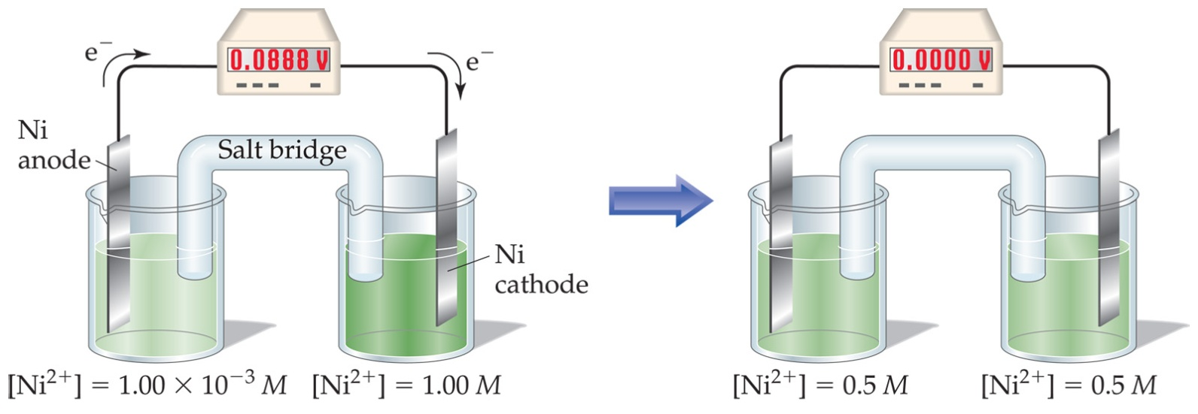
Concentration Cells
Notice that the Nernst equation implies that a cell could be created that has the same substance at both electrodes.
For such a cell,
E_{cell}
would be 0, but Q would not.
°
Therefore, as long as the concentrations are different, E will not be 0.

Slide 44
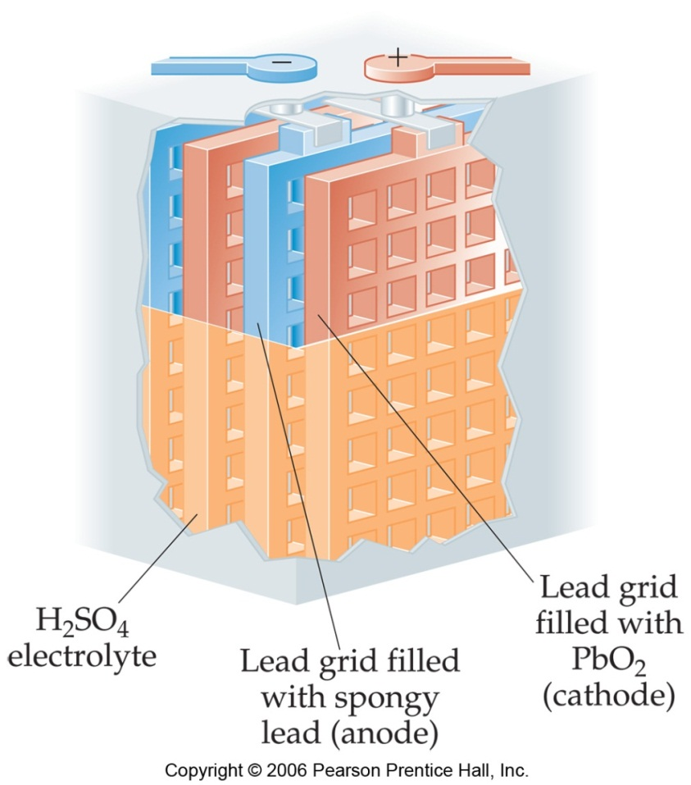
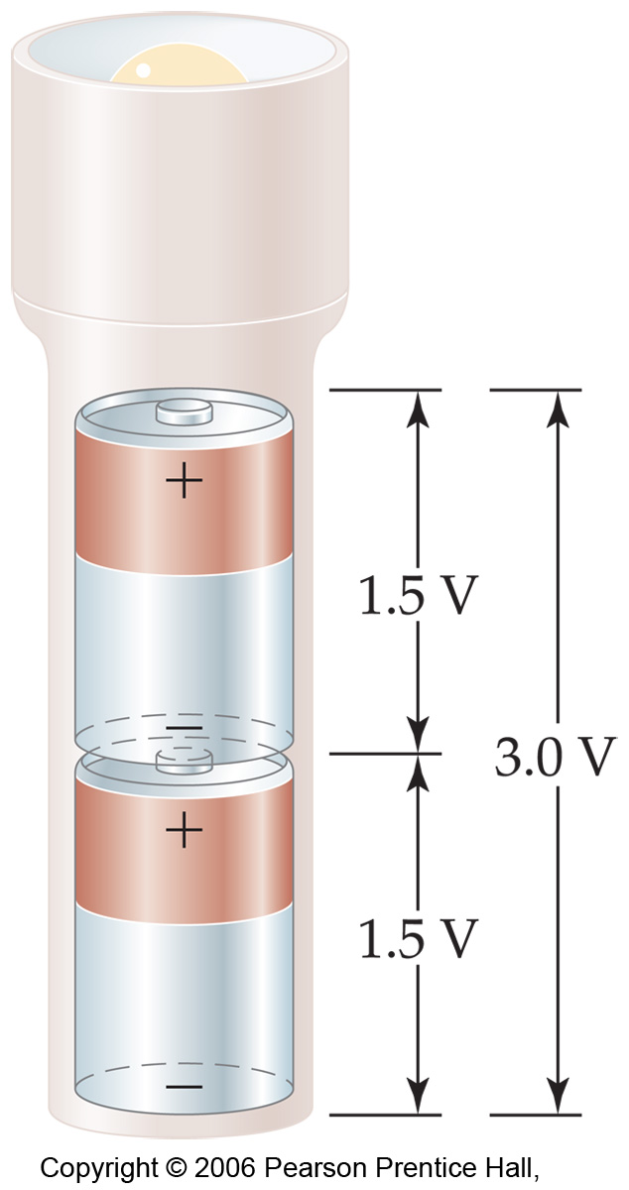
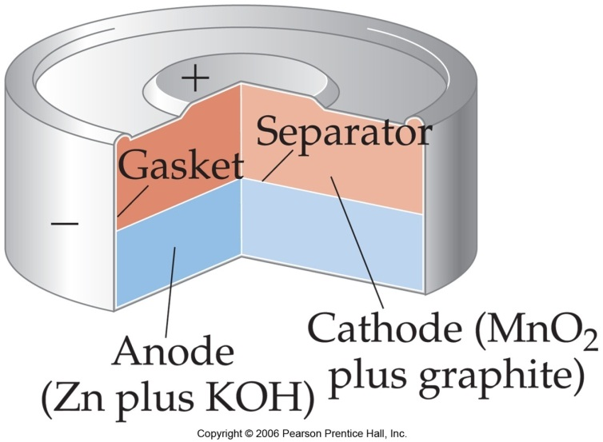
Applications of
Oxidation-Reduction Reactions
Batteries

Slide 45
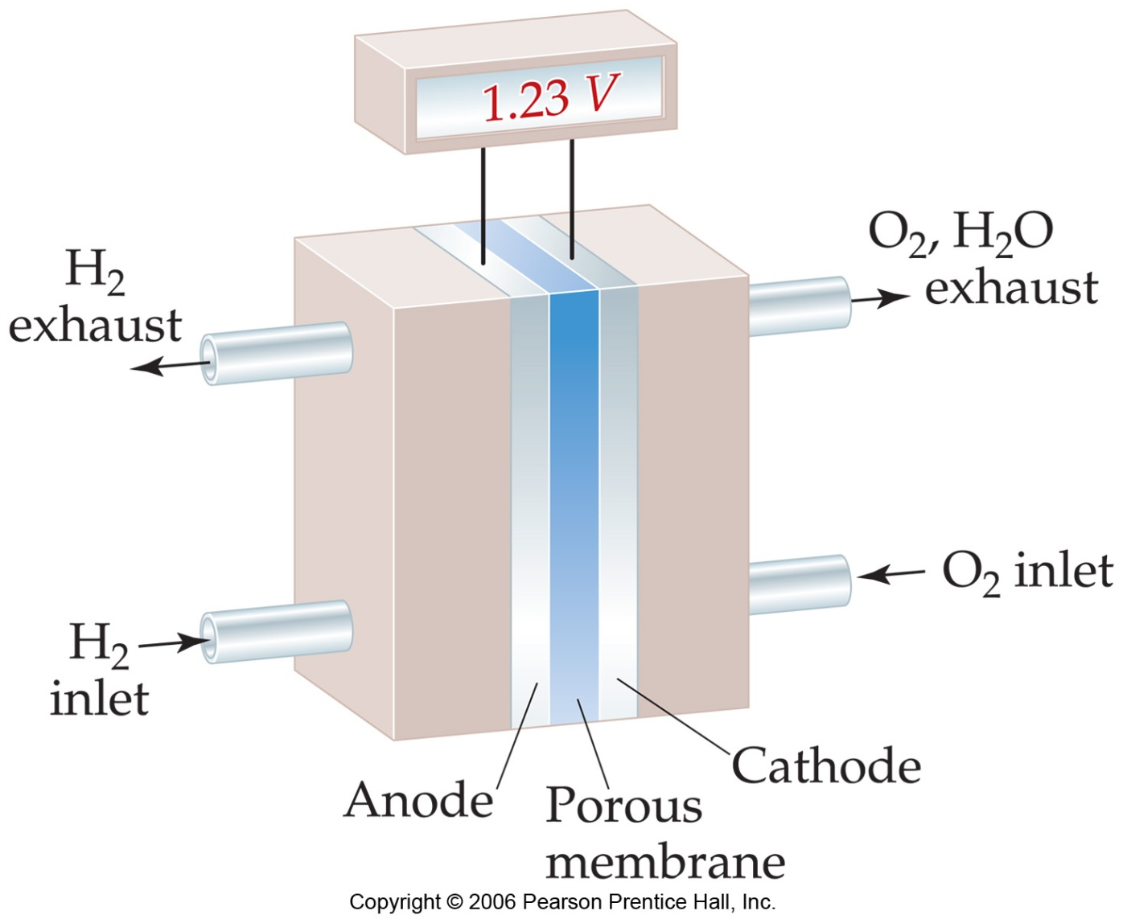
Hydrogen Fuel Cells

Slide 46
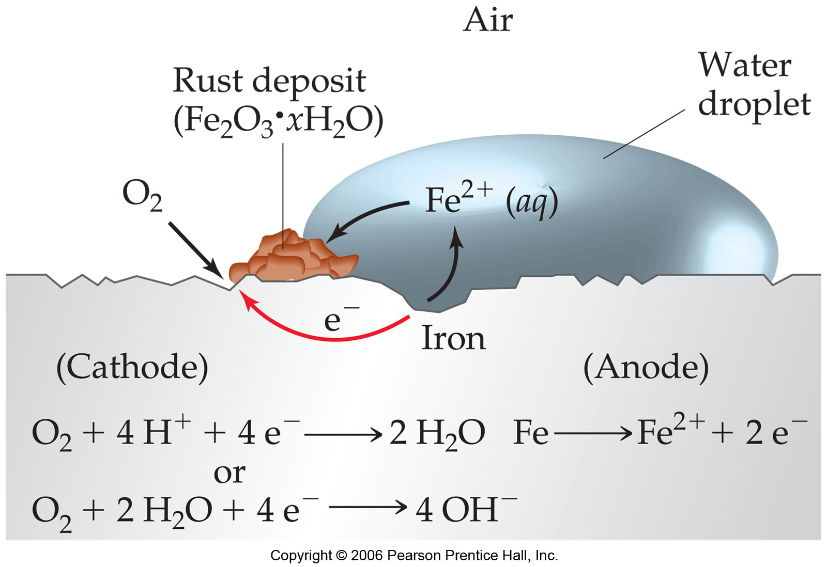
Corrosion and…

Slide 47
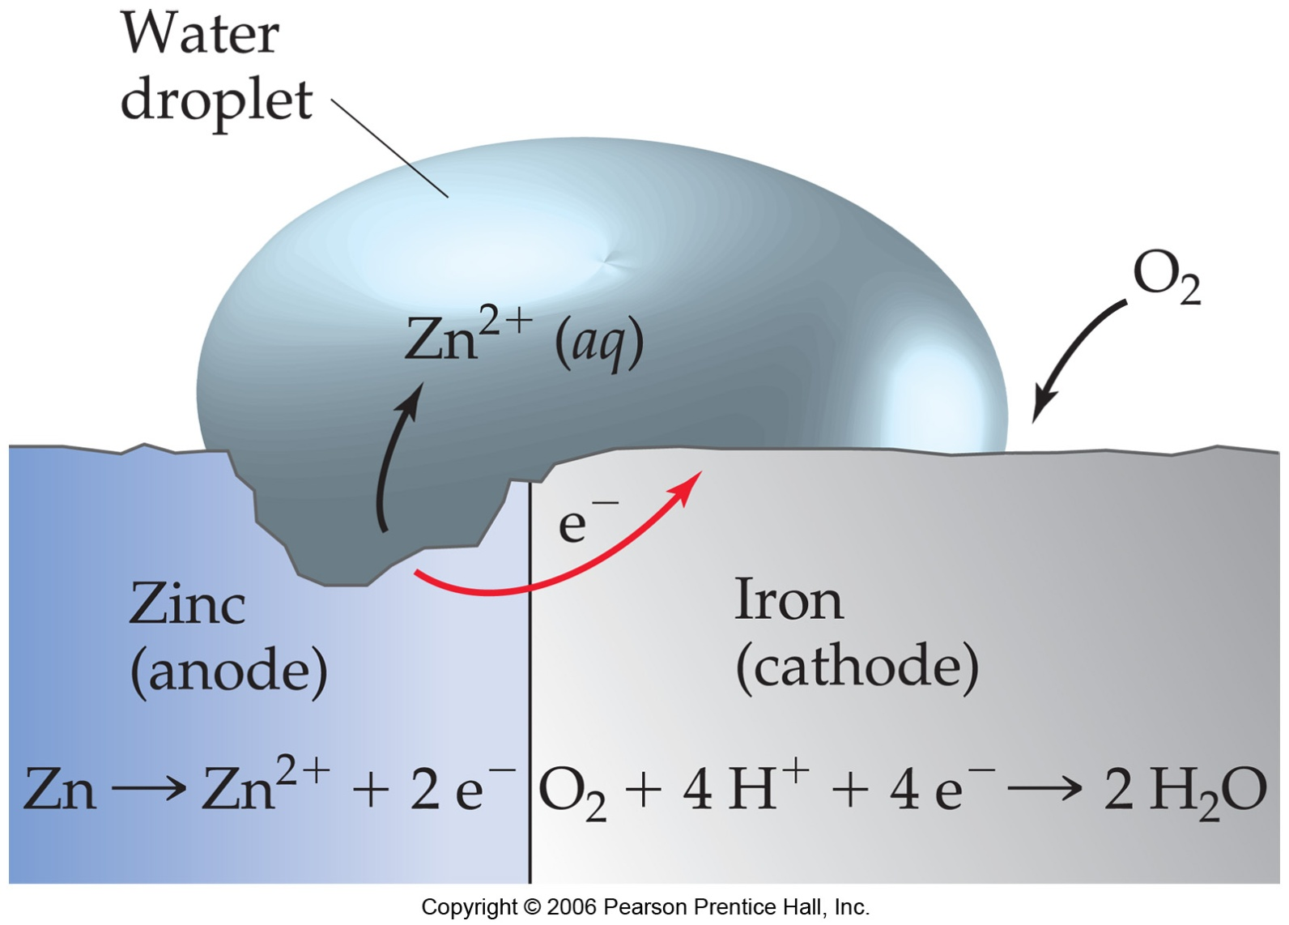
…Corrosion Prevention

Slide 48
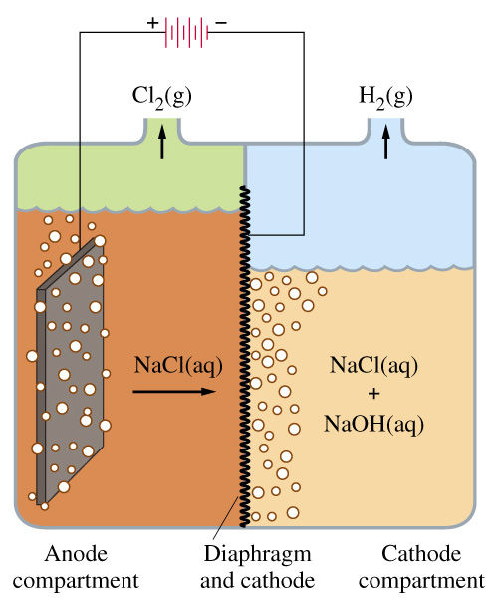
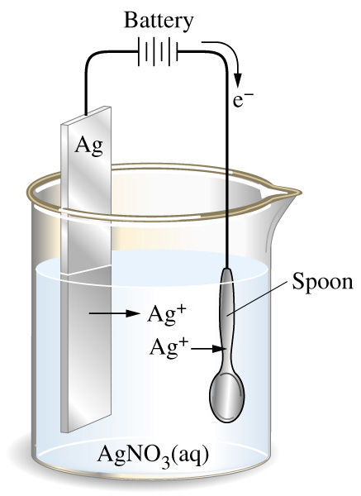
Electrolysis (animations)
Using electrical energy to drive a reaction in a non-spontaneous direction

Slide 49
Electrolysis
Using electrical energy to drive a reaction in a nonspontaneous direction
Used for electroplating, electrolysis of water, separation of a mixture of ions, etc. (Most negative reduction potential is easiest to plate out of solution.)

Slide 50
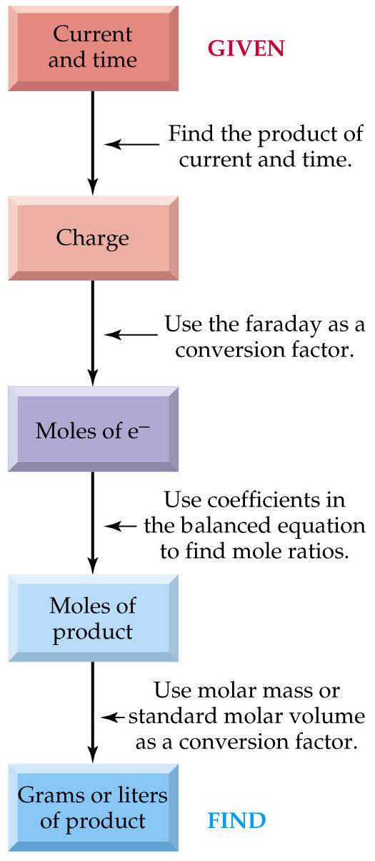
Calculating plating
Have to count charge.
Measure current I (in amperes)
1 amp = 1 coulomb of charge per second
q = I x t
q/nF = moles of metal
Mass of plated metal
Faraday Constant (F)
(96,480 C/mol e-) gives the amount of charge (in coulombs that exist in 1 mole of electrons passing through a circuit.
1volt = 1joule/coulomb

Slide 51
Calculating plating
Current x time = charge
Charge ∕Faraday = mole of e⁻
Mol of e⁻ to mole of element or compound
Mole to grams of compound
or the reverse these steps if you want to find the time to plate
How many grams of copper are deposited on the cathode of an electrolytic cell if an electric current of 2.00A is run through a solution of CuSO₄ for a period of 20min?
How many hours would it take to produce 75.0g of
metallic chromium by the electrolytic reduction of Cr³⁺ with a current of 2.25 A?

Slide 52
How many grams of copper are deposited on the cathode of an electrolytic cell if an electric current of 2.00A is run through a solution of CuSO₄ for a period of 20min?
Answer:
Cu²⁺(aq) + 2e- →Cu(s)
2.00A = 2.00C/s and 20min (60s/min) = 1200s
Coulombs of e- = (2.00C/s)(1200s) = 2400C
mol e- = (2400C)(1mol/96,480C) = .025mol
(.025mol e-)(1mol Cu/2mol e-) = .0125mol Cu
g Cu = (.0125mol Cu)(63.55g/mol) = .79g

Slide 53
How many hours would it take to produce 75.0g of
metallic chromium by the electrolytic reduction of Cr³⁺ with a current of 2.25 A?
Answer:
75.0g Cr/(52.0g/mol) = 1.44mol Cr
mol e- = (1.44mol Cr)(3mol e-/1mol Cr) = 4.32mol e-
Coulombs = (4.32mol e-)(96,480C/mol) = 416,793.6 C (4.17x10⁵C)
Seconds = (4.17x10⁵C)/(2.25C/s) = 1.85x10⁵ s
Hours = (1.85x10⁵ s)(1hr/3600 s) = 51.5 hours

Slide 54
Problem
A student places a copper electrode in a 1 M solution of CuSO₄ and in another beaker places a silver electrode in a 1 M solution of AgNO₃. A salt bridge composed of Na₂SO₄ connects the two beakers. The voltage measured across the electrodes is found to be + 0.42 volt.
(a) Draw a diagram of this cell.
(b) Describe what is happening at the cathode (Include any equations that may be useful.)

Slide 55
Problem
A student places a copper electrode in a 1 M solution of CuSO₄ and in another beaker places a silver electrode in a 1 M solution of AgNO₃. A salt bridge composed of Na₂SO₄ connects the two beakers. The voltage measured across the electrodes is found to be + 0.42 volt.
(c) Describe what is happening at the anode. (Include any equations that may be useful.)

Slide 56
Problem
A student places a copper electrode in a 1 M solution of CuSO₄ and in another beaker places a silver electrode in a 1 M solution of AgNO₃. A salt bridge composed of Na₂SO₄ connects the two beakers. The voltage measured across the electrodes is found to be + 0.42 volt.
(d) Write the balanced overall cell equation.
(e) Write the standard cell notation.

Slide 57
Problem
A student places a copper electrode in a 1 M solution of CuSO₄ and in another beaker places a silver electrode in a 1 M solution of AgNO₃. A salt bridge composed of Na₂SO₄ connects the two beakers. The voltage measured across the electrodes is found to be + 0.42 volt.
(f) The student adds 4 M ammonia to the copper sulfate solution, producing the complex ion Cu(NH₃)₄⁺² (aq). The student remeasures the cell potential and discovers the voltage to be 0.88 volt. What is the Cu²⁺ (aq) concentration in the cell after the ammonia has been added?

