Slide 1
Periodic Table
The Periodic Table of the Elements is the chemist’s friend. It is an extremely useful tool.
Based upon its trends, we can make many predictions in regard to element behavior and to some extent physical properties.

Slide 2
The first attempt at classification
Johann Dobereiner (1780 – 1849) was one of the first to group chemical elements (~1829)
- based upon similarity of behaviors/properties
- they formed groups of three related elements; triads

Slide 3
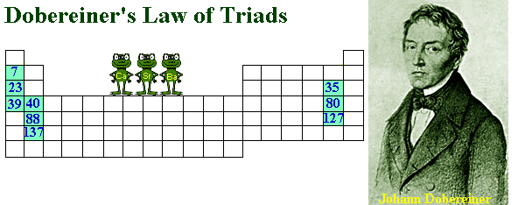
Triads

Slide 4
Alkali Metal Triad
Dobereiner's triads grouped elements with similar chemical properties. Consider lithium, sodium, and potassium, for example.
1. These elements all react with water at room temperature.
2. They react with chlorine to form compounds with similar formulas: LiCl, NaCl, and KCl.
3. They combine with hydrogen to form compounds with similar formulas: LiH, NaH, and KH.
4. They form hydroxides with similar formulas: LiOH, NaOH, and KOH.

Slide 5
Law of Triads
Dobereiner set forth the law of triads in around 1817
The law stated; the mass of the middle element was about the average of the masses of the elements on either side of it.

Slide 6
Examples of Triads
Dobereiner noticed the atomic weight of strontium fell midway between the weights of calcium and barium:
Ca Sr Ba (40 + 137) ÷ 2 = 88
40 88 137
Dobereiner observed a similar pattern for the alkali metal triad and the halogen triad.
Li Na K Cl Br I
7 23 39 35 80 127

Slide 7
Triads Disappear
As new elements were discovered, the triads were expanded and therefore eventually disappeared.

Slide 8
John Newlands
John Newlands (1837 – 1898) proposed the law of octaves (~1865)
It states; if the chemical elements are arranged according to increasing atomic weight, those with similar physical and chemical properties occur after each interval of seven elements. Meaning every eighth element shows similar properties.

Slide 9
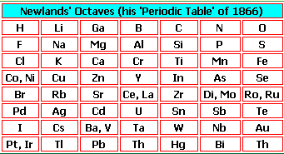
Newland’s Law of Octaves

Slide 10
Law of Octaves is Disregarded
Newlands' Law of octaves failed for the following reasons :
1. It was not valid for elements that had atomic masses higher than Ca.
2. When more elements were discovered, such as elements from the noble gases such as He, Ne, Ar, they could not be accommodated in his table.

Slide 11
More Elements Discovered
As chemical techniques were developed to “refine” ores and obtain or isolate their elements, more elements were discovered.
1800: ~ 31 elements identified
1865: ~ 63 elements identified

Slide 12
Mendeleev and Meyer
Dmitri Mendeleev (1834 – 1907) and Lothar Meyer published schemes for classifying elements around 1869

Slide 13
Lothar Meyer
In about 1868, Meyer prepared an expanded table, similar in many ways to Mendeleyev’s table published in 1869. It was not until 1870, however, that Meyer published his own table, a graph relating atomic volume and atomic number and clearly showing the periodic relationships of the elements.

Slide 14
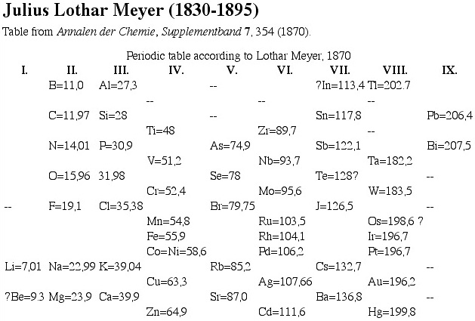
Meyer’s Table

Slide 15
D. Mendeleev
Dmitri Mendeleev – he is credited with the first comprehensive periodic table.
He classified the then known 56 elements on the basis of their physical and chemical properties in the increasing order of the atomic masses, in the form of a table.

Slide 16
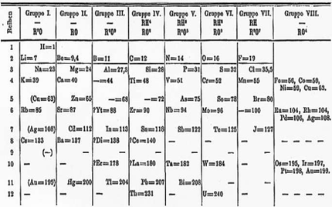
Mendeleev’s Periodic Table

Slide 17
Initial Periodic Law
Mendeleev had observed that properties of the elements orderly recur in a cyclic fashion.
He created the initial periodic law which stated; the properties of the elements are periodic functions of increasing atomic mass.

Slide 18
Oh, the Critics
Mendeleev’s periodic table had two points which critics needed to be answered.
Mendeleev’s periodic table had a few blank spots; it appeared elements should be in those spots and yet, there were none.
There were one or two areas where the elements, when aligned by increasing mass appeared to be “out of order” or switched

Slide 19
Missing Elements
In response to the missing elements, Mendeleev stated that there were elements yet to be discovered, and when discovered they would in fact “fill” these gaps in the table.
He was so confident in his table, he proceeded to predict several of the properties of the new elements.

Slide 20
Properties of the Missing Elements
One gap was below silicon and the other below aluminum, therefore, these missing elements Ge and Ga respectively were called ekasilicon and ekaluminum.

Slide 21
Prediction vs. Fact
Property | Ekasilicon | Germanium
atomic mass | 72.64 | 72.59
density (g/cm³) | 5.5 | 5.35
melting point (°C) | high | 947
color | gray | gray
oxide type | Refractory dioxide | refractory dioxide
oxide density (g/cm³) | 4.7 | 4.7
oxide activity | feebly basic | feebly basic
chloride boiling point (°C) | under 100 | 86 (GeCl₄)
chloride density (g/cm³) | 1.9 | 1.9

Slide 22
Table Support (no not legs!)
The accuracy of Mendeleev's predictions for undiscovered elements, based on his periodic table, convinced scientists of its validity.

Slide 23
Elements Not in Order
Mendeleev had one or two spots where elements when aligned by increasing atomic mass appeared to not exactly fit the properties of the other elements.
e.g. Co and Ni
58.933 200 14.006 74
e.g. Te and I
127.60 126.904 47

Slide 24
Mendeleev’s Response
Mendeleev thought properties should take precedence and therefore, aligned the elements according.
Their atomic mass was then out of order.
e.g. I reacted with Na to form NaI similar to NaCl, and NaBr whereas Na reacted with Te to form Na₂Te.
Te reacted more like sulfur and oxygen which combined with sodium to form Na₂O and Na₂S.

Slide 25
Ni and Co
Nickel was found to have properties more closely to palladium and cobalt had properties more closely to rhodium.

Slide 26
What was it Really
The reason some of the elements are not in order of increasing atomic mass is; for elements like cobalt there was a greater abundance of its higher mass isotopes. This larger percentage of higher massed isotopes skews the average atomic mass, making it greater.

Slide 27
Atomic Numbers
In 1913, Henry Moseley (killed at Gallipoli at age 28 in 1915)
- investigated the characteristic frequencies of X-rays produced by bombarding each of the elements in turn by high energy cathode rays (electrons).
Results - He discovered a mathematical relationship between the frequency and the amount of positive charge in the nucleus.
This led to the determination of the atomic numbers of the elements.

Slide 28
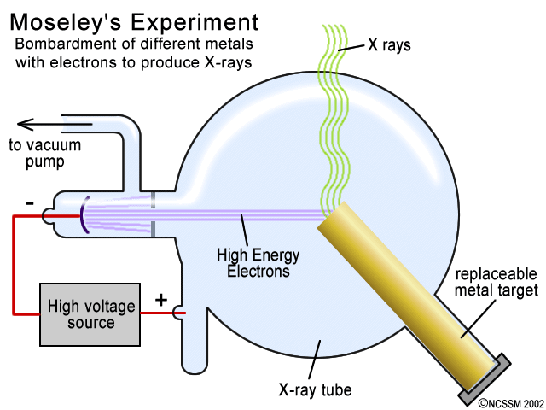
Moseley’s Experiment

Slide 29
What is happening?
Moseley was using various elements (metals) as targets in cathode ray tubes. He noticed that when struck by the cathode rays, different metals gave off x-rays with distinct wavelengths. Essentially what was happening was that the cathode rays (high energy electrons) were knocking out the inner-most electrons of the metal targets. X-rays were emitted when an outer electron "fell" down into this inner shell. Since the inner-most electrons are not shielded by other electrons, the energy required to knock them out is dependent upon the number of protons in the nucleus. Thus, the emitted x-ray frequency associated with an outer electron falling down into this shell is related to the number of protons in the nucleus. Moseley realized that the atomic numbers were not just a convenient numbering scheme for the elements, but had a real physical meaning - ultimately realized as being the number of protons (and electrons) in a (neutral) element.

Slide 30
Periodic Law Revised
As a result his determination, Moseley proceeded to restate the periodic law.
The “modern periodic law” now states; the properties of the elements are periodic functions of increasing atomic number.
This eliminated the problem Mendeleev had with his arrangement.

Slide 31
Effective Nuclear Charge
Effective nuclear charge (Z_{eff­}) is used to provide a relative idea of the actual coulombic attraction “felt” by the electrons due to the positive character of the nucleus.
This concept provides a great deal of insight into some of the trends observed on the periodic table, especially when applied to the valence shell electrons.

Slide 32
Two factors are considered when looking at effective nuclear charge.
The first factor is the atomic number (Z) of the element. This describes the number of protons found in the nucleus of an atom. Recall, Coulomb’s law [ f_{el} = k q₁ q₂ ] (a favorite of mine) which finds the r² electrostatic force directly related to the quantity of charge on one or both of the objects. Therefore, increases in atomic number mean greater number of protons in the nucleus producing a greater quantity of charge, and hence a greater force of attraction.

Slide 33
Shielding or Screening Effect
The second factor is called the screening or shielding effect. The effect results from lower energy level electrons blocking or screening nuclear attraction to electrons located at a further distance from the nucleus. The greater the number of lower energy level electrons, the greater the shielding effect.

Slide 34
Shielding or Screening Effect

Slide 35
Slater’s Rules
The equation generated appears as Z_{eff} = Z - S where S represents the shielding or screening effect. In order to determine the value of S, the electron configuration needs to be manipulated to appear as follows:
(1s)(2s 2p)(3s 3p)(3d)(4s 4p)(4d)(4f)(5s 5p), etc.
Notice the order and the grouping.

Slide 36
Shielding Contributions
Electron in Question found in | Electrons to the left | Shielding Contribution
ns or np group | (1s group) | 0.30
 | any other n group except 1s | 0.35
 | (n-1) | 0.85
 | any electron in a group lower than an (n-1) group | 1
nd or nf group
 | the nd or nf group which contains electron in question group | 0.35
 | any electron to the left of the “n” group | 1

Slide 37
Z_{eff} Trends on the Table
Moving across a period, the atomic number increases by 1 with each element. The shielding effect will also increase, but only by a value of 0.35. Therefore the Z_{eff} is increasing by 0.65 with each new element (proton). This means the nucleus increases its control or impact on the electron cloud as one goes across a period with increasing Z.

Slide 38
Z_{eff} Trends on the Table
Moving down a family or group the atomic number increases by some value. The shielding or screening also increases. However, if we evaluate Z_{eff}, we find that based upon the two factors Z and S, the effective nuclear charge remains fairly constant.
However, there is one factor that yet needs to be introduced in identifying what happens to effective nuclear charge moving down a group

Slide 39
Another Factor Impacting Z_{eff}
It is the distance the valence shell is from the nucleus. And, returning to Coulomb’s Law,
[ f_{el} = k q₁ q₂ ], we find that electrostatic force is r² related to distance, although the relationship is now inverse. Therefore, as we move down a group or family the distance to the valence shell increases. This means that going down a family, the nucleus is losing its control over the outer region of the electron cloud.

Slide 40
Atomic Radius or Atomic Size
Going across a period from left to right, the increase in the nuclear charge coupled with a minimal increase in shielding, causes a decrease in the atomic size because the electrons in the valence energy level are pulled closer due to increased coulombic attraction.

Slide 41
Atomic Radius or Atomic Size
Proceeding down a group, there is an increase in the number of energy levels that are being used. Consequently, moving down a family or group, the electrons in the valence energy level are moved further and further away from the nucleus because they are placed in energy levels of greater “n.” This increase in distance results in a weaker electrostatic force of attraction and an increase in atomic size.

Slide 42
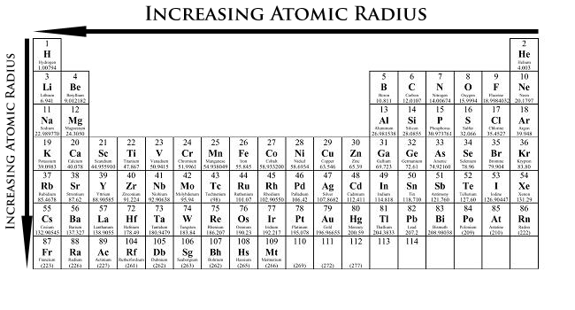
Trend in Atomic Radius/Size

Slide 43
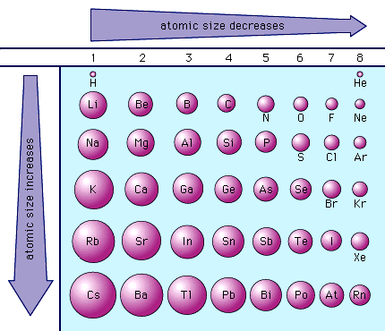
Atomic Radii or Representative Elements

Slide 44
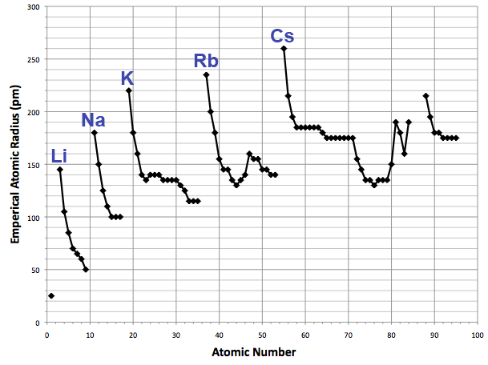
Chart of Atomic Radii

Slide 45
Ionization Energy
Ionization energy – is the energy needed to remove an electron from an atom
This energy is associated with the work needed to be done in overcoming the nuclear attraction of the electron. This is the force holding the electron within the electron cloud.

Slide 46
First Ionization Energy; I.E.₁
The first ionization energy is the amount of energy needed to remove the highest energy electron (valence shell) from a neutral gaseous atom of the element
Equation:
M_{(g)} + I. E.₁ ======> M⁺_{(g)} + e⁻

Slide 47
Additional Ionizations
Successive ionizations may occur as additional electrons are removed from the ion.
M⁺_{(g)} + I.E.₂ ====> M⁺²_{(g)} + e⁻
M_{(g)}⁺⁺ + I.E.₃ =====> M_{(g)}⁺⁺⁺ + e⁻
Recognize the ionization energies will increase with the removal of each additional electron [ I.E.₁ < I.E.₂ < I.E.₃ < …..]
Why?

Slide 48
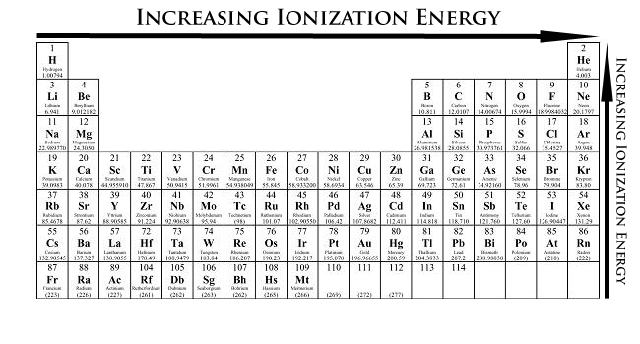
Trend in First Ionization Energy

Slide 49
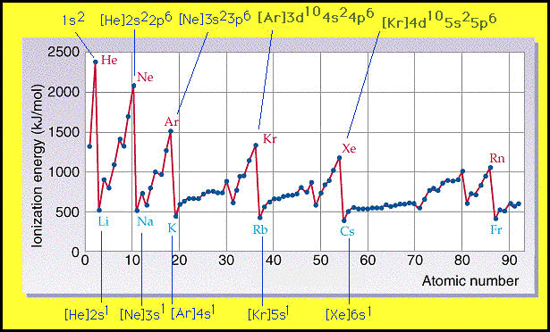
Chart of Trend in First Ionization Energy

Slide 50
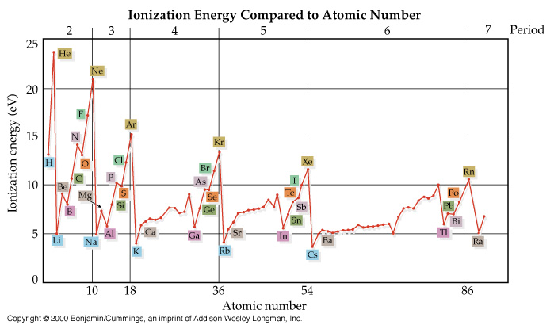
Chart of First Ionization Energy

Slide 51
Anomalies
Why are there some anomalies in the ionization energies within a period?
e.g. Look at Be – B; Mg – Al; N – O; P - S

Slide 52
Configurational Stability
There are certain electron configurations that provide additional stability to the atom. The configurations that provide some extent of “configurational” stability are:
#1) A full valence shell – for small atoms this is a “duet,” ns² and for the majority of atoms it is an “octet,” ns²np⁶. These configurations provide rather significant amounts of stability.
#2) This is a filled energy sublevel as in an s², d¹⁰, or f¹⁴.
#3). This is a half-filled energy sublevel as in an s¹, p³, d⁵, f⁷.

Slide 53
There is an impact on electron configuration due to the above:
Predicted Actual
Cr [Ar] 4s² 3d⁴ [Ar] 4s¹ 3d⁵
Cu [Ar] 4s² 3d⁹ [Ar] 4s¹ 3d¹⁰

Slide 54
Other Exceptions to Configuration
Lanthanum – expected configuration of [Xe] 6s² 4f¹ but actual [Xe] 6s² 5d¹
Cerium - expected configuration of [Xe] 6s² 4f² but actual [Xe] 6s² 5d¹ 4f¹
Actinium - expected configuration of [Rn] 7s² 5f¹ but actual [Rn] 7s² 6d¹
Thorium - expected configuration of [Rn] 7s² 5f² but actual [Rn] 7s² 6d²

Slide 55
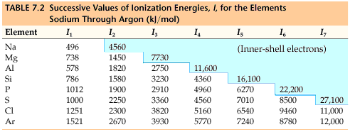
Successive Ionizations in Period 3
In evaluating the chart below, why are such drastic increases in ionization energy present for the removal of certain electrons?

Slide 56
Electron Affinity
Electron affinity is the energy released or gained when a gaseous neutral atom acquires an electron.
Therefore, it provides a “general” idea of whether an atom has a desire to capture an electron
Elements with positive electron affinities do not naturally support negative ions.
However, all elements have positive ions.
The more negative the electron affinity, the greater its desire to capture an electron

Slide 57
Electron Affinity Equations
Equation:
N_{(g)} + e⁻ =====> N⁻_{(g)} + E
The energy value here would represent a negative electron affinity as energy is on the product side
N_{(g)} + e⁻ + E =====> N⁻_{(g)}
The electron affinity here would represent a positive electron affinity as energy is on the reactant side

Slide 58
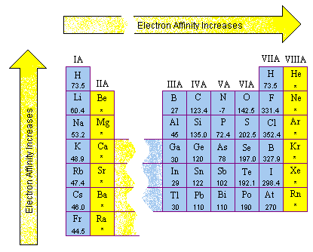
Trends with Respect to Electron Affinity

Slide 59
Questions about Electron Affinity
Electron affinity best applies to the “main block” or “representative elements.”
How do we explain the observed values for:
The noble gases
The halogens
The alkali metals
The alkaline earth metals
The nitrogen family
The chalcogens

Slide 60
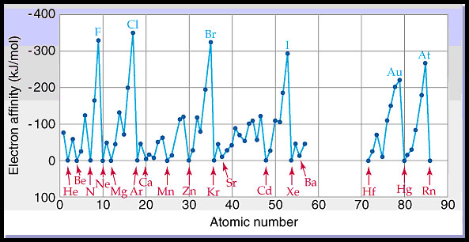
Chart of Electron Affinities

Slide 61
Electronegativity
Electronegativity is a measure of an atom’s strength to attract electrons in a bonded situation
According to Mullikan χ ∝ 0.5 (I.E.₁ + E.A.)
In general; if I.E.₁ is large and EA₁ fairly negative, giving up an electron is unlikely, but gaining an electron is likely, and the atom tends to act as an electron acceptor, or is ``electronegative.''
if I.E.₁ is small, and EA₁ is zero or positive, giving up an electron is likely, but gaining an electron is unlikely, and the atom tends to act as an electron donor, or is ``electropositive.''

Slide 62
Electronegativity Scales
The Pauling scale is the most commonly used. However, there are others as in the Allred-Rochow, Mullikan, etc.
On the Pauling scale, fluorine (the most electronegative element) is assigned a value of 4.0, and values range down to cesium and francium which are the least electronegative at 0.7

Slide 63
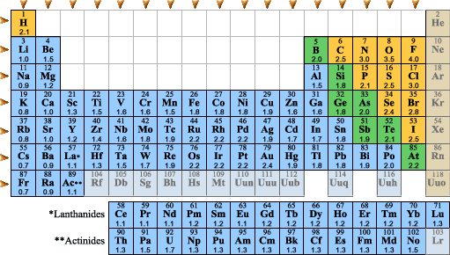
Pauling’s Table

Slide 64
Electronegativity Trends
Metals generally have low electronegativity values, while nonmetals have relatively high electronegativity values.
Electronegativity values generally increase from left to right with increasing Z in a period on the periodic table of the elements.
Electronegativity values generally increase from bottom to top within each family/group of elements within the periodic table.

Slide 65
Electronegativity
Note the trends - electronegativity increases moving left to right across a period and decreases moving top to bottom within a group.
Is the trend consistent everywhere?

Slide 66
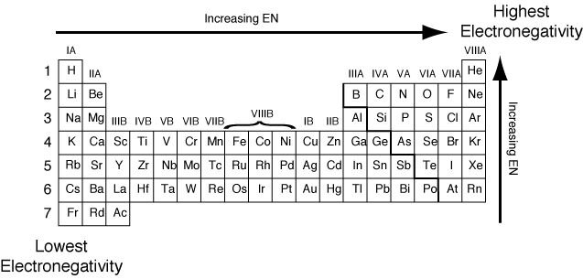
Electronegativity Trends

Slide 67
The importance of electronegativity
The difference in electronegativities between two bonded atoms provides insight into the character of the bond
Ionic bonding – a result of electron transfer between two atoms that leads to formation of oppositely charged ions
Covalent bonding – a result of sharing electrons [electron pair(s)] between two atoms

Slide 68
Bond Character
Most chemical bonds have some ionic and some covalent bond character.
Electronegativity Difference | Type of Bond
Greater than 1.7 (1.7 <) | Ionic
Less than or equal to 1.7 and greater than or equal to 0.4 (0.4≤ ≤ 1.7) | Polar covalent
Less than 0.4 (< 0.4) | Nonpolar covalent

Slide 69
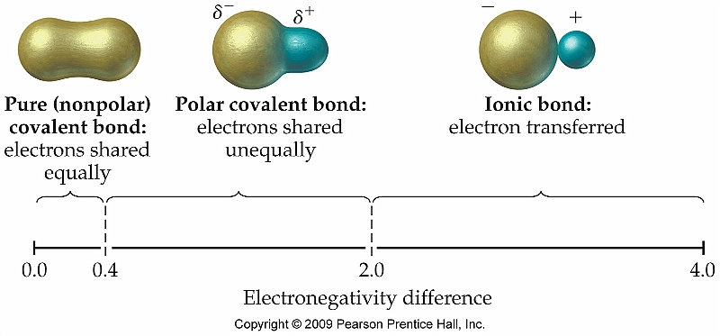
Bond Character and Electronegativity Difference

Slide 70
Metallic Character
Metallic character increases moving to the left and down, similar to the atomic radius trend

Slide 71
Diagonal Relationship
Beyond the vertical and horizontal relationships exhibited by the elements, certain elements of Period 2 and Period 3 show a diagonal relationship.
These elements have a similar size and similar electronegativity (Z_{eff})

Slide 72
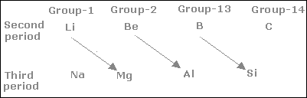
Elements with a Diagonal Relationship

Slide 73
Examples
As a result of diagonal relationship the physical properties such as the atomic size, electronegativity, density etc. and chemical properties of compounds such as reaction with water, nitrogen, decomposition reactions etc. are similar.
For example: The similarities between Li and Mg as a result of diagonal relationship are as follows:
Both are harder and lighter than the other elements in the respective groups.
Both react slowly with water; oxides of both are less soluble in water; hydroxides of both decompose on heating.

Slide 74
Examples cont’d
Both form nitrides (Li₃N and Mg₃N₂) by directly reacting with nitrogen.
On heating, carbonates of both give oxides and CO₂; hydrogen carbonates of both do not exist as solid.
Chlorides of both (LiCl, MgCl₂) are soluble in ethanol, deliquescent, and crystallize as hydrates (LiCl.2H₂O, MgCl₂.8H₂O).

