Slide 1
Concentration
The amount of solute in a solution

Slide 2
Unsaturated -- solvent can hold more solute under existing conditions.
Saturated -- solvent holds as much solute as it can under conditions.
Supersaturated -- solvent holds more solute than it should under conditions.
Dilute -- small amount of solute in large amount of solvent.
Concentrated -- large amount of solute in small amount of solvent.

Slide 3
PERCENT SOLUTIONS
w/w (by weight)
(g of solute/ g of solution) x 100 %
v/v (by volume)
(mL of solute/mL of solution) x 100 %
w/v ( by weight and volume)
(g of solute/mL of solution) x 100 %

Slide 4
Molarity (M) = moles of solute per volume of solution in liters:

Slide 5
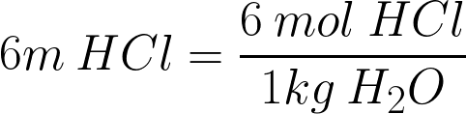
Molality(m)= moles of solute/kg of solvent
DO NOT CONFUSE WITH:
Molarity(M)= moles of solute/L of solution

Slide 6
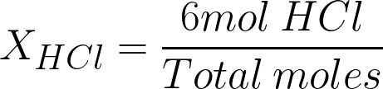
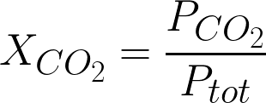
Mole fraction (X) = Moles of one component/ total number of moles
For gases = P_{A}/P_{Total}

Slide 7
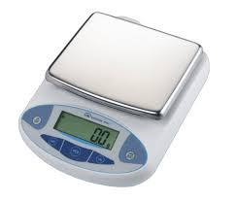
Percents, Molarity, Molality, Mole Fraction
Example 15.1

Slide 8
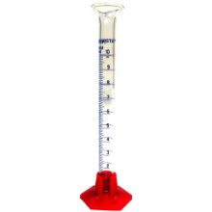
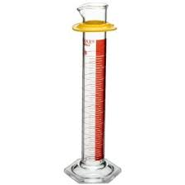
Percents, Molarity, Molality, Mole Fraction
We have 3ml of ethanol in 250 ml of water.

Slide 9
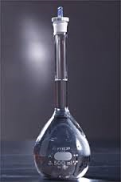
Percents, Molarity, Molality, Mole Fraction
We have 5g of ethanol in 200ml of solution.

Slide 10

Percents, Molarity, Molality, Mole Fraction
Example 15.3

Slide 11


Percents, Molarity, Molality, Mole Fraction
We have 5g of ethanol (C₂H₅OH) in 200ml of water

Slide 12


Percents, Molarity, Molality, Mole Fraction
We have 5g of ethanol (C₂H₅OH) in 200ml of water
OR

Slide 13
Percents, Molarity, Molality, Mole Fraction
We have 5g of ethanol {C₂H₅OH} in 10g of acetone {(CH₃)₂CO}
OR

Slide 14
Percents, Molarity, Molality, Mole Fraction
We have CO₂ contributing 0.2888 torr of pressure at STP.
OR

Slide 15
Standard Solutions, Dilutions
and Colligative Properties

Slide 16
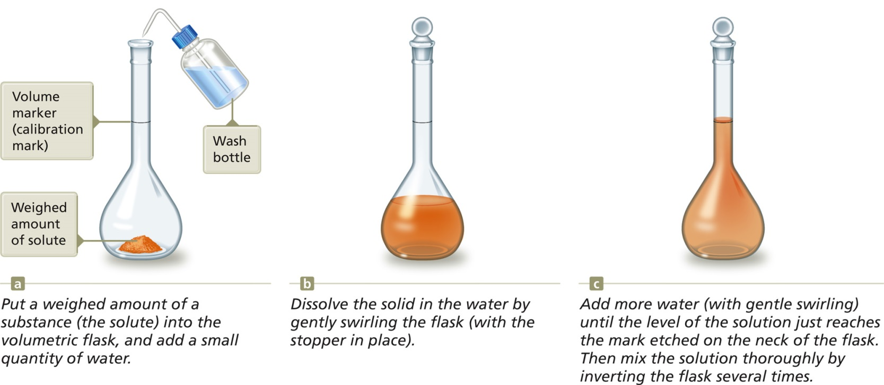
To Make a Standard Solution
Weigh out a sample of solute.
Transfer to a volumetric flask.
Add enough solvent to mark on flask.

Slide 17
The process of adding water to a concentrated or stock solution to achieve the molarity desired for a particular solution.
Dilution with water does not alter the numbers of moles of solute present.
Moles of solute before dilution = moles of solute after dilution

Slide 18
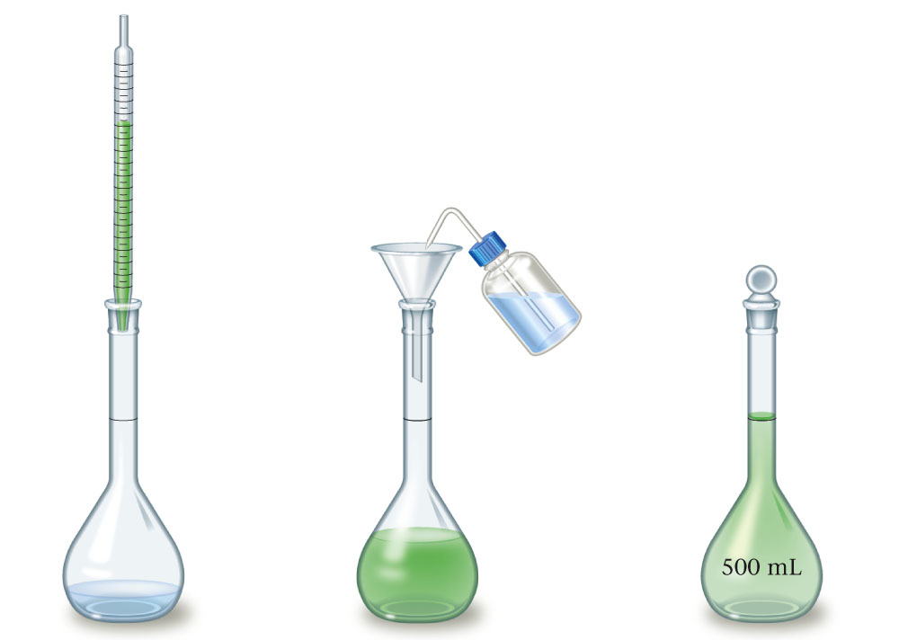
Diluting a Solution
Transfer a measured amount of original solution to a flask containing some water.
Add water to the flask to the mark (with swirling) and mix by inverting the flask.

Slide 19





Slide 20
Dilution
Example 15.8

Slide 21
Dilution
We have 5ml of a stock solution of 6M HCl, how much additional water do we need to add to end up with a 0.5M solution?

Slide 22
Dilution
We dilute 50ml of 18M H₂SO₄ with 2L of water, what is the resulting concentration?

Slide 23
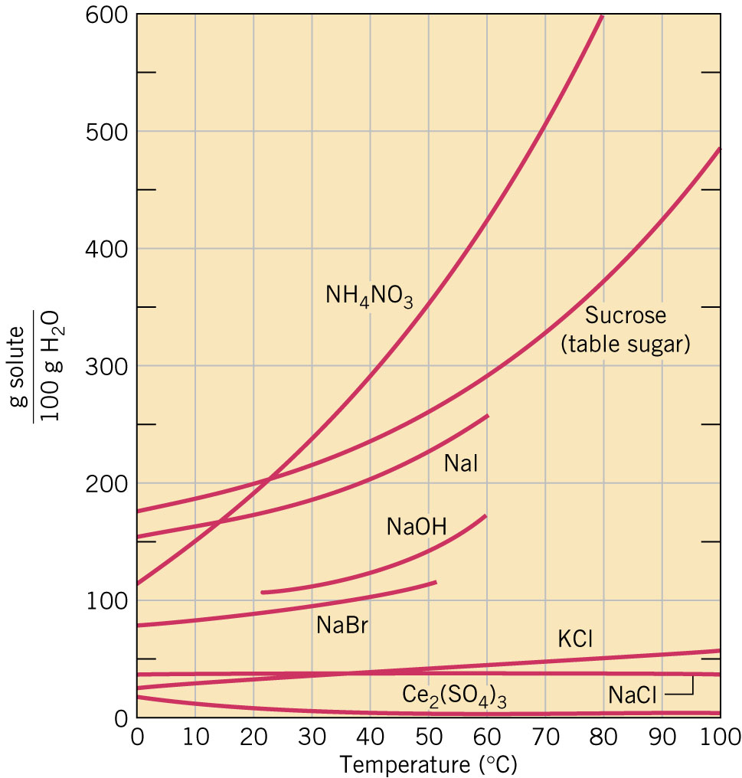

Slide 24
RATE OF DISSOLVING
Can be increased by:
increasing surface area (grind) -- more contact of solvent & solute.
Stirring -- more contact of solute & solvent.
Raise temperature -- Solvent molecules move faster & more contact solute.

Slide 25
COLLIGATIVE PROPERTIES
Colligative properties are properties that depend on the number of solute particles that are present.
1) Lowering of vapor pressure (Raoult’s Law)
2) Raising of boiling point
3) Lowering of freezing point

Slide 26
LOWERING VAPOR PRESSURE
The presence of a nonvolatile solute (one that does not evaporate) lowers the vapor pressure because the solute blocks the escape of some of the solvent.

Slide 27
RAISING OF BOILING POINT
The presence of a nonvolatile solute will raise the boiling point of a solution. Since the vapor pressure is lowered, the solution must be raised to a higher temperature before enough vapor will be created to equal the atmospheric pressure.

Slide 28
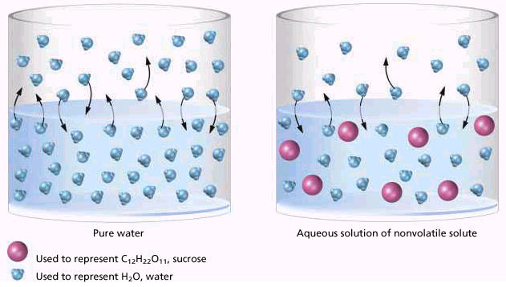
Boiling Point Elevation
Solute particles weaken IMF in the solvent.

Slide 29
LOWERING OF FREEZING POINT
For a liquid to freeze, the molecules must come closer together. When a nonvolatile solute is present, the particles get between the solvent molecules. Consequently, the temperature must be lowered further to remove enough energy to allow the molecules to attract one another.

Slide 30
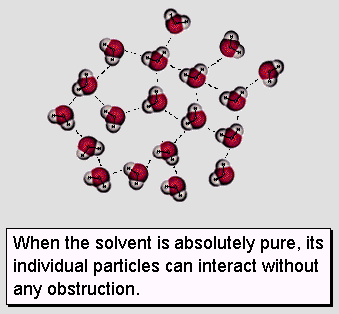
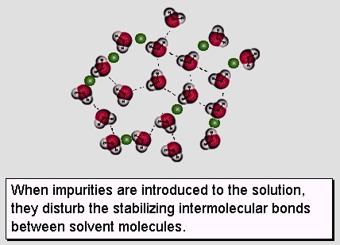
Freezing Point Depression
View Flash animation.

Slide 31
Calculations
Δt = k · m · n
Δt: change in temperature (°C)
k: constant based on the solvent (°C·kg/mol)
m: molality (m)
n: # of particles

Slide 32
Calculations
# of Particles
  Nonelectrolytes (covalent)
    remain intact when dissolved
    1 particle
  Electrolytes (ionic)
    dissociate into ions when dissolved
    2 or more particles

Slide 33
Boiling Point Elevation

Slide 34
Boiling Point Elevation

Slide 35
Freezing Point Depression

Slide 36
Freezing Point Depression

