Slide 1
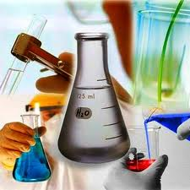
Laboratory Equipment

Slide 2
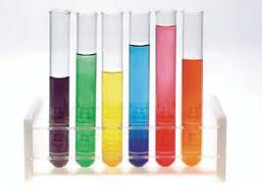
Test Tubes
Narrow glass cylinders, closed at one end, -used for mixing, heating, and storing small quantities of chemicals.
– many different sizes, which are given as the tubes' dimensions (diameter × height in mm)

Slide 3
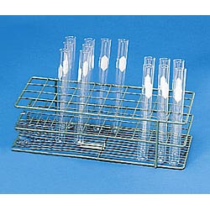

Test Tube Rack
• Racks made of wood, metal, or plastic
used for holding test tubes upright when they contain chemicals
also to hold test tubes upside down to dry.

Slide 4
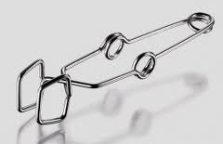
Test Tube Holder
• Tongs used to hold and transport hot test tubes
– Made of stainless steel or brass
– The test tube fits inside the jaws of the clamp
-be certain to hold test tube holder as shown so that if you squeeze your hand the test tube doesn’t fall out

Slide 5
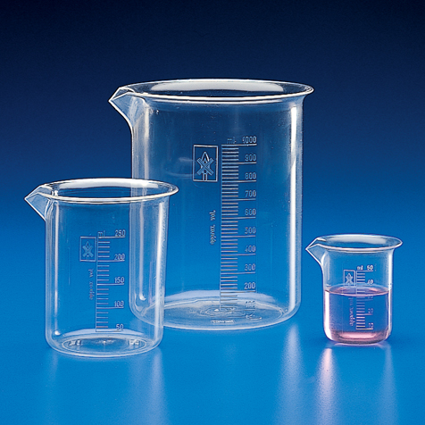
Beaker
Glass cylinder used for mixing and heating chemicals
diameter is the same from
top to bottom
markings are only
approximate values
DO NOT USE FOR
MEASURING EXACT VOLUME.

Slide 6
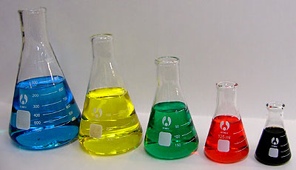
Erlenmeyer Flask
Cone shaped container used for mixing, heating and storing chemicals
Shape allows contents to be swirled without spilling and slows the rate at which contents cool.
Markings are only approximate values
DO NOT USE FOR
MEASURING EXACT
VOLUMES.

Slide 7
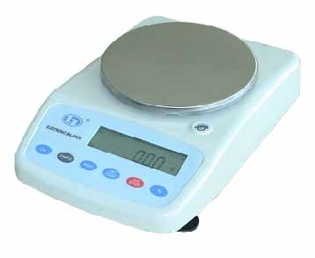
Electronic Balance
• Digital balance used to measure the mass of substances
very accurate and precise.
Balance is calibrated (adjusted) to a give mass value, which is then displayed on the LCD readout.
Note: when you push the
“tare” button, the reading goes to zero

Slide 8
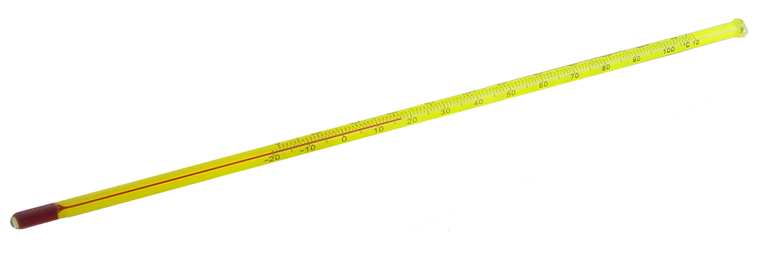
Thermometer
Sealed glass tube containing a colored alcohol solution that is used to measure the temperature of a substance.
Scale may be in °F or °C

Slide 9
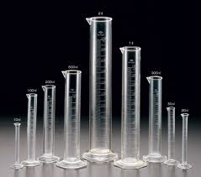
Graduated Cylinder
• Glass cylinders with many markings(graduations) that are used to measure liquid volumes accurately.
• Come in many sizes
Always use the smallest volume that can hold the volume you want to measure so that the measurement will be most accurate

Slide 10
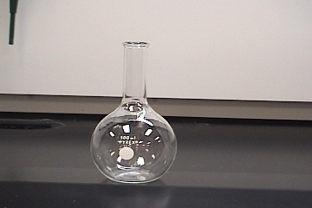
Florence Flask
• Glass container used for boiling liquids for long periods of time and to hold solutions
has a round body with a single long neck. Bottom may be flat or round.
Allows easy swirling and even
heating of chemicals.

Slide 11
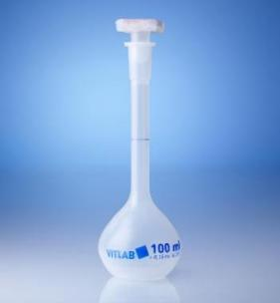
Volumetric Flask
Glass flasks used for preparing solutions and diluting chemicals
designed to measure liquid volume very accurately.
tear-drop shaped with a long cylindrical neck with a single circular etch around it.
Measures only one volume.
Etched line marks the level at which the flask will contain the designated volume.

Slide 12
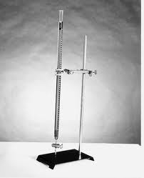
Buret
A narrow glass cylinder with many markings (graduations) that is used to measure and dispense liquid volumes accurately.
Often used during a process called titrating, in which the concentration of a solution is determined by combining it with a solution with a known concentration.

Slide 13
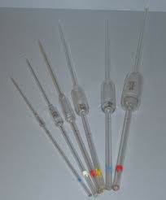
Volumetric Pipet
• Glass tubes with an etched line used to measure small liquid volumes very accurately
.– Some are straight tubes, while others have a bulb-shaped reservoir in the middle
• Each pipet is designed to only measure one volume. The etched line on the pipet marks the level at which the pipet will contain the designated volume.
– Come in many different sizes, depending on the amount of liquid that needs to be measured/transferred.

Slide 14
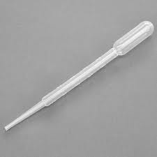
Dropper Pipette
• A glass or plastic device consisting of a bulb and a stem that is used for transferring and dispensing small volumes of liquids.

Slide 15
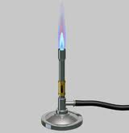
Bunsen Burner
•Device used for heating chemicals and equipment
• Consists of a hollow metal barrel that has one or more openings at its base to allow the entry of air
•Gas is piped in at the base, mixes with the air, and at the top of the barrel creates a flame of varying intensity (depending upon the ratio of air-gas)

Slide 16
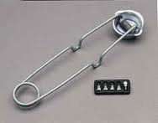
Stricker
• Device used to create sparks for lighting a bunsen burner.
• Strikers consist of a flint tip that is dragged across a piece of steel. The friction generates enough heat to create the sparks.
– should not be used when flammable gases are being generated or flammable liquids are being used

Slide 17
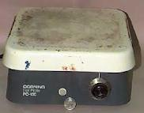
Hot Plate
• used to heat chemicals instead of Bunsen burners when open flames are not appropriate in the laboratory
• heat setting is controlled by a dial on the front of the hot plate

Slide 18
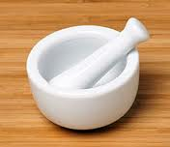
Mortar and Pestle
• The mortar is a ceramic, thick-walled bowl, while the pestle is a heavy, ceramic blunt- ended cylinder.
• Used to grind solid chemicals into smaller pieces so that they may dissolve or react with other chemicals more quickly.

Slide 19
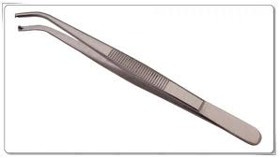
Forceps
• Forceps (not "tweezers") are made of stainless steel and are used to handle small pieces of solid material.

Slide 20
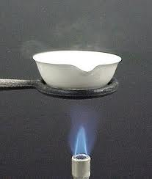
Evaporating Dish
• thin-walled ceramic dish used to evaporate the liquid away from a small volume of solution
– This is done to collect the solute that is dissolved in a solution.
– Care must be taken when recovering a solute in this manner;
if heated too strongly, the solute may actually "pop“ out of the dish resulting in erroneous results.

Slide 21
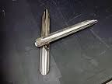
Scoopula
• Used to scoop (solid) chemicals and transfer them, and to scrape chemicals from containers, much like a spatula is used to scrape food from a bowl.

Slide 22
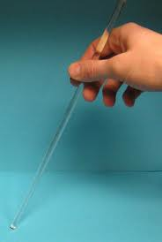
Stirring Rod
• Narrow glass rod used to stir mixtures and facilitate the pouring of liquids.
– Glass is best b/c of its resistance to chemical reactivity.
– When placed across the top of a beaker so that it lies along the spout, stirring rods can help prevent the liquid being poured from dribbling down the outside

Slide 23
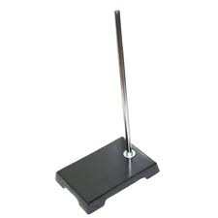
Ring Stand
• A stand with a weighted base with a narrow cylinder attached that is used to provide support for other lab equipment and a way of raising equipment above the work surface.

Slide 24

Wire Gauze
• A metal mesh screen with a ceramic fiber circle in the center that is used for supporting beakers and flasks when they are being heated with a Bunsen Burner

Slide 25
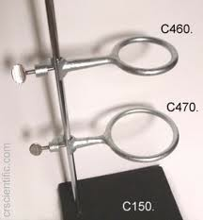
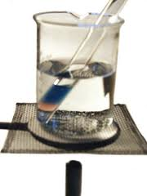
Iron Ring
• When attached to a ring stand, this device is used to support laboratory equipment above the work surface.
– Wire gauze is placed on top of the iron ring
to support beakers and flasks when heating
them.

Slide 26
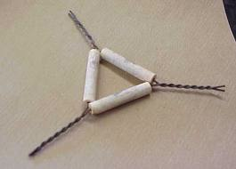
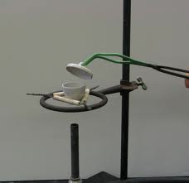
Clay Triangle
• Used to support crucibles when heating them.
– The clay portion is actually a ceramic material that can withstand extreme temperatures, such as those produced by a Bunsen burner.
• The triangle is set on top of an iron ring, and the crucible sits down in the center of the triangle.

Slide 27
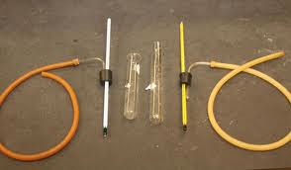
Rubber Tubing and Clamp
• Rubber tubing has a variety of uses in the chem lab, from transferring gases to be collected, to routing water through a condenser.
• The clamp is placed over the rubber tubing when it is necessary to shut off or prevent the flow of these fluids (gases and liquids)
– Double over the tubing before clamping for a tighter seal

Slide 28
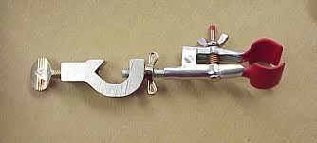
Utility Clamp
• A clamp used to provide stability and support for other equipment by attaching the equipment to a ring stand

Slide 29
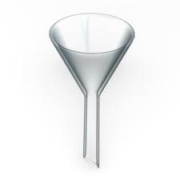
Funnel
• Device with a cone-shaped top and a long cylindrical stem at the bottom
• Used for transferring liquids(sometimes powders) to containers with small openings, in order to prevent spills. Can also be used with filter paper in the process of filtration
– Come in many different sizes
– Can be made of glass or plastic.

Slide 30
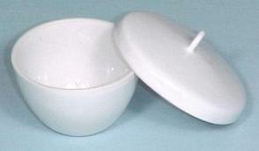
Crucible
• Small ceramic dish (with a lid that is used to heat chemicals (usually solids) to high temperatures
.– This may be necessary to dry a solid completely, or to initiate a reaction outside of solution.
– Crucibles are supported above a Bunsen burner by a clay triangle.

Slide 31
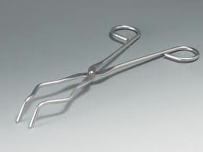
Crucible Tongs
• Tongs are made of stainless steel or brass that are used for handling crucibles, evaporating dishes, and other hot objects.

Slide 32
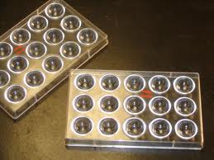
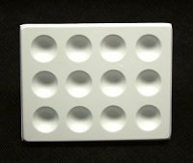
Spot Plate
• A ceramic or plastic plate with small wells or depressions built into it.
• The wells (or spots) are used for quantitative analysis or to perform reactions using very small amount of materials (microscale chem).

Slide 33
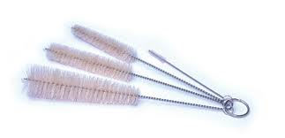
Brushes
• Brushes with coarse bristles used to scrub and clean glassware and other equipment
.– come in many different sizes, depending on the item being cleaned
• small ones for test tubes, to large ones for large beakers and flasks

Slide 34

Wash Bottle
• Most commonly used to store and dispense distilled water
– Wash bottle can be used to dispense distilled water whenever it is needed in an experimental procedure, as well as to provide a final rinse when glassware is washed at the end of an experiment.

