Slide 1
Operations with
Fractions

Slide 2
Fractions…
Multiplying
Fractions
Mixed to Improper
Adding/Subtracting
Fractions
Improper to Mixed
Dividing
Fractions

Slide 3
Adding and subtracting fractions
Do you have a common denominator?
YES
NO

Slide 4

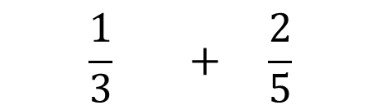
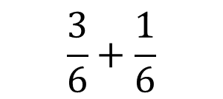




Find a common denominator
Find the lowest common denominator by finding the lowest number you can change each denominator into by multiplication.
Ex:
Ex:
$$\frac{1}{3} + \frac{2}{5}$$
$$\frac{·5}{·5}$$
$$\frac{·3}{·3}$$
$$\frac{·3}{·3}$$
$$\frac{1}{2} + \frac{1}{6}$$
$$\frac{5}{15}+\frac{6}{15}$$
$$\frac{3}{6}+\frac{1}{6}$$
NEXT STEP

Slide 5

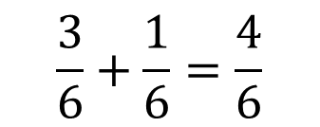
Adding and subtracting fractions
Add (or subtract) the numerators
Keep the denominator
$$\frac{3}{6}+\frac{1}{6}=\frac{4}{6}$$
÷ 2
$$=\frac{2}{3}$$
÷ 2
3) Reduce if possible

Slide 6


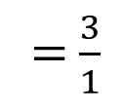

Multiply fractions
1) Change any mixed numbers to improper fractions.
1
3
$$4\frac{1}{3}·\frac{9}{13}$$
$$=\frac{13}{3}·\frac{9}{13}$$
+
=$\frac{3}{1}$
x
$$=3$$
1
1
2) Cross cancel if possible.
3) Multiply straight across.
4) Reduce if possible.

Slide 7




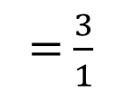

Divide fractions
1) Change any mixed numbers to improper fractions.
3
1
$$·\frac{9}{13}$$
$$4\frac{1}{3}÷\frac{13}{9}$$
$$=\frac{13}{3}$$
$$÷\frac{13}{9}$$
+
=$\frac{3}{1}$
x
$$=3$$
1
1
2) Flip the second fraction and multiply.
3) Cross cancel if possible.
4) Multiply across.
5) Reduce if possible.

Slide 8




Mixed to Improper
1) Multiply the numerator by the denominator
$$4\frac{2}{3}$$
$$+$$
$$×$$
= 12
2) Add the numerator
12 + 2 = 14
3) Make this number the numerator
$$\frac{14}{}$$
3
4) Keep the denominator

Slide 9




Improper to Mixed
1) See how many times the numerator can fit into the denominator without going over.
$$\frac{11}{3}$$
Make the answer the whole number
$$2$$
$$3\frac{}{}$$
$$3$$
2) Make the leftover amount the numerator
3) Keep the denominator

