Slide 1
Quadratics

Slide 2
What am I being asked to do?
Solve
Graph
Sketch
Find Max/Min

Slide 3
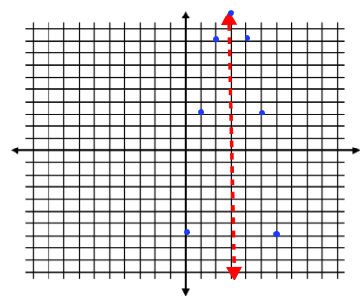
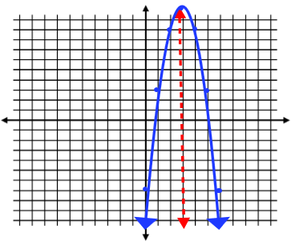
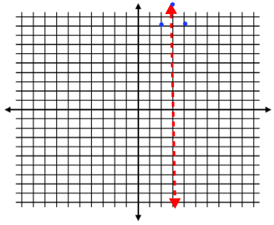
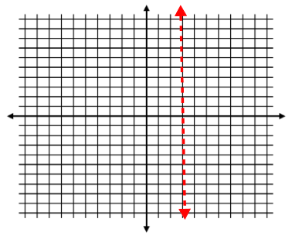
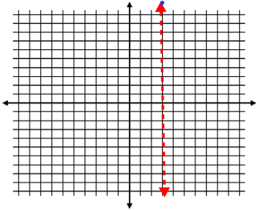
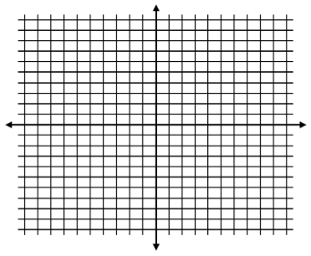

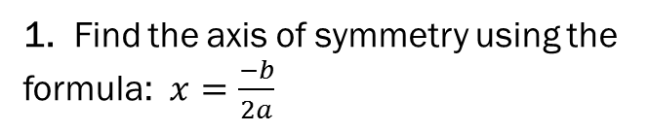
Graph a quadratic equation
*Recall that quadratics are written in the form:
y = ax² + bx + c
1. Find the axis of symmetry using the formula: $x=\frac{−b}{2a}$
Ex: y = –2x² + 12x – 7
x = $\frac{−12}{−4}=3$
2. Use this x-value to find the y-coordinate of the vertex.
Vertex: (3, 11)
3. Since parabolas are symmetrical, you can now build around your axis of symmetry. Choose an x-value on either the left or right side and find the y-value, and the x-value the same distance on the opposite side will have the same y-value. For example, x = 2 and x = 4 will both have the same y-value, because they are the same distance away from the axis of symmetry.

Slide 4
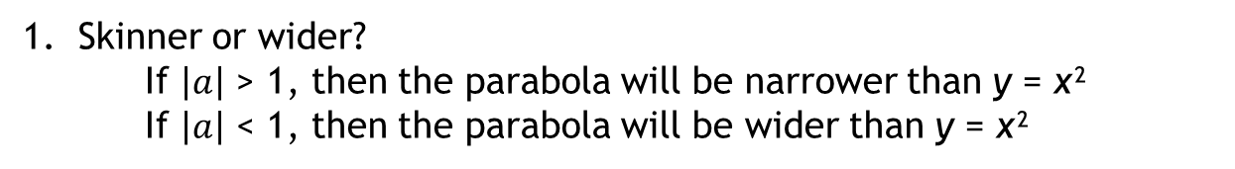
Characteristics of Parabolas
**RECALL** Quadratics are in the form: y = ax² + bx + c
Skinner or wider?
If $\left|a\right|$ > 1, then the parabola will be narrower than y = x²
If $\left|a\right|$ < 1, then the parabola will be wider than y = x²
2. Upward or downward?
If a is positive, then the parabola will face upward
If a is negative, then the parabola will face downward
3. Shift up or shift down? (*Only if b = 0)
If c is positive, the vertex is c spaces up on the y-axis
If c is negative, the vertex is c spaces down on the y-axis

Slide 5
Maximum or minimum
*Since the maximum or minimum value occurs at the vertex of the parabola, you need to find the coordinates of the vertex first.
1) Find the axis of symmetry by using the formula: $x=\frac{−b}{2a}$
2) Plug it back in to the quadratic equation to find the y-value of the vertex.
3) The maximum or minimum value is not the entire vertex. It is only the y-coordinate.

Slide 6
Solve by which method?
Graphing
Square Roots
Quad. Formula

Slide 7
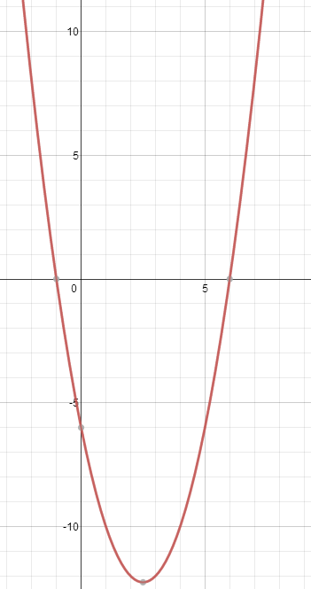
Solve a quadratic by graphing
1) Graph the quadratic equation (either use a graphing calculator or find the axis of symmetry, vertex, and then build around it) *Don’t forget to make it equal 0 before beginning!
y = x² - 5x + 6
2) Identify the “roots” or solutions by finding the values of x where y = 0.
This means find the x-intercepts since this is where on a graph y = 0.
x = 6
x = –1
3) Identify the solutions as x = #
*Its possible to find have one solution, two solutions or no solutions depending on the parabola.

Slide 8



Solve a quadratic by square roots
*If the quadratic is the form: y = ax² + c, then it can be solved by the square roots method. (*b = 0, if not, you can’t use square roots choose another method!
1) Isolate x²
2) · If x² > 0
· If x² < 0
· If x² = 0
There will be 2 answers. A positive and negative.
There will be no solutions because you cannot take the square root of a negative number
There will be one solution (which is 0)
Ex: 0 = 3x² –75
+75 +75
75 = 3x²
3 3
$$√$$
$$√$$
25 = x²
$$±5=x$$

Slide 9
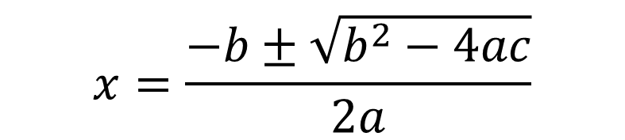
Solve a quadratic using the quadratic formula…
Make sure the quadratic equation equals 0 and is in written in standard form.
Identify a, b, and c.
Plug into the formula and solve.
y = ax² + bx + c
$$x=\frac{−b±\sqrt{b^{2}−4ac}}{2a}$$

