Slide 1
Simplifying Radicals
11.2

Slide 2
What type of problem do you have?
I need to simplify
There is a radical in the denominator
There is a fraction under the radical
I need to perform operations (Such as adding, multiplying, distributing, FOIL-ing

Slide 3



Simplify a Radical
*Remember that in order for a radical to be in simplest form it cannot have any perfect square factors. This means that numbers like 4, 9, 16, 25…etc, cannot divide a number under a radical sign.
1) Look for the biggest perfect square that will divide the number inside.
$$\sqrt{48}$$
2) Split the number into the product of the perfect square and the other number
$$\sqrt{16}\sqrt{3}$$
3) Take the square root of the one you can. Leave the other number inside.
$$4\sqrt{3}$$

Slide 4
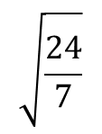
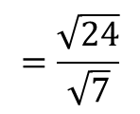
Split using division property
1) If there is a fraction inside the radical, the division property says you can split and give each piece its own radical sign. Simplify any raidcals possible.
$$\sqrt{\frac{24}{7}}$$
$$=\frac{\sqrt{24}}{\sqrt{7}}$$
I still need to rationalize the denominator
I forget how to simplify

Slide 5



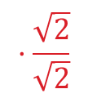
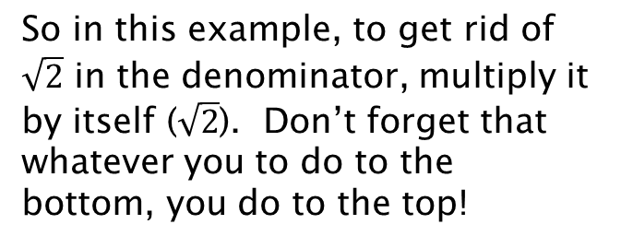
Rationalize the Denominator
*Remember that you cannot have a radical in the denominator. This would be an irrational number and your job is to rationalize it by getting rid of the radical in the denominator.
To undo something being square-rooted, the inverse operation is to square it (which means to multiply it by its exact self)
$$·\frac{\sqrt{2}}{\sqrt{2}}$$
So in this example, to get rid of $\sqrt{2}$ in the denominator, multiply it by itself ($\sqrt{2}$). Don’t forget that whatever you to do to the bottom, you do to the top!
$$\frac{2}{\sqrt{2}}$$
$$=\frac{2\sqrt{2}}{2}$$
$$=\sqrt{2}$$
Since the two green 2’s are both outside the radical, they can be simplified.
I still need to simplify a radical

Slide 6
Operations with Radicals
I am adding/
subtracting
I am multiplying/
distributing
I am
FOIL-ing

Slide 7




Adding or Subtracting Radicals
*Remember that in order to add or subtract radicals they must first be like terms. In order for this to occur, the number under the radical must be the same!
Like terms:
Not like terms:
$$2\sqrt{5}+3\sqrt{5}$$
$$4\sqrt{3}−3\sqrt{2}$$
*To add or subtract like radical terms, add or subtract the coefficients, keep the radical the same:
$$2\sqrt{5}+3\sqrt{5}$$
$$=5\sqrt{5}$$

Slide 8




Multiplying/Distributing Radicals
*When multiplying radicals, if there are two numbers outside the radical sign, you can multiply and any numbers inside the radical sign can be multiplied. Once complete, check to see if you can simplify.
$$4\sqrt{5}·2\sqrt{12}$$
= $8\sqrt{60}$
I still need to simplify.
*When distributing a radical, apply the distributive property and then follow the multiplication rules shown above. Once complete, check for like terms or radicals that can be simplified.
$$2\sqrt{5}\left(3\sqrt{2}+4\sqrt{10}\right)$$
$$=6\sqrt{10}+8\sqrt{50}$$

Slide 9





FOIL-ing Radicals
*FOIL is just distributing twice! It means:
F – First (which terms come first in each parenthesis)
O – Outer (which terms are on the outer edges)
I – Inner (which terms are inner-most)
L – Last (which terms come last in each parenthesis)
$$(5\sqrt{3}+2\sqrt{5})\left(3\sqrt{2}+4\sqrt{10}\right)$$
$$15\sqrt{6}$$
$$+20\sqrt{30}$$
$$+6\sqrt{10}$$
$$+8\sqrt{50}$$
Check to see if you can simplify any terms

