Slide 1
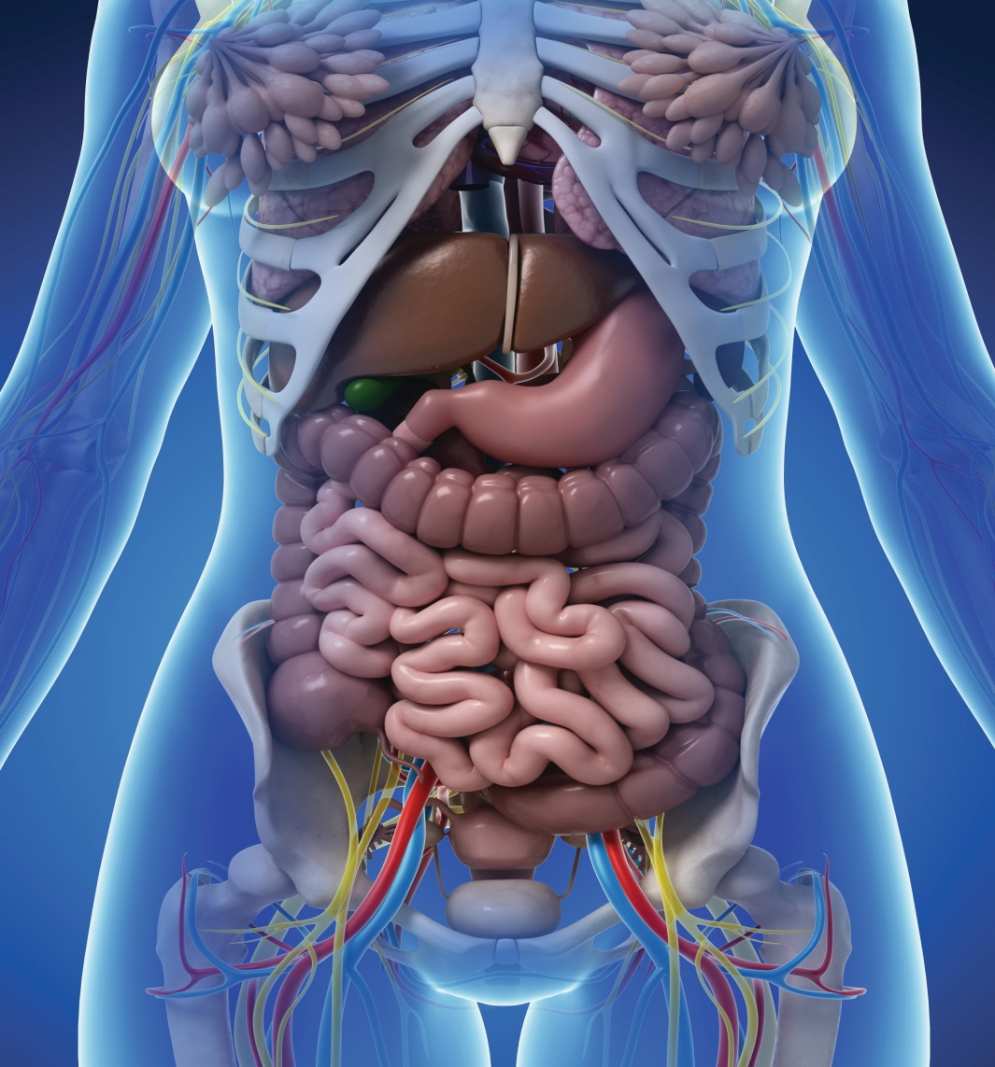
Chapter 1
Organization of the Human Body

Slide 2
Studies of the Human Body (cont.)
Anatomy
Study of body structure
  Dissection
Physiology
Study of body function

Slide 3
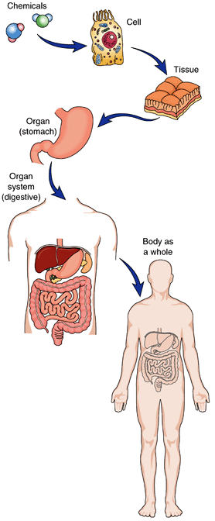
Levels of Organization
Chemicals
Cells
Tissues
Organs
Systems
Organism
Fig. 1-1
What do specialized groups of cells form?

Slide 4
Body Systems (Organized by Function)
Protection, support, and movement
  Integumentary
  Skeletal
  Muscular
Coordination and control
  Nervous
  Endocrine
Circulation and immunity
  Cardiovascular
  Lymphatic
Energy supply and fluid balance
  Respiratory
  Digestive
  Urinary
Production of offspring
  Reproductive

Slide 5
Effects of Aging
Gradual changes occur in all body systems.
Some changes are harmless.
  Wrinkles and gray hair
Some changes may result in injury and disease.
  Decreased kidney function
  Loss of bone mass
  Formation of deposits within blood vessels

Slide 6
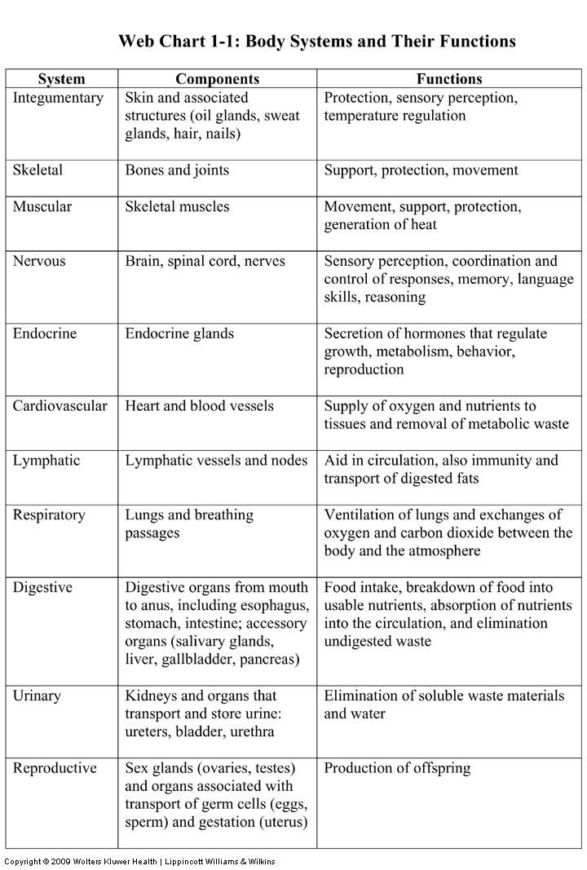
Body Systems: Summary
(See the Student Resources on thePoint for this chart summarizing the body systems and their functions. Additional resources may be found on thePoint.)

Slide 7
Homeostasis
Body’s maintenance of internal balance.
Body fluid balance is especially important.
  Extracellular fluid
    Blood plasma
    Lymph
    Fluid between cells
  Intracellular fluid
    Fluid within cells

Slide 8
Homeostasis and Negative Feedback
Negative feedback
  Critical for maintaining our health
  Keeps body conditions within a normal range by reversing any upward or downward shift
  Example:
    Increased calcium levels stimulate release of hormone to decrease calcium levels

Slide 9
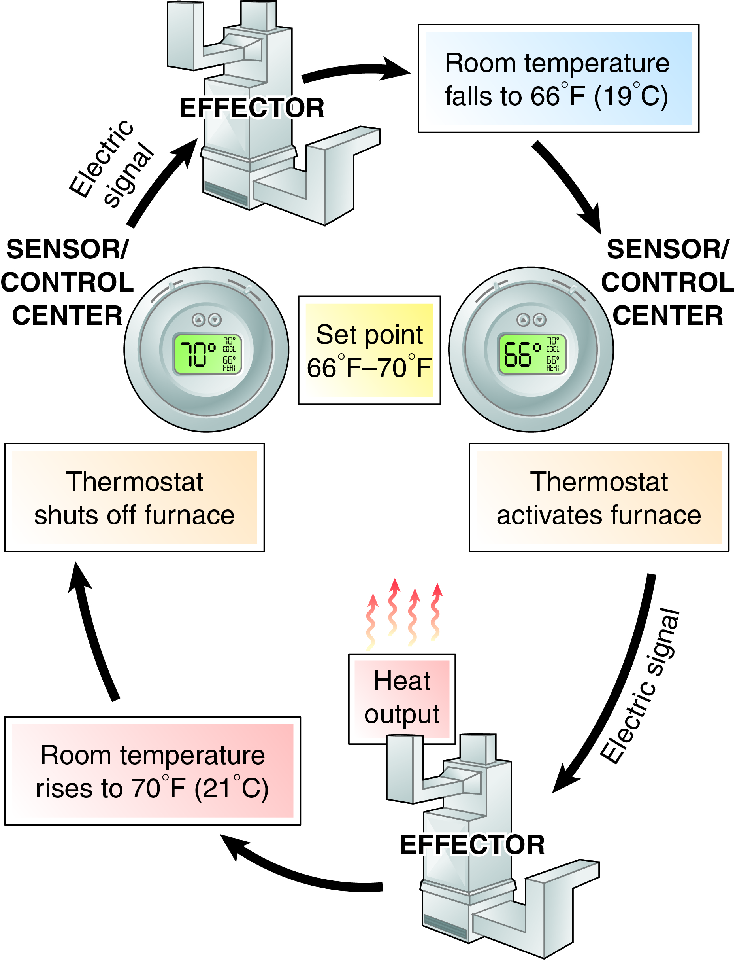
Negative Feedback
Fig. 1-2
How does a thermostat respond to a room temperature that falls below normal?

Slide 10
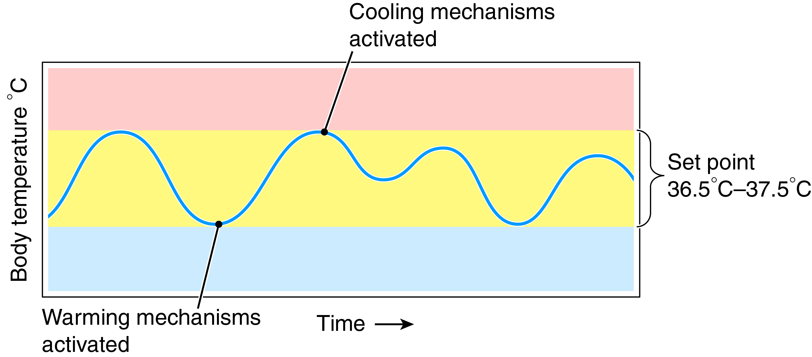
Negative Feedback and Body Temperature
Fig. 1-3
How does the brain respond to an increase in body temperature?

Slide 11
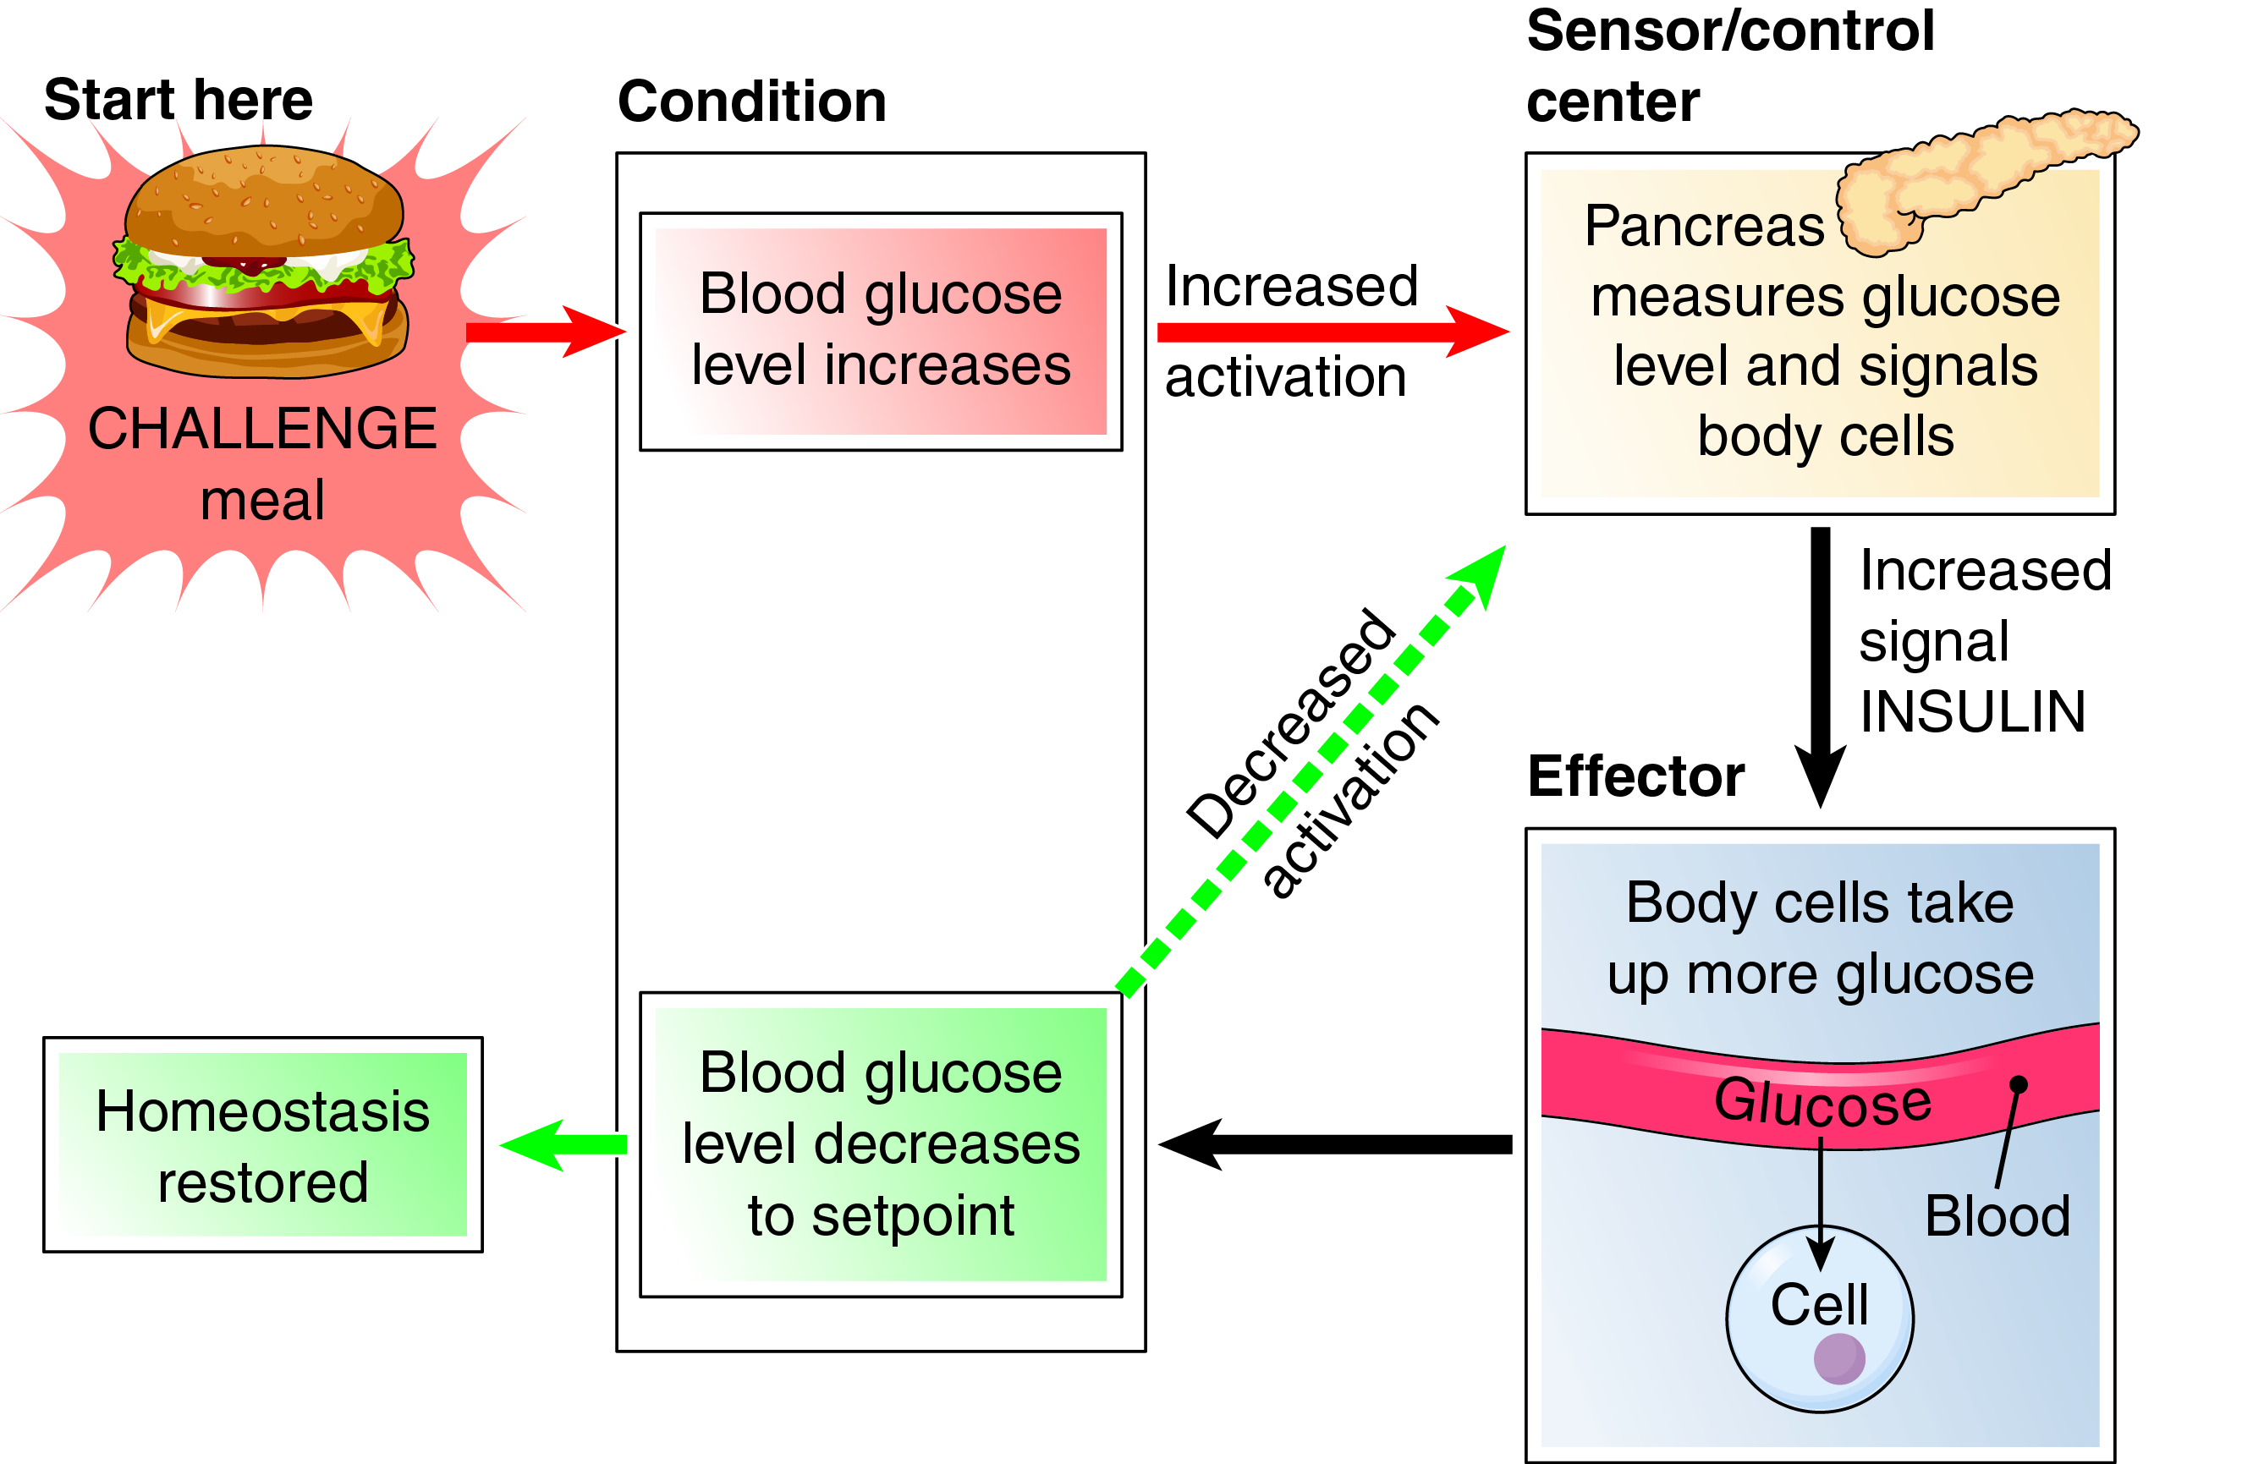
Negative Feedback in the Endocrine System
Fig. 1-4

Slide 12
Types of Metabolism
Catabolism
  Reactions that break substances down
  Used to form ATP
Anabolism
  Reactions that build substances up
  Often require ATP

Slide 13
Directional Terms
Healthcare professionals use standardized terms to describe body directions.
  Superior and inferior
  Anterior (ventral) and posterior (dorsal)
  Medial and lateral
  Proximal and distal
All descriptions assume that the body is in anatomic position.

Slide 14
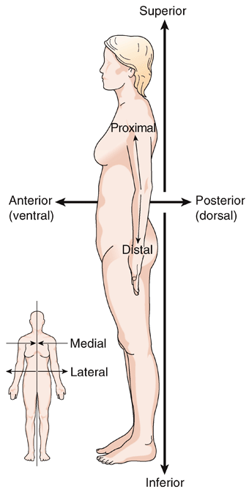
Directional Terms (cont.)
What is the scientific name for the position in which the figures are standing?
Fig. 1-6

Slide 15
Planes of Division
Anatomists can divide the body along three planes, each of which is a cut through the body in a different direction.
  Frontal plane
  Sagittal plane
  Transverse plane

Slide 16
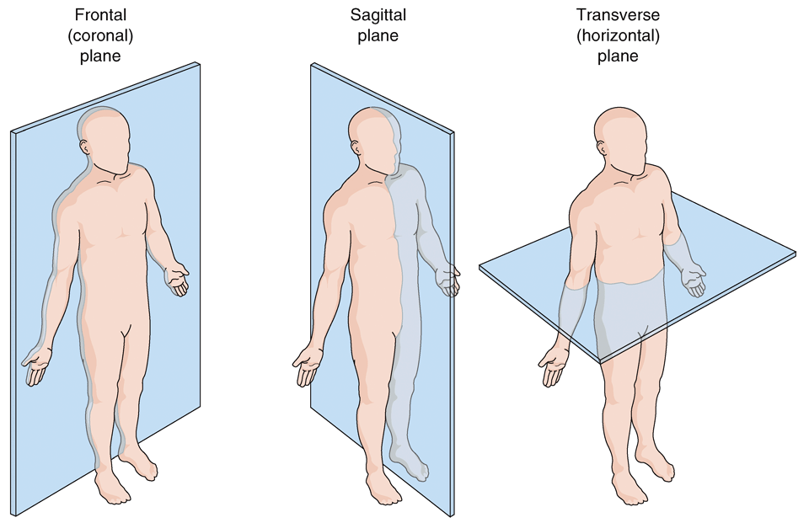
Planes of Division (cont.)
Fig. 1-7
Which plane divides the body into superior and inferior parts?
Which plane divides the body into anterior and posterior parts?

Slide 17
Planes of Division and Imaging
Some additional terms, usually “sections,” are used to describe tissues and CT (computed tomography) or MRI (magnetic resonance imaging) images.
  Cross-section
  Longitudinal section
  Oblique section

Slide 18
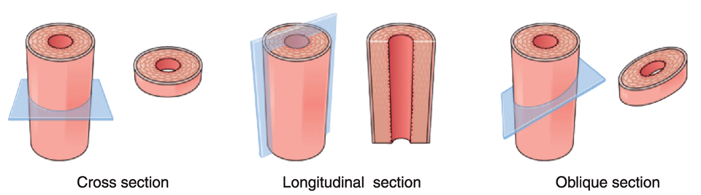
Tissue Sections
Fig. 1-8
Which section would cut a blood vessel in half along its long axis?

Slide 19
Major Body Cavities
The body is divided into two main cavities.
Dorsal Cavity
  Two main subdivisions
    Cranial cavity
    Spinal cavity
Ventral Cavity
  Two main subdivisions separated by the diaphragm
    Thoracic cavity
    Abdominopelvic cavity

Slide 20
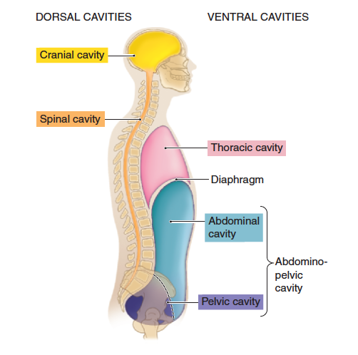
Body Cavities
Which cavity contains the diaphragm?
Fig. 1-10

Slide 21
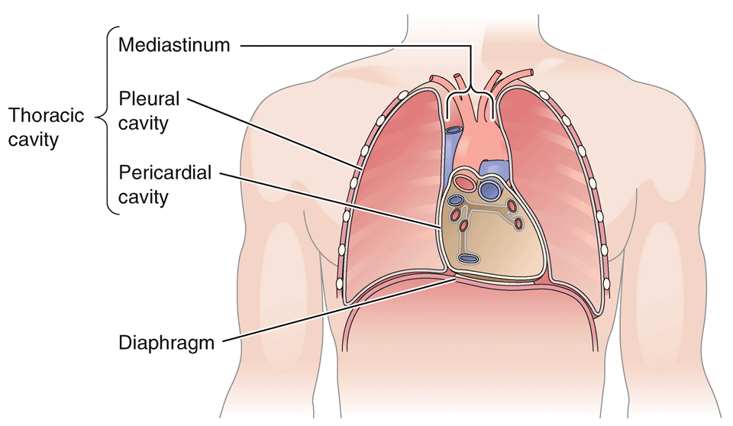
Thoracic Cavity
Subdivisions
  Pericardial cavity
  Pleural cavity
  Mediastinum
Which cavity contains the lung?
Fig. 1-11

Slide 22
Abdominopelvic Cavity
Subdivisions
  Abdominal cavity
    Contains the stomach, most of the intestine, liver, gallbladder, pancreas and spleen
  Pelvic cavity
Fig. 1-10

Slide 23
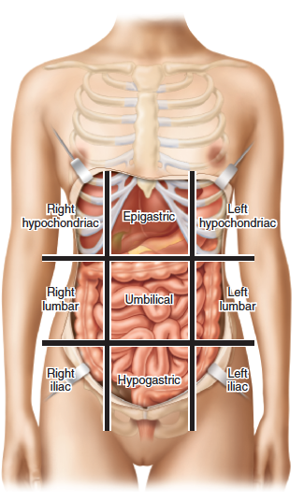
The Nine Regions of the Abdomen
Epigastric
Umbilical
Hypogastric
Hypochondriac (left and right)
Lumbar (left and right)
Iliac or inguinal (left and right)
  Named for the upper crest of the hip bone and groin region
Fig. 1-12
Which region contains the spleen?

Slide 24
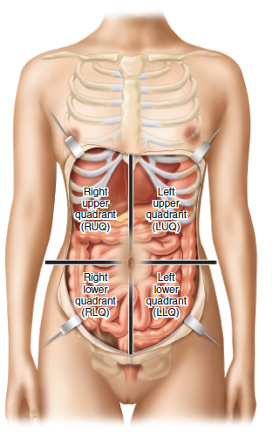
Four Quadrants of the Abdomen
  Right upper quadrant
  Left upper quadrant
  Right lower quadrant
  Left lower quadrant
Fig. 1-13
In which region is pain from appendicitis most likely to be felt?

Slide 25
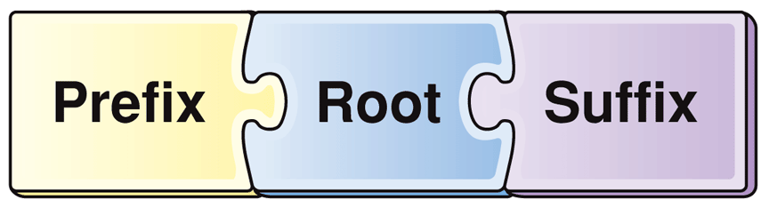
The Language of Health Care
Medical Terminology
Root: main part
Prefix: starts the word and modifies the root
Suffix: ends the word and modifies the root

Slide 26
Word Anatomy (cont.)
Word Part | Meaning | Example
Studies of the Human Body
dis- | apart, away from | To dissect is to cut apart.
-logy | study of | Radiology is the study and use of radioactive substances.
physi/o | nature, physical | Physiology is the study of how the body functions.
-tomy | cutting, incision of | Anatomy

Slide 27
Word Anatomy (cont.)
Word Part | Meaning | Example
Metabolism
ana- | upward, again, back | Anabolism is the building up of simple compounds into more complex substances.
cata- | down | Catabolism is the breakdown of complex substances.
extra- | outside of, beyond | Extracellular fluid is outside the cells.
home/o- | same | Homeostasis is the steady state (sameness) within an organism.
intra- | within | Intracellular fluid is within a cell.
stat, -stasis | stand, stoppage, constancy | In homeostasis, “-stasis” refers to constancy.

