Slide 1
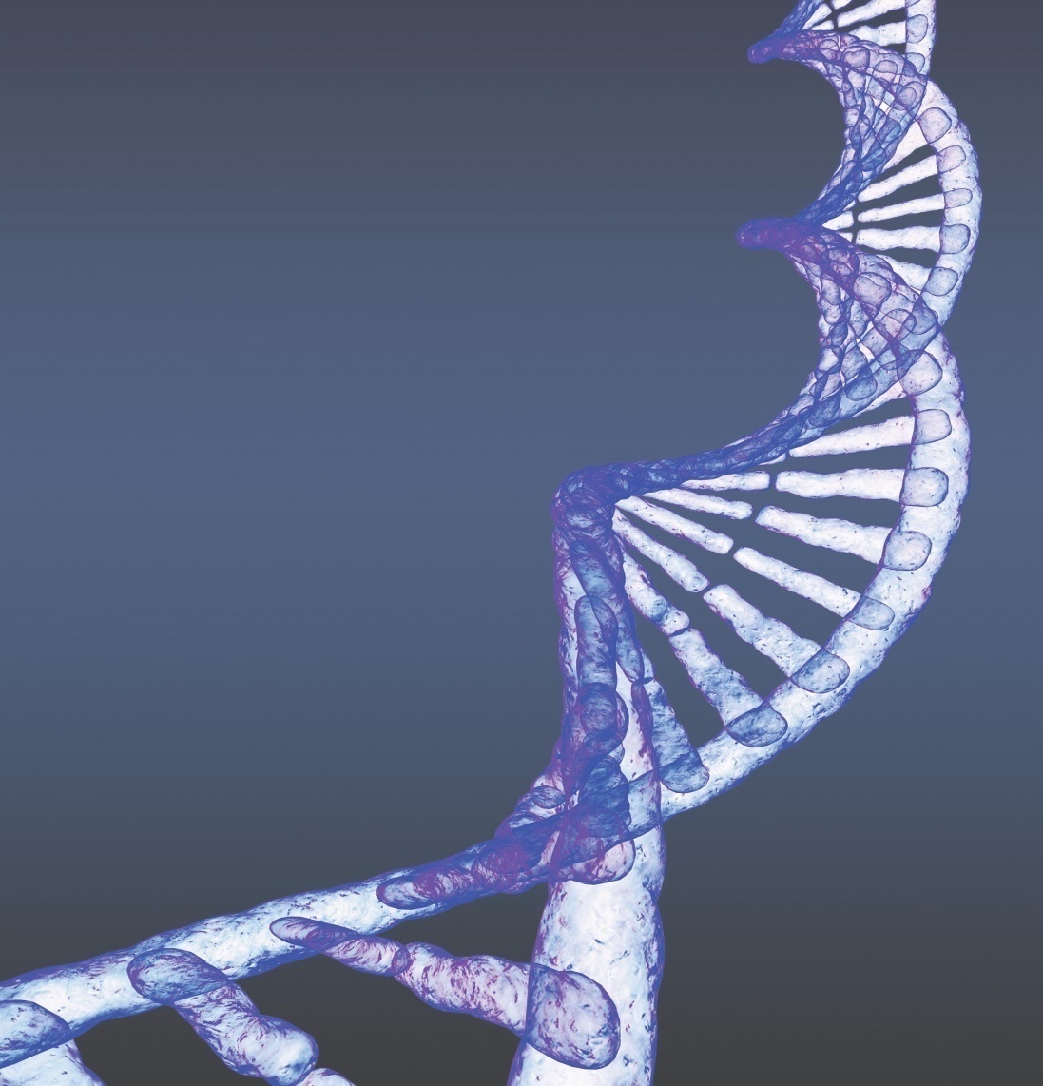
Chapter 2
Chemistry, Matter, and Life

Slide 2
Chemistry
Science that deals with matter’s composition and properties
Used to understand normal and abnormal body function

Slide 3
Elements and Matter
Matter
The substances from which the universe is made
Elements
All of the different types of matter
Identified by names or chemical
symbols
Also identified by number
Described and organized in the
periodic table
11
Sodium
Na
22.99

Slide 4
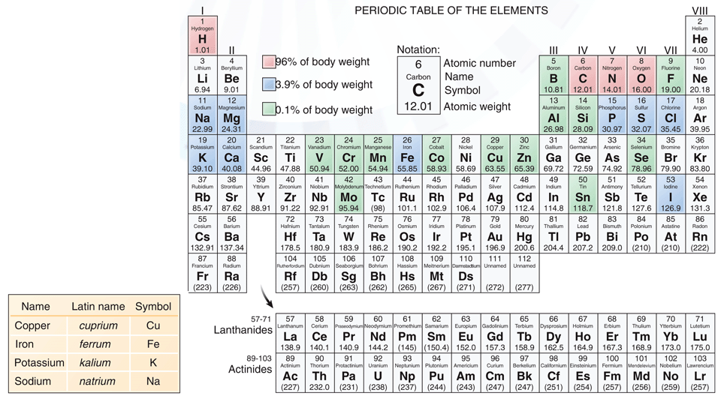
Appendix 1
Periodic Table of the Elements
What is the symbol and number for carbon?

Slide 5
Some Common Elements
Table 2-1
Name | Symbol | Function
**Oxygen | O | Part of water; needed to metabolize nutrients for energy
Carbon | C | Basis of all organic compounds; component of carbon dioxide, the gaseous byproduct of metabolism
Hydrogen | H | Part of water, participates in energy metabolism; determines the acidity of body fluids
Nitrogen | N | Present in all proteins, ATP (the energy-storing compound), and nucleic acids (DNA and RNA)
**Calcium | Ca | Builds bones and teeth; needed for muscle contraction, nerve impulse conduction, and blood clotting
Phosphorus | P | Active ingredient in ATP; builds bones and teeth; component of cell membranes and nucleic acids
Potassium | K | Active in nerve impulse conduction; muscle contraction
Sulfur | S | Part of many proteins
Sodium | Na | Active in water balance, nerve impulse conduction, and muscle contraction
Iron | Fe | Part of hemoglobin, the compound that carries oxygen in red blood cells
The elements are listed in decreasing order by weight in the body.

Slide 6
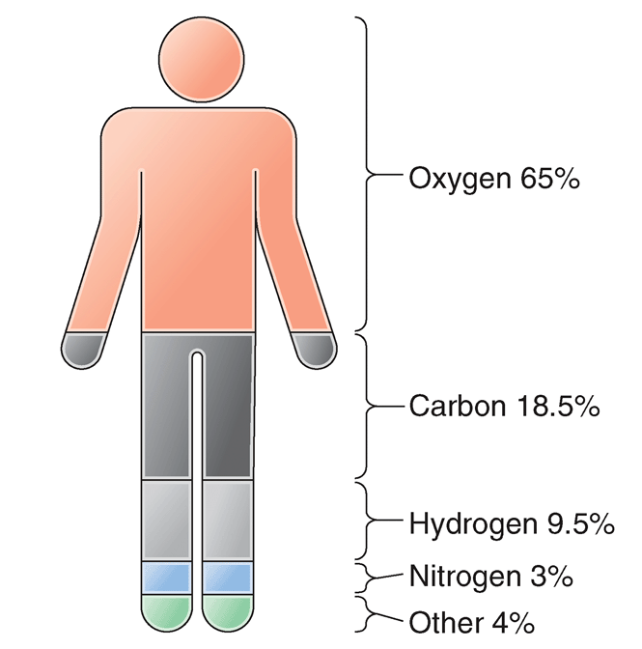
The Body’s Chemical Composition by Weight
Fig. 2-1

Slide 7
Atoms
Smallest subunits of elements
Cannot be broken down or changed by ordinary chemical and physical means

Slide 8
Atomic Structure
Nucleus
  At atom’s center
  Composed of
    Protons; positively charged
    Neutrons; not charged
Electrons
  Negatively charged
  Orbit in energy levels around the nucleus
  Determine atom’s chemical reactivity

Slide 9
Atomic Number
Equal to the number of protons in an atom’s nucleus.
Also represents the number of electrons orbiting the nucleus.
No two elements share the same atomic number.
8
Oxygen
O
16.00
Oxygen’s nucleus contains 8 protons. Its atomic number is 8.

Slide 10
Energy Levels
Regions around an atom’s nucleus where electrons orbit.
  Each region has space for a specific number of electrons.
  The first energy level has room for two electrons.
  The second energy level has room for eight electrons.
    An atom is most stable when its energy levels are filled with electrons.

Slide 11
Energy Levels of Common Atoms
 | 6
 | 2
 | 4
An atom will form chemical bonds with other atoms to fill its outermost energy level.
An atom will donate, accept, or share electrons to fill its outermost energy level.

Slide 12
Chemical Bonds (cont.)
An atom forms chemical bonds with other atoms to fill its outermost energy level with electrons.
  Electrons may be transferred between atoms.
  Electrons may be shared between atoms.

Slide 13
Valence
The number of bonds an atom needs to fill its outermost energy level.
Example
A carbon atom has six electrons. Its outermost energy level contains four electrons. It needs four more electrons to fill its outermost energy level. Carbon’s valence is 4.
6
Carbon
C
12.01

Slide 14
Ionic Bonds
Form when one atom transfers electrons to another atom
  The atom that donates an electron becomes a positively charged cation.
  The atom that accepts an electron becomes a negatively charged anion.
  The ionic bond is the attraction between oppositely charged ions.
Na⁺
Cl–
Na⁺
Cl–

Slide 15
Electrolytes
Compounds that separate into ions in solution
Term also used to refer to the ions themselves
Example
Sodium chloride (NaCl) is an electrolyte. When NaCl is added to water, it separates into Na⁺ and Cl⁻ ions. Both Na⁺ and Cl⁻ are electrolytes.

Slide 16
Electrolytes (cont.)
Electrolytes (ions) conduct electric currents in body fluid.
Measurement of a tissue’s electrical activity is used to diagnose disease.
Examples
Electrocardiogram | A record of the heart’s electrical activity
Electroencephalogram | A record of the brain’s electrical activity

Slide 17
Important Ions in the Body
Homeostasis maintains ion concentrations within tight limits.
Ions and Their Functions
Ion | Functions
Ca²⁺ | Blood clotting, muscle contraction
HCO₃⁻ | pH regulation

Slide 18
Covalent Bonds
Form when two atoms share electrons
The most common chemical bond in the body
Types:
  Nonpolar covalent bond
    Electrons are shared equally.
  Polar covalent bond
    Electrons are shared unequally.

Slide 19
Molecules and Compounds
Molecules
Chemicals composed of two or more atoms held together with covalent bonds
  Examples: O₂, H₂O
Compounds
Chemicals composed of two or more different atoms held together by ionic or covalent bonds
  Examples: NaCl, H₂O, CO₂

Slide 20
Types of Mixtures
Type | Definition | Example
Solution | Homogeneous mixture formed when one substance (solute) dissolves in another (solvent) | Table salt (NaCl) dissolved in water; table sugar (sucrose) dissolved in water
Suspension | Heterogeneous mixture in which one substance is dispersed in another but will settle out unless constantly mixed | Red blood cells in blood plasma; milk of magnesia
Colloid | Heterogeneous mixture in which the suspended particles remain evenly distributed based on the small size and opposing charges of the particles | Blood plasma; cytosol

Slide 21
The Importance of Water
Most abundant compound in body
Critical in all physiologic processes
Deficiency (dehydration) threatens health
Universal solvent
Stable liquid at ordinary temperatures
Participates in body’s chemical reactions
Some substances are hydrophobic

Slide 22
Acids, Bases, and Salts (cont.)
Acid
A substance that releases hydrogen ions
Base
A substance that releases hydroxide ions and accepts hydrogen ions
Salt
A substance formed by a reaction between an acid and a base
HCl → H⁺ + Cl⁻
NaOH → Na⁺ + OH⁻
HCl + NaOH → NaCl + H₂O

Slide 23
The pH Scale
Indicates the relative concentrations of hydrogen and hydroxide ions in a solution.
  Scale from 0 (most acidic) to 14 (most basic).
  Each unit represents a 10-fold change.
Normal body fluid pH range is between 7.35 and 7.45.
  Acidosis: Body fluid pH less than 7.35
  Alkalosis: Body fluid pH greater than 7.45

Slide 24
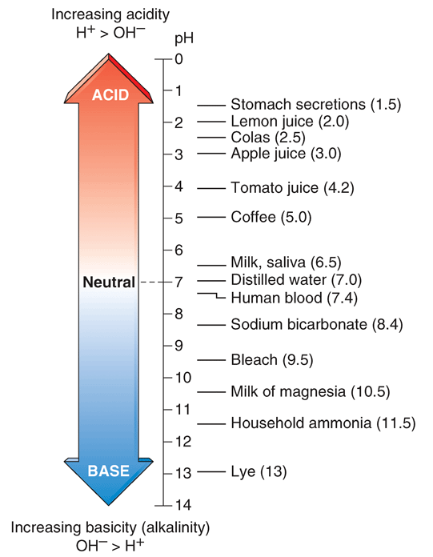
The pH Scale (cont.)
Fig. 2-7

Slide 25
Buffers
Chemicals that prevent sharp changes in H⁺ concentration
Are important in maintaining a relatively constant pH in body fluids

Slide 26
Isotopes
Forms of an element that have the same atomic number but different atomic weight
  Different atomic weight because of a different number of neutrons
May be stable or unstable (radioactive)
Examples
Isotope | Proton Number | Neutron Number | Atomic Weight
Carbon-12 | 6 | 6 | 12
Carbon-13 | 6 | 7 | 13
Carbon-14 | 6 | 8 | 14

Slide 27
Radioactivity
Radioactivity
Emission of atomic particles from an isotope
Use of Radioactive Isotopes
Used in the treatment of cancer
  Radiation penetrates and destroys tumor cells.
Used in diagnosis
  Radioactive elements can be administered and detected internally to identify abnormalities—these are called tracers. Example: Radioactive iodine is used to diagnose thyroid problems.

Slide 28
Organic Compounds (cont.)
Chemistry of Living Matter
Hydrogen, oxygen, carbon, and nitrogen make up 96% of body weight.
Organic Compounds
Chemical compounds found in living things
Built on the element carbon
Main types
  Carbohydrates
  Lipids
  Proteins

Slide 29
Carbohydrates
Monosaccharides
  Basic units of carbohydrates
Disaccharides
  Two monosaccharides linked together
Polysaccharides
  Many monosaccharides linked together
Carbohydrate | Examples
Monosaccharide | Glucose
Disaccharide | Sucrose and lactose
Polysaccharide | Glycogen and starch

Slide 30
Lipids (Fats)
Triglycerides
  Simple fat composed of glycerol and three fatty acids
Phospholipids
  Complex lipid containing phosphorus
Steroids
  Contain rings of carbon atoms (e.g., cholesterol)
Lipid | Functions
Triglyceride | Insulates body, protects organs, stores energy
Phospholipid | Main component of cell membranes
Steroid | Regulate body function (e.g., cortisol, sex hormones)

Slide 31
Proteins
  Contain nitrogen (and sometimes sulfur or phosphorus), carbon, hydrogen and oxygen
Found as structural materials and metabolically active compounds.
Composed of chains of amino acids held together by peptide bonds.
The overall three-dimensional shape of a protein is caused by folding.

Slide 32
Enzymes
Proteins that speed up (catalyze) chemical reactions
Work on specific substrates
Are not used up or changed during a chemical reaction
Work via the “lock-and-key” mechanism
Denature in harsh conditions (e.g., extremes of temperature or pH)

Slide 33
Nucleotides
Composed of:
  A nitrogenous base
  A sugar (usually ribose or deoxyribose)
  A phosphate group
Building blocks of DNA and RNA
One type is a component of ATP

Slide 34
Word Anatomy (cont.)
Word Part | Meaning |  | Example
Chemical Bonds
co- | together | Covalent bonds form when atoms share electrons.
Solutions and Suspensions
aqu/e | water | In an aqueous solution, water is the solvent.
heter/o- | different | Heterogeneous solutions are different (not uniform) throughout.
hom/o- | same | Homogeneous mixtures are the same throughout.
hydr/o | water | Dehydration is a deficiency of water.
-phil | to like | Hydrophilic substances “like” water—they mix with or dissolve in it.
-phobia | fear | Hydrophobic substances “fear” water—they repel and do not dissolve in it.

Slide 35
Word Anatomy (cont.)
Word Part |  | Meaning | Example
Organic Compounds
-ase | suffix used in naming enzymes |  | A lipase is an enzyme that acts on lipids.
de- | remove |  | Denaturation of a protein removes its ability to function (changes its nature).
di- | twice, double |  | A disaccharide consists of two simple sugars.
glyc/o- | glucose, sweet |  | Glycogen is a storage form of glucose. It breaks down to release glucose.
mon/o- | one |  | In a monosaccharide, “mono-” refers to one.
poly- | many |  | A polysaccharide consists of many simple sugars.
sacchar/o | sugar |  | A monosaccharide consists of one simple sugar.
tri- | three |  | Triglycerides have one fatty acid attached to each of three carbon atoms.

