Slide 1
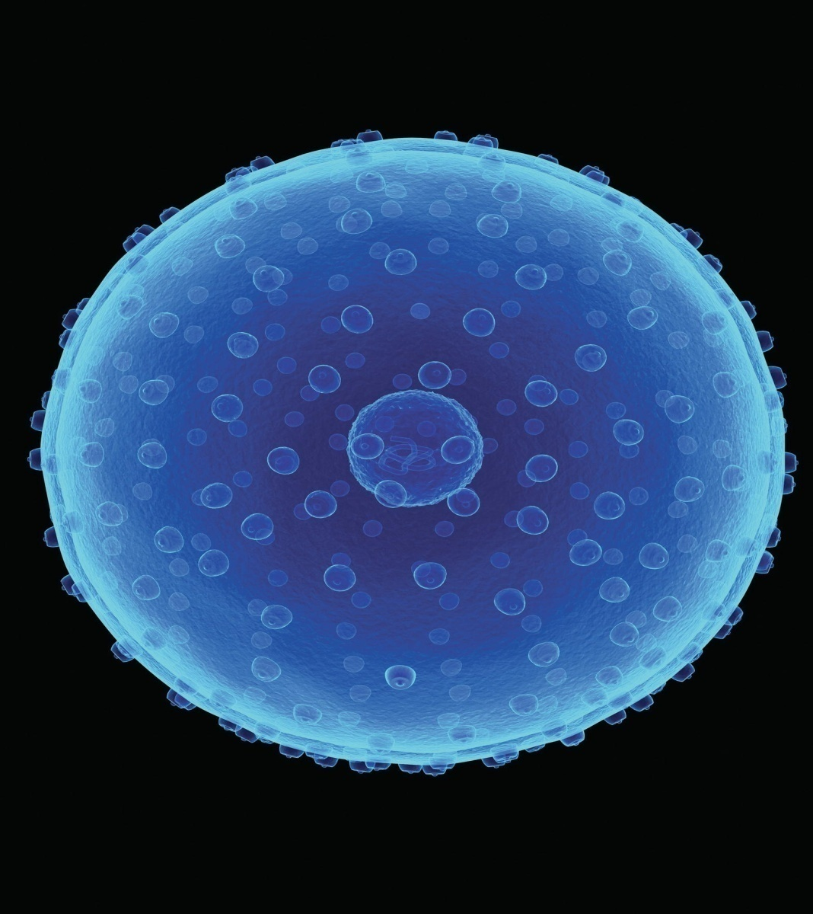
Chapter 3
Cells and Their Functions

Slide 2
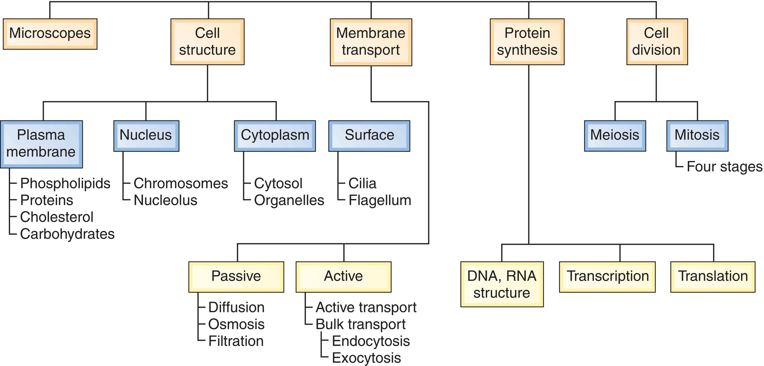
Overview

Slide 3
The Cell
Cytology
The study of cells
The Cell
The basic unit of life
Shows life characteristics
  Organization
  Metabolism
  Responsiveness
  Homeostasis
  Growth
  Reproduction

Slide 4
Microscopes
Cytology
The study of cells
Microscope
An instrument that magnifies structures not visible to the naked eye
Types of microscopes:
  Compound light microscope
  Transmission electron microscope
  Scanning electron microscope

Slide 5
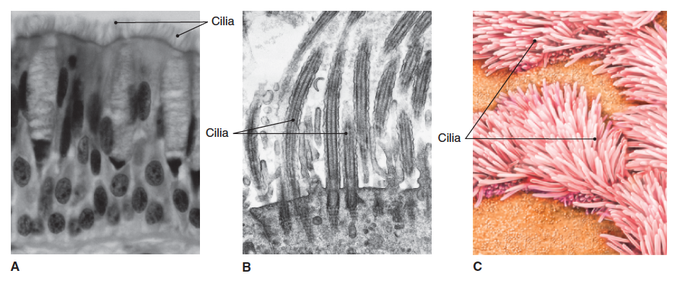
Microscopy
Fig. 3-1
Which microscope shows the most internal structure of the cilia? Which shows the cilia in three dimensions?

Slide 6
General Cell Organization
Plasma membrane
  Selectively permeable
  Also called the cell membrane
Nucleus
Cytoplasm
  Cytosol
  Organelles

Slide 7
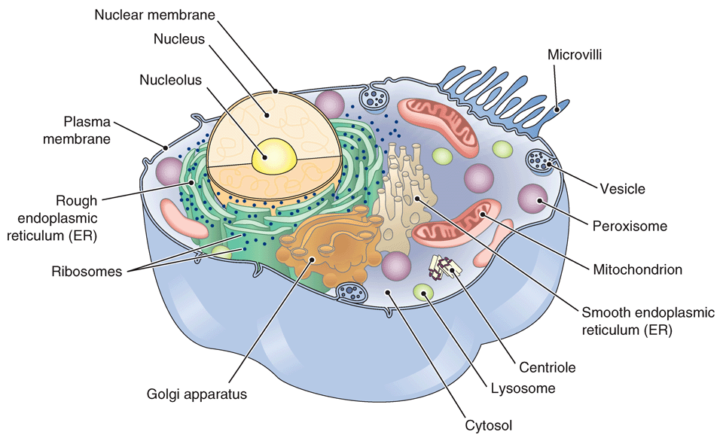
Cell Structure
Fig. 3-2
What is attached to the ER to make it look rough?
What is the liquid part of the cytoplasm called?

Slide 8
Plasma Membrane
Encloses cell contents
Regulates what enters and leaves cell
Participates in many cell activities (e.g., growth, reproduction, cell-to-cell interactions)
Plasma membrane components
  Phospholipid bilayer
  Cholesterol
  Proteins

Slide 9
Plasma Membrane Proteins
Table 3-1
Type of Protein | Function
Channels | Pores in the membrane that allow passage of specific substances
**Transporters | Shuttle substances across membrane
Receptors | Allow for attachment of substances to membrane; used for cell-to-cell signaling
Enzymes | Participate in chemical reactions at membrane surface
**Linkers | Help stabilize the plasma membrane and attach cells together
Cell identity markers | Proteins unique to a person’s cells; important in the immune system and in transplantation of tissue from one person to another

Slide 10
The Nucleus
Largest organelle of cell
Surrounded by a nuclear membrane
Contains
  Chromosomes
    Units of heredity; govern all cellular activity
  Nucleolus
    Assembles ribosomes

Slide 11
Cytoplasm
Material between the nuclear membrane and plasma membrane
Includes
  Cytosol
    Fluid portion of cytoplasm
  Organelles
    Specialized cell structures that perform different cell functions

Slide 12
Surface Projections
Structures that extend from the cell
Can include
  Cilia
    Short, hairlike projections
    Move fluids around cells
  Flagellum
    Long, whiplike extension from the cell
    Moves cell
    Only in spermatozoa

Slide 13
**Organelles
Name | Description | Function
Endoplasmic reticulum (ER) | Network of membranes within the cytoplasm. Rough ER has ribosomes attached to it; smooth ER does not | Rough ER modifies, folds, and sorts proteins; smooth ER participates in lipid synthesis
** Ribosomes | Small bodies free in the cytoplasm or attached to the ER; composed of RNA and protein | Manufacture proteins
Golgi apparatus | Layers of membranes | Further modifies proteins; sorts and prepares proteins for transport to other parts of the cell or out of the cell
Mitochondria | Large organelles with internal folded membranes | Convert energy from nutrients into ATP
**Lysosomes | Small sacs of digestive enzymes | Digest substances within the cell
Peroxisomes | Membrane-enclosed organelles containing enzymes | Break down harmful substances
Proteasomes | Barrel-shaped organelles | Destroy improperly synthesized proteins
Vesicles | Small membrane-bound sacs in the cytoplasm | Store materials and move materials into or out of the cell in bulk
Centrioles | Rod-shaped bodies (usually two) near the nucleus | Help separate the chromosomes during cell division

Slide 14
Cellular Diversity
Cell shape is related to cell function.
  A neuron’s long fibers transmit electric energy from place to place in the nervous system.
  Small round red blood cells slide through tiny blood vessels.
Cell organelle number is related to cell function.
  Lipid-producing cells have lots of smooth ER.
  Metabolically active cells have lots of mitochondria to manufacture ATP.

Slide 15
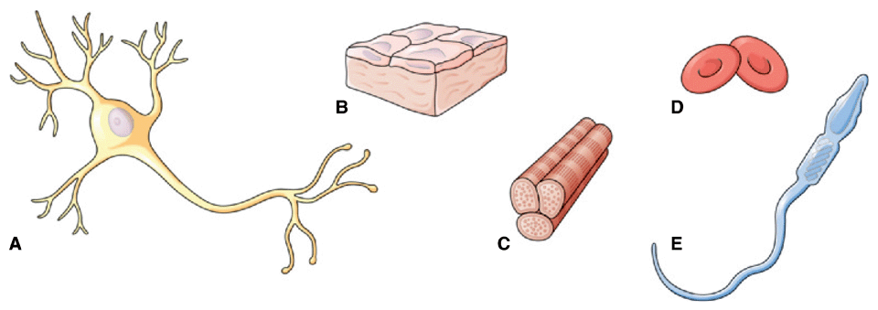
Cellular Diversity (cont.)
Fig. 3-4
Which of the cells shown would best cover a large surface area?

Slide 16
Membrane Transport
Plasma membrane regulates what enters and leaves.
Travel across membrane is based on several factors.
  Molecular size
  Solubility
  Electrical charge

Slide 17
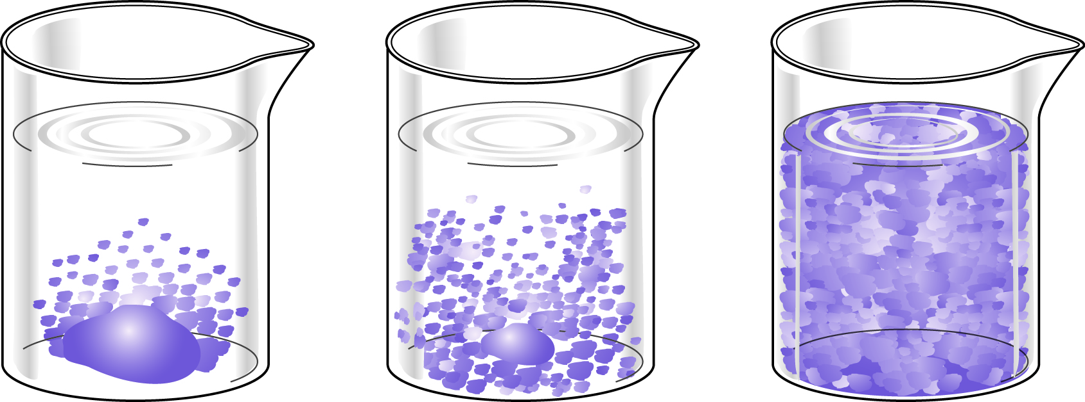
Diffusion of a Solid in a Liquid
Fig. 3-5

Slide 18
Osmosis and Cells
Another way to think about osmosis is in terms of solute concentration.
Water Follows the Salt
Low solute
High water
High solute
Low water
Osmosis

Slide 19
Tonicity
Solution | Description | Examples | Effect on Cells
Isotonic | Has the same concentration of dissolved substances as the fluid in the cell | 0.9% salt (normal saline); 5% glucose | None
Hypotonic | Has a lower concentration of dissolved substances than fluid in the cell | Less than 0.9% salt or 5% glucose | Cell takes in water and may burst (lysis)
Hypertonic | Has a higher concentration of dissolved substances than fluid in the cell | Higher than 0.9% salt or 5% glucose | Cell loses water and shrinks (crenation)

Slide 20
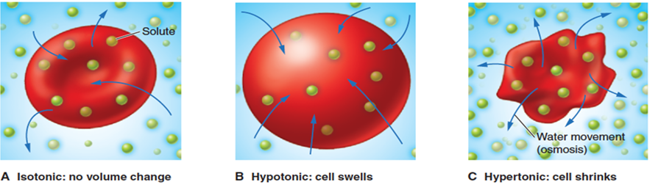
Tonicity (cont.)
Fig. 3.9
What would happen to red blood cells in the body if blood lost through injury were replaced with pure water?

Slide 21
Membrane Transport: Summary
Process | Definition | Example
Do not require cellular energy (passive)
Diffusion | Random movement of particles down the concentration gradient (from higher concentration to lower concentration) | Movement of gases through the membrane, ions through an ion channel, or nutrients via transporters
Osmosis | Diffusion of water through a semipermeable membrane | Movement of water across the plasma membrane through aquaporins
Filtration | Movement of materials through a membrane down a pressure gradient | Movement of materials out of the blood under the force of blood pressure
Require cellular energy
Active transport (pumps) | Movement of materials through the plasma membrane against the concentration gradient using transporters | Transport of ions (e.g., Na⁺, K⁺, and Ca²⁺) in neurons
Endocytosis | Transport of bulk amounts of materials into the cell using vesicles | Phagocytosis—intake of large particles, as when white blood cells take in waste materials; also pinocytosis (intake of fluid), and receptor-mediated endocytosis, requiring binding sites in the plasma membrane
Exocytosis | Transport of bulk materials out of the cell using vesicles | Release of neurotransmitters from neurons

Slide 22
Protein Synthesis (Overview)
Proteins perform structural and functional roles in a cell.
DNA directs protein synthesis.
  Nucleotides make up DNA
  DNA organized into genes
  Genes organized into chromosomes
RNA participates in protein synthesis but is not part of chromosomes.

Slide 23
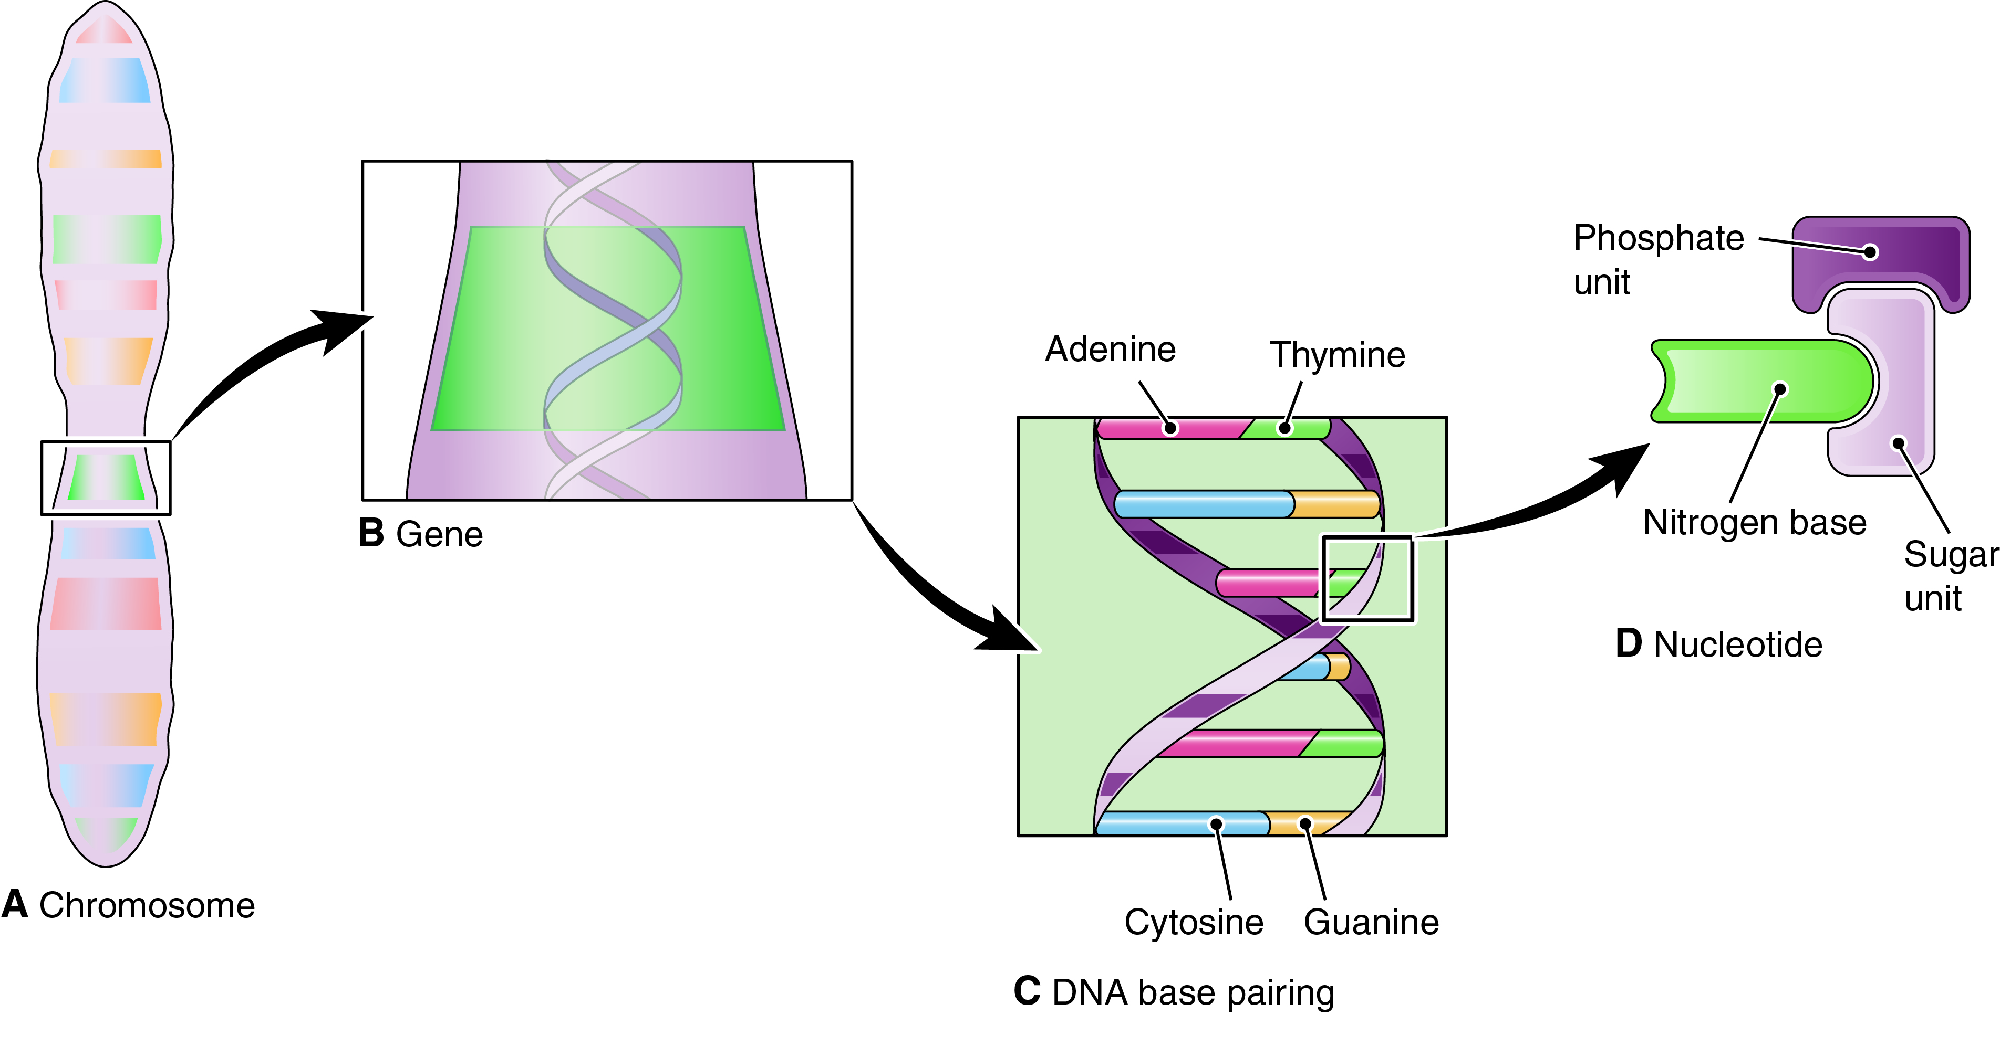
Chromosomes and DNA
Fig. 3-12

Slide 24
Comparison of DNA and RNA
Table 3-5
 | DNA | RNA
Location | Almost entirely in the nucleus | Almost entirely in the cytoplasm
Composition | Nucleotides contain adenine (A), guanine (G), cytosine (C), or thymine (T) Sugar: deoxyribose | Nucleotides contain adenine (A), guanine (G), cytosine (C), or uracil (U) Sugar: ribose
Structure | Double-stranded helix formed by nucleotide pairing A–T; G–C | Single strand
Function | Makes up the chromosomes, hereditary units that control all cellular activities; divided into genes that carry the nucleotide codes for the manufacture of proteins | Manufacture proteins according to the codes carried in the DNA; three main types: messenger RNA (mRNA), ribosomal RNA (rRNA), and transfer RNA (tRNA)

Slide 25
The Genetic Code
Table 3-6
Amino Acid | Transcribed DNA Triplet | mRNA | tRNA
Glycine | CCC | GGG | CCC
Proline | GGG | CCC | GGG
Valine | CAC | GUG | CAC
Phenylalanine | AAA | UUU | AAA

Slide 26
Types of RNA
Table 3-7
Types | Function
Messenger RNA (mRNA) | Is built on a strand of DNA in the nucleus and transcribes the nucleotide code Moves to cytoplasm and attaches to a ribosome
Ribosomal RNA (rRNA) | With protein makes up the ribosomes, the sites of protein synthesis in the cytoplasm Involved in the process of translating the genetic message into a protein
Transfer RNA (tRNA) | Works with other forms of RNA to translate the genetic code into protein; each molecule of tRNA carries an amino acid that can be used to build a protein at the ribosome

Slide 27
Transcription and Translation
Transcription
  First step; occurs in nucleus
  DNA code is transcribed into mRNA by nucleotide base pairing
Translation
  Second step; occurs in cytoplasm
  mRNA leaves nucleus and travels to ribosomes
  Ribosomes and tRNA translate mRNA into protein’s amino acid sequence

Slide 28
Types of Cell Division
Meiosis
  Produces gametes (n)
  Cuts chromosome number in half to prepare for union of egg and sperm during fertilization
Mitosis
  Produces somatic cells (2n)
  Parent stem cell gives rise to two identical daughter cells

Slide 29
Preparation for Mitosis: DNA Replication
DNA replicates during interphase
Identical strands held together at centromere until they separate during mitosis
DNA replication during interphase
Mitosis

Slide 30
Stages of Mitosis
 | Description
Prophase | DNA strands coil into chromosomes Nucleolus and nuclear membrane disappear Centrioles move to opposite poles and form spindle
Metaphase | Chromosomes line up across center of cell Chromosomes attach to spindle
Anaphase | Centromeres split Identical chromosomes move toward opposite centrioles
Telophase | Chromosomes continue to move toward centrioles Nuclear membrane forms around each group of chromosomes Plasma membrane pinches off in middle of cell to form two new identical daughter cells

Slide 31
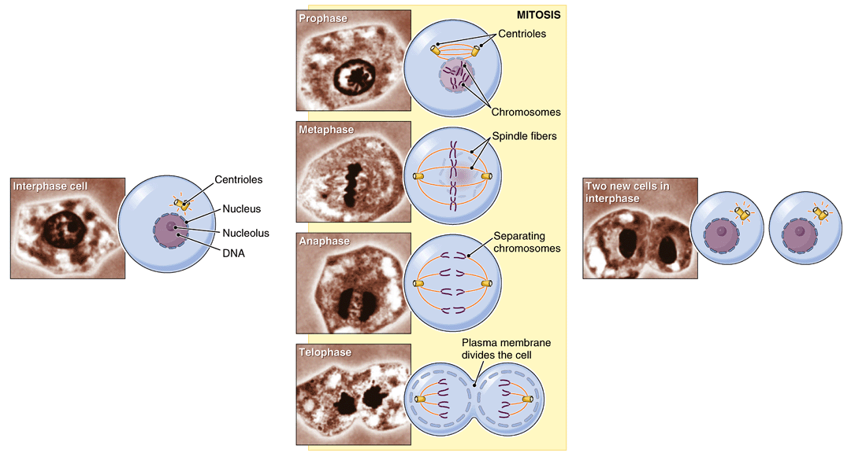
Stages of Mitosis (cont.)
Prophase
Interphase cell
Metaphase
Two new cells in Interphase
Anaphase
Fig. 3-15
Telophase
If the original cell shown has 46 chromosomes, how many chromosomes will each new daughter cell have?

Slide 32
Cell Aging
As cells multiply, changes occur that may lead to their damage or death.
  Free radical injury
  Enzyme injury
  Gene mutation
  Slowing cell activity
  Apoptosis

Slide 33
Cystic Fibrosis and the Plasma Membrane
Cystic fibrosis is an inherited disease
Ben’s parents each carried a defective gene in their DNA and both had by chance passed copies of the gene onto Ben
As a result, Ben was unable to synthesize a specific chloride channel protein, reducing chloride diffusion across the plasma membrane
Since water follows salt, osmosis was also disrupted
Without adequate osmosis, epithelial membranes produce abnormally thick and sticky mucus
Sticky mucus blocks passageways in the lungs (causing breathing problems) and pancreas (interfering with digestive enzyme secretion)
Without adequate osmosis, sweat is abnormally salty

Slide 34
Word Anatomy (cont.)
Word Part | Meaning | Example
Microscopes
cyt/o | cell | Cytology is the study of cells.
micr/o | small | Microscopes are used to view structures too small to see with the naked eye.
Cell Structure
bi- | two | The lipid bilayer is a double layer of lipid molecules.
chrom/o | color | Chromosomes are small, threadlike bodies that stain darkly with basic dyes.
end/o | in, within | The endoplasmic reticulum is a membranous network within the cytoplasm.
lys/o | loosening, dissolving, separating | Lysosomes are small bodies (organelles) with enzymes that dissolve materials (see also hemolysis).
-some | body | Ribosomes are small bodies in the cytoplasm that help make proteins.

