Slide 1
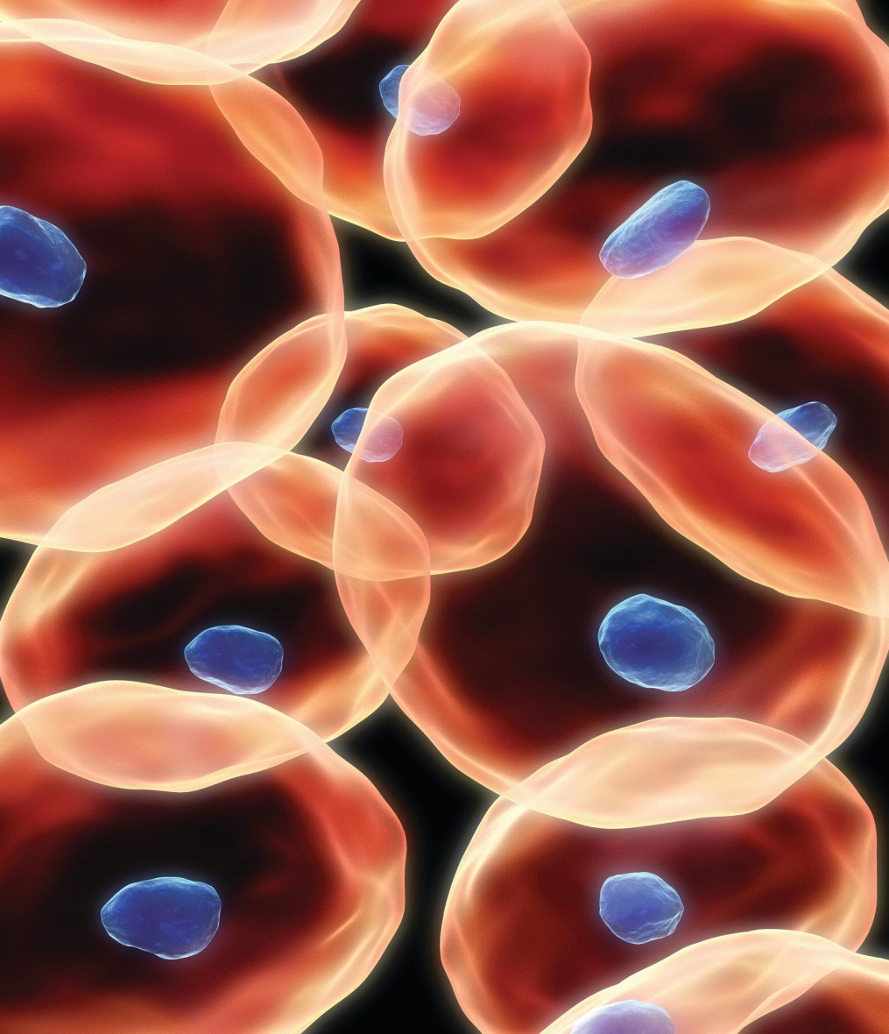
Chapter 4
Tissues, Glands, and Membranes

Slide 2
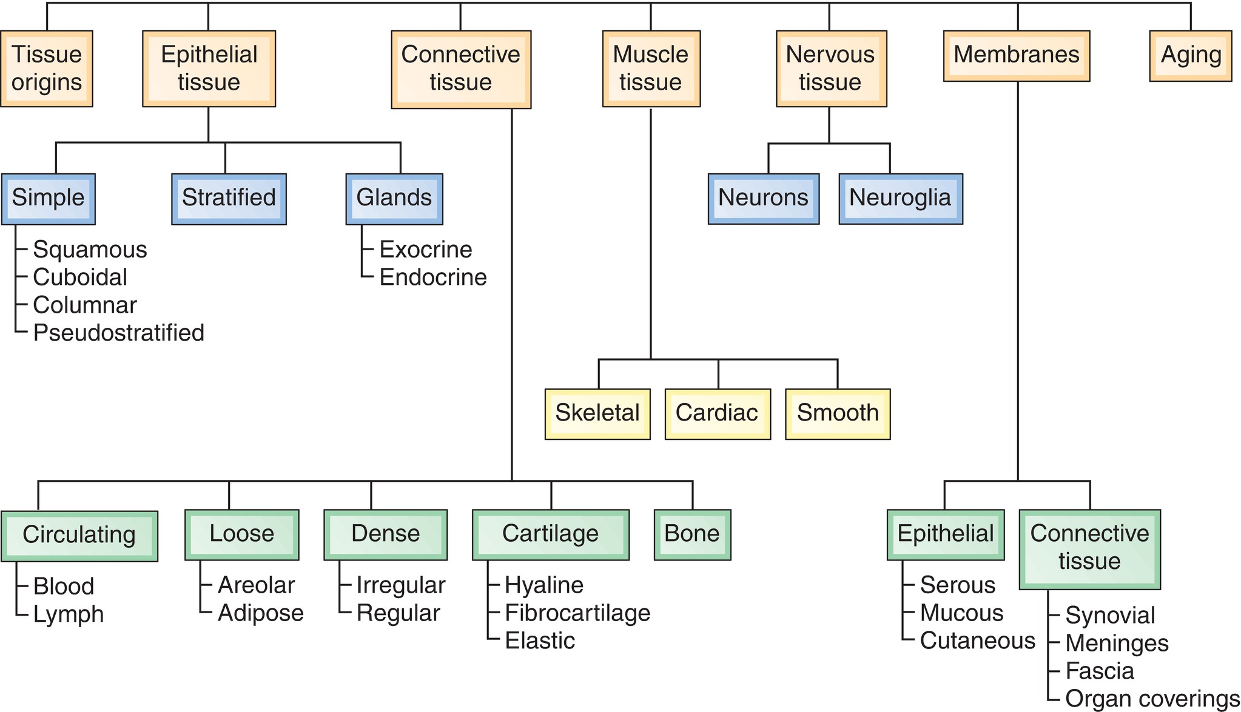
Overview

Slide 3
Key Terms
adipose | membrane
areolar | mucosa
cartilage | mucus
chondrocyte | neuroglia
collagen | neuron
endocrine | osteocyte
epithelium | parietal
exocrine | serosa
fascia | stem cell
fibroblast
histology
matrix

Slide 4
Tissue Origins and Classification
Learning Objectives
Define stem cells and describe their role in development and repair of tissue.
Name the four main groups of tissues and give the location and general characteristics of each.
Describe the difference between exocrine and endocrine glands and give examples of each.

Slide 5
Connective Tissue
Learning Objective
Classify the different types of connective tissue.

Slide 6
Membranes
Learning Objectives
Describe three types of epithelial membranes.
List six types of connective tissue membranes.

Slide 7
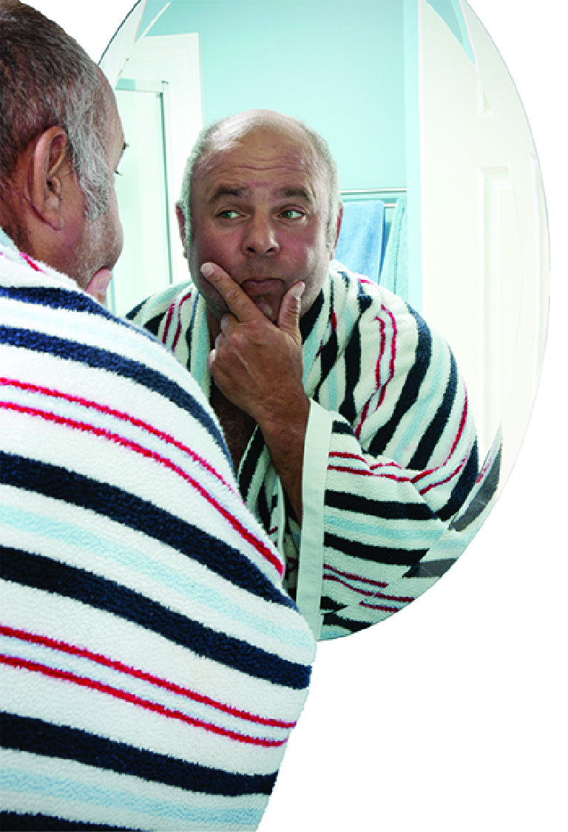
Case Study
Learning Objective
  Using examples from the case study, define histology and explain the role of histology in medical diagnosis and treatment

Slide 8

Word Anatomy
Learning Objective
8. Show how word parts are used to build words related to tissues, glands, and membranes.

Slide 9
Tissue Origins and Classification
Learning Objectives
Define stem cells and describe their role in development and repair of tissue.
Name the four main groups of tissues and give the location and general characteristics of each.
Describe the difference between exocrine and endocrine glands and give examples of each.

Slide 10
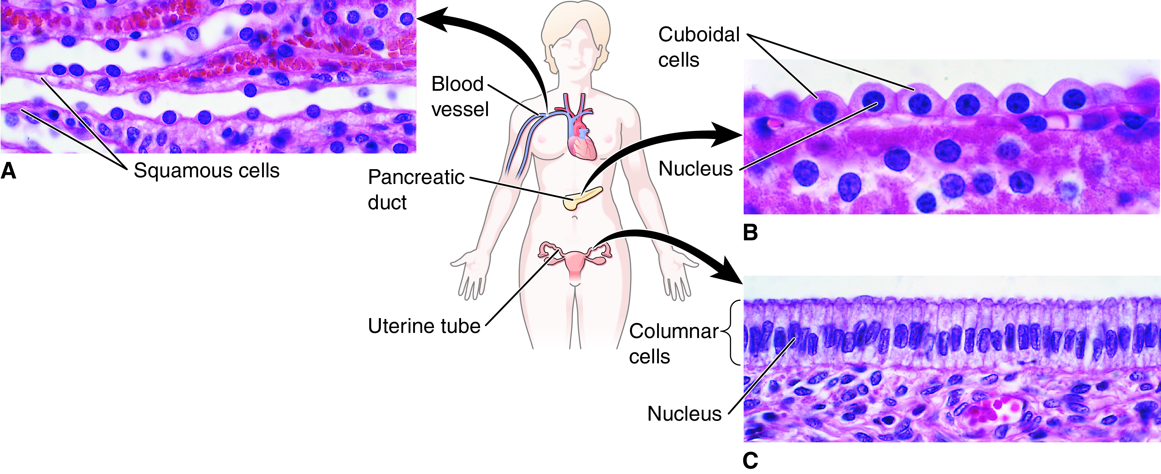
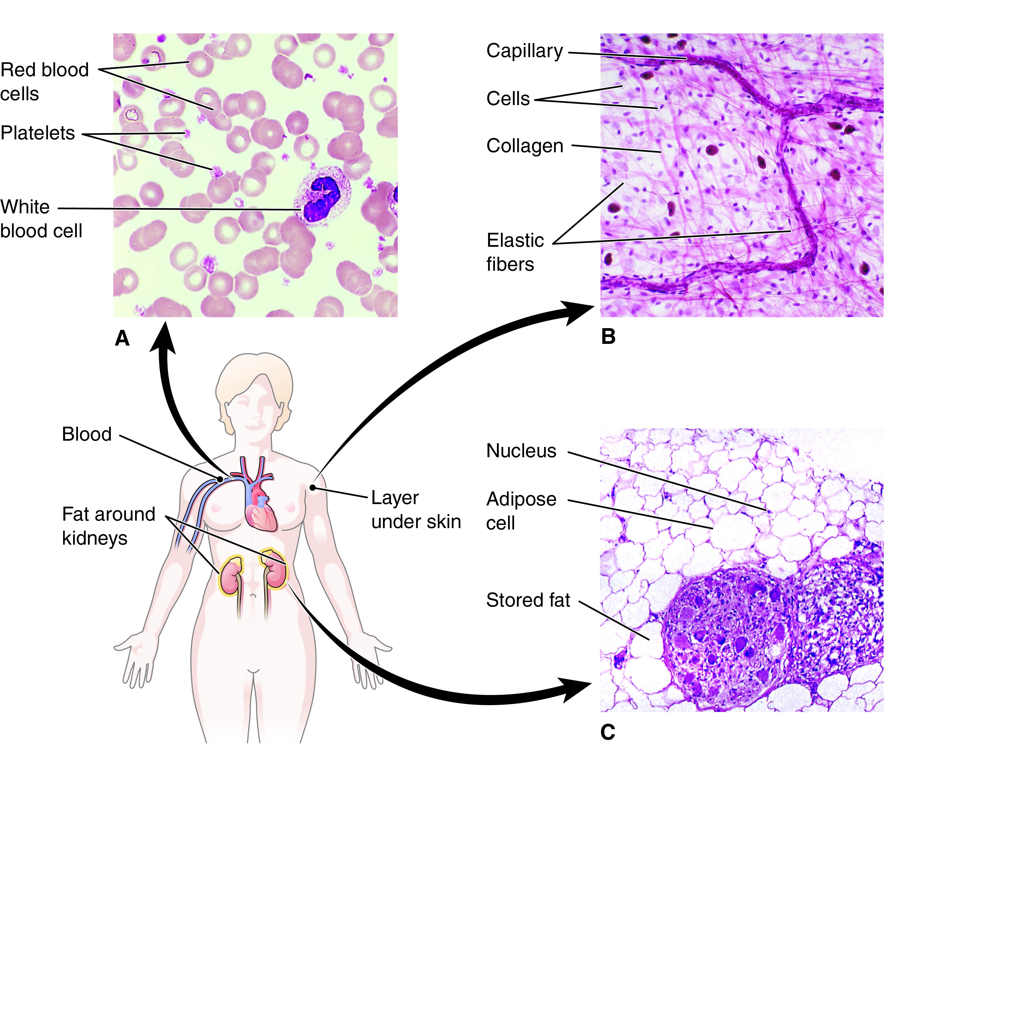
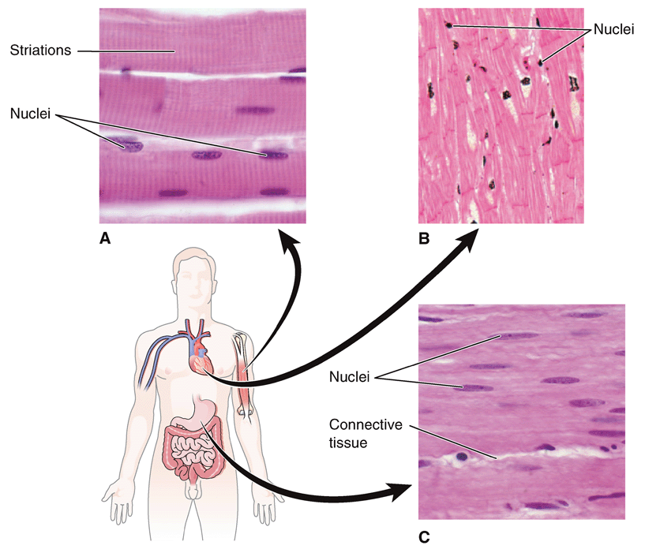
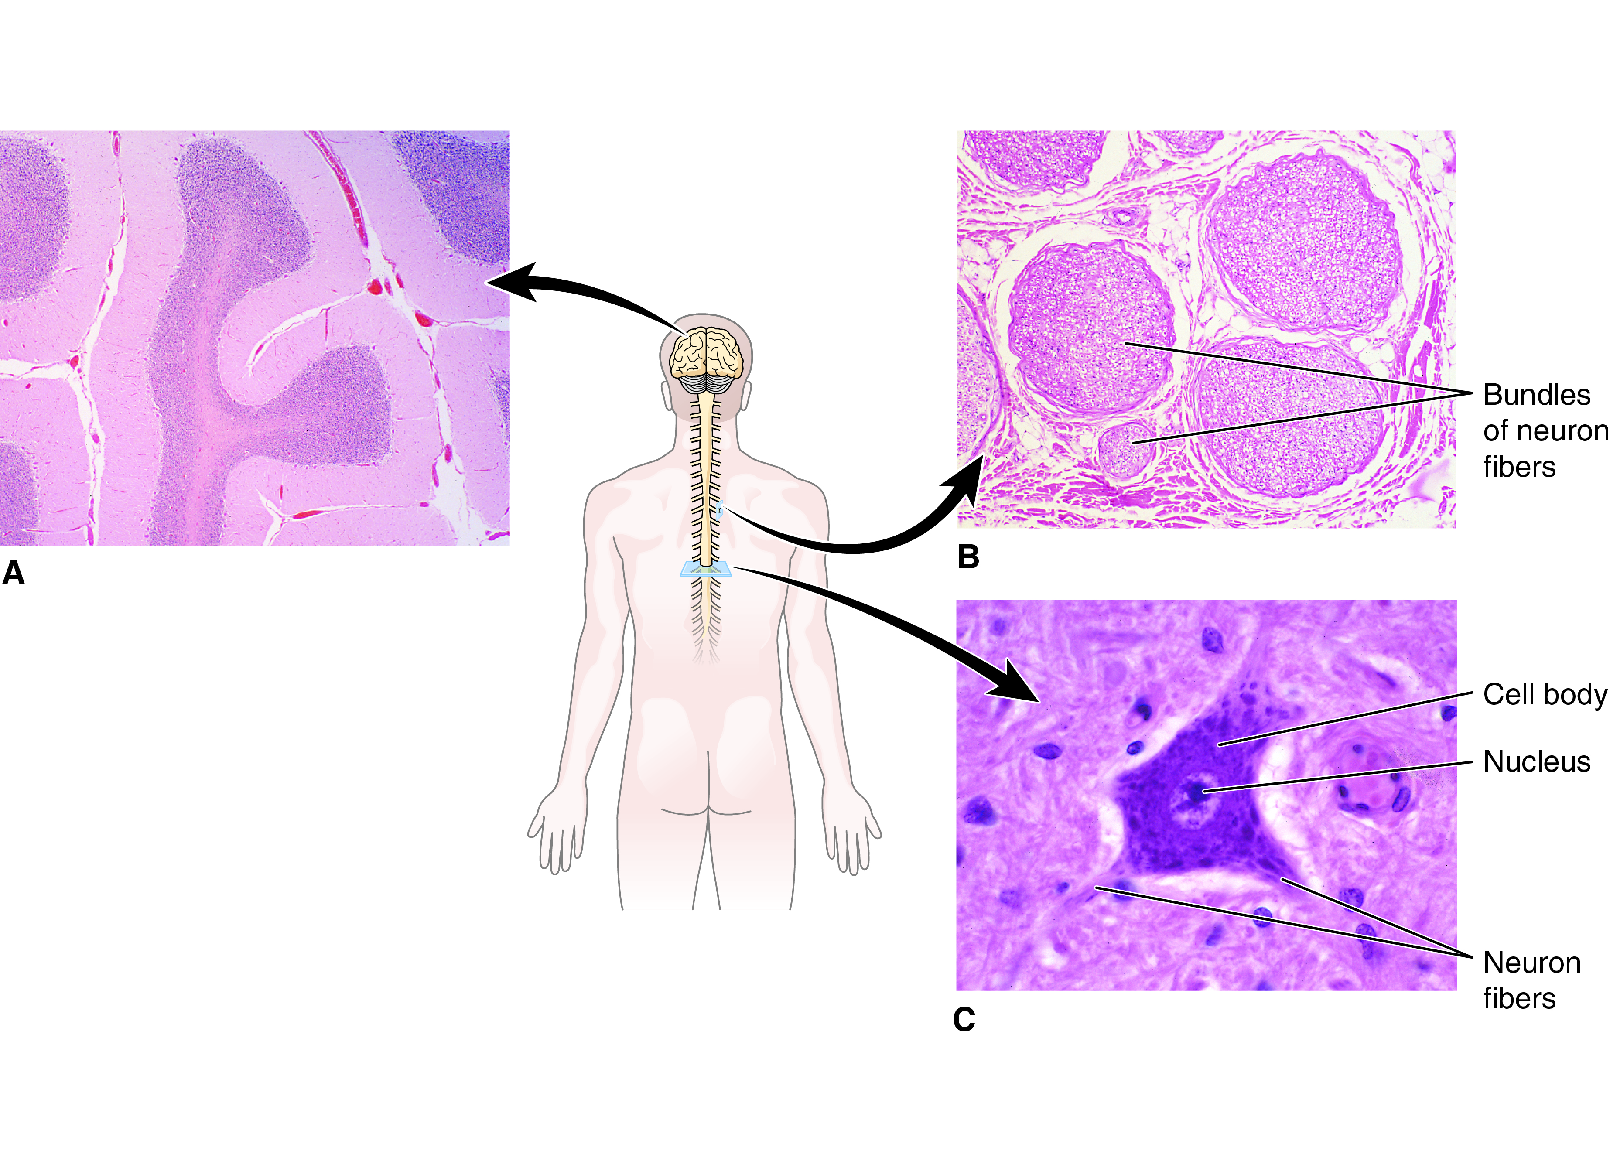
Histology: The Study of Tissues
Epithelial: Closely packed cells
Connective: Variable, but usually widely spaced cells in a protein-rich matrix
Muscle: Closely packed cells that generate force
Nervous: Neurons and associated cells involved in electric signaling

Slide 11
Epithelial Tissue
Forms a protective covering for the body
  Outer layer of skin
Forms membranes and ducts
Lines body cavities and hollow organs

Slide 12
Epithelial Tissue: Special Features
Goblet cells secrete mucus.
  Trap foreign particles in the respiratory tract
  Protect lining of digestive organs
Some epithelial cells have cilia.
  Sweep particles trapped in mucus away from the lungs
Epithelial cells repair and replace themselves quickly.

Slide 13
Epithelial Tissue: Classification
Classification by shape
  Squamous
  Cuboidal
  Columnar
Classification by layers
  Simple
  Stratified
  Pseudostratified

Slide 14
Simple Epithelium
Single-cell layer allows materials to pass from one system to another
Type | Description | Locations
Squamous | Flat, irregular cells with flat nuclei | Capillary walls, lung alveoli, glomerular capsule in the kidney, serous membranes
Cuboidal | Square cells with central round nuclei | Tubules and ducts, as in the kidney, liver, glands
Columnar | Long, narrow cells with ovoid basal nuclei | Lining of the stomach, intestine, oviducts
Pseudostratified | Columnar cells that appear stratified, but are not | Lining of respiratory passages

Slide 15
Simple Epithelium (cont.)
Fig. 4-1
In how many layers these epithelial cells are?

Slide 16
Stratified Epithelium
Multiple cell layers provide protection in areas subject to wear and tear.
Type | Description | Locations
Squamous | Flat, irregular cells in layers | Outer layer of skin, lining of the mouth, throat, anus, vagina
Cuboidal | Square cells in layers | Not common—some glands
Columnar | Long narrow cells in layers | Not common—larynx, some ducts
Transitional | Square cells that flatten as they are stretched and then return to original shape | Lining of the urinary bladder

Slide 17
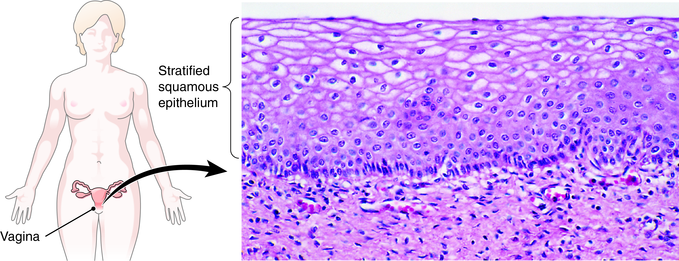
Stratified Squamous Epithelium
Fig. 4-2
What is the function of stratified epithelium?

Slide 18
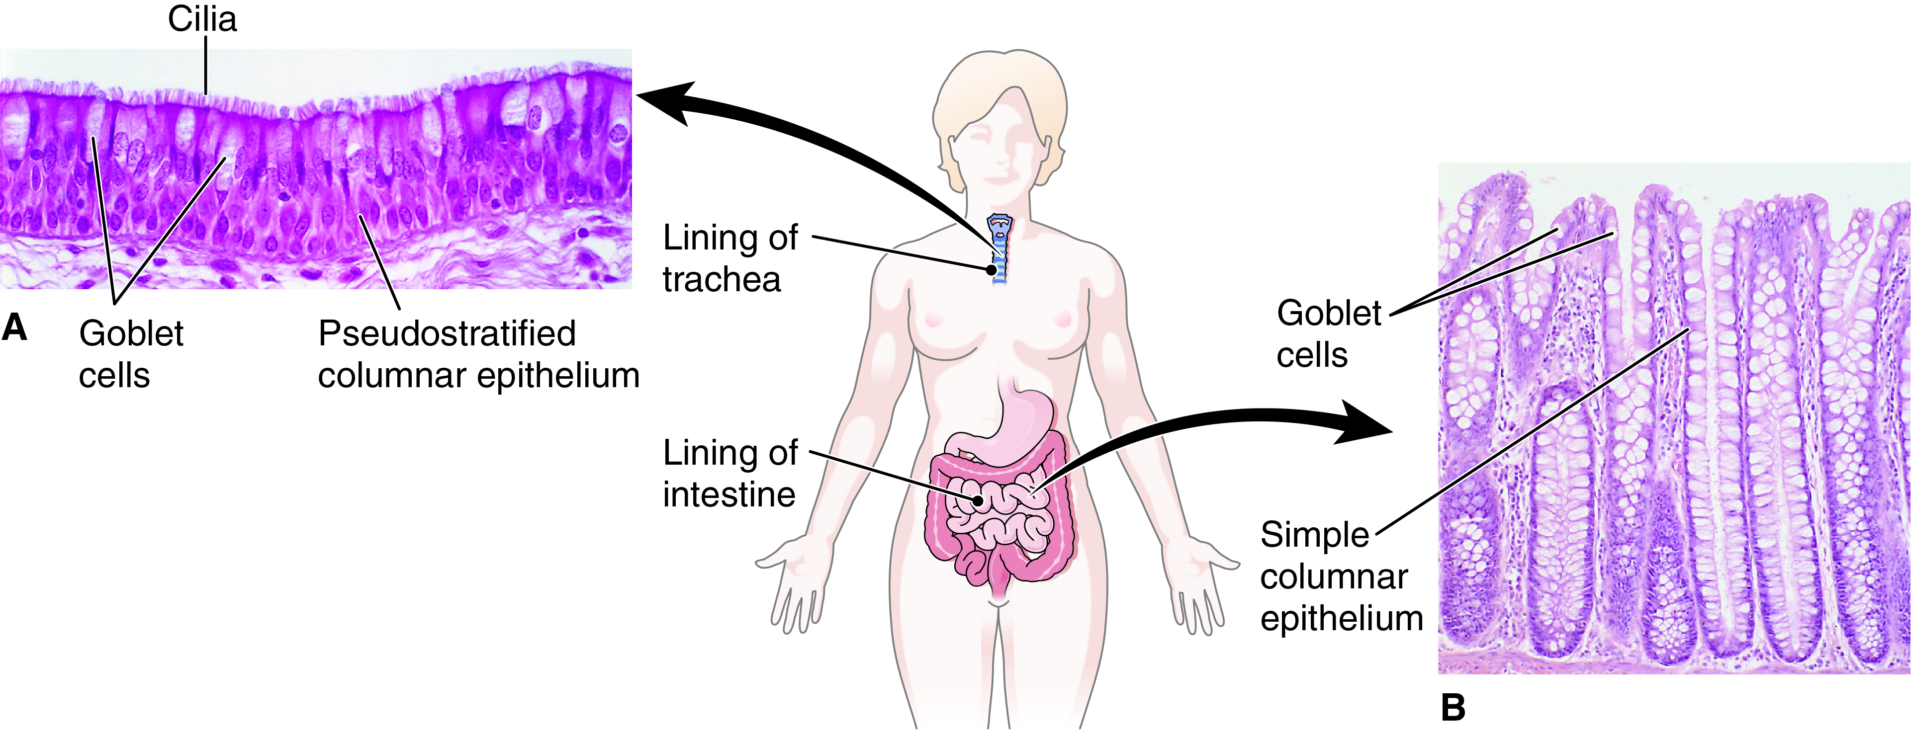
Epithelial Tissue and Goblet Cells
Fig. 4-3

Slide 19
Glands
Produce substances that are sent out to other parts of the body
Types
  Exocrine glands
    Use ducts to deliver product to other regions
      Example: Sweat and salivary glands
  Endocrine glands
    Secrete into extracellular fluid and use the circulatory system to deliver hormones to other regions
      Example: Adrenal gland and pancreas

Slide 20

Epithelial Tissue (Review)
✓
Checkpoints
4-1 What are the three basic shapes of epithelial cells?
4-2 What are the two categories of glands based on their methods of secretion?

Slide 21
Epithelial Tissue (Review) (cont.)
?
Pop Quiz
  4.1 You are studying a slide in anatomy lab. You see several layers of tile-shaped cells. What tissue is most likely on the slide?
  Simple columnar epithelium
  Stratified columnar epithelium
  Simple squamous epithelium
  Stratified squamous epithelium

Slide 22
Epithelial Tissue (Review) (cont.)
?
Pop Quiz Answer
  4.1 You are studying a slide in anatomy lab. You see several layers of tile-shaped cells. What tissue is most likely on the slide?
  Simple columnar epithelium
  Stratified columnar epithelium
  Simple squamous epithelium
  Stratified squamous epithelium

Slide 23
Epithelial Tissue (Review) (cont.)
?
Pop Quiz
  4.2 Which is an example of an endocrine gland?
  Glands secrete hydrochloric acid into the stomach.
  Pancreas secretes insulin, which regulates blood sugar.
  Respiratory epithelium secretes mucus on its surface.
  Salivary glands secrete enzymes into the mouth.

Slide 24
Epithelial Tissue (Review) (cont.)
?
Pop Quiz Answer
  4.2 Which is an example of an endocrine gland?
  Glands secrete hydrochloric acid into the stomach.
  Pancreas secretes insulin, which regulates blood sugar.
  Respiratory epithelium secretes mucus on its surface.
  Salivary glands secrete enzymes into the mouth.

Slide 25
Connective Tissue
Learning Objective
Classify the different types of connective tissue.

Slide 26
Connective Tissue: Overview
The supporting fabric of the body
Contains large amounts of matrix between cells
Categorized by the nature of the matrix

Slide 27
Circulating Connective Tissue
Fluid connective tissue that travels in vessels
Carries nutrients, gases, wastes, and other materials throughout body
Type | Description | Locations
Blood | Cells in a fluid matrix | Circulates through the heart and in blood vessels
Lymph | Fluid derived from blood plasma | Circulates in lymphatic vessels

Slide 28
Loose Connective Tissue
Soft matrix
Provides support and protection
Type | Description | Locations
Areolar | Cells in loose mixture of cells and fibers in a semiliquid matrix; abundant throughout body | Around organs and vessels, in membranes, under skin
Adipose | Composed of cells modified to store fat; insulates the body and is stored in tissues as energy supply | Padding around organs and joints, under skin

Slide 29
Circulating and Loose Connective Tissue
Fig. 4-4
Which of these tissues has the most fibers? Which of these tissues is modified for storage?

Slide 30
Dense Connective Tissue
Firm matrix with large numbers of collagen and elastic fibers
Provides protection, support, flexibility, and attachment
Type | Description | Locations
Irregular | Mostly collagen fibers in random arrangement | Fibrous membranes, capsules
Regular | Mostly collagen fibers in parallel alignment | Ligaments, tendons

Slide 31
Connective Tissue: Cartilage
Strong and flexible with a solid matrix
Provides protection, structure, shock absorption, and elasticity
Type | Description | Locations
Hyaline | Tough, translucent | Covers ends of bones, makes up tip of nose, connects ribs to the sternum, reinforces larynx and trachea
Fibrocartilage | Firm, rigid | Between vertebrae, in anterior pubic joint, knee joint
Elastic | High in elastic fibers; can stretch and return to original size | Larynx, epiglottis, outer ear

Slide 32
Connective Tissue: Bone
Solid matrix hardened with mineral salts
Makes up bones of skeleton
Gives structure, support, and protection to body
Works with muscles to produce movement

Slide 33
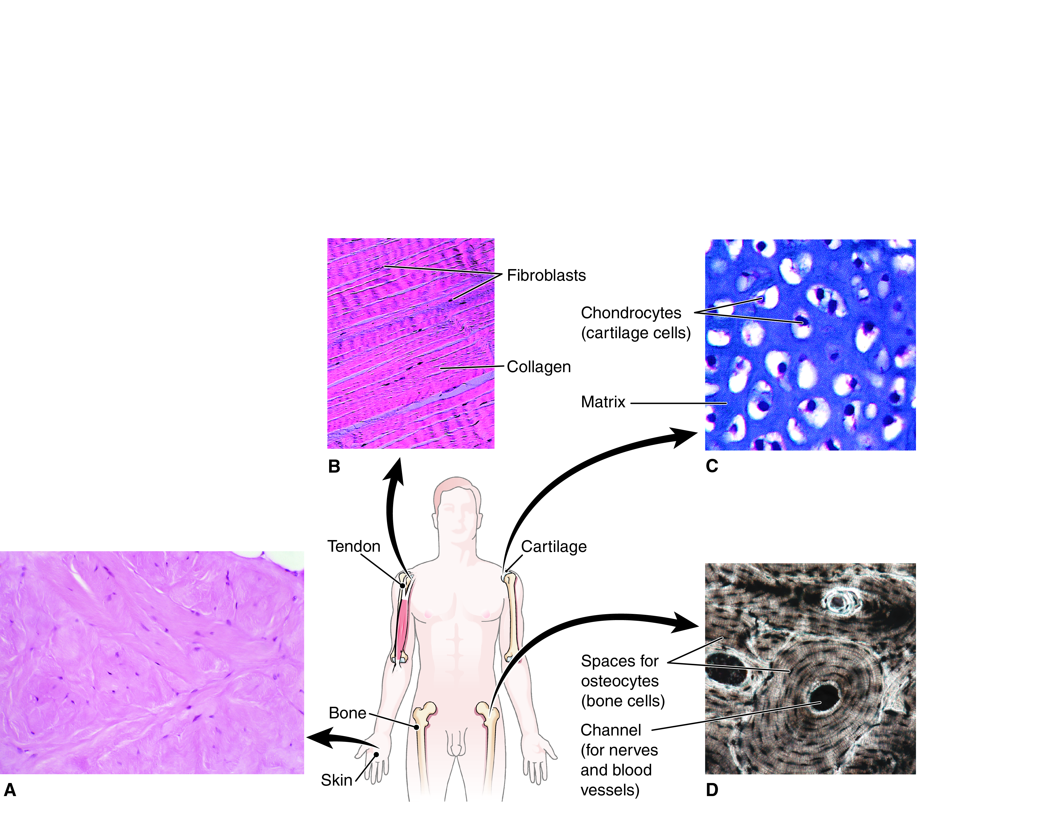
Dense Connective Tissue, Cartilage, Bone
Fig. 4-5

Slide 34
Connective Tissue (Review)
✓
Checkpoints
4-3 What is the general name for the intercellular material in connective tissue?
4-4 What protein makes up the most abundant fibers in connective tissue?
4-5 What type of cell characterizes dense connective tissue? Cartilage? Bone tissue?

Slide 35
Connective Tissue (Review) (cont.)
?
Pop Quiz
  4.3 Chondrocytes are to cartilage as osteocytes are to
  Bone
  Fat
  Muscle
  Tendon

Slide 36
Connective Tissue (Review) (cont.)
?
Pop Quiz Answer
  4.3 Chondrocytes are to cartilage as osteocytes are to
  Bone
  Fat
  Muscle
  Tendon

Slide 37
Connective Tissue (Review) (cont.)
?
Pop Quiz
  4.4 You are studying a slide of a body tissue in anatomy lab. You see a few similar cells that do not contact each other and many thick collagen fibers oriented in the same direction. What tissue is most likely on the slide?
  Areolar connective tissue
  Dense connective tissue
  Stratified epithelial tissue
  Transitional epithelial tissue

Slide 38
Connective Tissue (Review) (cont.)
?
Pop Quiz Answer
  4.4 You are studying a slide of a body tissue in anatomy lab. You see a few similar cells that do not contact each other and many thick collagen fibers oriented in the same direction. What tissue is most likely on the slide?
  Areolar connective tissue
  Dense connective tissue
  Stratified epithelial tissue
  Transitional epithelial tissue

Slide 39
Muscle Tissue
Types
Skeletal muscle
  Voluntary
  Striated
Cardiac muscle (myocardium)
  Involuntary
  Contains intercalated disks
Smooth muscle (visceral muscle)
  Involuntary
  Unstriated

Slide 40
Muscle Tissue (cont.)
Fig. 4-6

Slide 41
Nervous Tissue
Overview
Nervous tissue makes up body’s communication system.
Nervous system components:
  Brain
  Nerves
  Spinal cord
Cell types:
  Neuron
  Neuroglia

Slide 42
The Neuron
Basic unit of nervous tissue.
Neurons transmit nerve impulses.
Parts of a neuron
  Body
  Fibers
A nerve is a bundle of nerve fibers held together with connective tissue.

Slide 43
Neuroglia
Neuroglia
Support and protect nervous tissue
  Some protect the brain from harmful substances.
  Some get rid of foreign organisms and cellular debris.
  Some form myelin sheath around axons.
Do not transmit nerve impulses

Slide 44
Nervous Tissue
Fig. 4-7

Slide 45
Tissues (Review)
✓
Checkpoints
4-6 What are the three types of muscle tissue?
4-7 What is the basic cell of the nervous system, and what is its function?
4-8 What are the nonconducting support cells of the nervous system called?

Slide 46
Tissues (Review) (cont.)
?
Pop Quiz
  4.5 Which tissue is striated and under involuntary control?
  Areolar connective tissue
  Cardiac muscle tissue
  Skeletal muscle tissue
  Smooth muscle tissue

Slide 47
Tissues (Review) (cont.)
?
Pop Quiz Answer
  4.5 Which tissue is striated and under involuntary control?
  Areolar connective tissue
  Cardiac muscle tissue
  Skeletal muscle tissue
  Smooth muscle tissue

Slide 48
Membranes
Learning Objectives
Describe three types of epithelial membranes.
List six types of connective tissue membranes.

Slide 49
Membranes (cont.)
Thin sheets of tissue
Functions of membranes
  Cover surfaces
  Serve as dividers
  Line hollow organs or body cavities
  Anchor organs
  Secrete lubricants to ease the movement of organs
Two main categories
  Epithelial membranes
  Connective tissue membranes

Slide 50
Epithelial Membranes
Superficial layer is made of epithelium.
Deep layer is made of connective tissue.
Type | Description
Serous membranes | Line body cavities and cover internal organs
Mucous membranes | Line tubes and ducts that open to outside of the body
Cutaneous membrane | Commonly known as skin

Slide 51
Epithelial Membranes: Serous Membranes
Line body cavities and cover internal organs
Do not connect to the outside of the body
Secrete serous fluid that acts as a lubricant
Type | Description
Pleurae | Parietal layer lines the thoracic cavity. Visceral layer covers the lungs.
Serous pericardium | Parietal layer lines the pericardial sac. Visceral layer covers the heart.
Peritoneum | Parietal layer lines the abdominal cavity. Visceral layer covers abdominal organs.

Slide 52
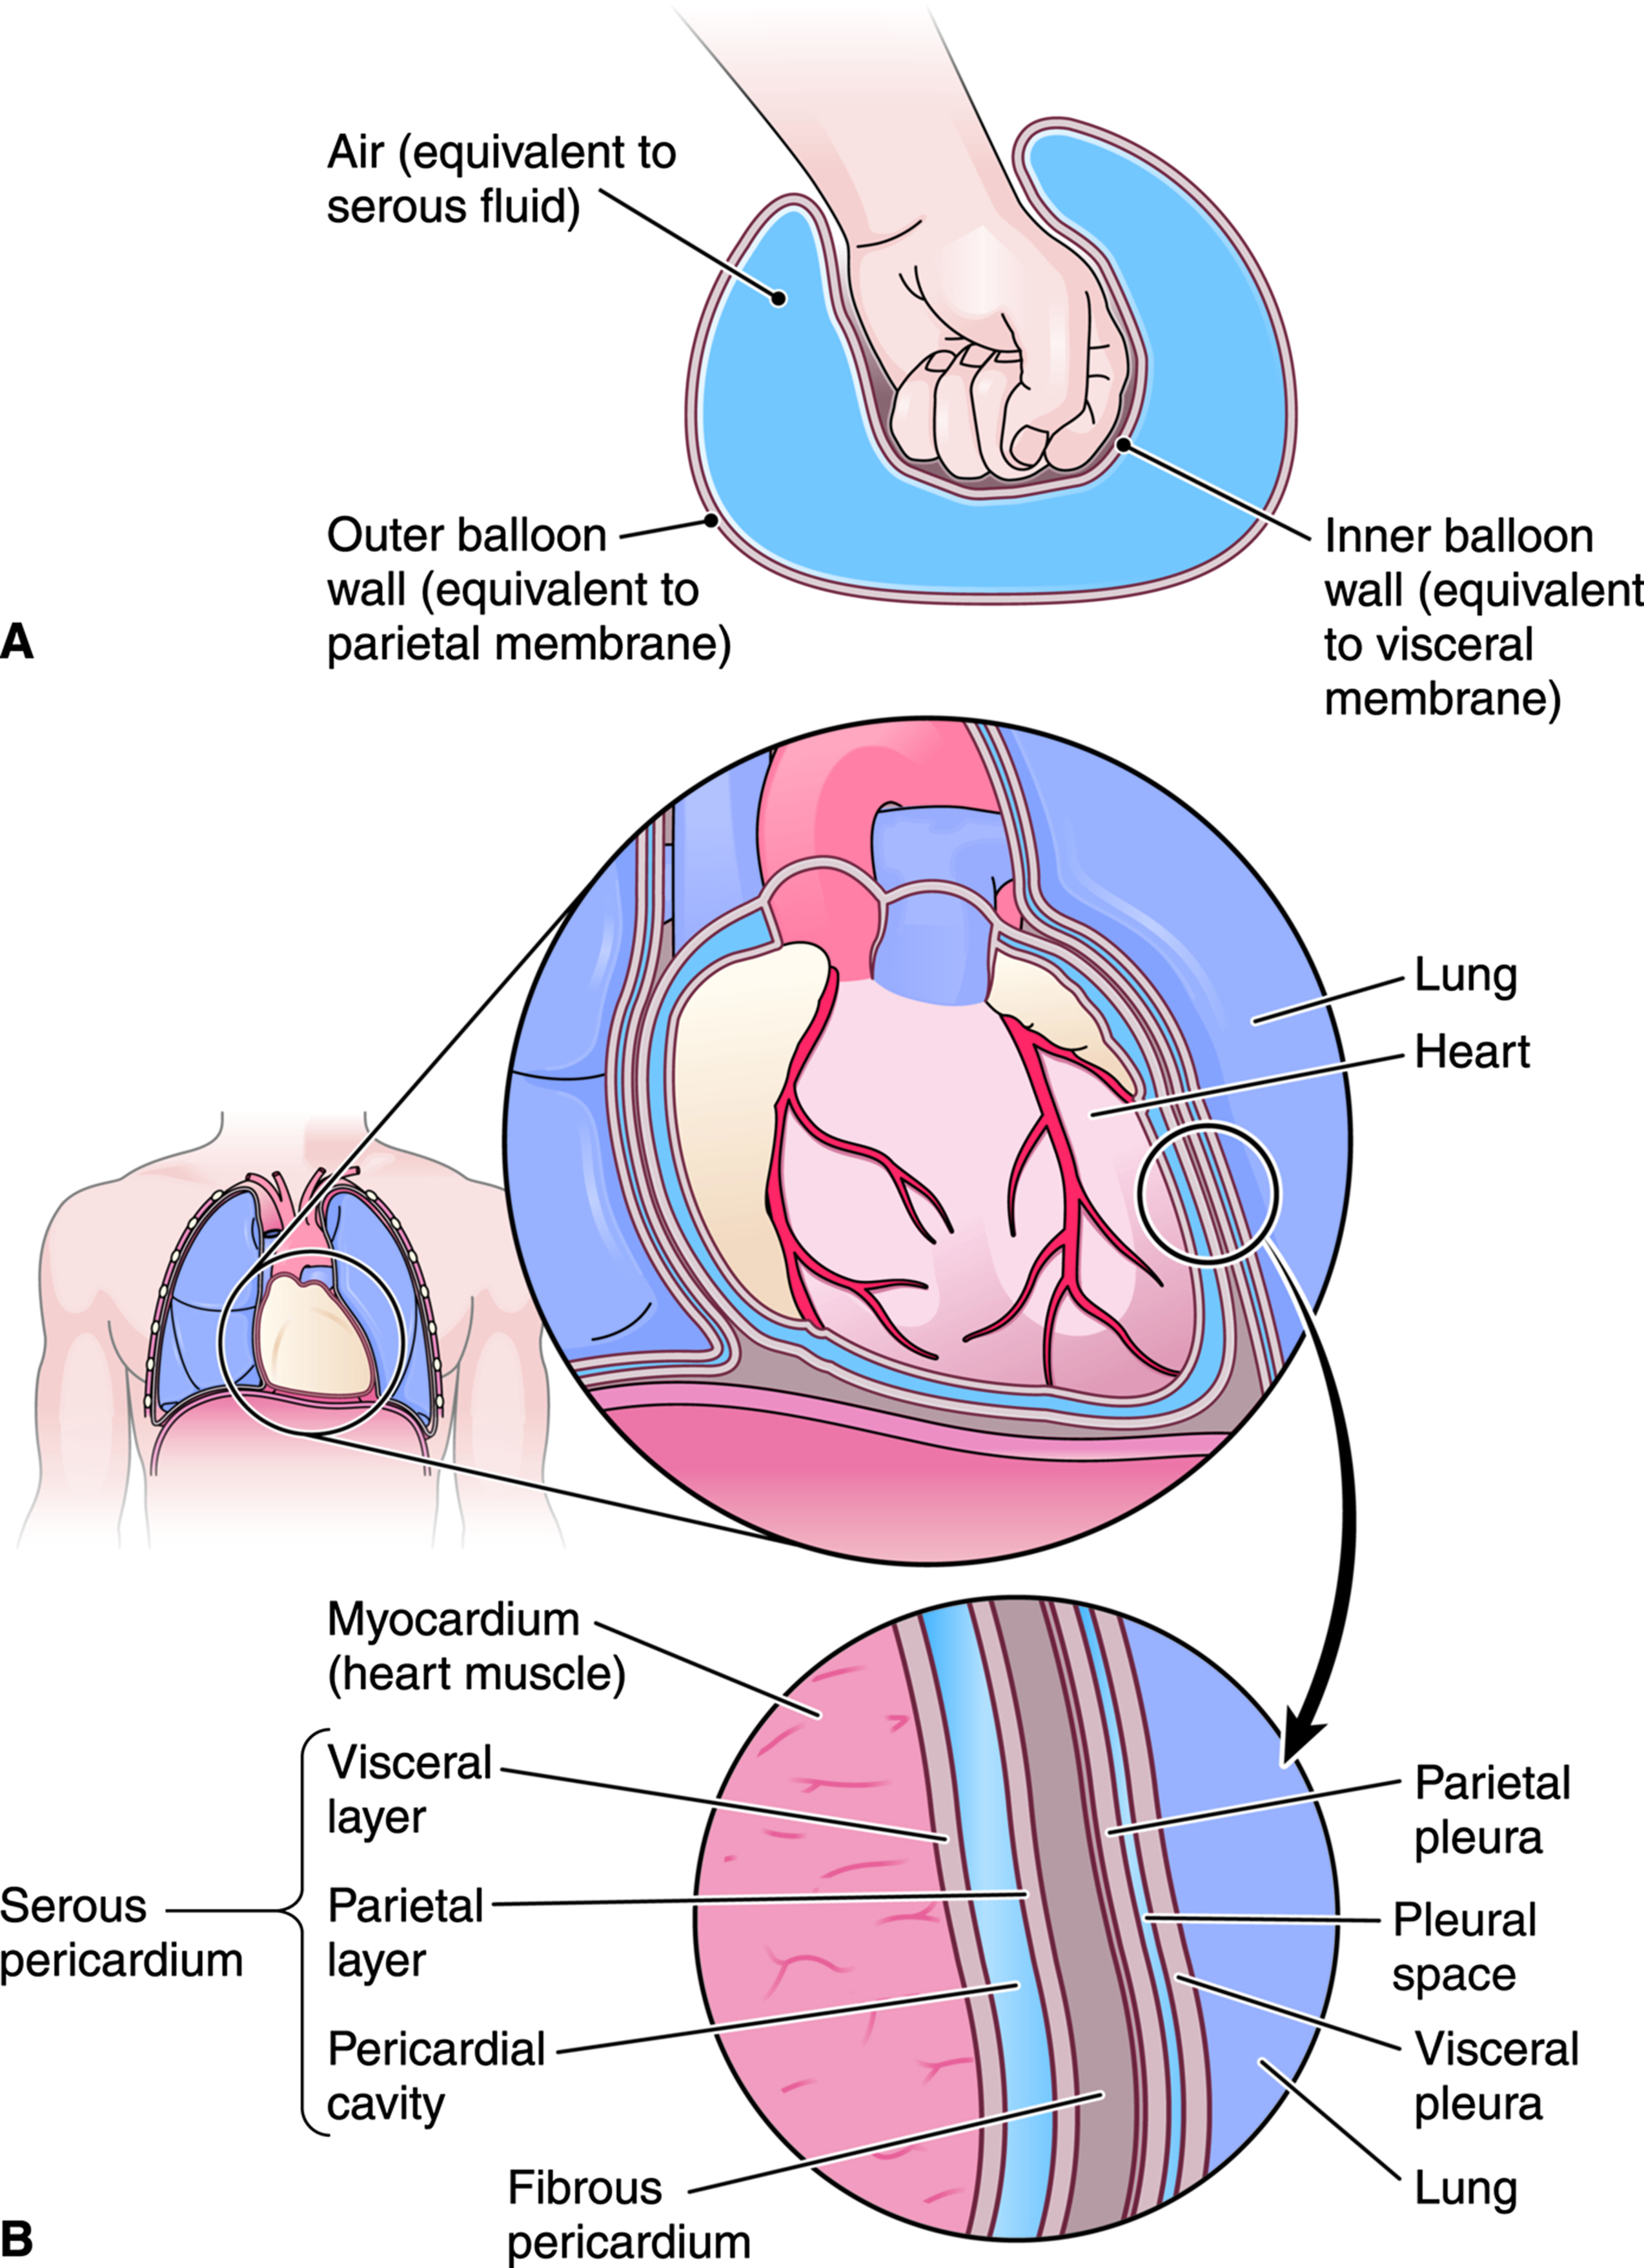
Organization of Serous Membranes
Fig. 4-8

Slide 53
Epithelial Membranes: Mucous Membranes
Line tubes and ducts that open to outside of the body
Vary in structure and function
  Trap and remove foreign particles
  Protect deeper tissue
  Absorb food materials

Slide 54
Connective Tissue Membranes
Composed of connective tissue with no epithelium
Type | Description
Synovial membranes | Line joint cavities and secrete synovial fluid, which lubricates joints Line small cushioning sacs near joints called bursae
Meninges | Cover the brain and spinal cord
Fascia | Superficial fascia underneath skin insulates body. Deep fascia covers, separates, and protects skeletal muscles.
Membranes that surround organs | Fibrous pericardium surrounds the heart. Periosteum surrounds bone. Perichondrium surrounds cartilage.

Slide 55
Membranes (Review)
✓
Checkpoints
4-9 What are the three types of epithelial membranes?
4-10 What is the difference between a parietal and a visceral serous membrane?
4-11 What is fascia, and where is it located?

Slide 56
Membranes (Review) (cont.)
?
Pop Quiz
  4.6 Which membrane contains epithelial tissue?
  Bursa
  Fascia
  Meninges
  Pleura

Slide 57
Membranes (Review) (cont.)
?
Pop Quiz Answer
  4.6 Which membrane contains epithelial tissue?
  Bursa
  Fascia
  Meninges
  Pleura

Slide 58
Tissues and Aging
Connective tissues lose elasticity as they age.
Blood vessels
Tendons and ligaments
Bones
Muscles

Slide 59
Case Study
Learning Objective
  Using examples from the case study, define histology and explain the role of histology in medical diagnosis and treatment.

Slide 60
Case Study (cont.)
Histology is the study of tissues.
Histological analysis of Paul’s skin tissue showed that it was distinctly different from normal skin tissue—it was cancerous.
Histological analysis of Paul’s skin tissue after the first surgery showed some remaining abnormal tissue, so the surgery was repeated.
After the second surgery, histological analysis of his skin tissue showed that he was cancer free.

Slide 61
Word Anatomy
Learning Objective
Show how word parts are used to build words related to tissues, glands, and membranes.

Slide 62

Case Study: Review
CasePoints
4-1 In the case study, Paul might have a squamous cell
carcinoma. Describe the shape of the cells that form this type of cancer.
4-2 What type of epithelial membrane was involved in Paul’s case study?

Slide 63
Word Anatomy (cont.)
Word Part | Meaning | Example
hist/o | tissue | Histology is the study of tissues.
Epithelial Tissue
epi- | on, upon | Epithelial tissue covers body surfaces.
pseud/o | false | Pseudostratified epithelium appears to be in multiple layers, but it is not.
Connective Tissue
blast/o | immature cell, early stage of cell | A fibroblast is a cell that produces fibers.
chondr/o | cartilage | A chondrocyte is a cartilage cell.
oss, osse/o | bone, bone tissue | Osseous tissue is bone tissue.
oste/o | bone, bone tissue | An osteocyte is a mature bone cell.
Muscle Tissue
cardi/o | heart | The myocardium is the heart muscle.
my/o | muscle | See preceding example.

Slide 64
Word Anatomy (cont.)
Word Part |  | Meaning | Example
Nervous Tissue
neur/o | nerve, nervous system |  |  | A neuron is a nerve cell.
Membranes
arthr/o | joint |  |  | Arthritis is inflammation of a joint.
peri- | around |  |  | The peritoneum wraps around the abdominal organs.
pleur/o | side, rib |  |  | The pleurae are membranes that line the chest cavity.

Slide 65

Notes:
65

