Slide 1
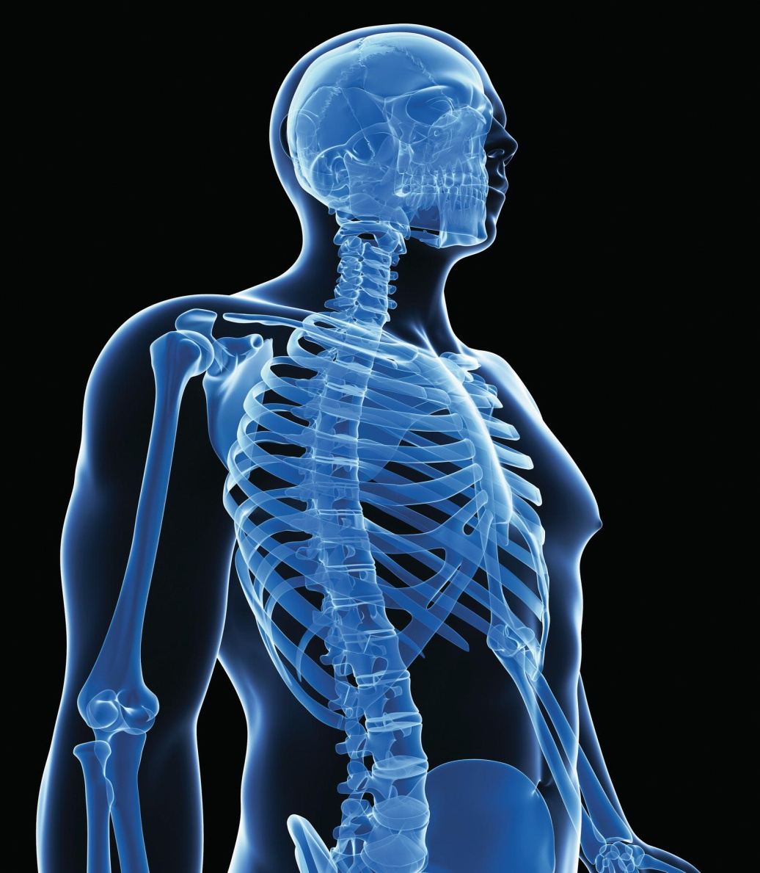
Chapter 6
The Skeleton:
Bones and Joints

Slide 2
The Skeleton
The skeletal system is made up of bones, joints, and supporting connective tissue.

Slide 3
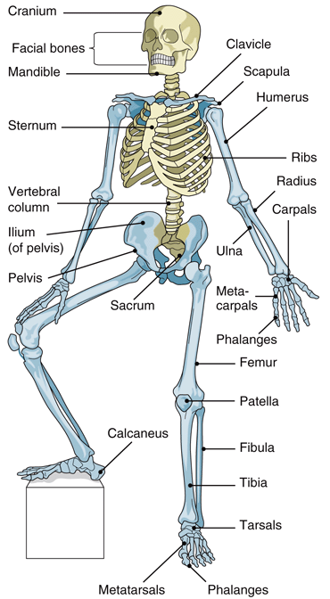
.

Slide 4
Bones
Bone Functions
Act as a framework for body
Protect delicate structures
  Examples: Brain and spinal cord
Work as levers to produce movement
Store calcium
Produce blood cells

Slide 5
Bones
Bone Structure
Diaphysis
  Long narrow shaft
  Medullary cavity
    Contains bone marrow
Epiphysis
  Tow irregular ends at the end of the long bone

Slide 6
Bones
Marrow
  Red
    Found in spongy bone at the ends of the long bones and center of other bones
  Yellow
Membranes
  Periosteum
  Endosteum

Slide 7
BONES
Tissues
  Compact
    Hard and dense, makes up the main shaft of a long bone and the outer layer of other bones
    Cells are located in rings of bone tissue around a central canal called a haversian canal
  Spongy
    Found at the epiphyses of the long bones and at the center of other bones

Slide 8
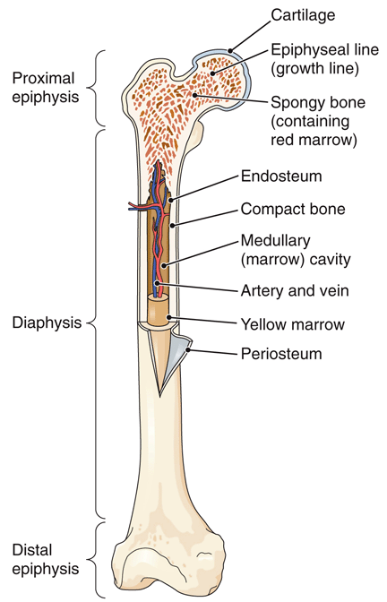
Figure 6-2 The structure of a long bone.

Slide 9
Bones
Bone Growth, Maintenance, and Repair
Osteoblasts are bone-building cells
  Manufacture the matrix (located between cells)
  This intercellular substance contains large amounts of collagen
Osteocytes
  Hardened intercellular material
  Maintain the existing bone matrix but do not produce new bone tissue

Slide 10
Bones
Bone Growth, Maintenance, and Repair
Long bone formation
  Epiphyseal plates
Bone resorption
  Osteoclasts resorb bone tissue.
Types of bone cells
  Osteocytes maintain and repair the existing bone matrix.
  Osteoclasts resorb bone tissue.
Ossification is conversion of cartilage to bone.

Slide 11
Bones
Bone Growth, Maintenance, and Repair
Long bone Growth
  Ossification is conversion of cartilage to bone.
    Cartilage begins to turn into bone.
    Epiphyseal plates develop across bone ends.
    Bones continue to lengthen.
    Bones stop lengthening.
    Bone resorption and formation continues.

Slide 12
Bones
Bone Markings
Projections | Depressions or Holes
Head-rounded, knoblike end separated from the rest of the bone | Foramen-a hole that allows a vessel or nerve to pass
Process-large projection of bone | Sinus-air filled chamber found in some skull bones
Condyle-rounded projection | Fossa-depression on a bone surface
Crest-distinct border or ridge | Meatus-short channel usually the external opening of a canal
Spine-sharp projection from the surface of a bone

Slide 13
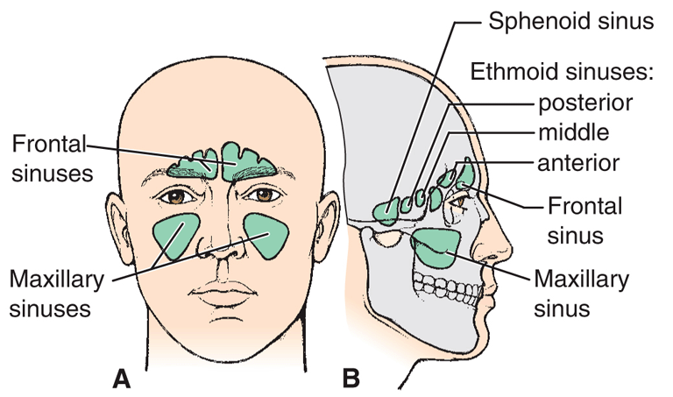
Figure 6-4 Sinuses.

Slide 14
Bones of the Axial Skeleton
Two main groups of bones:
  Axial skeleton—80 bones of the head and trunk
  Appendicular skeleton—126 bones of the extremities

Slide 15
Bones of the Axial Skeleton
Framework of the Skull
Bone | Description
Cranial bones
Frontal bone | Single bone forming forehead Contains frontal sinuses
Parietal bones | Paired bones forming most of top and sides of cranium
Temporal bones | Paired bones forming part of side and base of skull Each bone has a bony prominence behind the ears that is called a mastoid process. Each mastoid process contains mastoid sinus
Ethmoid bone | Single bone located between eye orbits forming superior part of nasal septum Contains ethmoid sinus

Slide 16
Bones of the Axial Skeleton
Framework of the Skull
Bone | Description
Cranial bones (continued)
Sphenoid bone | Single bone forming the skull base anterior to the temporal bones Contains sphenoid sinus Contains depression called sella turcica for housing the pituitary gland
Occipital bone | Single bone forming the posterior skull and base Contains foramen magnum for passage of spinal cord

Slide 17
Bones of the Axial Skeleton
Framework of the Skull
Bone | Description
Facial bones
Mandible | Single bone forming the lower jaw
Maxillae | Paired bones forming the upper jaw and anterior hard palate Each bone contains a maxillary sinus
Zygomatic bones | Paired bones forming the “cheek bones”
Nasal bones | Paired bones forming the bridge of the nose
Lacrimal bones | Paired bones forming parts of anterior eye orbit
Vomer | Single bone forming inferior part of nasal septum

Slide 18
Bones of the Axial Skeleton
Framework of the Skull
Bone | Description
Facial bones (continued)
Palatine bones | Paired bones forming posterior hard palate
Inferior nasal conchae | Paired bones located along lateral walls of nasal cavities

Slide 19
Bones of the Axial Skeleton
Framework of the Skull
Other bones
  Ear ossicles
  Hyoid bone
Sutures
  Coronal suture
  Squamous sutures
  Lambdoid suture

Slide 20
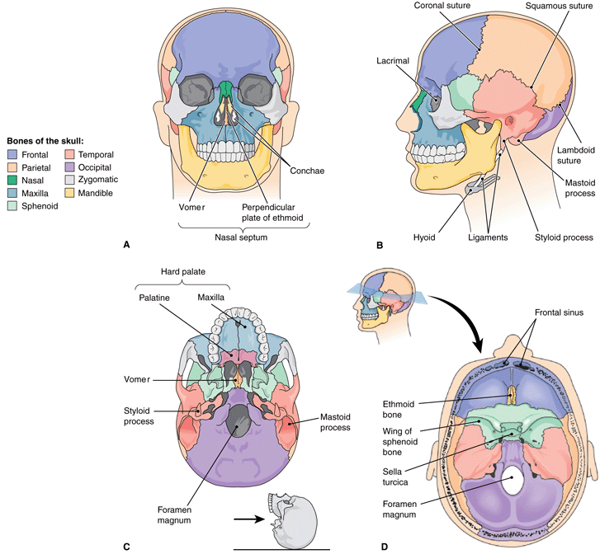
Notes:
20

Slide 21
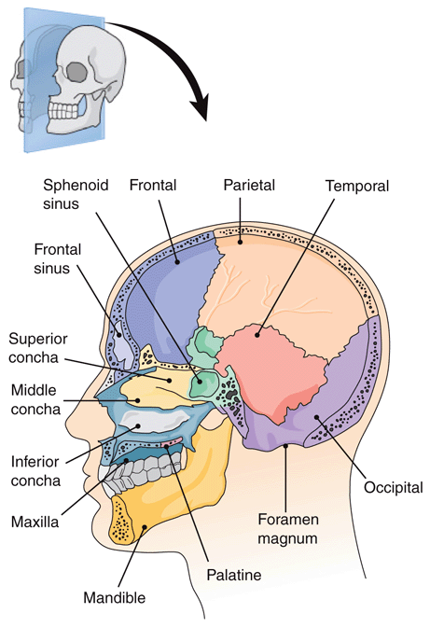
SKULL
Notes:
21

Slide 22
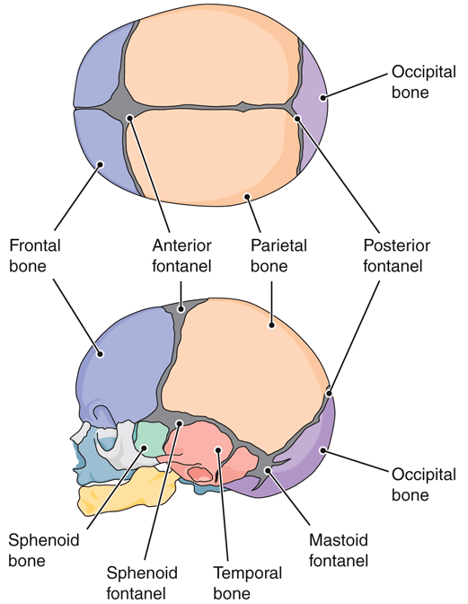
Figre 6-7 Infant skull, showing fontanels.
Notes:
22

Slide 23
Bones of the Axial Skeleton
Framework of the Trunk
Vertebral column
  Cervical vertebrae
    Contain atlas-supports head
    Axis-serves as a pivot
  Thoracic vertebrae
    Largest and strongest
  Lumbar vertebrae
  Sacral vertebrae (sacrum)
  Coccygeal vertebrae (coccyx)
    4-5 children
    1 adult
    Intervertebral foramina
    formed between vertebrae as they join together

Slide 24
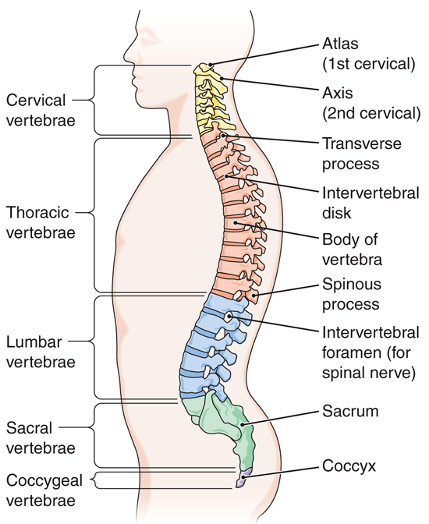
Figure 6-8 Vertebral column, left lateral view.
Notes:
24

Slide 25
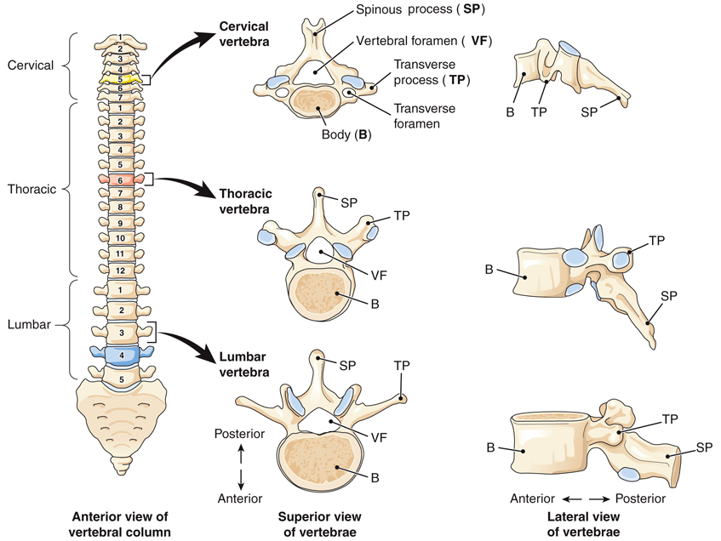
Figure 6-9 The vertebral column and vertebrae.
Which vertebrae
are the largest
and heaviest?
Why?
Notes:
25

Slide 26
Bones of the Axial Skeleton
Framework of the Trunk
Thorax
  Sternum
  Ribs
    True ribs-first 7 pair
    False ribs-remaining 5 pair
  Manubrium
  Clavicular notch
    Point on manubrium where the clavicle joins
  Sternal angle
  Xiphoid process

Slide 27
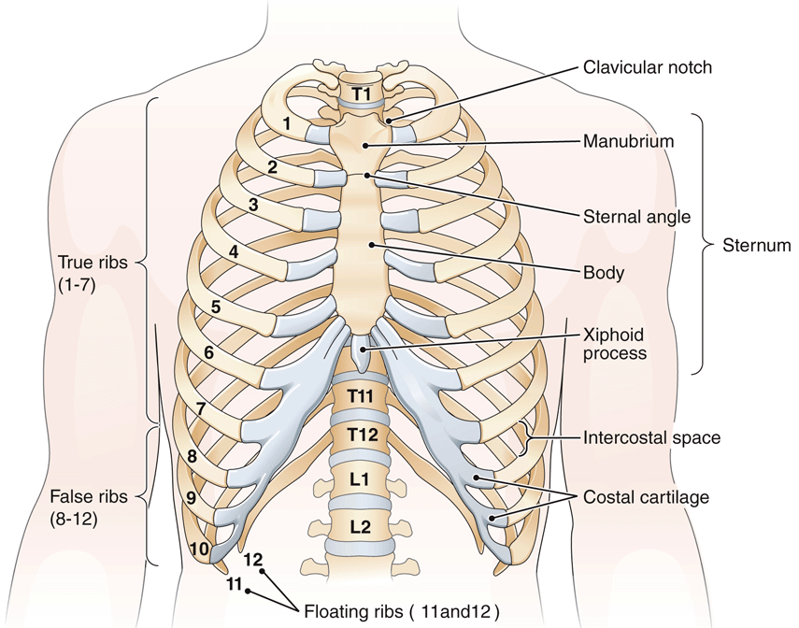
Figure 6-11 Bones of the thorax, anterior view.
Notes:
27

Slide 28
Bones of the Appendicular
Skeleton

Slide 29
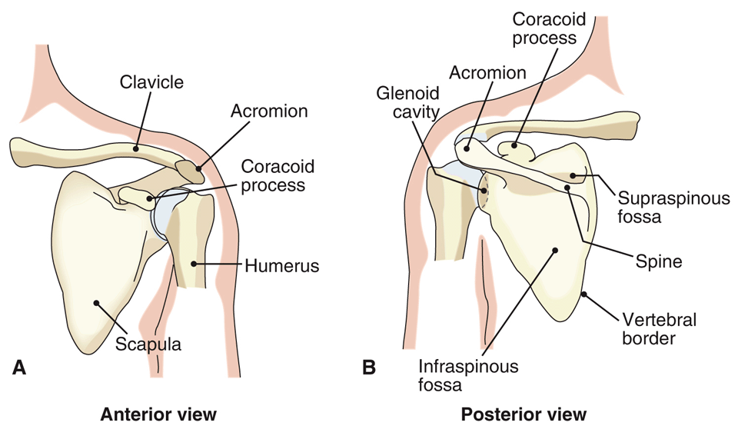
Figure 6-12 The shoulder girdle.
What does the prefix supra mean? What does the prefix infra mean?
Notes:
29

Slide 30
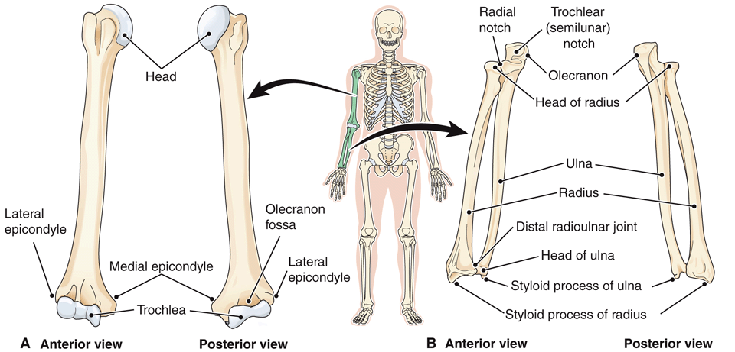
Figure 6-13 Bones of the upper extremity.
What is the medial bone of the forearm?
Notes:
30

Slide 31
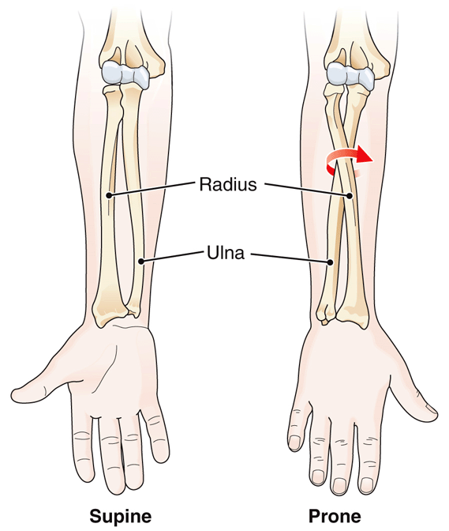
Figure 6-14 Movements of the forearm.
Notes:
31

Slide 32
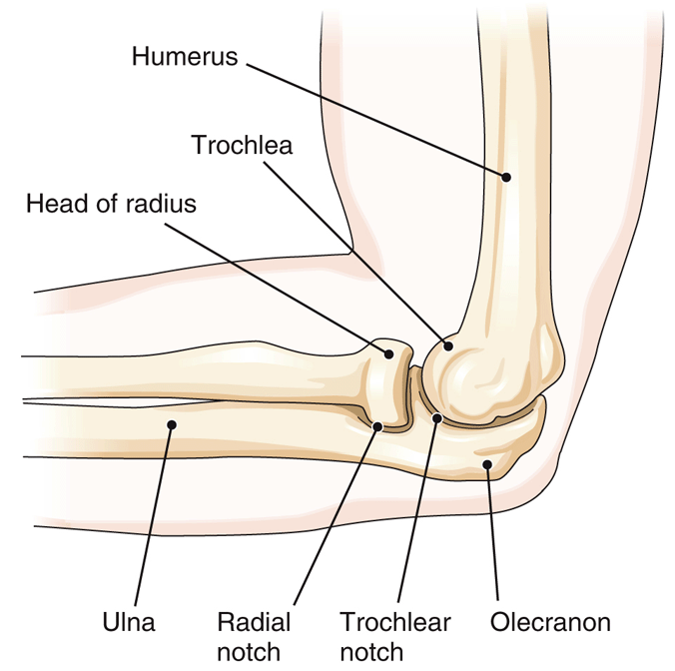
Figure 6-15 Left elbow, lateral view.
What part of what bone forms the bony prominence of the elbow?
Notes:
32

Slide 33
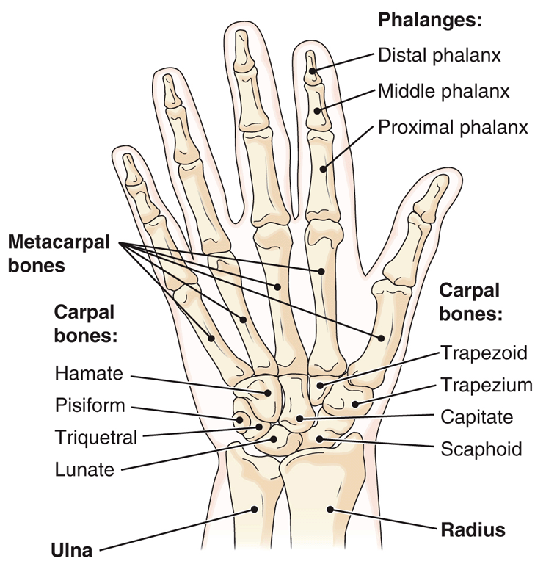
Figure 6-16 Bones of the right hand, anterior view.
How many phalanges
are there on each hand?
Notes:
33

Slide 34
PELVIS
Portions of all three pelvic bones (ileum, ischium and pubis) contribute to the formation of the acetabulum
  Deep socket that hold the head of the femur to form the hip joint
  Female pelvis is adapted for pregancy and childbirth
  lighter in weight
  Ilia wider and more flared
  Pubic arch is wider
  Pelvic inlet is wider and more rounded

Slide 35
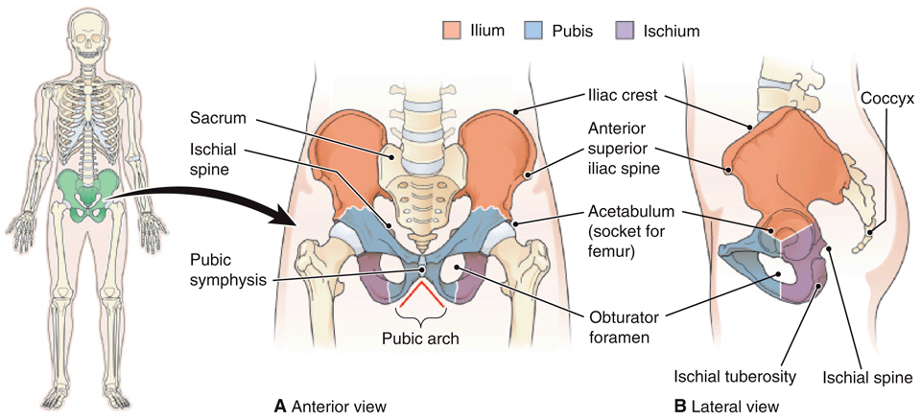
Figure 6-17 The pelvic bones.
Notes:
35

Slide 36
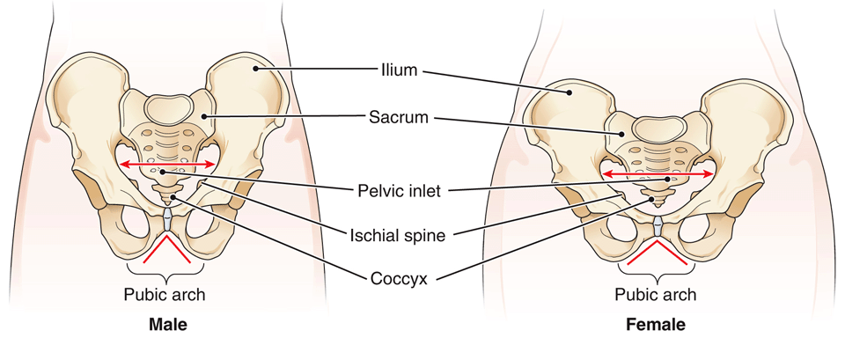
Figure 6-18 Comparison of male and female pelvis, anterior view.
Notes:
36

Slide 37
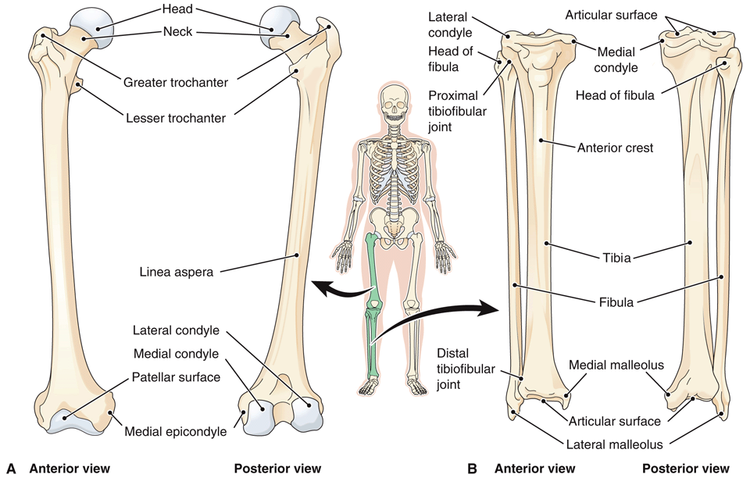
Figure 6-19 Bones of the lower extremity.
Notes:
37

Slide 38
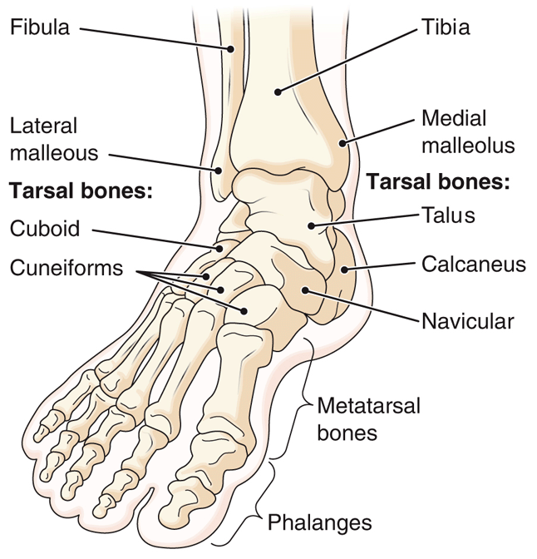
Figure 6-20 Bones of the right foot.
Notes:
38

Slide 39
Joints
Type | Movement | Material Between the Bones | Examples
Fibrous | Immovable (synarthrosis) | No joint cavity; fibrous connective tissue between bones | Sutures between skull bones
Cartilaginous | Slightly movable (amphiarthrosis) | No joint cavity; cartilage between bones | Pubic symphysis; between vertebral bodies
Synovial | Freely movable (diarthrosis) | Joint cavity containing synovial fluid | Gliding, hinge, pivot, condyloid, saddle, ball-and-socket joints

Slide 40
Joints
More About Synovial Joints
Bones are joined by other structures in synovial joints.
Synovial joint structure
  Ligaments
  Joint capsule
  Hyaline (articular) cartilage
    Smooth layer of cartilage that protects freely movable join bones
  Medial meniscus and lateral meniscus
  Fat
  Bursae

Slide 41
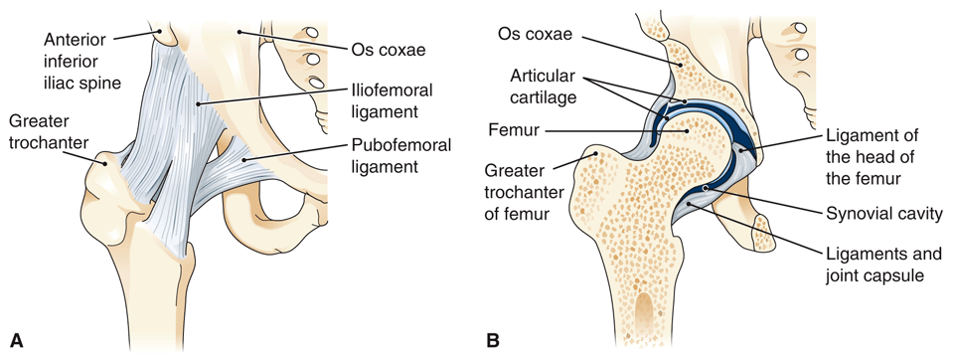
Figure 6-21 Structure of a synovial joint.
Notes:
41

Slide 42
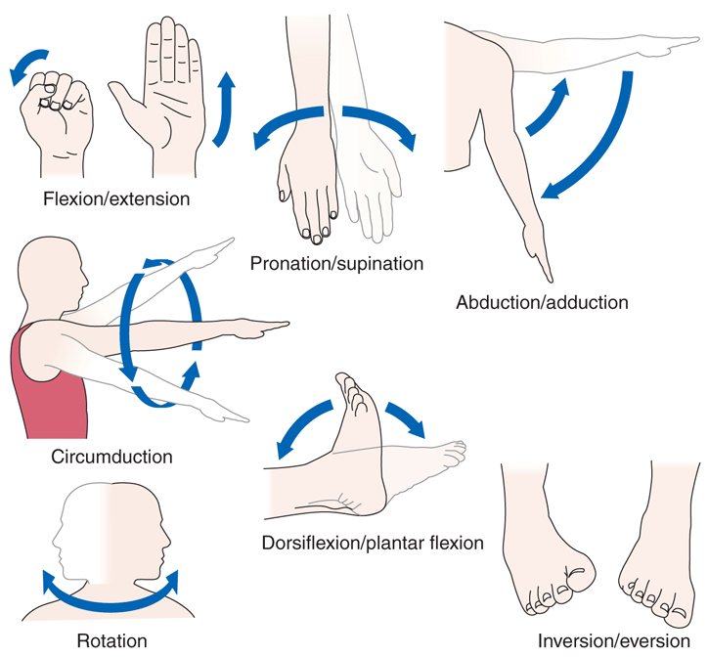
Figure 6-23 Movements at synovial joints.
Notes:
42

Slide 43
Effects of Aging on the Skeletal System
Bone
Loss of calcium salts and collagen
Bone weakening
Reduction in collagen
Joints
Thinning of cartilage
Decreased flexibility

