Slide 1
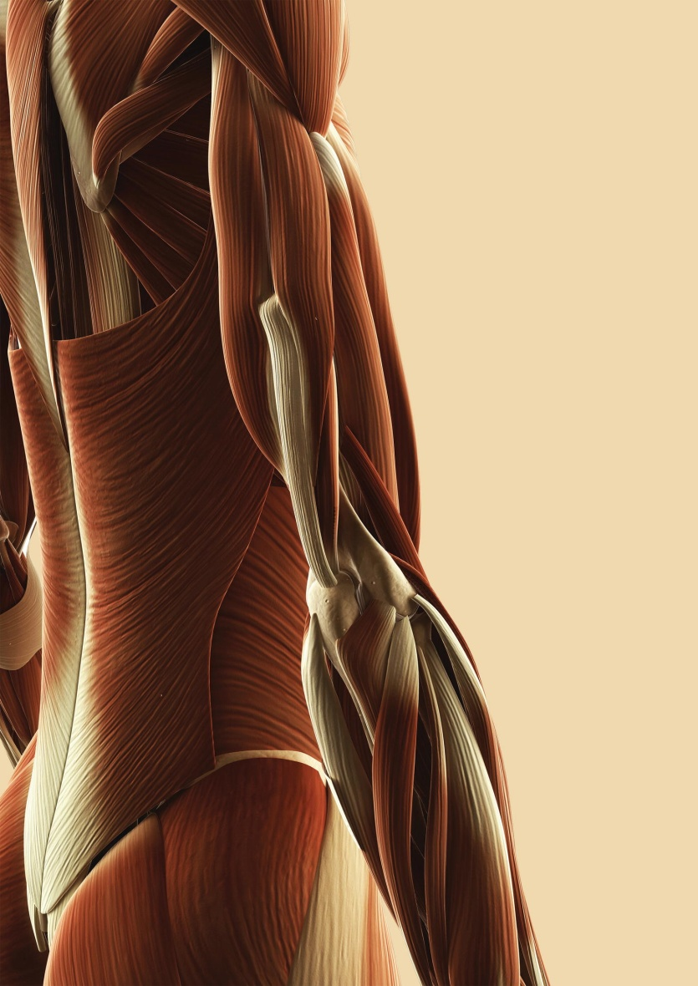
Chapter 7
The Muscular System

Slide 2
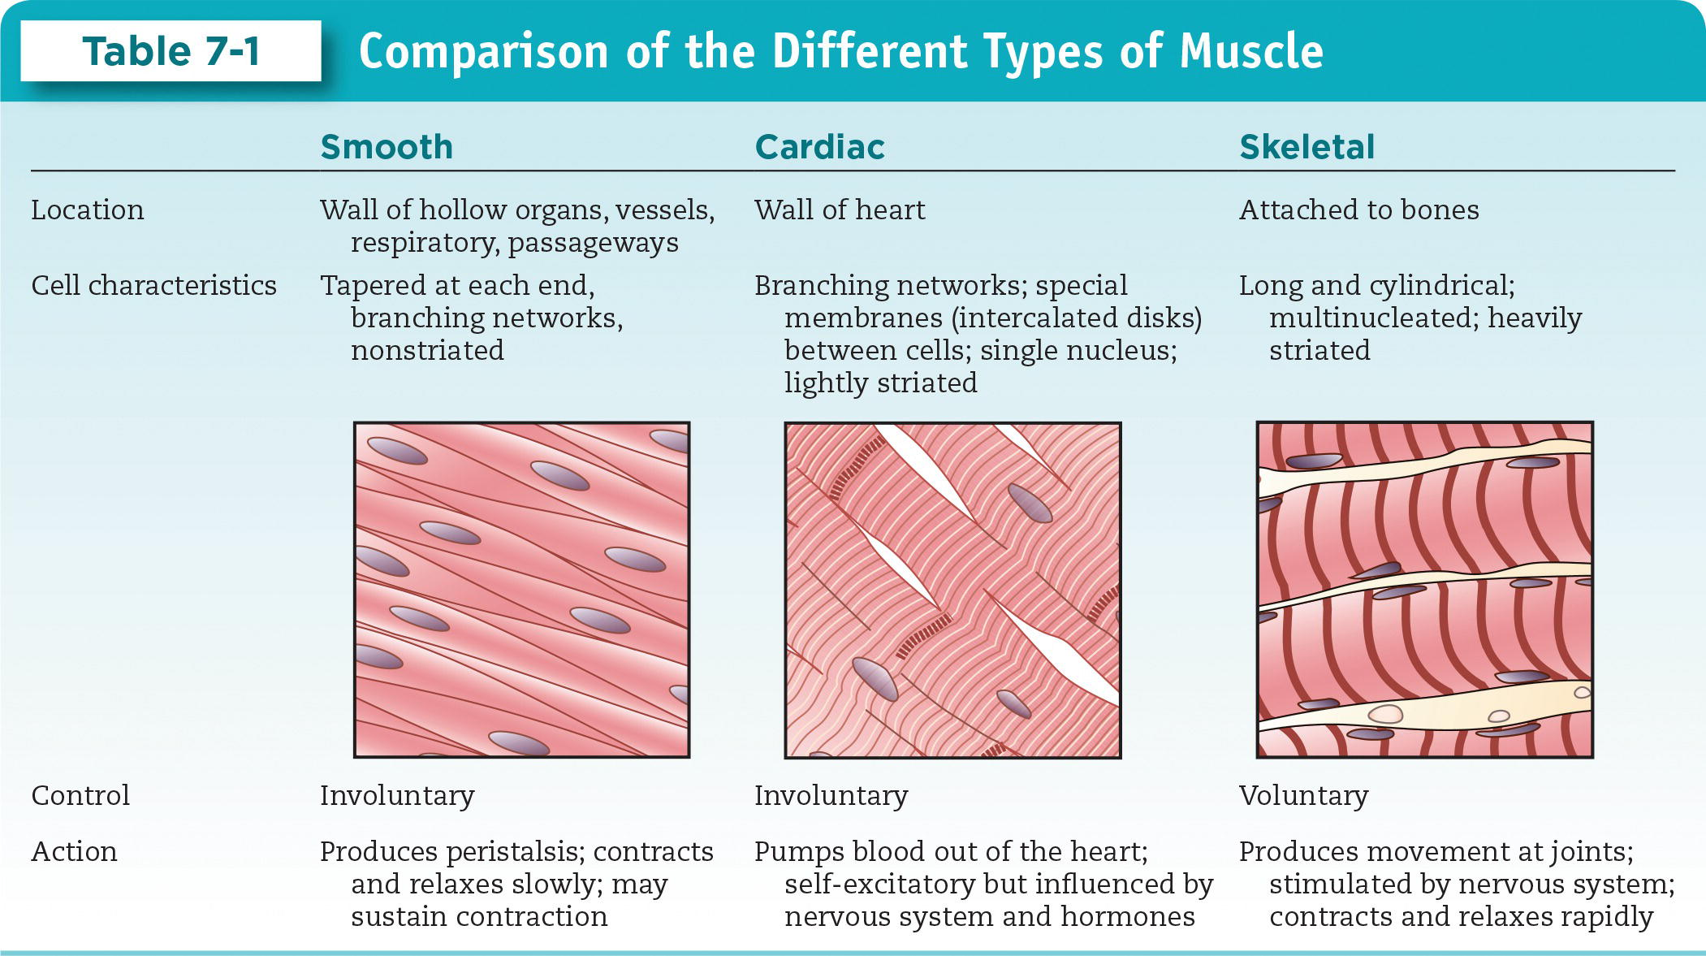
Types of Muscle Tissue (cont.)

Slide 3
Skeletal Muscle Function**
Skeletal movement
Posture maintenance
Heat generation

Slide 4
Skeletal Muscle Structure
Consists of skeletal muscle tissue and connective tissue membranes
Fiber: Single muscle cell
  Surrounded by endomysium
Fascicle: Bundle of muscle cells
  Surrounded by perimysium
Muscle: Bundle of fascicles
  Surrounded by epimysium
Tendon: Connects muscle to bone

Slide 5
Motor Units
Muscle organized into motor units
Motor unit: A single neuron and all the muscle fibers it stimulates
  Muscle fibers are scattered throughout muscle.
  Small motor units used for fine movements.
  Large motor units used for broad movements.

Slide 6
The Neuromuscular Junction (NMJ) (cont.)
An action potential in the neuron causes an action potential in the muscle fiber.
Events at the NMJ:
  ACh is released from motor neuron into synaptic cleft.
  ACh diffuses across synaptic cleft toward motor end plate.
  ACh binds to receptors on motor end plate and initiates action potential.
  Action potential causes muscle contraction.

Slide 7
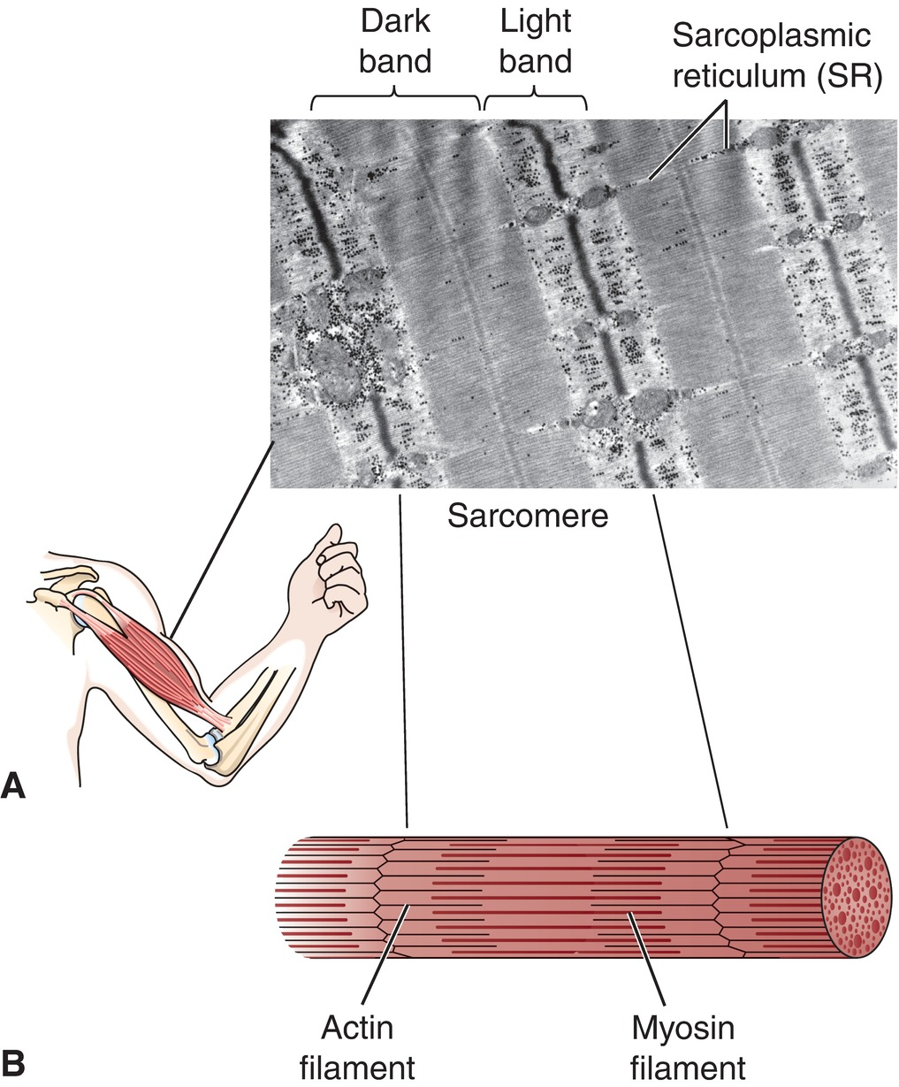
The Sarcomere
Functional unit of contraction in a skeletal muscle fiber
Consists of thick (myosin) and thin (actin) filaments
Thick filaments also have two regulatory proteins (troponin and tropomyosin)
Fig. 7-3
Notes:
7

Slide 8
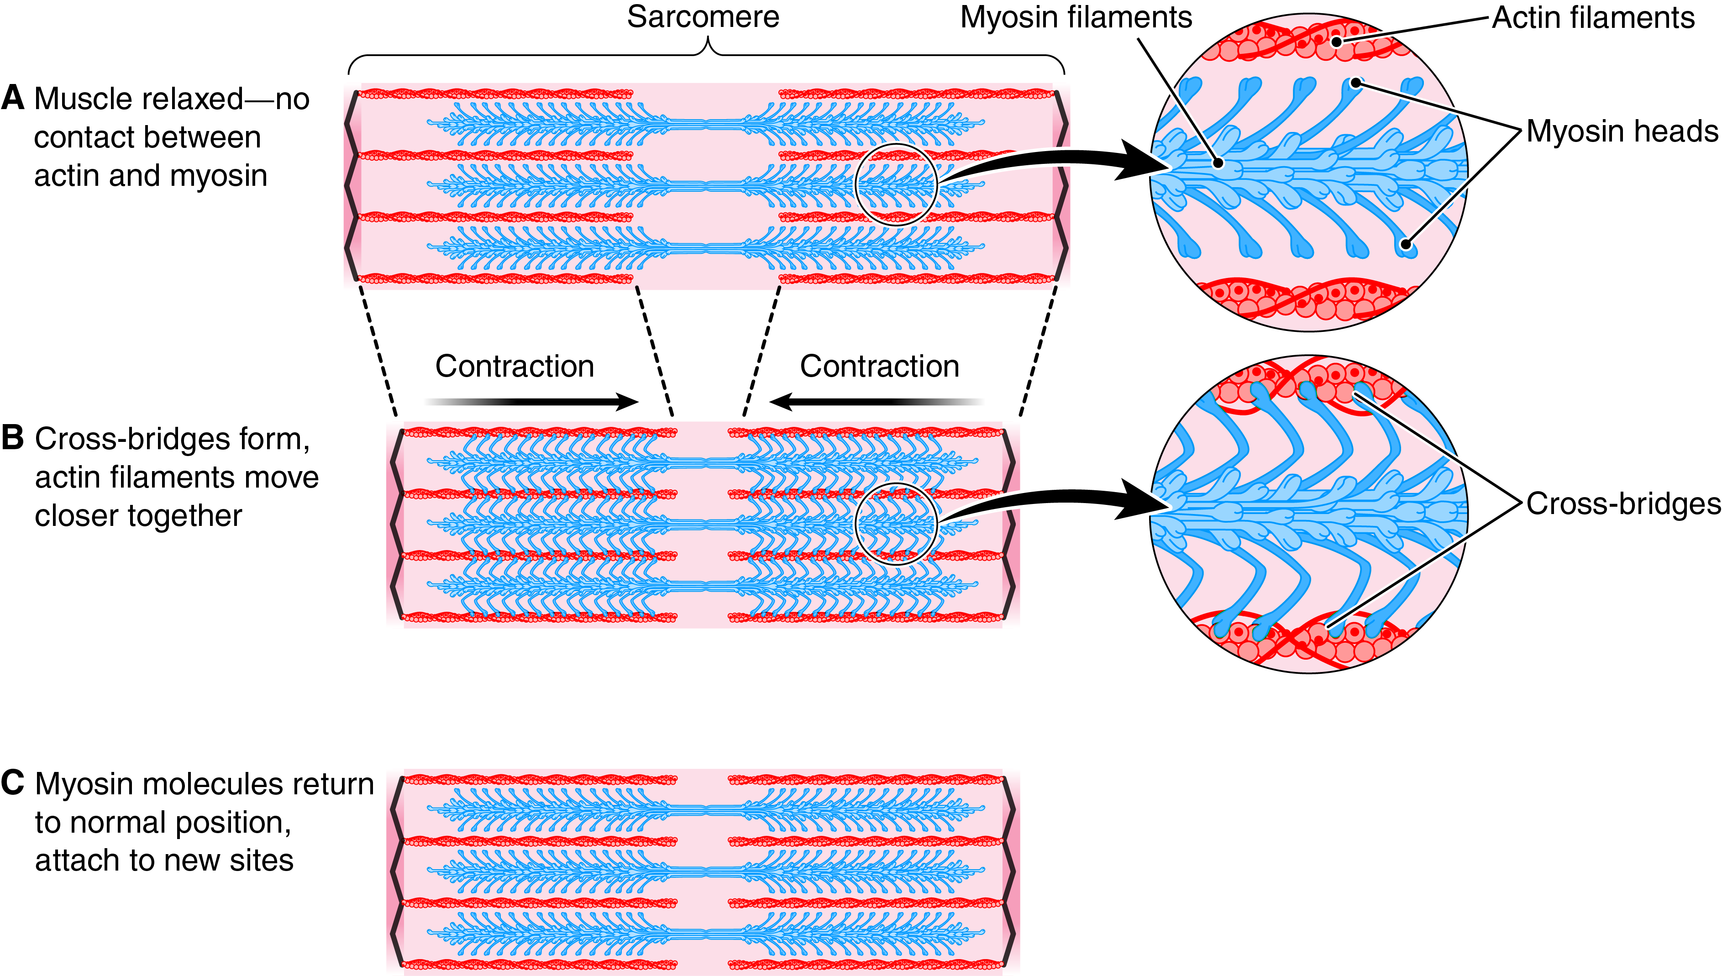
Sliding Filament Mechanism of Contraction
Fig. 7-4
Do the actin or myosin filaments change in length as contraction proceeds?
Notes:
8

Slide 9
Sliding Filament Mechanism
Sarcomeres contract via the sliding filament mechanism:
  Myosin heads bind to actin, forming cross-bridges.
  Using stored energy, myosin heads pull actin filaments together within the sarcomeres, and the cell shortens.
  *New ATP is used to detach myosin heads and move them back into position for another “power stroke.”

Slide 10
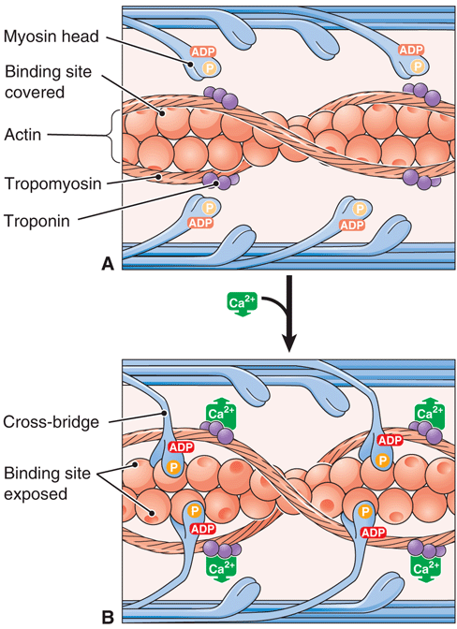
Role of Calcium
Action potential in muscle cell stimulates Ca²⁺ release from sarcoplasmic reticulum.
Ca²⁺ binds troponin.
Troponin displaces tropomyosin from binding sites.
Myosin forms cross-bridge with actin.
Contraction occurs.
Fig. 7-5
Notes:
10

Slide 11
Events of Muscle Contraction: Summary
ACh is released into synaptic cleft at the NMJ.
ACh binds to motor end plate and produces an action potential.
The action potential travels to the SR.
SR releases calcium into cytoplasm.
Calcium shifts troponin and tropomyosin off of thin filaments so that binding sites on actin are exposed.

Slide 12
Events of Muscle Contraction: Summary (cont.)
Myosin heads bind to actin, forming cross-bridges.
Using stored energy, myosin heads pull actin filaments together within sarcomeres, and cell shortens.
New ATP is used to detach myosin heads and move them back to position for another “power stroke.”
Muscle relaxes when stimulation ends and calcium is pumped back into SR.

Slide 13
Muscle Contraction Requires ATP
ATP provides energy for muscle contraction
Large-scale ATP generation requires:
  Nutrients
    Carbohydrates: glycogen (storage form) and glucose (useable form)
    Fats: triglycerides (storage form) and fatty acids (usable form)
  Oxygen
    Carried by hemoglobin in blood
    Stored in myoglobin in muscle
  Mitochondria

Slide 14
Sources of ATP Generation
ATP is generated as needed (minimal muscle stores).
 | Creatine Phosphate | Anaerobic Glycolysis | Aerobic Metabolism
Requirements | Creatine phosphate; does not require oxygen | Glucose; does not require oxygen | Pyruvate (from glucose) or fatty acids; mitochondria; oxygen
Speed | Fast | Moderately fast | Slow
Amount of ATP generated | Very small | Small | Large
When is it important? | Beginning of exercise bout; intense exercise | Beginning of exercise bout; intense exercise | Exercise lasting longer than 10s

Slide 15
Muscle Fatigue
Common: Brain reduces impulses to skeletal muscles.
Relatively rare: Muscle no longer responds to the brain’s signals, due to disruptions such as:
  Glycogen depletion
  Inadequate oxygen supply
  Accumulation of phosphate from ATP breakdown
  Increased muscle acidity
Lactic acid accumulation and ATP depletion are NOT thought to be common causes of fatigue.

Slide 16
Effects of Exercise
Improved balance, joint flexibility
Increased muscle size (hypertrophy)
Improved muscle tissue
Vasodilation
Strengthened heart muscle
Improved breathing and respiratory efficiency
Weight control
Stronger bones

Slide 17
Types of Muscle Contractions
Partial (muscle tone or tonus)
Isotonic
  Constant tension
  Muscle length changes, causing movement
    Eccentric: muscle lengthens
    Concentric: muscle shortens
Isometric
  Increase in tension
  Muscle length unchanged
  No movement

Slide 18
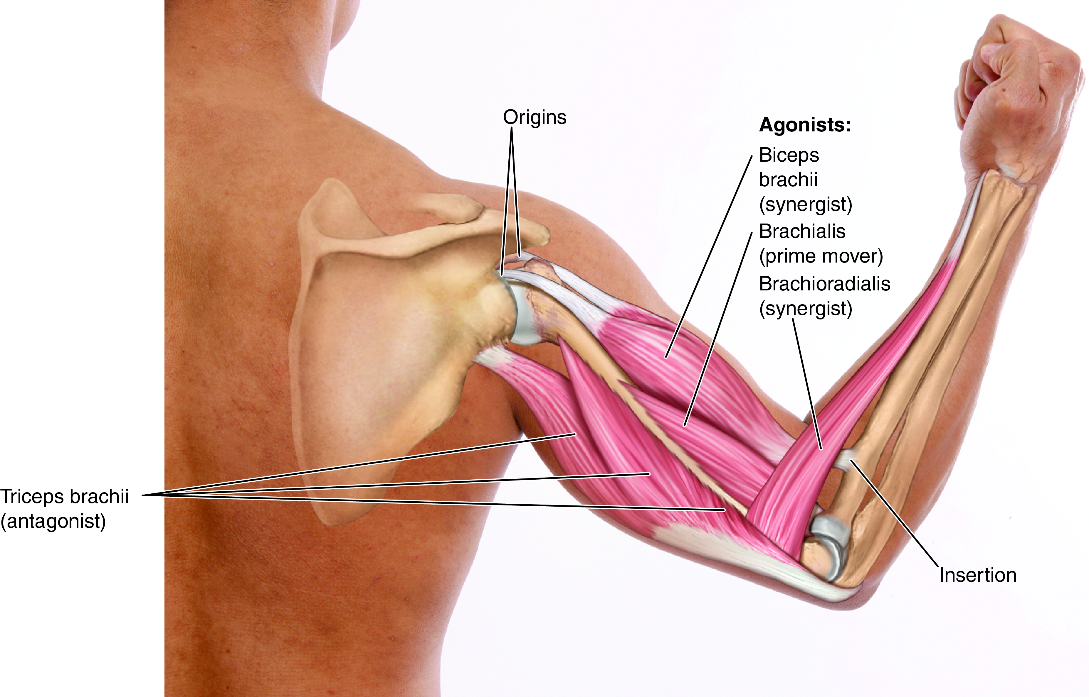
The Mechanics of Muscle Movement
Fig. 7-6
Notes:
18

Slide 19
The Mechanics of Muscle Movement (cont.)
Tendons attach muscles to bones.
  Origin: Attached to more fixed part of skeleton
  Insertion: Attached to more movable part of skeleton
Muscles work in groups.
  Prime mover: performs given movement
  Antagonist: relaxes to allow movement
  Synergist: assists prime movement

Slide 20
Levers and Body Mechanics
Musculoskeletal system as a lever system
  Lever—bone
  Fulcrum—joint
  Effort—applied by muscle
Levers classified by relative location of three components
  First class: fulcrum in the middle (rare)
  Second class: resistance in the middle (absent from body)
  Third class: effort in the middle (common)

Slide 21
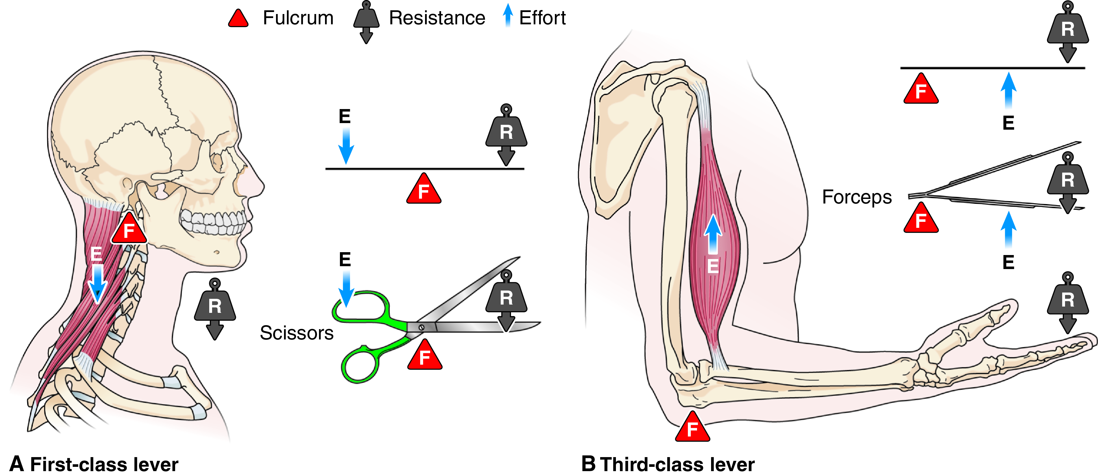
Levers and Muscle Action
Fig. 7-7
In a third-class lever system, where is the fulcrum with regard to the effort and the resistance?
Notes:
21

Slide 22
Characteristics for Naming Muscles
Characteristic | Example
Location | Temporalis; near the skull’s temple
Size | Gluteus maximus; the largest
Shape | Serratus anterior; serrated edge
Direction | External oblique; runs obliquely
Number of heads | Biceps brachii; two heads
Action | Flexor digitorum; flexes toes

Slide 23
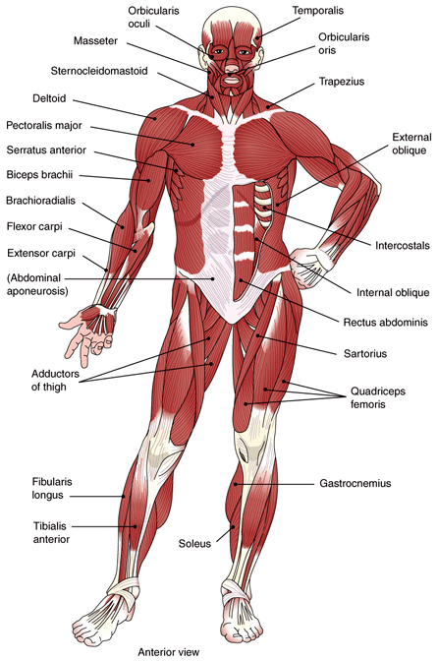
Superficial Muscles
Fig. 7-8

Slide 24
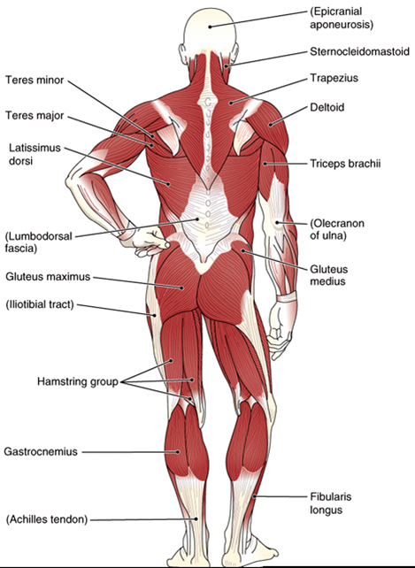
Superficial Muscles (cont.)
Fig. 7-9
Notes:
24

Slide 25
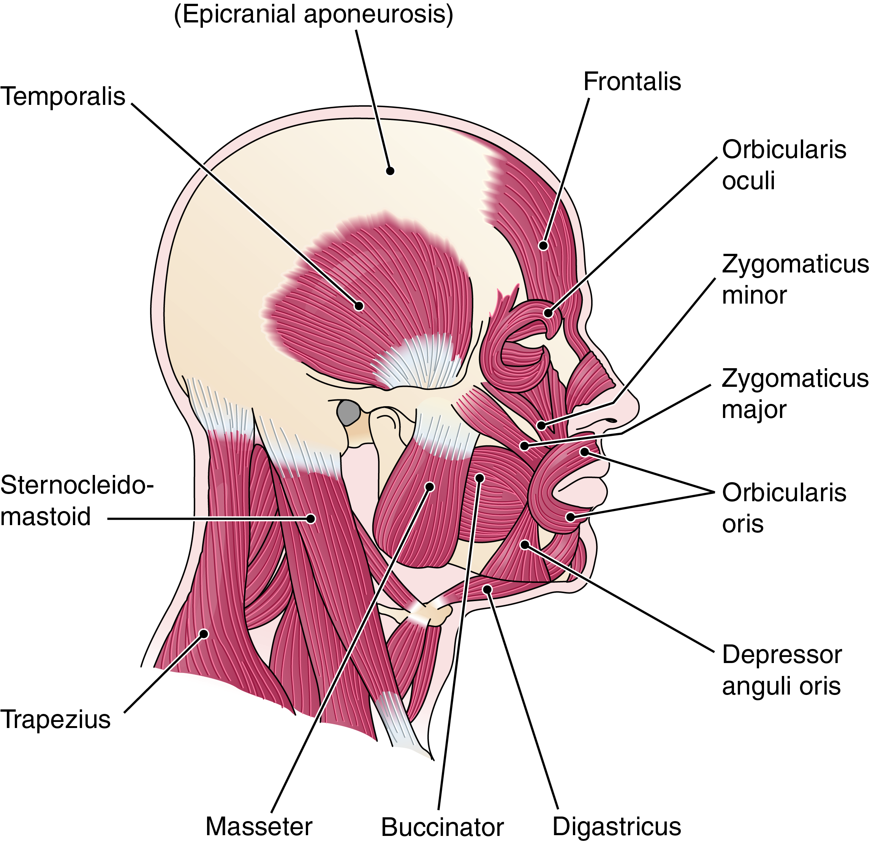
Head and Neck
Which of the muscles in this illustration are named for a nearby bone?
Fig. 7-10
Notes:
25

Slide 26
Muscles of the Head and Neck
Name | Location | Function
Orbicularis oculi | Encircles eyelid | Closes eye
Levator palpebrae superioris | Posterior orbit to upper eyelid | Opens eye
Orbicularis oris | Encircles mouth | Closes lips
Buccinator | Fleshy part of cheek | Flattens cheek; helps in eating, whistling, and blowing wind instruments
Zygomaticus major and minor | Cheekbone to mouth corners | Raises mouth corners upward and laterally (smile)
Depressor anguli oris | Mandible to mouth corners | Lowers mouth corners (grimace)
Temporalis | Above and near ear | Closes jaw
Masseter | At angle of jaw | Closes jaw
Sternocleidomastoid | Along lateral neck, to mastoid process | Flexes head; rotates head toward opposite side from muscle

Slide 27
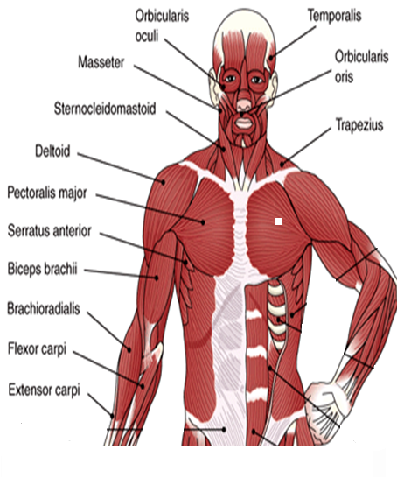
Muscles Moving the Shoulder and Arm
Figs. 7-8 and 7-9
Notes:
27

Slide 28
Muscles Moving the Shoulder and Arm (cont.)
Name | Location | Function
Trapezius | Posterior neck and upper back to clavicle and scapula | Raises shoulder and pulls it back; superior portion extends and turns head
Latissimus dorsi | Middle and lower back, to humerus | Extends and adducts arm (prime mover)
Pectoralis major | Superior, anterior chest, to humerus | Flexes and adducts arm; medially rotates arm across chest; pulls shoulder forward and downward
Serratus anterior | Inferior to axilla on lateral chest | Moves shoulder forward; synergist in arm flexion and abduction
Deltoid | Covers shoulder joint to lateral humerus | Abducts arm; synergist in arm flexion rotation and extension

Slide 29
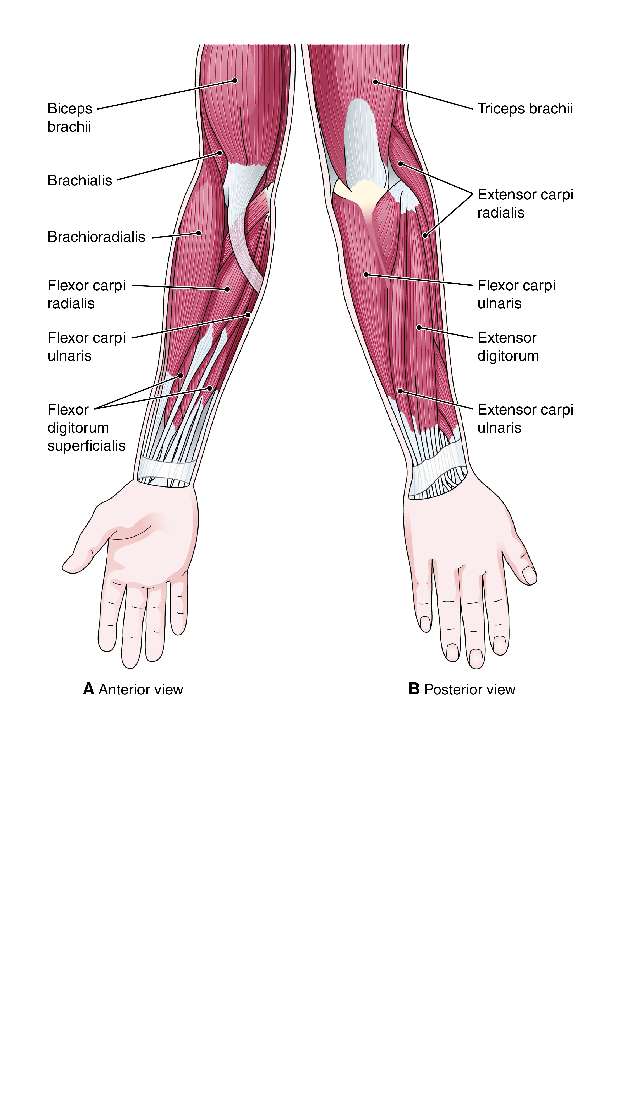
Muscles Moving the Forearm and Hand
Fig. 7-11
What does carpi refer to in the names of muscles? Digitorum?
Notes:
29

Slide 30
Muscles Moving the Forearm
Name | Location | Function
Biceps brachii | Anterior arm along humerus to radius | Supinates the forearm and hand; synergist in forearm flexion
Brachialis | Deep to biceps brachii; inserts at anterior elbow joint | Primary flexor of forearm
Brachioradialis | Lateral forearm from distal end of humerus to distal end of radius | Synergist in forearm flexion
Triceps brachii | Posterior arm to ulna | Extends forearm to straighten upper extremity

Slide 31
Muscles Moving the Hand and Fingers
Name | Location | Function
Flexor carpi group | Anterior forearm to hand | Flexes hand
Extensor carpi group | Posterior forearm to hand | Extends hand
Flexor digitorum group | Anterior forearm to fingers | Flexes fingers
Extensor digitorum group | Posterior forearm to fingers | Extends fingers

Slide 32
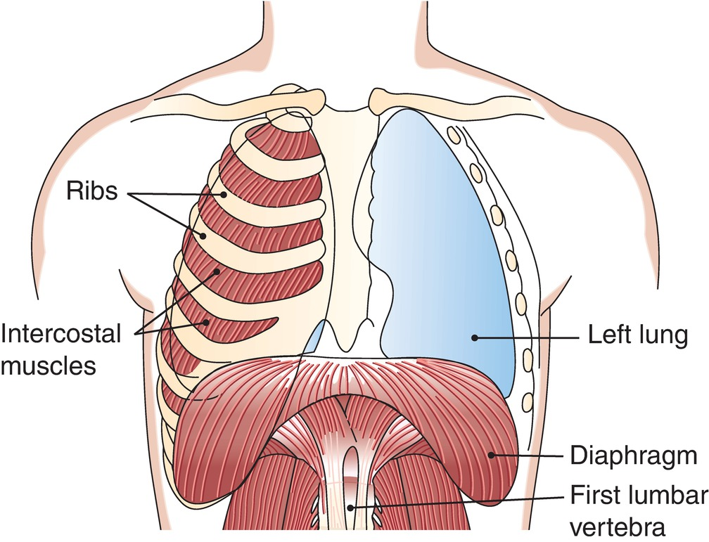
Muscles of Respiration
Fig. 7-12
Notes:
32

Slide 33
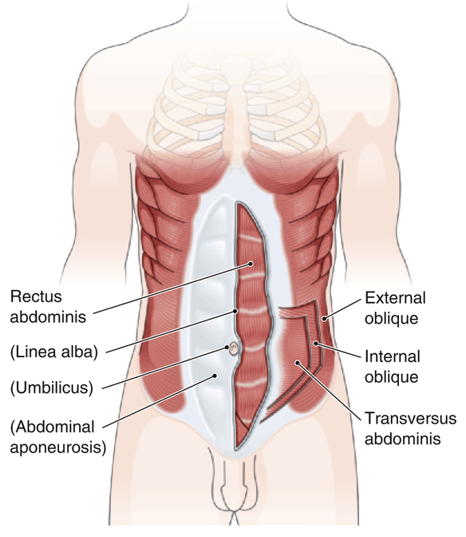
Abdominal Wall Muscles
What does rectus mean? Oblique?
Fig. 7-13
Notes:
33

Slide 34
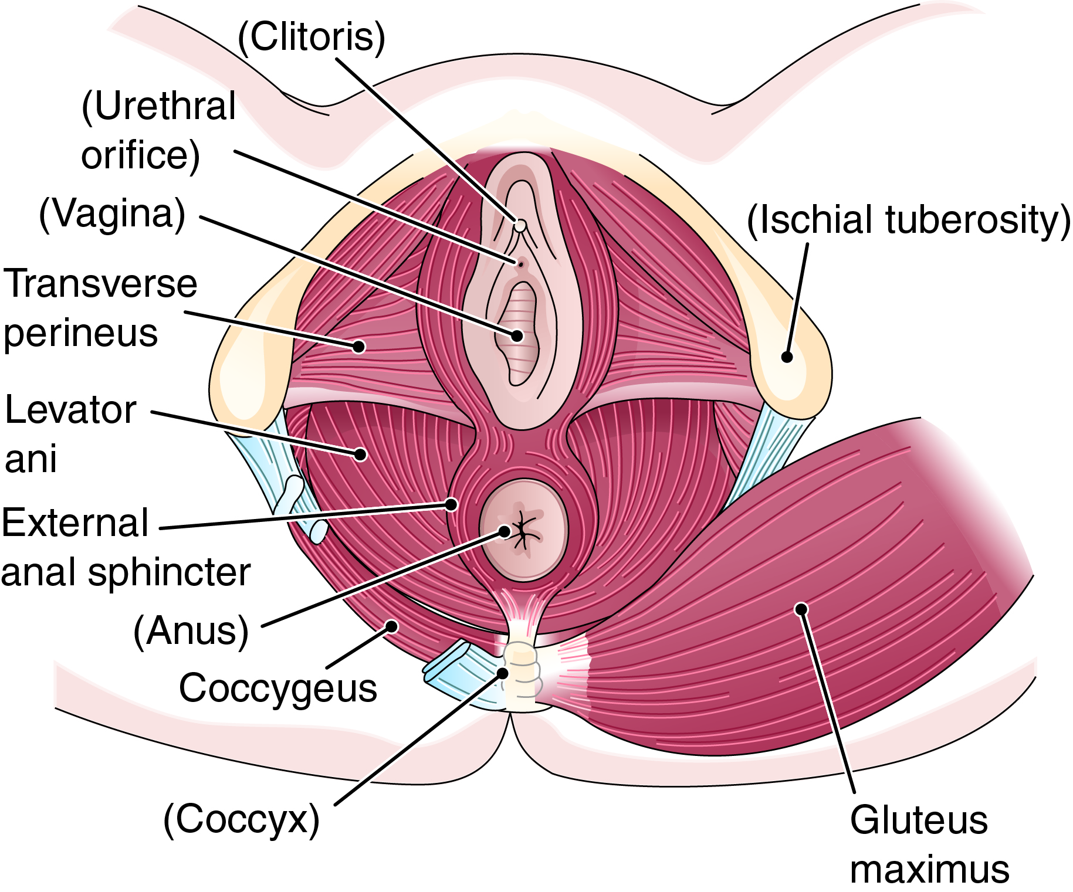
Muscles of the Female Perineum
Fig. 7-14
Notes:
34

Slide 35
Muscles of the Trunk
Name | Location | Function
Diaphragm | Dome-shaped partition between thoracic and abdominal cavities | Dome descends to enlarge thoracic cavity from top to bottom during ventilation
Intercostals | Between ribs | Alter thoracic cavity volume during ventilation
Muscles of abdominal wall: External oblique Internal oblique Transversus abdominis Rectus abdominis | Anterolateral abdominal wall | Compress the abdominal cavity and expel substances from the body; flex the spinal column
Levator ani | Pelvic floor | Aids in defecation
Erector spinae | Group of deep vertical muscles between the sacrum and skull | Extends the vertebral column to produce erect posture

Slide 36
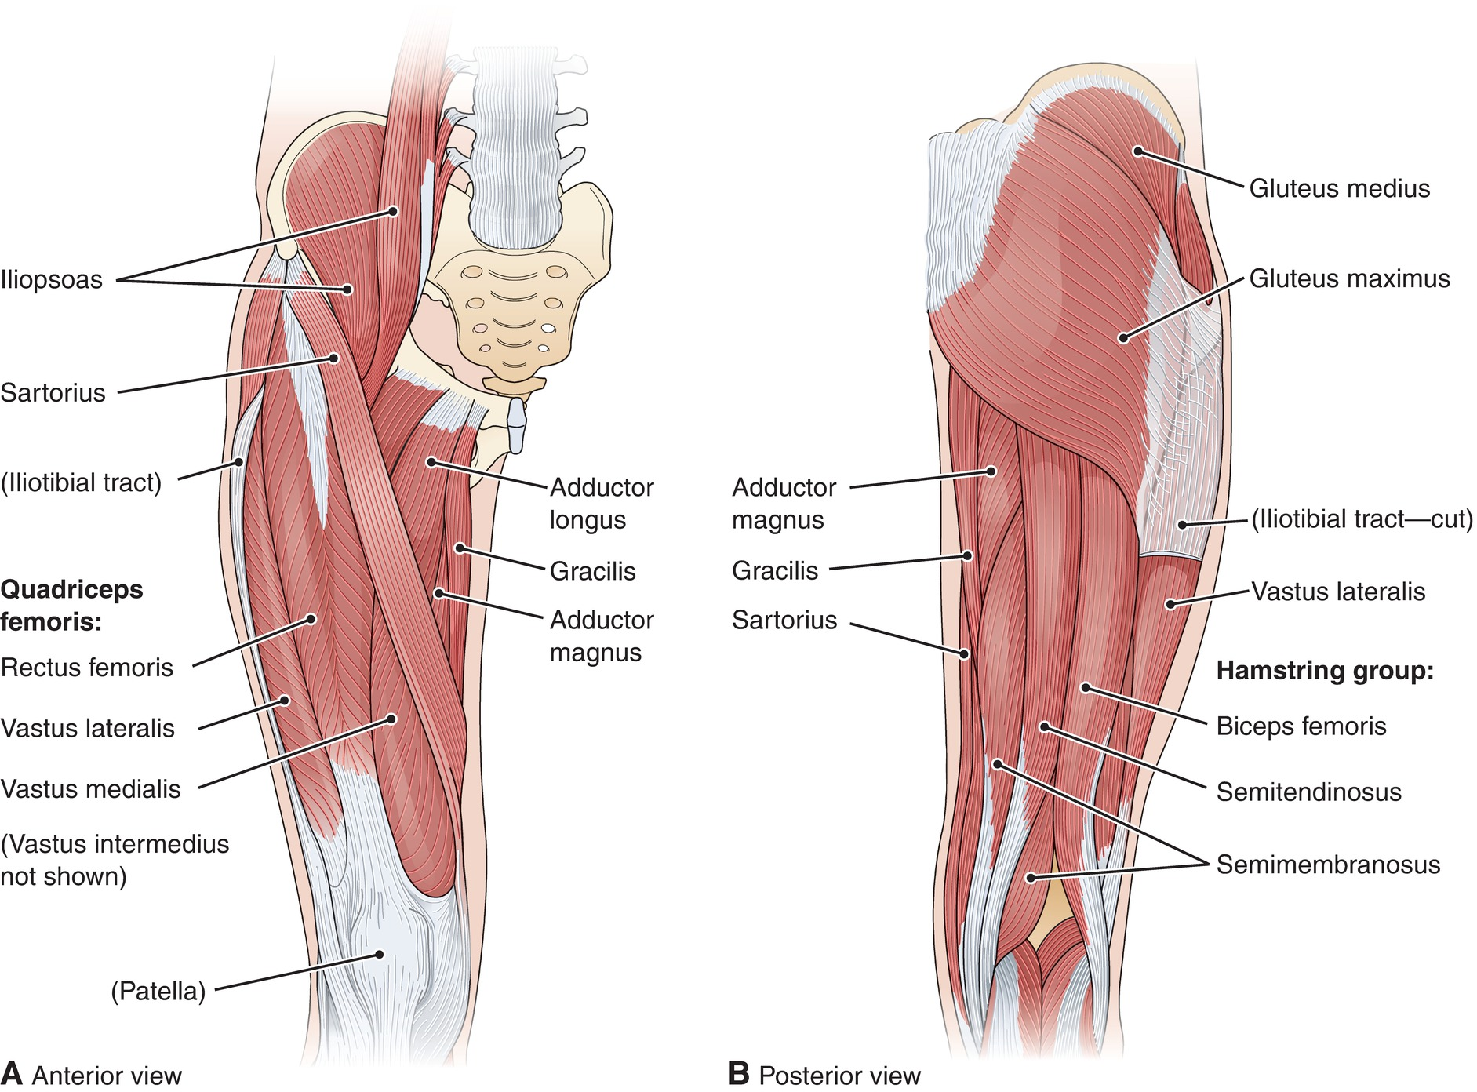
Muscles of the Thigh
Fig. 7-15
How many muscles make up the quadriceps femoris?
Notes:
36

Slide 37
Muscles of the Thigh (cont.)
Name | Location | Function
Gluteus maximus | Superficial buttock to femur | Extends thigh
Gluteus medius | Deep buttock to femur | Abducts thigh
Iliopsoas | Crosses anterior hip joint to femur | Flexes thigh when trunk is immobilized; flexes trunk when thighs are immobilized
Adductor group (e.g., adductor longus, adductor magnus) | Medial thigh to femur | Adducts thigh
Sartorius | Crosses anterior thigh from ilium to medial tibia | Flexes thigh and leg (to sit cross-legged)
Gracilis | Pubic bone to medial surface of tibia | Adducts thigh at hip; flexes leg at knee

Slide 38
Muscles of the Thigh (cont.)
Name | Location | Function
Quadriceps femoris Rectus femoris Vastus medialis Vastus lateralis Vastus intermedius | Anterior thigh to tibia | Extends leg
Hamstring group Biceps femoris Semimembranosus Semitendinosus | Posterior thigh; ischium and femur to tibia and fibula | Flexes leg at knee; extends and rotates thigh at hip

Slide 39
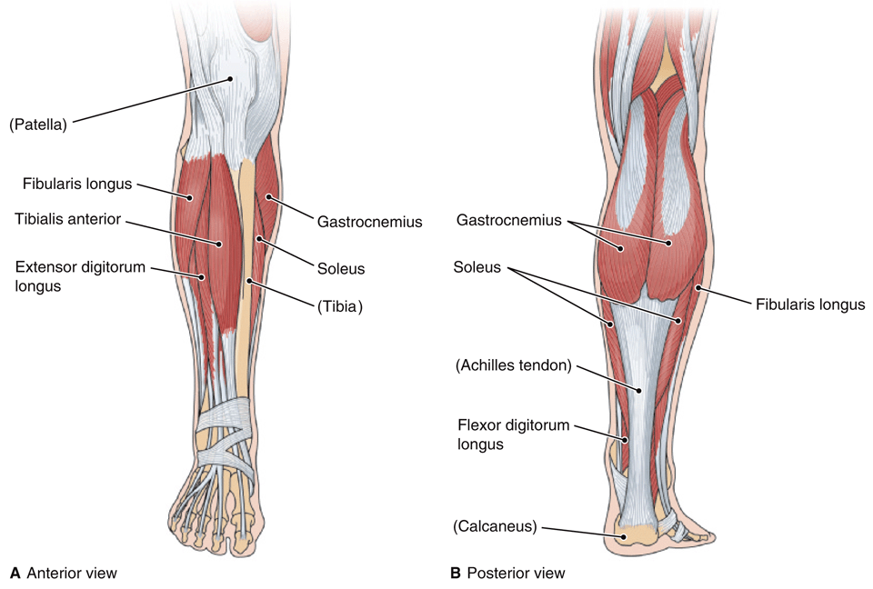
Muscles That Move the Foot
Fig. 7-16
On what bone does the Achilles tendon insert?
Notes:
39

Slide 40
Muscles That Move the Foot (cont.)
Name | Location | Function
Gastrocnemius | Posterior leg to calcaneus, inserting by the Achilles tendon | Plantar flexes foot (as in tiptoeing)
Soleus | Posterior leg deep to gastrocnemius | Plantar flexes foot
Tibialis anterior | Anterior and lateral leg to foot | Dorsiflexes and inverts foot at ankle (as in walking on heels); inverts foot (sole inward)
Fibularis longus | Lateral leg, to foot | Everts foot (sole outward)
Flexor digitorum group | Posterior leg and foot to inferior surface of phalanges | Flexes toes
Extensor digitorum group | Anterior surface of leg bones to superior surface of phalanges | Extends toes

Slide 41
Effects of Aging on Muscles (cont.)
Beginning at about age 40
Gradual loss of muscle cells
Loss of power
Tendency to flex hips and knees
Decrease in height

