Slide 1
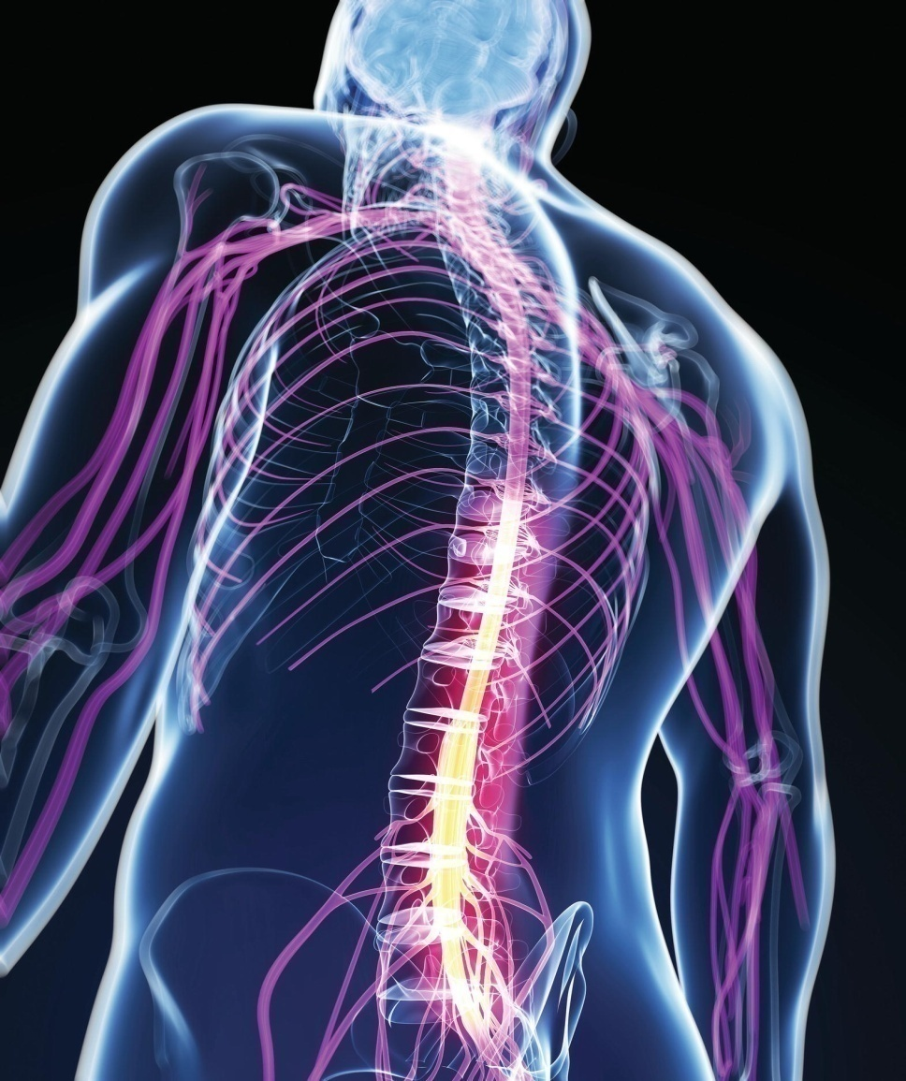
Chapter 8
The Nervous System:
The Spinal Cord
and Spinal Nerves

Slide 2
Role of the Nervous System
Nervous system coordinates all body systems
Detects and responds to stimuli
Brain and spinal cord act as switching centers
Nerves carry messages to and from centers

Slide 3
Structural Divisions
Central nervous system (CNS)
  Brain
  Spinal cord
*Peripheral nervous system (PNS)
  Cranial nerves
  Spinal nerves

Slide 4
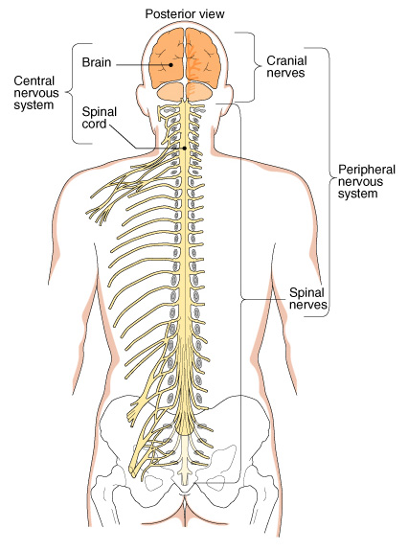
Anatomic divisions of the nervous system.

Slide 5
Functional Divisions
Somatic nervous system
Controlled voluntarily
*Effectors are skeletal muscles
No further subdivisions
Autonomic (or visceral) nervous system (ANS)
Controlled involuntarily
Effectors are smooth muscle, cardiac muscle, and glands
Subdivided into
  Sympathetic nervous system
  Parasympathetic nervous system

Slide 6
Overview of the Nervous System
Functional Divisions of the PNS
Division | Control | Effectors
Somatic nervous system | Voluntary | Skeletal muscle
Autonomic nervous system | Involuntary | Smooth muscle, cardiac muscle, and glands

Slide 7
Neurons and Their Functions
Neurons
Functional cells of nervous system
Highly specialized
Unique structure

Slide 8
Structure of a Neuron
Cell body
Nucleus
Other organelles
Cell fibers
Dendrites
  To cell body
Axons
  Away from cell body
  Some are protected by myelin sheath
  Schwann cells outermost coating is neurilemma

Slide 9
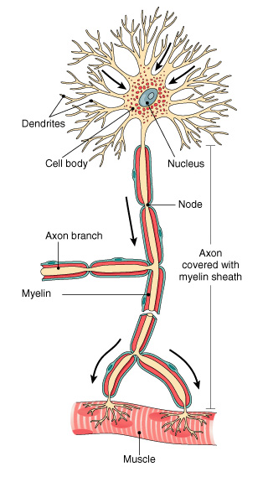
Diagram of a motor neuron. The break in the axon denotes length. The arrows show the direction of the nerve impulse.

Slide 10
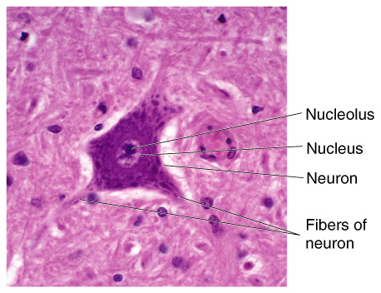
A typical neuron as seen under the microscope.

Slide 11
The Myelin Sheath
Some axons insulated and protected by a fatty myelin sheath.
In the PNS, myelin sheath is formed by Schwann cells.
  Outermost membrane of Schwann cell forms neurilemma*.
In the CNS, myelin sheath formed by oligodendrocytes.
Myelinated axons make up white matter.
Unmyelinated axons make up gray matter.

Slide 12
Types of Neurons
Sensory neurons (afferent neurons)
  Conduct impulses to spinal cord, brain
Motor neurons (efferent neurons)
  Conduct impulses to muscles, glands
Interneurons (central or association neurons)
  Conduct information within CNS

Slide 13
Nerves and Tracts
Nerve: fiber bundle within PNS
*Tract: fiber bundle within CNS
Organized into fascicles
Connective tissue layers
  Endoneurium
  Perineurium
  Epineurium

Slide 14
Nerves and Tracts
Some cranial nerves (motor) contain only motor fibers
Most cranial nerves and all spinal nerves contain both sensory and motor fibers and are MIXED nerves*

Slide 15
Neuroglia-astrocytes, schwann cells
Neuroglia (glial cells)
Protect and nourish nervous tissue
Support nervous tissue
Aid in cell repair
Remove pathogens and impurities
Regulation composition of fluids around and between cells
Schwann cells (type of neuroglia)

Slide 16
Neuroglia (cont.)
Type | Appearance | Function
Astrocytes (CNS) | Star-shaped | Physically support and anchor neurons; regulate extracellular fluid composition; act as stem cells to produce new neurons; help form the blood–brain barrier
Oligodendrocytes (CNS) | Round cells with many processes | Form myelin sheath around CNS neurons
Ependymal cells (CNS) | Ciliated epithelial cells | Line ventricles; synthesize CSF; help form the blood–brain barrier
Microglia (CNS) | Small cells with many processes | Act as phagocytes to remove pathogens and other wastes
Schwann cells (PNS) | Sausage-shaped cells wrapped around axon | Form myelin sheath around PNS neurons

Slide 17
The Nervous System at Work
Electrical impulses sent along neuron fibers and transmitted between cells at junctions

Slide 18
The Nerve Impulse: Basic Concepts
Plasma membranes are polarized.
  Unequal distribution of positive and negative ions on either side of plasma membrane
Membrane potential describes ion distribution.
Action potential: sudden change in membrane potential.
Neurons convey action potentials (electric impulses) over large distances down the axon.

Slide 19
Changes in Membrane Potential
Movement of ions across Plasma membrane changes the potential)
  Depolarization
    Less negarive
    Na flows into cell
  Repolarization
    Return to resting value
    K leaves cell
    Sodium/potassium (Na+/K+) pump
Membrane potential reverses, generates electrical charge (action potential)
Myelin sheath speeds conduction

Slide 20
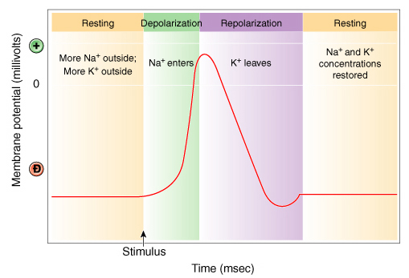
The action potential.

Slide 21
The Synapse
Junction point for transmitting nerve impulse
Axon (presynaptic cell)
Dendrite (postsynaptic cell)
Synaptic cleft
  Tiny gap between cells
Neurotransmitters
  Epinephrine (adrenaline)
  Norepinephrine (noradrenaline)
  Acetylcholine
*Receptors on postsynaptic cells pick up and respond to specific neurotransmitters

Slide 22
Examples of Neurotransmitters
Norepinephrine
Serotonin
Dopamine
Acetylcholine

Slide 23
The Spinal Cord
Contains CSF
Links PNS and brain
Helps coordinate impulses within CNS
Contained in and protected by vertebrae

Slide 24
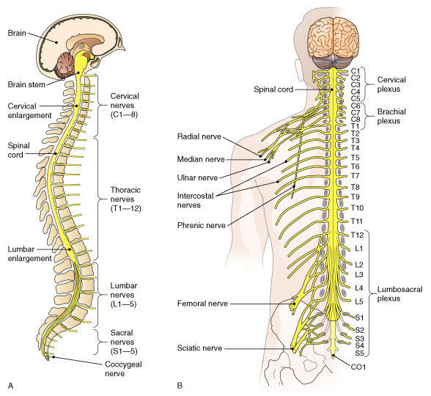
Spinal cord and spinal nerves.

Slide 25
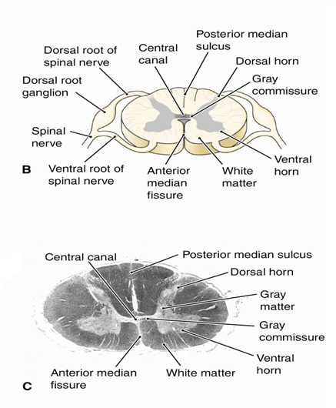
The Spinal Cord
Inner gray matter (unmyelinated axons)
  Dorsal and ventral horns connect with spinal nerves.
  Gray commissure connects horns.
  *Central canal contains CSF.
Outer white matter (myelinated axons)
  Ascending and descending tracts
  Posterior median sulcus
  Anterior median fissure
    Separates right and left portions of the anterior white matter
  Ascending and descending tracts
    Sensory travel ascending tract
    Motor impulses travel descending tracts
Fig. 8-11B and C

Slide 26
The Spinal Nerves
31 pairs
Each nerve attached to spinal cord by two roots
  Dorsal root
    Dorsal root ganglion-contains sensory neurons
  Ventral root
A ganglion is a collection of nerve cell bodies located outside the CNS
Nerves near end of cord travel together in the cord until each exits from its respective intervertebral foramen
Mixed nerves

Slide 27
Branches of the Spinal Nerves
Cervical plexus
  Activates the diaphragm
  Phrenic nerve
Brachial plexus
  Nerves to shoulder, arm, forearm, wrist and hand
  Radial nerve
Lumbosacral plexus
  Nerves to pelvis and legs
  Sciatic nerve
Dermatomes

Slide 28
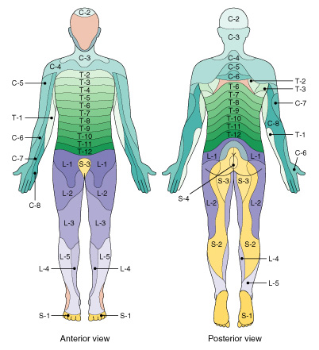
Dermatomes. A dermatome is a region of the skin supplied by a single spinal nerve.

Slide 29
Elements of a Reflex Arc
Component | Function
Receptor | Detects stimulus
Sensory neuron | Transmits nerve impulses toward the CNS
Central nervous system | Integrates information from sensory neuron(s) and plans response
Motor neuron | Transmits nerve impulses away from the CNS
Effector | Receives nerve impulses from the CNS and carries out response

Slide 30
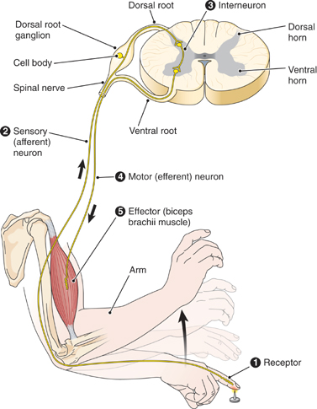
Typical reflex arc. Numbers show the sequence of impulses through the spinal cord (solid arrows). Contraction of the biceps brachii results in flexion of the arm at the elbow.

Slide 31
Reflex Activities
Simple reflex
  Rapid
  Uncomplicated
  Automatic
Spinal reflex
  Coordinated in spinal cord
  Stretch reflex is example

Slide 32
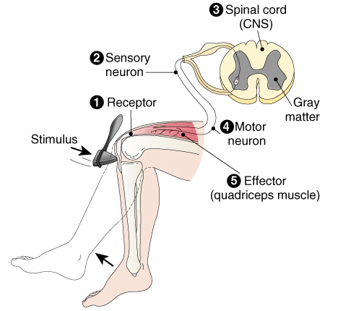
The patellar (knee-jerk) reflex is a simple, spinal and stretch reflex

Slide 33
The Autonomic Nervous
System (ANS)
Regulates the action of glands, smooth muscles of hollow organs and vessels, and heart muscle
Preganglionic neuron connects spinal cord to ganglion
Postganglionic neuron connects ganglion to effector

Slide 34
Divisions of the Autonomic Nervous
System
Sympathetic nervous system
Parasympathetic nervous system

Slide 35
Sympathetic nervous system
Thoracolumbar area
Collateral ganglia
  Celiac ganglion
  Superior mesenteric ganglion
  Inferior mesenteric ganglion
**Adrenergic system
Activated in the four E’s: excitement, emergency, embarassment, exercise

Slide 36
Parasympathetic nervous system
Arise in craniosacral areas
Terminal ganglia
Cholinergic system

Slide 37
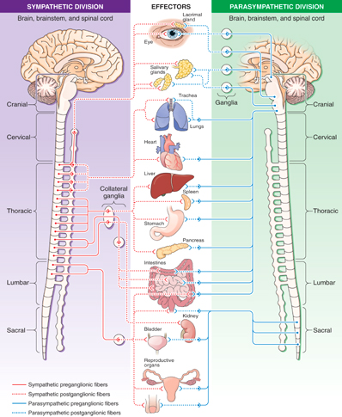

Slide 38
Neurotransmitter Receptors
Cholinergic receptors bind acetylcholine.
  Nicotinic cholinergic receptors
    Also bind nicotine
    Located on skeletal muscle cells
  Muscarinic cholinergic receptors
    Also bind muscarine (a poison)
    Located on all postganglionic ANS neurons
    Located on target cells of the parasympathetic NS
Adrenergic receptors bind epinephrine/norepinephrine.
  Found on target cells of the sympathetic nervous system

