Slide 1
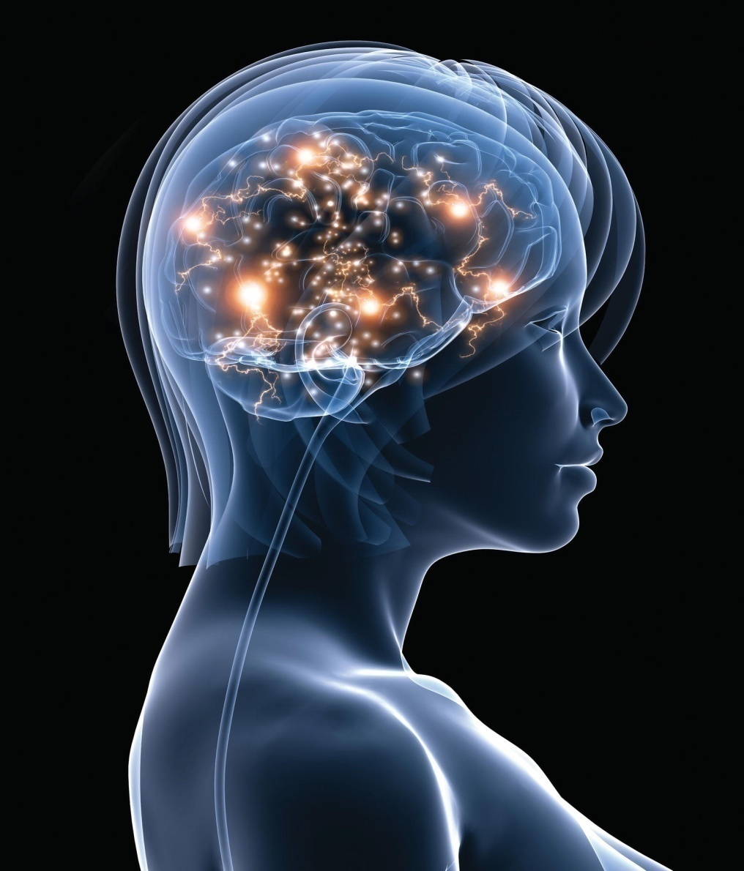
Chapter 9
The Nervous System: The Brain and Cranial Nerves

Slide 2
Overview of the Brain
Division | Description | Functions
Cerebrum | Largest and most superior portion of the brain *Divided into two hemispheres; each subdivided into lobes | Cortex (outer layer) is site for conscious thought, memory, reasoning, and abstract mental functions, all localized within specific lobes.
Diencephalon | Between the cerebrum and the brain stem Contains the thalamus and hypothalamus | The thalamus sorts and redirects sensory input. The hypothalamus maintains homeostasis; controls the autonomic nervous system and pituitary gland.

Slide 3
Overview of the Brain (cont.)
Division | Description | Functions
Brain stem Midbrain Pons Medulla oblongata | Anterior region below the cerebrum Below center of the cerebrum Anterior to the cerebellum Between the pons and spinal cord | Connects the cerebrum and diencephalon with the spinal cord Has reflex centers concerned with vision and hearing Connects the cerebrum with lower portions of the brain Helps regulate respiration Links the brain with spinal cord Centers for control of vital functions
Cerebellum (means “little brain”) | Below the posterior portion of the cerebrum Divided into two hemispheres | Coordinates voluntary muscles Maintains balance and muscle tone

Slide 4
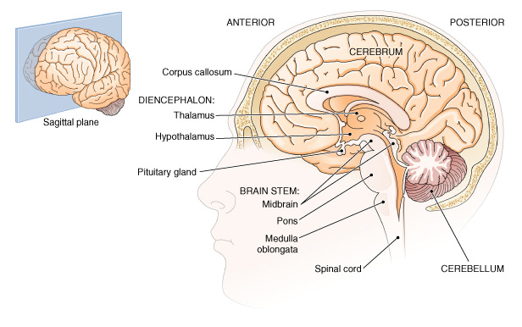
Brain, sagittal section. Main divisions are shown.

Slide 5
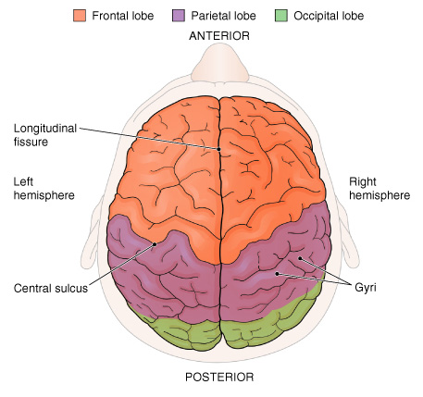
External surface of the brain, superior view.
The division into two hemispheres and into lobes is visible.

Slide 6
Protective Structures of the
Brain and Spinal Cord
Meninges-3 layers of connective tissue surrounding the brain and spinal cord
  Dura mater
    Outermost layer, thickest and toughest
    Dural sinuses
  Arachnoid
    Middle layer
  Pia mater
    Innermost layer
    Attached to the nervous tissue of the brain and spinal cord

Slide 7
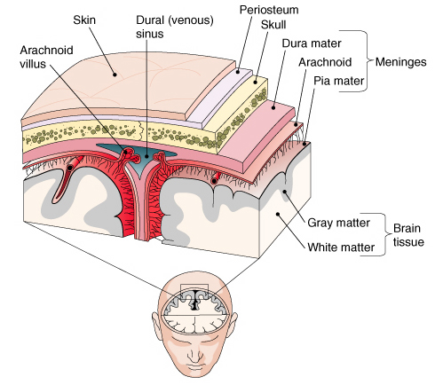
Frontal (coronal) section of the top of the head.

Slide 8
Cerebrospinal Fluid (CSF) Clear fluid circulating in and around the brain and spinal cord
Functions
  Supports nervous tissue, cushions from shock
  Carries nutrients to cells
  Transports waste products from cells
Produced in ventricles, CSF-filled spaces within brain
    Lateral (two)
    Third
    Fourth
  CSF manufactured by choroid plexus in each ventricle
    Contains many blood vessels, ependymal cells
    Interventricular foramina-lateral ventricles communicate with the third ventricle

Slide 9
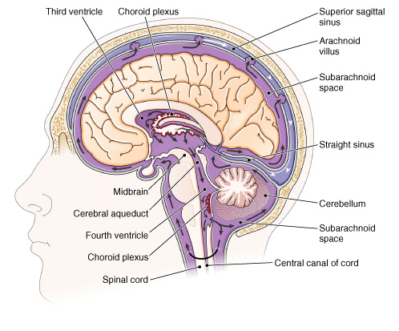
Flow of (CSF).

Slide 10
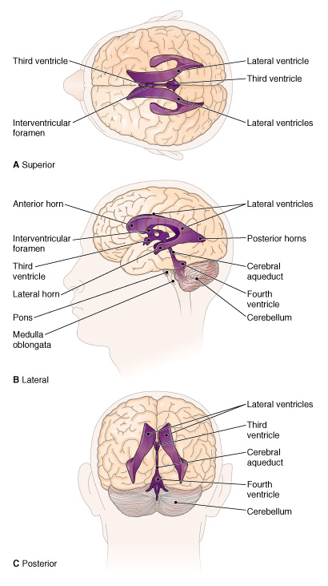
Ventricles of the brain. Three views are shown.

Slide 11
The Cerebral Hemispheres
Lobes
  Frontal
  Parietal
  Temporal
  Occipital
  Insula (within the hemisphere)
Cerebral cortex
  Gyri
  Sulci
    Central sulcus
    Lateral sulcus
Basal nuclei (basal ganglia)
Corpus callosum
Internal capsule

Slide 12
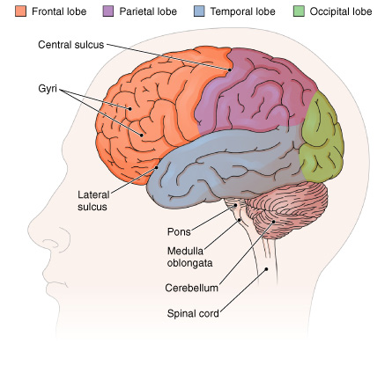
External surface of the brain, lateral view. The lobes and surface features of the cerebrum are visible.

Slide 13
Functions of the Cerebral Cortex
Frontal lobe
  Motor area
  Speech centers
Parietal lobe
  Sensory area
  Estimation of distances, sizes, shapes
Temporal lobe
  Auditory area
  Olfactory area
Occipital lobe
  Visual receiving area
  Visual association area

Slide 14
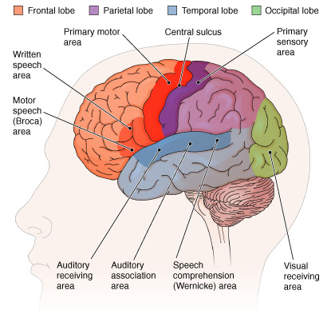
Functional areas of the cerebral cortex.

Slide 15
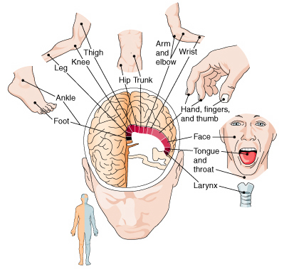
Motor areas of the cerebral cortex (frontal lobe).

Slide 16
Communication Areas
Auditory areas
  Auditory receiving
  Auditory association
  Speech comprehension (Wernicke area)
Motor areas
  Motor speech (Broca area)
  Written speech center
Visual areas
  Visual language images receiving

Slide 17
Memory and the Learning Process
Short-term memory
  Information lost unless reinforced
Long-term memory
  Rehearsal (repetition)
  Alertness

Slide 18
The Diencephalon
Thalamus
  Sorts sensory impulses
  Directs impulses within cerebral cortex
Hypothalamus
  Maintains homeostasis
  *Controls sympathetic and parasympathetic divisions of autonomic nervous system
  Influences heartbeat, blood flow, hormone secretion

Slide 19
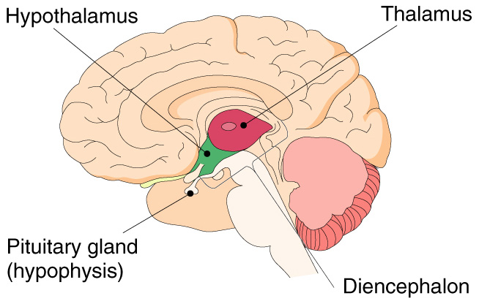
Regions of the diencephalon.

Slide 20
The Brain Stem
Connects cerebrum and diencephalon with the spinal cord
Composed of midbrain, pons, and medulla oblongata

Slide 21
The Midbrain
Superior part of brain stem
Four masses form superior part of midbrain
  These act as centers for some reflexes involving the eye and ear
Conducts impulses between higher centers of cerebrum and lower centers of pons, medulla, cerebellum, spinal cord

Slide 22
The Pons
Connecting link between cerebellum and rest of nervous system (connects the midbrain and medulla)
Some reflexes involving respiration

Slide 23
The Medulla Oblongata
Located between the pons and spinal cord
Respiratory center
Cardiac center
Vasomotor center
Contralateral (opposite side) control

Slide 24
The Cerebellum
Three parts
  Vermis
  Left hemisphere
  Right hemisphere
Outer area of gray matter with inner portion mainly white matter which is distributed in a treelike pattern
Functions
  Help coordinate voluntary muscles
  Help maintain balance
  Help maintain muscle tone

Slide 25
The Limbic System
Between cerebrum and diencephalon
Involved in emotional states, behavior
Involved in learning, long-term memory
Includes the hippocampus
  Located under the lateral ventricles
  Amygdala-clusters of nuclei deep in the temporal lobes

Slide 26
Widespread Neuronal Networks (Limbic Sx)
Basal Nuclei
  Modulates motor inputs and facilitates routine motor tasks
  Includes substantia nigra
Reticular Formation
  Reticular activating system (RAS): involved in wakefulness and attention*

Slide 27
Brain Studies
Imaging techniques to study the brain without surgery
Computed tomography (CT) scan
Magnetic resonance imaging (MRI)
Positron emission tomography (PET)
Electroencephalograph (EEG)

Slide 28
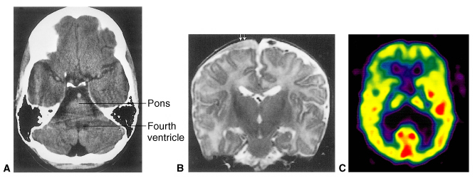
Imaging the brain.

Slide 29
Electroencephalograph
Record electric currents given off by brain nerve cells
Study sleep patterns
Diagnose disease
Locate tumors
Study drug effects
Determine brain death

Slide 30
Cranial Nerves
12 pairs
Four categories
  Special sensory impulses
  General sensory impulses
  Somatic motor impulses
  Visceral motor impulses

Slide 31
Names and Functions of the Cranial Nerves
I Olfactory-On
II Optic-Old
III Oculomotor-Olympus
IV Trochlear-Towering
V Trigeminal-Tops
VI Abducens-A
VII Facial-Finn
VIII Vestibulocochlear-Versus
IX Glossopharyngeal-German
X Vagus-Viewed
XI Accessory-All
XII Hypoglossal-Hops

Slide 32
Cranial Nerves-Sensory, Motor, Mixed (both)
I-Sensory-Some
II-Sensory-Say
III-Motor-Marry
IV-Motor-Money
V-Both-But
VI-Motor-My
VII-Both-Brother
VII-Sensory-Say
IX-Both-Bad
X-Both-Business
XI-Motor-Marry
XII-Motor-Money

Slide 33
Aging of the Nervous System
Decreased brain size and weight
Decreased speed of information processing
Slowed movements
Diminished memory
Reduced blood flow to brain

