Slide 1
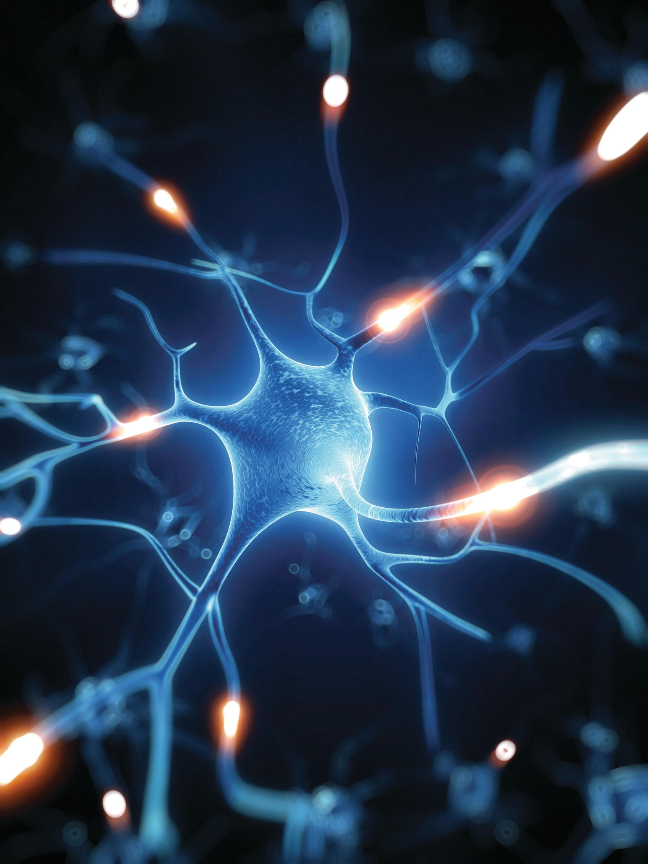
Chapter 10
The Sensory
System

Slide 2
The Senses
Sensory system detects environmental change
Environmental change initiates nerve impulse (stimulus)
Stimulus interpreted by cerebral cortex
Sensation experienced

Slide 3
Sensory Receptors
Classifying sensory receptors
Structure
  Free dendrite of sensory neuron
  End-organ on dendrite of afferent neuron
  Specialized cell associated with afferent neuron
Type of stimulus
  Chemoreceptors
  Photoreceptors
  Thermoreceptors
  Mechanoreceptors

Slide 4
Sensory Receptors
Distribution of sense receptors
Special senses in sense organ
  Vision
  Hearing
  Equilibrium
  Taste
  Smell
General senses throughout body
  Pressure, temperature, pain, touch
  Sense of position
Sensory receptors
  Chemoreceptors-respond to chemicals
  Photoreceptors-respond to light
  Thermoreceptors-respond to heat
  Mechanoreceptors-respond to movement

Slide 5
Sensory Adaptation
Occurs when receptors are exposed to continuous stimulus
Some receptors can adjust themselves so sensation becomes less acute
Receptors adapt at different rates
Pain receptors do not adapt

Slide 6
The Eye and Vision
Eye protection structures
Eye cavity bones
Eyelids
Eyelashes and eyebrow
Conjunctiva
  Lines inner surface of the eyelids and covers the sclera
Lacrimal glands
  Produce tears, lubricate the eye

Slide 7
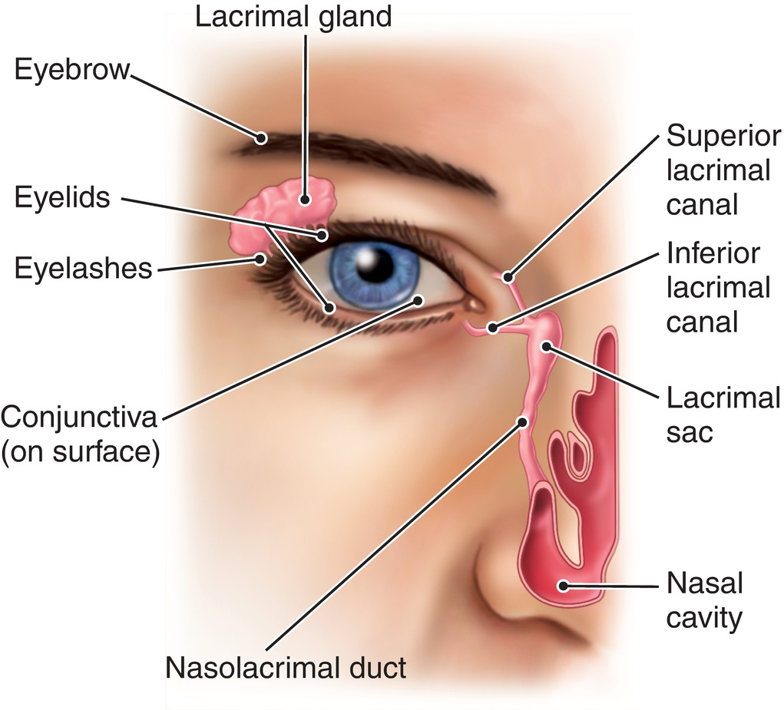
Protective Eye Structures
Fig. 10-1

Slide 8
The Extrinsic Muscles
Outer surface of eyeball
Voluntary
Control convergence for three-dimensional vision

Slide 9
Nerve Supply to the Eye
Optic nerve (cranial nerve II)
  Optic disk
Ophthalmic branch of trigeminal nerve (cranial nerve V)
Oculomotor nerve (cranial nerve III)
  Largest
  Supplies voluntary and involuntary motor impulses toall but two eye muscles
Trochlear (cranial nerve IV)
Abducens (cranial nerve VI)

Slide 10
Structure of the Eyeball
Eyeball has three separate coats (tunics)
Sclera
Choroid
  Contains pigment
Retina
  Innermost tunic
  Eyes actual receptor layer
  Contains rods and cones

Slide 11
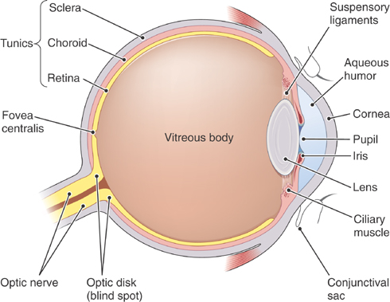
The eye.
Note the three tunics, the refractive parts of the eye (cornea, aqueous humor, lens, vitreous body), and other structures involved in vision.

Slide 12
Pathway of Light Rays and Refraction
Transparent parts of the eye that refract light
Cornea
  Transparent and colorless
Aqueous humor
  Watery fluid that maintains corneas slight forward curve
Crystalline lens
Vitreous body
  Soft jelly like substance that fills the entire space posterior to the lens

Slide 13
Functions of the Iris
Composed of two sets of muscle fibers that govern the size of the iris’s central opening-the pupil
Iris regulates amount of light entering eye

Slide 14
Function of the Retina
Pigmented layer
  Sensitive to light
Optic disk-blind spot
Rods
  Function in dim light
  Shades of gray
  Blurred images
  More numerous than cones
  Dark adaptation
Cones
  Function in bright light
    Localized at the fovea centralis
  Color sensitive
  Sharp images
  Localized at the retinal center in a tiny depressed area near the optic nerve called the fovea centralis
Rhodopsin

Slide 15
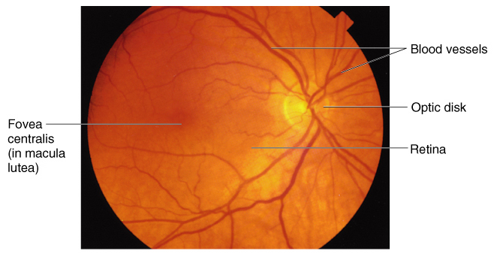
The fundus (back) of the eye as seen through an ophthalmoscope.

Slide 16
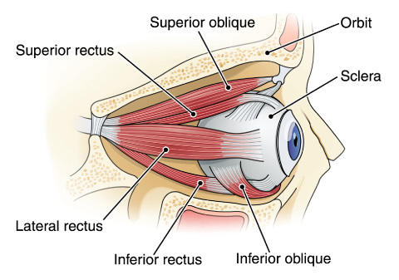
Extrinsic muscles of the eye. The medial rectus is not shown.
ZOOMING IN • What characteristics are used in naming the extrinsic eye muscles?

Slide 17
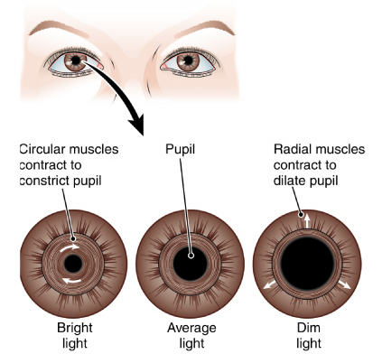
Function of the iris.

Slide 18
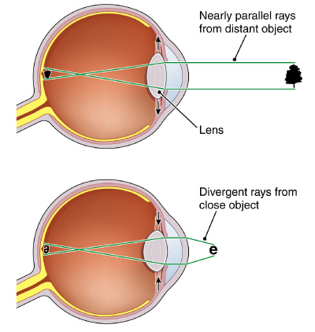
Corrective lenses
Box 10-1
Accommodation for near vision.

Slide 19
The Ear
Sense organ for hearing and equilibrium
Outer ear
Middle ear
Inner ear

Slide 20
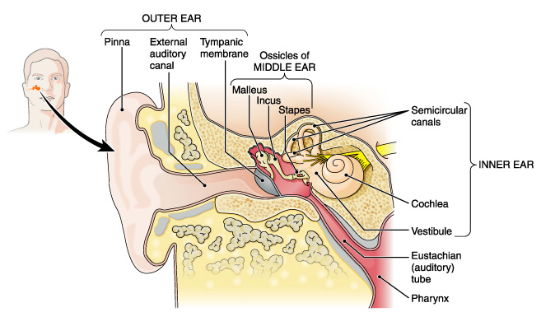
The ear. Structures in the outer, middle, and inner divisions are shown

Slide 21
The Outer Ear
Pinna (auricle)
  Directs sound waves into ear
External auditory canal (meatus)
  Ceruminous glands
Tympanic membrane
  Vibrates as sound waves enter ear

Slide 22
The Middle Ear and Ossicles
Middle ear cavity contains ossicles (small bones) that amplify sound waves and transmit sounds to inner ear
Malleus (hammer)
Incus (anvil)
Stapes (stirrup)

Slide 23
Eustachian Tube
Connects middle ear cavity with throat (pharynx)
Allows pressure to equalize on both sides of tympanic membrane
Continuous mucous membrane from pharynx to middle ear cavity

Slide 24
The Inner Ear
Bony labyrinth
  Perilymph fluid
Membranous labyrinth
  Vestibule
  Semicircular canals
  Cochlea
    Organ of Corti
  Endolymph fluid

Slide 25
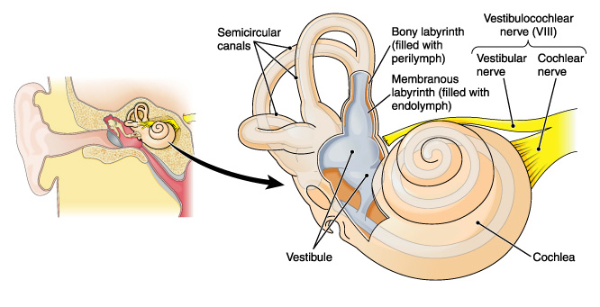
The inner ear.

Slide 26
Hearing
Organ of Corti
Located in membranous cochlea (cochlear duct)
Ciliated receptor cells
Tectorial membrane

Slide 27
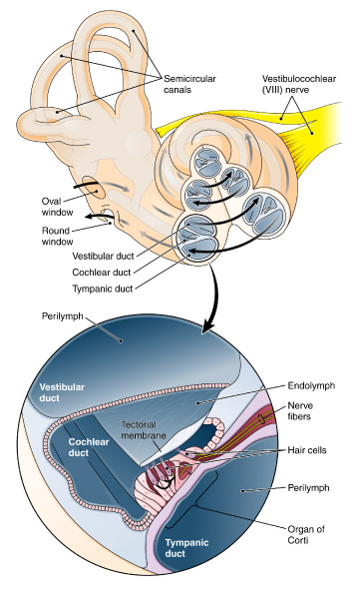
Cochlea and the organ of Corti.

Slide 28
Equilibrium
Ciliated equilibrium sensory receptors are located in vestibule and semicircular canals
Types of equilibrium
  Static
    Vestibule
    Maculae—receptors
    Otoliths fluid
  Dynamic
    Semicircular canals
    Cristae receptors
    Regulated by cranial nerve VIII

Slide 29
Other Special Sense Organs
Taste and smell sense organs respond to chemical stimuli

Slide 30
Sense of Taste
Taste receptors (buds) on tongue
  Stimulated by substance in solution
Basic tastes
  Sweet
  Salty
  Sour
  Bitter
Other tastes
  Water
  Alkaline
  Metallic
  Umami
Cranial nerves
  Facial (VII)
  Glossopharyngeal (IX)

Slide 31
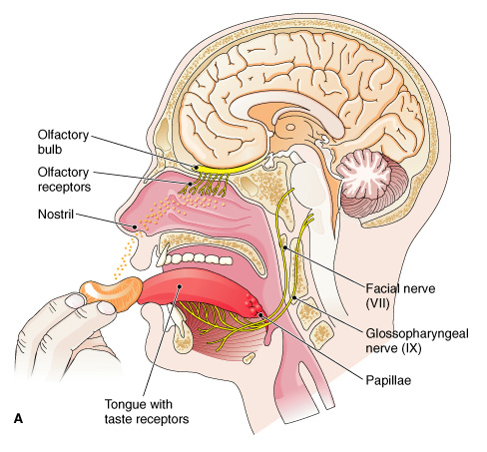
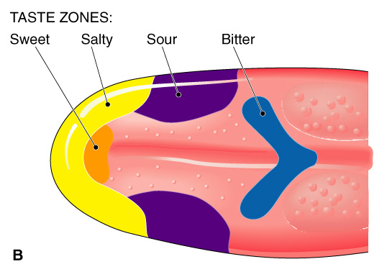
Special senses that respond to chemicals.
Organs of taste (gustation) and smell (olfaction).
(B) A taste map of the tongue.

Slide 32
Sense of Smell
Smell receptors in nasal cavity
  Stimulated by substances in solution in nasal fluids
  Smells stimulate appetite and flow of digestive juices
Olfactory nerve (cranial nerve I)

Slide 33
The General Senses
Receptors scattered throughout the body sense
Touch
Pressure
Heat
Cold
Position
Pain

Slide 34
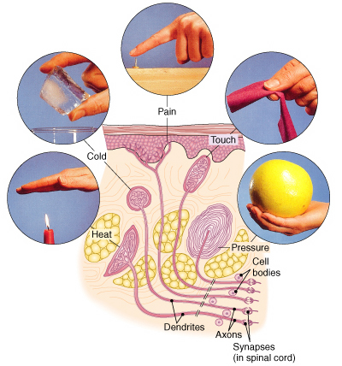
Sensory receptors in the skin.

Slide 35
Sense of Touch
Tactile corpuscles
Found mostly in dermis of skin and around hair follicles
Sensitivity varies with the number of receptors
Baroreceptors in walls of large arteries monitor blood pressure and trigger responses that control BP as vessels stretch.
Sense of Pressure
Receptors for deep touch located
In subcutaneous tissues
Near joints, muscles, and other deep tissues

Slide 36
Sense of Temperature
Temperature receptors
Are free nerve endings
Are widely distributed in the skin
Are separate for heat and cold
Occur in hypothalamus of brain
  Help to adjust body temperature according to temperature of circulating blood

Slide 37
Sense of Position
Proprioceptors (position receptors)
Are located in muscles, tendons, joints
Relay impulses of body parts in relation to each other
Send impulses to the cerebellum for coordination
Kinesthesia

Slide 38
Sense of Pain
Pain receptors
  Are free nerve endings
  Are found in skin, muscles, joints and (to a lesser extent) in most internal organs
Pain
Referred pain
  Analgesic drugs
  Itch-free nerve endings

