Slide 1
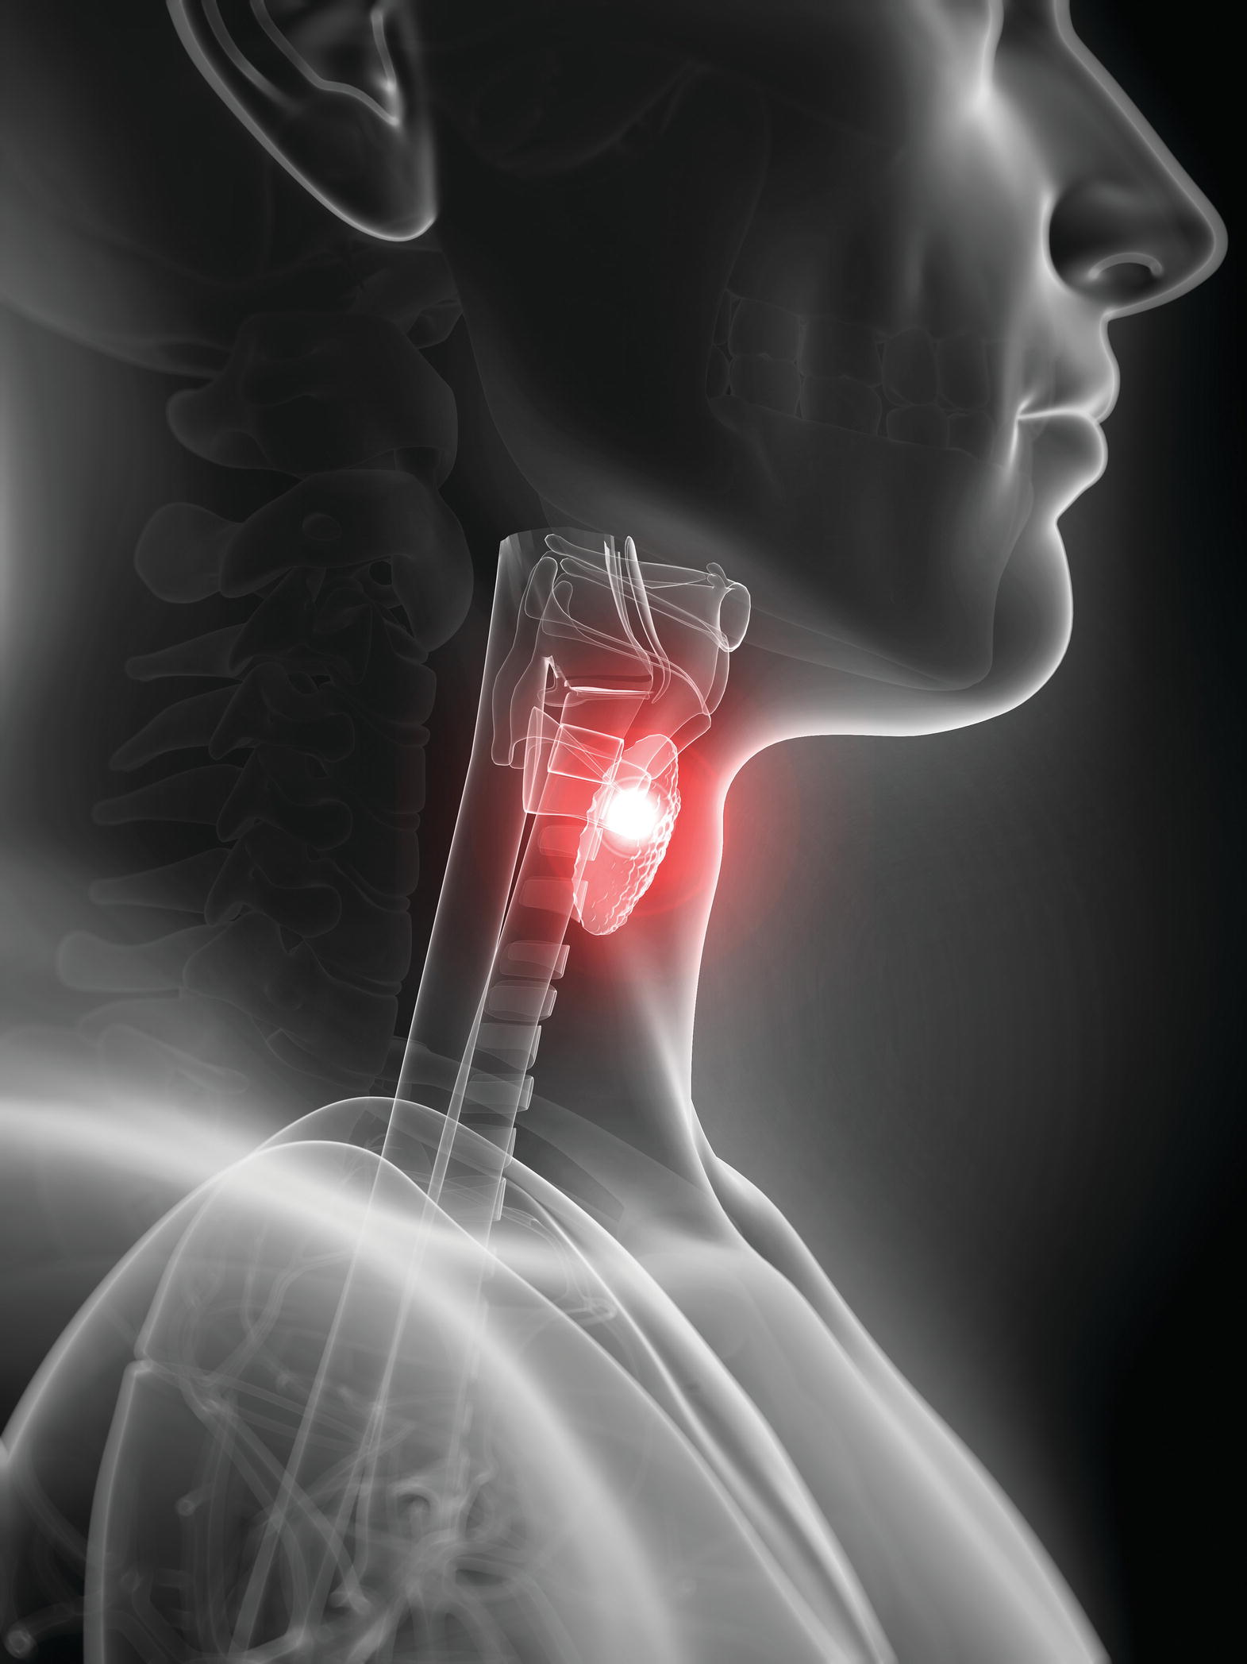
Chapter 11
The Endocrine System: Glands and Hormones

Slide 2
The Endocrine System
Consists of a group of glands that produce hormones
Works with nervous system to control and coordinate all other body systems
Affects body systems by chemical stimuli

Slide 3
Hormones
Chemical messengers with regulatory effects on cells or organs
Hormones from endocrine glands are released directly into tissue fluids; not through ducts
Some affect many tissues
  Growth hormone
  Thyroid hormone
  Insulin
Some affect a specific tissue (target tissue)
  Thyroid-stimulating hormone (TSH)
  Adrenocorticotropic hormone (ACTH)

Slide 4
Hormone Chemistry
Amino acid compounds
  Proteins or related compounds
  All hormones except steroids
Lipids
  Made of fatty acids
  Most are steroids, derived from the steroid cholesterol
  Produced in adrenal cortex and sex glands
  Prostaglandins are also lipids

Slide 5
Hormone Regulation
Negative feedback (most common)
  Endocrine gland oversecretes hormone
  Tissue becomes too active
  Tissue negatively effects gland to decrease secretion
Positive feedback
  Hormone response produces more hormone
Rhythmic pattern

Slide 6
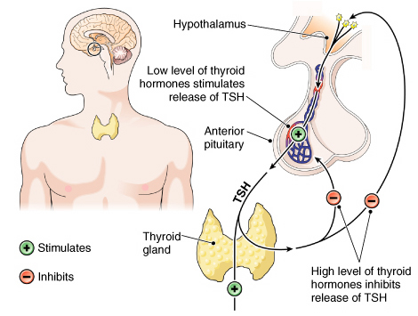
Negative feedback control of hormones.

Slide 7
The Endocrine Glands and
Their Hormones
Tissues other than endocrine glands also secrete hormones
Brain
Digestive organs
Kidney

Slide 8
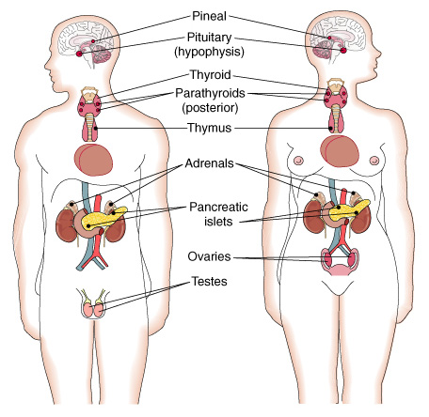
The endocrine glands.

Slide 9
The Pituitary
Pituitary (hypophysis) gland
Master gland
Releases hormones that affect working of other glands
Controlled by hypothalamus
  Connected to the hypothalamus by a stalk called the infundibulum

Slide 10
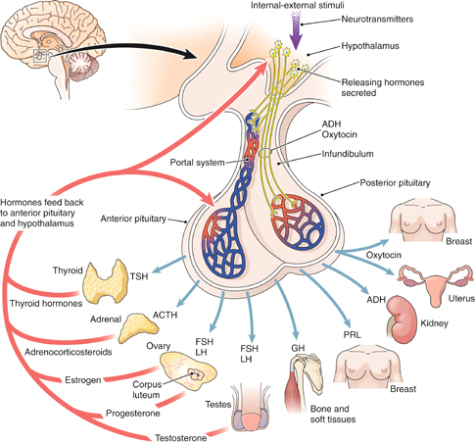
The hypothalamus, pituitary gland, and target tissues. Arrows indicate the hormones’ target issues and feedback pathways.

Slide 11
Control of the Pituitary
Hypothalamus
Sends releasing hormones (RH) and inhibiting hormones (IH) through a circulatory pathway called a portal system
  Hormones stimulate and suppress anterior pituitary secretions
Produces antidiuretic hormone (ADH) and oxytocin
  Stored in posterior pituitary
  Nerve impulses stimulate secretions

Slide 12
Hormones of the Anterior Lobe
Growth hormone (GH) or somatotropic
Thyroid-stimulating hormone (TSH) or thyrotropic
Adrenocorticotropic hormone
Prolactin (PRL)
Gonadotropins
  Follicle-stimulating hormone (FSH)
  Luteinizing hormone (LH)

Slide 13
Hormones of the Posterior Lobe
Antidiuretic hormone (ADH)
Oxytocin

Slide 14
The Thyroid Gland
Largest endocrine gland
Lateral lobes on either side of larynx
Connecting band (isthmus)
Enclosed by connective tissue capsule

Slide 15
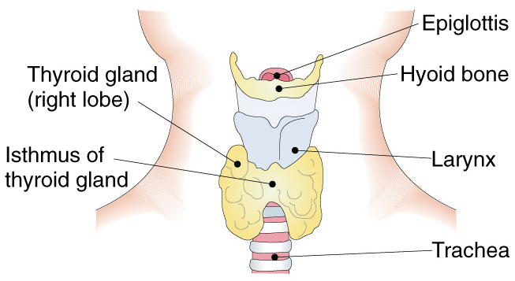
Thyroid gland (anterior view).

Slide 16
Hormones of the Thyroid Gland
Thyroxine (T4)
  Principle hormone
  Increases energy and protein metabolism rate
Triiodothyronine (T3)
  Increases energy and protein metabolism rate
Calcitonin
  Used to belieive that it assisted in
    Regulating calcium metabolism
    Works with parathyroid hormone and vitamin D
    Actually has little effect on humans

Slide 17
The Parathyroid Glands
Four glands in posterior capsule of thyroid
Secrete parathyroid hormone (PTH)
  Promotes release of calcium from bone tissue, thus increasing the amount of calcium circulating in the bloodstream. PTH also causes the kidney to conserve calcium**

Slide 18
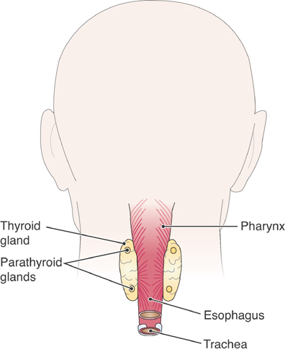
Parathyroid glands (anterior view).

Slide 19
Calcium Metabolism
Calcium balance requires
Calcitriol (dihydroxycholecalciferol)
  Produced by modifying vitamin D in liver then in kidney
  Increases intestinal absorption of calcium to raise blood calcium levels
Parathyroid hormone
Calcitonin

Slide 20
The Adrenal Glands
Two small glands on top of kidneys
Each gland has two parts that act as separate glands
  Medulla
  Cortex

Slide 21
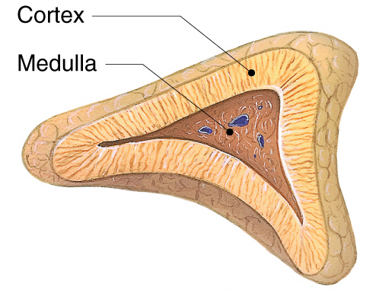
The adrenal gland.

Slide 22
Hormones from the Adrenal Medulla
Fight-or-flight hormones
Epinephrine (adrenaline)
Norepinephrine (noradrenalin)

Slide 23
Hormones from the Adrenal Cortex
Glucocorticoids
  *Cortisol or hydrocortisone
Mineralocorticoids
  Aldosterone
Sex hormones

Slide 24
The Pancreas and Its Hormones
Islets of Langerhans are specialized pancreas cells that secrete
*Insulin
  Lowers blood sugar level
  Stimulates manufacture of amino acids into protein
*Glucagon
  Increases blood sugar

Slide 25
The Sex Glands
Ovaries and testes produce hormones to
Develop sexual characteristics
Maintain reproductive organs

Slide 26
Hormones of the Sex Glands
Male sex hormone-androgens
  Testosterone
Female sex hormones
  Estrogen
  Progesterone

Slide 27
The Thymus Gland
Mass of lymphoid tissue in upper chest superior to heart
Important in development of immunity
Produces thymosin
  Assists in maturity of T lymphocytes

Slide 28
The Pineal Gland
Cone-shaped structure posterior to midbrain
Produces melatonin
  Influences sleep–wake cycles
  Appears to delay onset of puberty

Slide 29
Other Hormone-Producing Tissues (cont.)
Adipose tissue: leptin
Digestive tract: appetite-regulating hormones
Bone: osteocalcin
Kidney: erythropoietin (EPO)
Thymus: thymosin
Atria: atrial natriuretic peptide (ANP)
Placenta: pregnancy hormones

Slide 30
Prostaglandins
Group of hormones made by most body tissues
Produced, act, and rapidly inactivated in or close to origin
Constrict structures
Dilate structures
Promote inflammation

Slide 31
Hormones and Treatment
Hormones are extracted from animal tissue, manufactured in the lab, or genetically engineered
Growth hormone
*Insulin
*Adrenal steroids
*Epinephrine (adrenaline)
Thyroid hormones
*Oxytocin
Androgens
*Estrogen and progesterone

Slide 32
Impact of Insulin Deficiency
Deficiency in insulin production or action impairs the ability of cells to take up and use glucose.
Results in hyperglycemia (abnormally high blood glucose levels):
  Hyperglycemia causes excess urine production, dehydration, thirst
  Chronically, hyperglycemia damages small blood vessels and nerves
Results in impaired glucose metabolism:
  Lethargy, hunger
Impairs protein synthesis
  Tissue wasting

Slide 33
Hormones and Stress
Stress response involves both nervous and endocrine system
Hormones released during stress help body cope
Unchecked levels of hormones can harm body

Slide 34
Aging and the Endocrine System
Pancreas
  Adult-onset diabetes mellitus
Thyroid
  Decreased hormone secretion
Pituitary
  Decreased gonadotropic hormones
  Decreased growth hormone
Gonads
  Decreased sexual activity
  Loss of bone mass

