Slide 1
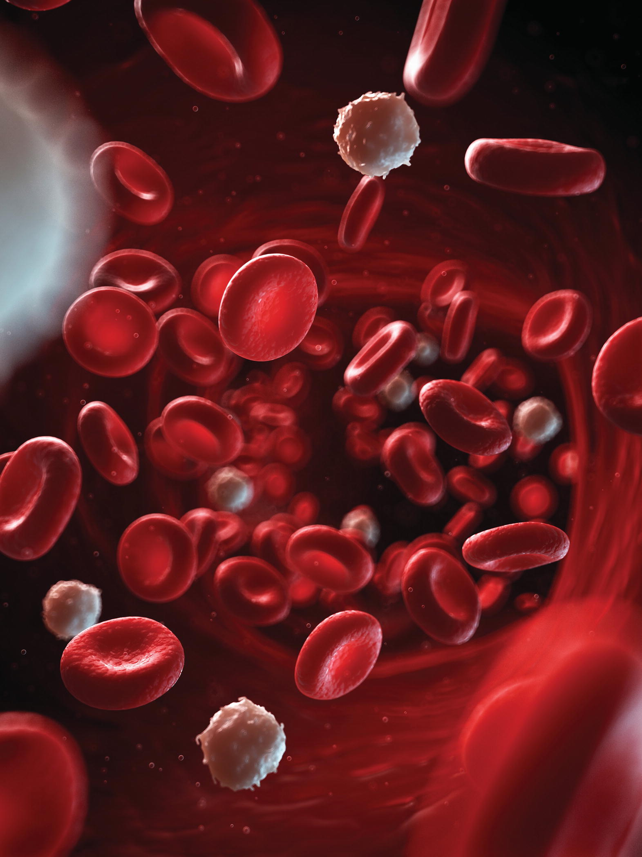
Chapter 12
The Blood

Slide 2
Circulating Blood
Important in maintaining homeostasis
Classed as connective tissue
Accounts for 8% of total body weight
Plasma-blood’s liquid matrix

Slide 3
Transportation
Blood
Carries oxygen to tissues
Carries carbon dioxide from tissues
Transports nutrients and other substances to cells
Transports waste products from cells
Carries hormones to organs

Slide 4
Regulation
Blood
Buffers keep pH of body fluids between 7.35 and 7.45
Substances maintain osmotic pressure to regulate fluid in tissues (fluid balance)
Transports heat generated in muscles to aid in regulation of body temperature

Slide 5
Protection
Blood
Carries cells and antibodies of immune system
Carries factors to protect against blood loss

Slide 6
Blood Constituents
Plasma
  Liquid portion
Formed elements
  Erythrocytes
  Leukocytes
  Platelets (thrombocytes)

Slide 7
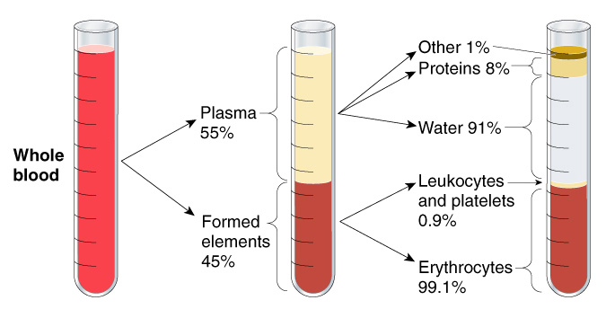
Composition of whole blood. Percentages show the relative proportions of the different components of plasma and formed elements.

Slide 8
Blood Plasma
Plasma is 55% of blood
**91% water
8% protein
  Albumin
    Most abundant
  Clotting factors
  Antibodies
  Complement
    Enzymes help antibodies fight against pathogens
1% other materials
  *Glucose
  Amino acids
  Lipids
  Electrolytes
  Vitamins
  Hormones
  Wastes
  Drugs
  Dissolved gases

Slide 9
The Formed Elements
Produced in red bone marrow
Hematopoietic (blood-forming) stem cells can develop into any blood cell
Short-lived tissue cells

Slide 10
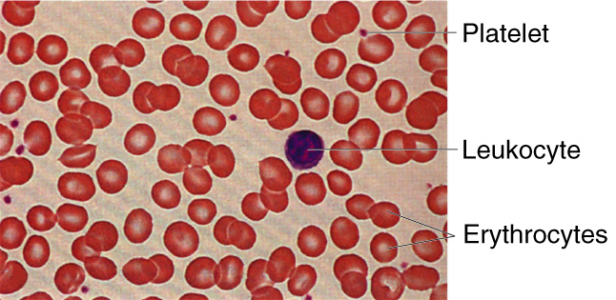
Blood cells as viewed under the microscope.

Slide 11
Erythrocytes
Red blood cells (RBCs) most numerous
  4.5-5 million per mcl
Biconcave shape
Stimulated by EPO
Mature cells anuclear
*Contain hemoglobin
  Binds to oxygen for transport
  Carries hydrogen ions for buffering
  Carries carbon dioxide for elimination

Slide 12
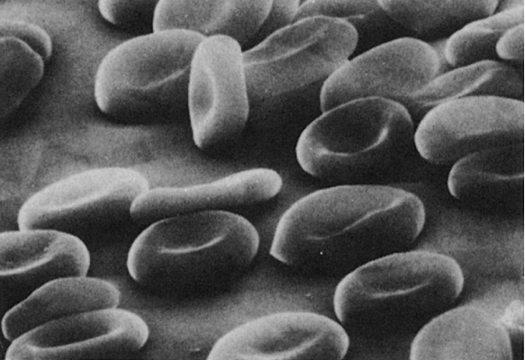
Red blood cells as seen under a scanning electron microscope.

Slide 13
Leukocytes
White blood cells (WBCs) colorless, round
  Granulocytes
    Neutrophils (polymorphs)
      *Most numerous
      Increase in band cells is a sign of infection
    Eosinophils
    Basophils
  Agranulocytes
    Lymphocytes
    Monocytes
Prominent nuclei

Slide 14
Function of leukocytes
Clear body of foreign material, cellular debris, pathogens
See table 12-2
Macrophages
Plasma cells

Slide 15
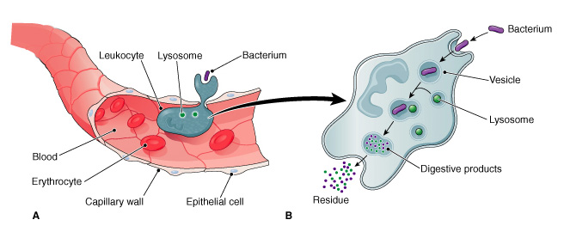
Phagocytosis.
A phagocytic leukocyte (white blood cell) squeezes through a capillary wall in the region of an infection and engulfs a bacterium.
(B) The bacterium is enclosed in a vesicle and digested by a lysosome.

Slide 16
Platelets
Platelets (thrombocytes)
Smallest formed element
Not cells—no nuclei or DNA
Fragments release from megakaryocytes
Essential for blood coagulation (clotting)

Slide 17
**Hemostasis
Prevents blood loss when blood vessel ruptures
Contraction of smooth muscles in blood vessel wall (vasoconstriction)
Formation of platelet plug
Formation of blood clot

Slide 18
Blood Clotting
Procoagulants: compounds that promote clotting
Anticoagulant: compounds that prevent clotting
Final steps in clotting:
  Damaged tissues release substances that form prothrombinase
  Prothrombinase converts prothrombin to thrombin
  Thrombin converts fibrinogen to fibrin
  Fibrin forms network of threads to form clot

Slide 19
Blood Clotting (cont’d)
Serum: fluid left over after clotting takes place
Plasma = serum + clotting factors

Slide 20
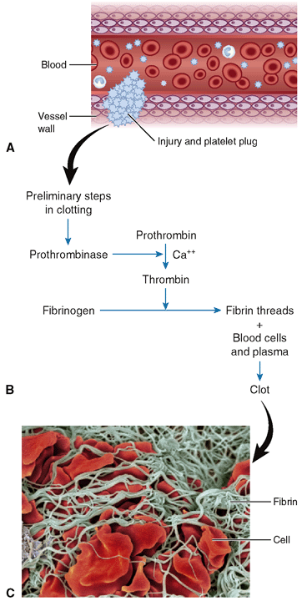
Figure 12-7 Blood clotting
(coagulation).
What part of the word prothrombinase
indicates that it is an enzyme?
What part of the word prothrombin
indicates that it is a precursor?
Notes:
20

Slide 21
Blood Types
Blood cells contain substances capable of causing an immune response (antigens)
Blood types must be compatible for blood transfusion from donor to patient
  In the event of hemorrhage or disease
Proteins (antigens or agglutinins) on red cells cause incompatibility
  A and B antigens
  Rh factor

Slide 22
The ABO Blood Type Group
Four blood types involving A and B antigens
A (only)
B (only)
AB (both antigens)
O (neither antigen)

Slide 23
Testing for Blood Type
Blood sera containing antibodies to A or B antigens (antisera) prepared
Sera added to blood sample
Corresponding red cells clump (agglutination)

Slide 24
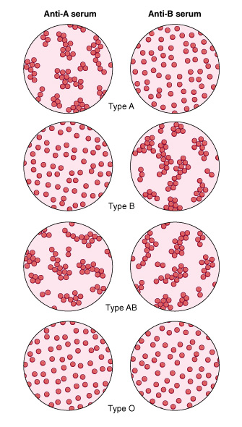
Blood typing. Labels at the top of each column denote the kind of antiserum added to the blood samples.
Anti-A serum agglutinates (causes to clump) red cells in type A blood, but anti-B serum does not.
Anti-B serum agglutinates red cells in type B blood, but anti-A serum does not. Both sera agglutinate type AB blood cells, and neither serum agglutinates type O blood.

Slide 25
Blood Compatibility
Safest transfusion is same blood type
Type O blood can be given to any ABO type
Type AB blood can receive any ABO type

Slide 26
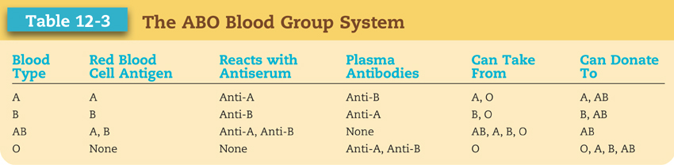

Slide 27
The Rh Factor
Red cell antigen group Rh (D antigen)
  Rh-positive blood has antigen
  Rh-negative blood lacks antigen
Rh incompatibility can lead to hemolytic disease of newborn (HDN)
  Rh negative mother and Rh positive fetus

Slide 28
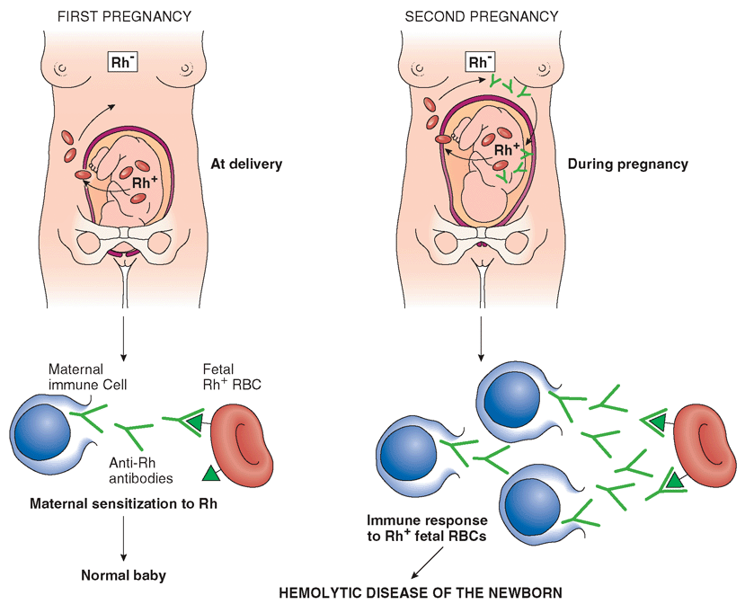
Figure 12-9 Rh incompatibility.
Notes:
28

Slide 29
Uses of Blood and Blood Components
Centrifuge-separates blood plasma from formed elements
Blood stored in blood banks up to 35 days
  Anti-clotting solution added
  Expiration date added
Blood donated before elective surgery (autologous blood)

Slide 30
Whole Blood Transfusions
Used for loss of large volume of blood
Massive hemorrhage from serious injuries
During internal bleeding
During or after an operation
Blood replacement in treatment of HDN

Slide 31
Use of Blood Components
Centrifuge separates plasma from formed elements
Hemapheresis—keep desired elements and return remainder to donor
Plasmapheresis—keep plasma and return formed elements to donor
See HANDOUT IN PACKET

Slide 32
Use of Plasma
Replace blood volume
Treat circulatory failure (shock)
Treat plasma protein deficiency
Replace clotting factors
Provide needed antibodies (gamma globulin fraction)

Slide 33
Blood Studies
Some blood tests are standard part of routine physical examination
Machines can perform several tests simultaneously

Slide 34
The Hematocrit
mL of red cells per 100 mL of whole blood
Performed in centrifuge
Adult range for men 42%–54%
Adult range women 36%–46%

Slide 35
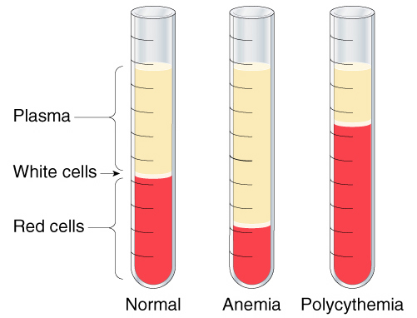
Hematocrit

Slide 36
Hemoglobin Tests
g of hemoglobin per 100 mL of whole blood
Performed by electrophoresis
Adult range for men 14–17 g
Adult range for women 12–15 g

Slide 37
Blood Cell Counts
Red cell counts
  Range 4.5–5.5 million cells per microliter (μL)
  Increase = polycythemia vera
White cell counts
  Range 5,000–10,000 cells per microliter (μL)
Platelet counts
  Range 150,000–450,000 per microliter (μL)

Slide 38
The Blood Slide (Smear)
Complete blood count (CBC) performed on drop stained blood slide
Red cells examined
Platelets examined
Parasites may be found
Differential white count performed

Slide 39
Blood Chemistry Tests
Batteries of blood serum tests often done by machine
Electrolytes
Blood glucose
Nitrogenous waste products
Creatine
Enzymes
Lipids
Plasma proteins
Hormones
Vitamins
Antibodies
Drug levels

Slide 40
Coagulation Studies
Performed before surgery and during treatment of certain diseases
Amounts of clotting factors
Bleeding time
Clotting time
Capillary strength
Platelet function

Slide 41
Bone Marrow Biopsy
Sample of red marrow through needle from sternum, sacrum, or iliac crest
Used in diagnosing bone marrow disorders
  Leukemia
  Some types of anemia

