Slide 1
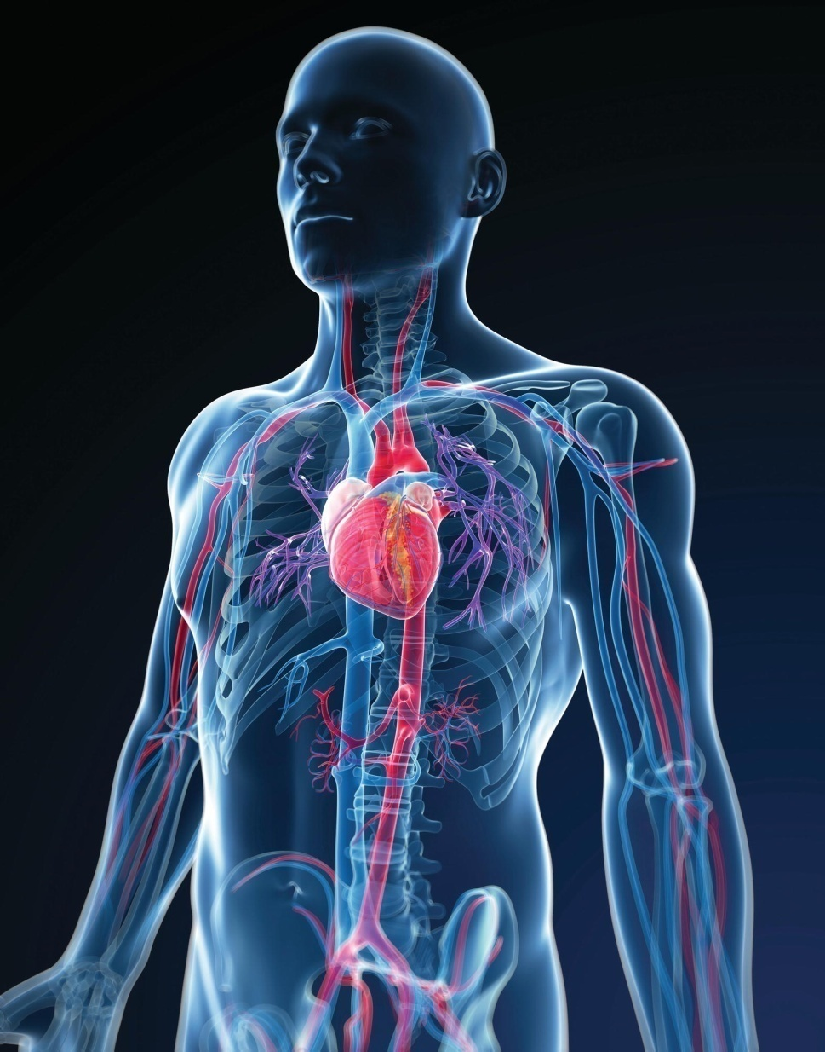
Chapter 14
Blood Vessels and Blood Circulation

Slide 2
The Vascular System
A closed system of vessels that transports blood to and from the lungs and body tissues

Slide 3
Blood Vessel Types
Type | Structure | Function
*Arteries | Thick walled, large tubes | Carry blood away from the heart
Arterioles | Small arterial subdivisions | Carry blood from arteries to capillaries; Narrow or widen to control blood pressure and blood distribution
*Capillaries | Very thin walled, narrow tubes | Site of exchanges between blood and tissues
Venules | Smallest veins, formed by the union of capillaries | Carry blood from capillaries to veins
*Veins | Thin walled, large tubes | Carry blood back to heart

Slide 4
Blood Circuits
Two groups of blood vessels
The pulmonary circuit
  Pulmonary artery and its branches
  Capillaries in lungs
  Pulmonary veins
The systemic circuit
  Aorta
  Systemic capillaries
  Systemic veins

Slide 5
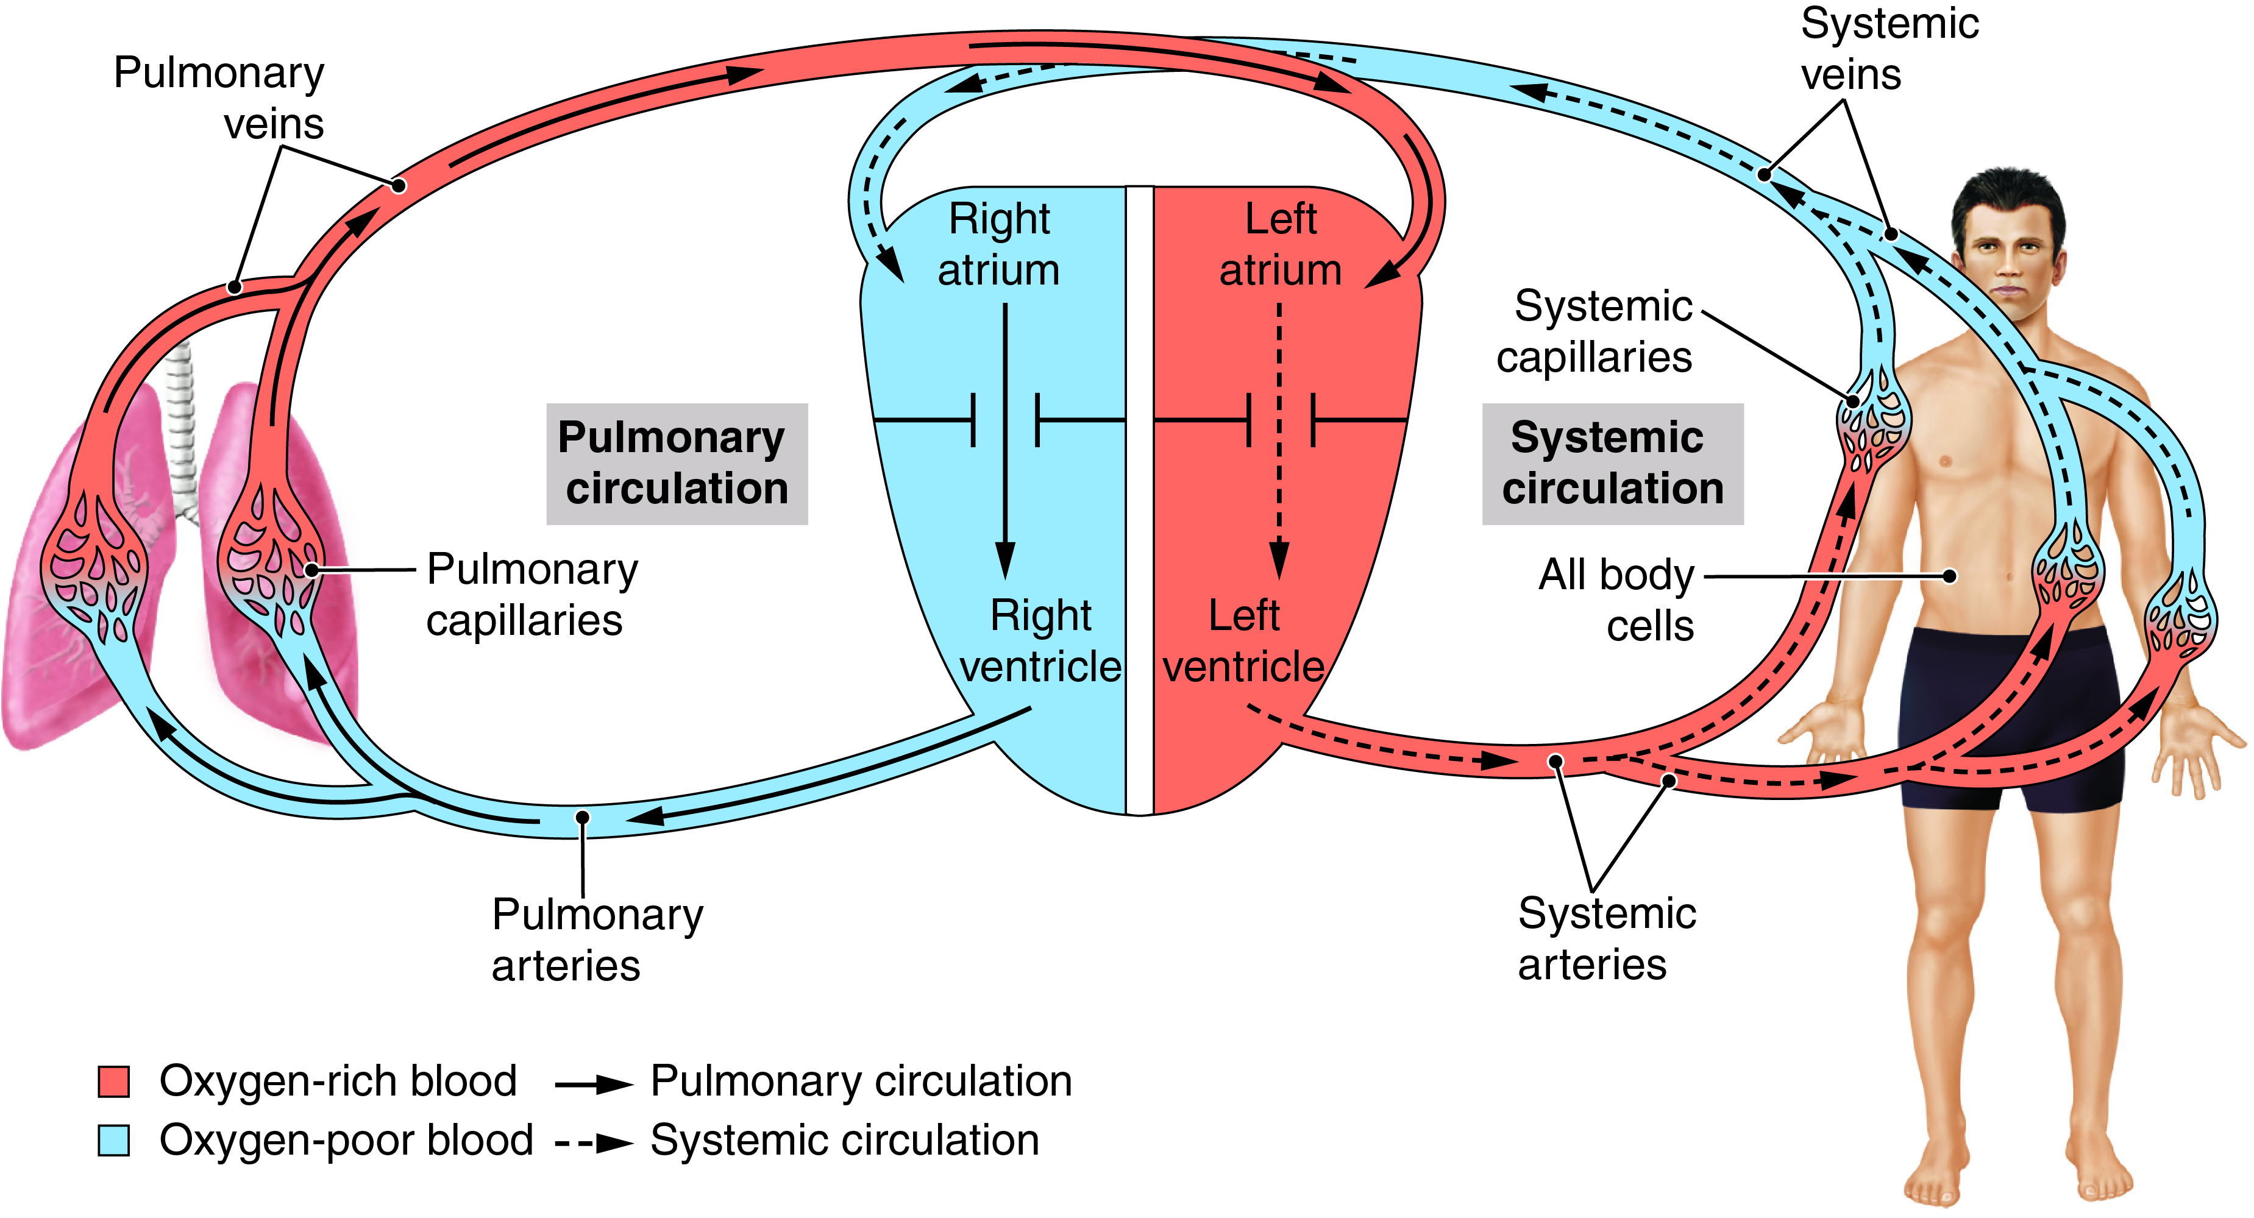
The Cardiovascular System
Fig. 14-1

Slide 6
Vessel Structure
Three tunics (coats) of arteries and veins
Inner (endothelium)
Middle (smooth [voluntary] muscle)
  Controlled by autonomic nervous system
  Thinner in veins
Outer (supporting connective tissue)

Slide 7
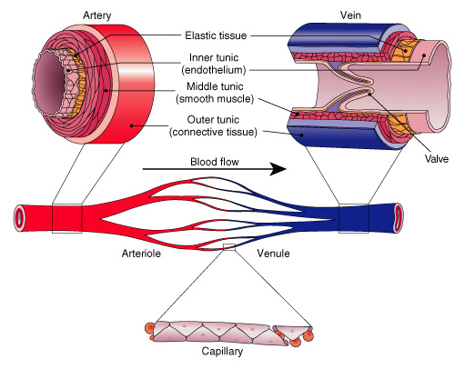
Sections of small blood vessels.

Slide 8
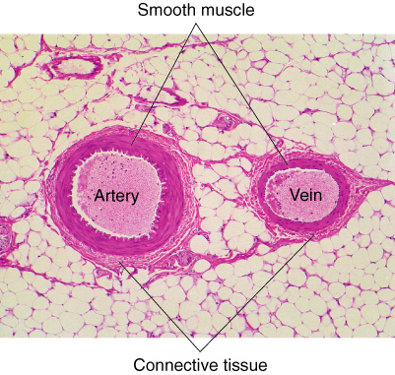
Cross-section of an artery and vein.

Slide 9
Systemic Arteries
The aorta
Largest artery
Receives blood from left ventricle
Branches to all organs

Slide 10
The Aorta and Its Parts
Ascending aorta
Aortic arch
Thoracic aorta
Abdominal aorta

Slide 11
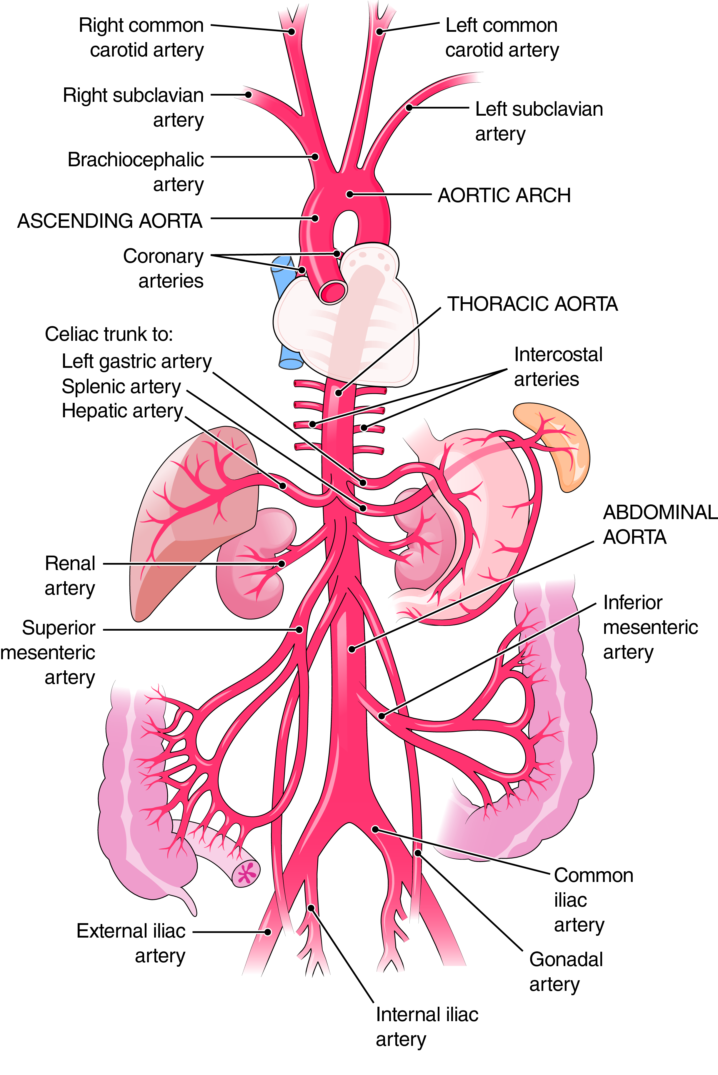
The Aorta
How many brachiocephalic arteries are there?
Fig. 14-4
Notes:
11

Slide 12
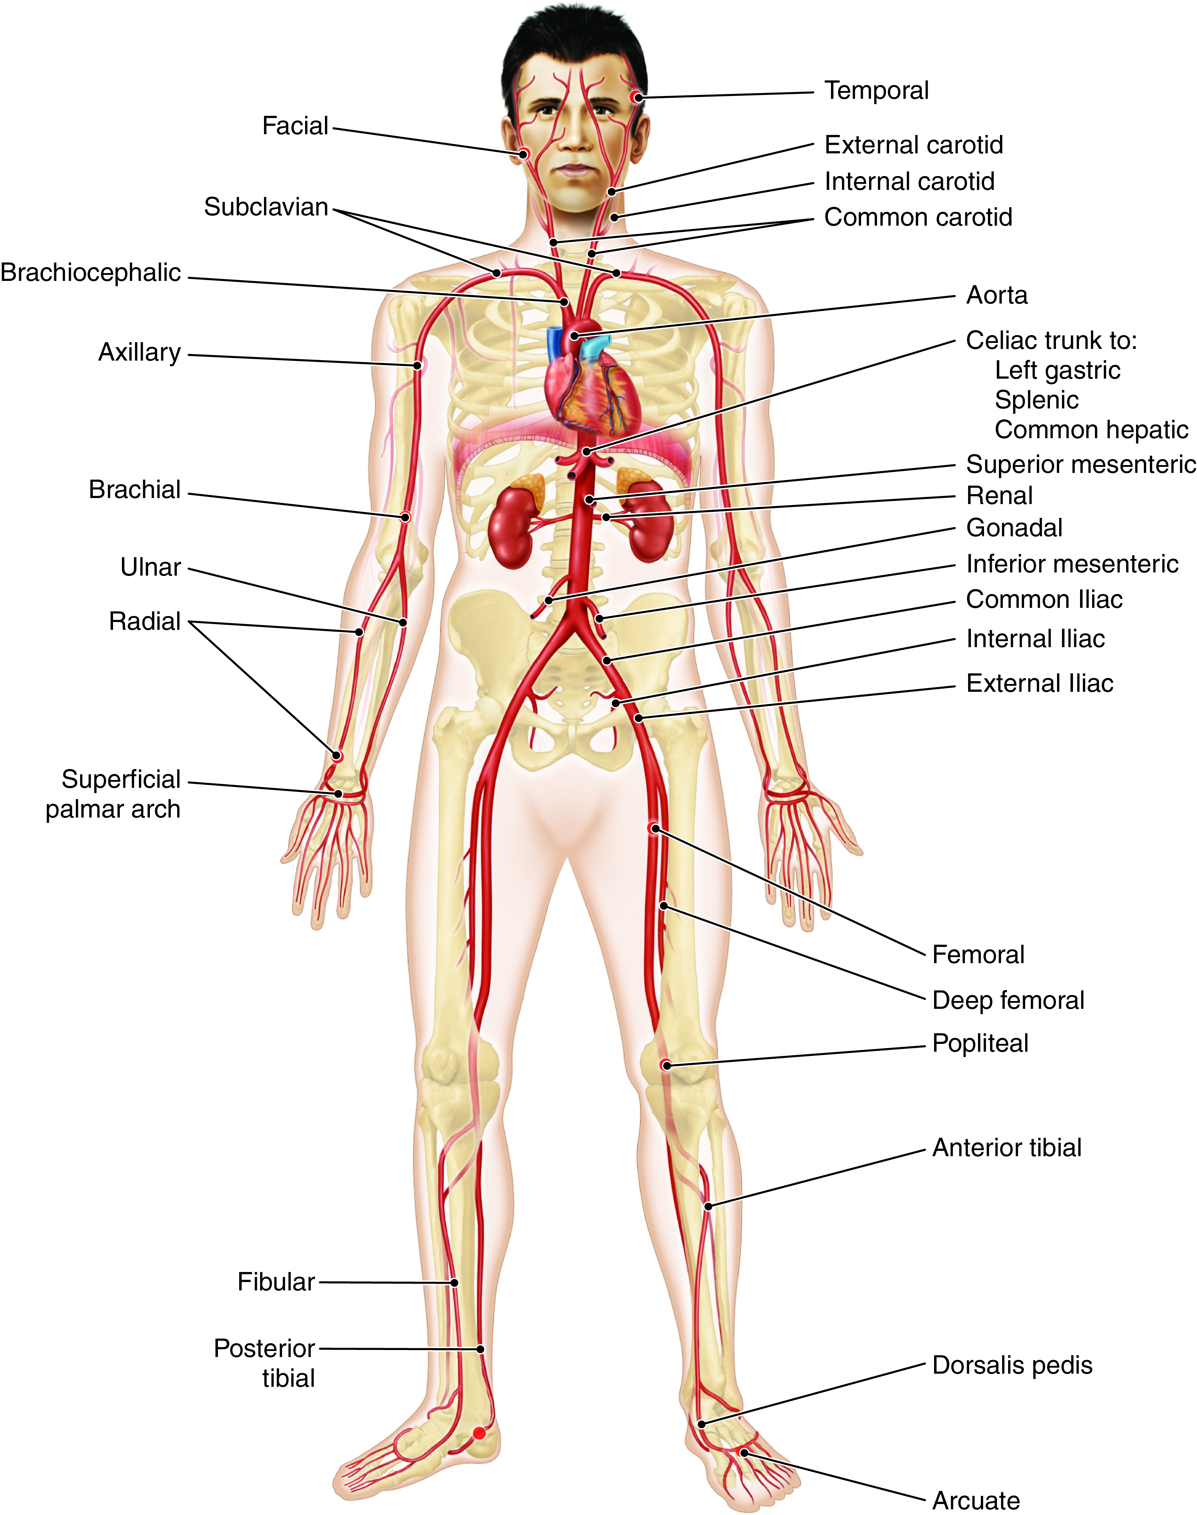
Systemic Arteries
What large vessels branch from the terminal aorta?
Fig. 14-5
Notes:
12

Slide 13
Branches of the Ascending Aorta and Aortic Arch
Ascending aorta
  *Left and right coronary arteries
Aortic arch
  Brachiocephalic artery
    Right subclavian artery
    *Right common carotid artery
  Left common carotid artery
  Left subclavian artery

Slide 14
Branches of the Thoracic Aorta
*Branches to chest wall, esophagus, and bronchi
Intercostal arteries

Slide 15
Branches of the Abdominal Aorta
Celiac trunk
  Left gastric artery
  Splenic artery
  Hepatic artery
Superior mesenteric artery
  Small intestine
Inferior mesenteric artery
**Paired lateral branches
  Phrenic arteries
  Suprarenal arteries
  Renal arteries
  Ovarian and testicular arteries
  Lumbar arteries

Slide 16
The Iliac Arteries and Their Subdivisions
Internal iliac arteries
  two
External iliac arteries
  Femoral artery
    Popliteal artery
      Tibial arteries
      Dorsalis pedis

Slide 17
Arteries That Branch to the Arm and Head
External carotid artery
Internal carotid artery
Subclavian artery
  Vertebral artery
  Axillary artery
    Brachial artery
      Radial artery
      Ulnar artery

Slide 18
Anastomoses
Communication between two vessels
Circle of Willis
Superficial palmar arch
Mesenteric arches
Arterial arches

Slide 19
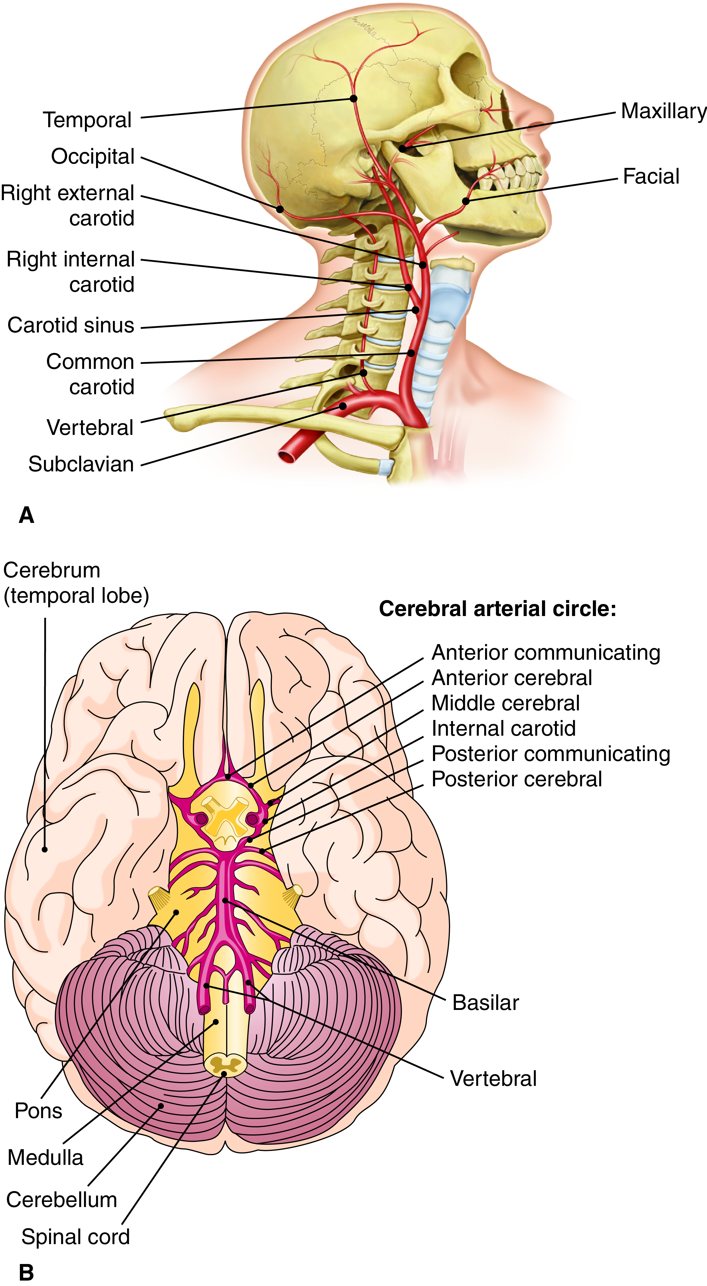
Arteries of the Neck and Head
Fig. 14-6A
Notes:
19

Slide 20
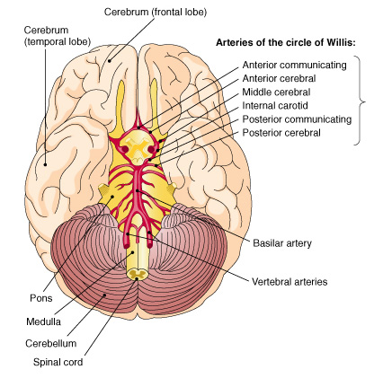
Arteries that supply the brain.
The bracket at right groups the arteries that make up the circle of Willis.

Slide 21
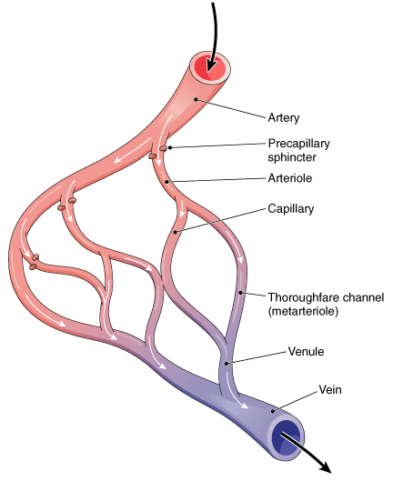
Capillary network showing an arteriovenous shunt (anastomosis).

Slide 22
Systemic Veins
**Superficial veins
  Cephalic, basilic, median cubital veins
  Saphenous veins-longest in body
**Deep veins
  Femoral and iliac vessels
  Brachial, axillary, subclavian vessels
  Jugular veins-two, drain carotids
  Brachiocephalic vein-formed by the union of the subclavian and jugular veins

Slide 23
The Venae Cavae and Their Tributaries
Superior vena cava
  Head, neck, upper extremities
Azygos vein
  Chest wall
Inferior vena cava
  Right, left veins from paired parts, organs such as the iliacs and lumbar veins
  Unpaired veins from spleen, digestive tract

Slide 24
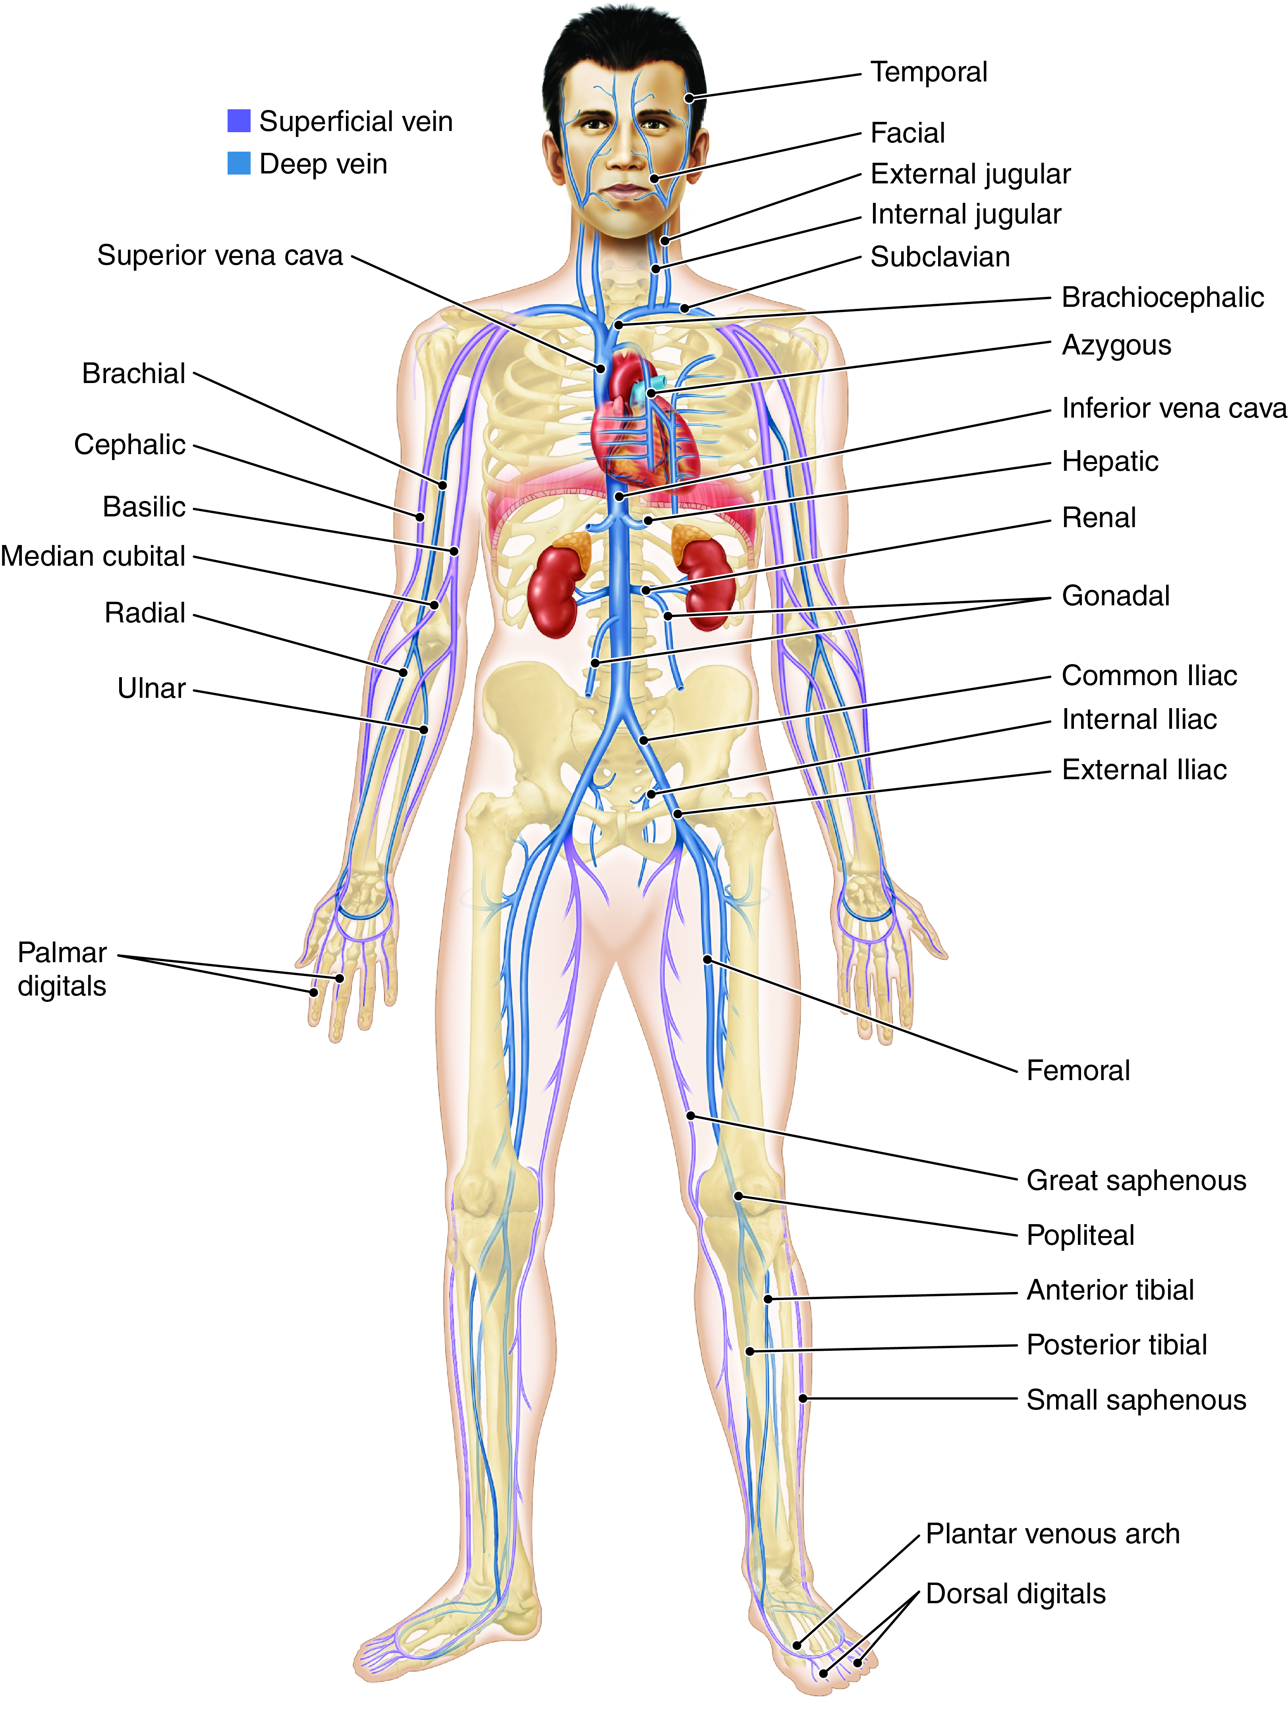
Systemic Veins (cont.)
How many brachiocephalic veins are there?
Fig. 14-7
Notes:
24

Slide 25
Venous Sinuses
Coronary sinus
Cranial venous sinuses
  Cavernous sinuses
    Petrosal sinuses
  Superior sagittal sinus
    Confluence of sinuses
  Transverse sinuses (lateral sinuses)

Slide 26
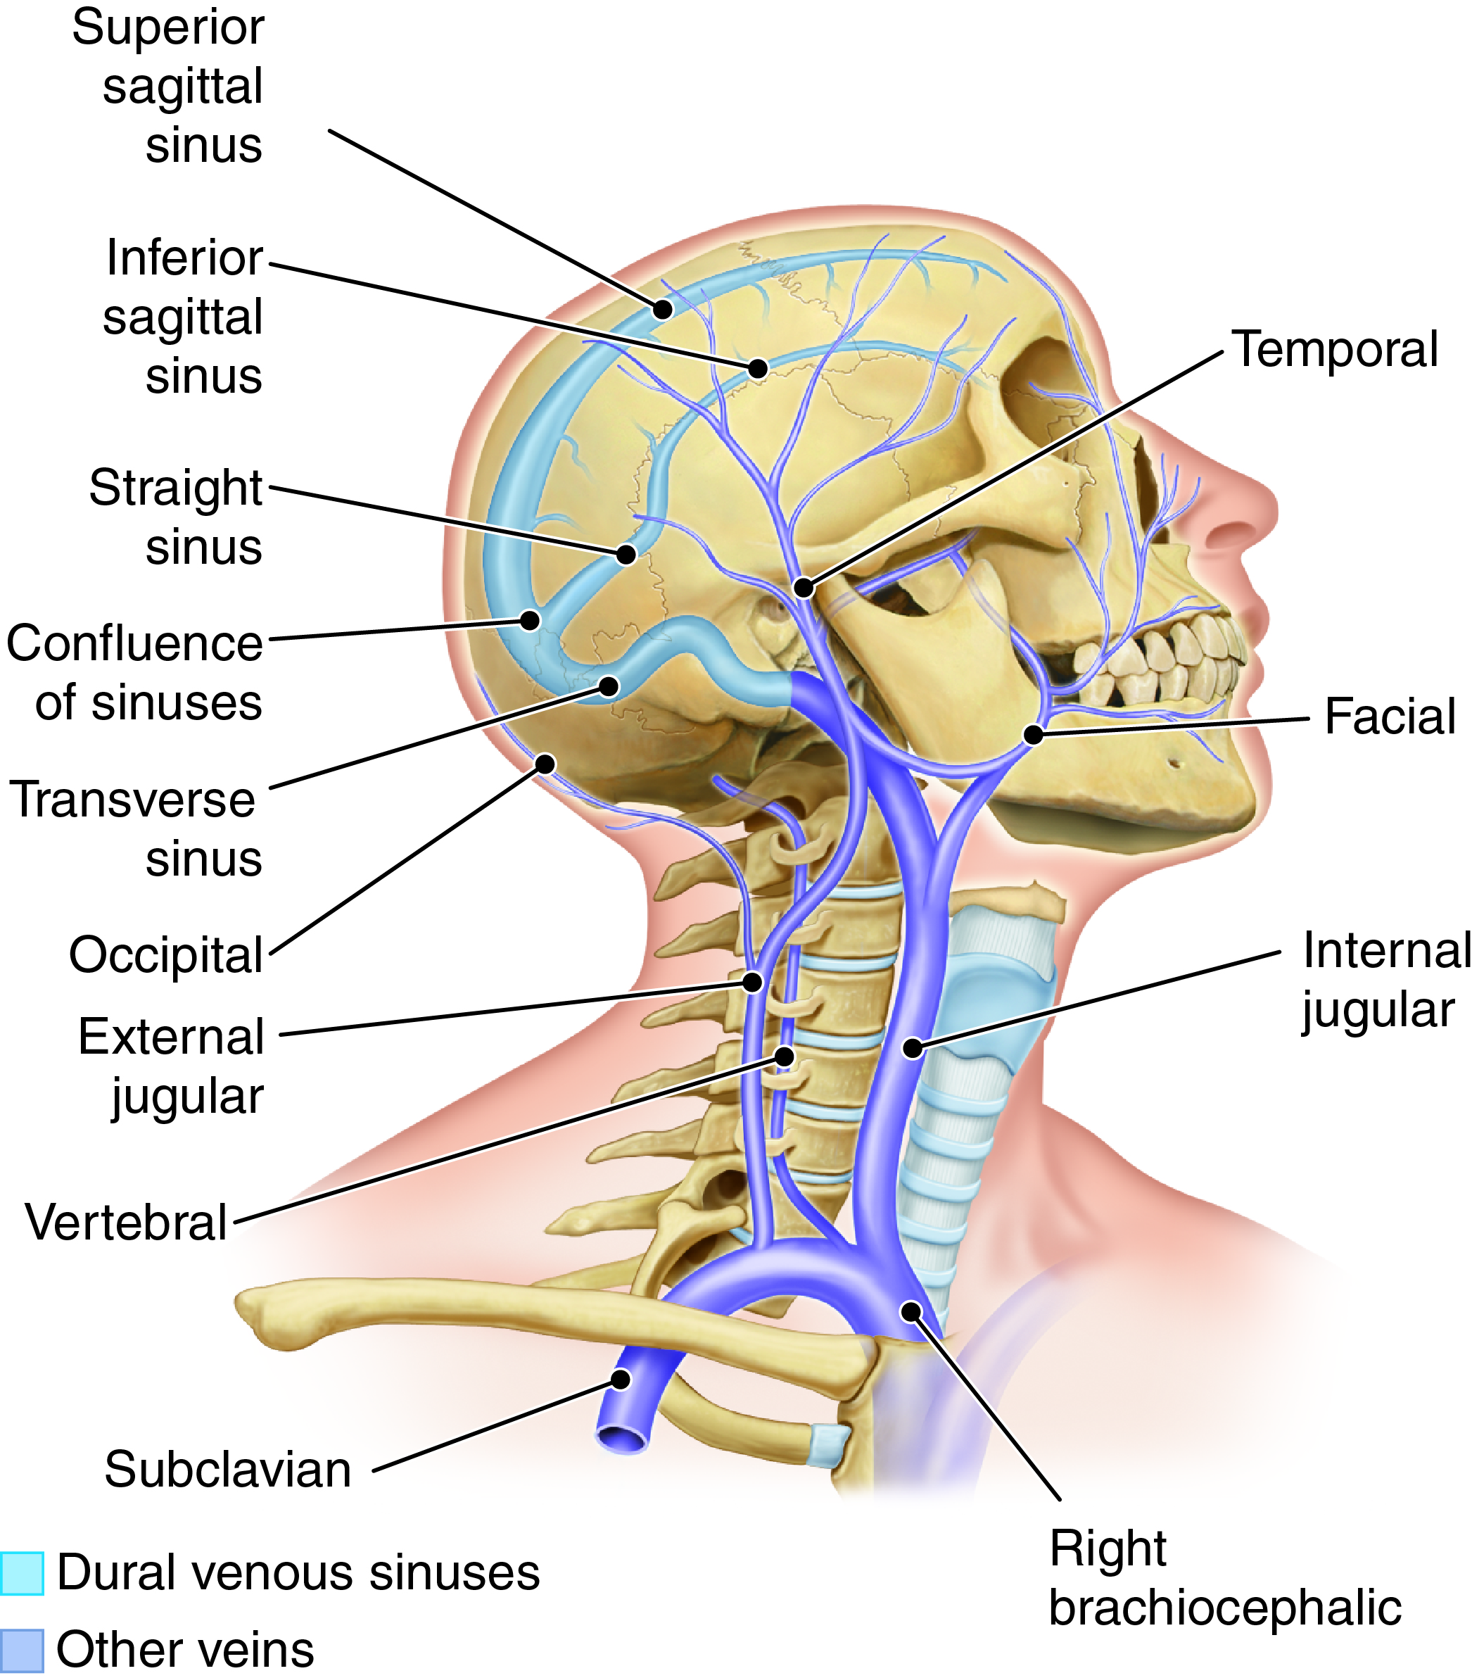
Head and Neck Veins
Which vein receives blood from the transverse sinus?
Fig. 14-8
Notes:
26

Slide 27
The Hepatic Portal System
Carries blood from abdominal organs to liver
Secondary capillary bed, organ
Includes veins that drain blood from capillaries 9in the spleen, stomach, intestine and pancreas
Superior mesenteric vein
Splenic vein
Gastric, pancreatic, inferior mesenteric veins
Sinusoids

Slide 28
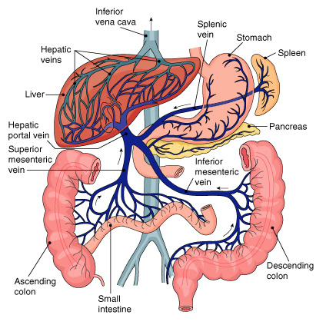
Hepatic portal system.

Slide 29
Circulation Physiology
Blood exchanges oxygen, carbon dioxide, other substances generated by cells
Tissue fluid (interstitial fluid) is exchange medium

Slide 30
Capillary Exchange Processes
Diffusion
  Solutes move down concentration gradients
Filtration
  Driving force: blood pressure
  Into tissue fluid
Osmotic pressure
  Moves material into capillaries

Slide 31
Capillary Exchange Processes (cont.)
Process | Driving Force | Direction of Movement | Substances Moved (examples)
Diffusion | Concentration gradients of individual solutes | Blood to Interstitial fluid | O₂, nutrients, electrolytes
 |  | Cells to interstitial fluid | CO₂, waste products, synthesized substances
Filtration | Blood pressure creates pressure gradient between blood and interstitial fluid | Blood to interstitial fluid | Water and dissolved substances
Osmosis | Proteins in plasma create osmotic gradient between interstitial fluid and blood | Interstitial fluid to blood | Water and dissolved substances

Slide 32
The Dynamics of Blood Flow
Vasomotor center in medulla regulates vasomotor activities
Vasodilation
Vasoconstriction
Precapillary sphincter
  Widens to allow more blood to enter when tissues need more oxygen

Slide 33
Return of Blood to the Heart
Mechanisms that promote blood’s return to heart
Contraction of skeletal muscles
Valves
Breathing
  Chest expansion causes pressure to drop in the thorax, this action serves to push and pull blood through these cavities and return it to the heart

Slide 34
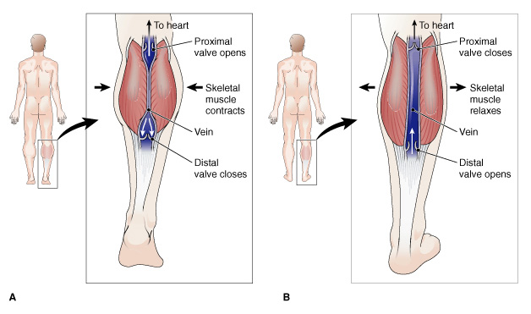
Role of skeletal muscles and valves in blood return.

Slide 35
The Pulse
Use 2nd or 3rd finger to obtain
Ventricular contraction
Wave of increased pressure
Begins at heart and travels to arteries
Influenced by various factors
  Body size
  Gender
  Age
    Newborn-120-140
    Adult-60-100
  Muscular activity
  Emotion
  Body temperature
  Thyroid secretion

Slide 36
Blood Pressure
Force exerted by blood against vessel walls
Determined by heart’s output and resistance to blood flow

Slide 37
Cardiac Output
Volume of blood pumped out of each ventricle in
one minute
Heart rate
  Beats per minute
Stroke volume
  Controlled by force of contractions

Slide 38
Resistance to Blood Flow
Peripheral resistance is affected by
Vasomotor changes
Baroreceptors in large arteries
Elasticity of blood vessels
Viscosity
Total blood volume

Slide 39
Blood Pressure Measurement
Pressure is measured in the brachial arm artery using a sphygmomanometer
Systolic pressure
  Occurs during heart contraction
  Normal systolic: 120 mmHg
Diastolic pressure
  Occurs during heart relaxation
  Normal diastolic: 80 mmHg

Slide 40
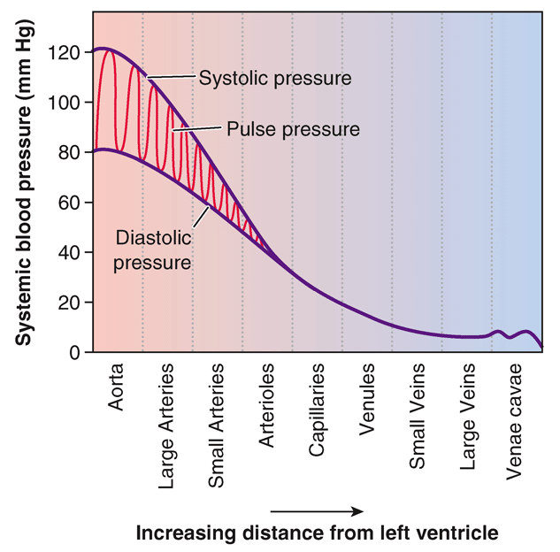
Figure 14-11 Blood pressure.
In which vessels does the pulse pressure drop to zero?
Notes:
40

Slide 41
Case Study
Pathway of an Embolus From the Femoral Vein to the Pulmonary Artery
Femoral vein → External iliac vein → Common iliac vein → Inferior vena cava → Right atrium → Right ventricle → Pulmonary trunk → Pulmonary arteries

