Slide 1
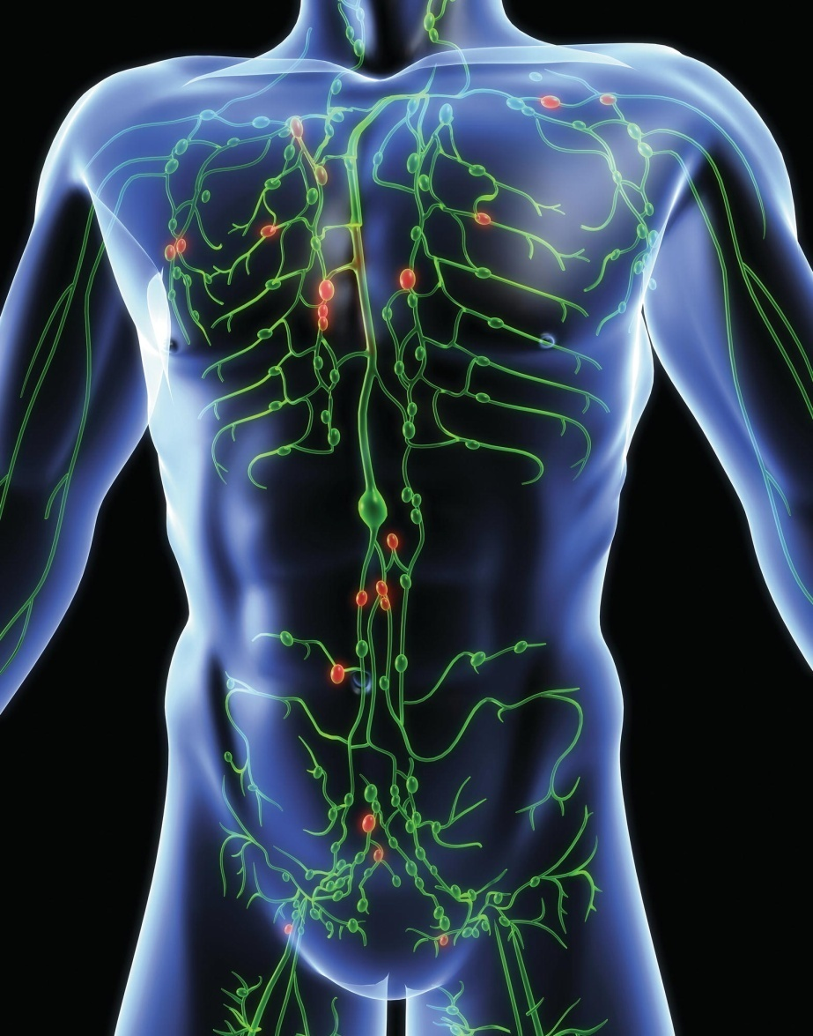
Chapter 15
The Lymphatic System and Immunity

Slide 2
The Lymphatic System
System of tissues and vessels
Scattered throughout the body
Services almost all regions

Slide 3
Functions of the Lymphatic System
Fluid balance
  Lymph fluid
Protection from infection
  lymphocytes
Absorption of fats

Slide 4
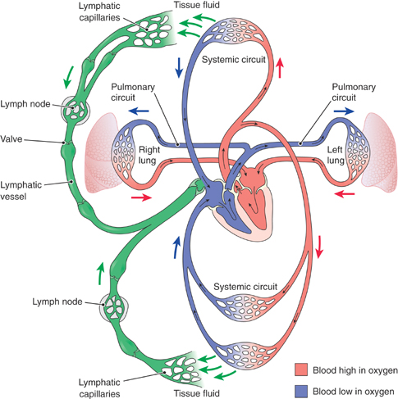
The lymphatic system in relation to the cardiovascular system. Lymphatic vessels pick up fluid in the tissues and return it to the blood in vessels near the heart.

Slide 5
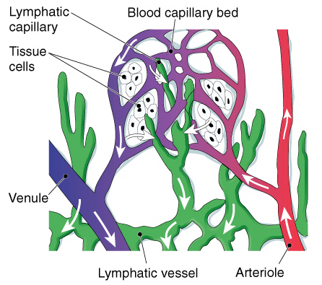
Pathway of lymphatic drainage in the tissues.

Slide 6
Lymphatic Circulation
One-way system
Begins in tissues
Ends in bloodstream

Slide 7
Lymphatic Capillaries
Capillary walls (endothelium) are flattened epithelial cells
More permeable than blood capillaries
Overlapping cells form one-way valves
Arise blindly (closed at one end)
Lacteals absorb digested fats
  Fats are transported into lymphatic vessels until lymph is added to the blood

Slide 8
Lymphatic Vessels
Thin walled, delicate
Have a beaded appearance
Superficial sets
Deep sets
Nodes

Slide 9
Right Lymphatic Duct
Short vessel
Receives lymph that comes from superior right quadrant
  Right side of head, neck, thorax
Empties into right subclavian vein

Slide 10
Thoracic Duct
Left lymphatic duct
Larger of two vessels
Receives lymph from all parts of the body except those above the diaphragm on right side
Cisterna chyli
  First portion
  Storage pouch

Slide 11
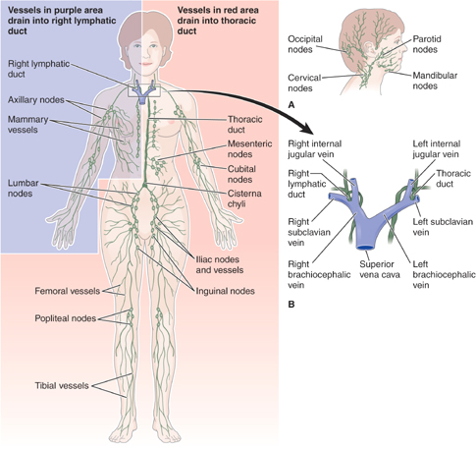
Vessels and nodes of the lymphatic system. (A) Lymph nodes and vessels of the head. (B) Drainage of right lymphatic duct and thoracic duct into subclavian veins.

Slide 12
Movement of Lymph
Segments of vessels located between the valves contract rhythmically
Skeletal muscles compress vessels

Slide 13
Lymphoid Tissue
Distributed throughout the body
Makes up specialized organs of lymphatic system

Slide 14
Lymph Nodes
Structure
  Fibrous connective tissue capsule from which partitions (trabeculae) extend into nodes substance
  Afferent lymphatic vessel
    Hilum
  Sinuses
  Cords
  Nodules
  Medulla
  Efferent lymphatic vessel
Grouping
  Cervical nodes
  Axillary nodes
  Mesenteric nodes
  Inguinal nodes

Slide 15
The Spleen
Cleanses blood
  Filtration
  Phagocytosis
Destroys old red blood cells
Produces red blood cells before birth
Is reservoir for blood

Slide 16
The Thymus
Plays key role in early immune system development
Produces thymosin
  Develops T lymphocyte cells
  Promotes lymphocyte growth
  Promotes lymphoid tissue activity
Shrinks after puberty

Slide 17
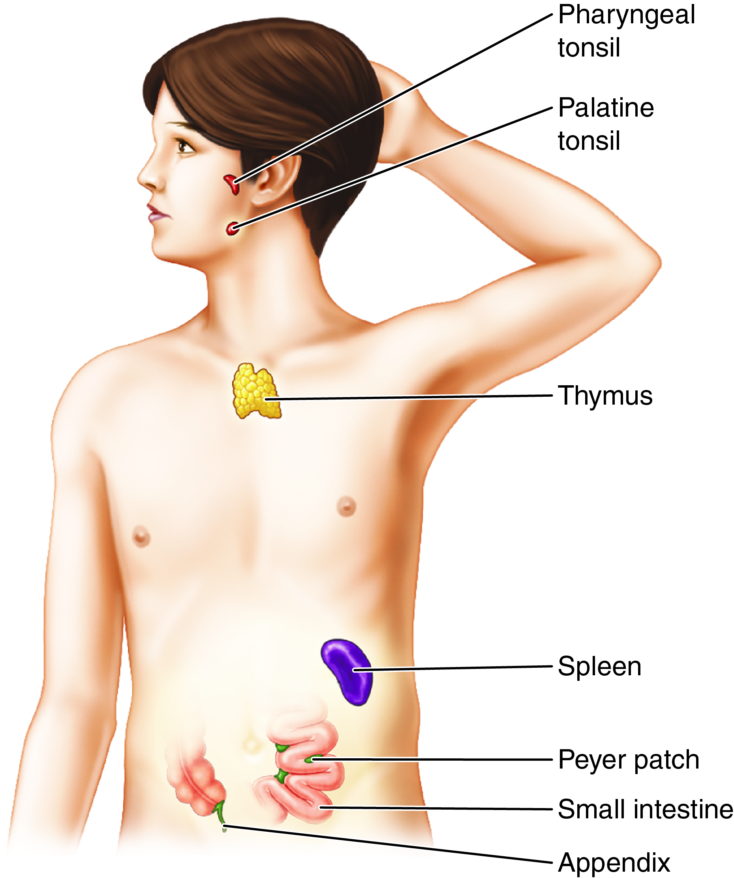
Lymphoid Organs
Fig. 15-5
Notes:
17

Slide 18
Mucosal-Associated Lymphoid Tissue
(MALT)
Mucosal-associated lymphoid tissue (MALT)
  Important barrier against infection
  Found in portions of the digestive, respiratory, and urogenital mucosal linings
  Helps to destroy foreign contaminants by means of phagocytosis and production of antibodies
  Includes gut-associated lymphoid tissue (GALT)
    Peyer patches
    Appendix
    Tonsils

Slide 19
The Tonsils
Remove contaminants and trap pathogens
Palatine tonsils
Pharyngeal tonsil (adenoids)
Lingual tonsils

Slide 20
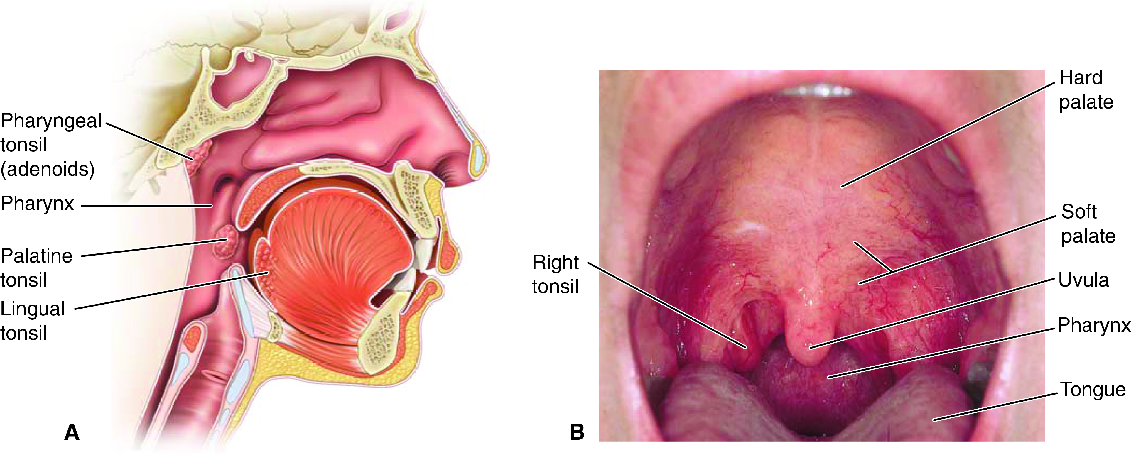
Tonsils
Fig. 15-6
Notes:
20

Slide 21
The First Line: Innate Barriers
Skin
Mucous membranes
Body secretions
Body reflexes
  Sneezing
  Coughing
  Vomiting
  Diarrhea

Slide 22
Second Line: Cells of Innate Immunity
Phagocytic cells: ingest pathogens, cellular debris
  Neutrophils
  Macrophages-derived from monocytes
  Kupffer cells
    Located in the liver sinusoids
  Dust cells
    Ingest solid particles that enter t
Natural killer cells
  Type of lymphocytes found in lymph nodes, spleen, bone marrow, blood
  Recognize body cells with abnormal membranes and secrete protein that breaks down the cell membrane

Slide 23
Phagocytosis
White blood cells take in and destroy waste and foreign
material
Neutrophils
Macrophages

Slide 24
Interferon
Group of substances that prevent nearby cells from producing more virus
  IFN a (alpha)
  IFN b (beta)
  IFN g (gamma)
Also acts nonspecifically on immune system cells

Slide 25
Inflammation
Infection is inflammation caused by pathogens
**Inflammatory reaction
  Heat, redness, swelling, pain
  Cells release histamine
  Leukocytes enter tissue
    Granulocytes, macrophages, mast cells
  Leukocytes and plasma produce inflammatory exudate
  Pus is produced
  Lymph nodes enlarge

Slide 26
Fever
As phagocytes work, they release substances that raise body temperature
Stimulates phagocytes
Increases metabolism
Decreases some organisms’ ability to multiply

Slide 27
Adaptive Immunity
Power to overcome a specific disease agent
  Specificity (species immunity)
Characteristics
  Specific response to specific pathogens
  Acquired over lifetime
  Stimulated by antigens
    Foreign substances that induce immune response of certain lymphocytes
Agents
  T cells
  Antigen-presenting cells
  B cells

Slide 28
T Lymphocytes (T cells): Cell-Mediated Immunity
Originate in red bone marrow
Mature in thymus
  Become sensitized to specific antigens
Four types
  Cytotoxic T cells: kill infected cells directly
  Helper T cells: secrete cytokines
  Regulatory T cells
  Memory T cells
Stimulated by antigen-presenting cells (macrophages, dendritic cells)

Slide 29
B Cells and Antibodies
Antibody (Ab) also known as immunoglobulin (Ig) is substance produced in response to antigen
Manufactured by B cells (B lymphocytes)
Must mature in fetal liver or in lymphoid tissue
Provides humoral immunity
Contained in gamma globulin fraction of blood plasma

Slide 30
Types of Adaptive Immunity: Definitions
Natural: without the involvement of a health professional
Artificial: with the involvement of a health professional
Passive: results in transient presence of antibodies; does not protect against future infections
Active: results in activation of immune response against pathogen; protects against future infections

Slide 31
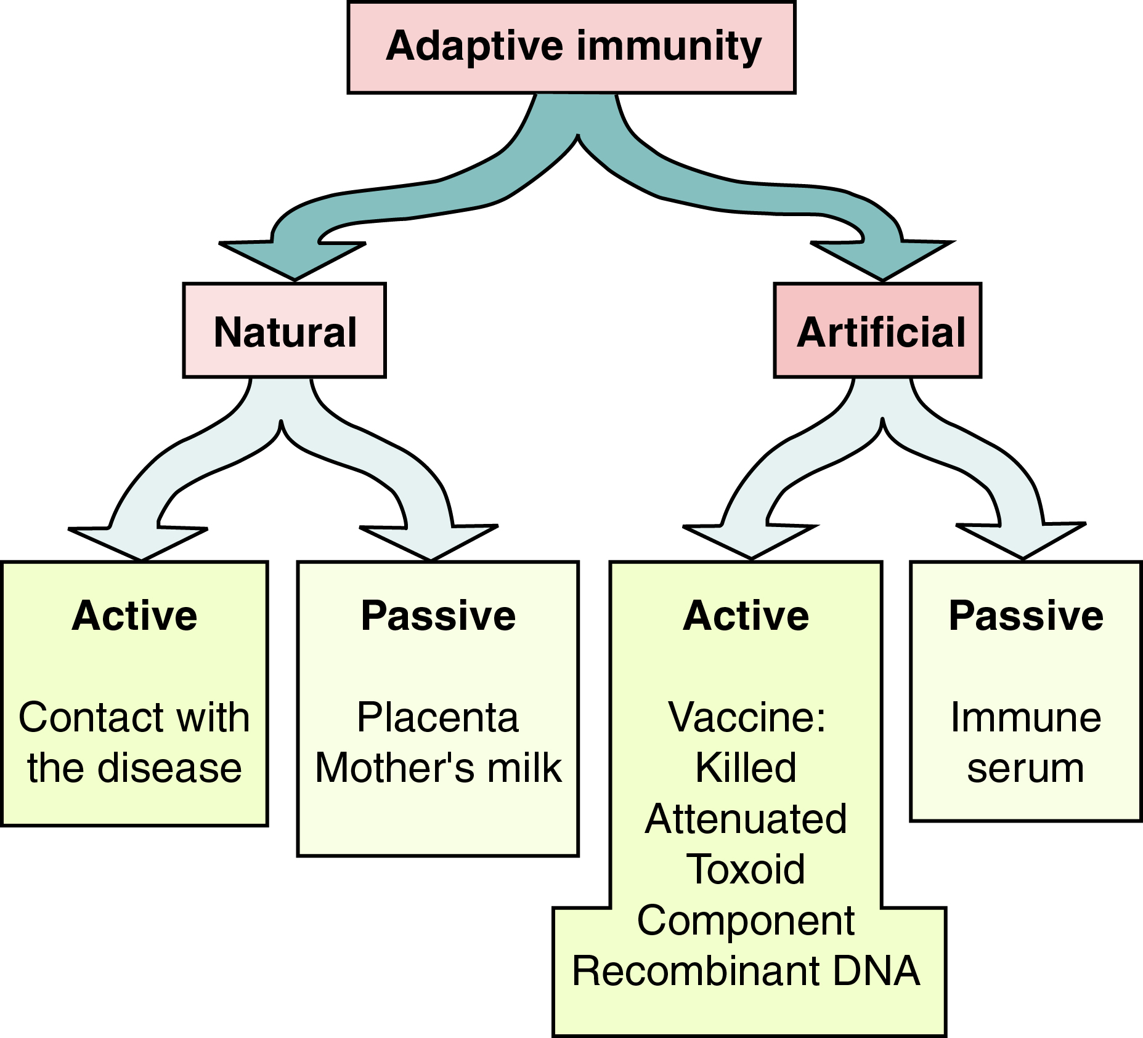
Types of Adaptive Immunity
Fig. 15-13
Notes:
31

Slide 32
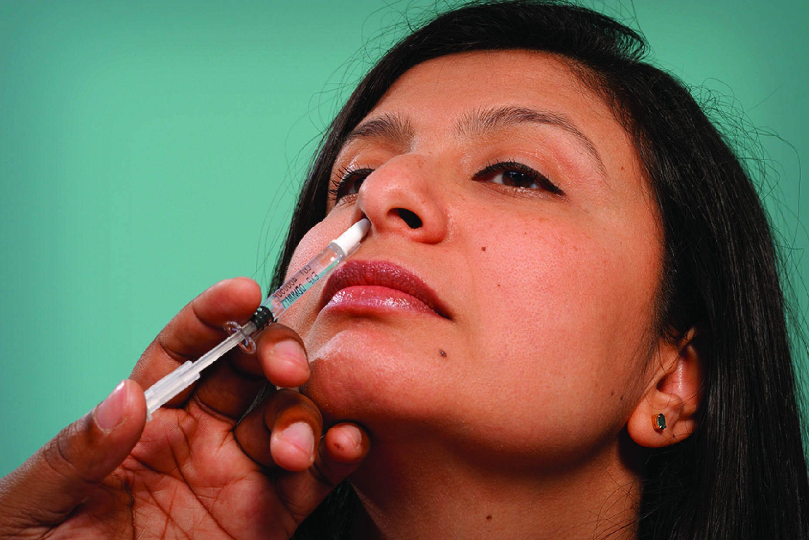
Vaccines: Artificial Active Immunity
Vaccine types
  Live virus
  Attenuated virus
  Toxoid (toxin treated with heat or chemicals)
  Purified or genetically engineered antigenic component
Modes of administration
  Injection
  Oral
  Intranasal spray

Slide 33
Boosters
Active immunity does not always last a lifetime.
Repeated inoculations (booster shots) help maintain high titer of antibodies in the blood.
Number and timing vary with vaccines.

Slide 34
Some Common Vaccines
Name | Diseases
Bacterial pathogens
DTaP | Diphtheria, tetanus, pertussis (whooping cough)
Hib | Haemophilus influenzae type B
PCV | Pneumococcus (pneumonia, meningitis)
Viral pathogens
Rotavirus | Rotavirus gastroenteritis
Varicella | Chickenpox
Zoster | Shingles
Influenza | Seasonal influenza (flu)
HPV | Human papillomavirus (causes reproductive cancers)

Slide 35
Antiserum: Artificial Passive Immunity
Readymade serum provides short-lived effective protection.
Usually prepared in animals
Some examples:
  Hepatitis B immune globulin
  Antivenins (anti-snake bite)
  Rabies

