Slide 1
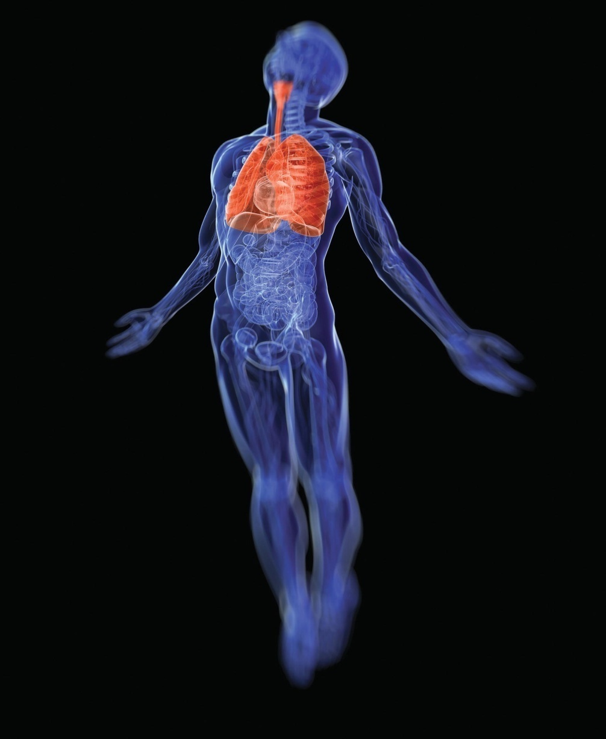
Chapter 16
The Respiratory System

Slide 2
Phases of Respiration
Process of obtaining oxygen from environment and
delivering it to cells
Pulmonary ventilation
External exchange of gases
Internal exchange of gases

Slide 3
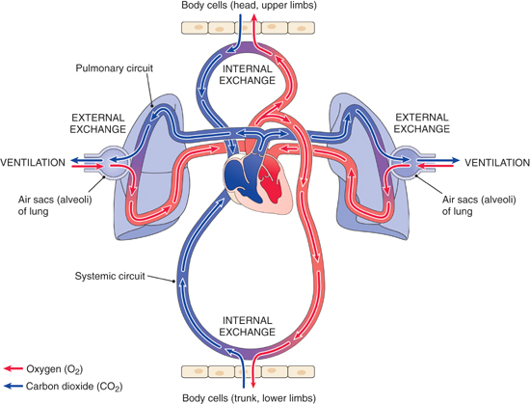
Overview of respiration.

Slide 4
The Respiratory System
Conducts air into lungs
Nasal cavities
Pharynx
Larynx
Trachea (windpipe)
Bronchi

Slide 5
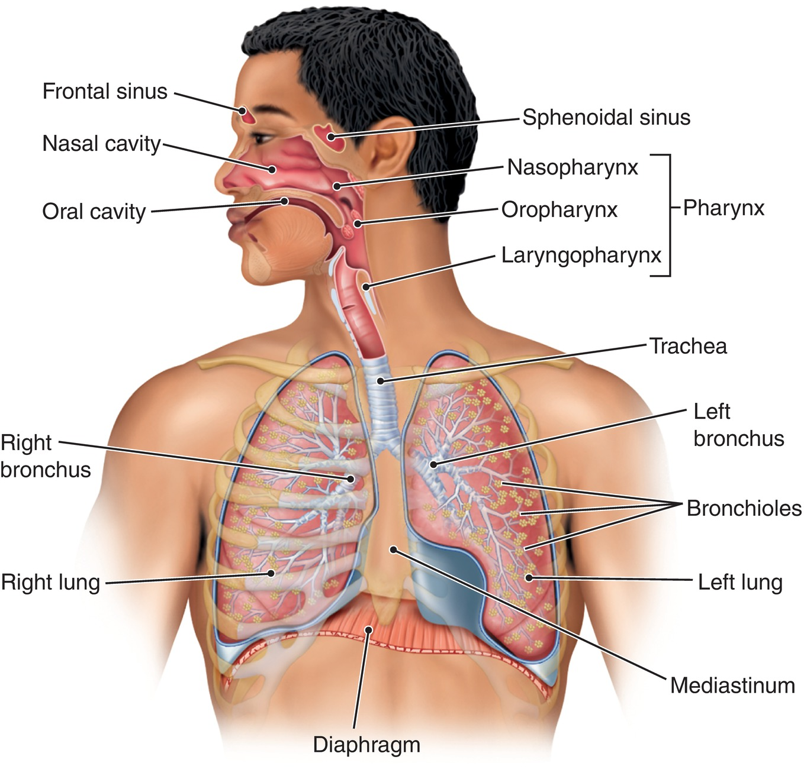
Respiratory System
Fig. 16-2
What organ is located in the medial depression of the left lung?
Notes:
5

Slide 6
The Nasal Cavities
Nostrils (nares)
Nasal cavities
  Mucous membrane
    Filters foreign bodies
    Warms air
    Moistens air
  Conchae
Nasal septum
  Separates nasal cavities
  Formed by thin plate of ethmoid bone that extedns down, the inferior portion is formed by the vomer
Sinuses

Slide 7
The Pharynx
Throat (pharynx) carries air to respiratory tract and food
to digestive system
Nasopharynx
  Superior portion.located behind the nasal cavity
Oropharynx
  Middle portion
Laryngeal pharynx
  Inferior portion

Slide 8
The Larynx
Larynx (voice box) is located between the pharynx
and trachea
Cartilage framework
  Thyroid cartilage (Adam’s apple)
Vocal folds (vocal cords)
  Used for speech
Glottis
  Space between vocal cords
Epiglottis
  Leaf shaped cartilage that covers the larynx

Slide 9
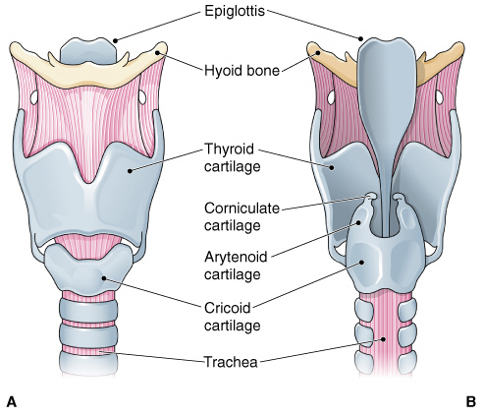
The larynx.

Slide 10
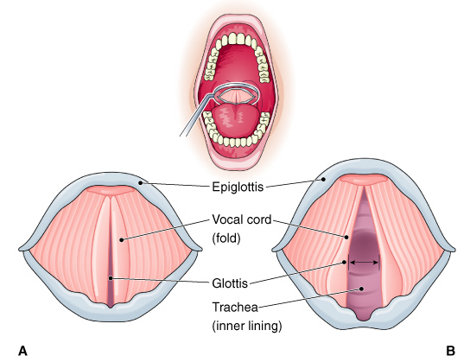
The vocal cords, superior view.

Slide 11
The Trachea
Trachea (wind pipe) conducts air between larynx and lungs
Framework of separate cartilages
  Keeps trachea open
Horseshoe shaped
Open at back for expansion during swallowing

Slide 12
The Bronchi
Trachea divides into two primary bronchi that enter
the lungs
Hilum
  Bronchus enters lung here
Epithelial tissue lining
  Pseudostratified
  Cilia

Slide 13
The Lungs
Mediastinum
  Heart, great vessels
  Space BETWEEN lungs
Lobes
  Bronchial tree
  Bronchioles
Alveoli
  Located at the terminal bronhioles
Diaphragm
**Pleura
  Parietal pleura
  Visceral pleura
  Pleural space

Slide 14
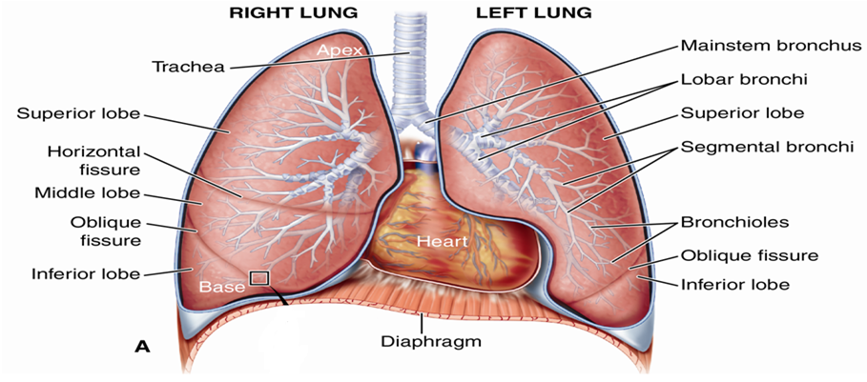
The Lungs
Fig. 16-5A
Notes:
14

Slide 15
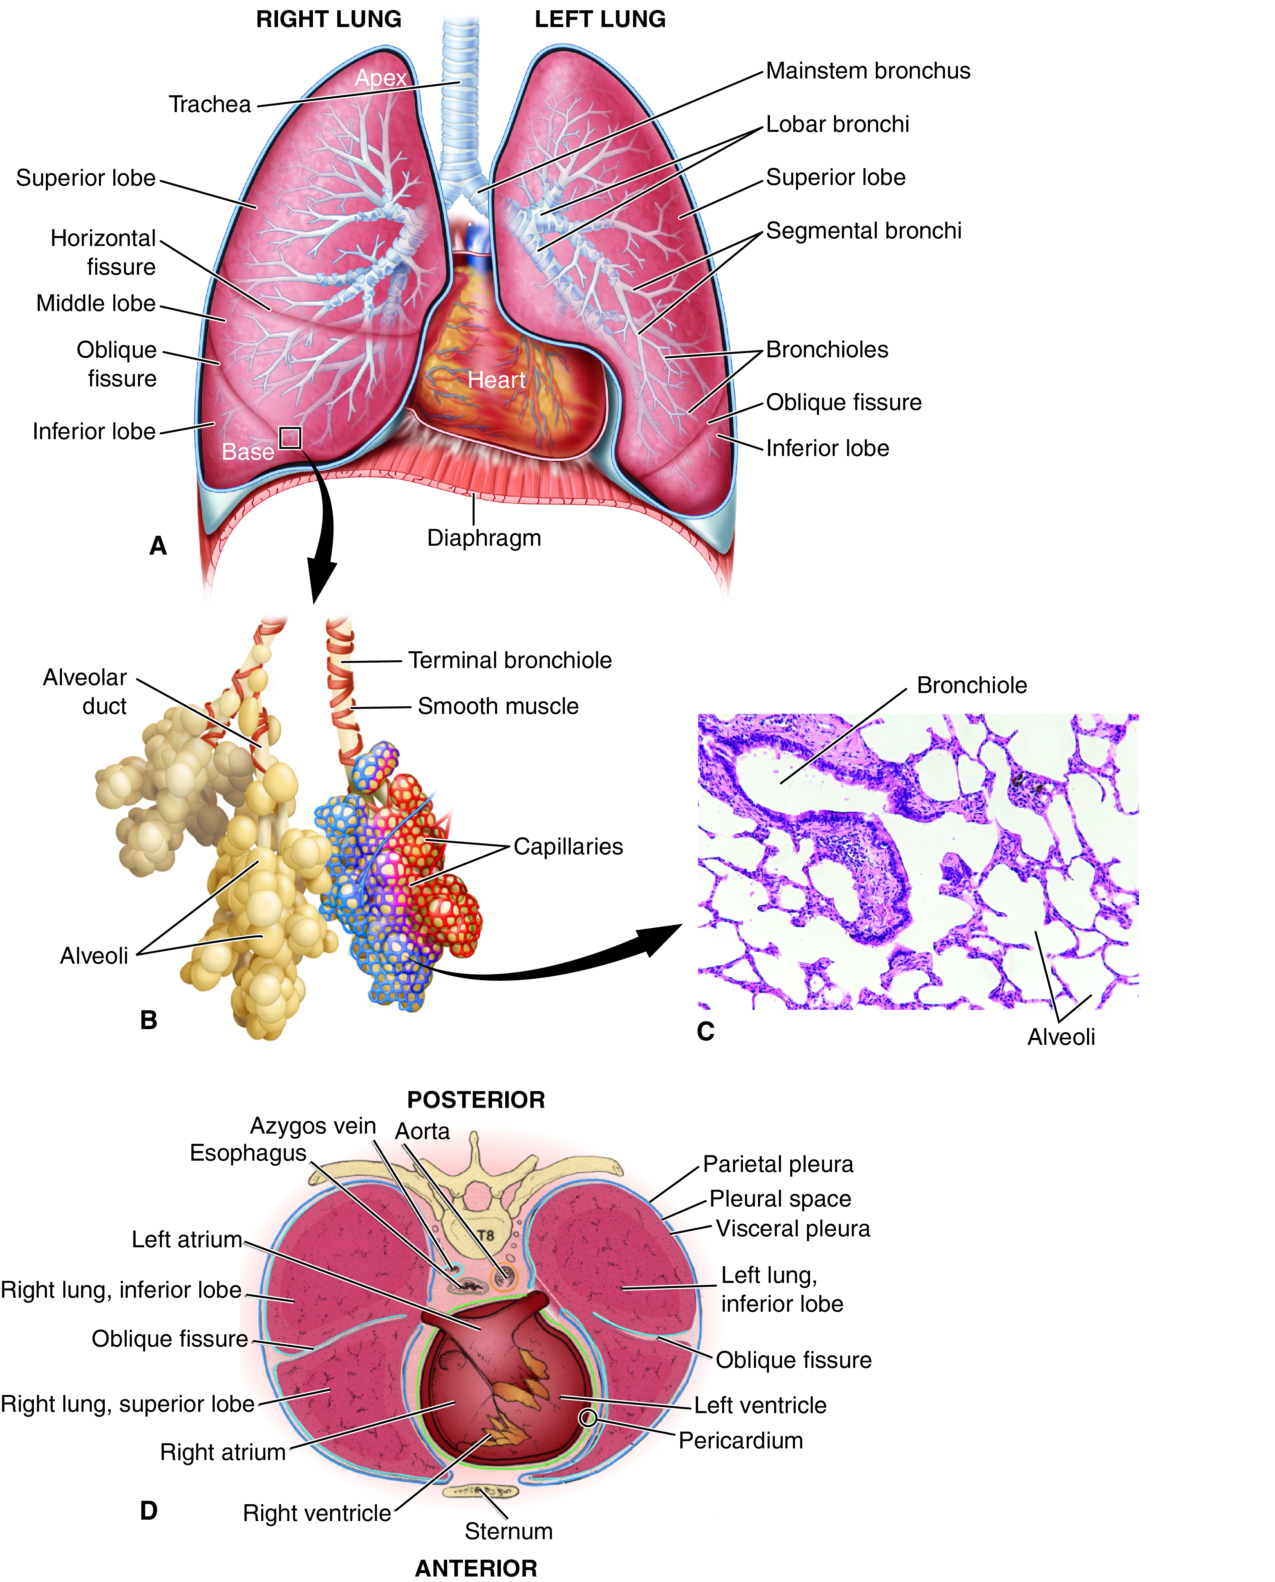
The Bronchioles and Alveoli
Bronchi branch into smaller bronchioles
Smallest bronchioles terminate in alveoli (air sacs)
Fig. 16-5B and C
Notes:
15

Slide 16
The Lungs and Pleurae
Fig. 16-5D
Pleura—continuous double sac covers the lung
  Parietal pleura—covers chest wall, diaphragm
  Visceral pleura—covers lung surface
  Pleural space—separates two layers
Notes:
16

Slide 17
The Process of Respiration
Ventilation of lungs
Exchange of gases
Transport of gases in blood

Slide 18
Pulmonary Ventilation
Inhalation (inspiration) is active phase
  Compliance
    Ease of lung expansion
  diaphragm
Exhalation (expiration) is passive phase
  Muscles of the neck and chest wall are involved
Lung capacity

Slide 19
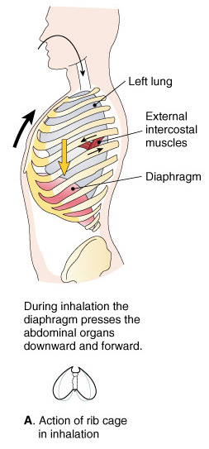
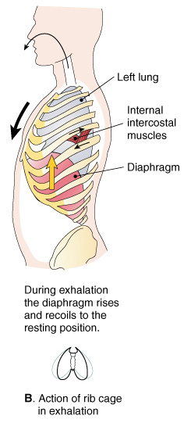
Pulmonary ventilation.
(A)Inhalation. (B)Exhalation.

Slide 20
Gas Exchange
Diffusion is movement of molecules from higher to lower concentration
Relative concentrations of these gases, oxygen diffuses out of the blood and CO2 enters
External exchange
  Gases move between alveoli and capillary blood
Internal exchange
  Gases move between blood and tissues

Slide 21
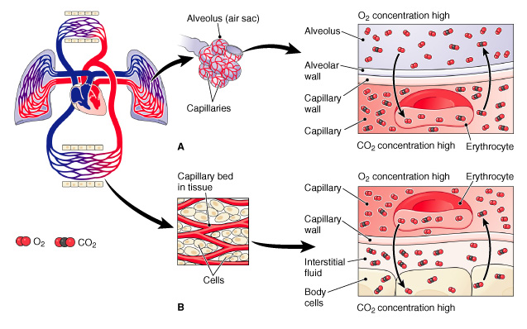
Gas exchange.

Slide 22
Transport of Oxygen
**Most oxygen in capillary blood binds to hemoglobin
Oxygen must separate from hemoglobin to enter cells

Slide 23
Transport of Carbon Dioxide
10% is dissolved in plasma and fluid in red blood cells
15% is combined with protein of hemoglobin and plasma proteins
*75% dissolves in blood fluids and is converted to bicarbonate ion
  First combines with water to form carbonic acid
  Carbonic acid ionizes (separates) into hydrogen and bicarbonate ions
  *Carbonic anhydrase enzyme speeds conversion
  Buffers blood to keep pH steady
    Carbon dioxide, bicarb regulates pH

Slide 24
Regulation of Respiration
Fundamental respiratory pattern
Controlled by central nervous system centers
  Partly in medulla (main control center), partly in pons (modifies patterns set in the medulla)
Modified by receptors detecting changes in blood chemistry

Slide 25
Nervous Control
Control center is located in medulla and pons of brain stem
Motor nerve fibers extend into spinal cord
Fibers extend through phrenic nerve to diaphragm

Slide 26
Chemical Control
Central chemoreceptors
  Located near medullary respiratory center
  Presence of hydrogen ions lower pH and stimulates chemoreceptors
  Respond to raised CO2 level (hypercapnia)
Peripheral chemoreceptors
  Located in neck (carotid) and aortic arch
  Respond to oxygen level considerably below normal

Slide 27
Abnormal Ventilation
Hyperventilation
  High oxygen level and low CO2 level (hypocapnia)
  Increases blood pH
Hypoventilation
  Insufficient air in alveoli
  Decreases blood pH

Slide 28
Breathing Patterns
Measured in breaths per minute
Adults: 12 to 20
Children: 20 to 40
Infants: more than 40

Slide 29
Some Terms for Altered Breathing
Hyperpnea
Hypopnea
Tachypnea
Apnea
Dyspnea
Orthopnea
Kussmaul respiration
Cheyne-Stokes respiration

Slide 30
Results of Inadequate Breathing
Cyanosis
Hypoxia
Hypoxemia
Suffocation

Slide 31
Age and the Respiratory Tract
Tissues lose elasticity, become more rigid
Decreased compliance, lung capacity
Increased susceptibility to infection
Increased incidence of emphysema
Reduced capacity for exercise

