Slide 1
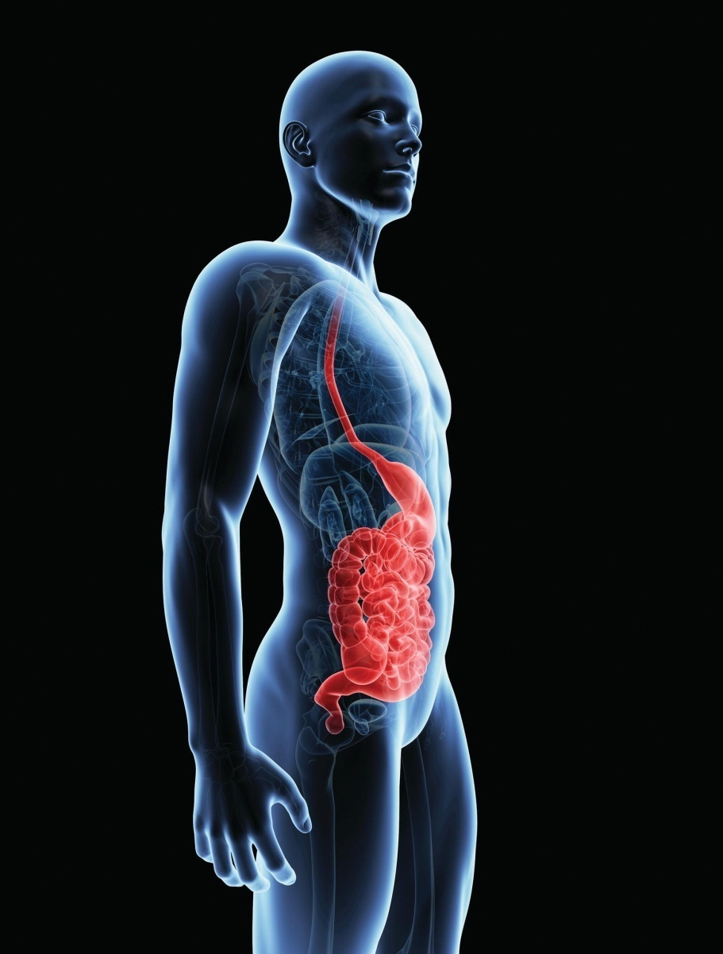
Chapter 17
The Digestive System

Slide 2
Function and Design of the Digestive System
Chief functions
  Digestion
  Absorption
  Elimination
Organs
  Digestive tract
  Accessory organs

Slide 3
The Peritoneum
Membrane that lines the abdominopelvic cavity
*Parietal peritoneum
*Visceral peritoneum
Mesentery
Mesocolon
*Greater omentum
*Lesser omentum

Slide 4
The Peritoneum (cont’d)
Peritoneal cavity: space between two layers of the membrane
Greater peritoneal cavity: main portion, located in abdominal cavity, extends into pelvic cavity
Lesser peritoneal cavity: extends to the liver and the back attachment of the diaphragm

Slide 5
The Wall of the Digestive Tract
Mucous membrane (mucosa)
  Digestive juice-secreting cells
  *Mucus-secreting cells (goblet cells)
Submucosa
  Connective tissue
  Contains blood vessels and nerves that help regulate digestion
Smooth muscle
  Inner layer - circular
  Outer layer - longitudinal
  Peristalsis
Serous membrane
  Epithelium
  Loose connective tissue

Slide 6
Organs of the Digestive Tract
Alimentary tract or gastrointestinal (GI) tract
Mouth
Pharynx
Esophagus
Stomach
Small intestine
Large intestine

Slide 7
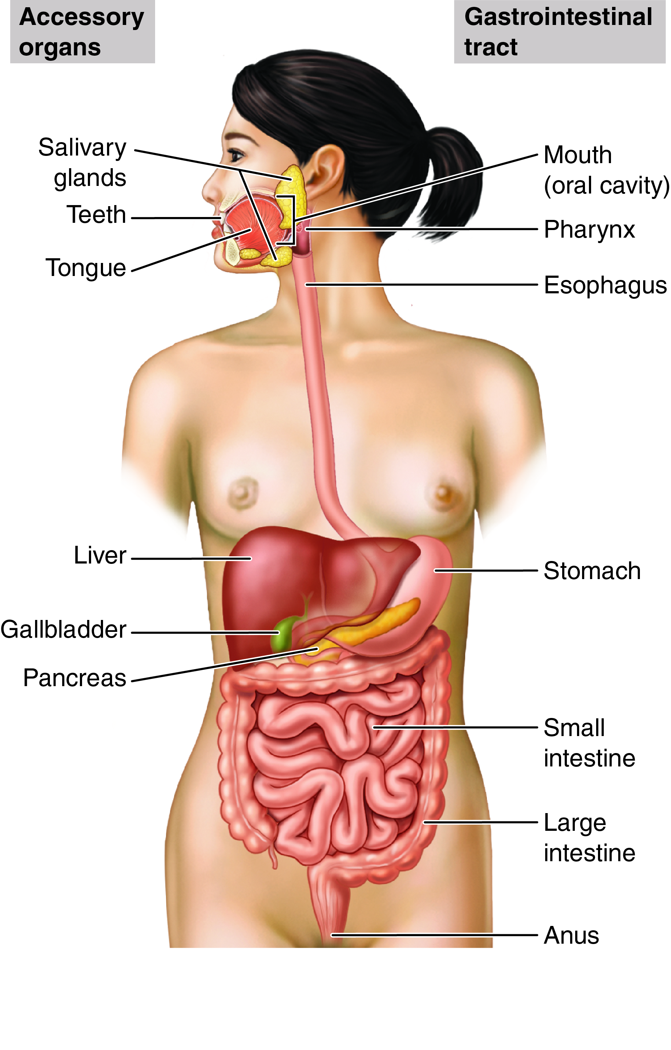
The Digestive System
Which accessory organs of digestion secrete into the mouth?
Fig. 17-1

Slide 8
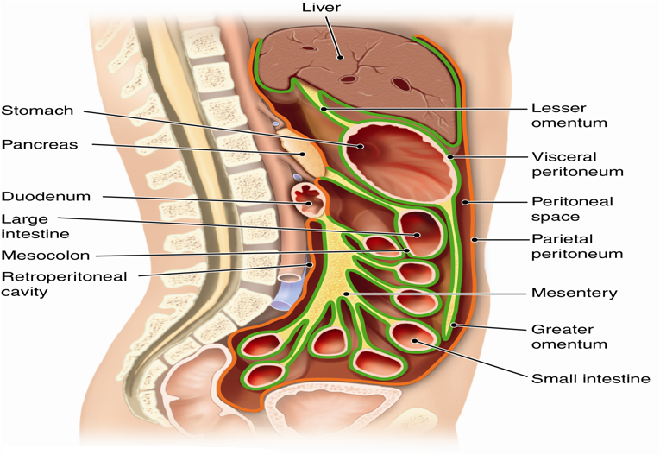
The Peritoneum
Fig. 17-2A
Which part of the peritoneum is around the small intestine?
Notes:
8

Slide 9
The Mouth
Also called oral cavity, processes food by
Ingestion
Mastication
Mixing with saliva
Deglutition

Slide 10
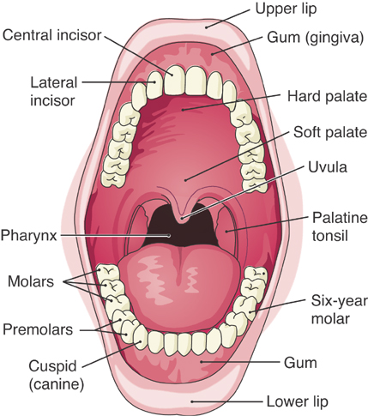
The mouth.

Slide 11
The Teeth
Deciduous teeth (baby teeth)
  20 teeth
Adult permanent teeth
  32 teeth
  Incisors
  *Cuspids (canines or eyeteeth)
  Molars
Structure
  Dentin
  Blood vessels
  Nerves
  Gingiva
    Projects above gum
  Crown
  Enamel
    Hardest substance
  Roots
  Cementum

Slide 12
The Pharynx
Also called the throat
Oropharynx
Palatine tonsils
Nasopharynx
Laryngeal pharynx
Soft palate
Uvula
Epiglottis

Slide 13
The Esophagus
Muscular tube
  No digestion occurs here
  Joins with stomach
Esophageal hiatus

Slide 14
The Stomach – Structure
Additional angled muscle layer
Greater and lesser curvature
Fundus
Lower esophageal sphincter (LES) (cardiac sphincter)
Pylorus
Pyloric sphincter
Rugae

Slide 15
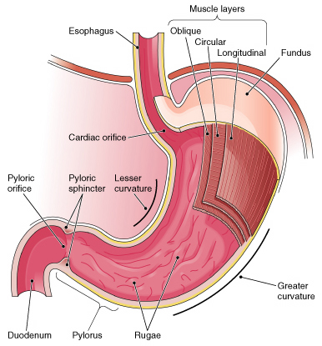
Longitudinal section of the stomach.

Slide 16
The Stomach – Functions
Store food and liquid
Rugae
Secrete gastric juice (hydrochloric acid and pepsin)
Secrete mucus
Chyme: highly acidic mixture of gastric juice and food that leaves the stomach for the small intestine

Slide 17
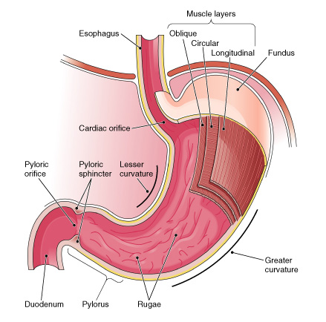
Longitudinal section of the stomach. The stomach’s interior is visible, along with a portion of the esophagus and the duodenum.

Slide 18
The Small Intestine – Structure
Duodenum
Jejunum
Ileum

Slide 19
The Small Intestine – Function
Secrete mucus
Secrete enzymes
Absorb digested food
  Villi
  Microvilli
  Blood vessels
  Specialized lymphatic capillaries (lacteals)

Slide 20
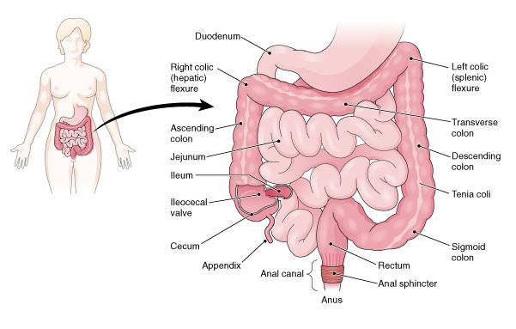
The small and large intestines.

Slide 21
The Large Intestine — Structure
Cecum
Ileocecal valve
Vermiform appendix
Colon
  Ascending
  Transverse
  Descending
  Sigmoid
Rectum
Anal canal
Anus

Slide 22
The Large Intestine – Function
Secrete mucus
Reabsorb some water
*Form feces (stool)
Defecation

Slide 23
The Accessory Organs
Release secretions through ducts into digestive tract
Salivary glands to mouth
All other organs to duodenum

Slide 24
The Salivary Glands
Functions of saliva
  Moistens food
  Facilitates mastication and deglutition
  Helps keep teeth and mouth clean
Production of saliva
  Parotid glands
    Largest, located inferior and anterior to ear
  Submandibular (submaxillary) glands
  Sublingual glands

Slide 25
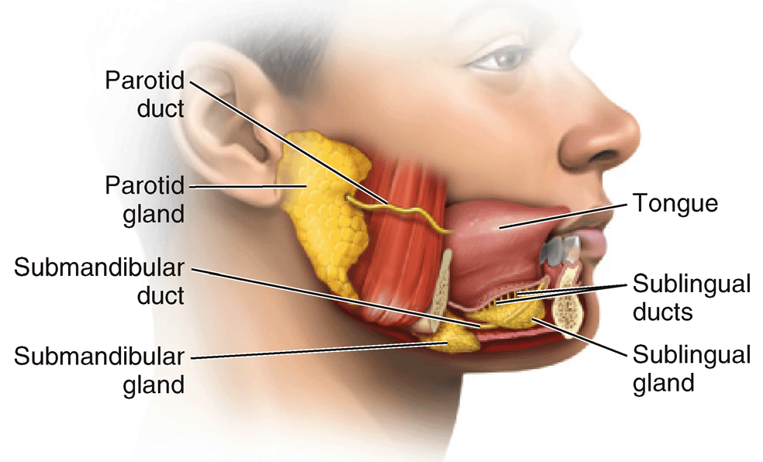
Figure 17-8 Salivary glands.
Which salivary glands are directly below the tongue?
Notes:
25

Slide 26
The Liver – Structure
Right, left lobes
Portal vein
Hepatic artery

Slide 27
The Liver – Function
Manufacture bile
**Store glycogen, convert to glucose
Modify fats
Store vitamins, iron
Form blood plasma proteins
**Destroy old red blood cells
**Synthesize urea
Detoxify harmful substances

Slide 28
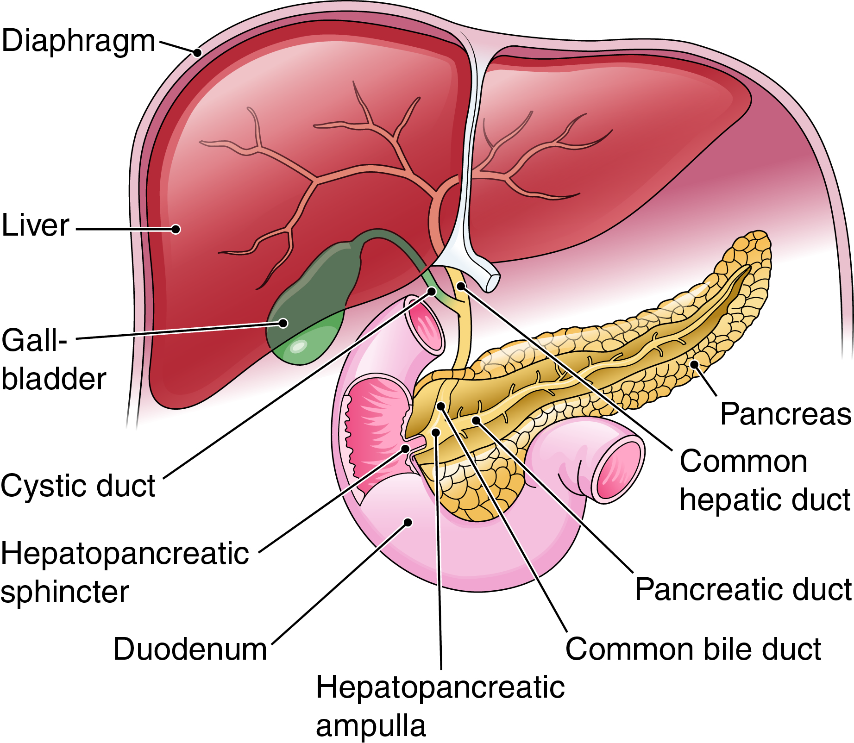
Accessory Organs
Fig. 17-9
Into which part of the small intestine do these accessory organs secrete?
Notes:
28

Slide 29
Bile
Emulsifies fat
Flows from liver through cystic duct
Is stored in gallbladder
Flows through cystic duct and common bile duct to duodenum when needed
  Common bile duct-cystic duct and hepatic duct

Slide 30
Gallbladder
Muscular sac on inferior surface of liver
Stores bile

Slide 31
The Pancreas
Releases enzymes that digest fats, proteins, carbohydrates, and nucleic acids
Produces alkaline (basic) fluid to neutralize acidic chyme in small intestine
Produces insulin and glucagon to regulate sugar metabolism

Slide 32
Enzymes and the Digestive Process
Enzymes
Speed up rate of chemical reactions
Are not changed or used up in reactions
Are proteins
Are highly specific in their actions
  Ex. CHO-digesting enzyme amylase splits starch into the disaccharide maltose

Slide 33
The Role of Water
Process of digestion technically hydrolysis (split by water)
Water is used to
Produce digestive juices
Dilute food
Aid chemical process of digestion
Added to nutrient molecules as they are split by enzymes

Slide 34
Digestion, Step-by-Step
Mouth
  Chews food, mixes with saliva
  Some starches changed to sugars
Stomach
  Secretes hydrochloric acid, enzymes
  Secretes mucus
  Forms chyme
  Begins digestion of proteins (with pepsin)
Small intestine
  Mixes chyme with bile
  *Receives pancreatic juice enzymes
    Lipase, amylase, trypsin (protease), nucleases
  Produces enzymes
    Maltase, sucrase, lactase
  Emulsifies fats

Slide 35
Absorption
Villi in mucosa of small intestine
  Arteriole and venule bridged with capillaries (lacteals)
Capillaries absorb
  Simple sugars
  Small proteins
  Amino acids
  Simple fatty acids
  Water
Portal system transports nutrients to liver

Slide 36
Absorption of Fats
Lacteals absorb fat
Fat/lymph mixture (chyle) drains from small intestine
Chyle merges with lymphatic circulation, enters blood in veins near heart
Liver further processes absorbed fats

Slide 37
Control of Digestion
Nervous
  Parasympathetic stimulation increases activity
  Sympathetic stimulation decreases activity
Hormonal
  Digestive organs produce hormones
    Gastrin
      Promotes motility
    Gastric-inhibitory peptide (GIP)
      Inhibits release of gastric juice
      Stimulates insulin release
    Secretin
      Stimulates pancreas to release water and bicarb
    Cholecystokinin
      Causes gallbladder to release bile

Slide 38
Hunger and Appetite
Hunger
  Hypothalamic centers regulate
  Blood nutrient levels stimulate
  Satisfied by adequate meal
Appetite
  No relationship to need for food
  May not be satisfied by adequate meal
  Leptin; hormone produced in adipose tissue; involved in weight regulation

Slide 39
Aging and the Digestive System
Loss of appetite
Difficulty swallowing
Decreased digestive organ activity
Digestive disorders
Tumors and cancer

