Slide 1
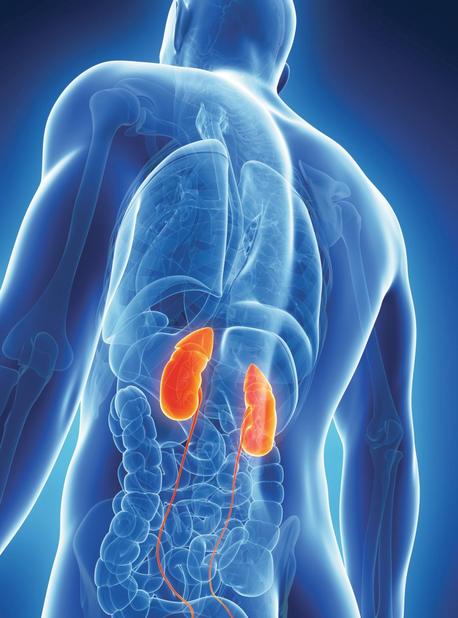
Chapter 19
The Urinary System and Body Fluids

Slide 2
BODY FLUIDS:
The Importance of Water
Body fluid maintenance
Thirst mechanism maintains volume
Kidney activity regulates volume and composition
Hormones regulate fluid volume and electrolytes
Buffers, respiration, and kidney function regulate pH

Slide 3
Fluid Compartments
Intracellular fluid (ICF)
  Two-thirds to three-fourths of all body fluids
Extracellular fluid (ECF)
  Interstitial fluid
  Blood plasma
  Lymph
  Fluid in special compartments

Slide 4
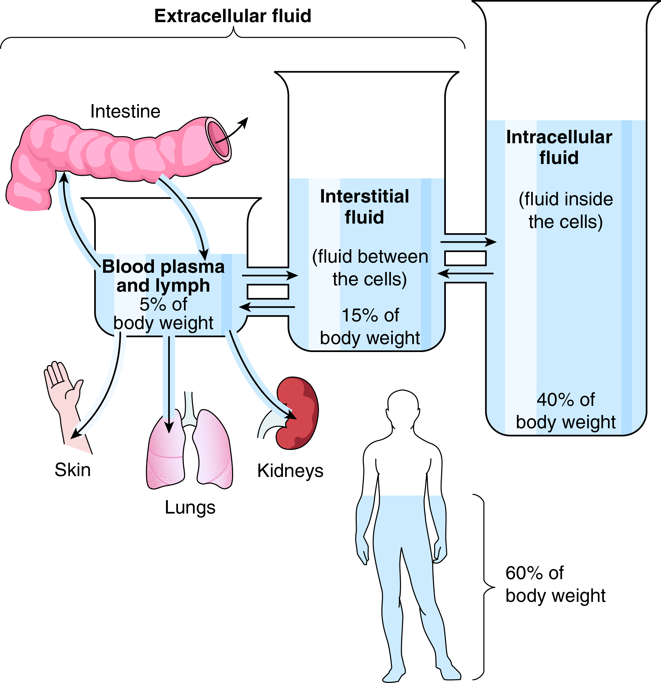
Fluid Compartments (cont.)
What are some avenues through which water is lost?
Fig. 19-1

Slide 5
Water and Its Functions
Water is important as:
  Solvent
  Transport medium
  Participant in metabolic reactions

Slide 6
Body Fluids and Blood Pressure
Sodium is the major extracellular ion
Sodium major determinant of body water content

Slide 7
Electrolytes and Their Functions
Conduct electrical current in solution
Positive ions (cations)
  Sodium
    Maintains osmotic balance and body fluid volume
  Potassium
  Calcium
    Required for bone formation, muscle contraction, nerve impulse transmission and blood clotting
Negative ions (anions)
  Phosphate
    Most abundant
    Esential CHO metabolism, bone formation and acid base balance
  Chloride

Slide 8
Systems involved in Excretion
Urinary
  Also called the excretory system
  Two kidneys
  Two ureters
  Single urinary bladder
  Single urethra
Digestive
Respiratory
Integumentary

Slide 9
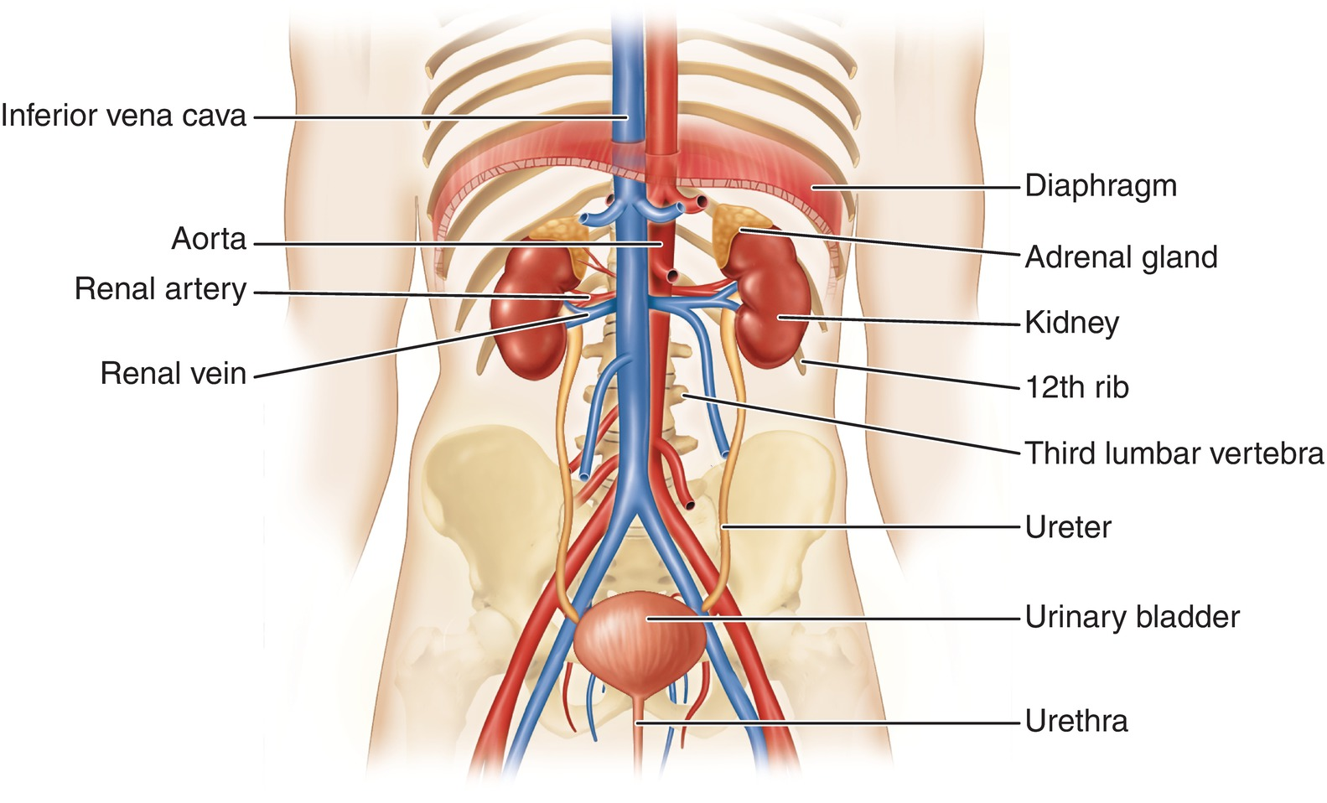
Urinary System
Fig19-3
Identify the structure that carries urine to and from the bladder.

Slide 10
Kidney Activities
Excretion
  Urea
Homeostasis of body fluids
Blood pressure regulation
  Angiotensin
  Aldosterone
Hormone production
  Red blood cell production regulation (EPO)

Slide 11
Kidney Structure
*Membranous renal capsule of fibrous connective tissue
Adipose capsule of fat
Fascia anchors kidney to peritoneum and abdominal wall
*Retroperitoneal space
Right kidney lower than left to accommodate liver

Slide 12
Kidney Organization
Hilum
Renal cortex (outer portion)
Renal medulla (inner portion)
  Renal pyramids
Renal pelvis-funnel shaped basin that forms the upper end of the ureter
  Calyces
    Collect urine

Slide 13
The Nephron and Its Blood Supply
  *Nephron- Creates urine
Glomerular capsule
Renal tubule
  Proximal tubule
  Nephron loop
  Distal tubule
Collecting duct
*Blood supply
  Afferent arteriole
  Glomerulus
  Efferent arteriole
  Peritubular capillaries

Slide 14
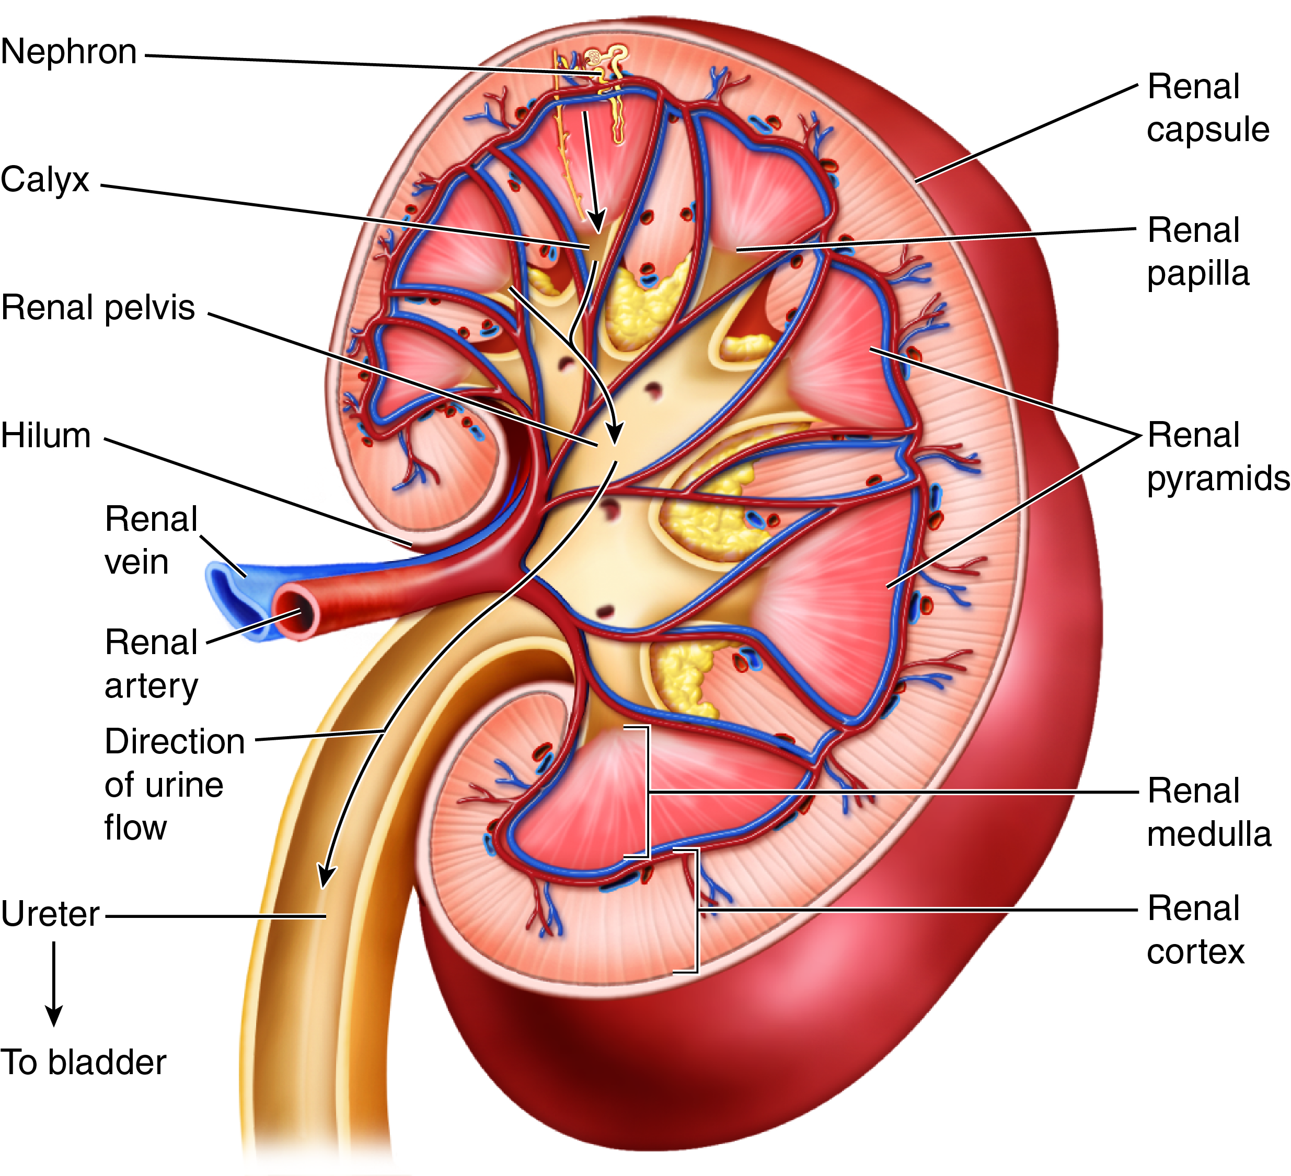
Kidney Structure (cont.)
Fig. 19-4
What is the outer region of the kidney called? What is the inner region of the kidney called?
Notes:
14

Slide 15
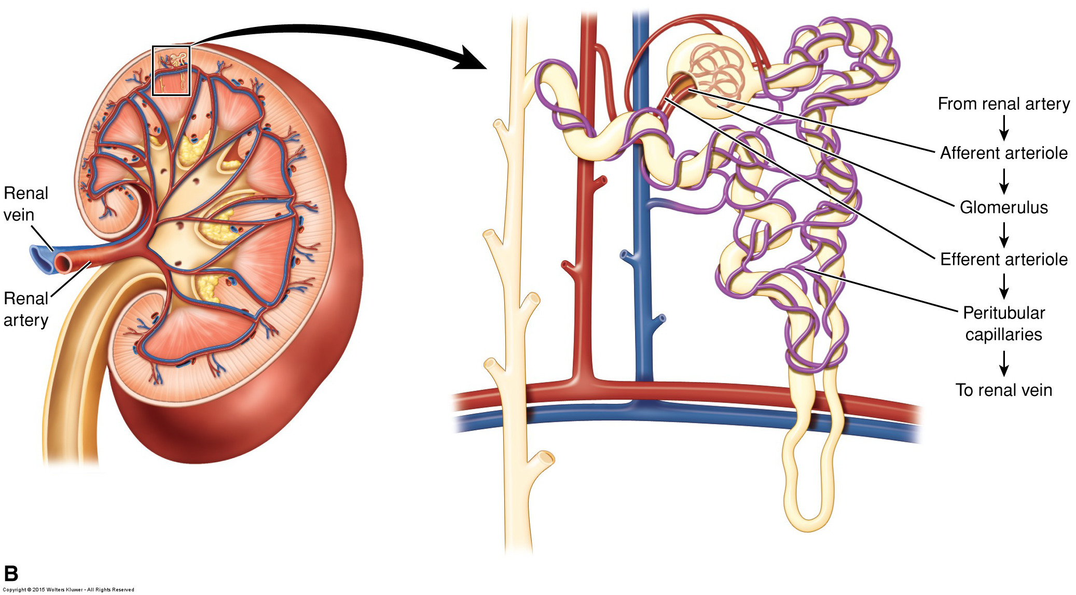
Nephron’s Blood Supply
Fig. 19-5B
The nephron is associated with two capillary beds. Which capillary bed receives blood first?
Notes:
15

Slide 16
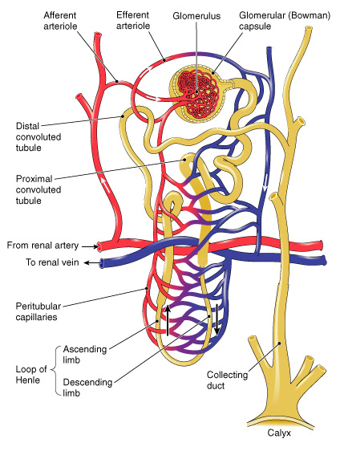
A nephron and its blood supply.

Slide 17
Formation of Urine
Glomerular filtration
  Glomerular filtrate
Tubular reabsorption
  Diffusion
  Osmosis
  Active transport
Tubular secretion
Countercurrent mechanism
  Concentration of urine
  Antidiuretic hormone (ADH)

Slide 18
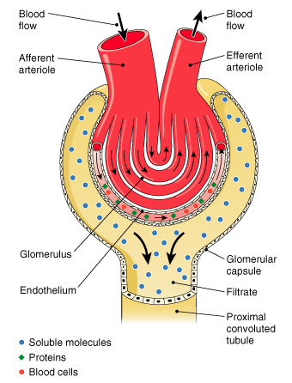
Filtration process in the formation of
urine.

Slide 19
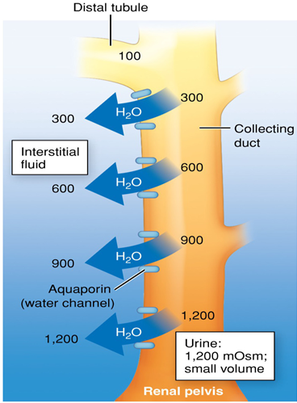
Urine Concentration: ADH
ADH stimulates aquaporin insertion into collecting duct membranes.
Water moves down medullary gradient by osmosis.
Urine becomes more concentrated.
Blood becomes less concentrated.
Fig. 19-8B
Notes:
19

Slide 20
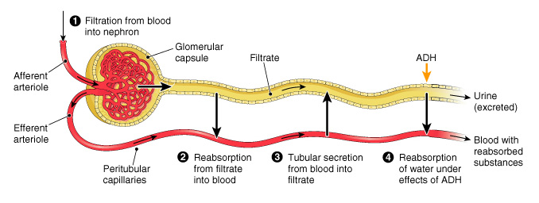
Summary of urine formation in a nephron.

Slide 21
Juxtaglomerular apparatus
Specialized cells that regulate kidney function
  Found where the DCT makes contact with the afferent arteriole
Triggered by low blood pressure
  Secretes renin enzyme

Slide 22
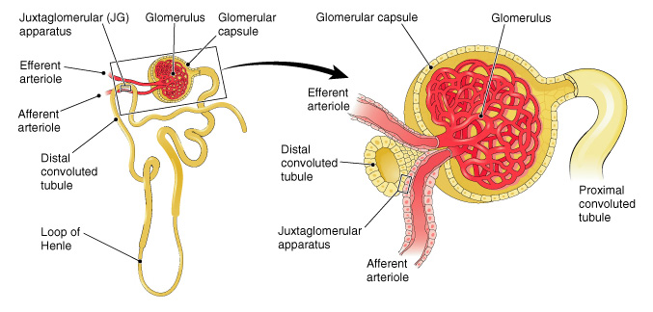
Structure of the juxtaglomerular (JG) apparatus. Note how the distal convoluted tubule contacts the afferent arteriole (right). Cells in these two structures make up the JG apparatus.

Slide 23
The Ureters
Long, slender, muscular tubes
  Epithelial cell lining
  Involuntary muscle layer
  Fibrous connective tissue coat
Entirely extraperitoneal
Extend from kidney to urinary bladder
Move urine by gravity and peristalsis

Slide 24
The Urinary Bladder
Temporary reservoir for urine
Multiple layers
Mucous membrane
  Transitional epithelium
  Rugae
  Connective tissue
  Three-layered coat of involuntary muscle tissue
  Incomplete coat of peritoneum
Trigone

Slide 25
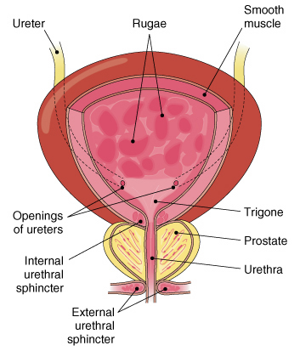
Interior of the male urinary bladder.

Slide 26
The Urethra
Tube that extends from the bladder to the outside
Male
  Part of both reproductive and urinary systems
Female
  Entirely separate from reproductive system

Slide 27
Urination
Process of expelling urine from bladder (micturition)
Involuntary control
  Internal urethral sphincter
Voluntary control
  External urethral sphincter

Slide 28
The Urine
95% water, 5% dissolved solids and gases
pH averages 6.0
Specific gravity measures amount of dissolved substances
  Normal range 1.002 to 1.040

Slide 29
Normal Constituents
Dissolved solids normally found in urine
Nitrogenous waste products
  Urea
  Uric acid
  Creatinine
Electrolytes
  Sodium chloride
  Sulfates
  Phosphates
Pigment

Slide 30
Abnormal Constituents
Urinalysis is evaluation of urine
Glucose
  Glycosuria
Albumin
  Albuminuria
Blood
  Hematuria
Ketones
  Diabetes mellitus and starvation
White blood cells
  Pyuria
Casts
  Nephron disease

Slide 31
The Effects of Aging
Loss of ability to concentrate urine
Decrease in number and size of nephrons
Increase in blood urea nitrogen (BUN)
Urinary infections
Prostate enlargement
Decreased bladder capacity
Incontinence

Slide 32
Water Balance
Water loss from
  Kidneys
  Skin
  Lungs
  Intestinal tract

Slide 33
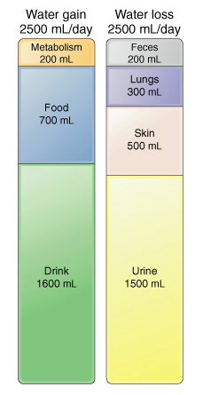
Daily gain and loss of water.

Slide 34
Sense of Thirst
Control center for thirst
Located in hypothalamus
Regulates total fluid volume

Slide 35
Control of Urine Output
Kidneys receive information about body fluid volume, composition
  Blood pressure, total body sodium content indicate body fluid volume (remember water follows salt)
  Blood osmotic pressure, individual ion concentrations indicate fluid composition
Involves hormone signals
  Aldosterone, antidiuretic hormone (ADH), angiotensin II (ATII), atrial natriuretic peptide (ANP)

Slide 36
Acid–Base Balance
pH scale measures hydrogen ion (H+) concentration
Body fluids have normal pH of 7.35 to 7.45
Three-tenths of a point shift in either direction is fatal

Slide 37
Regulation of pH
Buffer systems accept or release ions as needed
  Bicarbonate
  Phosphate
  Proteins
Respiration provides short-term regulation
Kidney function provides long-term regulation

