Slide 1
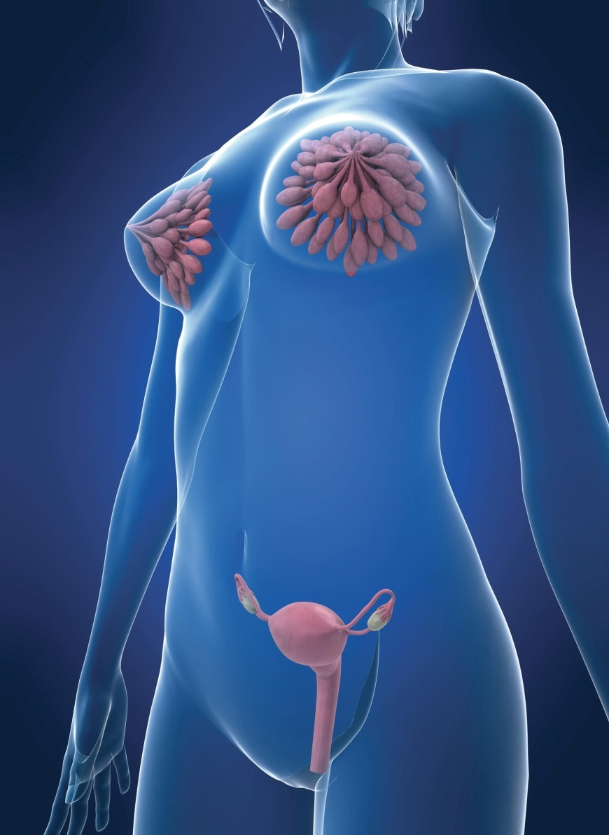
Chapter 20
The Male and Female Reproductive Systems

Slide 2
Sexual Reproduction
Requires males and females
Specialized sex cells (germ cells or gametes)
  Male cells are spermatozoa (sperm cells).
  Female cells are ova (egg cells).
Gametes produced by meiosis
  Results in gametes with half the normal chromosome number
  Male and female gametes combine to produce cell with normal chromosome number

Slide 3
Functions of the Male Reproductive System
Manufacture spermatozoa
Deliver spermatozoa to the female in semen

Slide 4
Spermatozoa Pathway
Testes (discussed later)
Epididymis
  Coiled tube located on the surface of the testis
  Temporarily stores sperm cells
Ductus deferens
    Ampulla (enlarged portion)
Ejaculatory duct
Urethra

Slide 5
Functions of Semen
Semen
  Ph 7.2-7.8
Nourishes spermatozoa
Transports spermatozoa
Neutralizes the acidity of the male urethra and female vagina
Lubricates the reproductive tract
Prevents infection

Slide 6
Male Reproductive Exocrine Glands
Seminal vesicle
  Twisted muscular tube posterior to urinary bladder
  Produces nourishing, alkaline secretion containing simple sugars
  Makes up large part of the semens volume
Prostate gland
  Located inferior to the urinary bladder, surrounds the first part of the urethra
  Alkaline secretion neutralizes vaginal acidity
Bulbourethral glands (Cowper glands)
  Located in the pelvic floor inferior to the prostate
  Secrete mucus to lubricate the urethra and penis tip

Slide 7
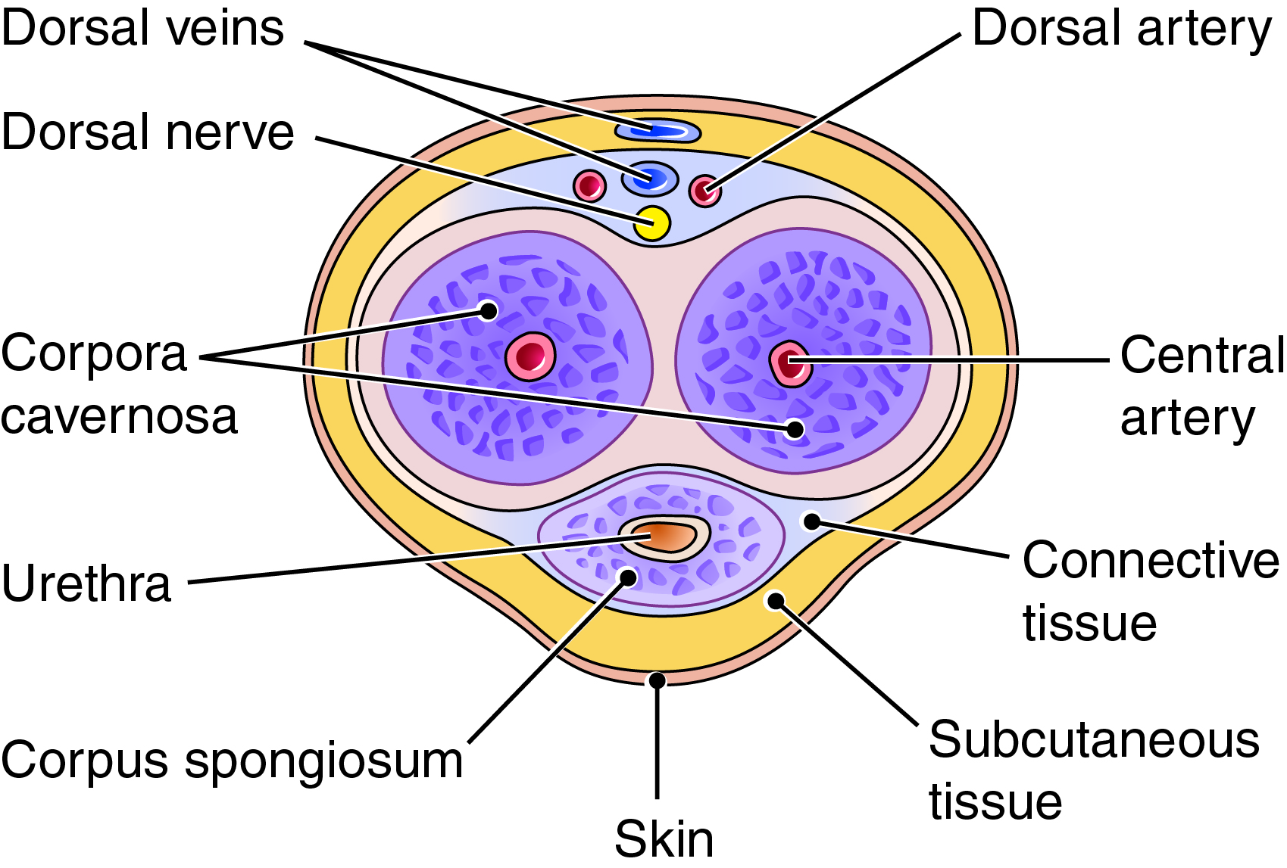
The Penis
Fig. 20-2
What subdivision of the penis contains the urethra?
Notes:
7

Slide 8
The Penis (cont.)
Parts
  Corpus spongiosum
    Glans penis: distal enlargement
    Prepuce
        Removed by circumcision
    Contains urethra
  Corpora cavernosa
Erection: blood spaces in corpora fill with blood
Ejaculation: semen passes through urethra

Slide 9
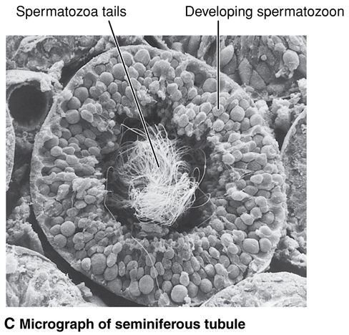
The Testes
Contained in scrotum
In fetus, descends through inguinal canal
Suspended by the spermatic cord
Internal structure
  Seminiferous tubules
    Sustentacular cells
  Interstitial cells
Fig. 20-3C

Slide 10
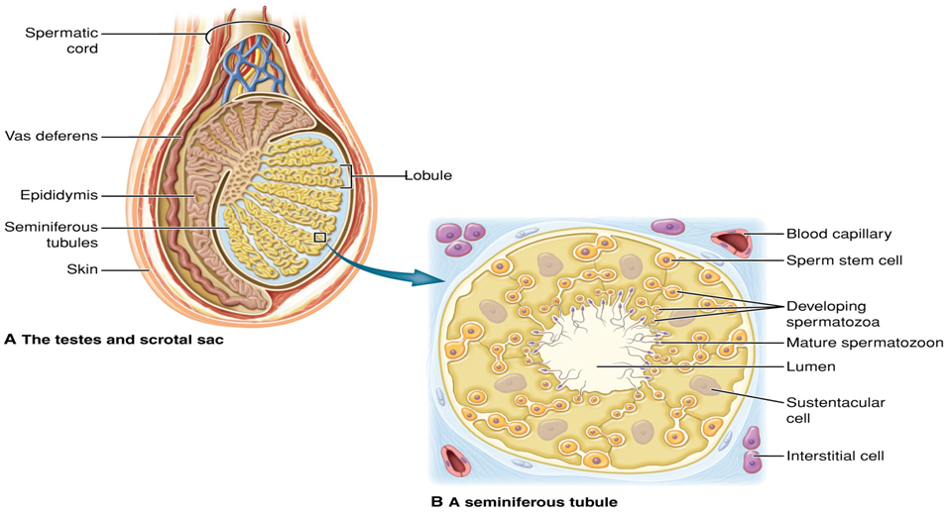
The Testes (cont.)
Fig. 20-3A and B
Where are the interstitial cells located?
Notes:
10

Slide 11
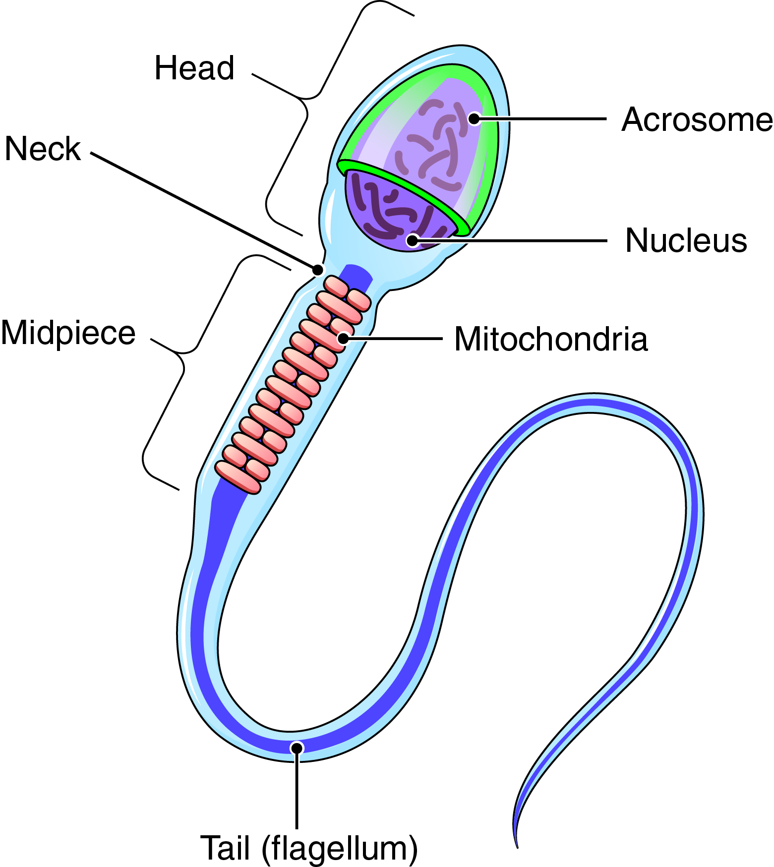
A Spermatozoon
Production begins at puberty
Acrosome: contains enzymes
Flagellum: propels sperm
Fig. 20-4
What organelles provide energy for sperm cell motility?
Notes:
11

Slide 12
Hormonal Control of Male Reproduction
Testicular Activity
Controlled by two hormones from the anterior pituitary
  Follicle-stimulating hormone (FSH)
  Luteinizing hormone (LH)
    testosterone
Testosterone
Functions:
  Development and maintenance of the male reproductive accessory organs
  Development of spermatozoa
  Development of secondary sex characteristics

Slide 13
The Effects of Aging on Male Reproduction
Decrease in testosterone and spermatozoa production
Decline in sperm motility and quality
Erectile dysfunction
Benign prostatic hypertrophy (BPH)

Slide 14
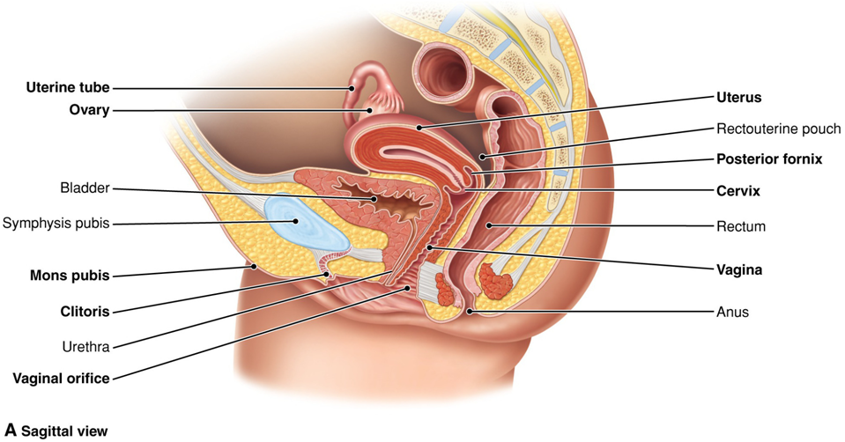
Female Reproductive System (cont.)
Fig. 20-6A
What is the deepest part of the uterus called? The most inferior portion?
Notes:
14

Slide 15
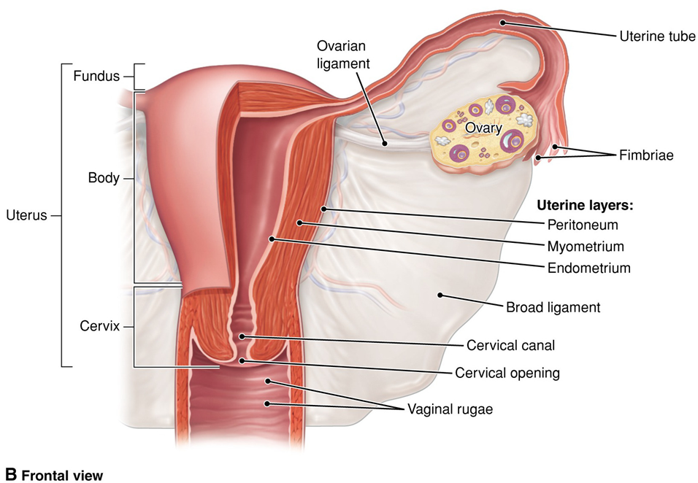
Female Reproductive System (cont.)
Fig. 20-6B
Notes:
15

Slide 16
Accessory Organs: The Uterus
Pear-shaped muscular organ in which fetus develops and matures
Three regions
  Body (corpus)
  Cervix (neck)
  Fundus
Three layers
  Peritoneum (perimetrium)
  Myometrium
  Endometrium
    Uterus lining

Slide 17
Accessory Organs
Uterine tubes (oviducts or fallopian tubes)
  Muscular structure extending from the uterus to a point near the ovary
  Fimbriae
The vagina
  Fornix
    Posterior fornix
  Rectouterine pouch
  Hymen

Slide 18
Accessory Organs (cont.)
The greater vestibular glands (Bartholin)
  Secrete mucus into the vestibule
  Provide lubrication
External genitalia (vulva)
  Labia (labia majora and labia minora)
  Clitoris
  Mons pubis

Slide 19
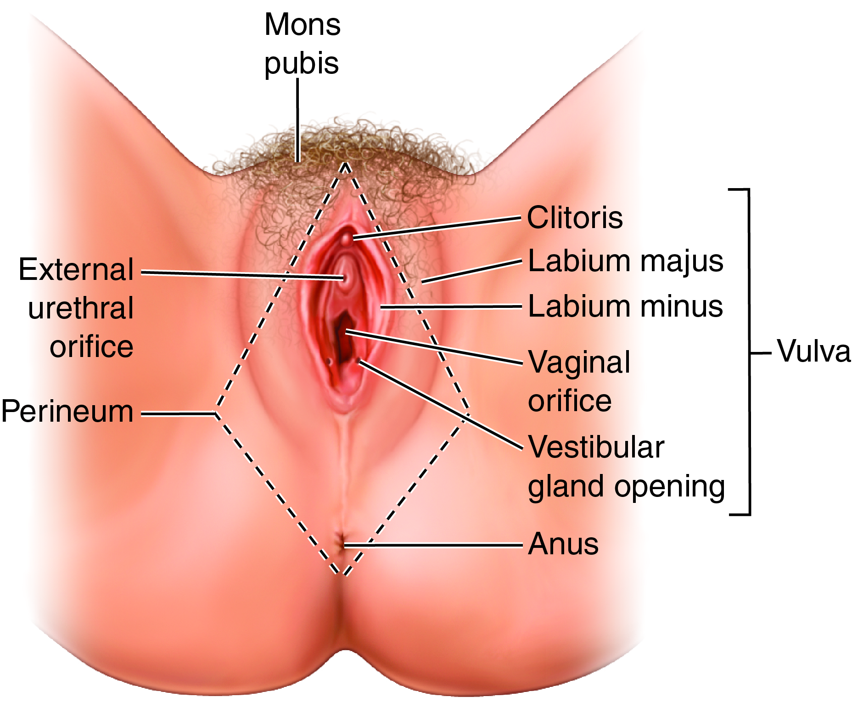
The External Genitalia
Fig. 20-7
Notes:
19

Slide 20
The Ovaries and Ova
Ovaries are located in the pelvic cavity
Ovaries produce ova
Ovarian follicle:
  Protects ovum
  Produces ovarian hormones
Ovaries contain gametes at birth.

Slide 21
The Female Reproductive Cycle (cont.)
Controlled by pituitary hormones LH and FSH, which are regulated by the hypothalamus
Cyclic pattern of hormonal activity
Each cycle begins with menstruation
One cycle averages 28 days
Ovulation (release of ovum) separates cycle into into preovulatory (follicular) and postovulatory (luteal) phases

Slide 22
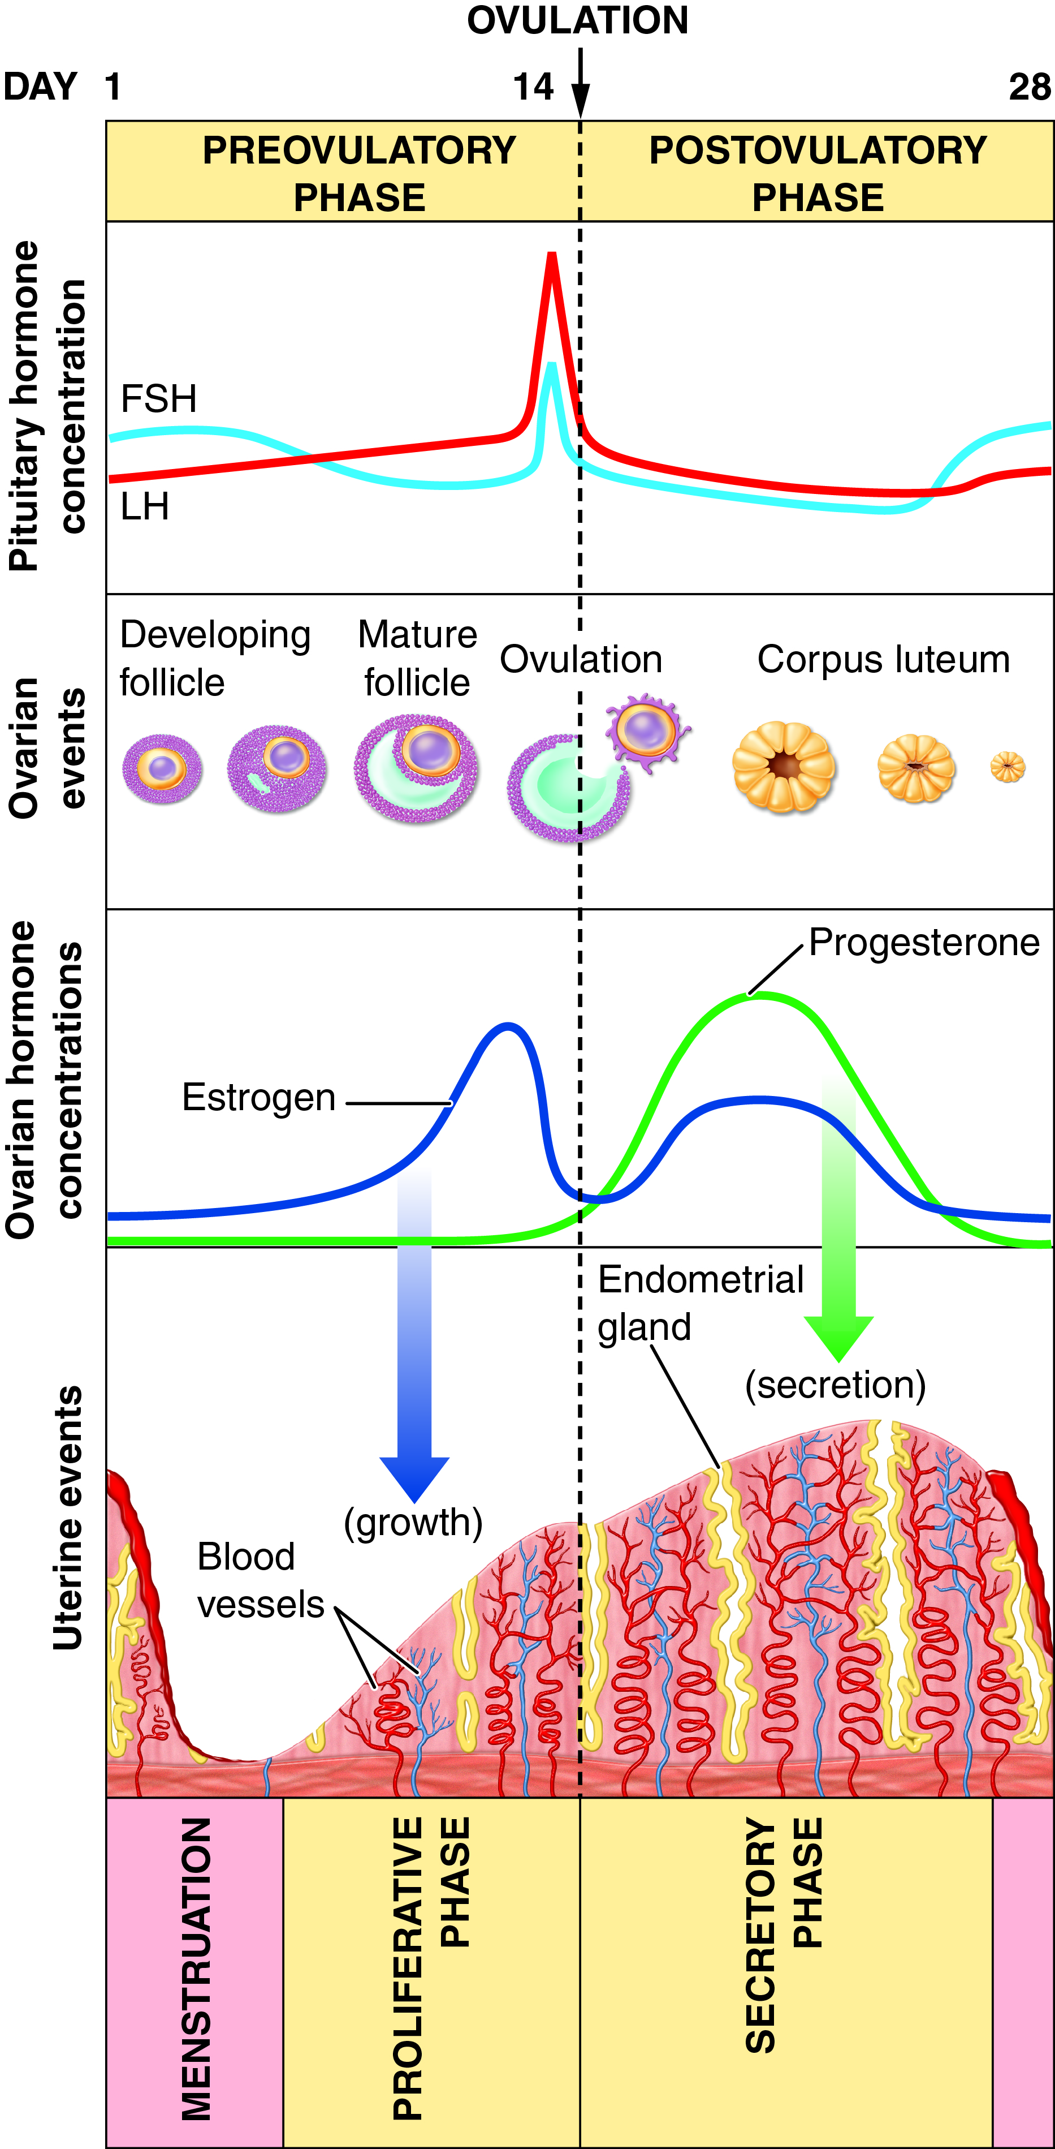
Reproductive Cycle
What ovarian hormone peaks closest to ovulation? What ovarian hormone peaks after ovulation?
Fig. 20-9
Notes:
22

Slide 23
The Female Reproductive Cycle: Preovulatory Phase
Preovulatory Phase
Several follicles enter final stages of maturation
*Increased production of estrogen
  Prepares the endometrium
    Elongates uterine secretory glands
    Proliferative phase in the uterus
  Inhibits release of FSH

Slide 24
The Female Reproductive Cycle: Ovulation and the Postovulatory Phase
LH surge in blood
  Causes ovulation
  *Transforms ruptured follicle into corpus luteum that secretes estrogen and progesterone
Endometrium continues to thicken
Glands and blood vessels increase in size
  Secretory phase in the uterus
*FSH and LH are inhibited via estrogen and progesterone feedback

Slide 25
Menstruation
If ovum is not fertilized, corpus luteum degenerates
  Estrogen, progesterone levels decrease
Endometrium degenerates, produces menses
Endometrium begins to rebuild
  *The decrease of estrogen and progesterone levels allows increased release of FSH from the anterior pituitary preventing follicular development and ovulation

Slide 26
Menopause
Menstruation ceases
Normal ovarian function declines
  Follicles stop maturing
  No appreciable amounts of estrogen and progesterone produced
Effects of menopause may include nervous symptoms, anxiety, insomnia, and “hot flashes” (resulting from low levels of estrogen)
Uterus, oviducts, vagina, vulva become somewhat atrophied
Vaginal mucosa becomes thinner, dryer, more sensitive

Slide 27
Hormone Replacement Therapy (HRT)
Combination of estrogen with synthetic progesterone prescribed to relieve menopause discomfort
Increases breast cancer risk
Increases thrombosis and embolism risk
Risks increase with duration of therapy

Slide 28
Contraceptive Methods
Surgical | Hormonal (Female) | Barrier | Other
Tubal ligation | Birth control pills | Male condom | Spermicide alone
Vasectomy | Birth control shot | Female condom | Fertility awareness
 | Birth control patch | Diaphragm (with spermicide)
 | Birth control ring | Contraceptive sponge (with spermicide)
 |  | Intrauterine device

Slide 29
Birth Control
Artificial means to prevent fertilization of the ovum
Surgical sterilization
  Tubal ligation (female)
  Vasectomy (male)
Hormonal methods for women
Male contraceptive pill still under investigation
Mifepristone (RU-486) (morning-after pill) is a drug taken after conception to terminate an early pregnancy
Male and female condoms

Slide 30
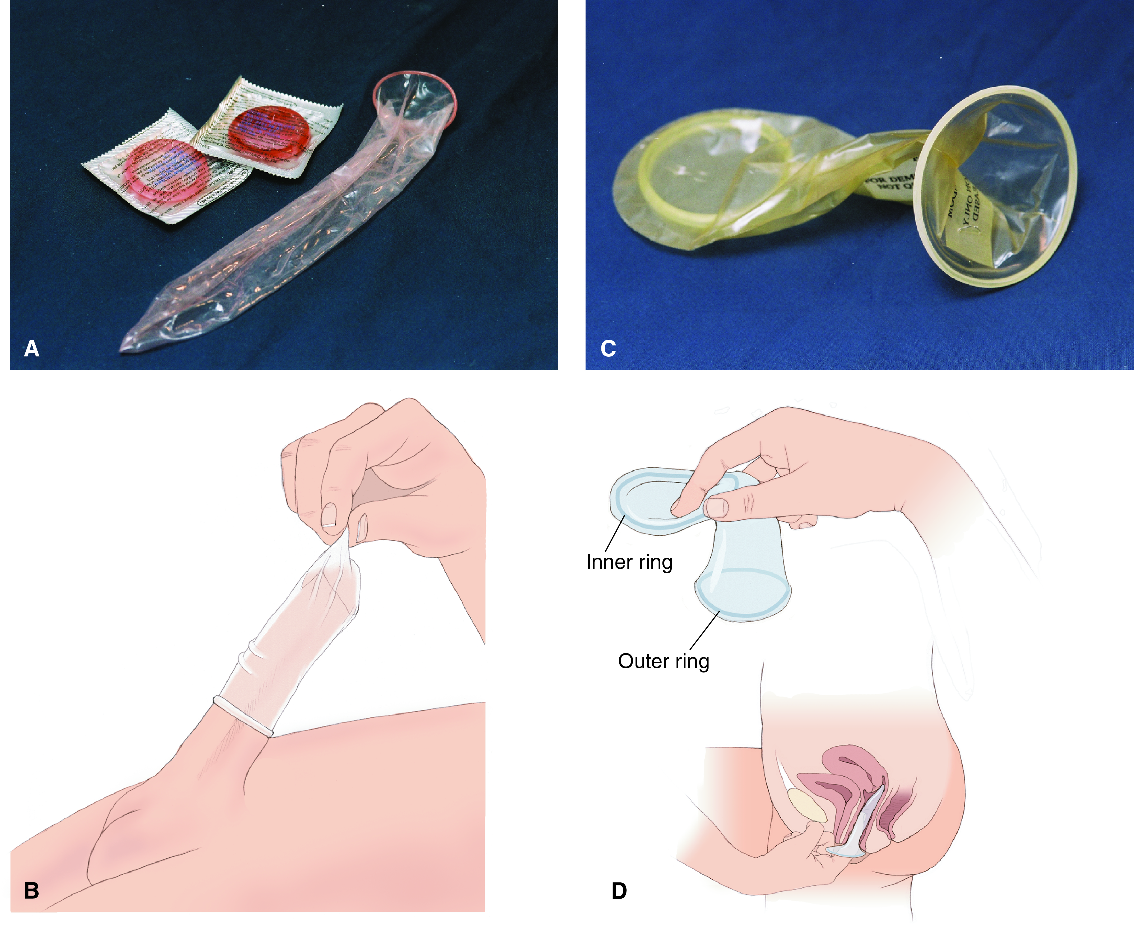
Male and Female Condoms
Fig. 20-10
Notes:
30

Slide 31
Health Maintenance
STI’s
  Chlamydia
  Gonorrhea
  Herpes

Slide 32
Male Infertility
Infertility: inability of a couple to achieve pregnancy after having regular, unprotected sexual intercourse for at least 1 year
Causes of male infertility
  Low sperm count
  Abnormal sperm shape
  Low sperm motility

Slide 33
Causes of Female Infertility
Endocrine disorders
Abnormalities in structure and function of reproductive organs
  Presence of inflammation or scar tissue in uterine tubes
Endometriosis
Early menopause
Malnutrition

