Slide 1
Chapter 1
Food, Nutrition, and Health
Notes:
Although we may define health and disease in a variety of ways, the primary basis for promoting health and preventing disease must start with a balanced diet and the nutrition it provides.
The study of nutrition is of primary importance in the following two ways: It is fundamental for our own health, and it is essential for the health and well-being of our patients and clients.

Slide 2
Health Promotion and Essential Nutrients
Optimal personal and community nutrition is a major component of health promotion.
Certain nutrients in food are essential to our health and well-being.

Slide 3
Health Promotion
Basic definitions
  Nutrition: Food people eat and how their bodies use it
  Nutrition science: Scientific knowledge of food requirements for maintenance, growth, activity, reproduction, lactation
  Dietetics: Health profession that applies nutrition science to promote health and treat disease
  Registered dietitian: Nutrition authority on the health-care team
Notes:
Ask students to name some recent nutrition discoveries or topics in the news pertaining to nutrition.
Discuss the scientific process with the students and how scientists build on previous research to discover new findings.

Slide 4
Health Promotion
Health and wellness
  Health: more than just absence of disease
  Includes meeting basic needs
  Recognizes individual as a whole
  Considers internal and external environments
  Wellness seeks full development of potential
Notes:
Ask students to identify uses of food other than to satisfy hunger.
Highlight the integral role nutrition plays in a patient’s plan of care and recovery.

Slide 5
Health Promotion
National health goals
  Continue focus on wellness
  Emphasize lifestyle and personal choice
  USDA:
  Healthy People 2020-focuses on the nations main objective of positive health promotion and disease prevention*
Notes:
Give an example of how decreased health costs result from preventive care. (Healthy weight reduces risks for chronic diseases.)
Give an example of a disease process directly related to nutritional status. (Iron-deficiency anemia or osteoporosis)

Slide 6
Health Promotion
Traditional and preventive approaches to health
  Preventive approach: identify and minimize risk factors
  Traditional approach: attempts change when symptoms of illness or disease appear
Notes:
Emphasize that the benefits of living well today are seen over time, just as the detriments of not living well today are seen over time.

Slide 7
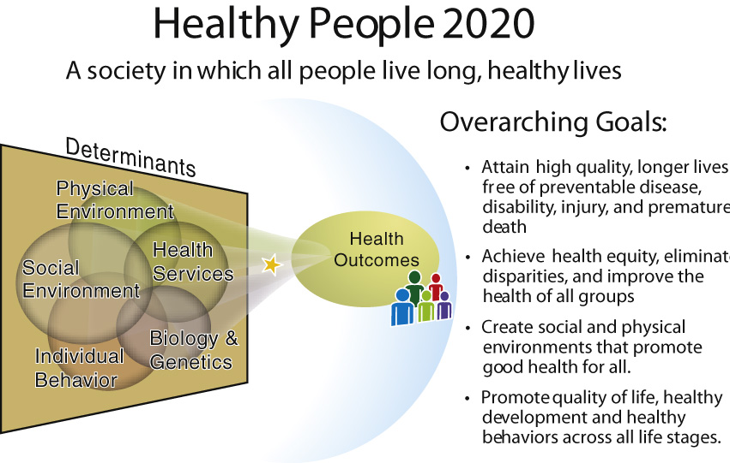
Health Promotion
Notes:
Ask students to name lifestyle choices that promote nutritional health.
Ask students to name lifestyle choices that reduce nutritional health.

Slide 8
Health Promotion
Importance of a balanced diet
  Six essential nutrients
    Carbohydrates
    Protein
    Fat
    Vitamins
    Minerals
    Water
Notes:
Ask students why so many people are focused mainly on eating to relieve hunger or satisfy their appetite and not as supplying their body with all the components of proper nutrition.

Slide 9
Health Promotion
Signs of good nutrition
  Well-developed body
  Ideal weight for height and body composition
  Good muscle development
  Smooth and clear skin
  Glossy hair
  Clear and bright eyes
Notes:
Using these seven signs of proper nutrition, discuss signs of malnutrition.

Slide 10
Functions of Nutrients in Food
Basic functions of food
  Provide energy
  Build tissue
  Regulate metabolic processes
  Metabolism
  sum of all body processes that accomplish the basic life-sustaining tasks*
Notes:
Explain blood glucose and its role as the body’s main energy source.
Provide an example of nutrients that work together. (Iron and vitamin C, fat-soluble vitamins and fats)
Ask students to give examples of diseases that result from a mineral deficiency or other nutrient deficiency, or from a nutrient excess.

Slide 11
Functions of Nutrients in Food
Energy sources
  Carbohydrates
    Primary source of fuel for heat and energy*
    Maintain body’s backup store of quick energy as glycogen*
    Should provide 45% to 65% of total kilocalories
    Each gram of CHO consumed yields 4 kcal of body energy*
Notes:
Give examples of simple and complex carbohydrates.

Slide 12
Functions of Nutrients in Food
Energy sources (cont’d)
  Fats
    Animal and plant sources
    Yields 9 kcal for each gram consumed*
    Secondary (storage) form of heat and energy
    Should provide no more than 20% to 35% of total kilocalories
Notes:
List plant and animal sources of fats.
Explain the importance of fat as an energy source.
Explain that men and women usually store fat in different parts of the body; have the students determine where these sites are located. (Men: abdomen; Women: hips)

Slide 13
Functions of Nutrients in Food
Energy sources (cont’d)
  Proteins
    Primary function is tissue building*
    Yields 4kcal per gram*
    Should provide 10% to 35% of total kilocalories
    Source of energy when supply from carbohydrates and fats is insufficient
Notes:
TALKING POINT:
Of what are proteins composed? (Amino acids)

Slide 14
Functions of Nutrients in Food
Tissue building
  Proteins
    Provide amino acids
    Necessary for building and repairing tissues
  Vitamins and minerals
    Vitamin C for tissue building
    Calcium and phosphorus for building and maintaining bone
Notes:
TALKING POINTS:
Ask students to list foods high in vitamin C, calcium, phosphorus, and iron.
Explain that the bones act as a reservoir for calcium; when calcium levels drop in the blood, calcium is taken from the bones and must be replenished by dietary intake.

Slide 15
Functions of Nutrients in Food
Tissue building (cont’d)
  Iron: essential part of hemoglobin in the blood
  Fatty acids: build central fat substance of cell walls
Notes:
TALKING POINT:
Explain why fat is important for infant brain development.

Slide 16
Functions of Nutrients in Food
Regulation and control
*vitamins and water are involved in metabolic regulation
  Vitamins
    Function as coenzyme factors
    Components of cell enzymes in governing a chemical reaction during cell metabolism*
  Minerals
    Also serve as coenzyme factors
Notes:
Which do students think are more susceptible to degradation or destruction: vitamins or minerals? (Vitamins)

Slide 17
Functions of Nutrients in Food
Regulation and control
  Water: fundamental agent for life itself, provides an essential base for all metabolic processes*
  Fiber: regulates passage of food material through gastrointestinal tract
Notes:
Explain that more than 60% of the human body is composed of water and explain how water is lost in urine, feces, sweat, and respiration.

Slide 18
Nutritional States
Optimal nutrition
  Varied and balanced diet
  Includes appropriate amounts of:
    Carbohydrates
    Fats
    Proteins
    Minerals
    Vitamins
    Water
Notes:
Discuss some ways health professionals promote variety and moderation.

Slide 19
Nutritional States
Malnutrition
  Improper or insufficient diet
  Includes undernutrition and overnutrition
  Increases risk for illness
  Limits work capacity, immune system, and mental activity
  Lack the nutritional reserves to meet any added physiologic or metabolic demands from injury or illness or to sustain fetal development during pregnancy or proper growth during childhood. May result from poor eating habits, stressful environment with little or no available food
Notes:
Discuss some of the social developments that lead to overnutrition.

Slide 20
Nutritional States
Undernutrition
  Nutritional reserves are depleted
  Insufficient intake to meet daily needs or added stress
  Can occur in hospitals
    In the event of trauma or chronic illness among older people, places*
  Those that are most vulnerable include: pregnant women, infants, children, elderly*
Notes:
What federal programs address undernutrition? (WIC, EFNEP [Coop Extension], Head Start)
What local programs address this issue? (Food banks, homeless shelters)

Slide 21
Nutritional States
Overnutrition
  Excess nutrient and energy intake over time*
  Produces harmful gross body weight
  Excessive amounts of nutrient supplements over time
Notes:
Discuss the idea of “if some is good, more is better” and how moderation relates to this.

Slide 22
Planning a Balanced Diet
Food and nutrient guides help us plan a balanced diet according to individual needs and goals.

Slide 23
Nutrient and Food Guides for Health Promotion
Nutrient standards
  Most countries have established minimum standards
  Vary by country
  In U.S., known as Dietary Reference Intakes (DRIs)
Notes:
What are some of the organizations throughout the world that set these standards?

Slide 24
Nutrient and Food Guides for Health Promotion
U.S. standards: dietary reference intakes (DRIs)
  National Academy of Sciences sets since 1941
  Recommended Dietary Allowances (RDAs)
  U.S. and Canadian scientists developed DRIs
  Includes recommendations for each gender and age group
Notes:
Explain the role of the National Academy of Sciences and who actually convenes to determine the DRIs.

Slide 25
Nutrient and Food Guides for Health Promotion
U.S. standards: Dietary Reference Intakes (DRIs) (cont’d)
  Encompass four interconnected categories of nutrient recommendations
    Recommended Dietary Allowance (RDA)
    Estimated Average Requirement (EAR)
    Adequate Intake (AI)
      Used as a guide when not enough scientific evidence is available to establish RDA*
    Tolerable Upper Intake Level (UL)
Notes:
Explain that these four categories are under the umbrella of DRIs, and draw a diagram if necessary.

Slide 26
Nutrient and Food Guides for Health Promotion
U.S. standards: Dietary Reference Intakes (DRIs) (cont’d)
  Recommended Dietary Allowance (RDA)
    Daily intake of nutrients that meet needs of almost all healthy individuals
  Estimated Average Requirement (EAR)
    Intake level that meets needs of half the individuals in a specific group
Notes:
Draw a graph of a bell curve to illustrate both the RDA and EAR.

Slide 27
Nutrient and Food Guides for Health Promotion
Food guides and recommendations
  My Plate
    USDA released in 2011
    Promotes variety, proportionality, gradual improvement, physical activity*
    Participants can personalize at Web site
Notes:
Can MyPlate be taught to children?
Ask students to list a sample diet that reflects the recommendations in MyPlate.

Slide 28


Slide 29
Nutrient and Food Guides for Health Promotion
Food guides and recommendations
  Dietary Guidelines for Americans
    Result of growing public concerns in the 1960s
    Based on chronic health problems of an aging population
    Relate current scientific thinking to America’s health problems
  Other recommendations from American Cancer Society and American Heart Association
Notes:
Ask students how environment might affect food choices and physical activity levels.
Explain the change that occurred in many households across the United States in the 1950s and 1960s that led to a change in food patterns.
Talk about the process of collecting scientific research to form a guideline.

Slide 30
Nutrient and Food Guides for Health Promotion
Individual needs
  Person-centered care
    Food patterns vary with needs, tastes, habits, living situations, energy needs
  Changing food environment
    Shift to fast, processed, prepackaged foods
    Malnutrition persists in all segments of population
    Society beginning to recognize relation between food and health
Notes:
Ask students how often they eat fast, processed, or prepackaged foods per week.
Ask students to explain why Americans suffer from malnutrition with such an abundant food supply.
Give some examples of fast food restaurants that have health-conscious alternatives: (McDonald’s, Arby’s, Chili’s)
If the students look at nutrition labels, what do they look for first?
Explain that the food label can be deceiving if the portion size is not considered. For example, bottled beverages often contain 2 or more servings, ice cream is labeled to be served in ½ cup portions, and 2 to 3 snack cookies equal a serving.

