Slide 1
Chapter 10
Nutrition during Pregnancy and Lactation
Notes:
This chapter explores the nutrition needs of pregnancy, nutrition-related risk factors and complications, and the physiologic process and nutrition demands of lactation.

Slide 2
Nutrition Before and During Pregnancy
The mother’s food habits and nutritional status before conception, as well as during pregnancy, influence the outcome of her pregnancy.
Pregnancy is a prime example of physiologic synergism in which the mother, fetus, and placenta collaborate to sustain and nurture new life.
Through the food a pregnant woman eats, she gives her unborn child the nourishment required to begin and support fetal growth and development.

Slide 3
Nutritional Demands of Pregnancy
Mother’s and child’s health depend on the pregnant woman eating a well-balanced diet with increased nutrients
Women who have eaten well-balanced diets before pregnancy are in a good state of nutrition before conception
Nine months of pregnancy require increased energy and nutrient support
General guidelines are based on DRIs
Notes:
When might a woman have a higher metabolic workload without being pregnant? (Training for a marathon and studying during finals week)
Protein is a major building block of cells.

Slide 4
Energy Needs Are Increased
Reasons for increased need
  To increase metabolic workload
  To spare protein for tissue-building requirements
Amount of energy increase
  **Second trimester: 340 kcal/day
  **Third trimester: 452 kcal/day
Notes:
What is an “enlarged metabolic workload”?
What are some complex carbohydrates? (Pasta, rice, and bread)

Slide 5
Protein Needs Are Increased
Development of placenta
Rapid growth of fetus
*Growth of maternal tissues
Increased maternal blood volume
Amniotic fluid
Storage reserves
Notes:
To have a larger blood volume, the body needs to make more hemoglobin and plasma protein, including albumin.
What happens if the body does not make enough albumin? (Excessive edema)
What is the purpose of amniotic fluid? (To protect the fetus from shock or injury)

Slide 6
Protein Increase
*Amount of protein increase: 25 g/day
Food sources
  Complete protein foods
    Milk, eggs, cheese, soy products, meat
  Incomplete proteins
    Legumes, grains
  Protein-rich foods contribute calcium, iron, B vitamins
Notes:
On average, a person eats 46 g of protein per day.
A pregnant woman should have approximately 70 g of protein per day—a 25 g/day increase.
Give an example of an incomplete protein.

Slide 7
Key Mineral and Vitamin Needs
Calcium
  Essential for fetal development of bones and teeth
  Supplements might be needed in cases of poor maternal stores or pregnancies involving more than one fetus
  * a diet that includes at least 3 cups of milk or milk substitute daily plus dairy or dairy substitute
Notes:
Calcium is necessary for blood to clot.
What are some foods high in iron? (Beef, green vegetables)
Why is more hemoglobin desired during pregnancy? (To increase maternal blood volume and for the infant’s storage of iron)
Why do doctors recommend taking iron with orange juice? (Vitamin C increases the body’s ability to absorb and use iron)

Slide 8
Key Mineral and Vitamin Needs (cont’d)
Iron
  *Iron essential for increased hemoglobin synthesis
  Deficiency affects 30% of low-income pregnant women
  Supplements often recommended
  *recommended intake 27 mg/day
Notes:
How can women avoid unpleasant GI effects when taking iron supplements? (Take iron supplement doses of 20 to 80 mg/day between meals or at bedtime to prevent side effects)

Slide 9
Key Mineral and Vitamin Needs (cont’d)
Vitamins
  *Vitamins A and C needed in higher amounts to support tissue growth
  *Vitamin B needed in higher amounts because of vital role as coenzyme factors in energy production and protein metabolism
Notes:
Emphasize that the pregnant woman should pay increased attention to her intake of all vitamins.

Slide 10
Key Mineral and Vitamin Needs (cont’d)
Folate
  Builds mature red blood cells during pregnancy
  *needed for healthy embryonic tissue
  Needed during early periconceptional period
  DRIs recommend daily folate intake of 600 mcg during pregnancy and 400 mcg/day for nonpregnant women during childbearing years
  May require folate supplements
  Sources: dark green leafy veg*, liver, legumes
Notes:
What does periconceptional mean? (Around the time of conception)
You might see “folic acid” on a bottle of vitamins instead of “folate” because folate is a salt of folic acid.
How can women prevent spina bifida and anencephaly in their infants? (Women should take folate for at least 2 months before and during pregnancy.)
What are some sources of folate? (Enriched flour and grain, green leafy vegetables, pinto beans, soybeans, orange juice, wheat germ, asparagus, and broccoli)

Slide 11
Key Mineral and Vitamin Needs (cont’d)
Vitamin D
  Deficiency is a worldwide problem
  Ensures absorption and utilization of calcium and phosphorus for fetal bone growth
  *Daily intake of at least 3 cups fortified milk
  Exposure to sunlight increases endogenous synthesis of vitamin D
  *vit D helps absorb calcium
    Fortified milk*
Notes:
Fortified milk contains extra vitamin D.
Phosphorous is another essential mineral for bone growth.
Phosphorous is generally found in the same foods as calcium.

Slide 12
Weight Gain During Pregnancy
**Set weight goals according to mother’s pregnancy nutritional status and body mass index
  Underweight women: 28 to 40 lbs
  Normal-weight women: 25 to 35 lbs
  Overweight women: 15 to 25 lbs
  Obese women: approximately 11 to 20 lbs
  Teenage girls: 35 to 40 lbs
  Women carrying twins or triplets: 25 to 54 lbs
Notes:
Women should be encouraged to gain the weight so that they have healthy babies.

Slide 13
Weight Gain During Pregnancy (cont’d)
**Rate of weight gain
  Average amount of weight gain during first trimester: 2 to 4 lbs
  1 lb per week weight gain during remainder of pregnancy
  Increased energy demand in late pregnancy
Notes:
A weight gain of more than 2 lbs/wk should be reported to the physician, midwife, or supervisor.
Normal sodium intake is 3 to 6 g/day, so there is no need for a supplement during pregnancy.
Why should weight reduction never be undertaken during pregnancy?

Slide 14
Daily Food Plan
Core food plan is designed to meet increased nutrition needs
Ethnic background, belief system, and lifestyle may require alternative food plans
Pregnant women should avoid alcohol, caffeine, tobacco, and drugs
Includes sufficient quantity and regular meals
Notes:
Pregnant women should not skip meals.
What are some belief systems that would require alternative food plans?
What foods should be increased for pregnant or lactating women? (Protein and complex carbohydrates)

Slide 15
Functional Gastrointestinal Problems
*Nausea and vomiting
  Morning sickness occurs briefly during the first trimester
    *HYPEREMESIS GRAVIDARUM
  Is caused by hormonal adaptations
  Small, frequent, dry, easily digested energy foods may relieve symptoms
  Consume liquids between, not with, meals
  Severe and prolonged sickness requires medical treatment
Notes:
Morning sickness does not necessarily occur only in the morning. It is worse for some women than others.
What can help resolve the symptom of morning sickness? (Dry crackers, dry toast)

Slide 16
Functional Gastrointestinal Problems (cont’d)
Constipation
  May occur in latter part of pregnancy
  The result of increased pressure of enlarging uterus and reduced normal peristalsis
  Remedies include exercise, increased fluid intake, high-fiber foods
Hemorrhoids
  Caused by increased weight of baby
  Usually controlled by dietary suggestions used for constipation
Notes:
What are some high-fiber foods that help prevent constipation and hemorrhoids? (Vegetables; dried fruits, especially prunes and figs; fruit; juices)
Rest can also relieve the pressure of the uterus on the lower intestine.

Slide 17
Functional Gastrointestinal Problems (cont’d)
Heartburn
  Caused by pressure of enlarging uterus crowding the stomach
  *Dividing day’s food intake into a series of small meals usually relieves condition
Notes:
The uterus can cause discomfort through both downward pressure and upward pressure.
Because of the upward pressure, a woman might experience irritation and burning from gastric reflux.
Sometimes the upward pressure is relieved by wearing loose clothing.

Slide 18
High-Risk Mothers and Infants
Identifying risk factors and addressing them early are critical.
Identifying poor food patterns can prevent nutrition problems.
  Insufficient food intake
  Poor food selection
  Poor food distribution throughout the day
Notes:
Good nutrition can prevent many problems related to pregnancy.
Approximately half of pregnancy-related deaths of women are preventable, according to the National Center for Chronic Disease Prevention and Health Promotion.

Slide 19
High-Risk Mothers and Infants (cont’d)
Teenage pregnancy
  U.S. has one of the highest rates in the industrialized world
  Special nutritional care is needed
  *pregnancy compromises teens needs due to her own unfinished growth and development
Notes:
Pregnant teens have higher rates of low-birth-weight infants and infant mortality.
What are some special considerations of pregnant teens? (Still growing, no income, smoking, drug experimentation, dieting)
How can nurses create a more supportive environment for a teen throughout her pregnancy? (Invite her friends and mother to appointments)

Slide 20
High-Risk Mothers and Infants (cont’d)
Recognizing special counseling needs
  *Age (adolescents <18, women >35 years) and parity (several pregnancies within a limited number of years)
  >35 at risk for obstetric and perinatal complications*
  *Alcohol abuse leading to fetal alcohol spectrum disorders
  Nicotine: smoking causing placental abnormalities and fetal damage
  Drug use: medicinal or recreational
Notes:
What are some considerations of pregnant women older than 35 years? (Hypertension, sodium intake)
Alcohol causes mental retardation and other birth defects.

Slide 21
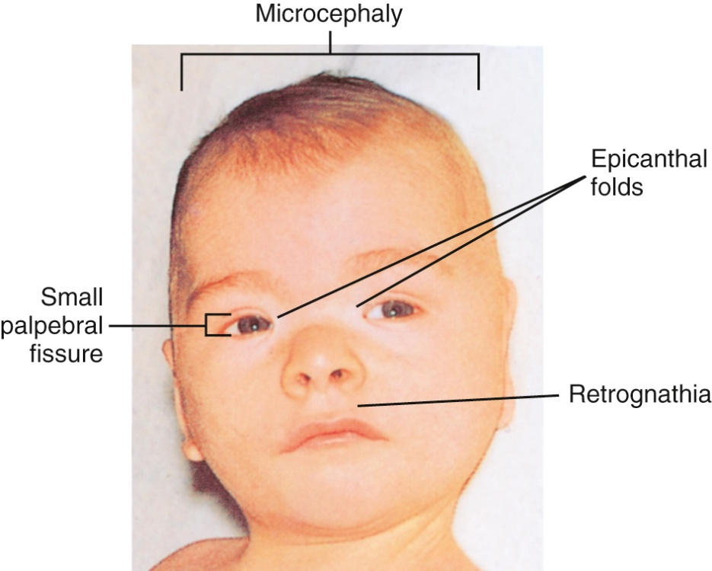
Fetal Alcohol Effects

Slide 22
High-Risk Mothers and Infants (cont’d)
Caffeine
  Remains in bloodstream of pregnant women longer
  Studies have found conflicting effects on pregnancy
*Pica
  Consumption of nonfood items
  Associated with iron-deficiency anemia
Socioeconomic problems
  Poverty reduces access to resources
  Community resources include WIC
Notes:
What is a teratogen? (A substance that causes birth defects)
What is WIC, and what are its services? (The Women, Infants, and Children program that provides food stamps and other services to pregnant women)
Caffeine stays in the bloodstream longer in pregnant women than in other adults.
What is a teratogen? (A substance that causes birth defects)
Pregnant women should have no more than three cups of coffee per day.

Slide 23
Complications of Pregnancy
*Anemia
  Deficiency of iron or folate in mother’s diet
  Dietary intake must be determined, supplements used as indicated
Neural tube defect
  Caused by low folate intake
Intrauterine growth restriction
  Caused by low pregnancy weight, inadequate weight gain, smoking
Notes:
Excessive iron intake causes decreased zinc in the body; insufficient iron causes anemia.
What are two types of neural tube defects? (Spina bifida and anencephaly)

Slide 24
Complications of Pregnancy (cont’d)
*Hypertensive disorders of pregnancy
  Etiology unknown
  Calcium supplementation may reduce risk in women pregnant for the first time
*Gestational diabetes
  Any degree of glucose intolerance with onset during pregnancy
  Screening done 24-28 weeks gestation using 50 G of glucose*
  Treated with special diet, exercise, and insulin (as needed)
*at risk if older than 30 and overweight
*glucosuria
Notes:
What are symptoms of pregnancy-induced hypertension? (Hypertension, excessive water retention, albumin in the urine, eclampsia)
If hypertension is not controlled in pregnancy, a woman could develop eclampsia or convulsions.
Gestational diabetes is a type of diabetes found only in pregnant women.
Women with gestational diabetes are at a higher risk for developing type 2 diabetes after pregnancy.
What are possible consequences of gestational diabetes? (Fetal damage, prematurity, macrosomia, elevated blood lipid levels)

Slide 25
Complications of Pregnancy (cont’d)
Preexisting disease
  Hypertension
  Diabetes
  Cardiovascular disease
  Inborn errors of metabolism
  Allergies or intolerances
Notes:
Women with these diseases can still have successful pregnancies.
Women need to work with physicians and nurses to follow a plan to manage their pregnancy.

Slide 26
Lactation
Through her diet, a breast-feeding mother continues to provide all her nursing baby’s nutritional needs.

Slide 27
Lactation
Recommended as exclusive source of nutrition for infants up to 6 months
Trends
  First year breast-feeding 18.8% in U.S., 37% worldwide first 6 months
  U.S. rate has been rising
Baby-friendly hospital initiative
  Launched by WHO and United Nations Children’s Fund
  Outlines 10 steps for successful breast-feeding
Notes:
New mothers need a lot of support for breast-feeding.
More community support is now available for breast-feeding.

Slide 28
Physiologic Process of Lactation
Mammary glands and hormones
  Mammary glands extract nutrients from maternal blood, synthesize other compounds
  Prolactin stimulates milk production
  Oxytocin stimulates letdown reflex
Notes:
Newborns often suckle for approximately 20 minutes every 2 hours.

Slide 29
Physiologic Process of Lactation (cont’d)
Supply and demand
  Infant feeding stimulates mammary glands to produce more milk
  More milk taken, more milk produced
Composition
  Colostrum is first: rich in antibodies
  Mature milk: within a few days of delivery
  Composition changes during feeding
Notes:
Why is cow’s milk inappropriate for infants younger than 1 year? (It has high protein and electrolyte levels.)

Slide 30
Nutrition & Lifestyle Needs
Milk production requires an extra 330 to 400 kcal/day
Need for protein during lactation is 25 g/day more than woman’s average need
*About 3 L/day of water, juices, milk, and soup contribute to necessary fluids
*Rest, moderate exercise, and relaxation are necessary
Notes:
Women who are breast-feeding should follow the basic diet for pregnancy with prenatal supplements.
What is our normal intake of fluid in liters? (2 L/day)

Slide 31
Long-Term Results of Feeding Methods
Risks of formula feeding
  Breast-feeding is the normal method
  Other methods carry risks for infants
*Advantages of breast-feeding
  Fewer infections
  Improved cognitive development
  Reduced rates of SIDS, diabetes, lymphoma, leukemia, Hodgkin disease, obesity, hypercholesterolemia, asthma
  Antibodies improve immune system
  Advantages for mother
  Box 10-3*
  Contraindicated- some medications, certain street drugs, multiple births, breast cancer survivor**
Notes:
Breast milk carries some antibodies to a newborn that prevent infections.
A positive relationship has been shown between breast-feeding and IQ.
Why would a breast-fed infant have fewer allergies than an infant receiving cow’s milk? (Cow’s milk contains a number of potentially allergy-causing proteins that human milk does not have.)

