Slide 1
Chapter 11
Nutrition during Infancy, Childhood, and Adolescence
Notes:
This chapter outlines the nutritional needs and food patterns of each age group and briefly discusses some of the more common health problems that have nutrition implications.

Slide 2
Lesson 11.1: Nutrition in Infancy
The normal growth of individual children varies within a relatively wide range of measures.
Human growth and development require both nutritional and psychosocial support.
Notes:
In any culture, food nurtures both the physical and the emotional process of “growing up” for each infant, child, and adolescent.
Food and eating during these significant years of childhood do not exist apart from the overall process of psychosocial development and physical growth.
The entire process plays a role in creating and shaping the whole person.

Slide 3
Growth and Development
Life cycle growth pattern
  Infancy: first year of life
  Childhood: between infancy and adolescence
  Adolescence: onset of puberty
  Adulthood: physical maturity
Notes:
In infancy, growth is rapid. Infants usually double their birth weight by 6 months before growth slows.
In childhood, growth occurs in spurts. Parents sometimes battle with their child over food, but the child usually remains healthy.
Adolescence brings another period of rapid growth.
Adulthood is the final stage, when physical growth levels off.
Ask students to talk about their children, younger siblings, or children they have cared for to discuss any situations they may have dealt with related to this material.

Slide 4
Measuring Childhood Growth
Individual growth rates: vary widely
  The nutrition needs of an individual will depend more on the person’s biologic age than his or her chronologic age.
Physical growth: WHO and CDC growth charts used
  Measurements are plotted as a percentile of the population in terms of a specific anthropometric measurement.
Charts use height (or length), weight, and head circumference
  Specialized growth charts are available for several conditions that affect standard childhood growth.
Psychosocial development: various assessments available
Notes:
What three things are critical for accurately assessing a child?
Anthropometric measurements are physical measurements.
[Ask students if they have experienced any strong attitudes toward food. For example:
“I didn’t like green peppers as a child, but I acquired a taste for them as I grew older.”
“I have a nephew who won’t eat anything green.”
“If a parent doesn’t eat certain foods, the child may not eat them either.”]

Slide 5
Energy Needs
Measured in kilocalories/kilogram body weight/day (kcal/kg/d)
  Needs are relatively large in childhood
  *average 5 year old’s basal metabolic rate is 50% of his/her daily caloric intake
Macronutrients
  *Carbohydrates as main energy source
  *Fat for backup energy and essential fatty acids
  *Protein for building tissue
Notes:
Energy needs are much higher in childhood; up to age 3 years, 80 to 120 kcal/kg/day versus adults at 30 to 40 kcal/kg/day.
Protein needs in infancy are about double that for adults per kg body weight. (1.52 vs. 0.8 g protein/kg body weight)
Nurses should encourage the use of foods, not tablets, to replace nutrients.

Slide 6
Requirements for Water, Minerals, and Vitamins
Water requirements
  Metabolic needs, especially during periods of rapid growth
  *Infants require more water per unit of body weight than do adults (larger proportion of the infants total body water is in the ECF space)
  Table 11-1*
Minerals and vitamins
  Calcium: critical in early life for skeleton and teeth
  Critical during the most rapid growth periods of infancy through adolescence*
Notes:
In 1 day, an infant generally consumes an amount of water that is equivalent to 10% to 15% of his or her body weight, whereas an adult consumes a daily amount that is equivalent to 2% to 4% of his or her body weight.
[Ask students to explain why calcium and iron are especially needed during periods of growth.]
[Review Table 11-1, Approximate Daily Fluid Needs during Growth Years.]
[Review Cultural Considerations: Racial Differences in Calcium Retention and Peak Bone Mass.]

Slide 7
Mineral and Vitamin Needs
Iron
  After 6 months, the infants nutrition needs for iron exceeds that provided by breast milk and the addition of solid foods such as enriched cereal is needed*
  Iron: essential for hemoglobin and cognitive development in early years

Slide 8
Vitamin Supplements
Vitamin K given to nearly all infants, critical for blood clotting
Vitamin D drops recommended for breastfed infants
Excessive amounts of vitamins A and D over time are of concern in children and may cause ignorance, carelessness or misunderstanding*
Notes:
Why do infants need vitamin K supplementation? (Infants are born without the bacterial flora that eventually produces vitamin K.)

Slide 9
Age Group Needs: Infancy
Term infants
  Better developed body systems
    Born between 37 and 42 weeks’ gestation
  Grow rapidly
  Will gain ~168 g (6 oz) per week during the first 6 months
  Human milk recommended
Notes:
The feeding process is an important part of the bonding relationship between parent and child.

Slide 10
Age Group Needs: Infancy (cont.)
Premature infants
  Weight: defined by birth weight: LBW, VLBW, ELBW
    *Low birth weigh less than 2500g
    Gestational age: premature, small-for-gestational age
  Size for gestational age classification: AGA, LGA, SGA, dSGA
  Feeding considerations
    Physiologic delays relevant to feeding
    Milk content for premature infants = normal feeding of breast milk recommended
    Methods of delivery: Nursing or bottle-feeding can be successful with care and support.
Notes:
Identify the three birth weights and their differences.
Low birth weight (LBW) infants weigh less than 2500 g (5 lb 8 oz); very low birth weight (VLBW) infants weigh less than 1500 g (3 lb 5 oz); extremely low birth weight (ELBW) babies weigh less than 100 g (2 lb 3 oz).
AGA, appropriate for gestational age (between the 10th to 90th percentiles); LGA, large for gestational age (>90th percentile); SGA small for gestational age (<10th percentile); dSGA, disproportionately small for gestational age (length and head circumference are of normal size but weight is ≤10th percentile.)
Identify the differences in premature and full-term infants.
Why are preterm babies subject to problems?

Slide 11

Breastfeeding
*Ideal first food for infants
  Rooting reflex
Importance of colostrum
  Thin yellow fluid that is first secreted by the mammary glands a few days after childbirth, preceding the mature breast milk*
Mature breast milk after 3 to 5 days
Copyright JupiterImages Corp.
Notes:
[Review the benefits of breastfeeding.]
The rooting reflex is a reflex that occurs when an infant’s cheek is stroked or touched. The infant will turn toward the stimuli and make sucking (or rooting) motions in an effort to nurse.
Note (in the photo) that the mother avoids touching the infant’s outer cheek so as not to counteract the infant’s natural rooting reflex at the touch of the breast.
[Review Table 11-2, Nutritional Values of Human Milk and Breast Milk Substitutes.]

Slide 12
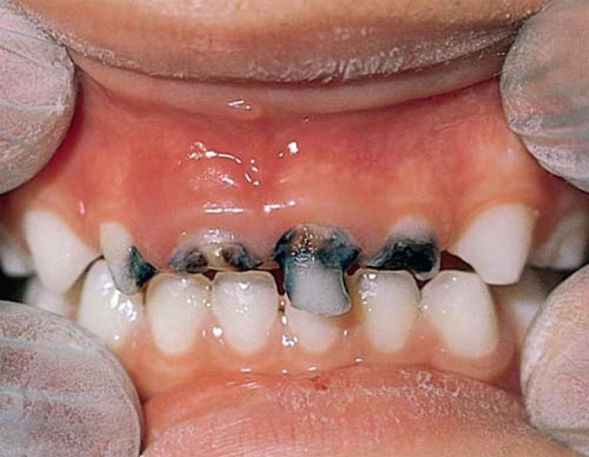
Breast Milk Substitute
Follow safety precautions
Standard commercial formulas or formulas for infants with allergies
Follow instructions precisely
Positioning of baby and bottle
Follow terminal sterilization method
Baby bottle tooth decay
From Swartz MH. Textbook of physical diagnosis, history, and examination. 5th ed. Philadelphia: Saunders; 2006.
Notes:
[Ask students to explain how to avoid problems when preparing the formula.]
Baby bottle tooth decay is shown in the photo.

Slide 13
Weaning and Cow’s Milk
Weaning
  Children set own pace
  May need encouragement to wean
Cow’s milk
  Never in first year of life
    Concentration may cause GI bleeding and it provides too heavy a load of solutes for the infants renal system
  No reduced-fat cow’s milk for those less than 2 years
Notes:
Discuss some methods that may help wean a baby from bottle-feeding.

Slide 14
How infants learn to eat
1-3 months
  Rooting, sucking, swallowing
4-6 months
  Sukling pattern with protruding tongue
7-9 months
  Pincer grasp
10-12 months
  Grasp a bottle or food and bring it to the mouth

Slide 15
Solid Food Additions
Iron-fortified cereals at ~6 months
  The most effective prevention regimen against allergic disease is to provide breast milk and to avoid all solid foods and cow’s milk (potential allergens) for a minimum of 17 weeks after birth.
  Thereafter, one new food every 3 to 5 days, as the infant tolerates, may be introduced.
Development of certain motor skills is signal
  *Needs to be able to hold head up
  *controlled movement of tongue
  After the extrusion reflex of early infancy disappears and the ability to swallow solid food is established
Some recommend vegetables and meat before fruit
Foods may be homemade
Commercial foods are available without the addition of sugar or unnecessary seasonings*
Notes:
What foods should be introduced first? Give reasons.
Why is it important to wait 3 to 5 days between introducing different foods? (Discuss identifying allergies.)
Allergens such as wheat, egg white, citrus juice, and nuts should not be given as the first solid foods but should be introduced soon after traditional solid foods are tolerated.
[Review Table 11-3, Guideline for Adding Solid Foods to an Infant’s Diet during the First Year.]
[Review For Further Focus Box, How Infants Learn to Eat.]

Slide 16
Lesson 11.2: Nutrition in Childhood and Adolescence
A variety of food patterns and habits supply the energy and nutrient requirements of normal growth and development, although basic nutritional needs change with each growth period.
Notes:
Nutrition in childhood and adolescence are discussed by age ranges: toddlers (1 to 3 years), preschool-aged children (3 to 5 years), school-aged children (5 to 12 years), adolescence (12 to 18 years).

Slide 17
Childhood
Toddlers (1 to 3 years)
  Increase variety of foods
  Pleasant surroundings
  Limit sweets
  May eat less because they are distracted*
Preschool children (3 to 5 years)
  Growth and appetite continue in spurts
  Patterns and attitudes form
  Occasional food jags
  *serve small portions
  Child-friendly version of MyPlate
Notes:
Toddlers need to have a variety of foods, including hand-held foods. Precautions need to be taken with some foods, such as baby carrots, which can cause choking and aspiration.
Preschoolers tend to eat on the run and in spurts. Food sprees and binges are normal.
Parents should not allow children to eat while moving about because of the risk of choking.
A food jag is a brief spree or binge of eating one particular food.
[Review Clinical Applications Box, Feeding Made Simple.]

Slide 18

Childhood (cont’d)
School-age children (5 to 12 years)
  *Slow, irregular growth
  Breakfast is important
  School breakfast and lunch programs
  Competitive foods harm nutrition
Reprinted from the U.S. Department of Agriculture, Food and Nutrition Service. Serving up MyPlate. Washington, DC: U.S. Government Printing Office; 2012. Available at: <www.fns.usda.gov/tn/myplate>.
Notes:
School-age girls tend to grow faster than boys at the end of the 5 to 12 year period and may need more food.
Parents should provide healthy snacks to prevent obesity. (Fig. 11-4)

Slide 19
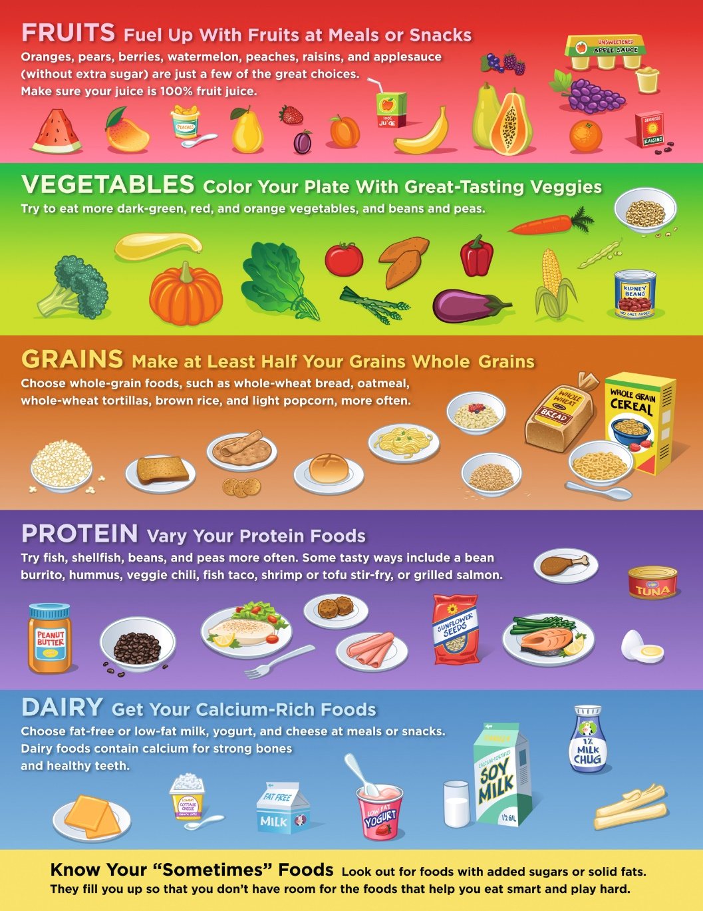
Childhood (cont’d)
Reprinted from the U.S. Department of Agriculture, Food and Nutrition Service. Serving up MyPlate. Washington, DC: U.S. Government Printing Office; 2012. Available at: <www.fns.usda.gov/tn/myplate>.
Notes:
[Ask students if any information on this page is new to them.] (Figure 11-4 cont.)

Slide 20
Common Nutrition Problems in Childhood
Failure to thrive: many possible causes-do not grow and develop normally*
Unusual nutrient needs or losses
  *overdilution of forumula
Anemia: infants consuming formula or cereal not iron-fortified; toddlers who consume excessive cow’s milk
  Anemia remains a concern for children with food insecurity and poor diets.
Obesity:genetics and environment play important roles
  Poor food selection, restrictive feeding practices contribute to binging behaviors and low physical activity*
Lead poisoning: from lead-based paint, damages CNS
Notes:
Food insecurity is limited or uncertain availability of nutritionally adequate and safe foods or limited or uncertain ability to acquire acceptable foods in socially acceptable ways.
[Discuss the rise in obesity and interventions developed to combat it.]
[Review Box 11-1, Childhood Overweight and Obesity Facts.]
[Review the Drug-Nutrient Interaction Box, Anticonvulsants and Nutrient Metabolism.]

Slide 21
Adolescence
Physical growth: Body composition
  Rapid growth during onset of puberty*
  Boys and girls differ in fat, muscle gain
  Risk of obesity continues
  Bone mineral density
Eating patterns
  Influenced by rapid growth, peer pressure
  Alcohol abuse
  Pressure to be thin
Notes:
The long-term benefits of maximizing bone growth during adolescence are of paramount importance for healthy bones throughout the remainder of life.
How does peer pressure affect eating habits?
[Review the Cultural Considerations Box, Growth Charts: Can You Use Them for All Children?]

Slide 22
Growth Charts
Breastfed infants grow more rapidly than non-breast fed infants for the first 2 months of life

Slide 23
Eating Disorders
Social, family, peer* pressures
Self-imposed crash diets, semistarvation
Parents can be the source of pressure to remain thin
Early detection and intervention are critical
Notes:
Describe how television ads affect the way adolescents feel about themselves.
[Ask students to identify signs and symptoms of eating disorders.]
[Emphasize the importance of early intervention.]

