Slide 1
Chapter 12
Nutrition for Adults: The Early, Middle, and Later Years
Notes:
This chapter explores the ways in which positive nutrition can help adults to lead healthier, disease-free lives.

Slide 2
Individual Process of Aging
Gradual aging throughout the adult years is a unique process based on an individual’s genetic heritage and life experience.
Notes:
The rapid growth and development of adolescence leads to physical maturity as adults.
Physical growth in size levels off, but the constant cell growth and regeneration that are necessary to maintain a healthy body continue.
Other aspects of growth and development—mental, social, psychologic, and spiritual—continue for a lifetime.
Life expectancy is increasing; thus health promotion and disease prevention are even more important to ensure quality of life throughout these extended years.

Slide 3
Adulthood: Continuing Human Growth and Development
Goals of Healthy People 2020: high-quality, longer lives, free of preventable disease, disability, injury, premature death
Population and age distribution
  By year 2060: U.S. population 416 million
  Number older than age 65 will more than double
  Median age will rise from 36.9 to 42
Notes:
[Ask students to identify factors that have increased life expectancy over the years.]

Slide 4
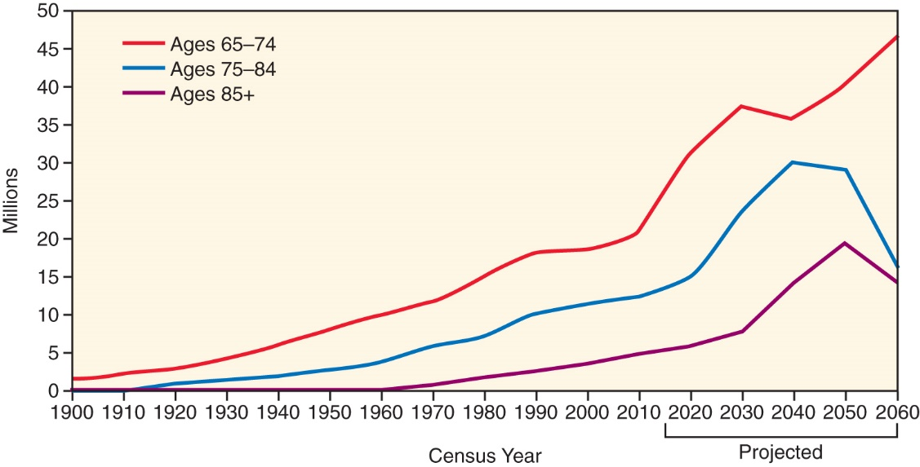
Population and Age Distribution
From U.S. Census Bureau, Population Division: Projections of the population by sex and age for the United States: 2015 to 2060 (NP2014-T9); release date December 2014.
Notes:
Your text Figure 12-1 shows the number of older adults by age group in the United States from 1900 and projected to 2060.
[Review Cultural Considerations: The Aging Composition of the U.S. Population.]

Slide 5
Life Expectancy and
Quality of Life
Life expectancy projected at 84 for men and 87.1 for women by 2060
Varies among population and income groups
Americans value health-related quality of life
Notes:
[Ask students to name some of the influences that shape adult growth and development.]
Health-related quality of life is one’s personal sense of physical and mental health and ability to act within the environment.

Slide 6
Impact on Health Care:
Career Opportunities
Disease prevention
Health promotion
Classes in healthy lifestyle and nutrition
Weight management, diabetes management
Dietitians, nurses, life coaches, personal trainers, psychologists
Notes:
As more of the population reaches old age, weight and diabetes management will be of great concern.
The health care system in America cannot continue to finance the ever increasing expense of disease treatment, particularly when most chronic diseases are preventable.

Slide 7
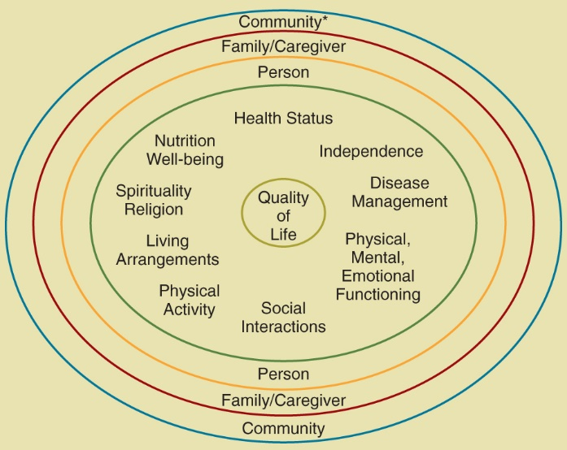
Shaping Influences on Adult Growth and Development
Physical
Psychosocial
Socioeconomic
Nutritional
Reprinted from Kuczmarski MF, Weddle DO, American Dietetic Association. Position paper of the American Dietetic Association: nutrition across the spectrum of aging. J Am Diet Assoc. 2005;105:616-630.
Notes:
[Ask students to identify some of the opportunities for growth and fulfillment in the early, middle, and later years of adulthood.]
The diagram (text Figure 12-2) shows factors that influence the quality of life of adults who are 60 years old and older. The term community includes health and supportive services at local, state, and federal levels and health professionals and researchers.

Slide 8
Physical Growth
Levels off in early adult years
Focus shifts to replacing old cells
Energy requirements decrease
Metabolic rate gradually declines
At older ages, individual vigor reflects the health status of the preceding years.
Notes:
Nutrition is key for physical growth and development.

Slide 9
Psychosocial Development
Young adult (20 to 44): Independence, new roles, life choices, long-term health patterns
Middle adult (45 to 64): Opportunity for personal growth, refocus of life direction, early evidence of chronic disease (DM), wellness, health promotion, and the reduction of disease risks continue to be major focuses on health care
Older adult (65 and older): Outcome depends on person’s ability to deal with older age
Notes:
[Ask students to explain how these psychosocial factors affect the growth of adults.
Give examples of all of these.]
Subdivisions of Older Adults = 65 to 74 (young old), 75 to 84 (elderly), 85+ (old old)

Slide 10
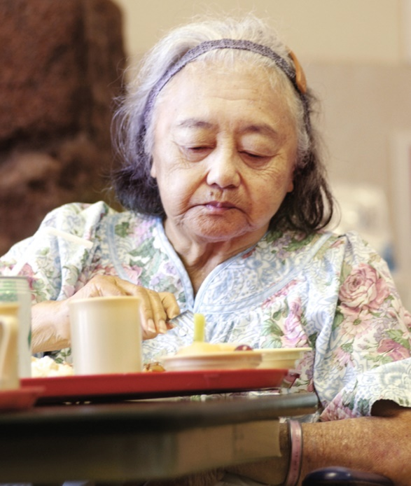
Socioeconomic Status
Pressures on food security, health, finances
Pressures and loss of productivity can combine to produce depression
**Failure to thrive
  unintentional weight loss
  Etiology-combination of chronic diseases and is associated with impaired physical function, malnutrition, depression and cognitive impairment
Copyright JupiterImages Corp.
Notes:
[Mention times throughout history when economic security was a major issue, such as the Great Depression and World War II.]
Elderly patients with declining health are particularly susceptible to depression, which is a common psychiatric condition seen in the elderly population and is a leading cause of unintentional weight loss. (Fig. 12-3)

Slide 11
Nutrition Needs
Depend on living and working situations
DRIs differ in 50- to 70-year-olds compared with 71+
Notes:
Every person needs differing amounts, depending on previous health and nutrition, current practices, and disease state.

Slide 12
Lesson 12.2: Biologic, Nutritional, Social, Economic, Psychologic, and Spiritual Aspects of Aging
Aging is a total life process that involves biologic, nutritional, social, economic, psychologic, and spiritual aspects.
Nutrition requirements change along with progressive physiologic changes of the body.
Notes:
Food and nutrition continue to provide essential support during the adult aging process.

Slide 13
The Aging Process and Nutrition Needs
Biologic changes
  Metabolism
    Gradual loss of cells results in lower metabolism, decreased muscle tone and increased adipose tissue*
    This change in metabolic rate reflects both lean muscle mass loss as well as a loss of high metabolically active organ tissues such as the brain, liver, heart and kidneys
    A contributing factor to sarcopenia is inadequate dietary protein metabolism and physical activity.
      Regular physical activity helps to maintain muscle mass and metabolic rate.
Notes:
Everyone ages in different ways, depending on their personal makeup and available resources. Ask students to identify some of these factors.

Slide 14
The Aging Process and Nutrition Needs
  Hormones
    Decline in melatonin
    Decline in insulin often results in diabetes
    Decrease in growth hormone and sex hormones
    Menopause changes body composition, risk of chronic disease

Slide 15
Effect on Food Patterns
GI secretions and motility decrease
Reduced senses affect appetite
  Vision, taste smell
  Reduced thirst
Reduced physical abilities
  Hand function
  Hand-eye coordination
Notes:
[Remind students of times when they had a cold. Did food taste, smell, or look as good?]
With a decrease in digestive juices, food is not absorbed and weight loss or fatigue may occur.

Slide 16
Individuality of the Aging Process
Senescence: process of growing old
Rate varies by individual
Rate depends on genetics and health and nutrition of past years
Notes:
Explain all the biologic changes that could be associated with nutrition problems in the elderly population.
Identify nursing measures that would address these changes.

Slide 17
Nutrition Needs
Macronutrients and fluids
  **BMR declines 1% to 2% per decade
  A more rapid decline at age 40 years for men and 50 years for women
  **Gradual loss of functioning body cells and reduced physical activity
  Mean energy expenditure for women 51 to 70: 2066 kcal/day
  For men in that age range, 2469 kcal/day
  Many factors affect energy and nutrient requirements.
Notes:
A decline in BMR means that less energy is needed for the body to function. Food intake should decrease as people age.

Slide 18
Macronutrients and Fluids
Carbohydrate: should be 45% to 65% (450-650 calories), mostly complex carbohydrates
Minimum of 130 g of CHO per day is necessary to maintain normal brain function in both children and adults**
Fat: 30% of total, backup energy source, fat-soluble vitamins, essential fatty acids
Protein: 10% to 35%, 0.8 g/kg body weight (below)
  Needs are related to the protein quality and number of total kilocalories in the diet*
Fluid: Water needs (relative to total energy needs) do not decline with age!
Notes:
Define the nutrition needs of the elderly and why they may differ from other age groups.
Dietary Protein Recommendations for Adults are shown in the table. (Table 12-1)
[Ask students whether adults over 65 years need more or less protein per kg per day? How does acute or chronic illness affect protein requirements?]

Slide 19
Micronutrients and
Health Concerns
Varied diet should be sufficient; some conditions may necessitate special attention
Osteoporosis, osteopenia increases with age*: vitamin D and calcium are essential
Safe food handling practices still important
Nutrient supplementation
  Over 55, DRI includes B₁₂ supplementation
  Vitamin D supplementation maybe needed
  Ask patients to report and discuss the use of dietary and herbal supplements.
  Recommended for people in debilitated states or to overcome malabsorption*
Notes:
Why is this population at risk for osteoporosis? (Inadequate calcium and vitamin D intake, physical inactivity, smoking and alcohol use, decreased estrogen after menopause in women, thin build, certain medical conditions and medications)

Slide 20
Bone health
*vitamin D and calcium are essential nutrients for growth and for the maintenance of healthy bone tissue

Slide 21
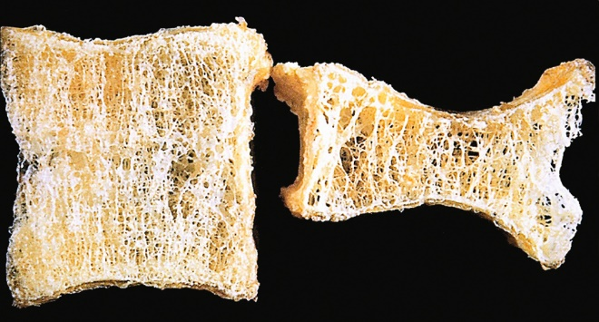
Osteoporosis
Reprinted from Kumar V, Abbas AK, Fausto N, Mitchell R. Robbins basic pathology. 8th ed. Philadelphia: Saunders; 2007.
Notes:
Osteoporosis (porous bone) is a disorder in which bone mineral density is low and bones become brittle, with a high risk of breaking.
This photo (your text Figure 12-4) shows an osteoporotic vertebral body (on the right) shortened by compression fractures compared with a normal vertebral body.
Note that the osteoporotic vertebra has a characteristic loss of horizontal trabeculae and thickened vertical trabeculae.

Slide 22
Vitamin D
*To meet the dietary recommendation for vitamin D, elderly individuals should consume foods that are fortified with vitamin D or take a dietary supplement to overcome the reduced ability to endogenously synthesize vitamin D

Slide 23
Clinical Needs of the Elderly
Health promotion and disease prevention
  Reducing risk for chronic disease
  Nutritional status
    **Poor food habits: lack of appetite, loneliness, lack of food availability
    Dental: missing teeth, poorly fitting dentures
    General gastrointestinal problems: decreased salivary secretions, inadequate hydrochloric acid in stomach, decreased enzyme and mucus secretions, and decreased motility of intestines
    Dehydration
Notes:
Be sure to emphasize the importance of fluid intake and ways to encourage more fluid intake in the elderly.
[Review Figure 12-6, Mini Nutritional Assessment.]
[Review Clinical Applications: Feeding Older Adults with Sensitivity.]

Slide 24
Clinical Needs of the Elderly
Clinical applications:
Assisted Feeding Suggestions
  Give sufficient time for the person to chew and swallow**

Slide 25
Health Promotion and
Disease Prevention
Weight management and physical activity
  *Malnutrition can produce unintentional weight gain or loss
  Over/undereating
  Regular physical activity is a major factor
    Improves blood glucose level
    Can help prevent debilitating conditions of old age by maintaining strength, functionality, independence and overall quality of life
  Need for adequate protein intake
  Risk of diabetes increases with age
Notes:
[Discuss how older adults may use overeating or undereating as a coping mechanism.]
What are some ways that older adults can increase their physical activity levels?
[Discuss the importance of a sensitive approach when assisting an older individual who has enjoyed many decades of independence and self-sufficiency.]
[Review Clinical Applications: Case Study: Situational Problem of an Elderly Woman.]

Slide 26
Health Promotion and
Disease Prevention
  Individual approach required
  Personal, sensitive approach
  *MNA standard assessment tools routinely used to evaluate nutritional risk in elderly individuals residing in nursing homes

Slide 27
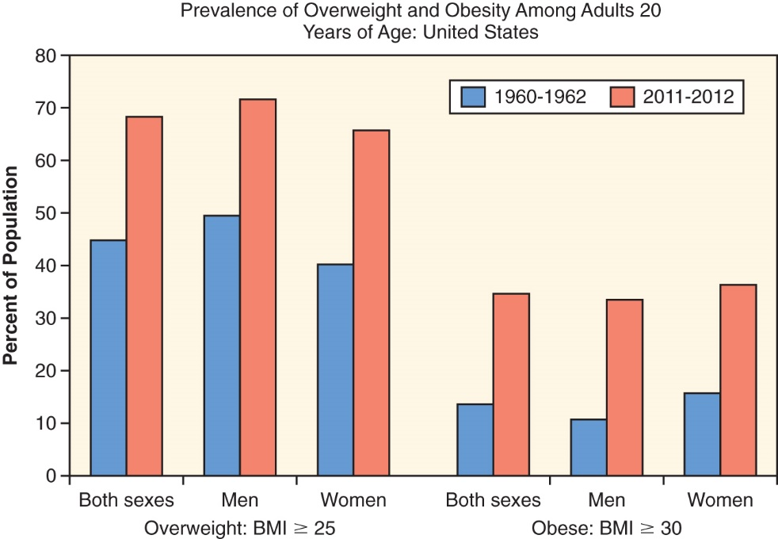
Weight Management
Data from Ogden CL et al. Prevalence of childhood and adult obesity in the United States, 2011-2012. JAMA. 2014;311[8]:806-814.
Notes:
The graph (text Figure 12-7) shows the prevalence of overweight and obesity among adults between the ages of 20 and 74 years in the United States.

Slide 28
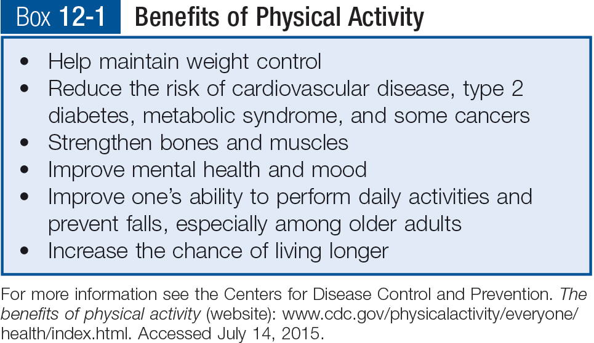
Benefits of Physical Activity
Notes:
[For more information see the Centers for Disease Control and Prevention. The benefits of physical activity (web site): www.cdc.gov/physicalactivity/everyone/health/index.html. Accessed July 14, 2015.] (Box 12-1)

Slide 29
Chronic Diseases of Aging
Hypertension
Heart disease
Stroke
Emphysema
Diabetes
Cancer
Arthritis
Asthma
Notes:
Chronic diseases are not inevitable with aging and can be prevented.
What are the lifestyle changes that can help prevent these chronic diseases? [(1) Participate in regular physical activity, (2) maintain a healthy weight by choosing a balanced diet rich in fruits and vegetables, (3) stop smoking and (4) limit alcohol intake]

Slide 30
Diet Modifications
Diet modifications in chronic disease will be covered in Chapters 17 to 23
Individual food plans are essential to recovery
Elderly that loose weight-calories less than energy needs*
Notes:
What are some patient education measures related to nutrition in various chronic diseases?
[Explain how eating more antioxidants helps the body prevent cancer in some cases.
Explain how moderate and consistent carbohydrate intake helps control diabetes.
Explain the need to monitor electrolyte levels in patients on dialysis.]

Slide 31
Medications
Polypharmacy can affect nutritional status.
Medications used by elderly can affect fluid balance, appetite, absorption of nutrients.
Ask about use of supplements or herbs
Drug-Nutrient Interaction
  Medication use in the adult
    Drug classes
      Antidepressants
      Antihyperlipidemics
      Antihypertensives
      NSAID’s
      antihistamines
Notes:
Mention drug and food interactions.
[Review Drug-Nutrient Interactions Box: Medication Use in the Adult.]

Slide 32
Community Resources
Government programs for older Americans
  Poverty has direct link to chronic diseases
  Older Americans Act
    Congregate nutrition services
    Home-delivered meals
    *services are focused on reaching the elderly with the greatest social and economic need
    Congregate nutrition services
    Hot noon meal in senior centers
    Home delivered meals
    ill or disabled adults who cannot travel, meals are delivered to home
Notes:
Congregate meals and home-delivered meals have been approved for nutrient and calorie content.

Slide 33
Community Resources (cont’d)
Government programs for older Americans
  U.S. Department of Agriculture
    Research centers: focus on nutrition in aging
    Extension services: in state land grant universities
    Supplemental Nutrition Assistance Program (SNAP): formerly known as food stamps, now use cards similar to debit cards
Notes:
Extension services are a nationwide program found through local county governments.

Slide 34
Community Resources (cont’d)
Government programs for older Americans (cont’d)
  U.S. Department of Agriculture (cont’d)
    Commodity Supplemental Food Program: food packages for eligible older adults
    Senior Farmers Market Nutrition Program: provides low-income older adults with coupons for fresh produce obtained from markets, roadside stands
  Public Health departments
    Division of Department of Health and Human Services
    Work through local and state public health departments
Notes:
[Ask students where they buy their produce. Is there a farmers’ market in your area?]

Slide 35
Professional Organizations and Resources
Professional organizations and resources
  National groups: societies of health care workers
  Community groups: medical, nursing, dietetic associations
  Volunteer organizations: national associations offer volunteer opportunities and resources
Notes:
The American Heart Association and the American Geriatric Society are examples of professional groups focusing on older adult health.

Slide 36
Alternative Living Arrangements
Independent living facilities: for those not needing medical care
Congregate care arrangements: keep elderly in their homes
Continuing care retirement communities
  Spectrum of long-term care
  Independent living to nursing care facilities
Notes:
A shortage of nursing staff at nursing homes is currently an issue in the United States.

Slide 37
Alternative Living Arrangements (cont’d)
Assisted living facilities
  Known by several names
  Provide all meals, housekeeping, assistance with activities of daily living
Nursing homes
  Provide the most medical, nursing, nutrition support
  Assistance with activities of daily living
  *Less emphasis on therapeutic diets is given for this population because a less-restrictive diet model is thought to be more beneficial at this stage in life.
Notes:
Most assisted living centers provide all meals and snacks, laundry, housekeeping, and help with personal hygiene.
Researchers believe that the autonomy, ambiance, and social interaction of family-style eating (compared with plated tray delivery) contribute to the significant increase in energy and nutrient intake.

