Slide 1
Chapter 13
Community Food Supply and Health
Notes:
This chapter explores the factors that influence the safety of food.

Slide 2
Food Safety and
Health Promotion
U.S. Food and Drug Administration
  Primary governing body of the American food supply, with the exception of commercial meat, poultry and egg products***
  Enforcement of Federal Food Safety Regulations
    FDA is a law enforcement agency
    Methods = recall, seizure, injunction, and prosecution
  Consumer Education and Research
    FDA and U.S. Department of Agriculture
      Total Diet Study
      Healthy People Initiative set goals for Healthy People 2020
Notes:
The FDA is the primary governing body of the food supply (except meat and poultry).
[Review Table 13-1: Agencies Involved in Food Safety Regulation.]
Federal regulations that the FDA enforces deal with:
enforcing food sanitation and quality control;
controlling food additives;
regulating the movement of foods across state lines;
maintaining the nutrition labeling of foods; and
ensuring the safety of public food service.

Slide 3
Food Labels
Early development of label regulations
  Food standards: list ingredients in order of relative amount
  Nutrition information: macronutrients, energy value, key micronutrients
Background of present FDA label regulations
  Increase in variety of food products
  Changing patterns of U.S. eating
Notes:
Many health-conscious Americans rely on food labels in making food choices.
Other food standard information on labels relates to food quality, fill of container, major food allergens, and enrichment or fortification.
Individuals who use and understand the food labels also have an overall healthier diet pattern than those individuals who do not.

Slide 4
Food Labels
Title = Nutrition Facts
Manufacturers may include additional information
Percent daily value
Serving size
*must be expressed in household measures
Front-of-package labeling
*FDA established 2000 kcal as reference amount for calculating the % daily value
Notes:
Nutrition information includes:
Amount of carbohydrates, proteins, fats
Calories
Vitamins, minerals
Sodium
Cholesterol
Saturated fat
Percentage of Recommended Dietary Allowance standard per defined portion.
[Review Figure 13-2 on front-of-package labeling.]

Slide 5
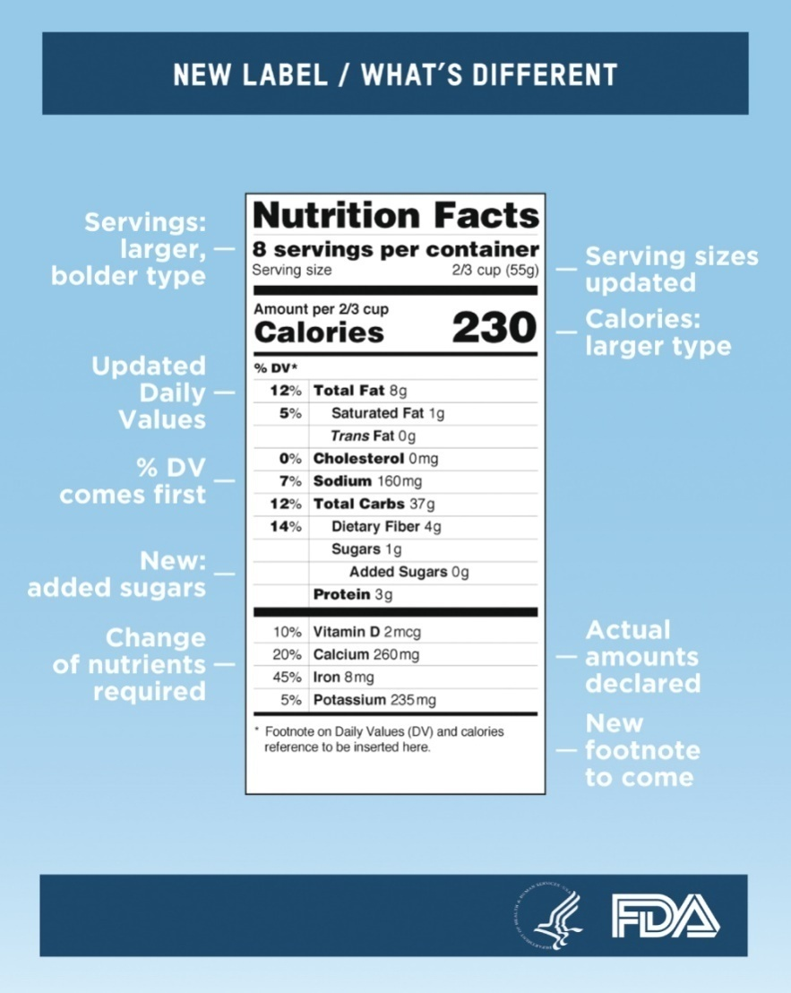
Food Safety and Health Promotion (cont’d)
Courtesy U.S. Food and Drug Administration, Washington, DC.
Notes:
Example (text Figure 13-1) of a food product label showing the detailed Nutrition Facts box of nutrition information proposed for the updated Nutrition Facts Label.
What changes do you notice here compared with the food labels currently in use? [Discuss.]
[Review For Further Focus Box: Glossary of Terms for Nutrition Facts Labels.]

Slide 6
Descriptive terms on products
Low cholesterol: < 20 mg of cholesterol per serving and per 100 g; 2 g of saturated fat or less per serving. Any label claim about low cholesterol is prohibited for all foods that contain more than 2 g of saturated fat per serving**

Slide 7
Health Claims
FDA must approve any claims linked to disease
  Health claims that link nutrients or food groups with a risk for disease are strictly regulated.
  Example- low sodium and the prevention of HTN*
Must use specific wording
Notes:
The FDA provides model claim statements.

Slide 8
Food Technology
Agricultural and food processing industries have developed chemicals and methods to increase and preserve food supply.
Critics are concerned about how some changes have affected food safety and the environment.
Notes:
Certain percentages of pesticides are acceptable and legally permitted in or on food commodities and animal feeds.

Slide 9
Agricultural Pesticides
Goal is to feed a growing population
**Pesticides improve crop yields
  Example: Chemicals destroy many destructive insects
Problems
  Pesticide residue on food
  Gradual leaching of chemicals into ground water and wells
  Increased exposure of farm workers
  Increased amounts required as insects develop tolerance
Notes:
[Ask students to identify some pesticides that have been found to be harmful to humans or the environment. (DDT)]

Slide 10
Alternative Agriculture:
Organic Farming
Grow foods without synthetic pesticides, fertilizers, sewage sludge, bioengineering, or ionizing radiation
Companies that use the label on their food without certification face a large fine*
*california is the major US supplier of fruits and vegetables
Raise animals and produce dairy products without antibiotics or growth hormones
The terms natural, hormone free, and free range are not synonymous with organic.
The term natural may be used on products that contain no artificial ingredients (e.g., coloring, chemical preservatives) and if the product and its ingredients are only minimally processed.
Notes:
Many farmers use an organic farming process so that pesticides and other harmful chemicals are not used during the growing process.
[Review For Further Focus Box: Organic Food Standards.]

Slide 11
Biotechnology
Genetically modified foods
  Reduce the need for toxic pesticides and herbicides
    Example: genetically modified corn that expresses a protein that acts as an insecticide
  Remain controversial around the world because of many unknown factors regarding the long-term effects on the environment and overall human health
Notes:
[Review text Figure 13-4: Adoption of genetically engineered crops continues to grow rapidly in the United States.]
More than 60% of processed foods contain some genetically modified ingredients.

Slide 12

Biotechnology
*Irradiation = use of ionizing radiation to kill bacteria and parasites on food after harvest.
  *May increase shelf-life
  FDA symbol required
  Variety of foods approved-meat poultry, grains, some seafood, fruits, vegetables, herbs and spices
Courtesy Food Safety and Inspection Service, U.S. Department of Agriculture, Washington, DC.
Notes:
The FDA requires that all irradiated foods be appropriately labeled either with the radura symbol for irradiation (shown) or with a written description that states that the food has been exposed to irradiation. (Fig. 13-5)

Slide 13
Food Additives
Chemicals intentionally added to foods to prevent spoilage and extend shelf-life
Benefits include:
  Enriched food with added nutrients
  Uniform quality
  Standardized functional factors (e.g., thickening)
  Preserves foods
  Controls acidity and alkalinity
  *sometimes increase the nutritional value
Notes:
“Food additive” is defined by the FDA as any substance used to provide a technical effect in foods. The use of food additives has become more prominent in recent years because of the increased production of prepared, processed, and fast foods.
[Review Table 13-2, Examples of Food Additives.]

Slide 14
Food-Borne Disease
Outbreaks of food-borne illness are more likely to be reported to the CDC than individual instances of illness.
Prevalence
  Disease-causing organisms found in food, water
  Prevention has improved
  Lapses still occur
Notes:
What are the most common infections in home and community outbreaks? (Salmonella, Campylobacter, Shigella, and Cryptosporidium)
[Review Figure 13-6: Relative rates of culture-confirmed infections with known pathogens compared with 2006-2008 rates, by year.]

Slide 15
Food Safety
Buying and storing food
  Start with quality food
  Dry or cold storage
  Clean: wash hands and surfaces often
  Separate: avoid cross-contamination
  Cook: to proper temperature
  **Chill: refrigerate promptly at less than 40 degrees
    Food does not need to be cooled to room temperature before refrigerating; this practice allows food to sit in a temperature range that is perfect for bacterial growth.
Notes:
Always refrigerate perishable food in less than 2 hours.
[Review Table 13-3: Cold storage.]

Slide 16
Preparing and Serving Food
Food handlers practice proper hygiene
Follow minimal internal temperatures
“Life begins at 40”: Keep hot foods hot; cold foods cold
HACCP** focus prevent food borne illness by identifying critical points and eliminating hazards
Notes:
Shown are the minimal internal temperatures to be reached when cooking various foods. [Ask students how hot various dishes need to be for safety.]
Foods should be kept colder than 40 degrees in the refrigerator, or hotter than 140 degrees. Hence the reminder, “Keep hot foods hot; cold foods cold.”

Slide 17
Food Contamination
Food-borne illness usually presents with flulike symptoms but can be lethal illness*
High-risk individuals: age, physical condition
  Young children
  Pregnant women
  Elderly
  Individuals with compromised immune systems
Notes:
Safe steps in food handling, cooking, and storage are essential to prevent food-borne illness.

Slide 18
Bacterial Food Infections
Result from eating food contaminated by large colonies of bacteria
  Salmonellosis, Shigellosis, Listerosis, Escherichia coli
Salmonellosis
  Caused by Salmonella, which grow readily in milk, custard, egg dishes, salad dressing, sandwich fillings, seafood from polluted waters
  Unsanitary food handling can spread bacteria
Notes:
Symptoms of Salmonellosis include diarrhea, fever, vomiting, and abdominal cramps.
Symptoms develop slowly, up to 48 hours later.
Illness lasts 4 to 7 days.
[Review Figure 13-8, The number of illnesses attributed to each food category during 2008-2012.]

Slide 19
Shigellosis
Caused by Shigella, which grow easily in milk
Most common in young children
Usually confined to large intestine
Transmitted by (4f’s) feces, fingers, and flies and by foods that are handled by unsanitary carriers
Notes:
Symptoms vary from mild intestinal disturbance to fatal dysentery in young children.

Slide 20
Listeriosis
Caused by Listeria
Grows in soft cheese, poultry, seafood, raw milk, refrigerated raw liquid whole eggs, meat products (such as pâté)
Can produce rare but often fatal illness, with diarrhea, flulike fever and headache, pneumonia, sepsis, meningitis, and endocarditis.
Pregnant women are 10 times more likely to get listeriosis than the general public*
Notes:
Pregnant women are 10 times more likely to get listeriosis than the general public.

Slide 21
Escherichia Coli
Many strains of E. coli; not all are harmful
  Some strains are part of the healthy gut flora that survive in the intestines and produce a valuable supply of vitamin K.
An estimated 265,000 infections occur annually in the United States.
Most dangerous to young children and elderly
Can result in hemolytic uremic syndrome, potentially fatal
Notes:
Emphasize the importance of proper hygiene in preventing the spread of E. coli.
Spread through fecal contamination, undercooked meat, unpasteurized foods
[Review the Drug-Nutrient Interaction Box: Drug-Resistant Escherichia coli and the Food Supply.]

Slide 22
Vibrio
Inhabits salt-water coastal regions of North America
Ingested via contaminated seafood
Immunocompromised individuals most at risk
Notes:
The importance of thoroughly cooking seafood, especially shellfish, to reduce the risk of vibrio infection cannot be overstated.

Slide 23
Bacterial Food Poisoning
*Food poisoning is caused by ingestion of toxins already produced by bacteria before the food is eaten.
    The toxin causes no change in the normal appearance, odor, or taste of the food.
    Most common types = Staphylococcal and Clostridial
Staphylococcal food poisoning
  Caused by Staphylococcus aureus
  Rapid onset of severe symptoms in 1 to 6 hours
  Recovery fairly rapid in 24 to 48 hours
  Usually passed via food-worker’s hand
    Bakery goods, potato salad, ham*
Notes:
Symptoms of staphylococcal food poisoning:
Severe cramping and abdominal pain
Nausea
Vomiting
Diarrhea
Headache, fever, sweating
Sometimes prostration and shock
[Review the Clinical Applications Box: Case Study: A Community Food Poisoning Incident.]

Slide 24
Clostridial Food Poisoning
Caused mostly by Clostridium perfringens and C. botulinum
*Clostridium perfringens develops in cooked meat dishes
  Multiplies in cooked meat and meat dishes and develops its toin in foods that are held at warm or room temperatures for extended periods
  Number of outbreaks from food eaten in restaurants, college dining rooms and school cafeterias
  In most cases cooked meat is improperly prepared or refrigerated*
  *known as buffet/cafeteria germ
*C. botulinum much more serious, often fatal
  *symptoms appear in 12-72 hours and can result in death.
  *mortality rates high
  *usually from improperly canned food
Notes:
C. perfringens
Multiply in cooked meat and meat dishes
Develop in food held at warm (109-117 degrees) or room temperature for extended period.
[Review Table 13-4, Examples of Food-Borne Disease.]

Slide 25
Viruses
Food-borne disease outbreaks resulting from norovirus contamination are estimated to be the most common cause of food-borne illness in the United States.
  However, norovirus is much less likely to cause hospitalization than other forms of food-borne illness such as Salmonella or E. coli contamination.
Hepatitis A is less common in the United States than in other countries due to vaccine.
Notes:
Strict control of community water and food supplies, personal hygiene, and sanitary practices of food workers are essential to protect viral contamination.

Slide 26
Parasites
Giardiasis (Giardia lamblia)
  Most common food-borne parasitic illness in the United States.
  Lives in intestine in infected individuals
Roundworms and Flatworms
  Examples: trichina worm found in pork (roundworm); tapeworms in beef and pork
  Control measures:
    Laws controlling hog/cattle food sources and pastures to prevent transmission of the parasites to the meat
    *The avoidance of rare beef and undercooked pork as an added personal precaution
Notes:
Discuss the two measures that have helped stop the spread of parasites in the food supply.

Slide 27
Environmental
Food Contaminants
Lead
  No level of lead in the blood is safe.
  Sources include lead paint, airborne lead particles, water from lead pipes
  *children with elevated blood lead levels have lower intellectual performance compared with similar children who do not suffer form lead toxicity
Natural toxins
  Mercury
  **Toxin that contaminates large bodies of water and the fish within that water
    Sources include fish from contaminated water
  Aflatoxin
    Produced by fungi
Notes:
Lead
Children are especially vulnerable.
Iron deficiency increases lead absorption.
[Review the Cultural Considerations Box: The Continued Burden of Lead Poisoning.]
Aflatoxin
May contaminate peanuts, tree nuts, corn, and animal feed.

Slide 28
Food-borne diseases
Bacillus
*Camplobacter jejuni
*Ecoli
Cryptosporidium
*Hepatitis A

Slide 29
Food-borne diseases
*Listeria
*Norovirus
*Salmonella
Shigella
Staph aureus

Slide 30
Lesson 13.3: Poverty and the Community Food Supply
Poverty often prevents individuals and families from having adequate access to their community food supply.
There are several aid programs available to help individuals secure food for themselves and their family.
Notes:
Potential health problems related to the food supply can arise from several sources, such as the lack of sanitation, food-borne disease, and poverty.

Slide 31
Food Needs and Costs:
Hunger and Malnutrition
Worldwide malnutrition
  Lack of sanitation
  Cultural inequality
  Overpopulation
  Economic and political structure
  Chronic food or nutrient shortages
In the United States
  More than 49 million individuals have food insecurity
Notes:
Chronic food and nutrient shortages within a population perpetuate the cycle of malnutrition; undernourished pregnant women give birth to low birth weight infants.
Low birth weight infants are highly susceptible to infant mortality or growth retardation.
What is food insecurity? [limited or uncertain availability of nutritionally adequate and safe foods or limited or
uncertain ability to acquire acceptable foods in socially acceptable ways.]

Slide 32
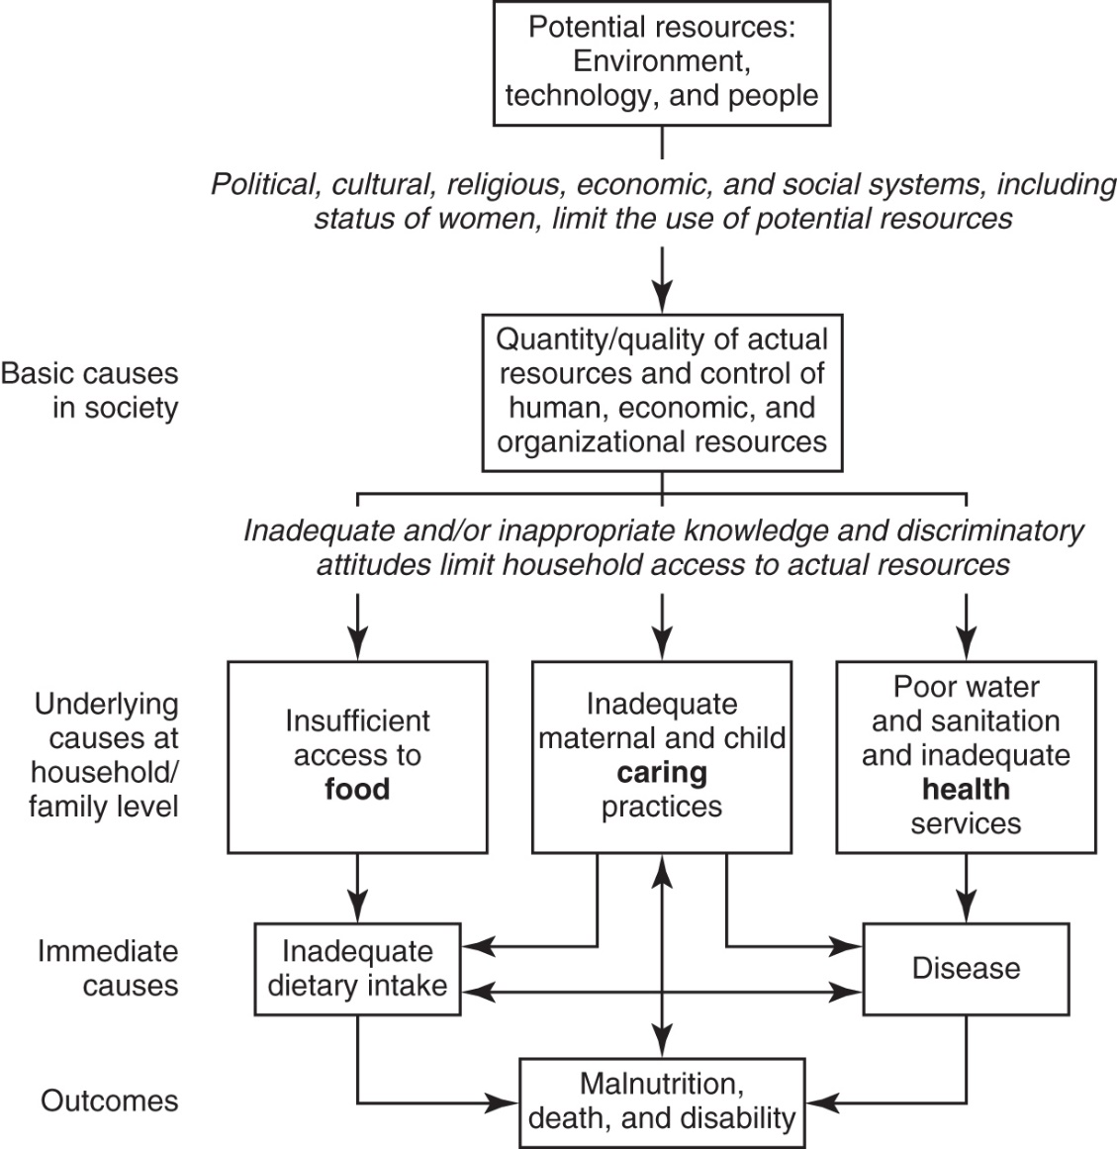
Multiple Causes of Malnutrition
Adapted from United Nations Children's Fund, The State of the World's Children, 1998, New York, NY UNICEF/Oxford University Press, 1998.
Notes:
Ask students to cite some examples of the causes of malnutrition at each level of this chart (text Figure 13-9).
[Also Review Figure 13-10, Differences in life outcomes when education, financial credit, and health care are accessible.]

Slide 33
Food Assistance Programs
*Commodity Supplemental Food Program
  USDA purchases and distributes food
  Low income elderly*
Supplemental Nutrition Assistance Program (SNAP)
  Households qualify based on low income
  Similar to debit card to supplement food for a month*
Special Supplemental Food Program for Women, Infants, and Children (WIC)
  For women who are pregnant, postpartum, or breastfeeding and their children younger than 5 years*
  Vouchers for fortified cereals, milk, eggs, cheese*
School breakfast and lunch programs
  Competitive foods
  National school lunch program**
Nutrition Services Incentive Program
  Promotes health for older individuals
  *congregate meals programs
Notes:
With the School Meals Programs, children eat for free or at reduced rates, and these meals often comprise their main food intake for the day.
Competitive foods historically contributed to the overconsumption of calories, plate waste of nutritionally balanced school lunches, and the decreased intake of nutrients by students.
Under the Nutrition Services Incentive Program, regardless of income, all people who are older than 60 years old can eat hot lunches at a community center under the Congregate Meals Program; if they are ill or disabled, they can receive meals at home by using the services of the Home-Delivered Meals Program.
[There are many possible topics of discussion regarding food assistance programs, including program outcomes, program operations and integrity, vulnerable populations, the relation between food assistance programs and the general economy, and food security in the United States.]

Slide 34
Food Buying and Handling Practices
Planning ahead to control impulse buying
Buy wisely
  Understand packaging, carefully reading labels, and watching for sale items
  Only buy in quantity if savings will be achieved and if can be safely stored
Store food safely
  Control waste and prevent illness
Cook food well
Notes:
Safe food handling practices from the store to the table are essential.
Wash hands and surfaces often.
Don’t cross-contaminate.
Refrigerate promptly.
Cook to safe temperatures.

