Slide 1
Chapter 14
Food Habits and Cultural Patterns
Notes:
Why do people eat what they eat?
Food is necessary to sustain life and health, but people eat certain foods for many reasons other than good health and nutrition, although these are important factors.
The broader food environment from which we have to choose is often influenced by factors such as politics and poverty, which limit personal control and choice.

Slide 2
Lesson 14.1: Social, Cultural, and Economic Patterns and Food Habits
Personal food habits develop as part of a person’s social and cultural heritage and his or her individual lifestyle and environment.
Social and economic changes often result in alterations in food patterns.
American eating patterns are influenced by many different cultures.
2
Notes:
All food habits are intimately related to people’s way of life: their values, beliefs, and situations.
However, sometimes these food patterns change over time with more exposure to other cultural patterns.

Slide 3
Social, Psychologic, and Economic Influences on Food Habits
Social impact
  *Groups may be formed by economic status, education, residence, occupation, family, cultural factors
  Group affiliation influences food attitudes and choices
  Food symbolizes acceptance and warmth in social relationships
  Certain foods trigger childhood memories
3
Notes:
Discuss how social structure, religion, education, and social status influence food habits.
People accept food advice from family, friends, or trusted authorities.
Who purchases, prepares, and distributes food in the family?

Slide 4
Factors that Influence Personal Food Choices
Ethnic patterns and cultural habits
Psychologic Influences
  Food has many personal meanings
  Many psychologic factors rooted in childhood
Food and psychosocial development
  Food relates closely to psychosocial development
  Toddlers may become “picky eaters” to control parents
  *Food neophobia (fear of unfamiliar foods) is normal developmental factor
4
Notes:
Does your culture have any food taboos?
What are your culture’s table manners?
Discuss comfort foods. What kinds of foods are more likely to be comfort foods?
Certain foods stimulate endorphins.
[Review Box 14-1, Factors That Determine Food Choices.]

Slide 5
Marketing and Environmental Influences
Media
*Peers
Convenience items
Grocery stores
Cartoon characters
Body-image expectations
5
Notes:
How do these factors influence food choices?
How have you been influenced to purchase specific products in grocery stores?

Slide 6
Economic Influences
Low-income families suffer extreme need
Illness, hunger, and malnutrition are more common in this group
About 14.5% of Americans live below poverty level
The costs of a healthy diet is difficult to achieve for families at or below the poverty level
6
Notes:
Cost and accessibility, education, and knowledge are the socioeconomic influences on food choices.
Would a tax on unhealthy foods, making them more expensive than fruits and vegetables, be a solution?

Slide 7
Cultural Development of
Food Habits
Strength of personal culture
  Language, religion, politics, location
    *Foods can have symbolic meanings related to major life events.
    *Ceremonies and religious rites involving food have surrounded certain events and seasons.
  Habits of everyday living and family relationships
  Americans have broad range of food habits shaped by diversity
7
Notes:
[Discuss how students formed their existing eating patterns and food habits.
Discuss how each of these influences affects individual food choices and habits.]

Slide 8
Traditional Culture-Specific
Food Patterns
Shift in focus from “melting pot” to “diversity”
American cities retain pockets of ethnic groups
Cultural food habits are retained
  Traditional foods have strong meanings and bind families and cultural communities
Individuals of any heritage may or may not consume typical American foods.
Acculturation to the typical Western diet of Americans is a significant concern for Hispanic and Latino immigrants.
8
Notes:
Where do you go to taste foods specific to a particular heritage?
Some cultures view adapting a typical Western diet to be associated with reduced quality of life due to chronic disease.

Slide 9
Spanish Influences
Mexican
  Basic foods: dried beans, tomatoes, corn, squash
  *basic fat is lard
  Small amounts of meat and eggs are used
  Fruit consumption depends on availability and price
Puerto Rican
  Food pattern is similar to Mexican
  Tropical fruits and vegetables are added
  Basic foods include viandas (starchy vegetables and fruits such as plantains and green bananas), rice, beans
9
Notes:
[Review the Cultural Considerations Box, Acculturation to an American Diet.]
Discuss the advantages and disadvantages of the Americanization of native diets.

Slide 10
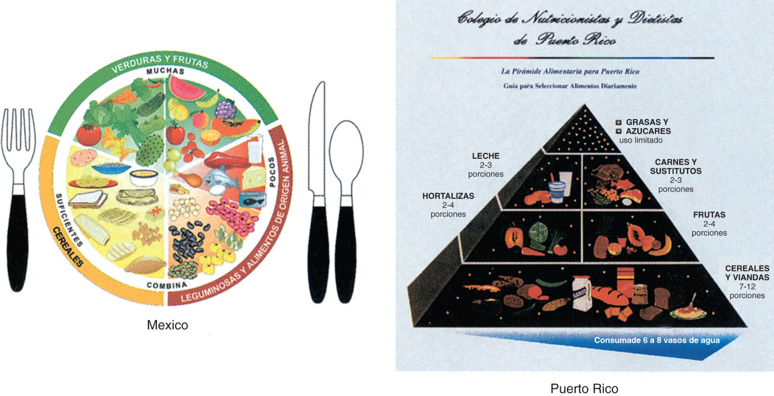
National Food Guides for
Mexico and Puerto Rico
Reprinted from Painter J, Rah JH, Lee YK. Comparison of international food guide pictorial representations. J Am Diet Assoc. 2002;102:483-489, with permission from the Academy of Nutrition and Dietetics.
10
11
Notes:
For individuals of Mexican heritage, a high prevalence of lactose intolerance limits large intakes of milk products. (Fig. 14-1)

Slide 11
Native American
American Indian and Alaska Natives
Hundreds of diverse groups
All have a spiritual devotion to the land
Food has great religious and social significance
Food differs according to what can be grown locally, harvested or hunted on the land, or fished from local waters.
  Corn/maize popular*
11
Notes:
Discuss changes in the Native American diet, including the addition of alcohol, high-fat foods, and high-sodium foods.
[Review Table 14-1, Historical Dietary Patterns of Spanish and Native American Cultures.]

Slide 12
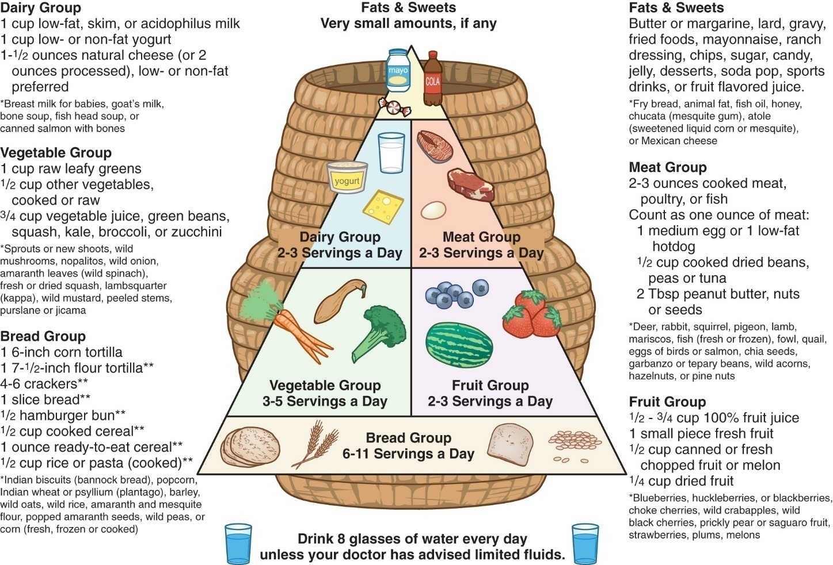
Native American: Southern Arizona American Indian Food Guide: Choices for a Healthy Life
Osterkamp LK, Longstaff L. Development of a dietary teaching tool for American Indians and Alaskan Natives in Southern Arizona. Nutr Educ Behav. 2004;36:272-274.
12
Notes:
What are some of the health benefits and health hazards of the Native American food habits? (Fig. 14-2)

Slide 13
Influences of
Southern United States
African Americans- “soul food”*
  Food patterns developed through creative ability to turn basic staples into memorable food
  Traditional breads include hot breads (biscuits, spoonbread, cornbread)
  Wide variety of vegetables and leafy greens (turnip, collard, mustard) are used
  Pork is a common meat
    Fry foods using lard or vegetable oils
    *high risk for HTN
13
Notes:
African Americans have a high prevalence of lactose intolerance. Consequently, some cheese is used in meals but not much milk.

Slide 14
Influences of
Southern United States (cont’d)
French American
  Cajun people in southern Louisiana are descendants of the French colonists of Arcadia (now Nova Scotia)
  French culinary background blended with Creole cooking around New Orleans
  Foods are strongly flavored, spicy
  Seafood is abundant
    Crawfish boil
14
Notes:
Popular seasonings include cayenne pepper, crushed black pepper, white pepper, bay leaves, thyme, and filé powder (from ground sassafras leaves).
Discuss advantages and disadvantages of Cajun cuisine.
[Review Table 14-2, Historical Dietary Patterns of the African-American and Cajun American Cultures.]

Slide 15
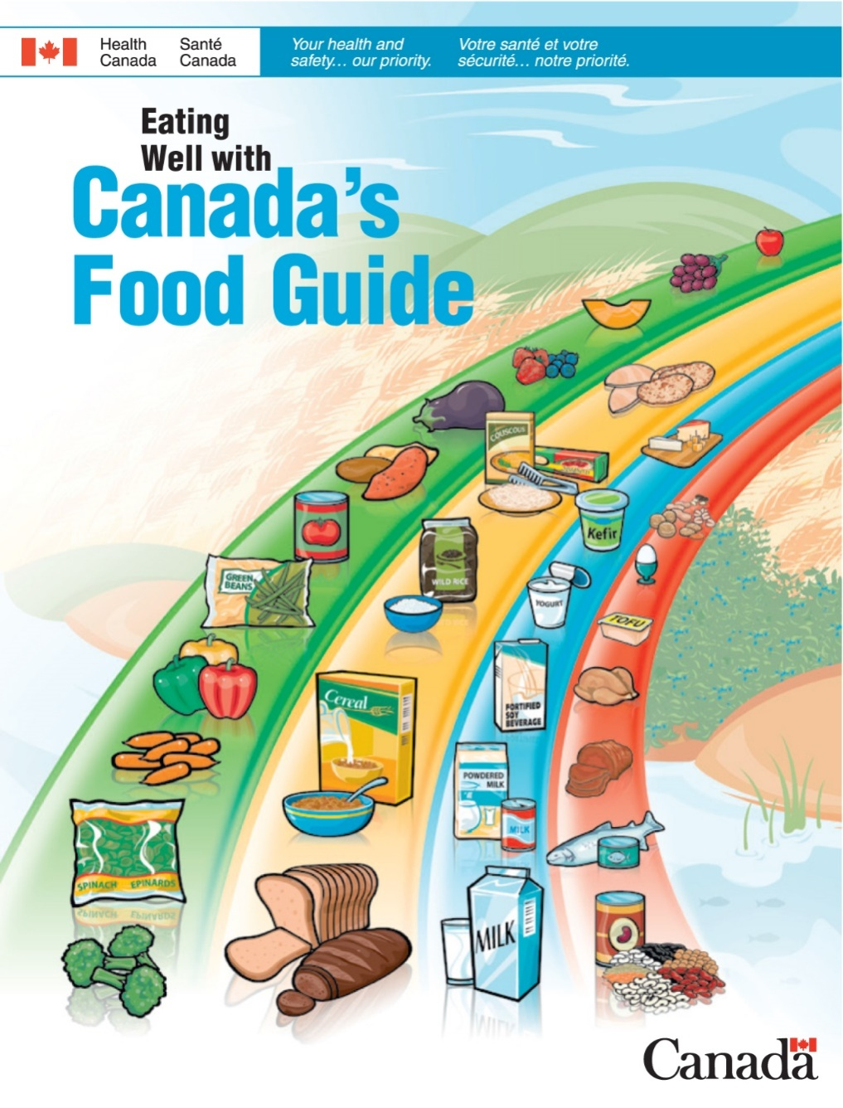
Canada
16
Notes:
[Ask students to point out the similarities between Canada’s Food Guide and the MyPlate recommendations from the United States.]

Slide 16
Asian Food Patterns
Chinese
  Large array of fruits and vegetables, rice a staple
  Use a wok for quick stir-frying with little fat
  Small amounts of meat, eggs, and tofu are sources of protein
Japanese
  Rice is basic grain
  Many varieties of fish and shellfish used
  Vegetables often steamed or pickled
  Diet is high in sodium, low in milk
16
Notes:
Most Asians living in America adhere to a traditional Asian diet interspersed with American foods.

Slide 17
Asian Food Patterns (cont’d)
Southeast Asian: Vietnamese, Indonesian, Cambodian, Laotian, Filipino
  Rice is a staple
  Soups are common
  Many fruits and vegetables
  Seafood, pork, chicken, and duck are common
  In a traditional diet, nuts and legumes are the primary sources of protein.
  Red meat eaten only in small quantities
17
Notes:
Stir-frying in a wok with a small amount of lard or peanut oil is a common method of cooking.

Slide 18
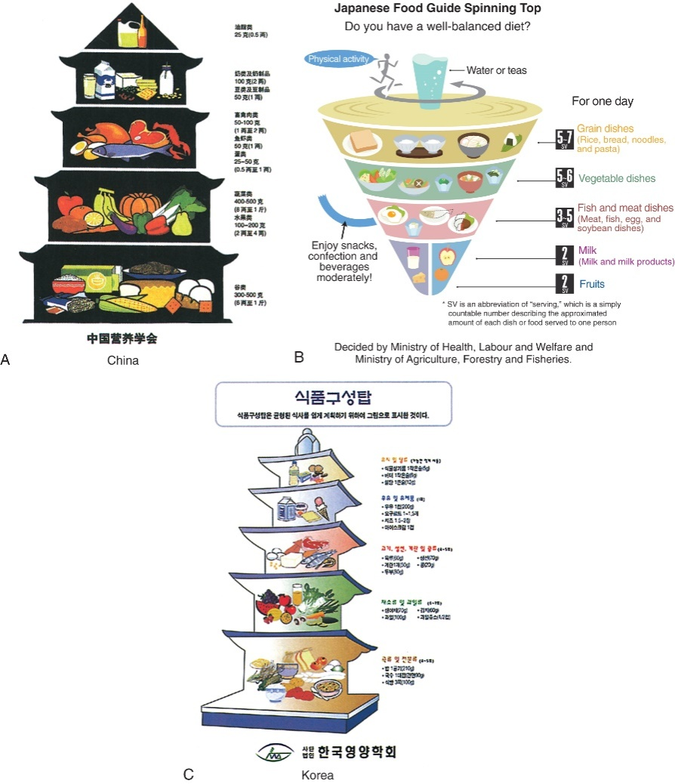
National Food Guides for
China, Japan, and Korea
Reprinted from Painter J, Rah JH, Lee YK. Comparison of international food guide pictorial representations. J Am Diet Assoc. 2002;102:483-489, with permission from the Academy of Nutrition and Dietetics; and Yoshiike N, Hayashi F, Takemi Y, et al. A new food guide in Japan: the Japanese food guide Spinning Top. Nutr Rev. 2007;65[4]:149-154.
18
Notes:
Compare the food guides of China, Japan, and Korea. How are they similar, and how do they differ? (Images are text Figure 14-4 A-C.)
[Review Table 14-3, Cultural Dietary Patterns of Asian Influence.]

Slide 19
Mediterranean Influences
Italian
  Bread and pasta are staples.
  Cheese, meats, poultry, fish, sausages, cold cuts, and vegetables commonly used
  Olive oil, garlic, herbs, and wine used in cooking
  Fruit as a snack
Greek
  Bread is the center of every meal.
  Cheese (feta), yogurt, vegetables, rice, lamb, and fish commonly used
19
Notes:
Mediterranean countries are known for leisurely dining. Eating more slowly, enjoying company, and mentally relaxing can all benefit health.

Slide 20
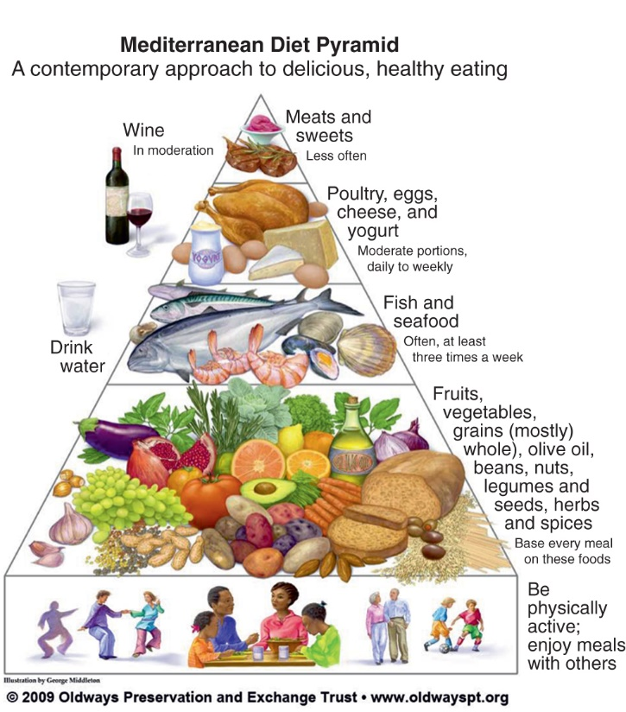
Mediterranean Influences (cont’d)
Copyright 2009, Oldways Preservation & Exchange Trust, Boston, Mass; www.oldwayspt.org/mediterranean-diet-pyramid.
20
Notes:
Discuss the benefits of the Mediterranean diet; why is it considered heart healthy? (Fig. 14-5)
Which other culture included physical activity in their food guide? [Japan]
[Review Table 14-4, Historical Dietary Patterns of the Mediterranean.]
[Review Clinical Application Box, Mediterranean Diet and Heart Disease.]

Slide 21
Religious Dietary Laws
Religious dietary laws:
  Christianity
    Catholic
    Protestant
    Eastern Orthodox
  Judaism
  Hinduism
  Buddhism
  Islam
21
Notes:
Some are applicable at all times, whereas other laws apply only during religious ceremonies.
Some dietary laws are interpreted by individuals.

Slide 22
Religious Dietary Laws (cont’d)
Different dietary laws depending on orthodox, conservative, or reform beliefs
Dietary laws are called Rules of Kashruth; foods prepared according to these laws are kosher
*Meat should come only from animals that chew their cud and have cloven hooves; no pork or birds of prey
*Meat and milk products are not mixed
*Shellfish and crustaceans are avoided
No eggs with blood spots are eaten
22
Notes:
Discuss the origins of the dietary laws.
Where can one obtain kosher food in your community?

Slide 23
Religious Dietary Laws (cont’d)
Many traditional Jewish foods relate to festivals of the Jewish calendar
Examples: bagels, blintzes, borscht, challah, gefilte fish, kasha, knishes, lox, matzo, strudel
23
Notes:
What are some Jewish holidays that involve food?
Have you heard of any of these foods before? Which have been adapted to American cuisine?

Slide 24
Religious Dietary Laws (cont’d)
Muslim
  Dietary laws depend on restriction or prohibition of some foods, promotion of other foods
    The laws are binding and must be followed at all times, even during pregnancy, hospitalization, and travel.
  Milk products: permitted at all times
  Fruits and vegetables: permitted unless fermented
  Breads and cereals: permitted unless contaminated
  Seafood and land animals (except pork): permitted
    Halal meat is the equivalent of kosher meat (no blood)
  **Alcohol: prohibited
24
Notes:
[Discuss the origins of the Islamic food laws.]
Consider how hard it would be for a person in America to follow Jewish or Islamic dietary laws.

Slide 25
Religious Dietary Laws (cont’d)
Representative Foods: Muslim
  **Bulgur
  Falafel
  Fatayeh
  Kibbeh
  Pilaf
  Pita
  **Tabouli
25
Notes:
Which of these have been adapted to American cuisine? Which ones have they eaten in the last few months?

Slide 26
Religious Dietary Laws (cont’d)
Influence of Festivals: Muslim
  Ramadan
    *30-day period of daylight fasting
    Nights often spent in special feasts
    All Muslims (past puberty), regardless of condition, observe this fasting
    Some patients (e.g., pregnant or breastfeeding) may have complications
26
Notes:
Explain the fasting during Ramadan and how this affects food choices and health.
Individuals may be exempt from fasting in certain situations but should make up the days of fasting before the next Ramadan fast.
[Review the Cultural Considerations Box: Id al-Fitr: The Post-Ramadan Festival.]
[Review Table 14-5, Religious Dietary Practices.]

Slide 27
Changing American Food Patterns
Household dynamics
  Working parents increasingly rely on foods and cooking methods that save time, space, and labor.
With whom and where we eat
How often and how much we eat
  Frequency: “grazing”
  Portion sizes
Economic buying
  Savings occur only if food can be adequately stored
27
Notes:
Do you eat more meals or snacks?
Do you sit down with others at a table when you eat?
Fast food restaurants are becoming a norm for dining in America. What are some healthier food options that can be ordered?
How do your portion sizes compare to the recommended size? [Example: ½ c. cooked pasta as one serving of grain.]

