Slide 1
Chapter 15
Weight Management
Notes:
This chapter examines the problem of weight management and seeks a more positive and realistic health model that recognizes personal needs and sound weight goals.

Slide 2
Lesson 15.1: Causes of Obesity and Risks of Food Fads
Underlying causes of obesity include a host of various genetic, environmental, and psychologic factors.
Short-term food patterns, or fads, often stem from food misinformation that appeals to some human psychologic need; however, these fads do not necessarily meet physiologic needs.
2
Notes:
Despite an apparent obsession with weight and the multibillion dollar industry of weight loss diets and products, Americans continue to grow in undesirable directions.

Slide 3
Introduction
Currently in the United States
  68.5% of adults are overweight
  35% are obese
  6.4% are extremely obese
  17% of children and adolescents are obese
3
Notes:
Do the people you see at school and work meet this statistic? Do those in your family meet this statistic?
Notice the number of children who are overweight or obese during this next week.
Weight-loss diets are abundant and do not lack in variety with regard to the philosophy of the methods used to shed unwanted pounds. This variety also leads to greater confusion about weight-loss methods and expectations.

Slide 4
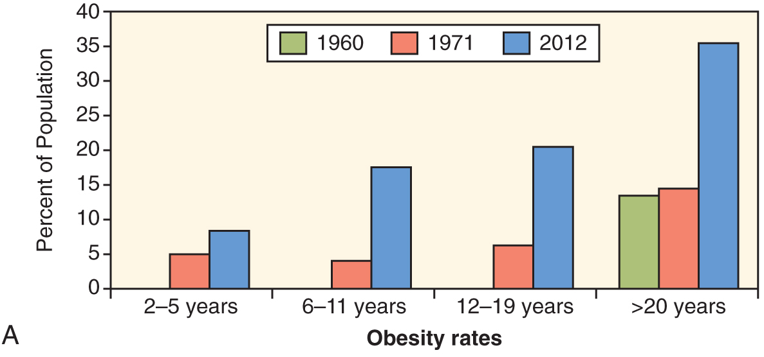
Overweight and obesity, by age: United States, 1960-2012
Modified from Fryar CD, Carroll MD. Prevalence of Overweight, Obesity, and Extreme Obesity Among Adults: United States, Trends 1960–1962 through 2011–2012. Atlanta, Ga: National Center for Health Statistics; 2014. Ogden CL, et al. Prevalence of childhood and adult obesity in the United States, 2011-2012. JAMA. 2014;311[8]:806-814.
4
Notes:
Obesity has risen dramatically over the last 50 years. (Fig. 15-1A)

Slide 5
Obesity and Weight Control
Definitions
  Overweight: body weight that is above a population weight-for-height standard
  Obesity: the relative excess amount of fat in the total body composition; a body mass index [BMI] of 30 or greater
  Body composition: the relative sizes of the four body compartments that make up the total body: lean body mass (muscle mass), fat, water, and bone
5
Notes:
Body composition considers muscle mass, body fat, water, and bones.
[Box Mass Index Classifications are on the next slide.]

Slide 6
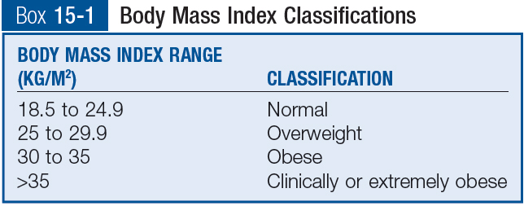
Body Mass Index (BMI)
*
7
Notes:
BMI is a reliable method of predicting the relative risk of becoming an overweight adult on the basis of the presence or absence of excess weight at various times throughout childhood.
[Encourage students to calculate their own BMI, either in class or using a web site calculator.]
For individuals with more muscle mass than the average person (such as weightlifters or football players), BMI may not be the most ideal means of assessing risks associated with weight. (Box 15-1)

Slide 7
Waist Circumference and Increased Risk
Men inches: >40 inches
Women: >35 inches
For the vast majority of the population, BMI coupled with waist circumference is closely associated with health risks stemming from excess body fat.
*those with more muscle mass than the average person, BMI may not be the most ideal means of assessing risks associated with weight
8
Notes:
How does the use of BMI plus waist circumference compare to height-and-weight tables in assessing weight? [Discuss.]

Slide 8
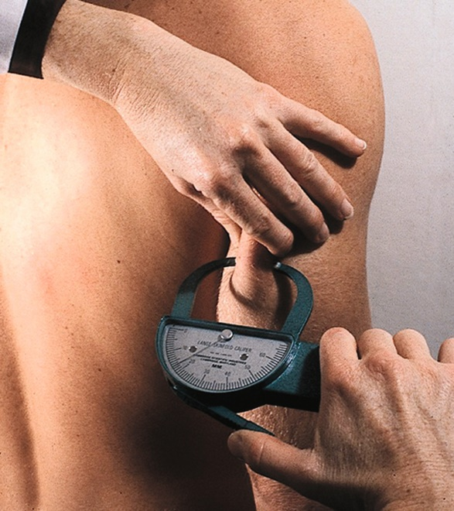
Obesity and Weight Control (cont’d)
Body composition measurements
  Body fat calipers
    Measure the width of skin folds at precise body sites
    Reliability varies with skill of technician
Reprinted from Mahan LK, Escott-Stump S. Krause's Food & Nutrition Therapy. 13th ed. Philadelphia: Saunders; 2011.
9
Notes:
BMI is related to body fat percentages for most individuals. However, body composition assessment provides an additional measure of overall health and fitness.
Calipers are an easy, portable, inexpensive, and noninvasive way to measure body fat. (Fig. 15-3)

Slide 9
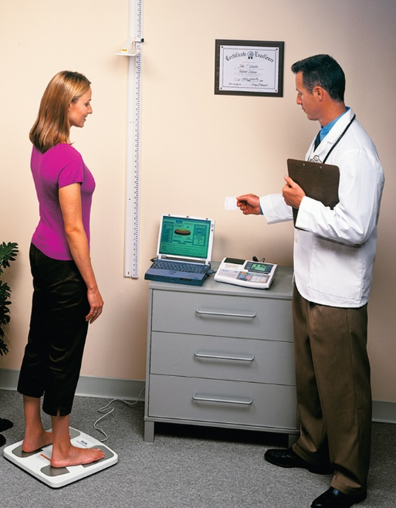
Obesity and Weight Control (cont’d)
Body composition measurements (cont’d)
  **Hydrostatic weighing
    Requires complete submersion of an individual in water
  Bioelectrical impedance analysis
    Easy, portable, inexpensive, and noninvasive tool
Courtesy Tanita Corp., Arlington Heights, Ill.
10
Notes:
Although hydrostatic weighing is relatively accurate, it is not easy, portable, or inexpensive, and many patients are not willing or able to perform the test.
Shown in the photo is one type of bioelectrical impedance analysis, a foot-to-foot analyzer, that requires the person stand on a modified scale with bare feet while an undetectable electrical current travels through his or her body.
The analyzer determines the individual’s body fat percentage on the basis of gender, age, height, weight, total body water, and the rate at which the electrical current travels.
[Additional more complex and expensive methods of measuring body composition are discussed in the text.] (Fig. 15-4)

Slide 10
Obesity and Weight Control (cont’d)
A body fat content
  *For men, within the range of 21% to 25.8% of total body weight (typically equivalent to a BMI of ≤25 kg/m²) is associated with the lowest risk of chronic disease for men between the ages of 20 and 79 years.
  *For women of the same age, the ideal range is somewhat higher: 32.2% to 36.9%.
  To obtain total body fat content: take weight and multiply by 32.2-36.9%**
  Very lean and excellent body fatness levels when their body fat percentages are between 4.2% and 10.5% for 20-29 year old men
10
Notes:
Ask students to explain why these health problems are associated with obesity.
[Review Figure 15-7 with students, Body fat percentage by fitness level.]

Slide 11
Obesity and Weight Control (cont’d)
Measures of weight maintenance goals
  Standard height/weight tables
  Healthy weight range
    Hamwi method
    Body frame, individual variation
    Necessity of body fat
Obesity and Health
  *Weight extremes: Clinically severe or significant obesity is a health hazard.
  *Obesity increases the risk of related conditions such as hypertension, type 2 diabetes, heart disease, arthritis, and certain types of cancer.
11
Notes:
Height/weight tables are general population guides that were developed by insurance companies and are not representative of the current population.
Ideal weight is based on many factors.
[Have students calculate their own healthy weight by using the Hamwi method for determining healthy or ideal weight goals:
Men: 106 lb for the first 5 feet, then add or subtract 6 lb for each inch above or below 5 feet, respectively. A range is then taken by adding and subtracting 10% to account for small and large body frames.
Women: 100 lb for the first 5 feet, then add or subtract 5 lb for each inch above or below 5 feet, respectively. A range is then taken by adding and subtracting 10% to account for small and large body frames.]

Slide 12
Causes of Obesity
Basic energy balance:
  physical inactivity**
  Clinically severe or significant obesity: BMI of 40 or more or BMI of 35-39 with at least one obesity related disorder**
  Regular exercise has a significant effect on increasing lean body mass and reducing the risk of chronic diseases associated with obesity
  Overall energy imbalance intake from food and drink than energy output through physical activity and basal metabolic needs
  *Approximately 3500 kcal is stored in 1 pound
12
Notes:
Some individuals have been identified as having severe early-onset obesity and lack the leptin receptor, thereby receiving no negative feedback regarding energy intake.
Ghrelin is an appetite stimulant that is secreted from the stomach to activate the appetite-regulating network.
Work, family, and social environments may cultivate emotional stress, which many people respond to by eating for comfort.
[Discuss some of the environmental factors that can help contribute to obesity in a society.]
[Review text Figure 15-8, Interwoven influence among genetics, environmental effects, physiology, behavior, and energy balance.]
[Review the Cultural Considerations Box, Genetics and the Predisposition for Obesity.]

Slide 13
Hormonal control
  Ghrelin is an appetite stimulant*
  *leptin thought to play a role in determining a persons set point for fat storage

Slide 14
Genetic and environmental factors
  *Genetic control: obesity associated with genetics
  Family reinforcement: genetic predisposition for increased body fat is reinforced by inappropriate family food patterns*
  Physiologic factors: number of fat cells in the body
  Psychologic factors: emotional stress, yo-yo dieting causing reductions in metabolic rate and lean body mass
  Other environmental factors: availability of energy-dense, fast foods, convenient foods

Slide 15
Individual Differences and Extreme Practices
Individual energy balance levels
  Energy out vs. energy in
Extreme practices
  Fad diets
    Scientific inaccuracies and misinformation
    Failure to address the necessity of changing long-term habits
    Many fad dieters caught in a vicious cycle of chronic dieting syndrome and its harmful physical and psychologic effects
15
Notes:
What are some current fad diets?
Name some individual differences. Do you lose or gain weight differently than your friends?
[Review Table 15-1, Comparison of Select Common Weight-Loss Diets.]

Slide 16
Extreme Practices (cont’d)
*Fasting: negative health effects, rebound effect
Specific macronutrient restrictions: no evidence to support, carry health risks
Clothing and body wraps: cause temporary water loss
Drugs: FDA regulates, should be combined with lifestyle changes: Orlistat (Alli, Xenical) was approved in 1999 for clinically significant obesity*, available OTC
*Surgery-clinically severe obesity with no wt. loss results
  gastric restriction
  lipectomy
16
Notes:
Fat mass cannot be melted away without using the stored energy (i.e., burning the calories) in the adipocytes (fat cells).
All nutrients are poorly absorbed in the gut of a gastric bypass patient, including vitamins and minerals, warranting special supplementation.
[Review the Drug-Nutrient Interaction Box, Orlistat: An Over-the-Counter Weight-Loss Aid.]
Orlistat has been successful with weight loss, but reports indicate that maximal benefits occur only when it is combined with lifestyle changes that induce a negative energy balance.
[Surgical approaches are diagrammed on the next slide.]
A type of cosmetic surgery developed during the 1980s is a form of local fat removal, lipectomy, which is commonly called liposuction.

Slide 17
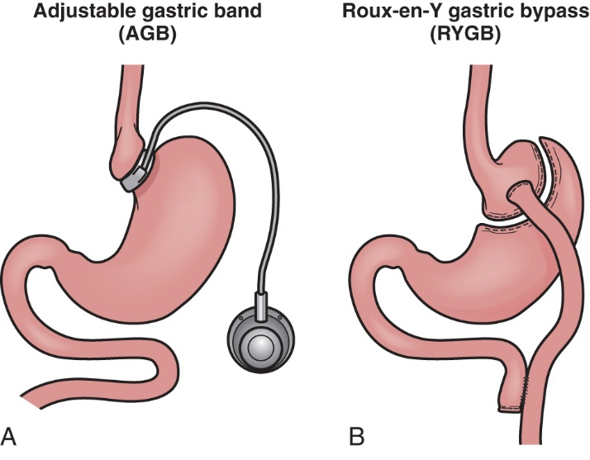
Surgical Treatments for Obesity
17
Notes:
Surgical procedures are usually reserved for severely obese patients who have not had success with other weight-loss methods.
Following either procedure, counseling by a dietitian is imperative to avoiding dumping syndrome, condition in which there is a quick emptying of the stomach of a hyperosmolar content into the small intestine, causing fluid to shift into the intestinal lumen from the intravascular compartment. (Fig. 15-9)

Slide 18
Lesson 15.2: Weight Management Tools and Risks of Being Underweight
Realistic weight management focuses on individual needs and health promotion, including meal pattern planning and regular physical activity.
Severe underweight carries physiologic and psychologic risk to the body.
18
Notes:
Weight management requires a personalized program that focuses on changing lifestyle factors such as food and exercise behaviors.

Slide 19
A Sound Weight Management Program
Essential characteristics: hard work and strong individual motivation*
Behavior modification
  Help change patterns that contribute to excessive weight and can help empower individuals to plan constructive actions*
  Basic principles: cue, response, consequences
  Basic strategies and actions
    Defining problem behavior/ behavior modification*
    Control eating behavior (small portions)
    Promote physical activity
    Pursuit of emotional, social and psychologic health*
19
Notes:
The focus is on eating behaviors, increase in exercise, and emotional well-being.
[Review Clinical Applications Box, Breaking Old Links: Strategies for Changing Food Behavior.]

Slide 20
Dietary Modification
*Realistic goals: ½ to 1 lb per week loss
Negative energy balance: 500 to 1000 kcal/day
Nutritional adequacy: choose nutrient-dense foods
Cultural appeal: to allow permanent change in habits
Energy readjustment to maintain weight: when desired weight is reached
20
Notes:
The program should focus on achieving lasting success.
The program’s goals must be realistic.
Negative energy balance should be achieved through a combination of reduced energy in and increased energy out.
The program must ensure nutritional adequacy.
The program should take cultural appeal into account.
Food caloric intake should be reduced and physical activity should be increased to be successful.

Slide 21
Energy Balance Components
Energy input: food behaviors
  Choose food wisely, emphasizing whole foods
Energy output: exercise behaviors
  A regular daily exercise schedule that starts with simple walking for about 1/2 hour daily would be appropriate for someone who is unaccustomed to exercise.
**To lose 1 lb per week there needs to be a 500-kcal energy deficit per day.
  Deficit is the difference between energy in and out
21
Notes:
What works for one person will not necessarily work for another because of genetic and physiologic factors.
For someone who has no planned physical activity, a regular daily exercise schedule that starts with simple walking for approximately a half hour each day and building up to a brisk pace is a great way to begin.
[Review Clinical Applications Box, Practical Suggestions for Changing Food Behaviors.]
[Review For Further Focus Box, Benefits of Aerobic Exercise in Weight Management.]
[Review Box 15-2, Kilocalorie Adjustment Necessary for Weight Loss.]
[Review Box 15-3, Estimation of Adult Energy Needs.]

Slide 22
Principles of a Sound Food Plan
Diet Hx
Energy balance: modifications to energy intake and output
Nutrient balance: carbohydrate, protein, fat proportions (macronutrients)
Distribution balance and portion control: spread food throughout the day
Food guide: Academy of Nutrition and Dietetics
Preventive approach: overweight children become obese adults
Clinical application table*
22
Notes:
The best way to achieve weight loss is through combining decreased energy intake with increased energy output.
Eating snacks between meals can help prevent drops in glucose.
[Review Table 15-2, U.S. Department of Agriculture Food Patterns.]

Slide 23
Food Misinformation and Fads
Types of claims
  Food cures: certain foods cure specific conditions
  Harmful foods: certain foods are harmful
  Food combinations: specific combinations restore health
  “Natural” foods: only “natural” foods can meet body needs
23
Notes:
[Give examples of each.]
What food combinations have you heard about that claim weight loss?
Food cures often are based on testimonials, not scientific data.
“Natural” foods are more appealing because the term leads us to think foods we normally eat are not natural and therefore are dangerous to our health. Is this true?

Slide 24
Food Misinformation and Fads (cont’d)
Erroneous claims
Dangers
  To health
  Often expensive
  Perpetuates superstitions
  Distrust of food market
Vulnerable groups
  Elderly, young persons, obese persons, athletes and coaches, entertainers
24
Notes:
Dangers include dangers to health, cost, lack of sound knowledge, and distrust of the food market.
What is the answer?
Use reliable sources.
Recognize human needs.
Remain alert to teaching opportunities.
Think scientifically.
Know responsible authorities.
[Review Box 15-4, The Food and Nutrition Science Alliance’s 10 Red Flags of Junk Science.]

Slide 25
Underweight
10% below the average weight for height and age is considered underweight
*General causes
  Wasting disease
  Poor food intake
  Malabsorption
  Hormonal imbalance
  Low energy availability
  Poor living situation
25
Notes:
Being underweight can be just as detrimental to health as being overweight.
Their resistance to infection is lowered, their general health is poor, and their strength is reduced.
Someone who is 20% or more below the average weight has cause for significant health concerns.

Slide 26
Underweight (cont’d)
Dietary Treatment
  High-calorie diet
  High protein
  High carbohydrate
  Moderate fat
  Good sources of vitamins and minerals
Ideal weight gain includes both lean and fat tissue.
  To gain muscle, physical exercise must be part of the treatment.
26
Notes:
Being underweight often is seen in the elderly as their drive for eating decreases.
[Review Clinical Applications Box, Problems of Weight Loss among Older Adults in Long-Term Care Facilities.]
Being underweight often is a side effect of depression.
An exercise program should ideally be implemented along with an increase in calories to promote lean body mass.

Slide 27
Disordered Eating
Definition of normal eating
Disordered eating
  Anorexia nervosa: results in self-imposed starvation
  Bulimia nervosa: binge-and-purge cycle
  Binge eating disorder: often follows stress or anxiety
  Body dysmorphic disorder
  Significant mortality rates, slow recovery
  Treatments involve multidisciplinary approach
27
Notes:
Body dysmorphic disorder an obsession with a perceived defect of the body.
These disorders can be serious and can lead to death if not treated.
Patients need extensive counseling.
[Review Box 15-5, American Psychiatric Association Diagnostic Criteria.]
[Review Table 15-3, Nutrition-Related Clinical Signs Commonly Associated with Anorexia Nervosa and Bulimia Nervosa.]

Slide 28
anorexia
*body dysmorphic disorder
Negative self-evaluation
s/s
  Hypotension, amenorrhea, anemia, menstrual irregularities*

Slide 29
Bulimia
Eating disorder that involves repeated episodes of binge eating followed by one or more compensatory mechanisms to rid the body of excess calories**
s/s
  Dental caries, tooth erosion**

