Slide 1
Williams' Basic Nutrition & Diet Therapy
15th Edition
Chapter 17
Nutrition Care
1

Slide 2
Individualized Care and the Health Care Team
Valid health care is centered on the patient and his or her individual needs.
Comprehensive health care is best provided by a team of health professionals and support staff.
2

Slide 3
Introduction
Nutrition support
  Vital to successful treatment of disease
  Often is the primary therapy
Registered dietitian provides comprehensive nutrition care
Nurses also identify nutrition needs
3
Notes:
What are some of the institutions in which patients receive care? (Hospital, extended-care facility, outpatient clinic, home)

Slide 4
The Therapeutic Process
Health care setting
Person-centered care
  Based on individual needs*
Health care team
  Physician and support staff
  Role of the nurse and clinical dietitian
    Dietitian develops, manages, evaluates nutrition therapy
    Nurse develops, supports, carries out plan of care
4
Notes:
Ask students to explain how the roles of the nurse and dietitian differ.

Slide 5
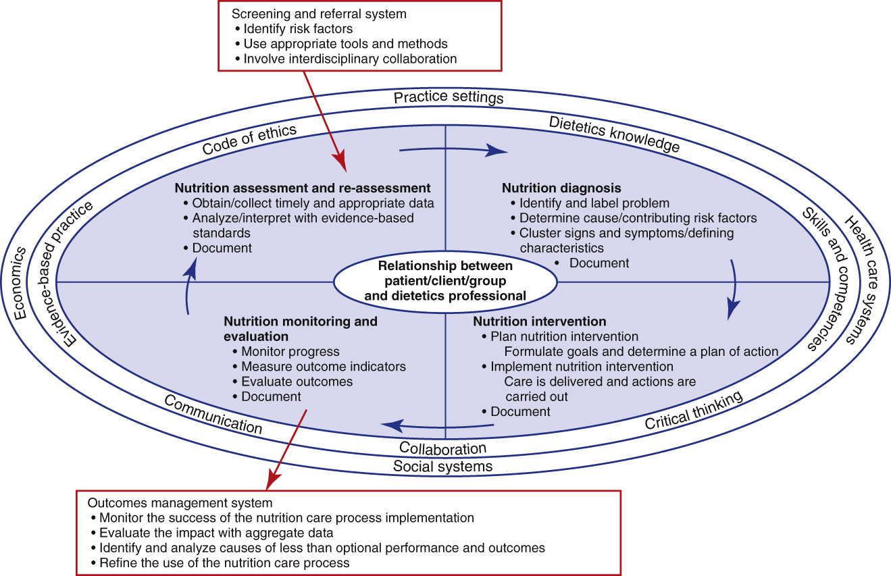
The Therapeutic Process
**
5
Notes:
The nutrition care process model.

Slide 6
Health Care Team
RD carries major responsibility of medical nutrition therapy*
Nursing role
  Coordinator and advocate: nurse works as advocate for patient nutrition
  Interpreter: explanations help reduce anxiety
  Teacher and counselor: reinforces dietitian’s work with patient
  *nurses are in the closest continuous contact with patients and their families
6
Notes:
Explain that the nurse often is the communicator between the physician and the family.

Slide 7
PHASES OF The Care Process
A personalized health care plan, evaluation, and follow-up care guide actions to promote healing and health.
Drug-nutrient interactions can create significant medical complications.
7

Slide 8
Phases of the Care Process
Academy of Nutrition and Dietetics : Nutrition Care Process for RDs
Systematic problem-solving method with four steps
  Nutrition assessment
  Diagnosis
    *nurses clinical judgment about a clients response to actual or potential health conditions or needs
  Intervention
  Monitoring and evaluation
8
Notes:
Be sure to discuss the nurse’s role in each phase of the care process.
The plan of care must be congruent with the patient’s wishes and must be effective.

Slide 9
Nutrition Assessment
Nutrition assessment
  Family and medical history questionnaires
  Current status and goals
  Patient and family are primary sources
9
Notes:
Evaluation should be ongoing.

Slide 10
Food and Nutrition-Related History
RD responsible for evaluating patient’s diet
Guides for gathering a nutrition history
Underreporting energy intake is common
Physical activity logs
10
Notes:
Energy output/physical activity also tends to be overreported in a portion of the population.

Slide 11
Anthropometric Measurements
Height: fixed measuring stick against wall is preferred
  *nonambulatory clients-use total arm span
Weight and BMI: weight at consistent times
Body composition: skinfold thickness,-with calipers* hydrostatic weighing, bioelectrical impedance analysis, x-ray absorptiometry,
  Determines relative levels of fat compared with muscle
Waist circumference: fat stored in waist raises risks
11
Notes:
Weight and height are used to calculate body mass index.
Nurses must be vigilant in obtaining accurate weights.

Slide 12
Table 17-1
*24 hour food record
*food record or diary
*diet history
12
Notes:
Measuring height in an infant.

Slide 13
*Biochemical Data, Medical Tests, and Procedures
*Plasma proteins
Liver enzymes
Blood urea nitrogen, serum electrolytes
Urinary urea nitrogen excretion
Creatinine height index
Complete blood count
Fasting glucose
*Total lymphocyte count
13
Notes:
These tests can be quite effective in identifying chronic problems.

Slide 14
Skeletal System Integrity
Skeletal system integrity: several tests for bone integrity, osteoporosis
Gastrointestinal function
Resting metabolic rate: to determine total energy needs
14
Notes:
Accurate assessments are important in determining patient needs.

Slide 15
Nutrition-Focused Physical Findings
Nutrition-focused physical findings: See Table 17-2*
Client history
  Guided questioning
  Dietary supplements
  Socioeconomic status, religion, culture, etc.
  Psychological and emotional problems
  Evaluate the data collected
15
Notes:
Ask students to identify some of the reasons a geriatric patient might suffer from depression and weight loss.

Slide 16
Nutrition Diagnosis
Problem: data is analyzed and diagnostic category assigned
Etiology: cause or contributing risk factors identified
Signs and symptoms: changes in patient’s health status that indicate nutrition problem
16
Notes:
In terms of drug-food interactions, certain foods may affect absorption, distribution, metabolism, or elimination of drugs.

Slide 17
Nutrition Intervention
Nutrition intervention: follows assessment and diagnosis
  Written care plan addresses personal and medical needs
  Food and/or nutrient delivery
    Personalized: needs, disease, therapy affect food plan
    Modes of feeding: total energy of diet, nutrient modification, texture
  Enteral feedings when patient cannot consume food orally*
17
Notes:
Ask students to explain the difference between enteral and parenteral feeding.

Slide 18
Nutrition Education and Counseling
Nutrition education and counseling
  Patients with education more likely to be compliant
  Long-term lifestyle modifications
Coordination of nutrition care
  Dietitians, nurses, prescribing physicians, pharmacist
  Family, friends, care providers
18
Notes:
Ask students to name some reasons why a person may have difficulty following a diet.

Slide 19
Nutrition Monitoring and Evaluation
Measures progress toward patient goals
Three components
  Monitor progress
  Measure outcomes
  Evaluate outcomes
19
Notes:
Nutrition monitoring and evaluation give feedback on the nutrition diagnosis and the intervention plan.

Slide 20
Drug Interactions
Risks with polypharmacy, especially in elderly
*Must gather information about all drug use, including OTC, prescription, alcohol, street drugs
20
Notes:
What is polypharmacy? (The use of multiple medications by a patient)

Slide 21
Drug-Food Interactions
High-fat meal
High-fiber meal
Grapefruit juice (furanocoumarin)
  Decreased the bioavailabilty of certain drugs to a dangerous level*
Warfarin and certain foods
Medications that alter taste or smell sensations
Medications that stimulate appetite
21
Notes:
Grapefruit juice has come under particular scrutiny because of its ability to dramatically alter the bioavailability of certain drugs to a dangerous level.

Slide 22
Drug-Nutrient Interactions
Usually medications taken with OTC supplements
Patients rarely report supplements to physicians
22
Notes:
Caregivers must make a point of asking patients what other medications they are taking, including vitamin and mineral supplements.

Slide 23
Drug-Herb Interactions
*Least well-defined category
  Interactions that involve prescription drugs and herbs
St. John’s wort interacts with many medication groups
Others include papaya extract, devil’s claw, Gingko biloba, evening primrose, valerian, kelp, ginseng, ginger
23
Notes:
The use of herbs should be evaluated on an individual basis.

