Slide 1
Chapter 22
Surgery and Nutrition Support
Notes:
This chapter looks at the nutrition needs of surgical and burn patients and the enteral and parenteral feeding methods of providing nutrition support.

Slide 2
Introduction
Clinical signs of malnutrition in:
  3.2% of all hospitalized patients in the United States
Effective nutrition should:
  Reverse malnutrition
  Improve prognosis
  Speed recovery
2
Notes:
The surgical process also places physiologic and psychologic stress on the patient, which may lead to further nutrition demands and increases the risk for clinical problems. That is, malnutrition hinders healing.

Slide 3
Nutrition Needs of
General Surgery Patients
Nutrition needs are greatly increased in patients undergoing surgery
Deficiencies can develop
Pay careful attention to:
  Nutritional status before surgery
  Individual nutrition needs after surgery
3
Notes:
Proper nutrition after surgery is essential for wound healing and recovery.

Slide 4
Poor Nutritional Status
Has been associated with:
  Impaired wound healing
  Increased risk of postoperative infection
  Increased necessity of enteral or parenteral nutrition support
  Increased morbidity and mortality
  Increased hospital stay
  Increased cost
4
Notes:
[Ask students to explain how an impaired immune system, impaired wound healing, and an increased risk of infection are related.]
[Review Table 22-1, Characteristics to Diagnose Malnutrition.]

Slide 5
Preoperative Nutrition Care: Nutrient Reserves
Nutrient reserves can be built up before elective surgery to fortify a patient
**Protein deficiencies are common among pediatric and geriatric hospitalized patients
Sufficient kilocalories are required when increased protein is needed for tissue building
Vitamin and mineral needs increase proportionately
Water balance should be assessed
5
Notes:
Why is extra protein so important? [To counteract blood loss during surgery, prevent tissue breakdown, and promote bone healing after surgery]
Describe a sample preoperative menu for increasing protein reserves.

Slide 6
Immediate Preoperative Period
**Patients are typically directed not to take anything orally for at least 8 hours before surgery
Before gastrointestinal surgery, a nonresidue diet may be prescribed
Nonresidue elemental formulas provide complete diet in liquid form
6
Notes:
Why is it necessary to avoid eating 8 hours before surgery? (To prevent aspiration of food during anesthesia and complications from food in the stomach)
[Review Table 22-2, Fiber-Restricted Diet.]

Slide 7
Emergency Surgery
No time for building up ideal nutrient reserves
Reason for maintaining good nutrition status at all times
7
Notes:
Following a healthy diet at all times ensures that one will have the nutrient status needed for urgent surgery.
[Review For Further Focus box, Protein-Energy Malnutrition after Surgery.]

Slide 8
Postoperative Nutrition Care: Nutrient Needs for Healing
Postoperative nutrient losses are great, but food intake is diminished.
Catabolism usually occurs after surgery (tissue breakdown and loss exceed tissue buildup).
Weight loss and malnutrition are common among patients who are experiencing catabolic stress, but the maintenance of lean body mass improves the survival of catabolic patients.
If a patient is not able to resume adequate oral intake within a few days, an alternative form of nutrition support must be considered.
8
Notes:
Several nutrients require particular attention during this time.

Slide 9
Need for Increased Protein
Building tissue for wound healing
Replace losses:
  From tissue breakdown and blood loss
  Body fluid loss from exudates
Controlling edema
  Sufficient supply of plasma protein is necessary to maintain blood volume
  edema is characterized by puffiness or swelling of the tissue from the excess fluid being held there instead of returning to circulation
9
Notes:
Identify some of the risks of protein deficiency after surgery. (Poor wound healing, rupture of the suture lines, delayed healing of fractures, depressed heart and lung function, anemia, failure of GI stomas, reduced resistance to infection, liver damage, extensive weight loss, muscle wasting, and increased risk of death)

Slide 10
Need for Increased Protein
Controlling shock by maintaining blood volume
Healing bone: protein is essential
Resisting infection: protein tissues are major components of immune system
Transporting lipids: fat is important component of tissue structure

Slide 11
Need for Increased Protein (cont’d)
Postsurgical protein deficiency can cause:
  Poor wound healing
  Rupture of the suture lines (i.e., dehiscence)
  Delayed healing of fractures
  Depressed heart and lung function
  Anemia and liver damage
  Failure of GI stomas
  Reduced resistance to infection
  Extensive weight loss and muscle wasting
  Increased mortality risk
11
Notes:
Because protein has many important functions during recovery from surgery, protein deficiency at this time can lead to many clinical complications.

Slide 12
Energy
Provide sufficient nonprotein kilocalories for energy to spare protein for tissue building
Mifflin–St. Jeor equations:
  Male: BMR = [(10 × Weight in kg) + (6.25 × Height in cm) – (5 × Age in yr) + 5] × injury factor
  Female: BMR = [(10 × Weight in kg) + (6.25 × Height in cm) – (5 × Age in yr) – 161] × injury factor
Energy needs increased for extensive surgery or burn patients
*CHO spare protein for tissue building and help to avoid liver damage by maintaining glycogen reserves in the liver
12
Notes:
Energy requirements can be estimated by first calculating the individual’s basal metabolic rate (BMR) with the Mifflin-St. Jeor equation (see Chapter 6) and then multiplying by an injury factor (1.0 to 2, depending on the patient’s status) to meet the added energy needs of stress and sepsis.
Carbohydrates also help prevent liver damage by maintaining glycogen reserves in the liver tissue.
Overfeeding, though, is counterproductive.

Slide 13
Water
To prevent dehydration, maintain circulation, prevent complications
Specific fluid replacement needs to be individualized.
Elderly require special attention
**Large water losses possible from vomiting, hemorrhage, fever, infection, or diuresis
IV fluids are used initially
Oral fluids as soon as possible
13
Notes:
Surgery disrupts fluid distribution in the patient, which can reduce circulation and hinder recovery.
Elderly patients have depressed thirst mechanisms.

Slide 14
Vitamins
*Vitamin C to build connective tissue
  Parenteral administration protects microvascular functions, decreases length of stay in the hospital for post cardiac-surgery patients, decreases the risk for morbidity, and may be particularly beneficial for critically ill patients with sepsis.
B vitamins to metabolize protein and energy
  Needs rise proportionately to increased protein and energy needs.
B-complex vitamins to build hemoglobin
*Vitamin K to promote blood clotting for those on long-term antibiotic therapy
14
Notes:
These vitamins are important in wound healing.

Slide 15
Minerals
Potassium, Phosphorus
  Tissue catabolism results in cell potassium and phosphorus loss**
Sodium, Chloride
  Fluid loss may affect these minerals
Iron
  Iron-deficiency anemia may develop from blood loss or inadequate iron absorption*
Zinc, Selenium
  Levels may be low because of inflammation
15
Notes:
Zinc is particularly important in wound healing, and even patients consuming normally adequate amounts of zinc through the diet may benefit from zinc supplementation.
[Review the Drug-Nutrient Interaction box, Aspirin and Iron Absorption.]

Slide 16
General Dietary Management
Routine IV fluids supply hydration and electrolytes, but not energy and nutrients
Methods of feeding
  Oral
  Enteral: Nourishment through regular gastrointestinal route, either by regular oral feedings or by tube feedings
  Parenteral: Nourishment through small peripheral veins or large central vein
  Conditions that require nutritional support-*Box 22-3
  Criteria for Selecting a nutrition support method
  Box 22-1**
16
Notes:
Oral feedings are the method of choice when they can be tolerated.
[Review Box 22-1, Criteria for Selecting a Nutrition Support Method.]
[Review Table 22-3, Conditions That often Require Nutrition Support.]
[Review Figure 22-1, Route of administration algorithm for nutrition support.]

Slide 17
Methods of Feeding: Oral
Includes a variety of diet plans
Allows more needed nutrients to be added
Stimulates normal action of the gastrointestinal tract
Early feedings associated with reduced complications
Progresses from clear to full liquids, then to a soft or regular diet
Routine house diet
Assisted oral feeding: try to avoid making patient feel inadequate
Box 22-2*
17
Notes:
What does “NPO” mean? (Nothing by mouth (nil per os in Latin))
Individual tolerance and needs serve as the guide.
Frequent small meals may be advised.
[Review Table 22-4, Routine Hospital Diets.]
[Review Box 22-2, Assisted Oral Feeding Guidelines.]

Slide 18
**Routine hospital diets
Clear liquid
Full liquid
Mechanical soft
Regular

Slide 19
Methods of Feeding: Enteral
Used when oral feeding cannot be tolerated
  Nasogastric tube is most common route
  **Nasoduodenal or nasojejunal tube more appropriate for patients at risk for aspiration, reflux, or continuous vomiting
  A tube is first inserted through the nose and then passed down the esophagus and into the stomach. It is then passed through the stomach and into the appropriate portion of the small intestine by peristaltic activity or endoscopic or fluoroscopic guidance.
  Correct placement of the tube is verified by radiography, auscultation, or gastric content aspiration.
19
Notes:
Modern small-bore feeding tubes are relatively comfortable for patients.
[Review Figure 22-1, Route of administration algorithm for nutrition support.]

Slide 20
Routes: Enterostomy
Esophagostomy
Percutaneous endoscopic gastrostomy
Percutaneous endoscopic jejunostomy
20
Notes:
The nasoenteric route is used for short-term feedings, but these alternative routes are more comfortable for long-term feeding.

Slide 21
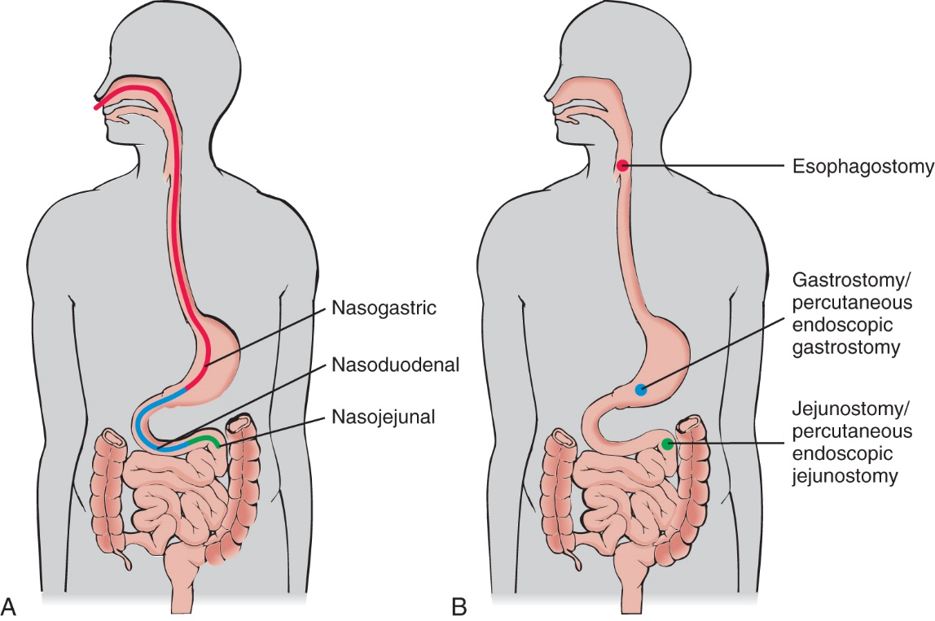
Methods of Feeding
Copyright Rolin Graphics.
21
Notes:
Types of enteral feeding: A, Nonsurgical routes accessed through the nasal cavity. B, Surgically placed feeding routes. [Shown is text Figure 22-2.]

Slide 22
Alternative Route Formulas
Generally prescribed by the physician and clinical dietician
Wide variety of commercial formulas available
Pureed table food Precautions:
  Physical form: fit through tube?
  Safety: blender-mixed formulas carry problems of bacterial growth and infection, inconsistent nutrient composition because the solid components settle out**
  Digestion and absorption: require hydrolysis?
Must regulate amount and rate
Rate: bolus or continuous feedings
Monitoring for complications: diarrhea is most common complication
22
Notes:
Adding fiber-rich formulas may improve bowel function and help reduce diarrhea.
[Review Clinical Applications Box, Calculating a Tube Feeding.]
[Review Box 22-3, Monitoring the Patient Who is Receiving Enteral Nutrition.]
[Review Table 22-5, Problem-Solving Tips for Patients Who Are Receiving Enteral Nutrition.]

Slide 23
Parenteral Feedings
**Definition: any method other than the normal GI route
Peripheral parenteral nutrition: less than 10 to 14 days
**Central parenteral nutrition: for large nutrient needs or full nutrition support for longer periods
PN provides crucial nutrition support from solutions that contain glucose, amino acids, electrolytes, vitamins and minerals**
A team of specialists including physicians, dietitians, pharmacists, and nurses works closely together during the administration of PN.
Must be discussed with patient and/or family first
23
Notes:
These methods are used when the patient cannot tolerate food or formula through the GI tract.
[Review Box 22-4, The Administration of Parenteral Nutrition Formulas.]
[Review Drug-Nutrient Interaction box, Propofol and Lipids in Nutrition Support.]
[Review Cultural Considerations box, Cultural Differences in Advanced Care Planning.]

Slide 24
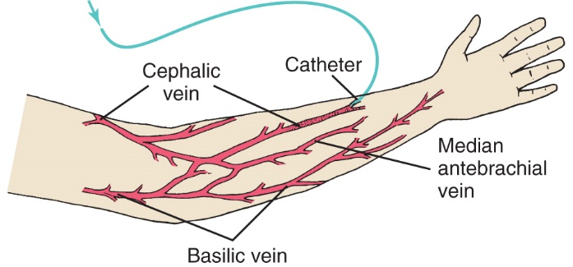
Peripheral Parenteral Feeding
24
Notes:
Peripheral parenteral nutrition feeding into small veins in the arm. (Figure 22-3)

Slide 25
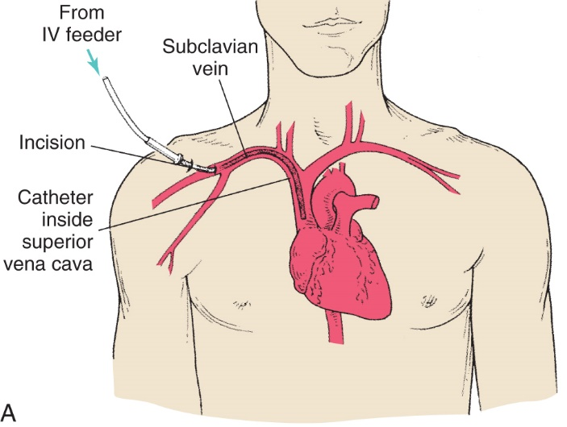
Total Parenteral Nutrition
25
Notes:
Catheter placement for TPN: Direct line by subclavian vein to superior vena cava. (Figure 22-4A)

Slide 26
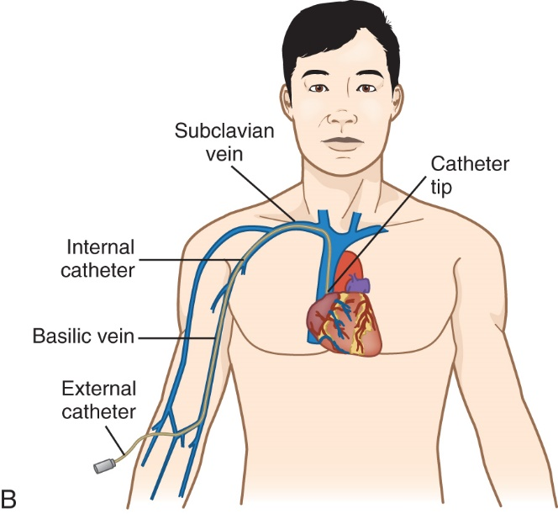
Total Parenteral Nutrition (cont’d)
26
Notes:
Catheter placement for TPN: Peripherally inserted central catheter line. (Figure 22-4B)

Slide 27
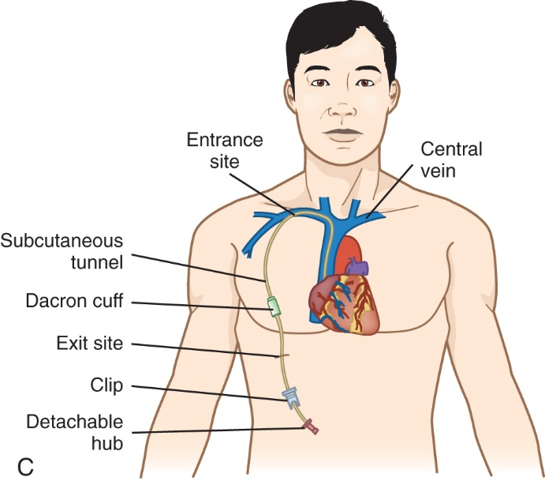
Total Parenteral Nutrition (cont’d)
27
Notes:
Catheter placement for TPN: Tunneled catheter. (Figure 22-4C)

Slide 28
Parenteral formula
Box 22-4
*monitor phlebitis
*complications of PN
  Metabolic
  Rebound hypoglycemia
  Hyperglycemia
  Infection
  Lipid emulsions contibutes 1.1 kcal/ml**
  patients on propofol must have reduced calories from fat to compensate for those that are provided with propofol (energy metabolism generates CO2)

Slide 29
Lesson 22.2: Nutrition Support Related to GI Surgery
Nutrition problems related to GI surgery require diet modifications because of the surgery’s effect on normal food passage.
29

Slide 30
Special Nutrition Needs after Gastrointestinal Surgery
Gastrointestinal surgery requires special nutrition attention.
Nutrition therapy varies depending on the surgery site.
30
Notes:
Sites of gastrointestinal surgery include the mouth, throat and neck, stomach, gallbladder, intestines, or rectum.

Slide 31
Mouth, Throat, and Neck Surgery
Requires modification in the mode of eating
Patients cannot chew or swallow normally
Oral liquid feedings ensure adequate nutrition
Mechanical soft diet may be optimal; fiber supplement may be needed
  Whole foods that are easy to chew and swallow are included as tolerated*
*Enteral (tube) feedings required for radical neck or facial surgery
  The earliest functioning point of access to the GI tract should be used to maintain gut integrity
31
Notes:
[Review side effects and nursing care for tube feedings.]

Slide 32
Gastric Surgery
Because the stomach is the first major food reservoir in the gastrointestinal tract, stomach surgery poses special problems in maintaining adequate nutrition.
Problems may develop immediately after surgery or after regular diet resumes.
The goals of nutrition therapy are to promote healing, to prevent dumping syndrome and nutrient deficiency, and to minimize complications such as malabsorption and maldigestion.
32
Notes:
Describe causes for stomach surgery and its incidence.
[If needed, review the anatomy and physiology of the stomach in relation to the entire gastrointestinal system.]

Slide 33
Gastrectomy
Increased gastric fullness and distention may result if gastric resection involved a vagotomy (cutting of the vagus nerve).
  Because it lacks the normal nerve stimulus, the stomach becomes atonic and empties poorly.
Weight loss is common.
**Patient may be fed by jejunostomy immediately after surgery.
**Frequent small, simple oral feedings are resumed according to patient’s tolerance.
33
Notes:
Possible results of vagotomy: stomach empties poorly, allowing food to ferment; this can lead to gas and diarrhea.
[Review Clinical Applications box, Case Study: John Has a Gastrectomy.]

Slide 34
Dumping Syndrome
Common complication of extensive gastric resection; readily soluble carbohydrates rapidly “dump” into small intestine**
  This rapidly entering food mass is a concentrated solution with a higher osmolality compared with the surrounding circulation of blood.
Symptoms include:
  **cramping, full feeling; rapid pulse; wave of weakness, cold sweating, dizziness; nausea, vomiting, diarrhea
  Osmotic balance
  water is drawn from circulatory system into the intestine. This water shift rapidly shrinks the vascular fluid volume, thereby causing shock. BP drops and signs of rapid heart rate to rebuild blood volume appear*
If the meal consisted of simple CHO’s, late dumping may occur approximately 2 hours after eating**
34
Notes:
Define higher osmolality and describe its implications.

Slide 35
Bariatric Surgery
Typical deficiencies in several micronutrients
Progress from clear liquid to regular diet over about 6 weeks
Thereafter limited to about 1 cup of food
Patients should avoid using a straw to reduce air swallowing, which can cause discomfort.
Subject to dumping syndrome
35
Notes:
Patients can avoid most of the distressing symptoms if they carefully adhere to the postoperative diet.
[Review For Further Focus box, Nutrient Deficiencies after Bariatric Surgery.]

Slide 36
Gallbladder Surgery
**Cholecystectomy is removal of the gallbladder.
Function of GB is to concentrate and store bile, which helps with the digestion and absorption of fat, some moderation in dietary fat intake is usually indicated
Laparoscopic surgery is minimally invasive.
Some moderation in dietary fat is usually indicated after surgery.
Depending on individual tolerance and response, a relatively low-fat diet may be needed over a period of time.
36
Notes:
After surgery, the hormonal stimulation for bile secretion still functions in the surgical area, causing pain with high intake of fats.

Slide 37
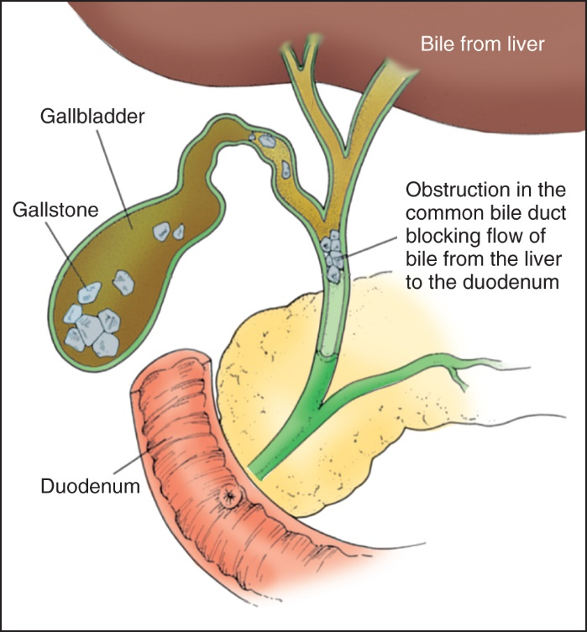
Gallbladder Surgery (cont’d)
37
Notes:
Gallbladder with stones (cholelithiasis) [text Figure 22-5].

Slide 38
Intestinal Surgery
*Intestinal resections are required in cases involving tumors, lesions, or obstructions.
When most of the small intestine is removed, total parenteral nutrition is used with small allowance of oral feeding.
*Stoma may be created for elimination of fecal waste (ileostomy, colostomy) in the wall of the intestine
  Food mass is still fairly liquid at this point in the GI tract, and more problems are encountered with management*
Patients need support and practical help with learning about self-care for an ostomy.
Progression to a regular diet is important for nutritional value and emotional support.
38
Notes:
In less-severe cases, a low-fiber diet may be used briefly after surgery to allow healing.
Regular food provides psychologic comfort, and dietary adjustments to individual preferences for specific foods can be made.

Slide 39
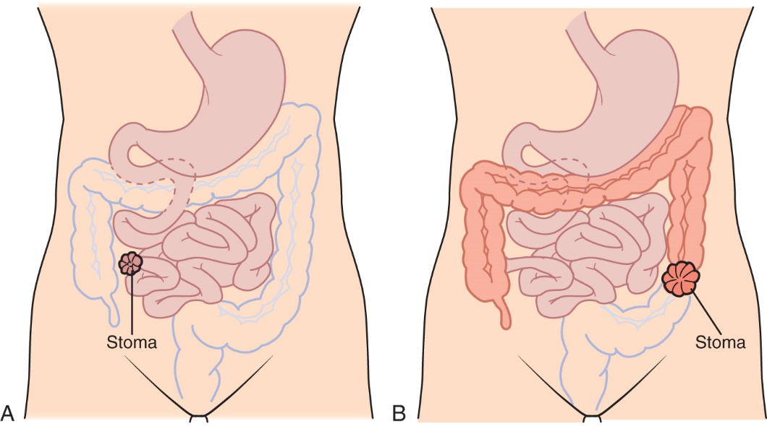
Ileostomy and Colostomy
43
Notes:
Note the difference in placement of the stoma.
Eliminating gas-producing foods, odor-causing foods, and foods that may cause an obstruction will help to facilitate maintenance.
The goal is to advance to an individualized diet that is acceptable to the patient as soon as tolerated.

Slide 40
Rectal Surgery
Clear fluid or nonresidue diet may be indicated after surgery to reduce painful elimination and allow healing.
Return to a regular diet is usually rapid.
40
Notes:
Describe items included in a clear liquid diet.

Slide 41
Special Nutrition Needs for Patients with Burns
Tremendous nutritional challenge
Plan of care influenced by:
  Location of burn
  **Burn severity
    1st degree
    2nd degree
    3rd degree
  Co-morbidities
Plan constantly adjusted
Critical attention required:
  Amino acid needs
  Fluid and electrolyte balance
  Energy support
41
Notes:
Why are amino acid needs so important at each stage? (For tissue rebuilding, fluid-electrolyte balance, energy (kilocalorie) support)

Slide 42
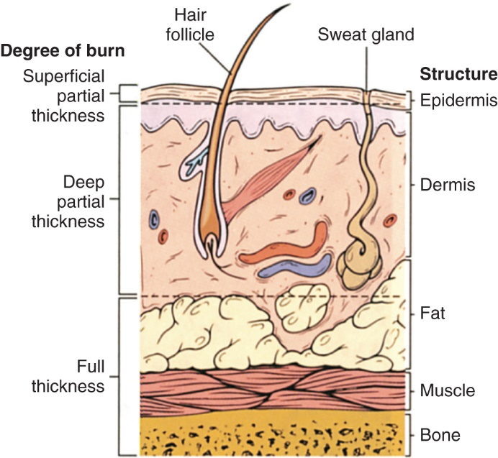
Special Nutrition Needs for Patients with Burns (cont’d)
Reprinted from Lewis SM, Heitkemper MM, Dirksen SR. Medical-Surgical Nursing: Assessment and Management of Clinical Problems. 7th ed. St Louis: Mosby; 2007.
42
Notes:
Type and extent of burns. The depth of the burn affects its treatment and its healing process.
Superficial (i.e., first-degree) burns involve cell damage only to the epidermis.
Second-degree burns are classified as either superficial partial-thickness burns, which involve cell damage to the dermis, or deep partial-thickness burns, which involve both the first and second layers of skin.
Full-thickness (i.e., third-degree) burns result in complete skin loss, including the underlying fat layer.
Subdermal (i.e. fourth-degree) burns leave bone and tendon exposed.
Patients with burn injuries of more than 10% of the total body surface area (TBSA) are referred to a regional burn unit facility for specialized burn team care that includes nutrition support. (Figure 22-7)

Slide 43
Stages of Nutrition Care of Burn Patients
Burn shock or ebb phase
  Immediate loss of heat, water, electrolytes, protein
  Blood volume and pressure drop; urinary output drops; cell dehydration follows
  Body temperature and resting energy needs drop in this short time period (to ~ day 2 of care)
  **Immediate IV fluid therapy with salt solution or lactated Ringer’s solution
    Increases plasma volume*
  After 12 hours, albumin solutions or plasma
  Ideally, nutrition support established by 12 hours
43
Notes:
This period of time lasts from the first hours through about the 2nd day of care.
Stability and resuscitation of the patient are more important than nutrition at this stage.

Slide 44
Stages of Nutrition Care of Burn Patients (cont’d)
Acute or flow phase (begins ~48 to 72 hours)
  Tissue fluids and electrolytes are gradually reabsorbed, and the pattern of massive tissue loss is stabilized.
  Sudden diuresis indicates initial therapy success.
  Constant attention to fluid intake and output to evaluate for dehydration or overhydration
  Around the end of first week, bowel function returns and rigorous MNT begins.
  The flow phase of hypermetabolism may last weeks to months.
44
Notes:
Increased nutrient and energy needs have three causes:
Tissue destruction, which means large losses of protein and electrolytes that must be replaced
Tissue catabolism follows the injury, with further loss of lean body mass and nitrogen
Increased metabolism brings increased nutrition needs

Slide 45
Medical Nutrition Therapy for Burn Patients
Patients with burns <20% TBSA
  Can consume an oral meal plan adequate in nutrients, unless the burn site hinders eating
High energy intake
  Caloric needs should be calculated precisely, ideally by indirect calorimetry
  High portion of kilocalories from carbohydrates
  Avoid overfeeding
High protein intake
High vitamin and mineral intake
45
Notes:
The frequent recalculation of energy needs may be necessary if the patient is gaining or losing weight.
Which vitamins and minerals are needed? (Vitamins A and C, zinc, thiamin, riboflavin, niacin)
Pay close attention to electrolytes and calcium/phosphorus ratios.
[Review Table 22-6, Estimated Energy Needs for Burn Patients.]

Slide 46
Stages of Nutrition Care of Burn Patients (p. 408)
Dietary management
  Careful intake record
  Oral feedings preferred
  Enteral or parenteral route may be used if oral intake deficient; as early as 6-12 hours after injury
Follow-up reconstruction
  Nutrition support for skin grafting, reconstructive surgery
  Personal support to rebuild will and spirit
46
Notes:
Initiating nutrition support soon after the burn injury (e.g., as early as 6 to 12 hours after injury) is effective and safe, stimulates protein retention and reduces the hypermetabolic response, stress hormones, risk of infection, and length of hospital stay.

