Slide 1
Chapter 23
Nutrition Support in
Cancer and HIV
Notes:
This chapter looks at nutrition support in relation to both cancer and HIV/AIDS. Both diseases have important nutrition connections for prevention and therapy.

Slide 2
Nutrition Support in Cancer
Environmental agents, genetic factors, and weaknesses in the body’s immune system can contribute to the development of cancer.
The strength of the body’s immune system is influenced by its overall nutritional status.
2
Notes:
Cancer continues to be a prevalent cause for morbidity and mortality in the United States.
Because cancer is generally associated with aging, increases in life expectancy contribute to this growing incidence.

Slide 3
Process of Cancer Development
The nature of cancer
  Multiple forms: highly variable nature
  Second leading cause of death in United States
  Cancer is the general term that designates a malignant tumor or neoplasm
  The orderly process of cell division can be lost as the result of a mutation, particularly when the mutation occurs in a regulatory gene; Cancer is:
    Normal cell growth that has gone wrong
    Loss of cell control over normal cell replication
    **Continuous process of cell division is guided by the genetic code that is contained in the DNA of the cell nucleus
3
Notes:
Normally, the continuous process of cell division is guided by the genetic code that is contained in the deoxyribonucleic acid (DNA) of the cell nucleus.
Growth of a mutated cell may form a malignant tumor when normal gene control is lost.

Slide 4
The Nature of Cancer
Malignancies are identified by
  Primary site of origin
  Stage or tumor size
  Presence of metastasis
  Grade
Factors responsible for carcinogenesis include chemical carcinogens, radiation, oncogenic viruses, epidemiologic factors, psychologic stress, and dietary factors.
4
Notes:
Epidemiologic factors include race, region, age, heredity, and occupation.
This chapter only focuses on dietary factors, including prevention and therapy.
[Review Cultural Considerations, Types and Incidence of Cancer in American Populations.]

Slide 5
Causes of Cancer Cell Development
Factors contribute to loss of cell control : chemical carcinogens, radiation*
Dietary factors
  Risks
    Diets high in trans fat and alcohol
    Obesity
  Prevention
    A well-balanced diet that includes an ample intake of fruits, vegetables, whole grains, and fiber and limits excess fat and alcohol is the general recommendation for health promotion and disease prevention.
    Adequate vitamin and mineral intake
    Ideal body weight
  Therapy: nutritional support for treatment
5
Notes:
This chapter only focuses on dietary factors, including prevention and therapy.
There is an increase in cancer risk for individuals who consume diets high in trans fat and alcohol.
Adequate vitamin and mineral intake (through either food or dietary supplement) is linked with a decreased risk of DNA damage and cancer incidence.
Diet and lifestyle behaviors should also support and maintain an ideal body weight because obesity is associated with several types of cancer.

Slide 6
The Body’s Defense System
*Two types of lymphocytes (defensive immune system cells)
  T cells
  B cells
T cells activate phagocytes
*Phagocytes destroy invaders and antigens
*B cells produce antibodies, which kill antigens
6
Notes:
The body’s defense system is remarkably efficient and complex.
Lymphocytes develop early in life from a common stem cell in the bone marrow.

Slide 7
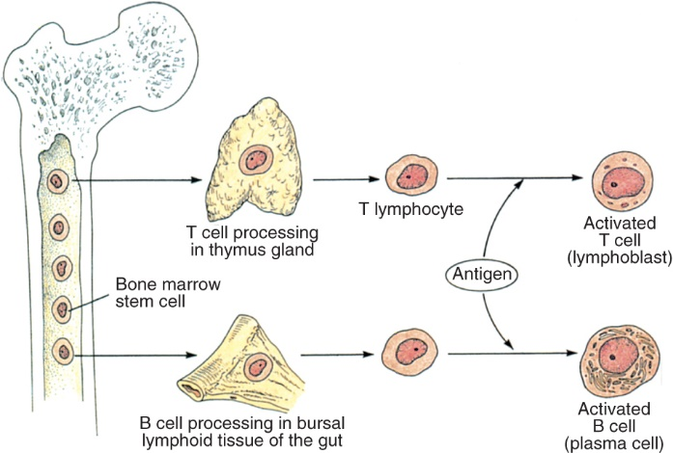
Development of T and B Cells
Courtesy Eileen Draper.
7
Notes:
This diagram shows the development of the T and B cells, which are the lymphocyte components of the body’s immune system. (Figure 23-1)

Slide 8
Relation of Nutrition to Immunity and Healing
Immunity
  Balanced nutrition maintains immune system
  Malnutrition reduces capacity of immune system via atrophy of organs and tissues involved in immunity
  Nutrition vital in combatting sustained attacks of diseases (e.g., cancer)
8
Notes:
Nutrition support is needed to maintain the integrity of the immune system.
Severely malnourished people show changes in the structure and function of their immune systems.

Slide 9
Relation of Nutrition to Immunity and Healing (cont’d)
Healing
  Strength of any body tissue is maintained through the constant building and rebuilding of tissue protein*
  Tissue building and healing requires optimal nutrition
  Vigorous MNT speeds recovery after surgery for cancer
  Careful, early use of vigorous nutrition support provides recovery of normal nutritional status and immunocompetence of cancer patients.
9
Notes:
Immunocompetence improves a patient’s response to therapy and his or her prognosis.
Nutrition support has specifically been shown to improve postoperative outcomes and to reduce the complications of patients with cancer of the gastrointestinal tract.

Slide 10
Nutrition Complications of
Cancer Treatment
Three major forms of therapy used to treat cancer
  Surgery
  *Radiation
    External or implanted radioactive isotopes
    Abdominal area-affects intestinal mucosa causing a loss of villi and possible nutrient malabsorption**
  Chemotherapy complications
    Bone marrow**
    GI tract
      Mucositis*
    Hair follicle
10
Notes:
Each of these treatment modalities requires nutrition support.
Drug-nutrient interactions are also a complication that may happen with any form of treatment.

Slide 11
Surgery
All surgery requires nutrition support for the healing process
General condition of cancer patients often is weakened by the disease process
11
Notes:
Nutrition support is required before and after surgery.
Changes in food texture or nutrient content may be required depending on surgical site or function of the organ involved.

Slide 12
Radiation
Involves high-energy radiographs targeted on the cancer site
Often kills surrounding healthy cells and cancerous cells
Nutrition problems driven by site and intensity of radiation treatment
Sense of taste may be affected, prompting efforts to enhance food appearance and aroma
Ulcers, inflammation, obstructions, or fistulas may also develop as a result of tissue breakdown, and these conditions interfere with the normal functioning of the involved tissue.
12
Notes:
Radiation therapy is often used by itself or in conjunction with other treatments.
Radiation to the abdominal area affects intestinal mucosa, causing loss of villi and, subsequently, absorption. Malabsorption problems follow.

Slide 13
Chemotherapy
Highly toxic drugs administered via the bloodstream to kill cancer cells
Normal, healthy cells also affected
Complications include these areas:
  Bone marrow
    Reduced RBC, WBC, and platelet production
  Gastrointestinal
    nausea/vomiting, loss of normal taste sensations, anorexia, diarrhea, ulcers, malabsorption, mucositis
  Hair loss
13
Notes:
Unlike radiation therapy, chemotherapy is administered via general blood circulation throughout the body.
Chemotherapeutic agents destroy rapidly growing cancer cells.

Slide 14
Drug-Nutrient Interactions
*Antineoplastic drugs have drug-nutrient interactions
Many patients use herbs to prevent or treat cancer; can have food-drug interactions
14
Notes:
The patient should be questioned carefully about any herb use, and possible interactions should be discussed.
[Review Table 23-1, Drug-Nutrient Interactions with Commonly Used Medications in Patients with Cancer.]

Slide 15
Drug nutrient interactions with antineoplastics
Bexarotene
Methotrexate
Plicamycin
*Procarbazine
  *Low tyramine diet
  *Foods containing tyramine:chocolate; alcoholic beverages; and fermented foods, such as most cheeses (except ricotta, cottage, cream and Neufchâtel cheeses), sour cream, yogurt,shrimp paste, soy sauce, soybean condiments, teriyaki sauce, tempeh,miso soup, sauerkraut
Temozolomide

Slide 16
Nutrition Problems Related to the Disease Process
General systemic effects of cancer
  *Anorexia, loss of appetite results from poor food intake
  Increased metabolism = increased nutrient needs
  Negative nitrogen balance-results in lean tissue catabolism*
The extent of these effects may vary widely from a mild response, to malnutrition, or to an extreme form of debilitating cachexia.
*improve appetite: small amounts of ETOH, coffee, avoid odors, avoid liquids at meals
16
Notes:
Negative nitrogen balance results in more catabolism (breaking down of body tissues).
Tumors can cause obstructions or lesions in the GI tract, accessory organs, or the surrounding tissue.
Patients with forms of cancer that involve hormone or steroid therapy (e.g., breast and prostate cancer) are at risk for significant weight gain.

Slide 17
Basic Objectives of Nutrition Plan
Nutrition screening and assessment
  Primary responsibility of clinical dietitian
  Other members of health care team take part
    Anthropometric measurements
    Laboratory tests and results interpretation
    Clinical observations
    Dietary analysis
    Screening for malnutrition
17
Notes:
This is the first part of the fundamental process of identifying needs and planning care based on those needs.

Slide 18
Basic Objectives of Nutrition Plan (cont’d)
Nutrition intervention
  Prevent weight loss
  Prevent malnutrition*
  Maintain lean body mass
  Prevent unintentional weight gain
  *Identify and manage treatment-related side effects
18
Notes:
Patients with hormone-related cancer, such as breast cancer, and those receiving high-dose steroids are at risk for weight gain.

Slide 19
Prevention of Catabolism
MNT to meet increased metabolic demands of disease process
  Maximize oral intake of nutrient-dense foods
  Liberalize any diet restrictions
  Encourage small, frequent meals
Medications used to:
  Increase appetite
  Reduce nausea
  Prevent protein degradation
  Increase caloric intake
19
Notes:
Enteral or parenteral feedings should be used with patients who cannot meet their metabolic needs orally.

Slide 20
Relief of Symptoms
Tremendous contribution is made by the nursing staff and other health care personnel with regard to day-to-day support and counseling to help patients meet their nutrient requirements.
Strategies:
  Stress management
  Pain management
  Relaxation techniques
  Psychologic support
  Physical activity
20
Notes:
[Review the For Further Focus box, Cannabis as a Treatment for Anorexia.]

Slide 21
Nutrition Monitoring and Evaluation
Dietitian develops customized MNT plan for patient
Plan is evaluated regularly with patient and family
Plan adjusted as needed
21
Notes:
[Ask students to name some of the factors that the dietitian considers when developing the MNT for the patient.]

Slide 22
Medical Nutrition Therapy
*Energy: cancer places great metabolic demands-more kilocalories may be needed in accordance with the degree of metabolic stress, the amount of tissue synthesis that is taking place and physical activity levels
Malnourished client requires significantly more energy*
*Protein: essential amino acids and nitrogen for rebuilding
  Animal sources are best*
Vitamins and minerals: at least to DRI standards
Fluid: to replace losses, remove waste products
22
Notes:
Energy: carbohydrate and fat intake frees up protein (essential amino acids and nitrogen) so that it can be used for tissue building.
Vitamins and minerals: control protein and energy metabolism through their coenzyme roles
Adequate fluid intake: replace losses, help kidneys dispose of metabolic waste from destroyed cancer cells and toxic drugs
[Review Drug-Nutrient Interaction box, Antiestrogens and Breast Cancer.]
[Review Drug-Nutrient Interaction box, Antioxidants and Chemotherapy.]

Slide 23
Nutrition Management
Enteral: oral diet with supplementation
  Most desired form of feeding when tolerated*
  Preferred route
  Adjust to maximize palatability
  Maximize energy and nutrient density
23
Notes:
A well-planned diet provides energy and nutrient density in small quantities of food.

Slide 24
Enteral: Oral Diet with Supplementation
Loss of appetite
  Major issue with cancer
  Can lead to cachexia
  Requires vigorous program of eating that does not depend on appetite
24
Notes:
Nurses must assist in addressing loss of appetite, mouth problems, gastrointestinal problems, and pain/discomfort.
[Review Table 23-2, Dietary Modifications for Nutrition-Related Side Effects of Cancer, Human Immunodeficiency Virus, and Acquired Immunodeficiency Syndrome.]

Slide 25
Enteral: Oral Diet with Supplementation (cont’d)
Oral complications
  Ensure basic mouth care
  Frequent small snacks rather than traditional meals
  Strong seasonings, high-protein drinks
  *food processor or blender can turn foods into a semisolid or liquid form for easier swallowing
GI problems
  Avoid hot, sweet, fatty, spicy foods as needed
  Small, frequent feedings of soft to liquid foods
  Antinausea drugs
25
Notes:
[Ask students what actions are included in “basic mouth care”.]
Surgical treatment of the GI tract brings its own MNT (see Chapter 22), and chemotherapy and radiation treatment can affect the mucosal cells that secrete lactase, creating lactose intolerance.

Slide 26
Enteral: Oral Diet with Supplementation (cont’d)
Loss of lean tissue
  Dietary supplements containing fish oils to prevent loss of lean tissue
Pain and discomfort
  Severe pain controlled and comfortable position allows patients to eat more**
  Pain medication as needed
  Preventive therapy to avoid constipation
26
Notes:
Children undergoing painful treatments particularly need effective pain management.

Slide 27
Enteral and Parenteral Feeding
Enteral: when gastrointestinal tract can be used but patient is unable to eat
Parenteral: when GI tract cannot be used
27
Notes:
[See Chapter 22 for details on enteral and parenteral feedings.]

Slide 28
Dietary modifications box 23-2
Xerostomia
Diarrhea
Constipation
Mucositis and stomatitis
Neutropenia*
dehydration

Slide 29
Cancer Prevention
American Cancer Society, World Cancer Research Fund, American Institute for Cancer Prevention
  Be as lean as possible within normal range
  Adopt a physically active lifestyle
  Consume a healthy diet
  Limit alcohol consumption
  Do not rely on supplements
  Breastfeed infants exclusively for 6 months
29
Notes:
[Ask students how much exercise of moderate to vigorous intensity they get per week.]

Slide 30
Cancer Prevention (cont’d)
U.S. FDA claims approved for labels
  Dietary fat (lipids) and cancer
  Fiber-containing grain products
  Fruits, vegetables, and cancer
    Most people need a total of about 5 servings of fruits and vegetables per day.
Ongoing cancer research: foods that may increase or reduce risk of
  Breast cancer: risk increases with obesity
  Gastric cancer: fruits and vegetables protective
  Colorectal cancer: 70 to 90% due to dietary factors
30
Notes:
[Ask students how many servings of fruits and vegetables they have had in the past 24 hours.]
National Cancer Institute is the federal research body funded by the Department of Health and Human Services.
Eating a healthful diet low in fat may help reduce the risk of some types of cancers.
Fiber-containing grain products, fruits, and vegetables may reduce risk of some types of cancer.
Fruits and vegetables may reduce risk of some types of cancer.
If patients are made to feel uncomfortable about discussing their CAM practices with their health care provider, they are much less likely to disclose the use of CAM and serious consequences may result.

Slide 31
Nutrition Support in HIV/AIDS
Nutrition problems affect the nature of the disease process and the medical treatment methods for patients with cancer or human immunodeficiency virus (HIV).
The progressive effects of HIV to the final stage of acquired immunodeficiency syndrome (AIDS) have many nutrition implications and often require aggressive medical nutrition therapy.
31
Notes:
Although cancer and HIV/AIDS share a direct relationship with the body’s immune system and basic nutrition needs, their courses and outcomes are distinct.

Slide 32
Progression of HIV
Evolution of human immunodeficiency virus
  First case identified in 1959
  By late 1970s and early 1980s had spread (pandemic) to Europe and United States
  Underlying infectious agent identified in 1983
Parasitic nature
  Viruses contain only shreds of genetic material.
  They invade a host cell and use it to make copies of itself.
32
Notes:
Like all viruses, HIV is a parasite that uses its host to replicate itself.
[Review Cultural Considerations, Types and Incidence of Human Immunodeficiency Virus and Acquired Immunodeficiency Syndrome in American Populations.]

Slide 33
Transmission and Stages of Disease Progression
Modes of transmission
Three distinct stages
  Primary infection and extended latent period of HIV incubation
  HIV-related diseases
  AIDS
33
Notes:
Transmission is through sexual contact (i.e., oral, anal, or vaginal)--the primary mode of transmission--and through the sharing of needles or syringes or through mother-to-child transmission.
Blood, tissue, and organ donations are now very closely screened for HIV antibodies in most countries, thereby reducing this form of transmission.
The individual course of HIV infection can vary widely among individuals.

Slide 34
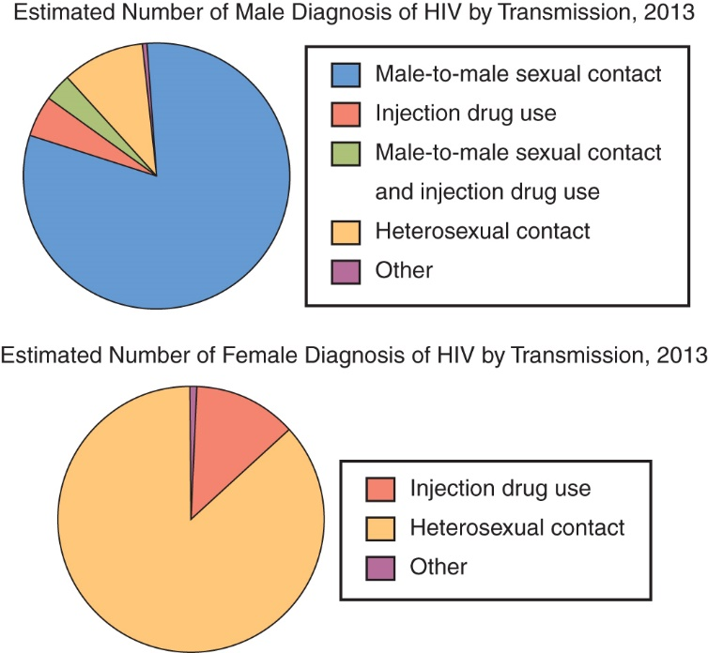
Modes of HIV Transmission
Source: Centers for Disease Control and Prevention. HIV surveillance report, 2013. 2015: <www.cdc.gov/hiv/library/reports/surveillance/>.
37
Notes:
Note the differences in transmission for men and women.
[Diagram’s source is Centers for Disease Control and Prevention. HIV surveillance report, 2013. 2015: <www.cdc.gov/hiv/library/reports/surveillance/>.]

Slide 35
CDC Classification for HIV
Stages 1, 2, 3 based on T-lymphocyte count
  Stage 0 and Stage unknown are other classifications
Clinical category
  *Category A: asymptomatic or acute HIV
    2-4 weeks after initial exposure and infection a mild flu like episode may occur
  Category B: symptomatic conditions
  Category C: AIDS-indicator conditions
38
Notes:
[Review Table 23-3, CDC Classification System for HIV.]
[Discuss hallmarks of the clinical categories.]

Slide 36
Progression: HIV Infection to AIDS
Terminal stage of HIV infection: AIDS
Rapidly declining T-lymphocyte counts
Opportunistic infections
  Category B characteristic infections
  Category C defining infections
    Kaposi’s sarcoma
    Cytomegalovirus
    Protozoan parasites
36
Notes:
When the virus kills enough white cells to overwhelm the immune system, death occurs.
[Review Box 23-2, Common Types of Opportunistic Infections in Patients Infected with Human Immunodeficiency Virus.]
[Review Box 23-3, Common Types of Opportunistic Infections In Patients Infected With Human Immunodeficiency Virus.]

Slide 37
Medical Management of Patient with HIV/AIDS
Initial management
  Delay progression of the infection and improve the immune system
  Prevent opportunistic illnesses
  Recognize the infection early
37
Notes:
Recognize the infection early and provide rapid treatment for complications, including infections and cancers.
[Review Box 23-4, Initial Evaluation of Patients Who Have Been Newly Diagnosed with Human.]

Slide 38
Drug Therapy
Effective drug therapy is difficult because of highly evolved nature of virus
Several drugs approved by FDA
Highly active antiretroviral therapy is current primary drug regimen
Protease inhibitors help to stop HIV by inhibiting the basic enzyme protease, which is essential to HIV development**
  *table 23-4
38
Notes:
The virus has mutated to become resistant to some HIV drugs, such as protease inhibitors.
[Review Table 23-4, Antiretroviral Therapy and Toxic Effects and Cautions.]

Slide 39
Vaccine Development
Vaccine would train body’s immune system to identify and destroy HIV virus
Vaccine undergoing trials in Thailand considered somewhat effective
CDC and NIH working with other worldwide agencies to coordinate development of effective vaccine
39
Notes:
[Ask students to identify three of the challenges to the development of an effective vaccine. (Degree of diversity of virus, ability of the virus to evade host’s immunity, lack of appropriate animal models)]

Slide 40
Medical Nutrition Therapy
The registered dietician nutritionist on the multidisciplinary team conducts this assessment*
*Assessment: ABCDEF for patients with HIV/AIDS
  Anthropometry
  Biochemical tests
  Clinical observations
  Diet observations
  Environmental, behavioral, and psychologic assessment
  Financial assessment
40
Notes:
The clinical dietitian on the AIDS team conducts this assessment and calculates daily nutrition needs.
[Review the Clinical Applications box, The ABCDEFs of Nutrition Assessment for Patients with HIV/AIDS.]

Slide 41
Medical Nutrition Therapy (cont’d)
Intervention
  No specific nutrient recommendations for patient with HIV
  Reduce or eliminate malnutrition
  Correct nutrition problems identified in assessment
  Prevent food- and water-borne illness
41
Notes:
Because of the patient’s weakened immune system, the prevention of food-borne illness is a priority.

Slide 42
Wasting Effects of HIV Infection on Nutritional Status
Severe malnutrition, weight loss
  Decreased appetite, insufficient energy intake in addition to elevated resting energy expenditure
  Malnutrition suppresses cellular immune function, thereby perpetuating the onset of opportunistic infections, which is the ultimate cause of death in patients with AIDS.
  *Major weight loss, eventual cachexia
42
Notes:
This wasting process plays a major role in the patient’s debilitating weakness and fatigue, decreased quality of life, and the progression of the disease.

Slide 43
Causes of Body Wasting
Inadequate food intake
Malabsorption of nutrients
Disordered metabolism
Lean tissue wasting
43
Notes:
Body wasting may result from any of these causes, alone or in combination.
Disuse coupled with systemic inflammation exacerbate muscle wasting and increase mortality. Resistance training, appropriate nutrition, and the administration of hormone replacement therapy may be effective for preventing lean tissue losses in some conditions of muscle wasting.
Providing a lipid-based nutritional supplement with soy or whey protein early in antiretroviral therapy (ART) treatment has been shown to help maintain lean body mass and strength.

Slide 44
Lipodystrophy
Gaining of fat in neck and abdomen
Concurrent loss of fat in face, buttocks, arms, legs
Treatment with antiretroviral therapy may be causative factor
*results in social stigmatism
*weight changes
*glucose intolerance
44
Notes:
Patients with lipodystrophy continue to lose lean tissue while changes in fat mass are taking place.
[Review the For Further Focus box, Highly Active Antiretroviral Therapy and Lipodystrophy.]

Slide 45
Nutrition Counseling, Education, and Supportive Care
Should focus on:
  Adequate food intake to maintain nutrition status and body composition
  Nutritional strategies and therapies for symptom management to reduce the effects of disease progression, co-morbidities, and medication intolerance
  Potential drug-nutrient interactions
  Benefits and risks of dietary supplements
  *the basic goal of nutrition counseling is to make the least amount of changes necessary in a persons lifestyle and food patterns to promote optimal nutritional status while providing maximal comfort and quality of life
45
Notes:
[Ask students for suggestions of nutritional strategies for symptom management.]

Slide 46
Counseling Principles
Motivation for dietary changes
Rationale for nutrition support
*Provider-patient agreement on plan
  The dietary plan supports the patients medication regimen
Development of manageable steps for change
46
Notes:
The goal is to make the smallest amount of changes necessary to promote optimal nutritional status.

Slide 47
Supportive Care
Personal food management skills
Community programs (e.g., Meals on Wheels, SNAP)
  Health care providers should ensure that a patient is economically, physically, and mentally capable of meeting his or her daily food needs or refer the patient to a social worker to assist in finding available programs within a patient’s community to help the patient’s access to food.
Psychosocial support
  Be particularly sensitive to the psychologic and social issues that confront their patients
  Use the assistance of social workers and clinical psychologists; stress reduction groups and activities
47
Notes:
Health care workers must examine their own stresses, values, fears, and preconceived judgments that can affect the provider-patient relationship.

Slide 48
Complementary medicine: herbal remedies
*Ginseng
  energy
*Echinacea
  Immune function
*Feverfew
  Prevention of migraine headaches
Garlic
  Tx hyperlipidemia
Ginger
  Aid digestion and treat motion sickness

Slide 49
Complementary medicine: herbal remedies
Ginkgo
  Improve cerebral ciculation
Saw palmetto
  Decrease urination difficulty
St. John’s wart
  Support treatment for anxiety and depression
Valerian
  Manage restlessness and sleep disorders

