Slide 1
Williams' Basic Nutrition & Diet Therapy
14th Edition
Chapter 4
Proteins
1

Slide 2
Proteins
Protein in food provides the amino acids necessary for building and maintaining body tissue.
Protein balance, both within the body and in the diet, is essential to life and health.

Slide 3
The Nature of Proteins
*Amino acids as basic building units
  Each protein is composed of hundreds of amino acids
  Amino acids form unique chain sequences to form specific proteins
  When protein foods are eaten, proteins are broken down into amino acids
  Amino acids are reassembled in the body to form a variety of proteins
Notes:
Each protein in the body has a unique structure and function.
The body needs amino acids to build proteins.
What are some common proteins in foods? (Casein in milk and cheese, gluten in wheat, albumin in egg white)

Slide 4
Dietary Importance
Amino acids
  Named for chemical structure
  *Basic structure of carbon, hydrogen, and oxygen
  Primary source of nitrogen in diet
    Approx. 16% nitrogen*
  Some contain small amounts of valuable minerals
Notes:
What are some of the minerals that may be supplied via amino acids in the diet? (Sulfur, phosphorus, iron, iodine)

Slide 5
Classes of Amino Acids
*Indispensable amino acids
  Body cannot manufacture in sufficient quantity
Dispensable amino acids
  Body can synthesize from indispensable
Conditionally indispensable amino acids
  Normally synthesized but some health conditions may require dietary intake
Notes:
Nine indispensable amino acids are necessary in the diet and cannot be omitted.
Five dispensable amino acids are easily synthesized by the body.
Six conditionally dispensable amino acids are normally synthesized, but stress, illness, and genetic disorders can make them indispensable.
Explain why stress and illness make the six conditionally dispensable amino acids indispensable.

Slide 6
Balance
Protein balance
  Catabolism: breakdown
  *Anabolism: resynthesized into tissue proteins as needed through a process called anabolism
Nitrogen balance (intake = excretion)
  Positive nitrogen balance: body stores more than it excretes
    Protein catabolism
    occur during periods of rapid growth 9infancey, childhood, adolescence) lactation and pregnancy
Notes:
Nitrogen balance indicates how well the body’s tissues are being maintained; it is achieved in healthy adults.
Positive nitrogen balance can occur during periods of rapid growth and pregnancy.
Negative nitrogen balances occur during periods of illness or malnutrition.
Explain that during a period of negative nitrogen balance the person is not getting enough protein in the diet and the body is breaking down tissue to provide energy or other critical functions.

Slide 7
Nitrogen Balance
Negative nitrogen balances occur during periods of illness or malnutrition.
the person is not getting enough protein in the diet and the body is breaking down tissue to provide energy or other critical functions.

Slide 8
Functions of Proteins
Primary tissue building
  Protein meets growth needs and maintains tissue health during the adult years*
Water and pH balance
  Albumin helps control water balance
Metabolism and transportation
  Protein acts as a vehicle where nutrients are carried throughout the body
Body defense system
  immunity
Energy system
  Available fuel is 4kcal/g**
Notes:
Explain that all functions are critical for optimal health.

Slide 9
Food Sources of Protein
Contain all nine indispensable amino acids in sufficient quantity and ratio to meet the bodys needs*
Complete proteins-animal origins*
  Meat, fish, poultry, seafood
  Soy-only plant sources of complete proteins*
  Gelatin is an incomplete animal protein*
Incomplete proteins-deficient in one or more of the 9 indispensible amino acids
  Plant-origin foods
    Grains
    Legumes
    Nuts
    Seeds
    Fruits and vegetables
Notes:
Ingesting complementary proteins is the art of matching plant foods so that the amino acids missing in one food are supplied by another.

Slide 10
Vegetarian Diets
Must combine foods to cover all amino acid needs
***Types of vegetarian diets
  Lacto-ovo vegetarian-allows dairy and eggs
  Lacto-vegetarian
    Dairy only from animal sources, use of milk and mild products with a diet of whole or enriched grains, legumes, nuts, seeds, fruit and vegetables in sufficient quantities.*
  Ovo-vegetarian-allows only eggs
  Vegan-no animal products
Notes:
About 2.3% of the U.S. population followed vegetarian diets in 2006.
Lacto-ovo vegetarian: Dairy products and eggs, excluding meat and fish, to complement diet of plant foods
Lacto-vegetarian: Milk and milk products to complement diet of plant foods
Ovo-vegetarian: Eggs are only animal foods to complement diet of plant foods
Vegan: No animal foods, diet of plant foods only

Slide 11
Complementary proteins
Mix plant foods so that the amino acids missing in one food are supplied by another*
*families of foods (grains, legumes, dairy) must be mixed
*milk products and eggs enhances the amino acid adequacy of lacto-ovo-vegetarians
Grains and peas, beans or lentils
Brown rice and beans
Legumes and seeds
Grains and dairy
EX: macaroni and cheese, tamales and beans*

Slide 12
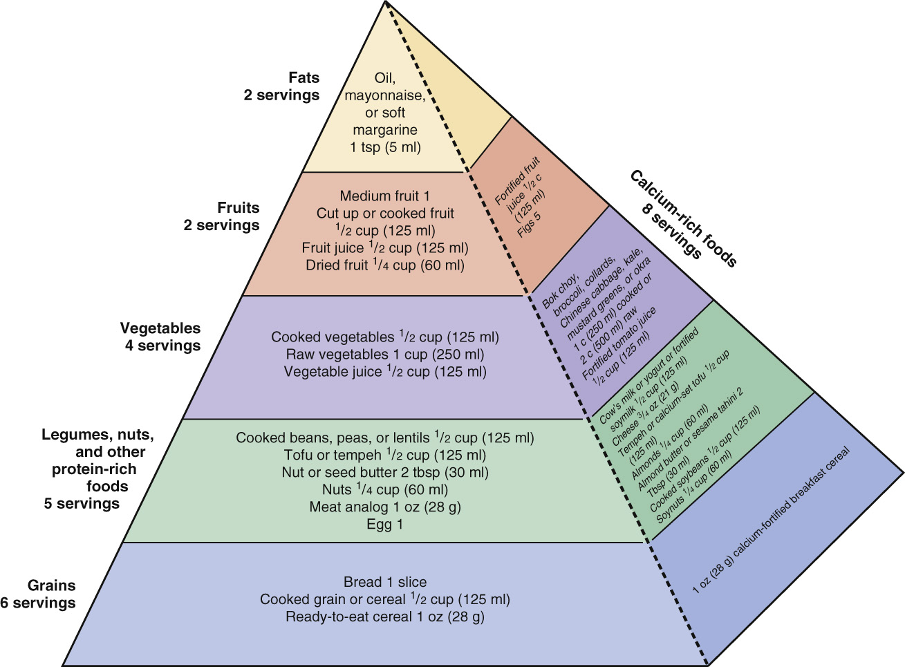
Vegetarian Diets
Notes:
List other nutrients in which a vegetarian diet might be deficient.

Slide 13
Vegetarian Diets
Health benefits and risks
  Less saturated fat and cholesterol
  More fruits, vegetables, whole grains, other healthful foods
  Lower BMI and risk of obesity
  Lower rate of cardiovascular disease
  Lower risk of renal disease
  Lower risk of type 2 diabetes
  Risk-No natural source of vitamin B12*
Notes:
What are some of the key nutrients that vegetarians are at risk of consuming in insufficient quantities? (Protein, iron, zinc, calcium, vitamin D, vitamin B₁₂, and omega-3 fatty acids)

Slide 14
Digestion of Proteins
Mouth-mechanical breakdown of food
Stomach: Proteins are large and complex and are broken down by a series of enzymes by proenzymes (zymogens)
  Hydrochloric acid
    Provides the acid medium necessary to convert pepsinogen to pepsin (enzyme specific to proetin*
  Pepsin-changes large proteins into short chains
  Rennin-only present in infancy and childhood to aid in the digestion of milk. It slows down the passage of milk to the small intestine by turning it into curds
Notes:
Enzymes must be stored in inactive proenzyme form as zymogens, which are activated by need.
Pepsin is the main gastric enzyme specific to proteins.
Hydrochloric acid changes inactive pepsinogen to pepsin.
Rennin is only present in infancy and childhood to aid in the digestion of milk. It slows down the passage of milk to the small intestine by turning it into curds.

Slide 15
Digestion of proteins
Protein digestion begins in the acidity of the stomach and is completed in the alkaline environment of the small intestine
  Pancreatic secretions
    Trypsin-secreted first as inactive trypsinogen activated by enterokinase
    Chymotrypsin-activated by trypsin, continues protein splitting action
    Carboxypeptidase-produces some free amino acids
  Intestinal secretions
    Aminopeptidase-releases amino acids one at a time
    Dipeptidase-final protein splitting enzyme

Slide 16
Recommendations for Dietary Protein
Tissue growth
  During rapid growth periods, more protein per unit of body weight is necessary to build new tissues
Notes:
During rapid growth periods, more protein per unit of body size is necessary to build new tissue.
Chemical score is the value derived from the amino acid pattern of the food (an egg has a value of 100).
Biologic value is based on nitrogen balance.
Net protein utilization is based on biologic value and the degree of digestibility.
Protein efficiency ratio is based on weight gain relative to protein intake.

Slide 17
Recommendations for Dietary Protein
Illness or disease raise body’s need for protein
  Fever
  Catabolic tissue breakdown
  Traumatic injury
  Recovery from surgery
  Burns, pressure sores
Notes:
Ask students to explain why each of these conditions would increase the body’s need for protein.

Slide 18
Recommendations for Dietary Protein
Dietary deficiency or excess
  Protein energy malnutrition
    *Kwashiorkor
      Affects ages 18-24 months who are breastfed and then rapidly weaned
      s/s: generalized edema and fatty liver balance
    *Marasmus
      Chronic form of energy and protein deficiency (starvation)
      s/s: little to no body fat, affects ALL age groups
  Excess protein
    Usually also means excess fat intake
    Protein displaces other healthy foods in diet
    Extra burden on kidneys
Notes:
Protein energy malnutrition is common in developing countries because of a lack of high-quality protein sources.
Kwashiorkor is common in children between the ages of 18 and 24 months who are rapidly weaned and switched to a diet of mostly carbohydrates and little protein. Characteristics include edema in the feet and legs and a bloated abdomen. What function of protein does this relate to? (Water balance)
Marasmus is chronic energy and protein deficiency. Characteristics include wasting without edema and a “skin and bones” appearance.

Slide 19
Dietary Guides
Recommended Dietary Allowances (RDAs)
  Relate to age, sex, weight
  Highest at birth and slowly declines into adulthood
  Men and women: 0.8 g/kg of desirable weight
Notes:
Ask students to explain why protein needs are highest at birth.

Slide 20
Dietary Guides
Dietary Reference Intakes (DRIs) from National Academy of Sciences
  10% to 35% of total caloric intake from protein (children and adults)
Notes:
Ask students to calculate the RDA of high-quality protein for a woman weighing about 120 lbs. (Divide 120 by 2.2 = about 54.5 kg. Multiply 54.5 by 0.8 g = about 47 g/day of high-quality protein.)

Slide 21
Dietary Guidelines for Americans
High consumption of animal protein in the U.S.
  No benefits
  Some risks
    Cancer
    Coronary heart disease
    Kidney stones
    Chronic renal failure
Notes:
What are some of the components of animal protein that increase the risk of these conditions? (Saturated fat and cholesterol)

Slide 22
Dietary Guidelines for Americans
Recommendations
  Choose variety of protein foods
  Increase amount and variety of seafood
  Choose proteins with less solid fats and oils
Notes:
What are some alternatives to meat proteins? (Beans, nuts, and seeds)

