Slide 1
Chapter 7
Vitamins
Notes:
This chapter looks at the vitamins both as a group and as individual nutrients.
It explores general and specific vitamin needs and reasonable and realistic dietary supplement use.

Slide 2
The Nature of Vitamins
Vitamins are noncaloric essential nutrients necessary for many metabolic tasks.

Slide 3
Dietary Reference Intakes
Recommendations for nutrient intake by healthy population groups
Based on gender and age
  RDA: Recommended Dietary Allowance
  EAR: Estimated Average Requirement
  AI: Adequate Intake
  UL: Tolerable Upper Intake Level
Notes:
Review the DRI acronyms and percentage of the population they cover.

Slide 4
The Nature of Vitamins
Discovered while searching for cures for classic diseases
  Dr. James Lind and scurvy
    Sailors dying on long voyages without fresh food
    Lemons and limes provided, no one became ill
    British soldiers got the nickname, “limeys”
Notes:
Explain that although vitamins do not produce energy, they are needed for metabolic processes and tissue building, as is the case for vitamin C and collagen.

Slide 5
The Nature of Vitamins (cont’d)
Dr. Frederich Hopkins of Cambridge University
  Two groups of rats
  Group 1: Fed synthetic mix of protein, carbohydrate, fat, mineral salts, and water: All rats died
  Group 2: Fed same ration but with purified milk: All rats grew normally
  Proved that accessory factors are present in natural foods that are essential to life
Notes:
Define the term synthetic. Explain that plants make the macronutrients as well as vitamins and phytochemicals.

Slide 6
The Nature of Vitamins (cont’d)
Most vitamins were discovered in the first half of the 1900s
At first, scientists assigned letters of the alphabet to each vitamin
  A, C, D, E, K
This practice was abandoned in favor of more specific names based on structure and function
  Cobalamin, pyridoxine, choline
Notes:
Cobalamin is another name for vitamin B₁₂; it contains cobalt.
Another name for vitamin A is retinol. What part of the eye does this sound like? Explain that vitamin A is required for eyesight.

Slide 7
Definition of Vitamins
It must be a vital, organic substance that is only necessary in extremely small amounts
It cannot be manufactured by the body in sufficient quantities to sustain life, so it must be supplied by diet
Notes:
Explain that some vitamins can be manufactured by the body, like vitamin D, but often not in sufficient amounts.

Slide 8
General Functions of Vitamins
Metabolic tasks
Components of coenzymes
Antioxidants
Components of hormones that affect gene expression
Component of light-sensitive rhodopsin molecule (vitamin A)
Notes:
What is the end product of glucose metabolism? (Energy)

Slide 9
General Functions of Vitamins (cont’d)
Metabolism: enzymes and coenzymes
Example: B vitamins are part of coenzymes
  Coenzymes needed to perform certain functions, such as:
  Glucose metabolism
  Protein metabolism
  Fatty acid metabolism
Notes:
Without coenzymes, energy production is impossible, leading to death.

Slide 10
General Functions of Vitamins (cont’d)
Tissue structure and protection (e.g., vitamin C)
Antioxidants to protect cells
Prevention of deficiency diseases
  Example: vitamin C prevents scurvy
Notes:
What other deficiency diseases can students name?
Reinforce that these diseases are solely based on vitamin deficiency. Any single vitamin that is not eaten in sufficient amounts will result in a deficiency, even if all other nutrient intake is adequate.

Slide 11
Vitamin Metabolism
Fat soluble
  Vitamins incorporated with absorbed fat and transported by chylomicrons
  Best absorbed when eaten with fat
  May be stored for long periods
Water soluble
  Easily absorbed and transported by the portal circulation
  Not stored, so must be eaten on regular basis (exceptions: B₁₂ and B₆)
Notes:
Explain that fat-soluble vitamins are stored for longer periods because they are deposited in adipose tissue and the liver.
Explain that most water-soluble vitamins are kept in circulation and do not have a storage site.

Slide 12
Fat-Soluble Vitamins
Certain health problems are related to inadequate or excessive vitamin intake.
Vitamins occur in a wide variety of foods packaged with the energy-yielding macronutrients (carbohydrate, fat, and protein).
*stored in the liver and adipose tissue for long periods of time

Slide 13
Vitamin A (Retinol)
Functions
  Vision
    *rhodopsin enables the eye to adjust to different amounts of available light.
    *Mild vitamin A deficiency may cause night blindness, slow adaptation
  Tissue strength and immunity
  Growth
Requirements
  Food forms and units of measure
  Body storage
Notes:
What does retinol do in the body? (It is part of rhodopsin, which is a substance that enables the eye to adjust to different amounts of available light. Fluctuations in retinol levels can cause deficiencies with sight.)

Slide 14
Vitamin A Food Forms
Food forms and units of measure
  Preformed vitamin A: animal sources
  *Provitamin A: yellow, orange, or deep green fruits or vegetables
Notes:
Note that foods that are naturally colorful often are good sources of vitamins.

Slide 15
Vitamin A Deficiency and Toxicity
Deficiency disease
  Xerosis
  *Xerophthalmia
Toxicity symptoms
  Hypervitaminosis A
Notes:
What might a mild deficiency cause? (Night blindness, slow adaptation to darkness, glare blindness)

Slide 16
Vitamin A Food Sources
Food sources
  Preformed vitamin A: Fish liver oils, liver, egg yolk, butter, cream, milk fat
  Beta-carotene: dark green leafy vegetables, (spinach) dark orange vegetables (carrots, sweet potatoes) and fruits
Stability: quick cooking with little water to preserve
Notes:
Ask each student to name one food that is a significant source of vitamin A.
Cooking vegetables in an uncovered pot destroys much of their vitamin content.

Slide 17
Vitamin D (Calciferol)
Functions
  *Absorption of calcium and phosphorus
  *Bone mineralization
  *activated and functional form of vitamin D is calcitriol*
  *calcitriol acts with PTH and thyroid hormone to control calcium and phosphorus metabolism.
Notes:
Vitamin D is not a true vitamin because it is made in the body with the help of the sun’s ultraviolet rays. However, it can be a true vitamin without sufficient sun exposure.

Slide 18
Vitamin D Deficiency and Toxicity
Deficiency disease
  *Rickets
  Osteoporosis
Toxicity syndromes
  Infants and children susceptible
  Hypervitaminosis D includes the calcification of the soft tissues*
Notes:
Explain how vitamin D controls calcium metabolism in bone building.

Slide 19
Vitamin D (Calciferol) (cont’d)
Few good natural sources other than fatty fish
Large portion of intake must come from fortified foods (e.g., milk)**
Notes:
Ask the students to name two natural sources of vitamin D. (Yeast, fish liver oils)
What are some sources of vitamin D from fortified foods? (Milk and dairy products)

Slide 20
  Vitamin E (Tocopherol) Antioxidant to protect cell membranes
    *the polyunsaturated fatty acids in the phospholipids of cell and organelle membranes are susceptible to free radical oxidation
    *a-tocopherol intercepts this oxidation process and detects the polyunsaturated fatty acids from damage
  Selenium works with a-tocopherol as an antioxidant*
Notes:
What is the most vital function of vitamin E? (It acts as an antioxidant in many tissues.)

Slide 21
Vitamin E Deficiency and Toxicity
Deficiency disease
  Hemolytic anemia in young infants
  Dietary deficiency is rare
Toxicity syndromes
  Excessive supplements can interfere with vitamin K activity
Notes:
Who is most vulnerable to diseases caused by deficiency in tocopherol? (Young infants, especially premature infants)

Slide 22
Vitamin E Food Sources
Food sources
  Best: vegetable oils**
  Nuts, fortified cereal, avocado
Stability
  Unstable to heat and alkalis
Notes:
Ask each student to name a significant source of vitamin E.

Slide 23
Vitamin K
*Functions
  Blood clotting: essential component of four clotting factors
  Bone development: five proteins in bone and cartilage require vitamin K–dependent modifications
Requirements
  Intestinal bacteria synthesize a constant supply
  Insufficient evidence to establish RDA
Notes:
Because intestinal bacteria synthesize a form of vitamin K, a constant supply is normally available to support dietary sources.

Slide 24
Vitamin K Deficiency and Toxicity
Deficiency disease: blood loss
  Uncommon
  Patients with a malabsorption syndrome
  Patients treated with antibiotic that kills intestinal bacteria
  Routinely given to infants at birth because deficient at gestation
Toxicity symptoms
  None observed
Notes:
Who is most likely to suffer from a vitamin K deficiency? (Patients with severe malabsorption disorders, such as Crohn’s disease, or those who lack intestinal bacteria to synthesize the vitamin.)

Slide 25
Vitamin K Food Sources
Food sources
  Green, leafy vegetables*
  *if on anticoagulants-maintain a consistent intake of vitamin K
  Small amounts of phylloquinone from dairy products, meats, fortified cereals, fruits, vegetables
Stability
  Fairly stable
  Sensitive to light and irradiation
  Stored in dark bottles
Notes:
Discuss food sources of vitamin K.

Slide 26
Water-Soluble Vitamins and Supplements
Certain health problems are related to inadequate or excessive vitamin intake.
Vitamins occur in a wide variety of foods packaged with the energy-yielding macronutrients (carbohydrate, fat, and protein).
The body uses vitamins to make coenzymes required for some enzymes to function.
The need for particular vitamin supplements depends on a person’s vitamin status.

Slide 27
Vitamin C (Ascorbic Acid)
Many functions
  Connective tissue: helps build strong tissues through collagen synthesis
  General body metabolism: used by adrenals, brain, kidney, liver, pancreas, thymus, spleen
  Antioxidant: similar to vitamin E-works to protect body against free radicals*
Requirements
  75 mg/day for women, 90 mg/day for men; *extra 35 mg/day for smokers
Notes:
The more metabolically active body tissues contain greater concentrations of ascorbic acid.

Slide 28
Vitamin C Deficiency and Toxicity
Deficiency disease
  Tissue bleeding
  Bone fracture
  *Scurvy
    Sore gums, hemorrhages, es
Toxicity symptoms
  Kidney stone formation
  GI disturbances
  Osmotic diarrhea
Notes:
Vitamin C deficiency has several symptoms: easy bruising, pinpoint skin hemorrhages, bone and joint bleeding, susceptibility to bone fracture, poor wound healing, bleeding gums.

Slide 29
Vitamin C Food Sources
Food sources
  Citrus fruits
  *tomatoes
  *green and yellow vegetables
Stability
  Quickly oxidized upon exposure to air and heat
Notes:
Explain that vitamin C is readily oxidized when exposed to air. To put it practically, this means that once an orange is peeled, vitamin C content begins to decline.

Slide 30
Thiamin (Vitamin B₁)
*Function
  Gastrointestinal system
  Nervous system
  Cardiovascular system
Requirements: 1.2 mg/day for men, 1.1 for women
Deficiency disease
  Poor appetite, indigestion, constipation, Beriberi
  *wernicke’s encephalopathy- affects mental alertness, ST memory and muscle coordination
Toxicity symptoms: no evidence of toxicity
Food sources: especially enriched grains
Stability: fairly stable
Notes:
The basic function of thiamin as a coenzyme factor relates to the production of energy from glucose and the storage of energy as fat, making energy available to support normal growth.
What three body systems is thiamin especially necessary for? (Gastrointestinal system, nervous system, and cardiovascular system)
Historically, beriberi was found in Asian countries; in industrialized countries today, thiamin deficiency is found in alcoholics and those with a poor diet.

Slide 31
Riboflavin (Vitamin B₂)
Functions
  *Macronutrient metabolism to product ATP
Requirements
  Related to total energy requirements
  RDA for adults: 1.3 and 1.1 mg/day for men and women, respectively
Deficiency disease
  Areas of the body with rapid cell regeneration (lips, mouth, tongue)
Notes:
What are some signs of riboflavin deficiency? (Signs include cracked lips and mouth corners; a swollen, red tongue; eyes burning, itching, or tearing from extra blood vessels in the cornea; and a scaly, greasy dermatitis in skin folds. A rare condition, ariboflavinosis, has symptoms of tissue inflammation and breakdown and poor wound healing.)

Slide 32
Riboflavin (Vitamin B₂) (cont’d)
Toxicity symptoms
  None reported
Food sources
  Most important is milk*
  Enriched grains and animal protein
Stability
  Destroyed by light*
Notes:
What is the most important source of riboflavin in the American diet? (Milk)
Knowing that riboflavin is destroyed by light, what precautions have been taken with milk cartons to ensure this happens at a much slower rate? (Cartons are made of cardboard or plastic with an opaque finish.)
Because riboflavin has a yellowish-orange color, excessive intake may turn urine this color.

Slide 33
Niacin (Vitamin B₃)
Functions
  Energy metabolism
  DNA repair
Requirements
  Depends of many factors
  16 niacin equivalents/day for men, 14 for women
Deficiency disease
  Weakness, poor appetite, systemic symptoms
  *Pellagra-4D’s dermatitis, diarrhea, dementia, death
Notes:
Niacin partners with riboflavin and thiamin for what function? (Production of energy)
Niacin given in doses of 50 mg/day or greater may improve blood lipid profiles.
There are four Ds associated with pellagra: dermatitis, diarrhea, dementia, and death.

Slide 34
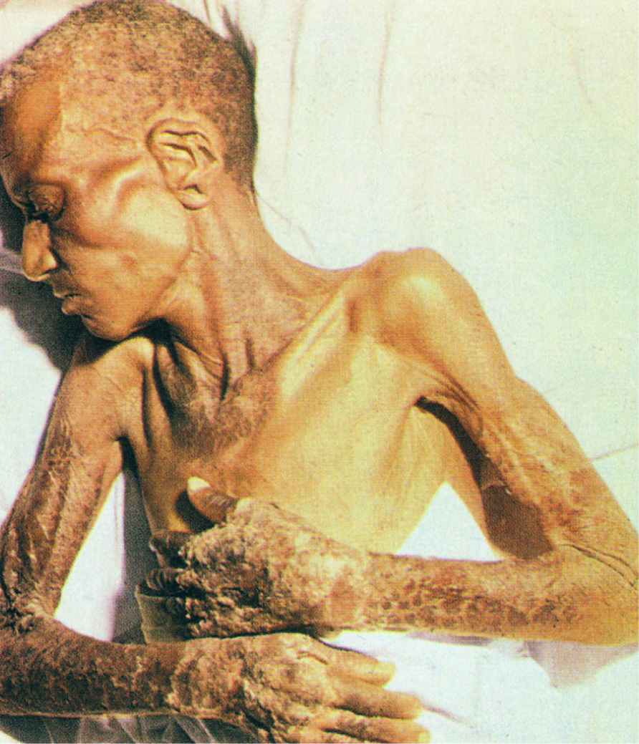
Niacin (Vitamin B₃) (cont’d)
Notes:
Pellagra results from a niacin deficiency.

Slide 35
Niacin (Vitamin B₃) (cont’d)
Toxicity symptoms
  From supplements
  Skin flushing
Food sources
  *Meat, poultry, fish, legumes
  *Enriched grain products
Stability
  Lost in cooking water unless water is consumed (soup)
  Treats high cholesterol*
Notes:
Ask students to name some food sources of niacin.

Slide 36
Vitamin B₆ (Pyridoxine)
Functions
  Protein metabolism
  Neurotransmitter
Requirements
  Vary with protein intake
  1.3 mg/day for men and women up to age 50
Deficiency disease
  Deficiency unlikely
Notes:
Vitamin B₆ is one of the water-soluble vitamins that is stored in tissues, particularly muscle tissue.
Deficiency symptoms include abnormal central nervous system function with hyperirritability, neuritis, and possible convulsions.

Slide 37
Vitamin B₆ (Pyridoxine) (cont’d)
Toxicity symptoms
  From supplements
  Uncoordinated movement and nerve damage
*Food sources
  Widespread in foods
Stability
  Stable to heat but sensitive to light and alkalis
Notes:
Is it difficult to find sufficient amounts of vitamin B₆ in the diet? (A deficiency of B₆ is unlikely because much more is available in the typical diet than is needed.)

Slide 38
Folate
**Functions
  DNA synthesis
  *protein metabolism
  Regulation of blood homocysteine levels
Requirements
  400 mcg/day
Deficiency diseases:
  *Megaloblastic anemia
  *Neural tube defects
    Defect occurs within the first 28 days after conception-before female realizes shes pregnant
Notes:
In its basic coenzyme role, folate is essential to the formation of all body cells because it takes part in the creation of DNA.
Explain that high homocysteine levels are seen in those with cardiovascular disease. Whether this is the cause or an effect of cardiovascular disease is unknown.

Slide 39
Folate (cont’d)
Toxicity symptoms
  None from intake of food
Food sources
  Widely distributed in foods, both naturally occurring and fortified
  *green leafy vegetables
Stability
  Easily destroyed by heat and leaches into cooking water
Notes:
What are some natural and fortified food sources of folate? (Green, leafy vegetables; orange juice; dried beans; liver; enriched grain: white flour, white rice, corn grits, corn meal, noodles, breakfast cereals, bread, rolls, buns)

Slide 40
Cobalamin (Vitamin B₁₂)
Functions
  Regulation of blood homocysteine levels
  Heme synthesis
  DNA synthesis and cell division
Requirements
  Small amount usually met by diet
Deficiency disease
  Pernicious anemia **
  Intrinsic factor is necessary for absorption of B12*
Notes:
What led to the discovery of vitamin B₁₂? (The search for the controlling agent responsible for pernicious anemia)
What oxygen-carrying protein is heme an integral part of? (Hemoglobin)
Explain that intrinsic factor from gastric digestive juices is essential for B₁₂ absorption. Without enough hydrochloric acid or intrinsic factor, individuals will develop a deficiency even if they are getting adequate amounts through diet.

Slide 41
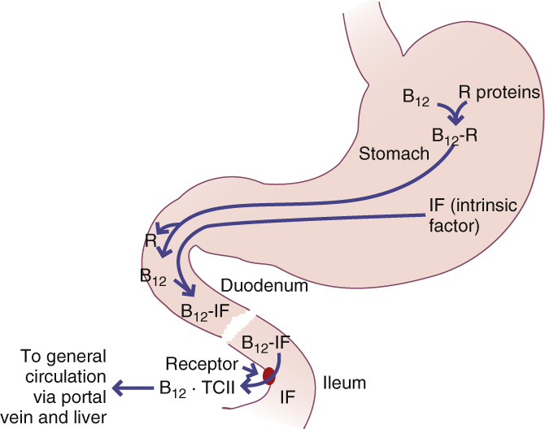
Cobalamin (Vitamin B₁₂) (cont’d)
Notes:
Digestion and absorption of vitamin B₁₂.

Slide 42
Cobalamin (Vitamin B₁₂) (cont’d)
Toxicity symptoms
  None found
Food sources
  Bound to protein in foods*
  *beef
Stability
  Stable in ordinary cooking
Notes:
Ask students to name sources of vitamin B₁₂. Are any of these sources plant sources?

Slide 43
Pantothenic Acid
Functions
  Cellular metabolism
  Protein acetylation and protein acylation
Requirements
  No specific RDA
Deficiency disease: unlikely
Toxicity symptoms: none observed
Food sources: occurs widely in food
Stability: stable to acid and heat but sensitive to alkalis
Notes:
Pantothenic acid is present in all forms of living things and is essential to all forms of life.
Pantothen refers to the Greek word meaning “from every side.”
Explain that pantothenic acid is essential to the synthesis and functioning of the body’s key activating agent, coenzyme A, which controls many cell metabolic reactions involving fat and cholesterol, heme formation, and amino acid activation.

Slide 44
Biotin
Functions
  Coenzyme for carboxylases
Deficiency disease: no natural deficiency known
Toxicity symptoms: none known
Food sources: widely distributed in natural foods
Stability: stable but water-soluble
Notes:
A supply of biotin is synthesized by normal intestinal bacteria.
Avidin, a protein in uncooked egg whites, binds biotin and may lead to a deficiency if eaten in excess.
What type of feeding in the clinical setting may lead to a biotin deficiency if not added to the diet? (Total parenteral nutrition)
What are the best sources of biotin? (Liver, egg yolk, soy flour, cereals [except bound forms in wheat], meats, tomatoes, and yeast)

Slide 45
Choline
Data insufficient to determine its essentiality
Functions
  Structural integrity of cell membranes
  Neurotransmission
Notes:
As a nutrient, it is important in maintaining the structural integrity of cell membranes.
Acetylcholine, a neurotransmitter, is involved with involuntary functions, voluntary movement, and long-term memory storage.
With what part of the cell membrane is choline associated? (The phospholipid lecithin)

Slide 46
Choline (cont’d)
Deficiency disease: liver and muscle damage
Toxicity symptoms: lowered blood pressure, fishy body odor
Food sources: occurs in a wide variety of foods
Stability: relatively stable nutrient and water-soluble
Notes:
Name sources of choline. (Milk, eggs, liver, peanuts)

Slide 47
Phytochemicals
Bioactive molecules with health benefits
Nonessential
People eating whole fruits and vegetables benefitted more than those who did not
Notes:
Phytochemicals are only found in whole foods, mostly whole grains, fruits, and vegetables.

Slide 48
Phytochemical Functions
*Function: wide variety
  Antioxidant function
  Hormonal actions
  Interactions with enzymes and DNA replication
  Antibacterial effects
Notes:
What are some of the beneficial effects of phytochemicals that have been documented? (Reduced risk of chronic disease, protection against coronary heart disease, improved overall colon function, prevention of age-related macular degeneration and cancer, and increased antioxidant status)
Ask students which phytochemicals they have heard discussed in the media.

Slide 49
Phytochemical Intake
Recommended intake
  No established DRIs
  Consume a colorful variety of fruits, vegetables, whole grains, nuts
*Food sources
  Seven color categories
Notes:
Explain that eating a variety of foods is important for phytochemical intake.

Slide 50
Vitamin Supplementation
Definition
Use is common in United States
Only 3% to 4% of Americans eat according to guidelines
Recommendations for nutrient supplementation
  Life cycle needs
  Pregnancy and lactation
  Infants, children, adolescents
  Older adults
Notes:
Why are supplements beneficial for pregnant or lactating women? (Folic acid is extremely important in preventing possible birth defects. Supplements ensure adequate intake of a variety of nutrients needed by the fetus and the pregnant woman.)

Slide 51
Vitamin Supplementation (cont’d)
Lifestyle
  Restricted diets: those following fad diets, vegans-need supplemental B12*
  Smoking: reduces vitamin C pool
  Alcohol: can reduce absorption of B-complex vitamins*
  Disease: requires nutrition assessment
Notes:
Explain that with lifestyle factors listed, vitamins are not consumed in efficient amounts, are needed in greater amounts, or are bound before they can be absorbed.
What does biochemical individuality mean? (The body’s chemical composition is not the same for every individual; this pattern changes during the normal life cycle and in disease. It is influenced by things such as age, sex, work environment, personal habits, living situation, and health status.)

Slide 52
Megadoses
Use of vitamins to:
  Alleviate illness
  Prevent disease
  Relieve symptoms
Notes:
Explain that megadoses of one vitamin may lead to a deficiency of another from competing absorption or masking.
How many students are currently taking a supplement?

Slide 53
Supplementation Principles
Read labels carefully
Vitamins can be harmful in large amounts
Professional should determine individual’s need
All nutrients work together to promote good health
Food is the best source of nutrients
Evaluate the information
Notes:
What do megadoses of ascorbic acid cause? (Gastrointestinal pain, increased risk for kidney stone formation, and reduced action of leukocytes against bacteria)

Slide 54
Functional Foods
No legal definition
Food that provides a health benefit beyond its basic nutritional value
American Dietetic Association recognizes possible benefit
Recommendations for intake not established
Notes:
Ask students to identify some of the functional foods in Box 7-3 that they consume regularly.

