Slide 1
Chapter 8
Minerals
Notes:
This chapter looks at minerals and shows how they differ from vitamins with regard to the variety of their tasks and in the amounts, which range from relatively large to exceedingly small, that are necessary to do those tasks.

Slide 2
Nature of
Body Minerals
The human body requires a variety of minerals to perform numerous metabolic tasks.

Slide 3
Nature of Body Minerals
Building blocks of life-4 elements*
  Hydrogen
  Carbon
  Nitrogen
  Oxygen
25 elements also are essential to human life
Notes:
What are the four fundamental elements that make up most living matter? (Hydrogen, carbon, oxygen, and nitrogen)

Slide 4
Classes of Body Minerals
Classes of body minerals
  Major minerals: recommended intake of more than 100 mg/day
    Calcium-2% of our total body weight*
    Phosphorus
    Sodium
    Potassium
    Magnesium
    Chloride
    Sulfur
  Trace minerals
    18 elements
    Recommended intake of less than 100 mg/day-smaller amounts needed in the body*
Notes:
Ask students to name a major or trace mineral.

Slide 5
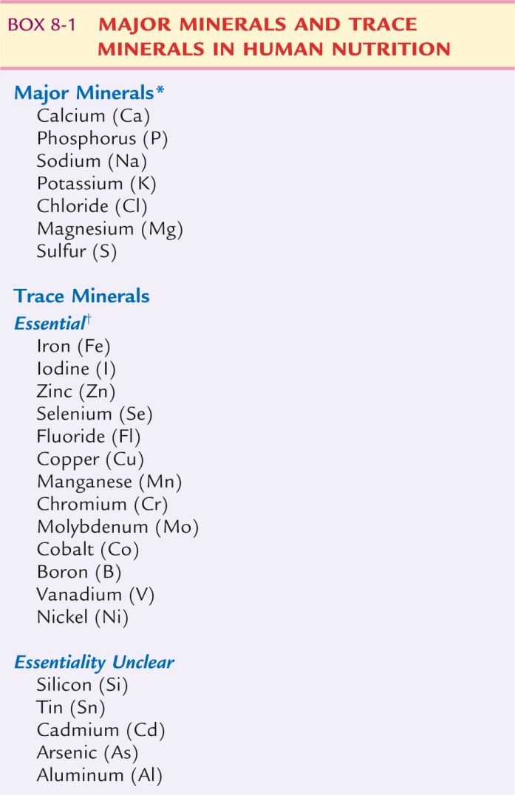
Classes of Body Minerals
Notes:
Explain that unlike carbohydrates, proteins, and fat, minerals do not require a great deal of mechanical or chemical digestion before absorption.

Slide 6
Functions of Minerals
Functions of minerals
  Building tissue
  Activating, regulating, transmitting, and controlling metabolic processes
Notes:
What are two of the key players in water balance? (Sodium and potassium)

Slide 7
Mineral Metabolism
Mineral metabolism
  Digestion: minerals do not require much digestion
  Absorption: rate determined by food form, body need, tissue health
  Transport: enter through portal circulation, bound to proteins
  Tissue uptake: controlled by hormones, excess excreted in urine
  Occurrence in the body: basic forms are free ions and covalently bound
Notes:
Explain the role of thyroid-stimulating hormone in controlling the update of iodine from the blood.

Slide 8
Major Minerals
Calcium
Phosphorus
Sodium
Potassium
Chloride
Magnesium
Sulfur
Notes:
Review the list of major minerals with students.

Slide 9
Calcium
Absorption controlled by 3 factors:
  Calcitonin, PTH, vitamin D*
Functions
  Bone and tooth formation
  Blood clotting-essential for formation of fibrin*
  Muscle and nerve action
  Metabolic reactions: absorption of B₁₂, activation of pancreatic lipase, secretion of insulin, cell membrane permeability
Notes:
What factors determine the absorption of dietary calcium? (The food form, the interaction of three hormones that directly control absorption, and indirect metabolic stimuli from the estrogen hormones)
Where can most of the body’s calcium be found? (Bones and teeth)
Explain that calcium in the bones acts as a pool for calcium that can then be used to maintain blood calcium levels.
Calcium is essential for muscle contraction.

Slide 10
Calcium (cont’d)
Requirements: 1000 mg/day for men and women 19 to 50
Deficiency states
  Rickets-softening of bones*
  Hypocalcemia-may result in tetany*
  Osteoporosis
Toxicity symptoms: hypercalcemia
*Food sources
  Milk is the major food source
  Green vegetables, fish with bones, fortified food
Notes:
What factors determine the absorption of dietary calcium? (The food form, the interaction of three hormones that directly control absorption, and indirect metabolic stimuli from the estrogen hormones)

Slide 11
Calcium
*Oxalic acid is a compound that is found in plants such as spinach and it interferes with the intestinal absorption of calcium
*Phytate-found in grains such as wheat can bind with calcium and interferes with its intestinal absorption

Slide 12
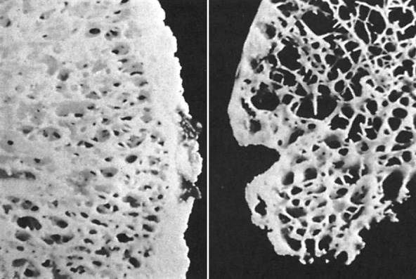
Calcium (cont’d)
Notes:
Left side: normal, healthy bone
Right side: osteoporotic bone
Which bone looks easier to break?

Slide 13
Phosphorus
Functions
  Bone and tooth formation
  Energy metabolism: oxidation of carbohydrate, fat, and protein; protein construction; cell function; genetic inheritance
  Acid–base balance-chemical buffer that helps to maintain the ph homeostasis of body fluids*
Notes:
What other mineral is essential for bone and tooth formation? (Calcium)
DNA has phosphorous in its backbone.

Slide 14
Phosphorus (cont’d)
Requirements: 700 mg/day
Deficiency states: hypophosphatemia
Toxicity symptoms
*Food sources
  Milk, milk products, fish, eggs
Notes:
If a phosphorus deficiency does develop, what are the characteristics? (Weakness, loss of appetite, fatigue, pain)
Is it difficult for most Americans to meet the requirement for phosphorus?

Slide 15
Sodium
Functions
  Water balance-main function*
    Ionized sodium concentration is the major influence on the volume of body water outside of the cells (extracellular)
  Muscle action
  Nutrient absorption
Notes:
What is the main function of sodium? (Water balance)
Explain that sodium is needed for glucose to be absorbed.

Slide 16
Sodium (cont’d)
Requirements
  AI: 1.5 g/day
  UL: 2.3 g/day
Deficiency states: hyponatremia
Toxicity symptoms: salt sensitivity and hypertension, hypernatremia
Food sources
  Table salt, cured meat, canned soups, processed food
Notes:
Excess sodium can lead to what chronic disease? (Hypertension)
What is the main dietary source of sodium? (Table salt)

Slide 17
Potassium
Functions
  Water balance
    *major intracellular electrolyte
  Metabolic reactions
    Energy production
    Conversion of blood glucose to glycogen
    Synthesis of muscle protein
  Muscle action
  Insulin release
  Blood pressure: role in hypertension
Notes:
Explain that sodium and potassium work with each other to maintain water balance. Mention that sodium is extracellular and potassium is intracellular.
Does potassium raise or lower blood pressure?

Slide 18
Potassium (cont’d)
Requirements: AI: 4.7 g/day
Deficiency states: hypokalemia
  Likely to develop during clinical situations such as prolonged vomiting or diarrhea*
Toxicity symptoms: hyperkalemia
Food sources
  Fruits, vegetables, leafy greens, whole grains, fresh meats
Notes:
When are potassium deficiencies more likely to occur? (During clinical situations such as prolonged vomiting or diarrhea, during use of diuretic drugs, during use of hypertension drugs, as a result of severe malnutrition, or after surgery)
What is the result of extremely high potassium levels? (Fatal arrhythmia)

Slide 19
Chloride
*Found ECF
Functions
  *Digestion: component of hydrochloric acid
  Respiration: chloride shift
Notes:
Emphasize that chloride is needed for digestion of all foods through hydrochloric acid.

Slide 20
Chloride (cont’d)
Requirements: AI: 2.3 g/day
Deficiency states: through vomiting
Toxicity symptoms: from severe dehydration
Food sources: table salt
Notes:
What is the primary reason for chloride deficiency? (Excessive fluid losses through vomiting, which leads to metabolic alkalosis)
The only known development of toxicity is through dehydration.

Slide 21
Magnesium
Functions
  *General metabolism: necessary catalyst for ~300+ reactions in cells
  *Protein synthesis: activates amino acids, role in synthesis and maintenance of DNA
  *Muscle action-conduction of nerve impulses that stimulate muscle contraction
  Basal metabolic rate: influences secretion of thyroxine
Notes:
Where in the body is magnesium found? (In all body cells; it has widespread metabolic functions.)
Review what a catalyst is. Why are catalysts important?
Discuss basal metabolic rate and how magnesium deficiency could influence it.

Slide 22
Magnesium (cont’d)
Requirements: ~300 to 400 mg/day
Deficiency states: hypomagnesemia, rare with balanced diet
Toxicity symptoms: excessive supplements may produce GI symptoms
Food sources
  Nuts, soybeans, cocoa, seafood, peas, green vegetables
Notes:
What are some of the deficiency symptoms? (Muscle weakness and cramps, hypertension, and blood vessel constriction in the heart and brain)
Which individuals are at greater risk for developing magnesium toxicity? (Those with renal insufficiency)
Which sources are relatively poor sources of magnesium? (Most fruits, except bananas; milk; meat; and fish)

Slide 23
Sulfur
Part of the amino acids cysteine and methionine*
Functions
  Hair, skin, nails
General metabolic functions
  High-energy bond
  Transfer energy
Vitamin structure: component of thiamin and biotin
Collagen structure-important in the building of connective tissue*
Notes:
Where is collagen found and what is its function? (It is a connective tissue found in the gums and joints.)

Slide 24
Sulfur (cont’d)
Requirements: not stated, obtained through amino acids methionine and cysteine
Deficiency states: not reported
Toxicity symptoms: unlikely
Food sources: animal proteins
  Meat, nuts, soy, fish, cheese, eggs
Notes:
Because sulfur is obtained through amino acids, many of its functions are the same as protein (e.g., maintenance of hair and nails and collagen formation).
What are other food sources that contain protein, and thus sulfur-containing amino acids?
Are methionine and cysteine essential or nonessential amino acids?

Slide 25
Trace Minerals
A mixed diet of varied foods and adequate energy value is the best source of the minerals necessary for health.
Of the total amount of minerals a person consumes, only a relatively limited amount is available to the body.

Slide 26
Trace Minerals
Iron
Iodine
Zinc
Selenium
Fluoride
Copper
Manganese
Chromium
Molybdenum
Other essential trace minerals
Notes:
The recommended intake for trace minerals is less than 100 mg/day.

Slide 27
Iron
Functions
  *Hemoglobin synthesis
  General metabolism:
    Proper glucose metabolism
    Antibody production
    Drug detoxification in the liver
    Collagen and purine synthesis
    *Conversion of carotene to vitamin A
Notes:
70% of the body’s iron occurs where? (In red blood cells)
Iron is best known for its role in hemoglobin and therefore its essentiality in oxygen transport.

Slide 28
Iron (cont’d)
Requirements
  8 to 11 mg/day for males
  8 to 18 mg/day for females
*Deficiency states: anemia
Toxicity symptoms
  Overdose from supplements
  Hemochromatosis
Food sources
  Heme
  Nonheme
  *body absorbs iron more easily when it is taken along with vitamin C
Notes:
What is one clinical test to determine iron-deficiency anemia? (Hemoglobin levels, hematocrit)
Why do women need more iron than men? (Menses)
Explain that hemochromatosis is a genetic condition enabling the body to retain more iron than needed.
Discuss the signs and symptoms of iron-deficiency anemia.
Explain that heme iron is only found in animal products, whereas nonheme iron is found in animal and plant products.
Nonheme iron is more tightly bound than heme iron.

Slide 29
Iodine
Functions: participation in thyroid gland’s synthesis of thyroxine
  T3 and T4*
Requirements: 150 mcg/day
Notes:
What is the function of thyroxine? (Regulates metabolic rate)

Slide 30
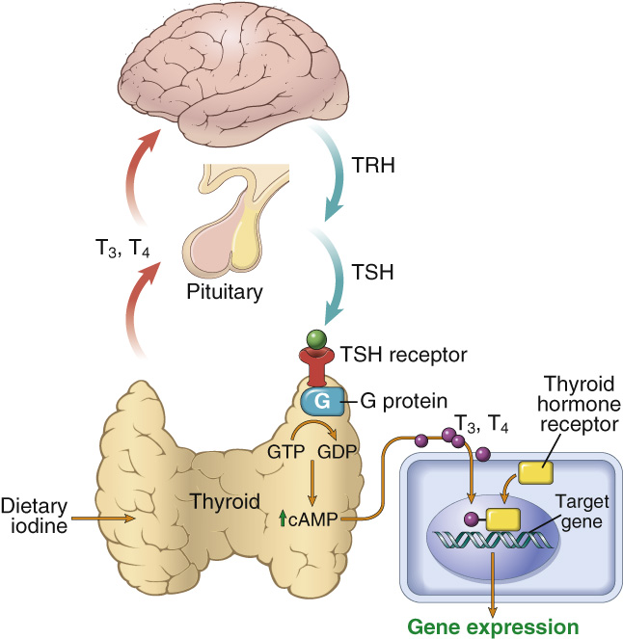
Iodine (cont’d)
Notes:
Guide students through the diagram, explaining that iodine is needed in the regulation gene expression.

Slide 31
Iodine (cont’d)
Deficiency states
  *Goiter
  Cretinism
  Hypothyroidism
  Hyperthyroidism
Toxicity symptoms
*Food sources
  Iodized table salt, seafood; depends on soil content
Notes:
What is the difference between hypothyroidism and hyperthyroidism?
Cretinism results from a mother consuming insufficient amounts of iodine during fetal development.

Slide 32
Zinc
Important during growth periods such as pregnancy, lactation, infancy, childhood and adolescence*
Functions
  Enzyme constituent
  Immune system
  Other functions
Requirements
  11 mg/day for males
  8 mg/day for females
Notes:
Zinc is especially important during what growth periods? (Pregnancy, lactation, infancy, childhood, and adolescence)
Who reported the lowest zinc intake on the National Health and Nutritional Examination Survey? (Children aged 1 to 3 years, adolescent girls, and persons older than 71 years)

Slide 33
Zinc (cont’d)
Deficiency states
  Poor wound healing
  Impaired taste and smell
  *acrodermatitis
    Rare autosomal recessive disorder that results in severe zinc deficiency and death
Toxicity symptoms
Food sources
  Meat, seafood, legumes, whole grains
Notes:
TALKING POINTS:
Zinc supplements often are supplied to patients with open wounds.

Slide 34
Selenium
Functions
  Aids in protection from free radicals
Requirements
  RDA: 55 mcg/day
Deficiency states
Toxicity symptoms
*Food sources
  Seafood, kidney, liver; depends on soil content
Notes:
Selenium functions with specific proteins as an essential part of an antioxidant enzyme, glutathione peroxidase, which protects cells and their lipid membranes from oxidative damage.
It also functions as a part of the protein center of teeth and participates in the regulation of thyroid hormone action and vitamin C activity.
A mild selenium deficiency can have what effect? (It may decrease a person’s ability to fight infection. Severe deficiency may put individuals at risk for certain types of cancer.)

Slide 35
Fluoride, Copper, Manganese
Fluoride
  *Functions by preventing dental caries
  Exceeding UL may cause fluorosis
Copper
  *“Iron twin”
  Metabolized similar to iron and is a component of cell enzymes*
Manganese
  Inhalation toxicity
Notes:
Explain why copper is called the “iron twin.” (They have many of the same functions.)
Manganese toxicity can result from mining.

Slide 36
Chromium, Molybdenum, Other Essential Trace Minerals
Chromium
  Previously thought to reduce insulin resistance
Molybdenum
  Inadequate dietary intake improbable
Other essential trace minerals
  Aluminum, arsenic, boron, nickel, silicon, tin, vanadium
Notes:
A recent clinical trial showed no effect with chromium supplementation and reduced insulin resistance.
Molybdenum is needed in minute amounts.

Slide 37
Manganese
Function
  Component of cell enzymes
  Toxicity
  accumulates in the liver and CNS
  produces neuromuscular symptoms similar to Parkinsons disease*

Slide 38
Mineral Depletion
*diuretics
  Deplete sodium and potassium

Slide 39
Mineral Supplementation
Life cycle needs
  Pregnancy and lactation: for both fetus and mother
  Adolescence: rapid bone growth
  Adulthood: postmenopausal women
Clinical needs
  Iron-deficiency anemia
  Zinc deficiency
Notes:
Special needs during growth periods and in clinical situations may require individual supplements of specific major minerals or trace elements.
Ask students to name five high-risk groups that may need to supplement their diet and explain why. (Adolescent girls on poor diets, low-income adolescent boys, athletes, vegetarians, and elderly persons on poor diets)

