Slide 1
Chapter 9
Water and Electrolyte Balance
Notes:
Water is the most vital nutrient to human existence.
Humans can survive far longer without food than without water. Only the continuous need for air is more demanding.

Slide 2
Lesson 9.1: Water Compartments and Solute Particles
Water compartments inside and outside cells maintain a balanced distribution of total body water.
The concentration of various solute particles in water determines internal shifts and movement of water.

Slide 3
Body Water Functions and Requirements
Basic principles
  A unified whole: virtually every space inside and outside the cells is filled with water-based fluids
  Body water compartments
    Dynamic systems within the body
    Intracellular or extracellular
  Particles in the water solution: determine all internal shifts and balances between compartments
Notes:
Explain the importance of water by emphasizing its need in making the body a unified whole.

Slide 4
Homeostasis
Body’s state of dynamic balance
Capacity of the body to maintain life systems despite what enters the system from outside
Homeostatic mechanisms protect the body’s water supply
Notes:
Homeostasis is a Greek word. What do the two parts, homeo and -stasis mean? (Homeo means “similar”; -stasis means “balance.”)
Ask students to provide examples of the body reaching homeostasis from what they have learned previously.
How does the body reach homeostasis with blood glucose?
How is homeostasis reached with blood calcium levels?

Slide 5
Body Water Functions
Solvent: basic liquid solvent for all chemical processes within the body
Transport: nutrients carried through the body in water-based fluids (e.g., blood, secretions)
Thermoregulation: maintains stable body temperature
Body lubricant: in moving parts of the body
Notes:
Describe the difference between a solvent and a solute.
What is an example of a body lubricant? (The fluid inside joints, or synovial fluid, helps provide smooth movement.)
Besides nutrients, what else does body water transport? (Secretions, metabolites or products formed from metabolism, proteins, and other materials)

Slide 6
Body Water Requirements
Surrounding environment
  Body water is lost as sweat and must be replaced
Activity level
  Water is lost as sweat
  More water is needed for increased metabolic demand in physical activity
Functional losses
  Disease process affects water requirements
Notes:
How does body water help control body temperature? (Body water is lost as sweat in an effort to maintain body temperature.)
How does activity level affect body water? (As water is lost as sweat, more water is necessary for the increased metabolic demand of physical activity.)
Discuss the need for fluids during prolonged diarrhea, especially in children.

Slide 7
Body Water Requirements (cont’d)
Metabolic needs
  1000 ml of water necessary for every 1000 kcal in the diet
Age
  Infants need 700 to 800 ml of water per day
Notes:
Emphasize special risks infants face when not enough fluids are provided.
What are diuretics? Provide examples. (Any substance that induces urination and subsequent fluid loss: alcohol and caffeine)
Individuals on medications promoting water loss should be monitored for dehydration and electrolyte balance.

Slide 8
Body Water Requirements (cont’d)
Dehydration
  >2% total body weight loss
  Special concern in the elderly
Water intoxication
  Infants
  Psychiatric patients
  Patients on psychotropic drugs
  Endurance athletes
Notes:
Explain the decreased thirst mechanism in the elderly and why they are at risk.
Discuss hyponatremia and that intoxication may occur during an endurance event even with plain water replacement.

Slide 9
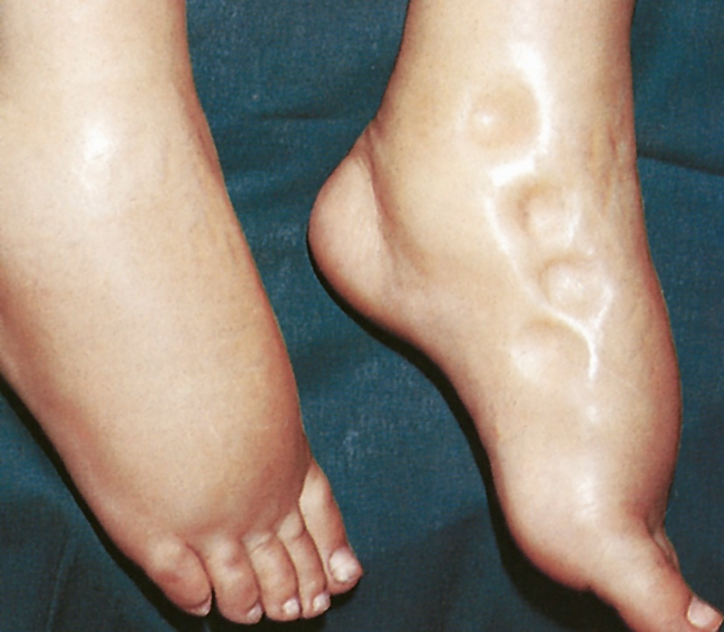
Body Water Requirements (cont’d)
Notes:
Edema. Note the figure-shaped depressions that do not rapidly refill after an examiner has exerted pressure.

Slide 10
Case Study
Mrs. Cannon is a 75-year-old female who lives by herself. She keeps active by gardening. She has been gardening for about 2 hours on this mid-June late morning with an outside temperature of 81 degrees. Before going outside she ate her breakfast, which consisted of 2 cups of coffee, 1/3 cup oatmeal, and ½ grapefruit.
Notes:
Case Study
Mrs. Cannon is a 75-year-old female who lives by herself. She keeps active by gardening. She has been gardening for about 2 hours on this mid-June late morning. Before going outside she ate her breakfast, which consisted of 2 cups of coffee, 1/3 cup oatmeal, and ½ grapefruit.

Slide 11
Case Study (cont’d)
Mrs. Cannon feels weak and is very thirsty. She did not drink anything while she was working.
What may Mrs. Cannon be currently experiencing?
Notes:
Mrs. Cannon feels weak and is very thirsty. She did not drink anything while she was working.
What may Mrs. Cannon be currently experiencing?
Explain that Mrs. Cannon is experiencing dehydration probably in view of her age, outside temperature, and physical performance. Also she drank only coffee, which serves as a diuretic, and did not drink any other fluids (the grapefruit gave some fluid but not enough).

Slide 12
Water Balance
Body water: the solvent
  Amount and distribution: 45% to 75% of body weight in adults
  10% more body water in men than women
  Two major compartments
    Extracellular fluid: blood plasma, interstitial fluid, lymphatic circulation, transcellular fluid
    Intracellular fluid: twice that of water outside cells
  Overall water balance: average adult metabolizes 2.5 to 3 L/day
Notes:
Is there more intracellular fluid or extracellular fluid in the body? (Intracellular fluid. It collectively amounts to approximately twice of that outside of cells, making up about 30% to 40% of the total body weight.)
Who has the largest volume of body fluids, a man, woman, or infant? (An infant’s body—70% to 75% of the total body weight—is water.)

Slide 13
Water Intake
Water intake
  Preformed water in liquids that are consumed
  Preformed water in foods that are eaten
  Product of cell oxidation
  Older adults must maintain proper intake of water because of the tendency for dehydration
Notes:
Explain that water is a by-product of cellular metabolism by way of energy production.
Ask students how a home health nurse can encourage fluids during her visits to an elderly patient.

Slide 14
Water Output
Water output
  Obligatory water loss: leaves the body through kidneys, skin, lungs, and feces
  Optional water loss: varies according to climate and physical activity
Notes:
Which organ system provides most of the water loss? (Kidneys)
Ask students for examples of how climate and physical activity affect water loss.
What are additional fluid recommendations for athletes? (One recommendation is to drink 400 to 600 ml of fluid 2 to 3 hours before exercise.)

Slide 15
Solute Particles in Solution
Electrolytes: small, inorganic substances that can break apart in solution and carry an electrical charge
  Cations: positive charge
  Anions: negative charge
Balance between cation and anion concentration maintains chemical neutrality necessary for life
Notes:
What does the Greek word ion mean? (“Wanderer”)
How do electrolytes help maintain chemical balance in the body? (These particles are free to wander through a solution to maintain its chemical balance.)
Review the difference between a cation and an anion.
How are electrolytes measured? (Electrolyte concentration in body fluids is measured in terms of milliequivalents [mEq]).

Slide 16
Solute Particles in Solution (cont’d)
Plasma proteins
  Mainly albumin and globulin
  Organic compounds of large molecular size
  Retained in blood vessels
  Control water movement
  Colloids guard blood volume (colloidal osmotic pressure)
Notes:
How are plasma proteins different from electrolytes? (They do not move freely across membranes.)
Explain that proteins also help regulate fluid balance because of their chemical polarity. Although they do not leave the bloodstream, they attract water to reenter the bloodstream from the interstitial space.
What is another name for plasma proteins? (Colloids)

Slide 17
Lesson 9.2: State of Dynamic Equilibrium
A state of dynamic equilibrium among all parts of the body’s water balance system sustains life.

Slide 18
Small Organic Compounds
Generally concentration too low to influence shifts of water
Exception: glucose can increase water loss from body: polyuria
Notes:
Review the mechanisms by which type 1 and type 2 diabetes can produce abnormally large concentrations of glucose.

Slide 19
Small Organic Compounds (cont’d)
Capillary membranes
  Thin and porous
  Water molecules, electrolytes, and nutrients move freely across them
Cell membrane
  Thicker membranes
  Constructed to protect and nourish cell contents
  Uses channels to limit passage to specific molecules
Notes:
Cell membranes are structured almost in a sandwich fashion, or a phospholipid bilayer.
Cell membranes have outer layers and penetrating channels of protein and an inner structure of fat material.
Why is the difference between capillary membranes and cell membranes important? (Capillary membranes allow more movement of molecules, providing nutrients to be distributed in the interstitial space surrounding cells. Cell membranes are more selective and only need certain nutrients; in fact, too much of a nutrient may be detrimental. A thicker membrane allows more control and regulation.)

Slide 20
Forces Moving Water and Solutes Across Membranes
Osmosis
  Process or force that impels water molecules to move throughout body
  Moves water molecules from an area of greater concentration to an area of lesser concentration
Diffusion
  Force by which particles in solution move outward in all directions from an area of greater concentration to an area of lesser concentration
Notes:
Osmosis applies to water molecules and diffusion applies to the particles in solution.
The relative movement of water molecules and solute particles by osmosis and diffusion effectively balances solution concentrations—and pressures—on both sides of the separating membrane.
Provide an example of diffusion by describing the process of dissolving salt in water.

Slide 21
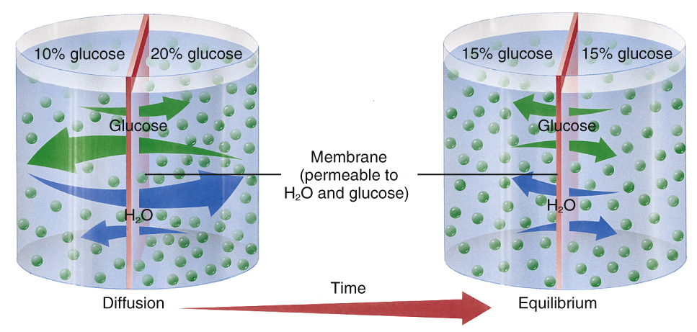
Forces Moving Water and Solutes Across Membranes (cont’d)
Notes:
Osmosis and diffusion through a membrane. Note that the membrane separating a 10% glucose solution from a 20% glucose solution allows glucose and water to pass.

Slide 22
Forces Moving Water and Solutes Across Membranes (cont’d)
Facilitated diffusion
  Similar to simple diffusion
  Addition of transporters that assist particles across membrane
Filtration
  Water is forced through membrane pores when pressure outside the membrane is different
Active transport
  Necessary to carry particles “upstream” across separating membranes
Pinocytosis
  Larger molecules attach to thicker cell membrane, then are engulfed by cell
Notes:
What is the literal meaning of pinocytosis? (“Cell drinking”)
What is a vacuole? (A small space or cavity formed in the protoplasm of the cells)
Pinocytosis is one of the basic mechanisms by which fat is absorbed from the small intestine.

Slide 23
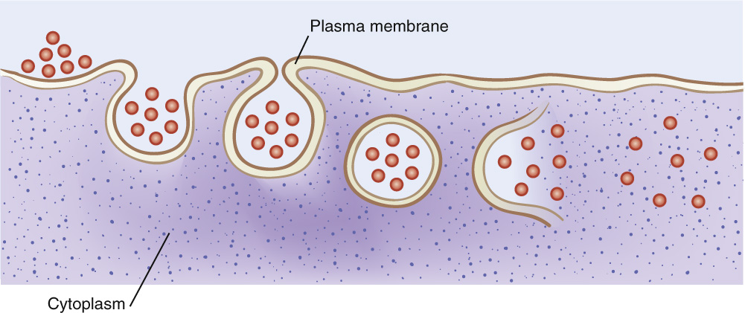
Pinocytosis
Notes:
Pinocytosis, a cell engulfing a large molecule.

Slide 24
Tissue Water Circulation
Tissue water circulation: the capillary fluid shift mechanism
  Purpose: take in water, oxygen, and nutrients, remove water and waste
  Process: blood pressure forces water and nutrients into tissue, colloid osmotic pressure draws water and metabolites back into capillary circulation
Notes:
What is hydrostatic pressure? (Intracapillary blood pressure from the contracting heart muscle pushing blood into circulation)
What is colloidal osmotic pressure? (Pressure from plasma proteins drawing tissue fluids back into ongoing circulation)

Slide 25
Organ Systems Involved
Gastrointestinal circulation
  Water from blood plasma is continually secreted into the gastrointestinal tract.
  In the latter portion of the intestine, most water and electrolytes are reabsorbed into the blood.
  Is maintained in isotonicity
  Isotonicity: equal osmotic pressure
  Clinical applications: loss of isotonicity through vomiting or prolong diarrhea
Notes:
What is isotonicity? (State of equal osmotic pressure resulting from equal concentrations of electrolytes and other solute particles)
Discuss clinical applications of isotonicity.

Slide 26
Organ Systems Involved (cont’d)
Renal circulation
  Kidney “laundering” of the blood helps maintain water balance and proper solution of blood
Hormonal controls:
  Antidiuretic hormone mechanism
  Renin-angiotensin-aldosterone system
Notes:
What is antidiuretic hormone? (Water-conserving mechanism that works on kidneys’ nephrons to induce reabsorption of water)
What is the aldosterone mechanism? (Produced by adrenal glands, the mechanism triggers kidney’s nephrons to reabsorb sodium.)
Explain that if sodium is retained, water is retained with it because of sodium’s charge as an electrolyte.

Slide 27
Case Study (cont’d)
In regard to Mrs. Cannon, outline the compensatory mechanisms in place with hormonal control of antidiuretic hormone and aldosterone.
Notes:
Hormonal controls operate in the kidneys to help maintain constant body water balance. Antidiuretic hormone (ADH) is water conserving and works on the kidneys’ nephrons to induce reabsorption of water. With loss of body water, this hormone is released to conserve body water.
Aldosterone is produced by the adrenal glands in response to a reduced renal filtration rate or decreased sodium level. Aldosterone triggers the nephrons to reabsorb sodium. It also exerts a secondary control over water reabsorption, since water follows sodium.

Slide 28
Acid–Base Balance
Optimal degree of acidity or alkalinity must be maintained in body water solutions and secretions
Achieved by chemical and physiologic buffer systems
Acidity expressed in terms of pH
Notes:
Review the pH scale and that it is a logarithm. A product with a pH of 3 compared with one having a pH of 2 indicates that the product with a pH of 2 is 10 times as acidic.

Slide 29
Acids and Bases
Acids and bases: refers to hydrogen ion concentration, pH of 7 is neutral
  Acid: compound has more hydrogen ions, can release ions when in solution
  Base: compound with fewer hydrogen ions, can accept ions when in solution
Notes:
What is an acid? (A compound that has available hydrogen ions)

Slide 30
Acid–Base Buffer System
Human body has many buffer systems
Relatively narrow pH range (7.35 to 7.45) is compatible with life
Notes:
What is a base? (A compound that has fewer hydrogen ions; in solution it takes up hydrogen ions, reducing the solution’s acidity)

Slide 31
Chemical and Physiologic Buffer Systems
Chemical buffer system
  Mixture of acid and base that protects a solution from wide variations in pH
  Main buffer system: carbonic acid/base bicarbonate
Physiologic buffer systems
  Respiratory control: carbon dioxide leaves the body
  Urinary control: kidney monitors hydrogen ions
Notes:
Lungs and kidneys easily adjust to changes in acidity, quickly return body fluids to a normal pH level. They also work closely together to prevent metabolic or respiratory acidosis or alkalosis.

