Slide 1
Thinking Question: Day 2
We all have an idea of what ADD/ADHD is. Hypothesize a potential cause AND/OR treatment of ADD/ADHD from the following 4 perspectives:
  Psychoanalytic (Freud’s unconscious mind, repressed childhood memories, Oedipus Complex)
  Behavioral (observable behavior)
  Humanistic (the touchy feely one, self-esteem, self-actualization)
  Cognitive (mind organization, how the mind receives, codes, and organizes information)
Funny is okay, as long as it fits with the perspective and makes sense!

Slide 2

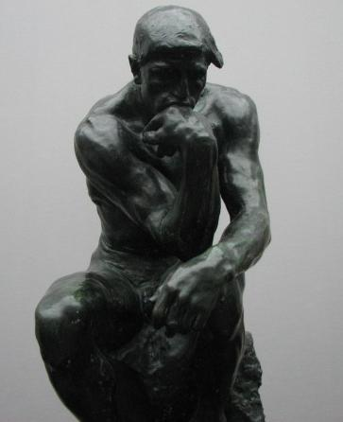
Unit I: History of Psychology & Thinking Critically with Psychological Science
Prologue & Chapter 1 (Myers)
Andy Filipowicz
Ocean Lakes HS, Virginia Beach, VA

Slide 3
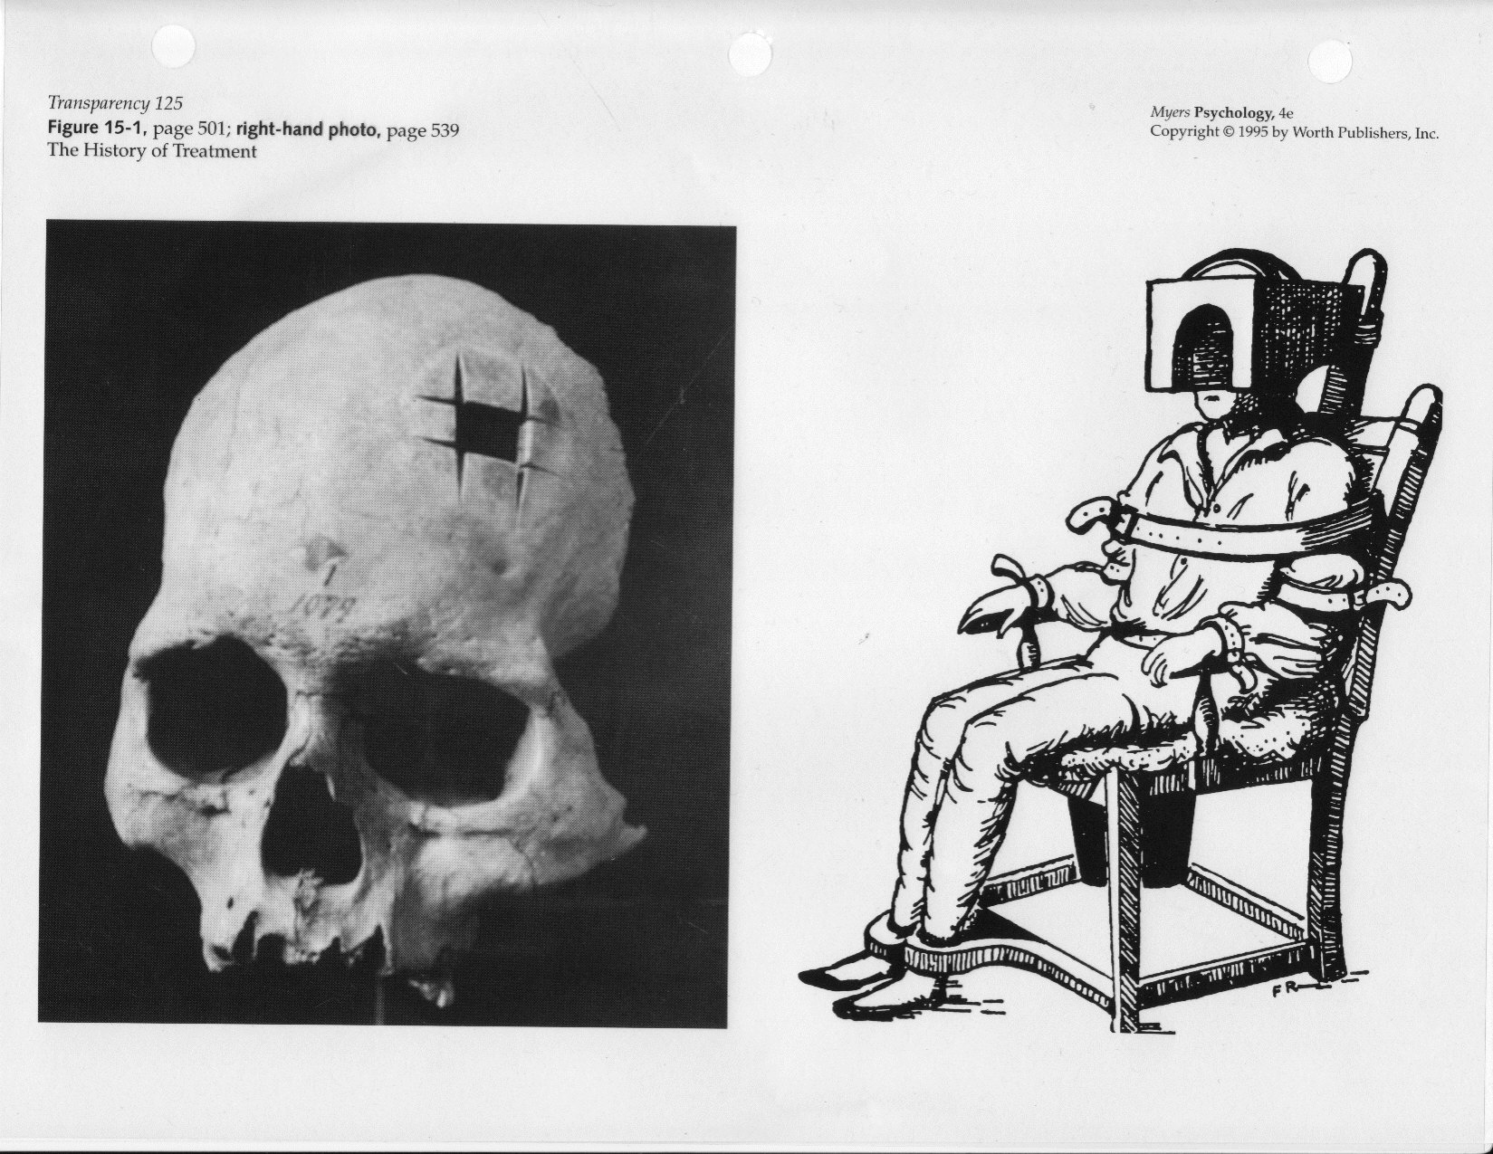
Trephening – Roman Times?
ROME!

Slide 4
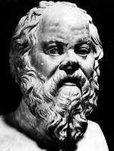
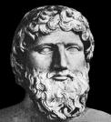
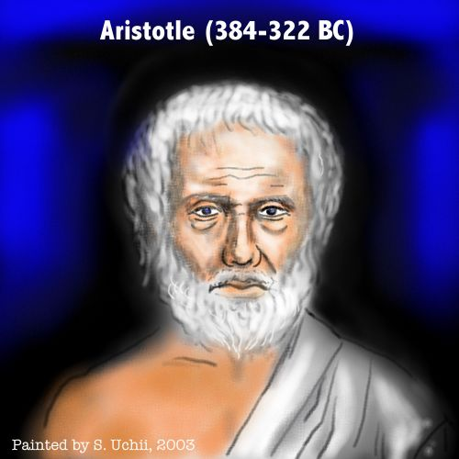
Pre-Scientific Psychology
Philosophy – What is Knowledge?
Socrates and Plato (5th and 4th c. BCE)
  Principles through inborn logic (nature)
Aristotle (4th c. BCE)
  Sense perceptions are the raw material of logic (nurture)
  The Mind is a blank slate (nurture)
Notes:
Aristotle: For example, he claimed that mice die if they drink in summertime, that eels are generated spontaneously, that humans have only eight ribs, and that men have more teeth than women. He also thought that the mind must be in the heart because people can recover from head injuries, while wounds to the heart are always fatal. The brain’s function? For Aristotle, it was to cool the blood when it becomes overly warm.
Nonetheless, Aristotle anticipated modern science in his insistence that sense perceptions are the essential raw material of knowledge. Direct observation, he claimed, is the foundation of understanding. In admitting that he did not know how bees procreate, he wrote: “The facts have not yet been sufficiently established. If ever they are, then credit must be given to observation rather than to theories, and to theories only insofar as they are confirmed by the observed facts.”
He was a monist…mind and body must coexist (neither can live without the other)
Reason was an active, organizing process that acts upon sense data.
Developed a theory of catharsis for emotions

Slide 5
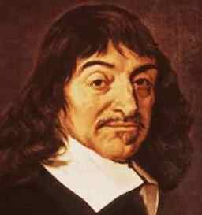
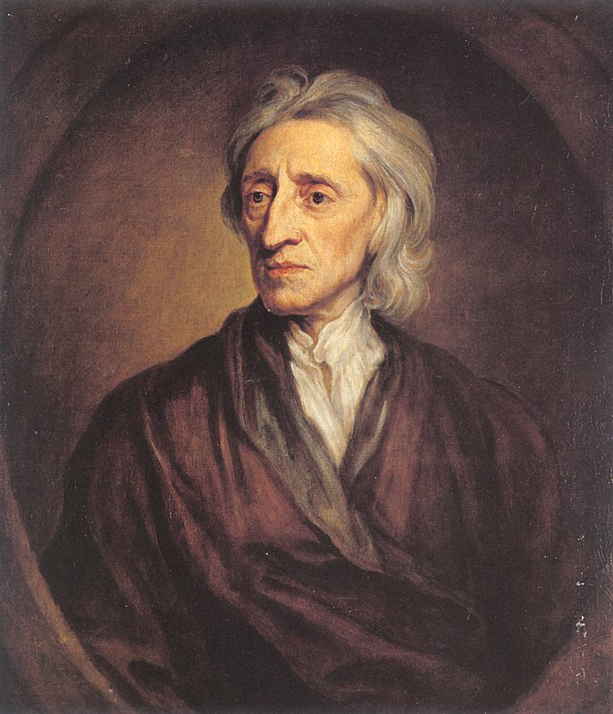
Pre-Scientific Psychology
Rene Descartes (1596-1650)
  A “Dualist” – Mind & Body are separate machines, but interact
John Locke (1632-1704)
  Empiricist – knowledge through the scientific method
  The Mind is a blank slate.. (like Aristotle!)

Slide 6
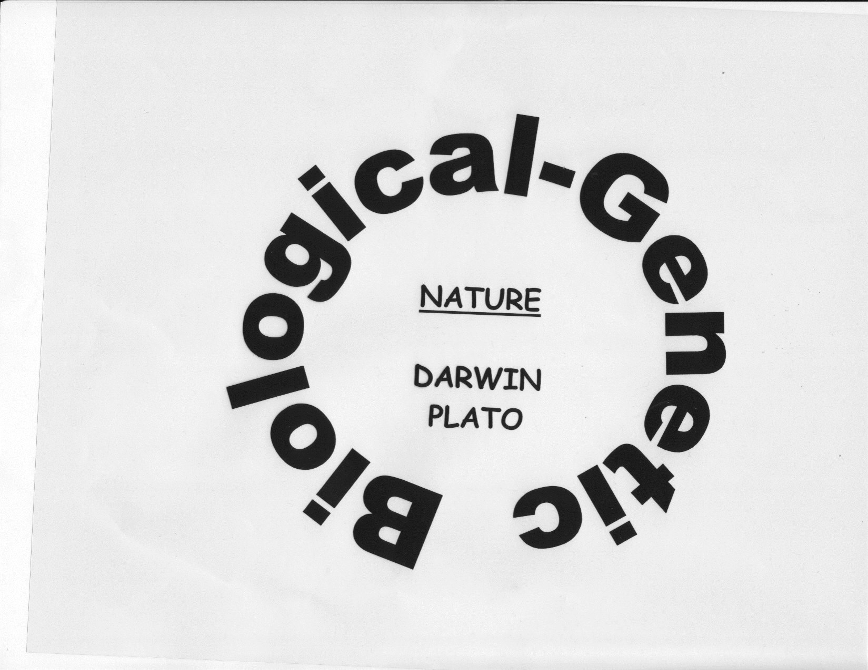
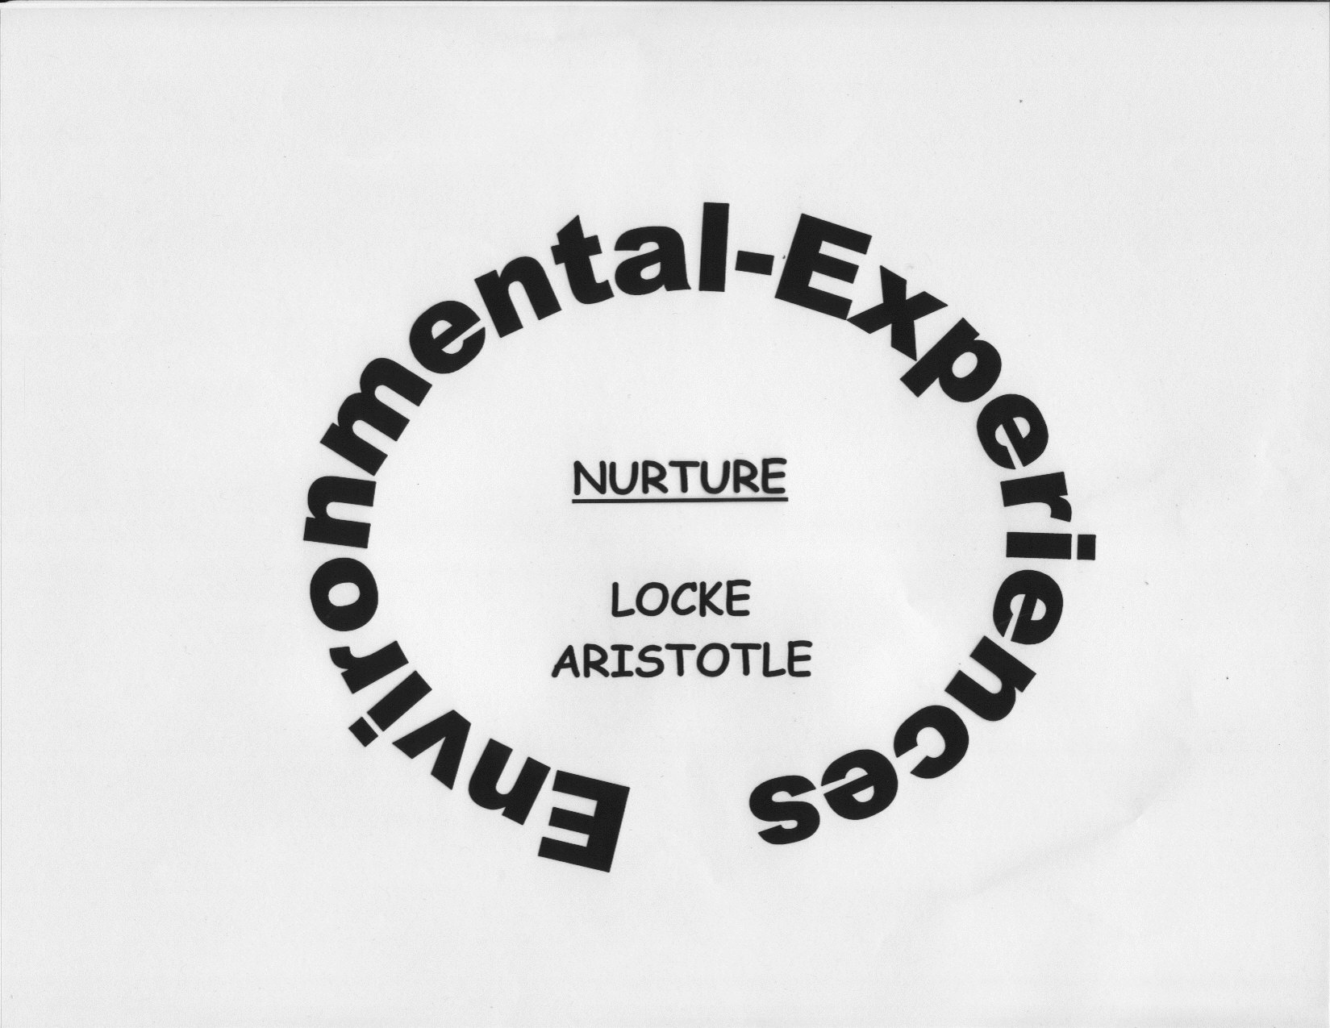

Slide 7
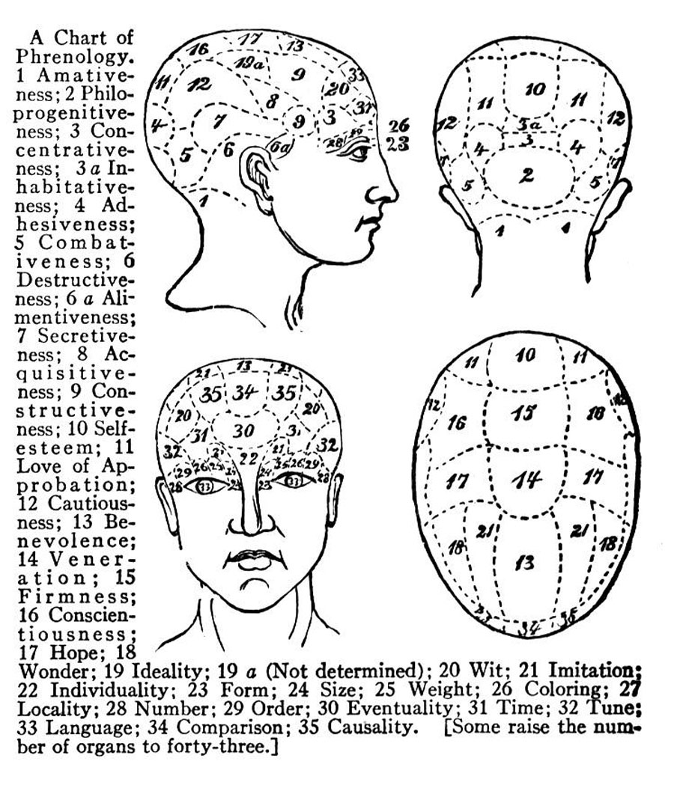
Phrenology
Sir Francis Gall (early 1800s)
  Brain areas should grow when exercised, like muscles
  “You ought to have your head examined…”

Slide 8
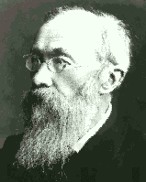
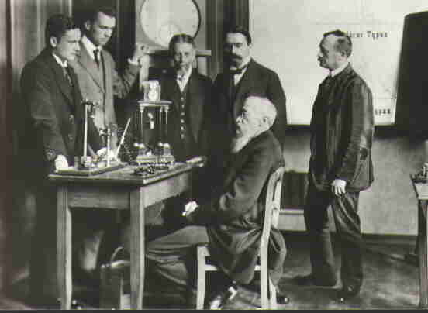
Wave 1 – Introspection
Wilhelm Wundt (1832-1920)
  1st research lab in Leipzig, Germany
  Studied reaction time to a audible stimulus – how long to press a button after hearing a bell
  Then, Consciousness
    Feelings
    Emotions
    Ideas
  Asked people to look inside (introspection)
  Considered the “father of psychology”
“Physiological psychology is, therefore, first of all psychology “ – Wundt

Slide 9
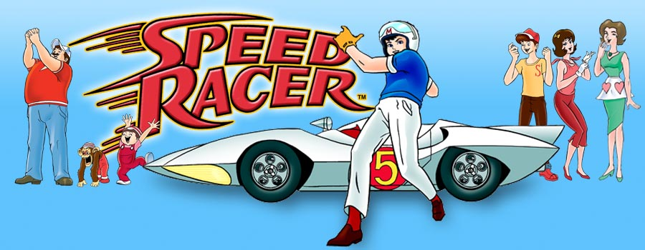
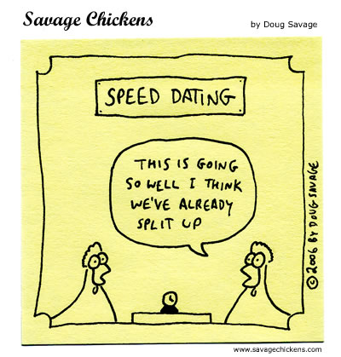
Chain Reaction Time:
Measuring the Speed of Thought

Slide 10
The Egyptians
Let’s back up a moment…
King Psamatick’s hypothesis: Egyptian is the oldest language on Earth.
How would you go about attempting to support this claim?
Notes:
He posed the hypothesis that if children had no opportunity to learn a language from the people around them, they would spontaneously 4 Prologue The Story of Psychology speak the primal, inborn language of humankind, that
is, the natural language of its most ancient people, which Psamtick presumed to be Egyptian. To test his hypothesis, Psamtick kidnapped two infants of a lowerclass mother and ordered a herdsman in a remote area to raise them. The children were to be properly fed and cared for but were never to hear anyone speak a word. The experiment worked, although not with the result expected by Psamtick. One day, when the children were just 2 years old, they ran up to the herdsman as he returned to his cottage from work and cried out “Becos!” Although he did not understand them, when they continued to repeat the word, he reported back to the king. The children were brought to the royal court. When the king also heard them say “Becos,” he inquired and learned that becos was the Phrygian word for bread. To his great disappointment, the king concluded that the Phrygians were an older race than the Egyptians.

Slide 11
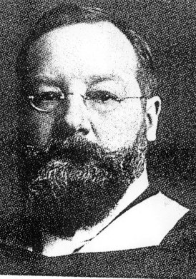
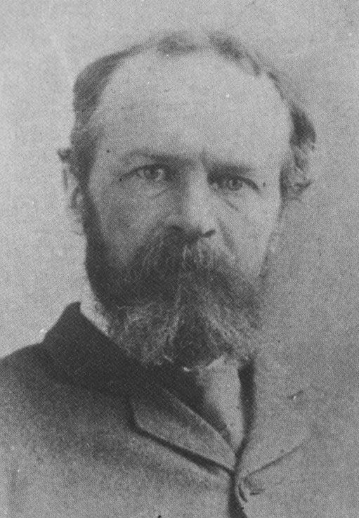
Wave 1 – Introspection
Edward Titchener (English Prof in America)
  Structuralism = mind is a combo of emotions and sensations
  Oxygen, Hydrogen = H20
  Sensations, Thoughts = mind
  Consciousness can be broken down into component parts
William James
  Author of 1st textbook in psych, Principles of Psychology (1890)
  Functionalism – how the structures function
    Borrowed from Darwin
    Consciousness must have evolved (it was functional)
  Father of American Psychology

Slide 12
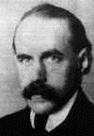
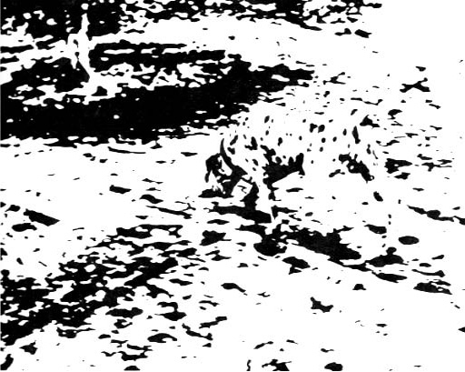
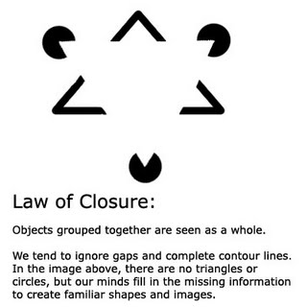
Wave 2 – Gestalt Psychology
Gestalt = “whole”
The whole is greater than the sum of the parts…
This was a reaction against the structuralism and functionalism of the past
  Can’t break down the mind…whole is more important
[ ][ ][ ]
Notes:
The structuralists couldn’t explain movement…

Slide 13
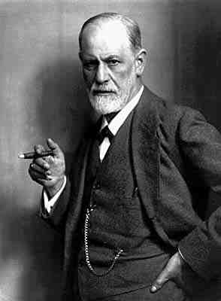
Wave 3 – Psychoanalysis
The unconscious mind!
  “Thoughts, memories, and desires…below the surface of conscious behavior, but that nonetheless exert great influence on behavior.”
Sexual urges / immediate gratification (libido) play a large role
  Simpsons Video next

Slide 14
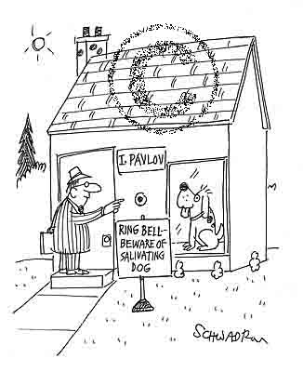
Wave 4 – Behaviorism
Ivan Pavlov’s dogs
All behavior is governed by external stimuli
Free will is an illusion

Slide 15
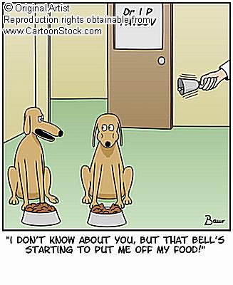
Wave 4 – Behaviorism
Ivan Pavlov’s dogs
Organisms tend to repeat responses that lead to positive outcomes
…not to repeat those that lead to neutral or negative outcomes
Actions = not actively controlled by will

Slide 16
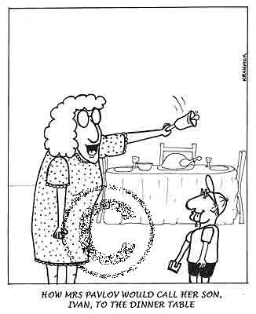
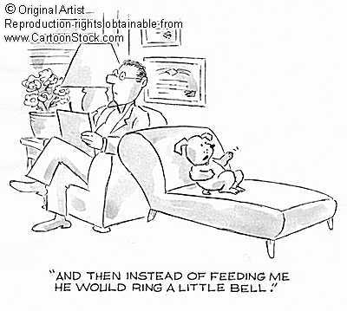
Wave 4 – Behaviorism

Slide 17
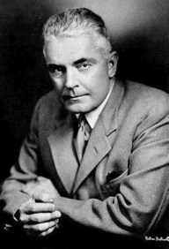
Behaviorism
John B Watson
  Classical Conditioning
  The Little Albert Experiment –
  Little Albert!

Slide 18
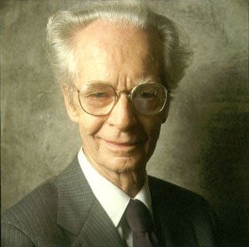
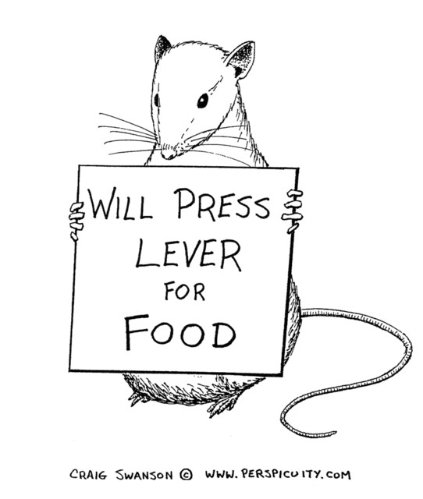
Behaviorism
B.F. Skinner
  Operant conditioning
  Reinforcement schedules (punishment / reward)

Slide 19
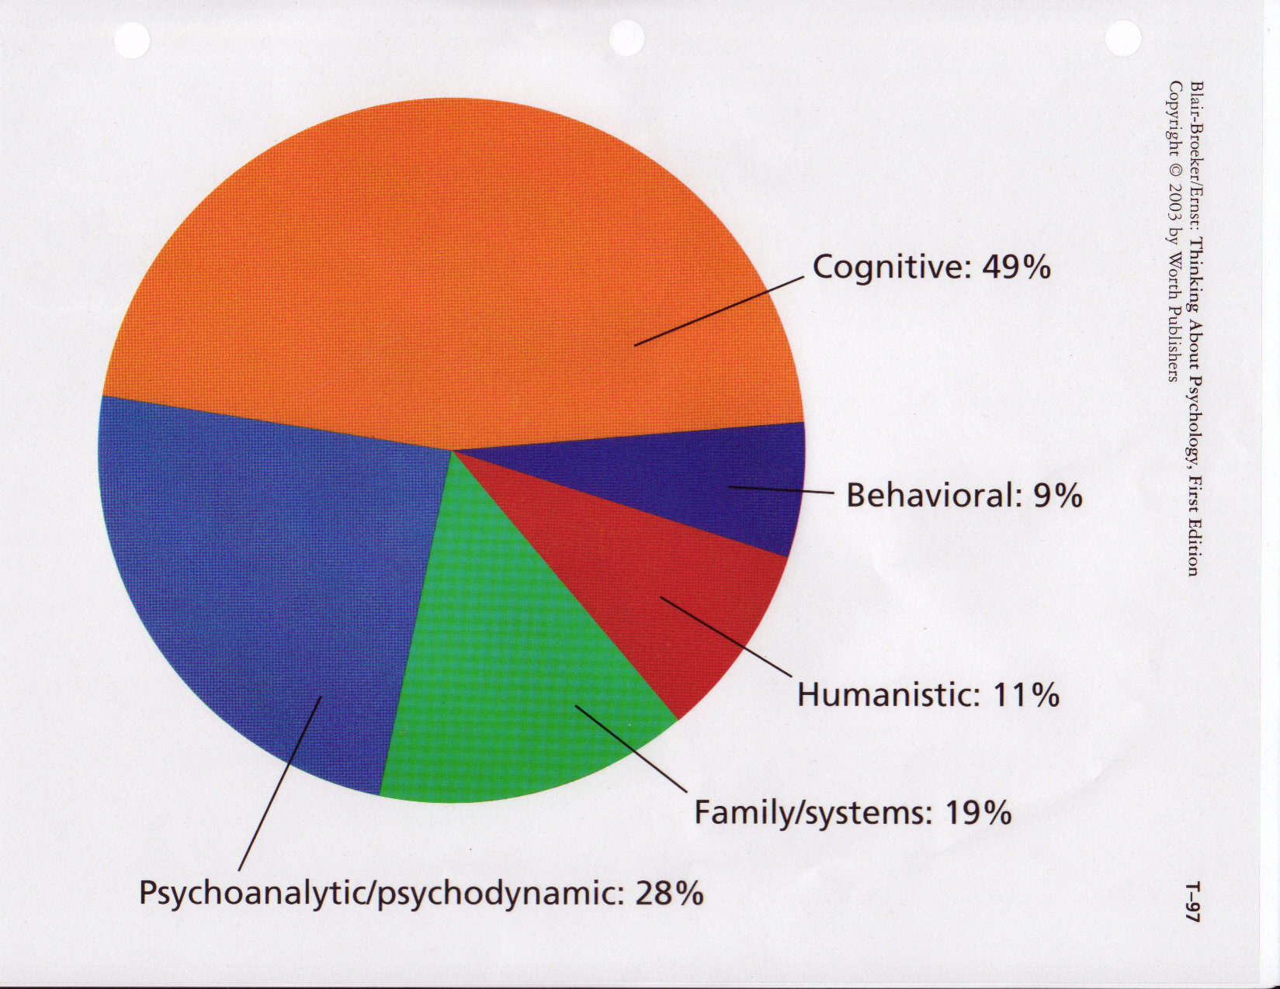
Wave 5 – Multiple Perspectives
Eclectic approach
Cognitive Psych is the most cited in research and clinical settings

Slide 20
Psychology’s Current 3 Big Issues
Stability vs. Change
  Do individual traits change as we age?
  Does intelligence vary across the lifespan?
Nature vs. Nurture
  Are people primarily dominated by nature (what they were born with) or nurture (changed by the environment)?
Rationality vs. Irrationality
  Are people inherently rational or irrational?

Slide 21
Psychology’s 4 Main Goals
Describe
Explain
Predict
Control

Slide 22
The Current 4 Main Schools
Behaviorism
  Pavlov, Watson, Skinner
Psychoanalysis
  Freud, Jung, Horney
Humanistic
  Carl Rodgers
  Abraham Maslow
Cognitive
  Most present day psychologists incorporate this somehow
  Cognitive-behavioral; socio-cognitive; bio-cognitive

Slide 23
Latest Schools of Psych
Handout and Overhead
GRASPS activity? Or for review later?

Slide 24
RAFT Activity??
Try to include as much pertinent information about the psychologist as possible within your product – be informative in addition to creative/funny
Your group will present the finished product to the class
You have 25 minutes to develop your product
  spend the 1st 5-10 gathering information

Slide 25
Thinking Question: Day 3
Ethical guidelines for psychological studies are sometimes blurry and have changed greatly over the years. Come up with a few things you think one ethically can do and can’t do to humans/animals while researching them? Examples:
  Can we lie to humans?
  Can we give electric shocks to humans/animals?
  Can we purposefully deceive humans?
  Are we responsible for unintentional bodily harm to humans/animals?
  Do we have to tell humans what the experiment is about (before or after)?
  Can we experiment on trapped wild animals?
  Can we give potentially dangerous (may even cause death) new drugs to humans or animals?

Slide 26
Movie time!
“Moving Images” – The Scientific Attitude
  Faith vs. Science
  The Placebo Effect

Slide 27
Hypothesis
Males react faster than females
Do you agree or not?

Slide 28
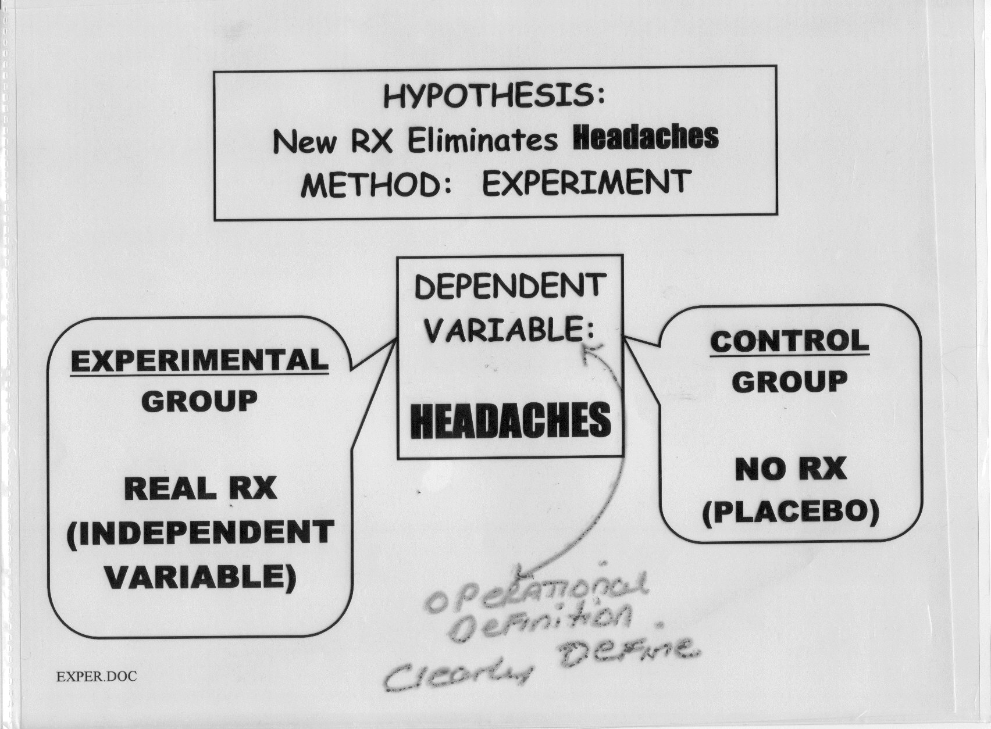
Some Terminology
IV, DV
What was the Operational Def?

Slide 29
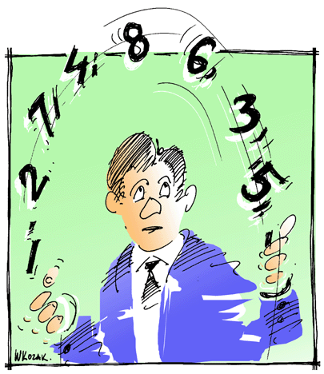

Sample, population, subjects/participants
Stratified sampling / random sampling
  Based on hyp: Asians do better than non-Asians
  DO NOT HAVE TO EQUAL OTHER DEMOGRAPHICS IF THEY ARE NOT PART OF THE HYPOTHESIS
Situation-relevant confounding variables
  Experimenter bias – figure out the day of the week you were born on…DO NOT TELL ANYONE!
    Double Blinds
  Subject bias – subjects aim to please!
    Hawthorne effect (eliminate with single blind)
  Order effects
    Solve with counterbalancing
    Example:

Slide 30
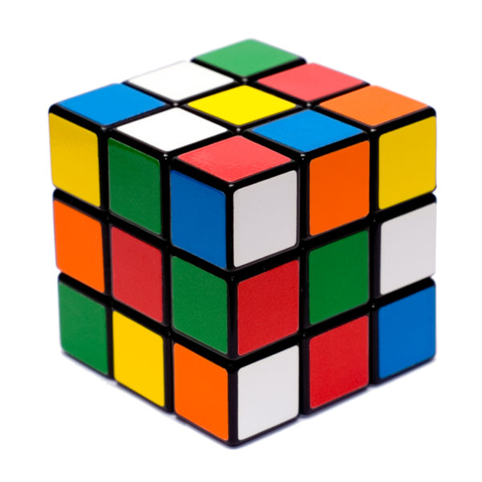
Counterbalancing
Hyp: How does frustration affect memory?
Experiment:
  Non-frustrating task (count ceiling tiles)
  Memory Test 1
  Frustrating task (Rubik’s cube) (http://www.scribd.com/doc/219723/How-To-Solve-A-Rubiks-Cube)
  Memory Test 2
What’s the problem here?
Switch order of non-frustrating task & frustrating task…why?
To control for the effect of “practice”

Slide 31


Now, it’s your turn!
Experiment Worksheet

Slide 32
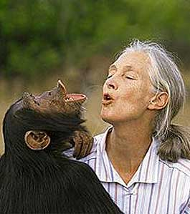
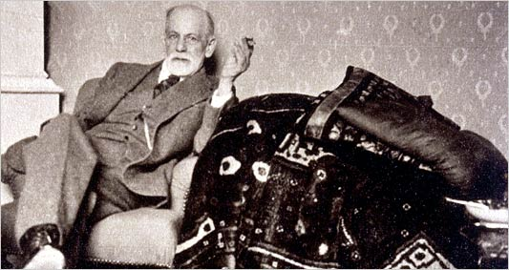



Methods (Back of 4 goals)
Survey: Kinsey’s sex studies
Naturalistic Observation: Jane Goodall’s apes
Case Study: Freud’s couch method
Correlation: SAT scores and college performance
Experiment: anytime you actually manipulate things in a controlled environment

Slide 33
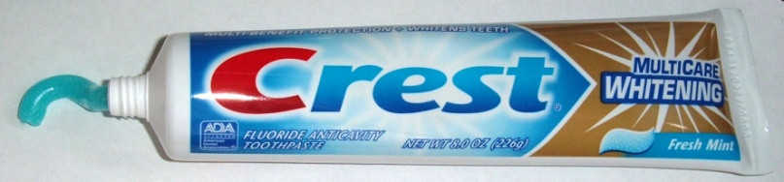

What’s the Difference between Correlation and Experiment?
Experiment of “CREST” toothpaste results in less cavities than “AIM”
  Parps, random selection vs. random assignment, IV, DV
Correlational study of CREST
  Variable 1 = toothpaste brushing
  Variable 2 = # of cavities
  What kind of correlation would we want?
  What does r = +0.81 mean? +.08?
Ads and Disads of each?

Slide 34
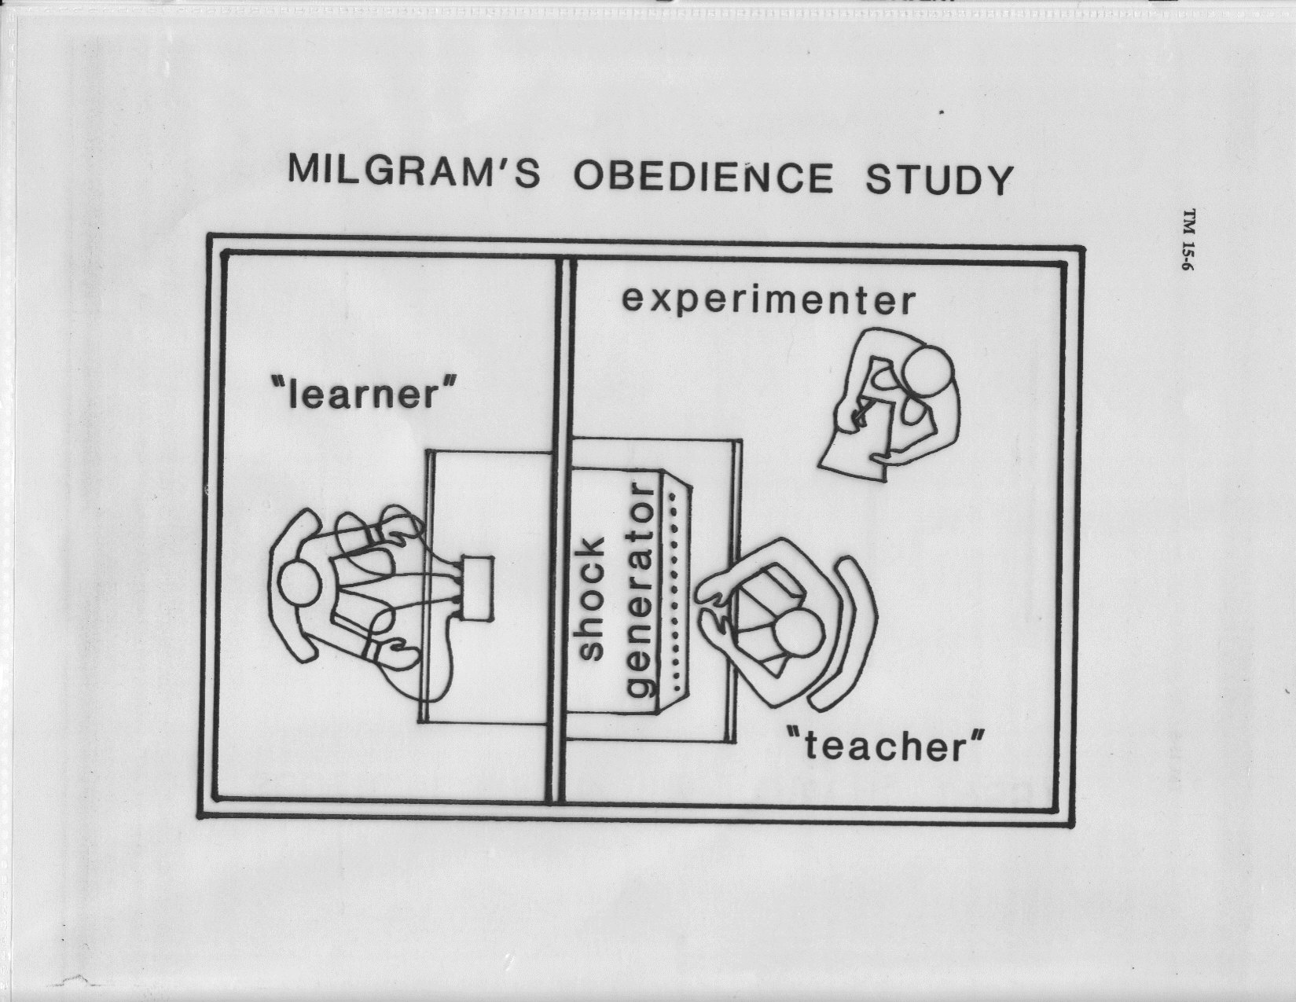
Ethics -- Stanley Milgram’s Obedience Study
Notes:
Milgram's Obedience to Authority Experiment 2009 (youtube) Parts I II and III (only first half) (16 min total)

Slide 35
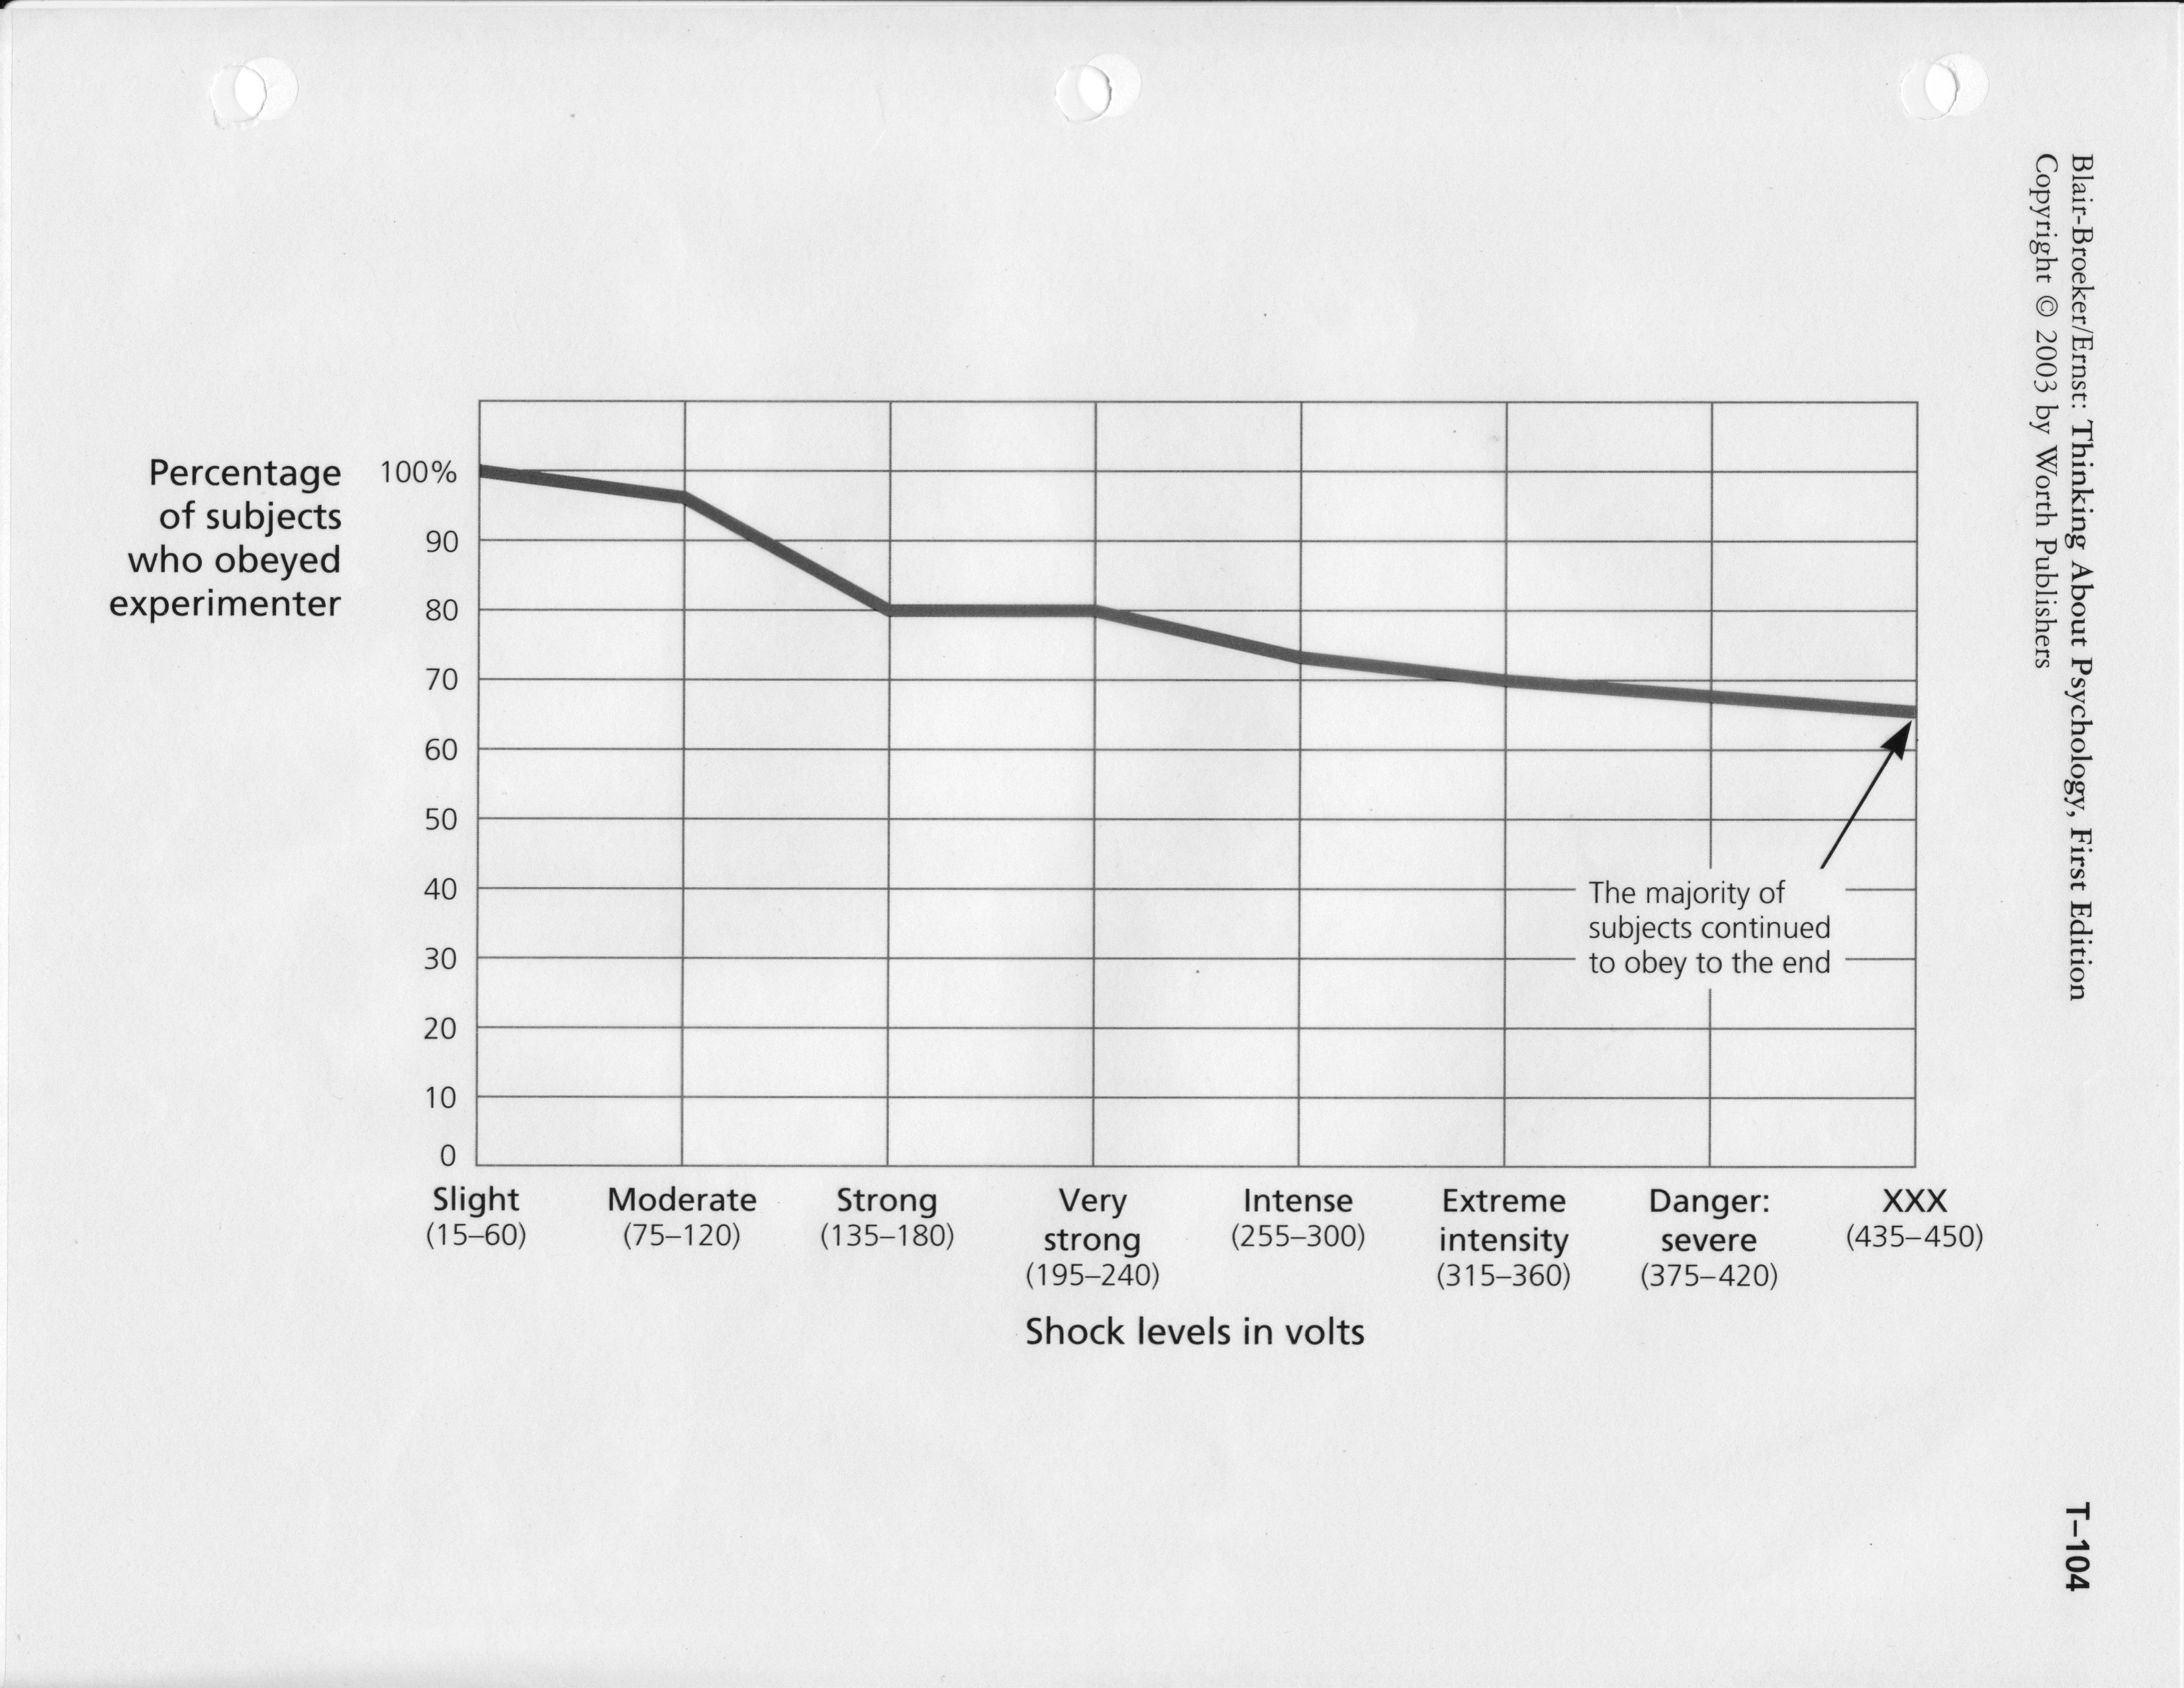

Slide 36
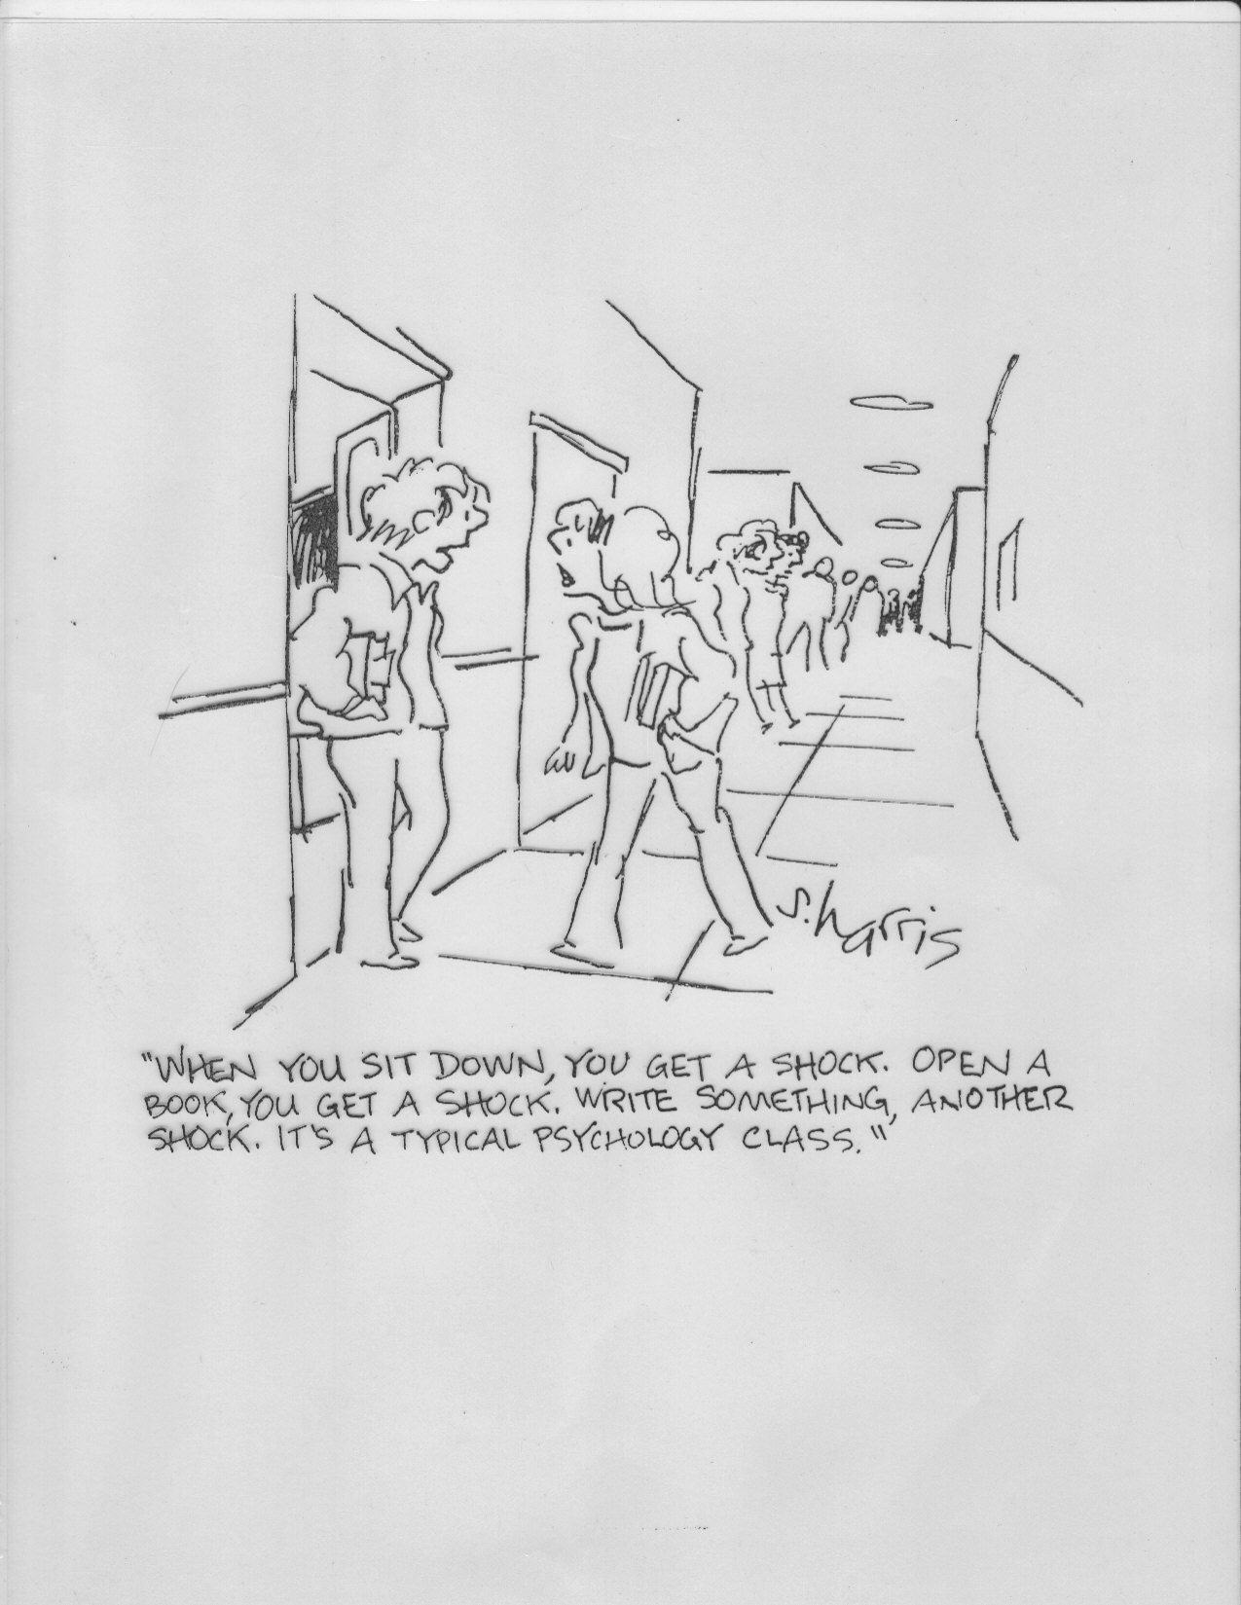

Slide 37

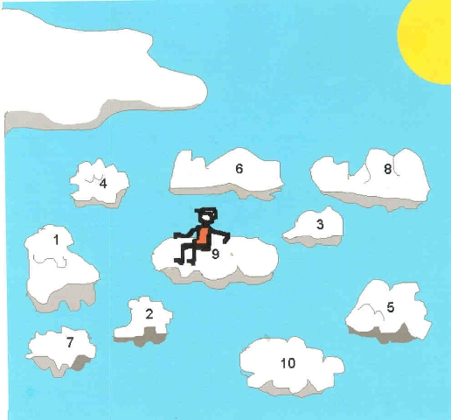
More Psych Terms You Already Know
Illusory correlation
  Sugar makes children hyperactive
  Infertile couples conceive after adoption
  The Myth of the Hot Hand
False Consensus Effects
  Romantic Relationships
    Eventually, Cloud 9 wears off and we realize we aren’t the same as we thought we were

Slide 38
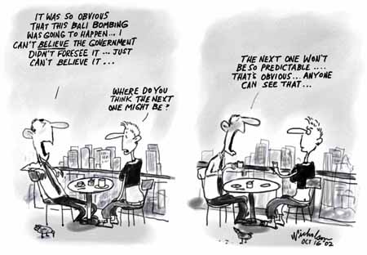
More Psych Terms You Already Know
Hindsight Bias
  9/11 easy to predict right!
  Monday Morning quarterbacking

Slide 39
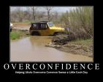
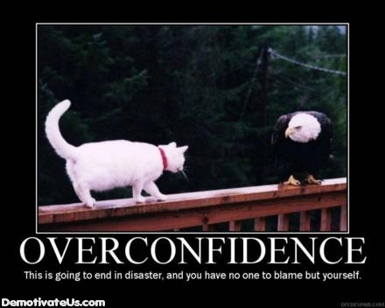
Overconfidence
  Feedback right away is important for protecting against overconfidence
  Why do you think we’re doing tests online!!!

Slide 40
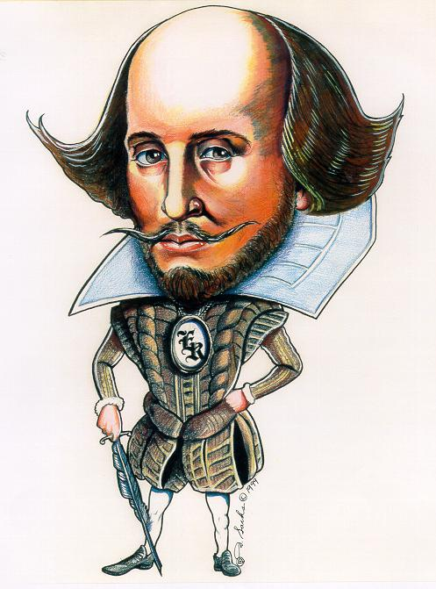
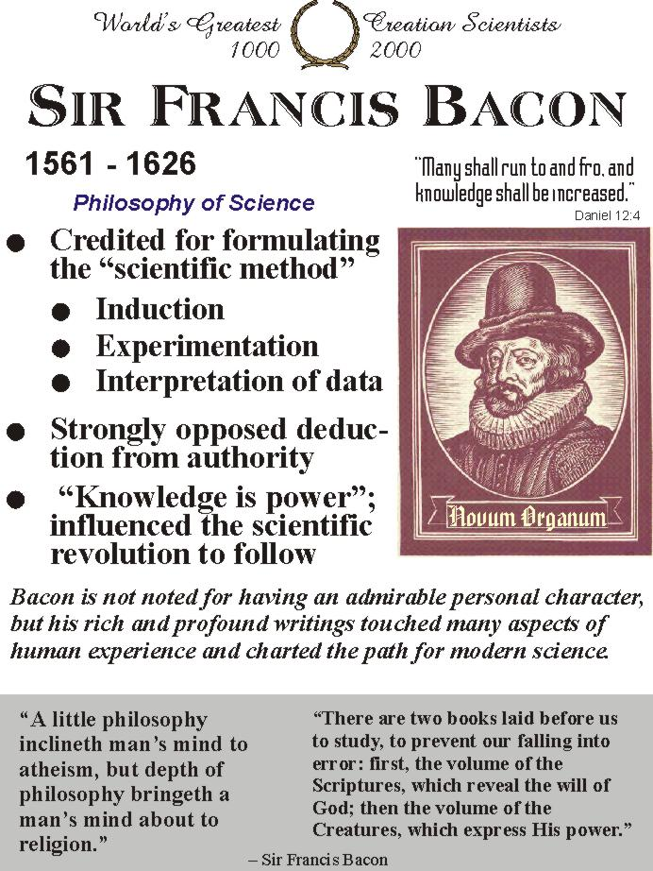
Data Measurement
Mean, Median, Mode
  Shakespeare’s mode was 4
  Bacon’s mode was 3
Reliability vs. Validity
  Reliability requires replication

Slide 41
Psychology as a Profession
Applied vs. Basic Research
  Applied = everyday practical problems
  Basic = the normal “science” stuff
    Length of short term memory
    Types of rods / cones in the eye
    What people / in what situations help others in need?
WW1 = aptitude tests for soldiers
Clinical Psychology: diagnosis and treatment of psychological disorders (Ph.D, Psy.D)
WW2 = 40k veterans who returned from war seeking health and medical treatment

Slide 42
Some Non-Clinical Specialties
A) Experimental psychologists (Psy.D) - conduct laboratory studies of learning, motivation, emotion, sensation and perception, physiology, human performance and cognition.
B) Educational psychologists (Ed.D) - study principles that explain learning and look for ways to improve learning in educational systems.
C) Developmental psychologist (Psy.D) - study how people change and grow physically, mentally and socially over time.
D) Social psychologist (Psy.D) - study how groups, institutions and the social context influence individuals and vice versa.

Slide 43
Putting it in Perspective:
Think about…
3 Themes Related to Psychology as a Field of Study
Psychology is Empirical- Empiricism is the premise that knowledge should be acquired through observation. Psychologist’s conclusions are based according to their gathered observation, speculation, traditional beliefs, or their common sense.
Psychology is Theoretically Diverse- Theory a system of interrelated ideas used to explain a set of observations. Because of the theoretical diversity within psychology, there are several opposing theories, views, etc. to explain several things.
Psychology Evolves in a Sociohistorical Context- psychology is both an influence and is influenced by several worldly things such as trends, issues, and values in a society. i.e. raising children, sexual urges, etc.

Slide 44
Putting it in Perspective:
4 additional ideas
Behavior is Determined by Multiple Causes- behavior is a complex component of all people and is determined by several causes. This idea that behavior is governed by several factors is called multifactorial causation of behavior.
Our Behavior Is Shaped by Our Cultural Heritage- Culture- refers to the widely shared customs, beliefs, values, norms, institutions, and other products of a community that are transmitted socially across generations. Culture carries an impact on ones thoughts, feelings, and behavior and is important to factor in when researching for any subject.

Slide 45
Putting it in Perspective:
Hereditary and Environment Jointly Influence Behavior- many theorists argued over the fact that personal traits and abilities are governed completely by hereditary, or completely by environment. Today most psychologists believe that both environment and hereditary are important factors that govern people.
Our Experience of the World is Highly Subjective- people process incoming information very differently while ignoring some factors and focusing on others. People may see or what they choose to see or what they expect to see and this has been tested through experiments by researchers like Hastorf and Cantril.

Slide 46
REVIEW
30 NOTECARDS!!!!
For full credit, use proper format!!!
Only Effortful notecards will earn full credit
The test requires thinking….it will not be simple regurgitation of terms/defs…hence the reason I want to eliminate these on your notecards
Think like a teacher…what questions might I ask?
Practice test on Quia…unlimited attempts

