Slide 1
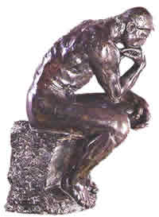
Thinking

Slide 2
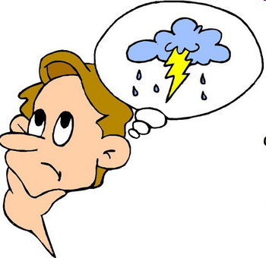
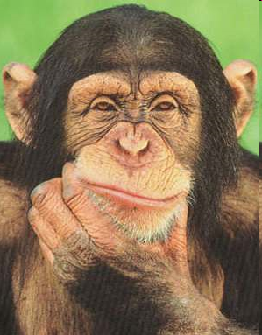
Thinking…aka Cognition
Another term for thinking, knowing and remembering
Does the way we think really matter?
By studying the way we think, we can think better…so, let’s try it!! (warmups)

Slide 3
Problem 1
What number is next in this series?
10, 4, 3, 11, 15
A) 14 B) 1 C)17 D)12 & WHY?

Slide 4
Problem 2
The maker doesn’t want it, the buyer doesn’t use it, and the user doesn’t see it. What is it?

Slide 5
Problem 3
A man left home one morning. He turned right and ran straight ahead. Then he turned left. After a while, he turned left again, running faster and faster. Then he turned left once more and decided to go home. In the distance he could see two masked men waiting for him. Who were they?

Slide 6
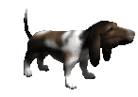
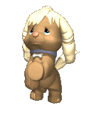
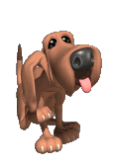
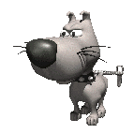
Concepts
In order to think about the world, we form……..
A mental grouping of similar objects, events, ideas or people.
Concepts are similar to Piaget’s idea of….
Schemas
These animals all look different, but they fall under our concept of “dogs”.

Slide 7
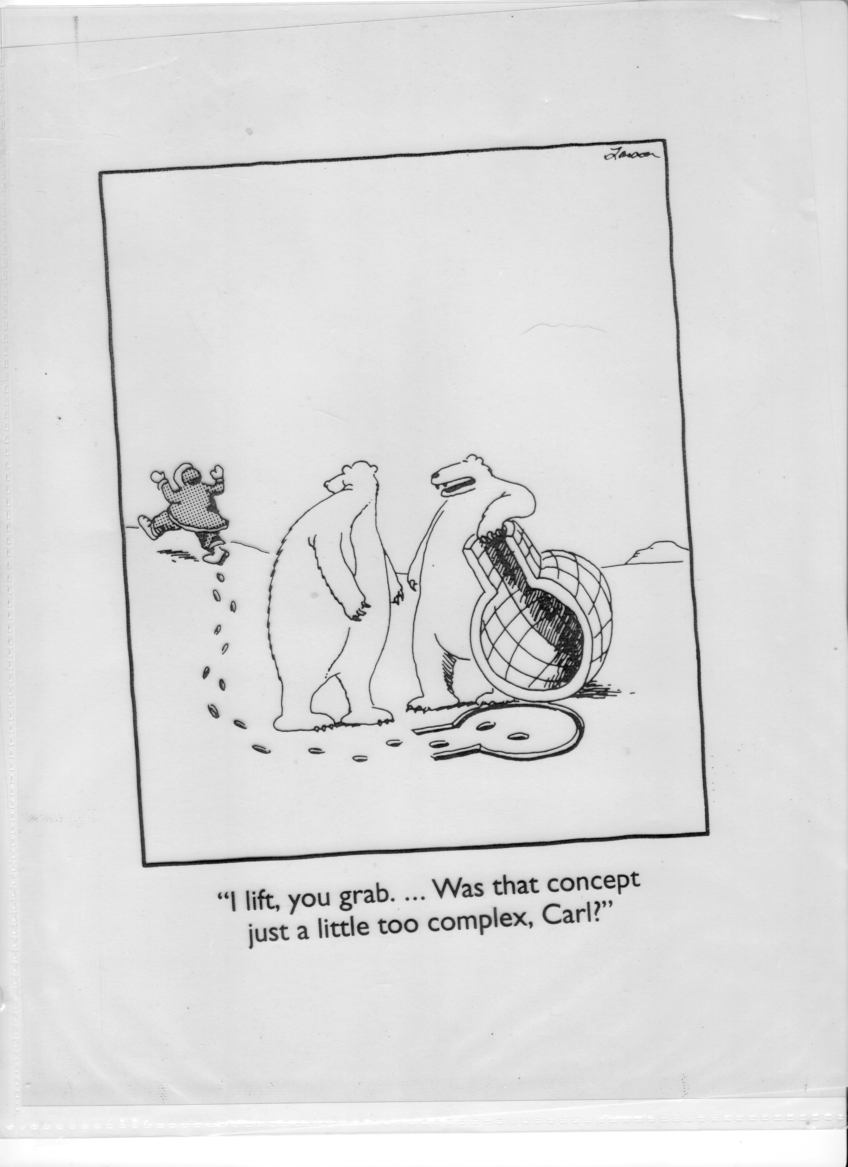

Slide 8
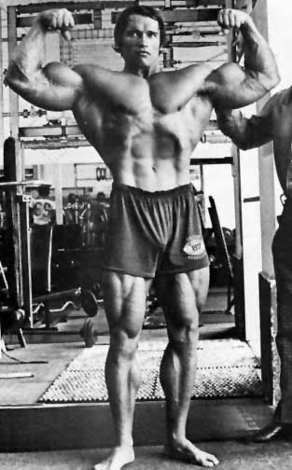
Prototypes
We base our concepts on ….
A mental image or best example of a category.
If a new object is similar to our prototype, we are better able to recognize it.
Let’s Try It (Introducing Prototypes)

Slide 9
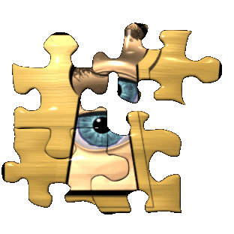
How do we solve problems?

Slide 10
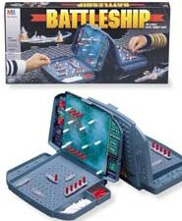
Trial and Error

Slide 11


Slide 12
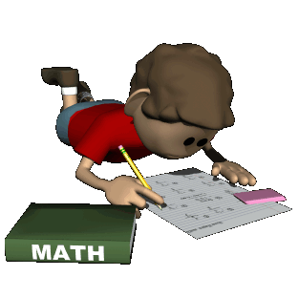
Algorithms
Where is the horseradish??
A methodical, logical rule or procedure that guarantees solving a particular problem.
What are the benefits and detriments of algorithms?

Slide 13
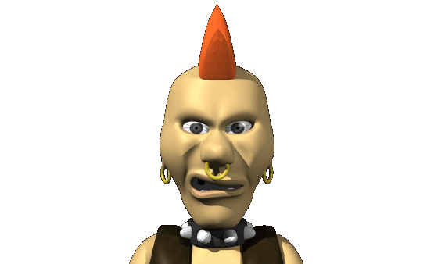
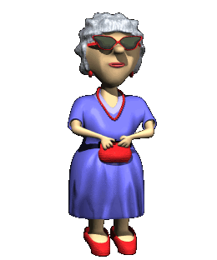
Heuristics
A rule-of-thumb strategy that often allows us to make judgments and solve problems efficiently.
Who would you trust to baby-sit your child?
A short cut (that can be prone to errors).
Your answer is based on your heuristic of their appearances.

Slide 14
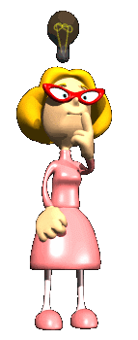
Insight
Insert Handout 10-5 with clipping tool
A sudden and often novel realization of the solution to a problem.
No real strategy involved
What psychologist studied insightful learning & HOW?
Koehler working with Chimps!

Slide 15
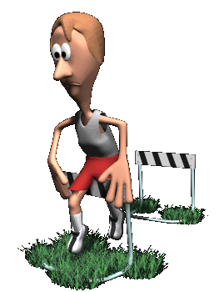
Obstacles to problem solving

Slide 16
Limits to Intuition
A bat and a ball cost $1.10 total.
The bat costs $1 more than the ball.
How much does the ball cost?

Slide 17
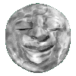
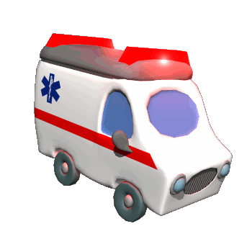
Confirmation Bias
Confirmation Bias (SEINFELD)
Longer Version (begins @55sec)
A tendency to search for information that confirms one’s preconceptions.
For example, if you believe that during a full moon there is an increase in admissions to the emergency room where you work, you will take notice of admissions during a full moon, but be inattentive to the moon when admissions occur during other nights of the month.
This leads to a phenomenon we studied early in the year concerning noticing pregnancies after people adopt children…what is this called?
UNLUCKY!! Ha!

Slide 18
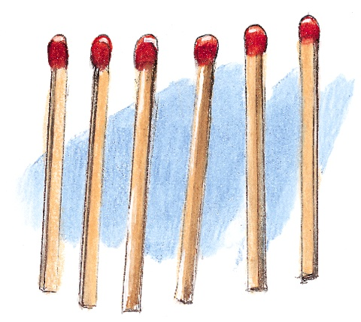
Match Problem
Can you arrange these six matches into four equilateral triangles?

Slide 19
Mental Set
A tendency to approach a problem in a particular way, especially if it has worked in the past.
May or may not be a good thing.
Let’s try it: Train Engineer

Slide 20
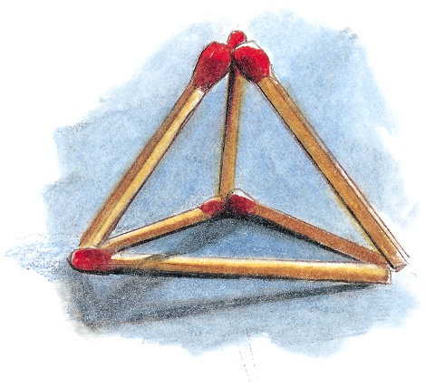
Match Problem
Fixation
The inability to see a problem from a new perspective.

Slide 21
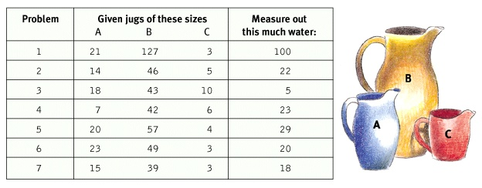
The Jug Problem

Slide 22
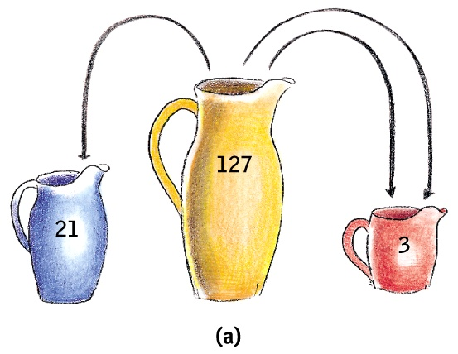
The Jug Problem
B – A – 2C = desired amount of water

Slide 23
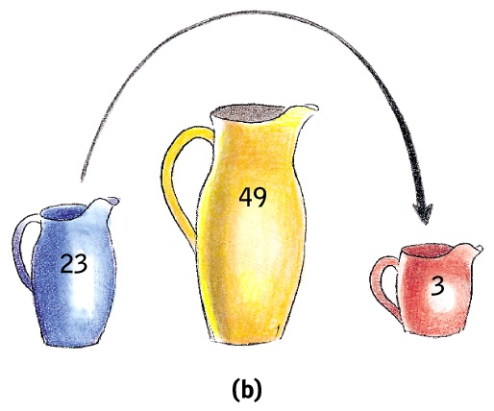
The Jug Problem
For problems 6 and 7 (20 and 18), there are easier ways than using your formula from your mental set.

Slide 24
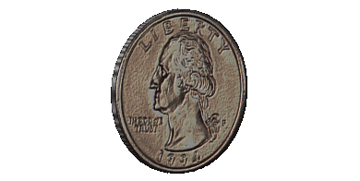
Functional Fixedness
The tendency to think of things only in terms of their usual functions.
What are some things I can do with this quarter (other than spend it)?

Slide 25
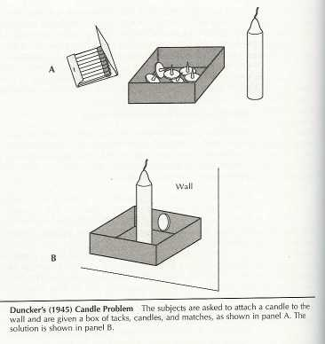

Slide 26
Types of Heuristics
(That often lead to errors)

Slide 27
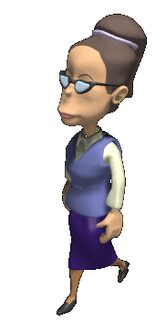
Representativeness Heuristic
A rule of thumb for judging the likelihood of things in terms of how well they match our prototype.
Different Types
  Gambler’s fallacy
Can cause us to ignore important information.
Below is Linda. She is 31, single, outspoken, and very bright…

Slide 28
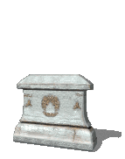
Availability Heuristic
The Summer of the Shark
What Parents SHOULD NOT Worry About
Estimating the likelihood of events based on their availability in our memory.
Although diseases kill many more people than accidents, it has been shown that people will judge accidents and diseases to be equally fatal. This is because accidents are more dramatic and are often written up in the paper or seen on the news on t.v., and are more available in memory than diseases.
If it comes to mind easily (maybe a vivid event) we presume it is common.

Slide 29
Overconfidence
The tendency to be more confident than correct.
To overestimate the accuracy of your beliefs and judgments.
Truth Lie game
10 slips
  5 say tell a lie
  5 say tell a truth
Parps:
  T/L
  0-100% confidence for each of the 10
52% correct
73% confident

Slide 30
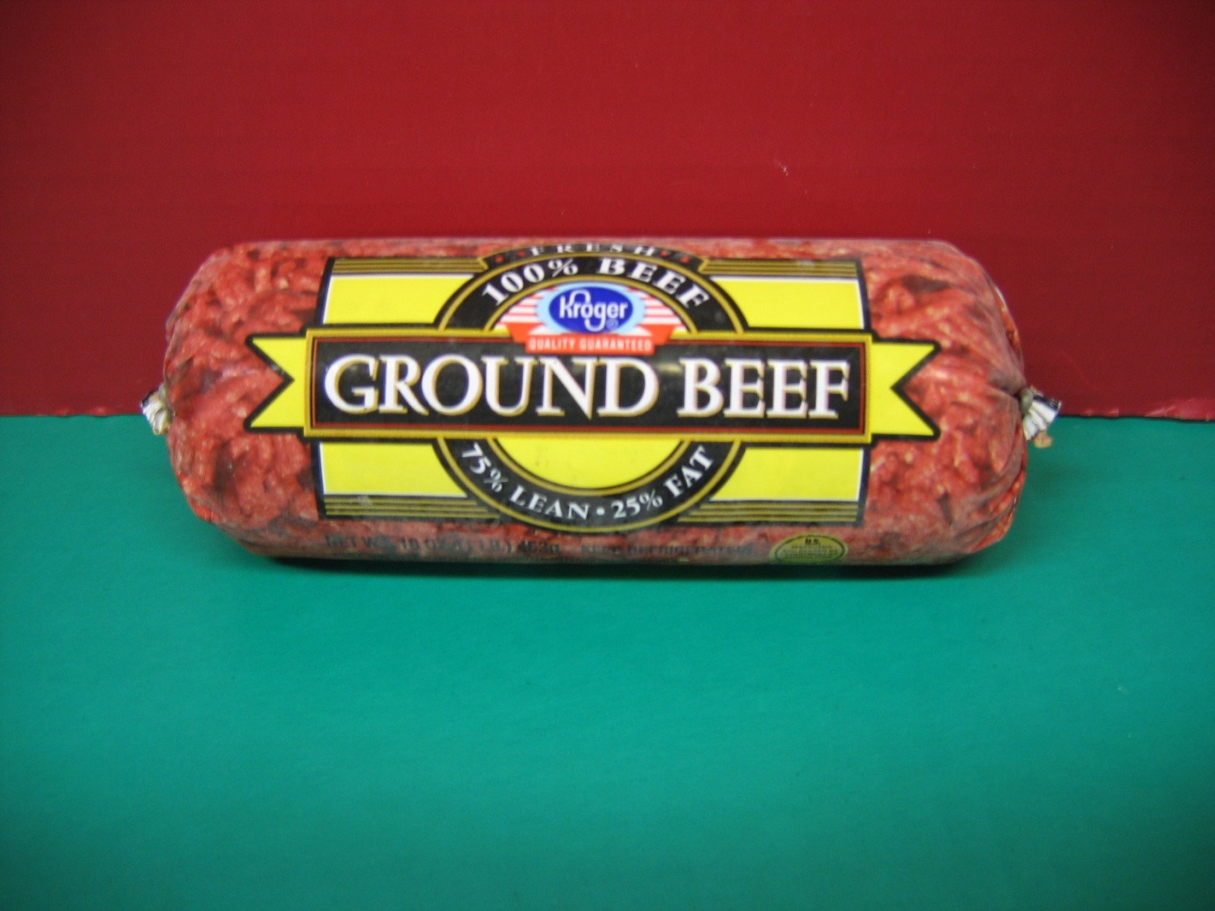
Framing
The way an issued is posed.
It can have drastic effects on your decisions and judgments.
75% Lean vs. 25% fat

Slide 31
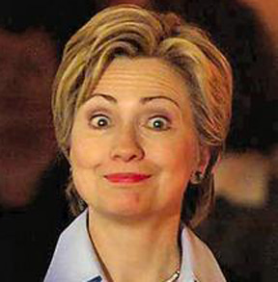
Belief Bias
Some A are B.
Some B are C.
Therefore, Some A are C.
The tendency for one’s preexisting beliefs to distort logical reasoning.
Sometimes making invalid conclusions valid or vice versa.
Some women are Democrats.
2. Some Democrats are men.
3. Therefore, some women are men…

Slide 32
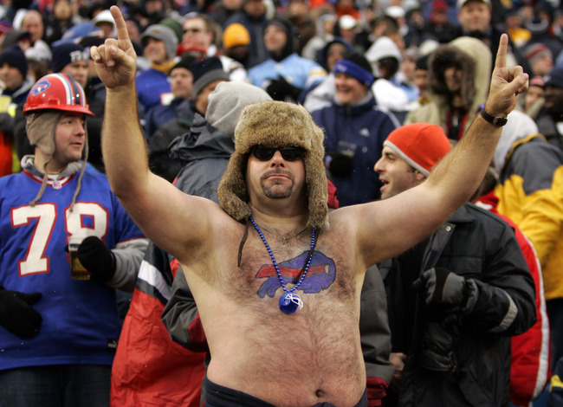
Belief Perseverance
Clinging to your initial conceptions after the basis on which they were formed has been discredited.
All Buffalo Bills fans who still believe that this (well, next) year is their year are suffering from belief perseverance. ☹

Slide 33
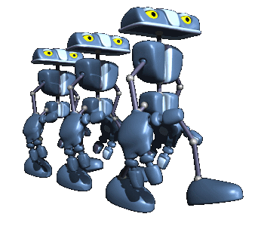
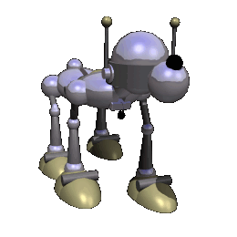
Artificial Intelligence
PARALLEL PROCESSING IS UNIQUE TO HUMANS
FOR NOW…HAHAHAHAHA!!!

