Slide 1

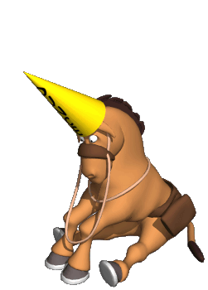
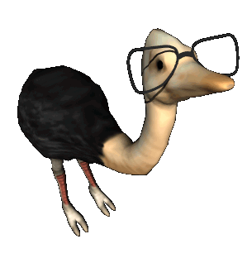
Intelligence
What makes us intelligent
Or
Not so intelligent

Slide 2
Thinking Question:
Who is the most intelligent person you know (fictional / non-fictional)? Describe their qualities and justify in your own words why they are so intelligent.

Slide 3

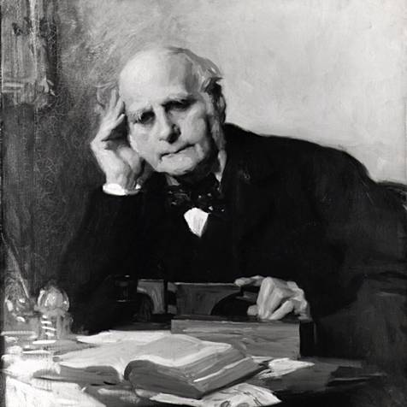
Sir Francis Galton (1822-1911)
English scientist
Cousin of Darwin
Head size determines intelligence
  This is hereditary
Coins the word “eugenics”
Hereditary Genius

Slide 4

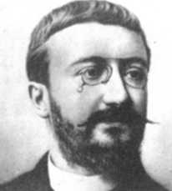

Alfred Binet
PREDICTING SCHOOL ACHIEVEMENT
  He was the French Minister of Public Education
Teachers are subjective. NO WAY!
  Didn’t trust their subjective explanations
True purpose was to classify, not measure

Slide 5
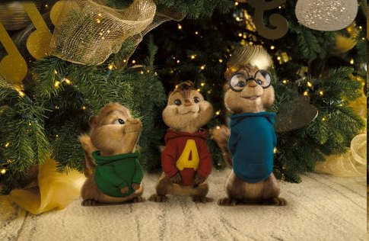
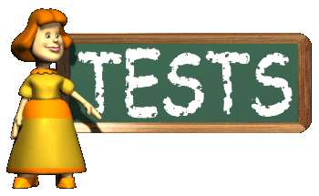
Binet &
Theodore Simon
Designed a test to compare intelligence
Mental Age
  Average 9 year old has MA of 9
  What an average person of a particular age should know
  This MA can predict future performance in school

Slide 6
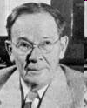
Lewis Terman
A 8 year old has a mental age of 10, what is her IQ?
A 12 year old has the mental age of 9, what is his IQ?
A boy has the mental age of 10 and an IQ of 200, how old is he?
Stanford-Binet Test
  A revised edition of Binet-Simon’s test
Is often given credit for the IQ
  MA/CA * 100
  William Stern (some German dude) actually suggested it
His test is in its 5th version and is used today.

Slide 7
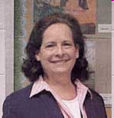

Problems with the IQ Formula
It does not really work well on adults, why?
If a person with an age of hmmm…54?
does as well as an average 27 year old
then her IQ would be 50!!!!!!
That makes no sense!!!!!

Slide 8
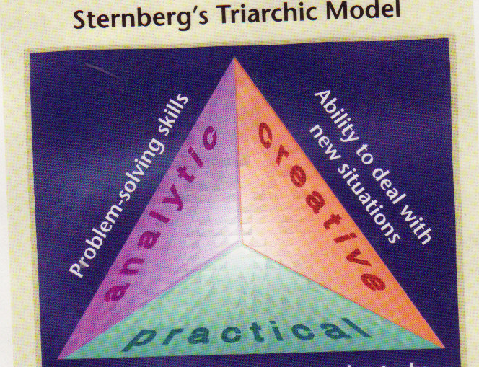
Robert Sternberg
Triarchic Theory of Intelligence
Alice, Barbara, and Celia
Notes:
Alice (Analytic) = excellent test scores and grades, teachers thought was very “smart”
Barbara (Creative) = not as good as Alice on tests, recommended to Yale b/c of creative and intuitive skills
Celia (Practical / Contextual) = highly successful in figuring out what she needed to do in order to succeed in an academic environment; knew how to get articles in journals, how to impress at job interviews,

Slide 9
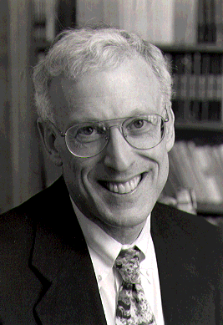
Sternberg’s Three Aspects of Intelligence
Sternberg Simplified
Analytical (academic problem solving).
Creative (generating novel ideas)
Practical (required for everyday tasks where multiple solutions exist).

Slide 10
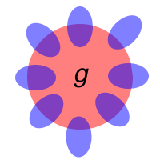
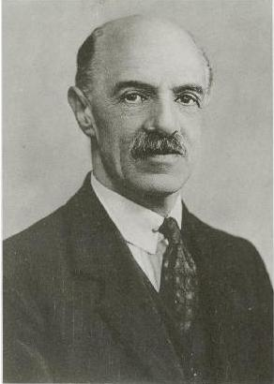
Charles Spearman
Student of Wundt
g Factor = general
  Underlies specific factors
  Those who score high on the g factor generally score higher in several areas
Developed factor analysis
  Huge in psych and other behavioral and social sciences (sociology)
  Takes multiple variables and finds correlations between / among them

Slide 11

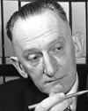
Charles Thurstone
Opposed Spearman’s “G” concept
7 Primary Mental Abilities
  Verbal Comprehension – define/understand words
  Word Fluency – produce words rapidly
  Number – arithmetic problems
  Memory – encode and recall
  Space – visualize relationships
  Perceptual Speed – see differences and similarities among objects
  Reasoning – ability to find rules

Slide 12
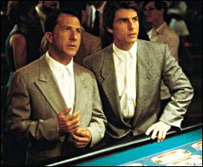
Howard Gardner
Also disagreed with Spearman’s “G”
Advanced the idea of “multiple intelligences.”
  Intelligence comes in different packages
  G factor can’t predict these
Study savants
  a condition where a person has limited mental ability but is exceptional in one area
  What could Rainman do awesomely!??
  The Real Rain Man

Slide 13

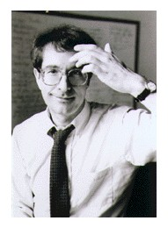
Gardner’s Multiple Intelligences
Visual/Spatial = Picaso, DaVinci
Verbal/Linguistic = Shakespeare
Logical/Mathematical = Einstein, Newton
Bodily/Kinesthetic = Michael Jordan
Musical/Rhythmic = Mozart, Clapton
Interpersonal = Ghandi, King
Intrapersonal = Freud?
Natural = Darwin
Learn More about Gardner

Slide 14
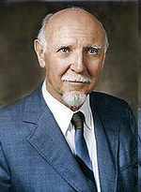
Raymond Cattell’s
Two Factor Theory of Intelligence
Crystallized Intelligence
  Left Brain Activity
  Verbal Skills
  Analogies Tests
  Based on Educational Experience
  INCREASES WITH AGE
Fluid Intelligence
  Right Brain Activity
  Logic Skills
  Reasoning Speed
  NOT based on Educational Experience
  DECREASES WITH AGE
VIDEO: MOVING IMAGES: Intelligence: 1 Ability or Many?

Slide 15
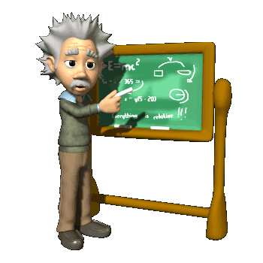
What is Intelligence?
What it’s not…
Capacity for GOAL DIRECTED BEHAVIOR
What goals?
Whatever your culture deems important!
  The Kpelle Tribesmen
  No such thing as a culture free test (pg. 61)

Slide 16
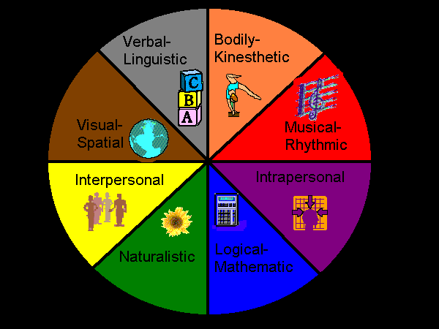




Is intelligence one thing or several different abilities?
Gardner:
  Separate neural centers for each intelligence
  Numerous case studies of patients who’ve lost certain intelligences, such as language
  Savants score below average on IQ tests, but have islands of brilliance
Spearman saw by using FA that doing well in one area of a test predicted that you will do well in another, so the separate intelligences didn’t really matter…
RainMan Scene

Slide 17
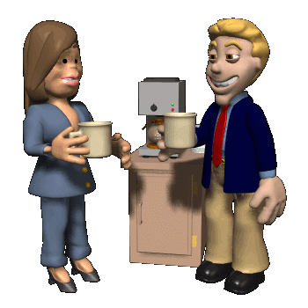
Emotional Intelligence (EQ)
Daniel Goleman – 90s
First called social intelligence.
The ability to perceive, express, understand, and regulate emotions.
Some studies show EQ to be a greater predictor for future success than IQ
Handout 11-7

Slide 18

Creativity
1 Minute…
What would happen if…
10 Antithetical Traits
NASA activity…

Slide 19
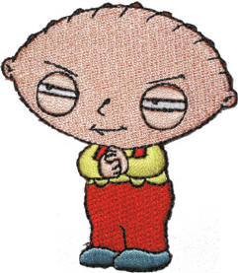
Brain Size and Intelligence
Is there a link?
YES, review from your reading

Slide 20
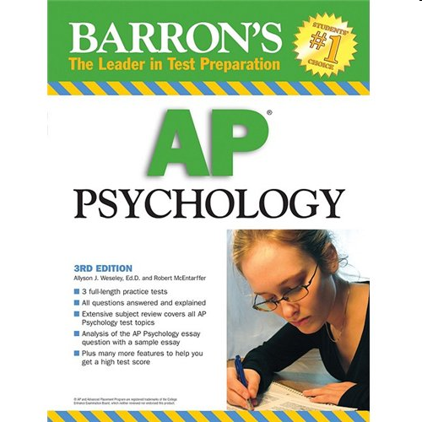
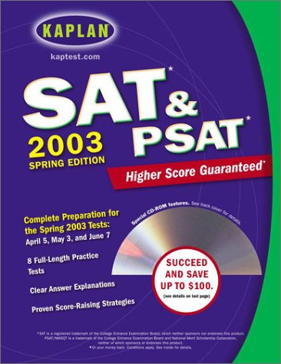
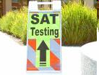
Aptitude v. Achievement Tests
Aptitude
A test designed to predict a person’s future performance.
The ability for that person to learn.
BUT, vocab can influence these
Achievement
A test designed to assess what a person has learned.

Slide 21
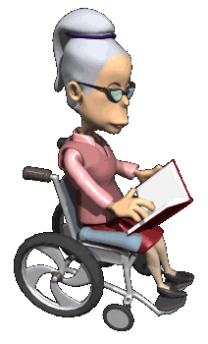
Modern Tests of Mental Abilities
Wechsler Adult Intelligence Scale (WAIS) consists of 11 subtests and cues us in to strengths by using…..
Factor Analysis
1 subtest includes analogies
  11-4 – these come from a MENSA Genius Quiz Book

Slide 22
Group vs. Individual Tests
GROUP
SAT and GREs and APs compare you to the rest of the population taking the test.
Your score depends upon the group’s mean, median, mode, standard deviation, etc.
INDIVIDUAL
More interaction between examiner and examinee…tend to be more subjective
Rorschach inkblot tests are good examples
Stanford Binet
Weschler (WAIS)
Source WebSite

Slide 23
Principles of Test Construction:
Tests must be:
Standardized
Reliable
Valid

Slide 24
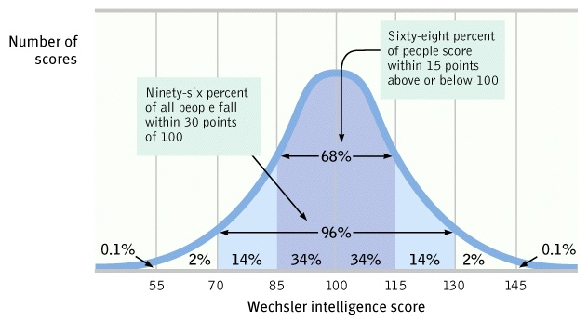
Standardization
The test must be pre-tested to a representative sample of people and
Form a normal distribution or bell curve
Scores should be relative to the group being tested…
Anybody know what z scores are?

Slide 25
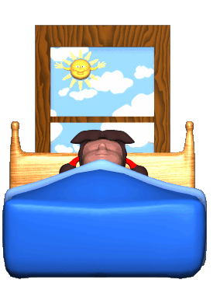
Reliability
The extent which a test yields consistent results over time.
Split-Half
  Split AP Calc exam in half (assume equal questions dispersed throughout)…does score on ½ equal other ½ ??
Equivalent form
  I may give out different versions of the semester exam. If someone takes both versions, will the scores correlate?
Test-Retest
  Are you a cheater? You get a 95 on the Civil War test after getting an average of 38 on your previous US History tests….time to Retest you...if you do it again, good for you

Slide 26
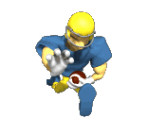
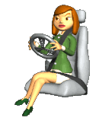
Validity
Does the test measure what it is suppose to measure? If so, it has validity.
Construct Validity: how well do test scores correlate with another ALREADY established test…
  Example: Our new tests shows you have high extroversion…do the old tests show the same thing (assuming the old tests are themselves reliable and valid)
Face Validity: We have a cake baking test set up. Good face value if looking for a chef, but not so much for a good doctor, right? DOES IT LOOK on face value like a good test?
  Requires intuitive judgment
Content Validity: A driving test should probably include a road test…test should mimic the experience we are attempting to test
  Requires statistical testing

Slide 27
Criterion Related Validity
Concurrent Validity: how much of a characteristic (criterion) the person has now
  Ex: does punching you in the face now and then taking a score of your anger mean you are always angry?
Predictive Validity: a measure of future performance
  Example: does a person have the qualities that will enable them to become a good pilot? What kind of test would be a good test to determine this?
  Probably a well-designed flight simulator

Slide 28
Reliability vs. Validity
IQ = shoe size x 10
This is MORE RELIABLE than most IQ tests
WHY???

Slide 29


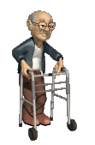

Does Intelligence
Change Over Time?
By age 3, a child’s IQ can predict adolescent IQ scores.
By 7, even more stable!
But, there are still plenty of environmental / situational reasons to fail in life…
Depends on the type of intelligence, crystallized or fluid.
  Which one goes up?
  Which one goes down?

Slide 30
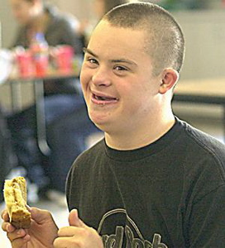
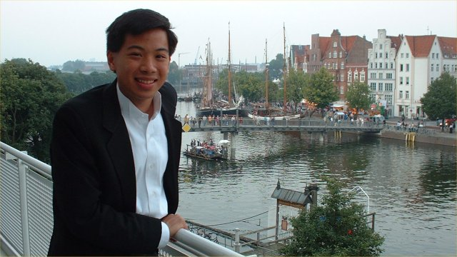
Extremes of Intelligence

Slide 31
Extremes of Intelligence
2.5-3% of the pop
90% of retardation is mild, and most often the cause is not known
Degrees of Mental Retardation
GIFTED & Genius Savants (IQ over 140)
MENSA is Latin for “Table” ?????
http://www.us.mensa.org

Slide 32
Results of Heritability Studies
In studies of intelligence and heritability between siblings:
  Identical twins (same genes) reared together (same environment) had a correlation of .86
  Fraternal twins (different genes) reared together (same environment) had a correlation of .62
  Siblings (different genes) reared together (same environment) had a correlation of .41
  Siblings (different genes) reared apart (different environment) had a correlation of .24

Slide 33
What Determines Intelligence? Overview Slide
(Nature vs. Nurture)
Heredity
Tryon’s maze bright and maze dull rats
IQ correlations in humans
Environment
Tryon’s and Rosenzweig’s rat studies
H. M. Skeels study of mentally retarded orphans
Notes:
27

Slide 34
Evidence for Heredity
Robert Tryon taught rats to run a maze
He bred the fastest learners with other fast learners over several generations
He did the same with the slowest learners
After several generations, he had two distinct populations: “maze bright rats” who learned quickly and “maze dull rats” who learned slowly

Slide 35
Evidence for Environment
Research by both Robert Tryon and Mark Rosenszweig showed that rats raised in a “stimulating” environment had more well developed brains and were brighter than rats raised in a plain and boring environment

Slide 36
Evidence for Environment
H. M. Skeels studied two groups of below average IQ orphans
One group was placed in a setting where they had “attention” from adult patients (also below average IQ)
The other group remained in the orphanage, receiving little attention
IQ scores INCREASED for the group placed with the adults

Slide 37
Gender Differences in Intelligence
Recent research finds little difference in the math and verbal abilities of males and females.
Males do have better spatial ability than females.
The average male and female IQ is about the same, but there is a higher proportion of men at the two extremes.
Notes:
31

Slide 38
Comedy?
Comedy helps to boost grades in testing by helping to relieve tension!
  So all my stupid jokes on tests are actually helping you do better!

Slide 39
Lessons to Apply from
Nature Nurture Debate
On Intelligence
See handout for points 1-5

Slide 40
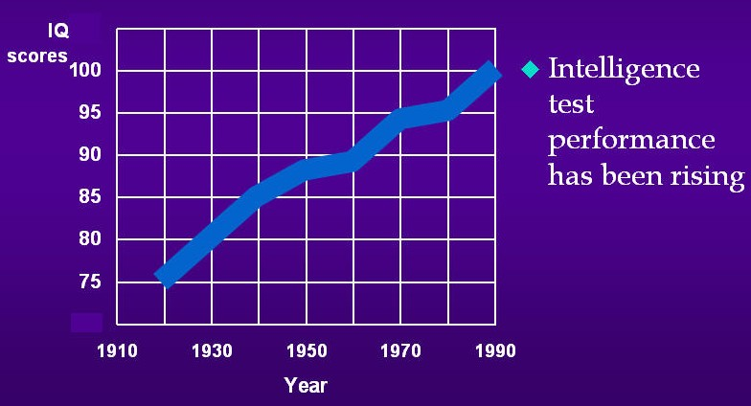
Flynn Effect

Slide 41
Group Differences in Intelligence Test Scores
Differences within groups generally are MUCH GREATER than the differences between groups…
Average IQ of whites is 100, blacks is 85
SATs
  Asians higher than whites
  Males higher than females (but average girl is better than average guy…what does that mean?)
    Males higher on math section
    Females higher on verbal ability
  Wealthy higher than poor
Why?
Nature or Nurture or
BOTH!!!!!!!!!!!!!!!!!!!!!

Slide 42
Well first, a not so funny cartoon
See Handout 11-14
Bring up on this page…
The Castelike Hypothesis
& Some Final Thoughts…

